Slide 1


Presentation at the 2015 TRB Planning Applications Conference
Atlantic City, NJ, May 17~21, 2015
MOSAIC – Model Of Sustainability And Integrated Corridors: A Comprehensive Tool for Multimodal Sustainable Corridor Planning
Lei Zhang, Ph.D.
Associate Professor
Director, National Transportation Center
Department of Civil and Environmental Engineering
University of Maryland
        301-405-2881, lei@umd.edu
Liang Tang, Nicholas Ferrari, Mingyang Ji
Graduate Research Assistant
University of Maryland
Eric Beckett, Subrat Mahapatra, and Greg Slater
Office of Planning and Preliminary Engineering
Maryland State Highway Administration

Slide 2

Research Objectives
MOSAIC
        Define sustainability indicators for SHA’s Sustainability Initiative and Comprehensive Highway Corridors (CHC) program;
        Provide a user-friendly tool for analyzing the impact of multimodal highway corridor improvements on mobility, safety, socioeconomics, energy and environment, natural resources, and cost;
        Improve current SHA processes related to long-range planning, highway needs inventory, project planning/screening, and environmental stewardship;
        Help SHA save money and time.

Slide 3
MOSAIC Tool Overview
Select a Corridor
Corridor Data from eGIS
Alternative Improvements
Sustainability Indicators
MOSAIC
Impact of Each Candidate Improvement Scenario on:
Mobility
Socioeconomics
Safety
Energy&Environment
Cost
Natural Resource

Slide 4
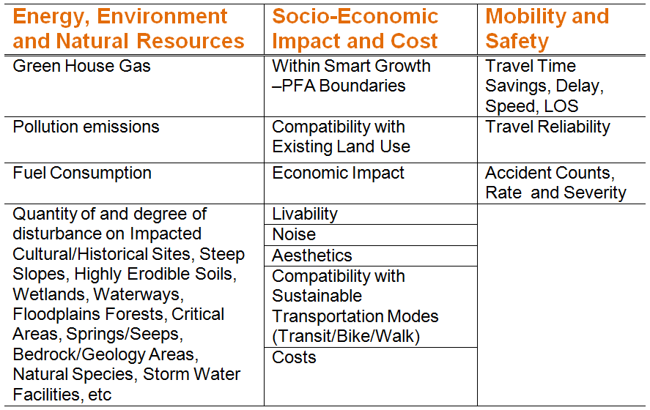
Sustainability Indicators
MOSAIC

Slide 5
MOSAIC Improvement Options
MOSAIC
GEOMETRIC IMPROVEMENTS | MULTIMODAL IMPROVEMENTS
Add General Purpose Lanes | Add High Occupancy Vehicle (HOV) Lane
Remove Lanes (Road Diet) | Add High Occupancy Toll (HOT) Lane
Convert At-grade Intersection to Grade Separated Interchange | Add Express Toll Lane (ETL)
 | Add Bus Only Lane / Bus Rapid Transit
 | Add Truck Only Lane
 | Add Light Rail Transit (LRT)
Through the multi-improvement analysis framework, MOSAIC also allows users to apply combinations of geometric improvement and multimodal improvement options to a corridor section at the same time

Slide 6
Modeling Framework
MOSAIC

Slide 7
Mode choice models
MOSAIC
        Changes to Existing Highway/Transit Services
          Pivot-point Mode Choice Model
        Data needs
  Current market shares of each mode;
  Proposed changes of the Level of Service (LOS) variables for each alternative.
        New Transit Service
          Extended Incremental Logit Model
        Data needs
  Current market shares of each mode;
  Proposed changes of the Level of Service (LOS) variables between the proposed and existing transit mode.

Slide 8
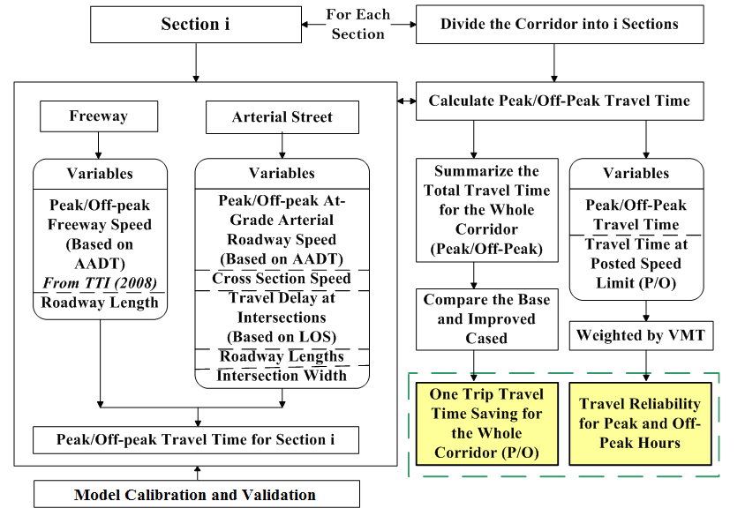
MOBILITY
MOSAIC

Slide 9
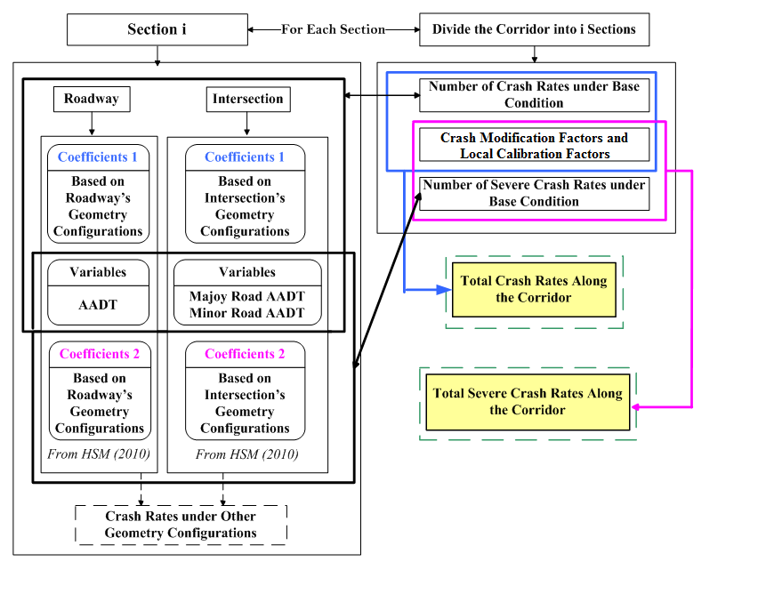
SAFETY
MOSAIC

Slide 10
SOCIO-ECONOMIC IMPACT
MOSAIC
Livability
Travel Time Scores
Land-use Mix Scores
Transit Implementation Scores
Aesthetics
Facilities’ Compatibility
Land Use Attractive
Visual Appealing
Historical Road and Sites Protection
Transportation Factors
Effective
Densities
Travel Time Between Zone Pairs
Costs of Travel/Time
Economic Benefits
Other Factors
Number of Employees
Employment Allocation
GDP
Noise
Categorizing Land-use Pattern & Defining Corresponding Noise Metric Criteria
Estimating Project Noise Exposure

Slide 11
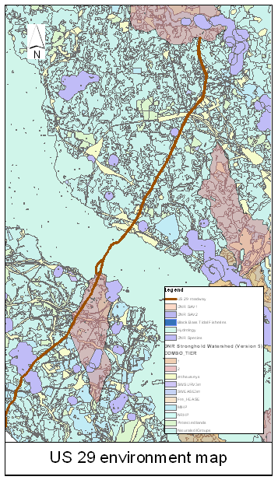
NATURAL RESOURCES
MOSAIC
        Cultural/Historical Sites,
        Steep Slopes,
        Highly Erodible Soils,
        Wetlands, Waterways, Springs/Seeps,
        Floodplains
        Forests,
        Critical Areas,
        Bedrock/Geology Areas,
        Natural Species,
        Storm Water Facilities, etc.

Slide 12
ENERGY AND EMISSIONS
MOSAIC

Slide 13
COST -- Roadway
MOSAIC
        General Purpose Lanes

Slide 14
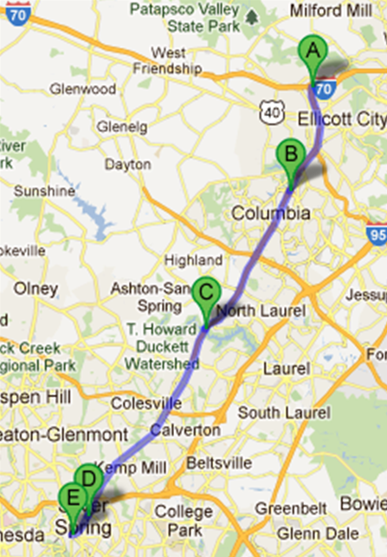
Demo: US 29 CASE STUDY
MOSAIC
Section 1 (A to B)
IS70 to MD175
Freeway with full access control
Section 2 (B to C)
MD175 to Montgomery Line
Freeway with full access control
Section 3 (C to D)
Montgomery Line to Dale DR
Freeway with traffic signals
Section 4 (D to E)
Dale DR to DC Line
Arterial street with traffic signals

Slide 15
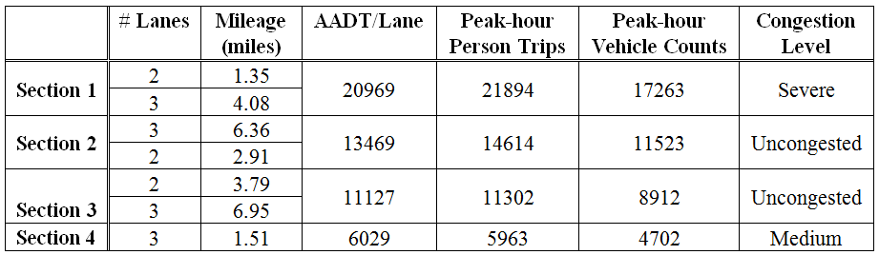
2010 Base Case Traffic Condition
MOSAIC

Slide 16
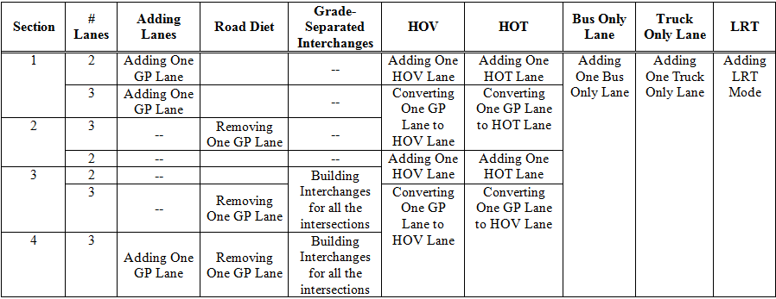
Improvement Alternatives
MOSAIC
Highway and Multimodal Improvement Alternatives

Slide 17
Evaluation Scores
MOSAIC

Slide 18
Comparison of Alternatives

Slide 19

Integrating MOSAIC and eGIS
Users
construct an eGIS-based system (widget) to select MOSAIC model parameters (spatial & non-spatial),
execute the MOSAIC models, and
create graphic & tabular reports.
Indicators
Mobility
Natural Resources
eGIS
MOSAIC Input Data
MOSAIC Models
Energy and Environment
MOSAIC Output
Socio-Economic
Numerical Results
Graphical Results
Safety
Cost
Summery Reports

Slide 20
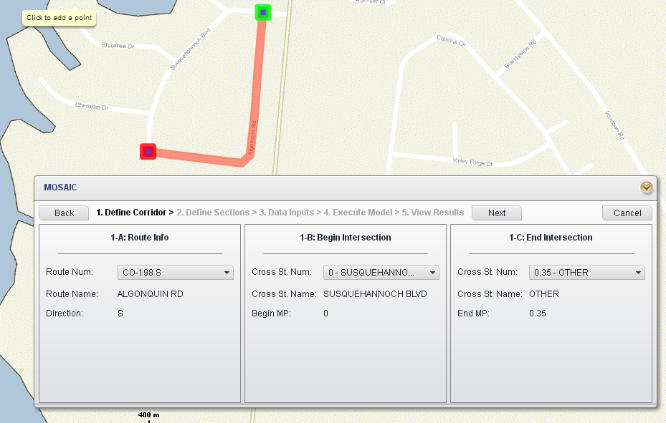
MOSAIC Widget in eGIS

Slide 21

Thank you!
MOSAIC
        Comments and suggestions are welcome.
Lei Zhang
Associate Professor
Director, National Transportation Center
Department of Civil and Environmental Engineering
University of Maryland
        301-405-2881, lei@umd.edu

