Slide 1
A National County-Level Long Distance Travel Model
#TRBAppCon
@Alliance_Trans
Mike Chaney, AICP
Tian Huang, PE, AICP, PTOE
Binbin Chen, AICP
15th TRB National Transportation Planning Applications Conference
May 19, 2015
Notes:
Target 15min
Good morning. Today I’d like to share with you how we went about forecasting ridership for a proposed passenger rail line in AR.
I have to mention that while I help design the effort, my colleges, Tian and Binbin did most of the work. And Tian is in the audience today. If you ask some difficult questions we can make her come up.
I provided the twitter tags if anyone wants to post a picture of me. Hint hint.

Slide 2
Project Background
Feasibility of extending the South Central High Speed Rail Corridor from Little Rock to Memphis, and improving the passenger rail corridor between Little Rock and Texarkana
Alternatives
Two possible routes
Two levels of service (operating speed) alternatives
79 mph
110 mph
Notes:
First a little background

Slide 3
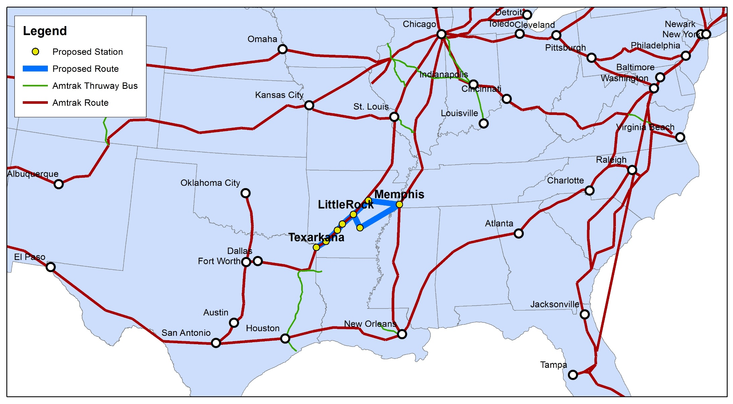
Project Location

Slide 4
Team
Arkansas State Highway and Transportation Department (AHTD)
FRA grant
Alliance Transportation Group
Notes:
Created for Arkansas state highway and transportation dept.

Slide 5
Existing Tools
FRA CONNECT Model
MSA to MSA
TSAM by Virginia Tech
Four step model, at county level
Auto, commercial air, passenger rail
Texas Statewide Model (SAM)
5 state version
Arkansas Statewide Model (AR TDM)
Auto, Urban rail & bus, Freight (rail, truck, water, air)
Notes:
Unclear is TSAM is maintained
SAM 2.5 is slow

Slide 6
Future Tools
FHWA on-going efforts to model long distance travel
A National Model System to Forecast Long Distance Passenger Travel
Trips over 50 miles made by auto, air, rail or bus
AASHTO – National Travel Demand Forecasting Model
Phase I final scope - NCHRP report 8-36-70
Notes:
large team are working on the FHWA
produced scope for National model

Slide 7
Why Build a National County-Level Long Distance Model
No readily available tool
Data sources typically national
A national model allows for the evaluation of alternative corridors
It is reusable/transferable with little modification
Notes:
Thank you to AHTD for trusting us to build the model
Can be used for HSR or AMTRAK expansion

Slide 8
Challenges in Building the Model
Long distance travel survey data
National datasets:
1995 ATS
2001 NHTS
2009 NHTS
Networks
AMTRAK network
Air network
Intercity bus network
Schedule
Notes:
1995 last comprehensive long distance survey – so be sure to provide feedback on the surveys we have left when they ask

Slide 9
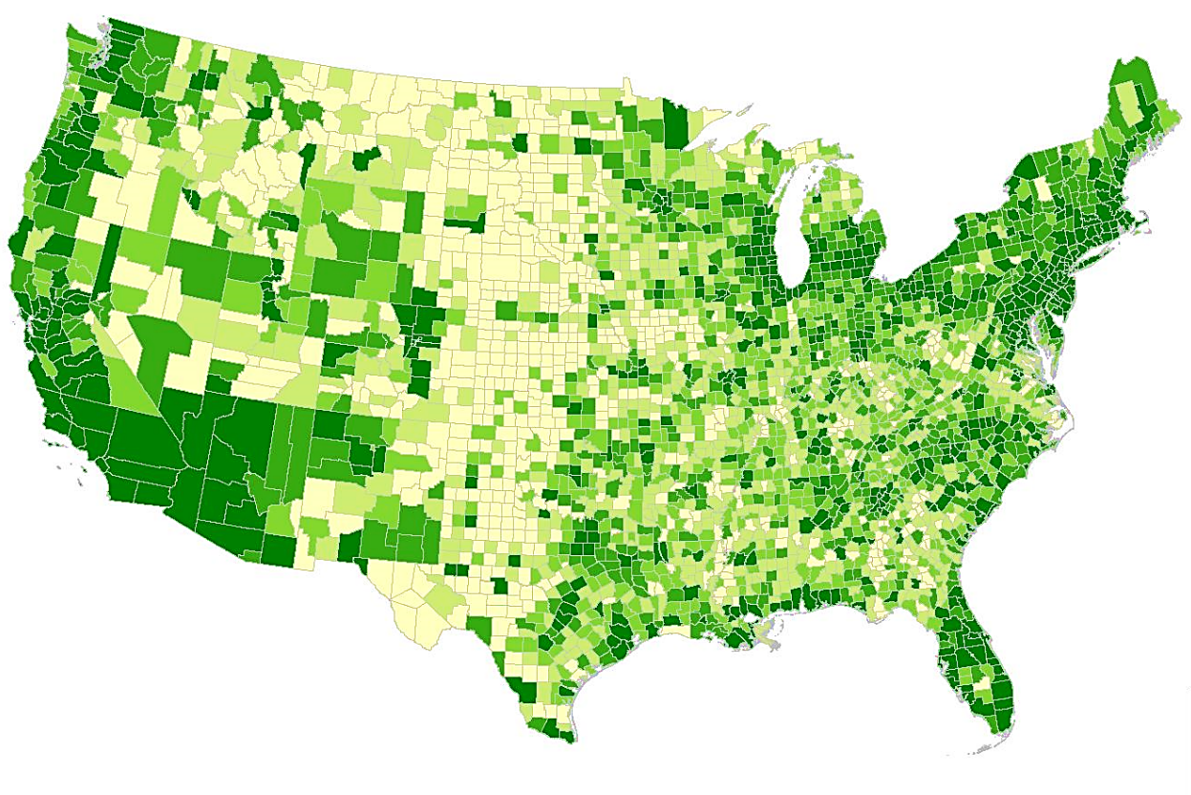
Model Overview
Trip is defined as trips over 100 miles, travels within the lower 48 states
Zones: 3,076 counties in the lower 48 continental states of the US
Networks:
Highway network
Multimodal Transit networks
Air
AMTRAK
Intercity bus
Potential rail routes
Notes:
Runs in 40 minutes - fast

Slide 10
Model Overview – Flow Chart
Trip Generation
Trip Distribution
Transit Assignment
Party size models
Trips are distributed by: party size, income and purpose
Transit trips are assigned to respective networks
Trips are split into modes by party size and income and purpose
CTPP
1995 ATS
W&P demographics
Mode Choice
1995 ATS
Notes:
Just basics on this slide
1995 ATS are used to estimate trip generation, party size model and the average trip lengths for trip distribution
The CTPP is used for obtaining the household distribution because the CEDDS does not have population by hhsize and hhincome.
Maintain trips by party size, income and purpose from trip generation to model choice
And then assign to network to get routing

Slide 11
Model Overview –Trip Generation
Trip purpose:
Business
Non-business
Trip rates:
Data source: 1995 ATS
By party size, household size, household income, and area type
10.1 long distance person round trips per household annually
22.8% business trips, 77.2% non-business trips
Notes:
The high income group averages 23 annual round trips per HH. 17 non-buss and 6 buss

Slide 12
Model Overview – Party Size
Party Size Model:
Estimated from 1995 ATS for each trip purpose
Binary choice between travel alone or travel in group
Applied during trip generation
Notes:
Party size important to mode choice.

Slide 13
Model Overview – Trip Distribution
Gravity model
Impedance = Distance
Average trip length (miles)
Notes:
For most of the long distance trips, urban congestion (auto travel time) is not a major consideration for trip distribution;
There is no reported travel time from the 1995 ATS, and different mode will have different time, and for long distance trips, people potentially make multiple stops along the way, and we cannot fully account for the cost and time associated with those stops for trip distribution; so the best information we have is the OD distance from the ATS (even the distance was not fully accurate in the ATS data). Intuitively, for long distance trips, people tend to choose destination based on their budget to decide how far to go.
In short, we do not have good data to derive average travel time. Distance is a reasonable choice based on available data.

Slide 14
Model Overview – Mode Choice
Alternatives:
Auto
Intercity rail
Intercity bus
High speed rail
Air
Level of service variables
In-vehicle time
Out-of-vehicle time
Cost
Notes:
We developed target mode shares from ATS by income, party size, and purpose.
The major coefficients include ivtt, ovtt, cost, constant (arrival/departure delay, reliability were essentially part of the constants that we separated out).
Party size gets reflected by the reduced cost for auto modes and drive access/egress cost.
The ivtt coefficients are loosely based on the one study that summarize various long distance mode choice model coefficients.
Ovtt we used a ratio of 2 on the ivtt coefficients; cost is based on USDOT VOT guideline and to be largely consistent with the income grouping.
And we asserted the constants.

Slide 15
Validation Data
AMTRAK ridership
AMTRAK provided ridership relevant to the study corridor
AMTRAK fiscal year report
Air ridership
FAA domestic T-100 segment data
Comparison are made for:
System total
By route
By airport
Notes:
Stop to stop ridership
Station on/off for key routes

Slide 16
Model Validation – Air and AMTRAK

Slide 17
Model Validation – AMTRAK
Notes:
For the 9 AMTRAK routes that are listed in the presentation,
The R-squared is 0.96, correlation is 0.98.
Correlation – is a measure of the linear correlation (dependence) between two variables X and Y
R-squared - is a number that indicates how well data fit a statistical model – sometimes simply a line or curve. It provides a measure of how well observed outcomes are replicated by the model, as the proportion of total variation of outcomes explained by the model

Slide 18
Model Validation – Key Airports
Notes:
For the 19 airports/region that are listed in the presentation,
The R-squared is 0.95, correlation is 0.97.

Slide 19
Project Status
Stayed on Schedule
Submitted Ridership to FRA
Service Development Plan
Alternative Analysis
Highway Impacts

Slide 20
Works with Statewide Model
Designed to work Arkansas Statewide Model
Arkansas statewide model passenger trip purposes:
Short trip: less than 100 miles
Long distance trips: 100 miles or above, separated by business/non-business trips
Notes:
Can model commuter trips with AR TDM and add intercity trips from long distance model

Slide 21
Take Away
Easily transferable
Validated to AMTRAK ridership
Potential Enhancements:
Refine model when newer survey data is available
Add special generators for tourist oriented areas
Expand intercity bus network
Backcast to 1995
Notes:
Michigan and Ohio have long distance travel surveys or validate to airsage data

Slide 22
Thank you
#TRBAppCon
@Chaney_TX
@Alliance_Trans
Mike Chaney
MChaney@emailATG.com

