Slide 1
Estimation of Destination Choice Models using Small Sample Sizes and Cellular Phone Data
Roberto O. Miquel
Chaitanya Paleti
Tae-Gyu Kim, Ph.D.
May 20, 2015

Slide 2
Acknowledgements
North Carolina Department of Transportation
Wilmington MPO

Slide 3
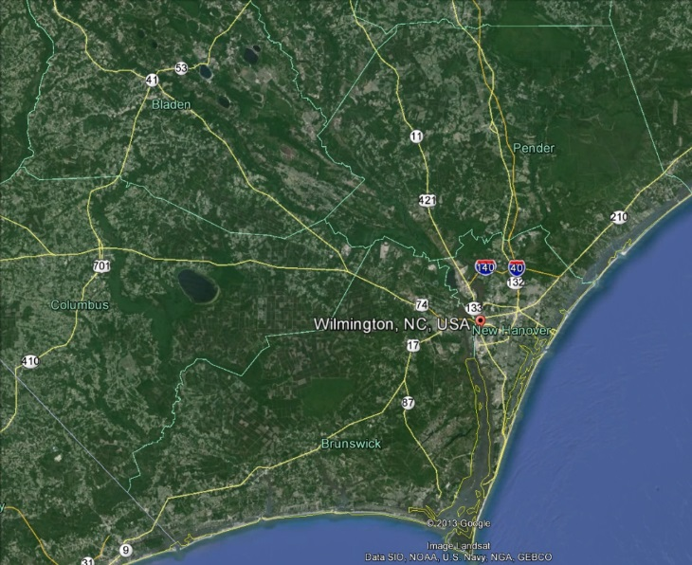

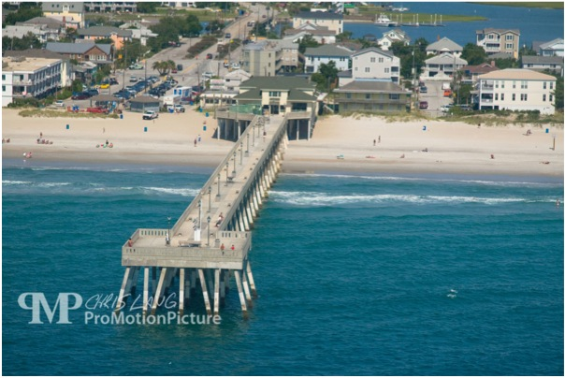

Introduction
Travel Demand Model for Wilmington, NC
Total Population ~ 260,000
Total Area ~ 405 Sq mi
Visitor Attractions: Downtown and Beaches

Slide 4
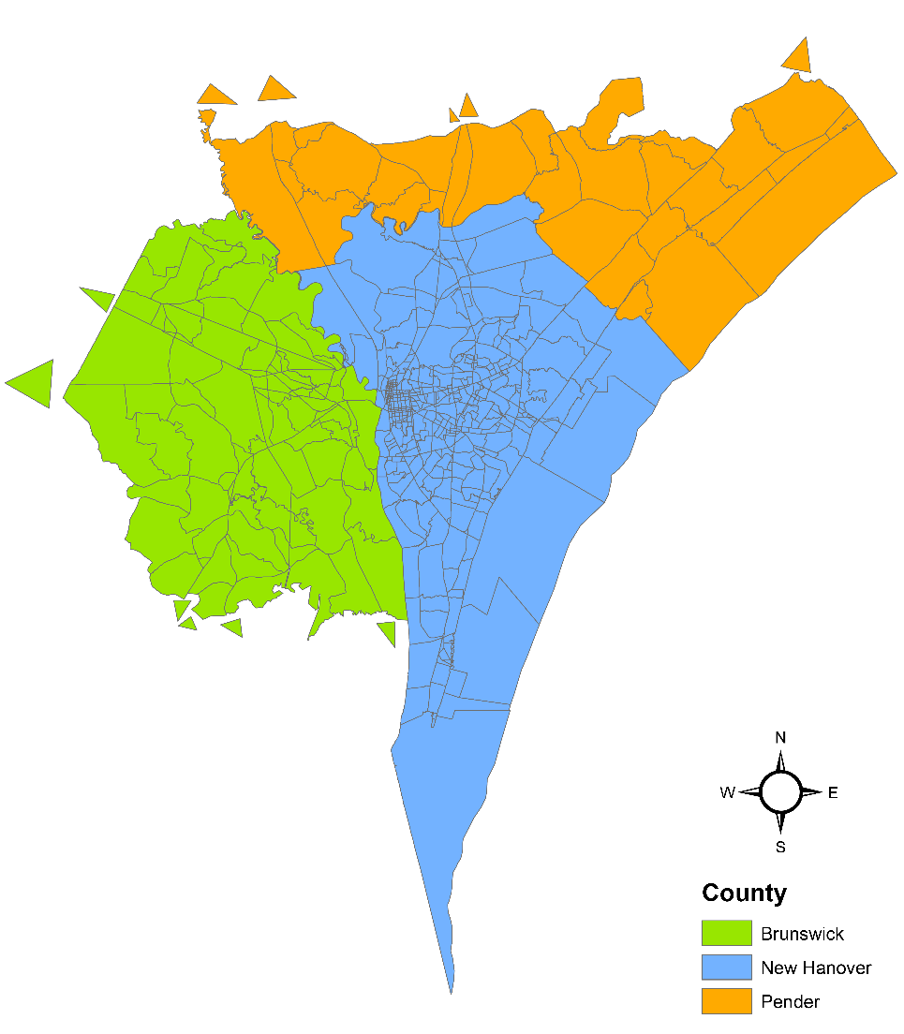
Introduction …
This enhanced model features:
  Extended area
  Refined TAZ system
  Visitor model
  Time-of-day components
  Destination choice model
No recent travel survey data
North Carolina NHTS Add-on – Small sample size
Cellular Phone Data for Origin-Destination

Slide 5
Cellular Phone Data
Identify study area origin-destination flows by trip purpose
Identify visitor trip movements in study area
Identify internal-external trip movements
Identify external-external trip movements
Calibrate Wilmington’s trip distribution models.

Slide 6
Cellular Phone Data Sample
One month of data (July)
475,506 unique devices
38,761 residents
5.1% sample rate
Visitors and residents
Daily trip tables
Directional purposes

Slide 7
Resident Origin-Destination Flows
OW (Trips > 50)
HW (Trips > 50)

Slide 8
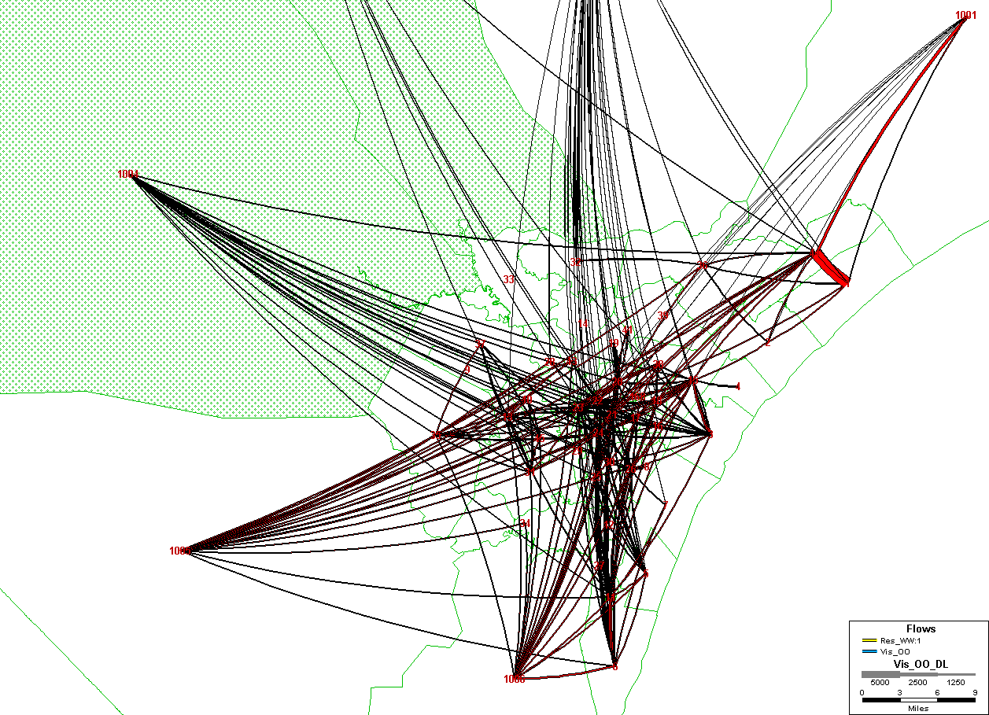
Visitor Origin-Destination Flows
OO (Trips > 50)

Slide 9
Destination Choice Model
Destination choice for trip distribution
Model estimated using
  NHTS data for trip ends – no recent survey data
  LEHD data for household earnings
  Household characteristics and generalized cost skims from the MPO model
NHTS Trips records – few Home Based Trips
Trip Purpose | # Records
Home Based Work Trips | 31
Home Based Shopping Trips | 67
Home Based Other trips | 107
Non Home Based Trips | 212
205 records

Slide 10
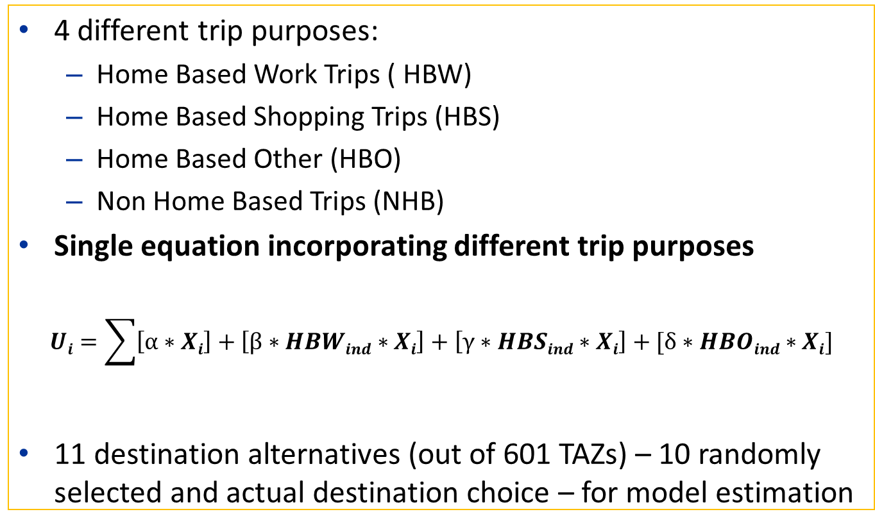
Destination Choice Model: Methodology
4 different trip purposes:
  Home Based Work Trips ( HBW)
  Home Based Shopping Trips (HBS)
  Home Based Other (HBO)
  Non Home Based Trips (NHB)
Single equation incorporating different trip purposes
$$Ui=\sum{\left[α∗Xi\right]+\left[β∗HBWind∗Xi\right]+\left[γ∗HBSind∗Xi\right]+[δ∗HBOind∗Xi]}$$
11 destination alternatives (out of 601 TAZs) – 10 randomly selected and actual destination choice – for model estimation
Exogenous variables and Interaction variables tying in different trip purposes

Slide 11
Destination Choice Model: Methodology …
Generalized cost=Time + Vehicle Operating Cost(VOC) + Toll Price
Destination choice additionally accounts for:
  Employment
  Income
  Earnings
  Children
Iterative technique - model estimation
Results validated using trip tables from cellular phone data
Labi and Sinha, 2011

Slide 12
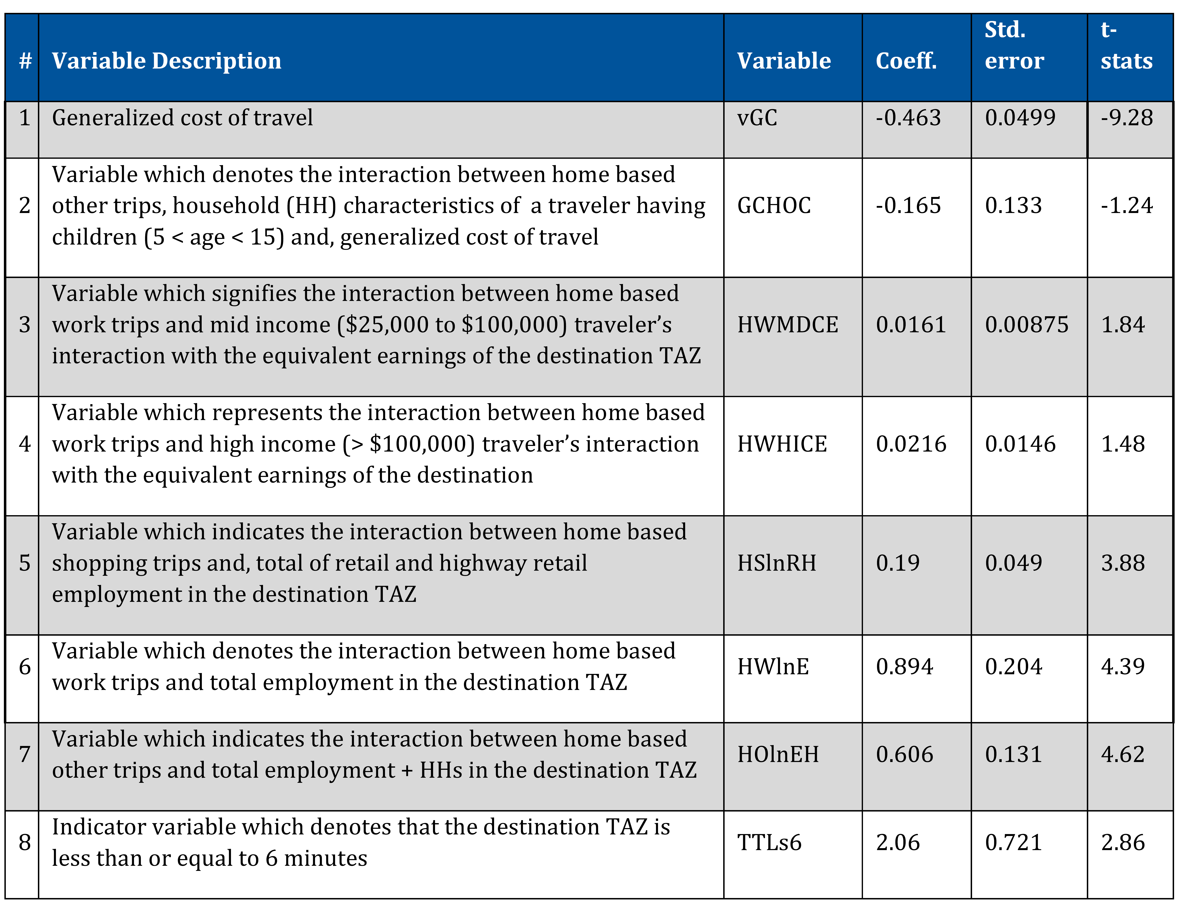
Destination Choice Model Results

Slide 13
Model Validation

Slide 14
Model Validation

Slide 15
Model Validation

Slide 16
Summary and Conclusions
Use of cellular phone data set helps to establish confidence in estimating a model using a small sample
Very short trips revealed in the cellular phone data set seem consistent with behavior estimated from the NHTS
Estimating destination choice models from small samples is not ideal, but is possible

Slide 17
Thank You
Chaitanya Paleti
CDM Smith
Raleigh, NC
paletisivasaic@cdmsmith.com
Roberto Miquel, AICP
CDM Smith
Raleigh, NC
miquelro@cdmsmith.com
Tae-Gyu Kim, Ph.D.
NCDOT
Raleigh, NC
tae-gyukim@ncdot.gov

