Slide 1
Beginning to Enjoy the “Outside View”
A First Glance at Transit Forecasting Uncertainty & Accuracy Using the Transit Forecasting Accuracy Database
David Schmitt, AICP
With very special thanks to Hongbo Chi
May 19, 2015
Notes:
Good morning! Today is the my 20th anniversary of being in this industry. I still remember the first words my first manager, the lovable Jeff Bruggeman, told me that morning 20 years ago, "welcome - thanks for coming on board, now you're 3 weeks late just like everyone else around here."
In my presentation I'll be discussing how the use of empirical data can improve the assessment of uncertainty in transit forecasting. Before I begin, I’d like to express my appreciation for Hongbo Chi who has been an invaluable help. He’s sent me emails in some very late hours, and I’d like to express my thanks for his work.

Slide 2
Topics
The Transit Forecasting Accuracy Database
Initial analysis in 3 areas
  Project assumptions & exogenous forecasts
  Forecast accuracy over time
  Determining useful reference classes
So what should we be doing differently?
Appendix: Materials for application
Notes:
Here is what I’ll be discussing. First I’ll describe the Transit Forecasting Accuracy Database I’ve developed. Then I’ll discuss some initial analysis using the information and some recommendations. I’ve included some materials in the appendix that I will not cover but they are the resources and data you'll need to apply the techniques I discuss here.

Slide 3
Motivation
Empirical observations (by others):
  Large inaccuracies in demand from large transit projects (Flyvbjerg, FTA, and others)
  Forecasting accuracy for large-scale transportation projects is not improving over time (Flyvbjerg [worldwide] and TRB [USA toll roads])
Empirical observations (by the author):
  Assessing uncertainty is not standard practice
  Absence of documenting uncertainty & risk in practice
  Lack of knowledge about forecast accuracy
Given historical inaccuracy, need exists to improve & promote better assessment of forecast uncertainty and risk
Notes:
My background is transit forecasting, so I’ve been very aware that over the past 25 years, many people have looked at the accuracy of transit and transportation projects. Almost unanimously they have found large inaccuracies in the demand forecasts, and that accuracy generally isn't getting better. But assessing uncertainty isn't standard practice from what I can see, and documenting risk is almost unheard of. So there's lots of inaccuracy being provided to decision makers but forecasters aren't disclosing the uncertainty and therefore exposing them to risk. That's a big problem and gets to my motivation for this work: (click) saying there is a need to improve and promote a better assessment of uncertainty and risk is an understatement to me.

Slide 4
Transit Forecasting Accuracy Database
Developed to report empirical results of project assumptions, exogenous forecasts and ridership forecasts
Includes all projects mentioned in Federal Transit Administration's (FTA’s) Predicted/Actual and Before/After reports
65 large-scale transit projects
  Project description and characteristics (city, length, # stations, CBD/non-CBD, mode)
  Tracks differences in forecasted/actual values of 10 project assumptions and exogenous forecasts
  Forecasted ridership (year of forecast, forecast year, value)
  Observed ridership (year of observation, value)
  Allows for multiple records of forecasted and observed ridership
Notes:
To find the answer, I developed what I call the Transit Forecasting Accuracy Database. It was developed at night in hotels after client visits and during soccer practices, games and tournaments. Consultants know this is the way to do more work without angering their spouse. After combing through all of FTA’s Predicted/Actual and Before/After reports, I gleaned information about 65 large-scale FTA projects. Besides project characteristics, (click) I track the forecasted and actual settings of 10 project assumptions and exogenous forecasts. The database includes forecasted ridership at different stages of the project, and actual ridership beginning in its first year and continuing throughout subsequent years.

Slide 5
Transit Forecasting Accuracy Database:
Projects by Mode & Decade of Opening
120 total records of forecasted ridership (mean= 1.8 per project)
218 total records of observed ridership (mean= 3.4 per project)
Notes:
Here is a summary of the 65 projects, showing the breakdown of the modes by decade of opening. As you can see, virtually every mode is represented covering the last three decades. This covers a just about every large-scale transit improvements sponsored by the federal government since the late 70s. The database has multiple records of forecasted ridership and observed ridership, which I plan to use in later analysis.

Slide 6
Project Assumptions & Exogenous Forecasts
Examples:
  Project characteristics (level of service, travel time, fare)
  Transit system (supporting and competing networks)
  Roadway system (level of congestion)
  Demographics (population, employment estimates)
  External conditions (economic, auto fuel prices)
Provided to transit forecasters, and typically accepted without review
  Are these assumptions and forecasts biased?
  If they are biased, how should transit forecasters
  present the impact of these assumptions/forecasts?
Notes:
Let’s first talk about project assumptions and exogenous forecasts, which cover aspects specific to the project and macro-economic conditions – things like the project’s travel time, service frequency, fare, the supporting and competing transit system service levels, demographic forecasts, and macro-level conditions - all these fall under assumptions and forecasts that are made by people and agencies external to the transit forecaster. These assumptions and forecasts are important because (a) the typically drive the ridership forecast, (b) the forecaster usually has to accept them without question, or doesn't have time to review them. Given the historical inaccuracy of ridership forecasts, the question to me was …(click) … Are these assumptions and forecasts accurate? And, if not, how should we address them?

Slide 7
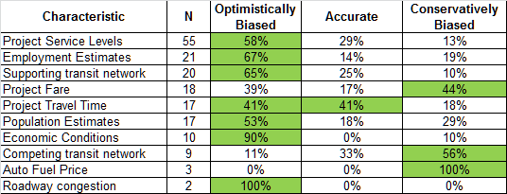
Historical (In)Accuracy of
Project Assumptions & Exogenous Forecasts
Filled cells represent highest proportion of each row
Significant optimism bias in assumptions & forecasts, which increases risk of ridership forecasting inaccuracy
Recommendations:
-Forecasters should not assume accuracy of project assumptions
-Forecasters should not absorb inaccuracy of project assumptions
-Forecasters need to perform an analysis of the uncertainties, demonstrating the impact of ridership forecast variability
Notes:
After creating the Database, I summarized the accuracy of the project assumptions for all projects where the accuracy could be reasonably determined. From left to right, the table shows the project characteristic, the number of projects that recorded the actual value of the characteristic, and whether the assumed value was skewed or accurate. Optimistically biased means the assumption will lead to an artificially higher forecast – conservatively biased assumptions would lead to a lower forecast.
The first row shows project service levels – or frequency – 55 of the 65 projects recorded an actual value. 58% of the 55 projects had the actual service level below what was assumed for the forecast. So in 58% of the projects, the actual service level was meaningfully below what was assumed. This means that project service levels have historically been optimistically skewed. As you scan down the table, you will notice that most characteristic show an optimistic bias. Project fare, the competing transit network, and auto fuel prices are conservatively skewed.
(pause)
(click) To me, this table provides powerful evidence that the assumptions that transit forecasters are given should not be trusted. (click 2x) We need to stop accepting the assumptions of other people and staff; they are just too inaccurate to be trusted. (click) More importantly we need to stop absorbing the inaccuracy of these forecasts into our demand forecasts. How do we do that exactly? (click) We perform an Uncertainly Analysis, similar to what FTA has recommended, to demonstrate the impact of their inaccuracies on our ridership forecasts. I have a reference of an example of uncertainty analysis in the appendix.

Slide 8
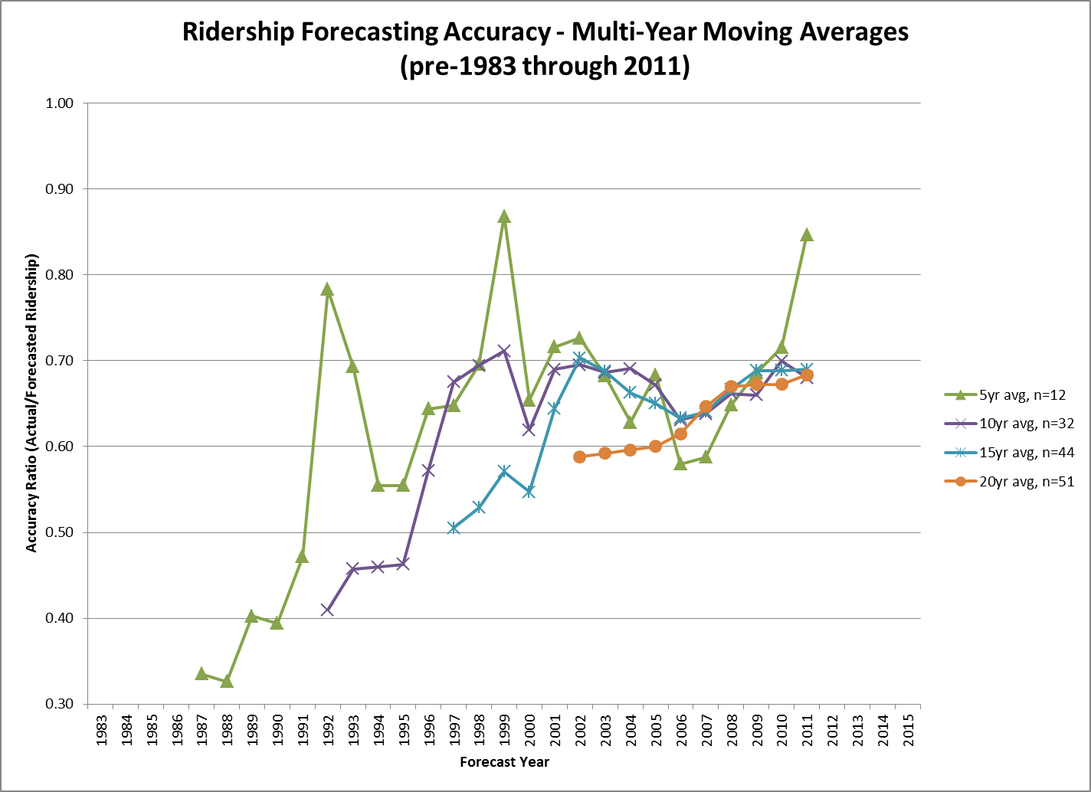
Notes:
So how have we been doing with these skewed inputs? This slide provides a start to the answer. It shows moving averages of forecasting accuracy using 4 different averages. The x-axis is forecast year, and the y-axis is the ratio of actual ridership to forecasted ridership. A ratio less than 1.0 means the forecast was higher than actual ridership. A ratio equal to 1.0 would mean than the actual ridership is equal to the forecast. And as you can see, none of these data points is in danger of exceeding 1.0. I have the sample sizes for the latest year for each moving average on the right. Overall, the trend is slightly positive –we appear to be getting better – but there isn’t a monotonic increase. For example, while the 5-year average is near its high but the previous two highs saw strong decreases in subsequent years.
The longer-interval averages have converged over the past 3-4 years to nearly 0.7. So right now the averages are saying that forecasts are about 40% higher than actual values – You get 40% by taking 1 / 0.7 and subtracting 1.0. The fact that forecasts are nearly 40% higher than ridership indicates that just running models isn’t enough, and an uncertainty analysis, while useful, still isn’t giving decision makers the entire picture. So (click) Reference Class Forecasting becomes an attractive solution.

Slide 9
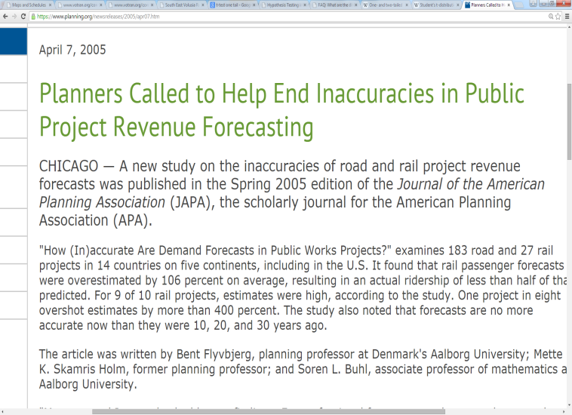
Reference Class Forecasting
The use of base-rate and distributional results derived from similar past situations and their outcomes (‘outside view’) to de-bias forecasts made using traditional methods
The American Planning Association recommended it’s use – in 2005
Empirical observations:
  Absence of reference class forecasting in USA practice
  Absence of reference classes focused on USA transit
  Objective: Determine appropriate reference classes for USA transit ridership forecasting
Notes:
Reference Class Forecasting is, defined here, using the base-rate and distribution results from similar situations in the past to improve forecast accuracy. Using the results from other similar situations is termed the outside view, and is one of the reasons for the name of my presentation. (Click) The APA actually recommended it’s use 10 years ago, and it’s also mentioned in famous Pickrell report by the way, (click) but my own observations of the industry show a distinct absence of this helpful technique. One reason for this is that there are no reference classes available for transit projects in this country. (Click) Flyvbjerg and others have international projects, but none for America specifically. So I took on the challenge of looking for some reference class for transit forecasting. (click)

Slide 10
Determining Appropriate Reference Classes:
Experiment Design
Ascertain statistically significant differences in average accuracy for 4 potential reference groups
For each project:
  Forecast Ridership: use most recent forecast made prior to construction
  Observed Ridership: use observation closest to forecast year
  Example: A 2009 forecast is compared to 2010 observed ridership, the earliest recorded observation after project opening
Accuracy: actual / forecasted ridership
  0.00-0.99, forecasted > actual ridership (over-forecast)
  = 1.00, forecasted matches actual ridership
  1.01+, forecasted < actual ridership (under-forecast)
For all projects in database:
Notes:
My design focused on 4 potential reference groups. Using statistical tests, I compared different sub-groups to see if they were noticeably different from each other. I’ll run through each of the 4 groups shortly. For each project we compare the most recent forecast to the observed ridership closest to the forecast year. The average ratio for all projects is shown here at 0.63, where the actual ridership is 37% lower than forecasting ridership. So here we go… (next slide)

Slide 11
Reference Class Groups | Hypothesis | Result
1 – Time Period | More recent projects are more accurate and more appropriate reference class | More recent projects (2007-present) are, on average, more accurate than less recent projects (2000-2006)
2 – Mode | Tested Downtown People Movers (DPM), Bus/BRT, Light Rail, Heavy Rail, & Commuter Rail | Light rail (better) and DPMs (worse) projects have statistically significant differences in average accuracy
3 – Project Development Phase | Forecasts are more accurate in later stages of project development: Planning → Engineering → Full Funding Grant Agreement | No statistically significant difference in forecast accuracy between any two project phases
4 – Impact to Transit System | Smaller changes to transit system are easier to predict (more accurate) than larger changes: 1st rail mode (largest) → new line → extension (smallest) | No statistically significant difference between projects with small or large changes
Notes:
The four reference class groups I tested were time period, mode, project development phase and the project’s level of impact to the existing transit system. Time constraints prevent a full rundown of the results here's the Cliff notes version.
I compared the accuracy of projects that have opened since 2000. I selected 2007 as the breakpoint because that was about the time we vastly improved our ability to see many problems and issues in models and forecasts that were previously hard to see. I found that the more recent projects were statistically significantly more accurate, so “Projects built since 2007” became my first reference class for transit forecasting.
Separately, I tested the average accuracy of five modes. The statistical tests showed that light rail projects were significantly more accurate than non-light rail projects, and that downtown people mover projects were significantly less accurate than non-people mover projects. So the results suggested that light rail projects should be reference class that forecasters should use.
My third experiment was the project development phase. I track forecasts in three general project phases. Planning/environmental phase is the earliest, then engineering/design, and funding decision/Full Funding Grant Agreement being the last phase. This experiment includes available forecasts from each phase for every project. The statistical tests proved the hypothesis wrong. None of the three phases showed significantly more accuracy than another. So no reference class here.
The final experiment looked at whether the projects’ expected change to the overall transit system could explain accuracy levels. The database keeps track of whether a project is the first rail mode in a region, a new line to an existing system, or extension of an existing system. The expected impact is thought to be important because forecasters have hypothesized that the smaller the impact, the easier it is to forecast and the larger the impact the harder it is to forecast. This hypothesis also turned out to be untrue: there are no differences in accuracy amongst any of the level of changes.

Slide 12
Reference Class Recommendations
Reference Class | Conditions for Application
Projects constructed since 2007 | Travel model properties have been thoroughly reviewed
LRT projects only | Project mode is LRT
All projects | If the conditions for other two classes cannot be met
Reference Class Reports and corresponding Project Assumption Accuracy Reports can be found in the Appendix to this presentation
Notes:
Slide 12 summarizes my three reference class recommendations for transit forecasting in this country. I’ve listed the conditions for application for each class. The distributional data for each reference class can be found in the appendix.

Slide 13
Conclusions
Project assumptions have historical bias towards over-forecasting ridership
Project assumptions are forecasts also and should be treated as such by transit forecasters
Transit forecasts, on average, are biased but have been (slowly and non-monotonically) getting more accurate
Three reference classes are appropriate for USA transit ridership forecasting
Notes:
I have 4 general conclusions in this first glance of the accuracy database, just statements of what I've shown you.

Slide 14
So What Should We Be Doing?
Review all project assumptions for reasonableness before accepting them into ridership forecasts
Improve the description of uncertainty & risk in ridership forecasts:
  Perform Uncertainty Analyses of project assumptions using historical ranges of variability
  Utilize Reference Class Forecasting techniques using most appropriate reference class
  Document forecasts fully, including all project assumptions & exogenous forecasts
Notes:
So, given all of this analysis, what should we be doing about the uncertainty and forecasting inaccuracy in transit forecasts? The first thing is to review project assumptions and exogenous forecasts for reasonableness. This is a no-brainier to me given the biased information we have been historically given. Going further, I recommend that we perform an uncertainty analysis and develop a reference class forecast to better disclose the uncertainty and historical inaccuracy of our transit forecasts. Finally, we need to document our forecasts better.

Slide 15
Freely-Available Materials for Application
(See Appendix to this Presentation)
Item | Available Materials
Uncertainty Analyses | Project Assumption Accuracy Report for each reference class: Empirical accuracy for each project assumption
Reference Classes | Reference Class Reports for each reference class: (a) Cumulative distribution function (b) Accuracy mean, median, std dev and variance
Notes:
The good news is that I am giving everyone the material, data and resources to conduct what I recommend. For each reference class, in the appendix to this presentation I am providing a Project Assumption Accuracy Report and a Reference Class Report. The first report contains the empirical accuracy for each project assumption. The RCRs include the cumulative distribution function as well as the four basic descriptive metrics. Describing exactly how to execute uncertainty analyses and reference class forecasts is beyond the time constraints here, but there are references to articles that show you how to do it in the appendix.

Slide 16
Final Comments
Updated Uncertainty Analysis and Reference Class Reports will be made publicly-available on a regular basis (through TMIP listserv or similar service)
To contribute/assist with projects not currently in the database, please contact David Schmitt (daves1997@gmail.com)
Notes:
Finally, I plan on making updates to these reference classes publicly available on a regular basis, probably through the TMIP listserv. My wish is for everyone to use these techniques so that we improve our understanding of uncertainty and inaccuracy, and convey effectively that same understanding to decision makers and the public. I did this on my free time, and Hongbo did the same. We hope you use it for your future transit forecasts.
If you have any information on projects not in the database or are interested in research opportunities, please email me at my Gmail account. As you can tell I'm very much enjoying the outside view now, so thank you very much for listening.

Slide 17
Thank you!
David Schmitt, AICP
daves1997@gmail.com

Slide 18
References
Flyvbjerg, Bent. From Nobel Prize to Project Management: Getting Risks Right. Project Management Journal. August 2006.
Flyvbjerg, Bent. How (In)accurate Are Demand Forecasts in Public Works Projects?: The Case of Transportation. Journal of American Planning Association. Vol. 71, No. 2. Spring 2005.
Flyvbjerg, Bent. Quality Control and Due Diligence in Project Management: Getting Decisions Right By Taking the Outside View. International Journal of Project Management. 2012.
Kahneman, Daniel and Amos Tversky. Intuitive Prediction: Biases and Corrective Procedures. Decision Research. June 1977.
Nicolaisen, Morten Skou and Patrick Arthur Driscoll. Ex-Post Evaluations of Demand Forecast Accuracy: A Literature Review. Transport Reviews. Vol. 34, No. 4, pp. 540-557. 2014.
Taleb, Nassim Nicholas. Antifragile: Things That Gain from Disorder. Random House, 2012-11-27. iBooks.
Taleb, Nassim Nicholas. The Black Swan: Second Edition. Random House Trade Paperbacks, 2010-05-11. iBooks.
Transportation Research Board. National Cooperative Highway Research Program Synthesis 364: Estimating Toll Road Demand and Revenue – A Synthesis of Highway Practice. 2006.
U.K. Department of Transport. Procedures for Dealing with Optimism Bias in Transport Planning: Guidance Document. June 2004.
U.S. Department of Transportation: Federal Transit Administration. Before-and-After Studies of New Starts Projects [annual reports to Congress]. 2007-2013.
U.S. Department of Transportation: Federal Transit Administration. Predicted and Actual Impacts of New Starts Projects: Capital Cost, Operating Cost and Ridership Data. September 2003.
U.S. Department of Transportation: Federal Transit Administration. The Predicted and Actual Impacts of New Starts Projects - 2007: Capital Cost and Ridership. April 2008.
U.S. Department of Transportation: Transportation Systems Center. Urban Rail Transit Projects: Forecast Versus Actual Ridership and Costs. October 1989.
U.S. Department of Transportation: Federal Transit Administration. Travel Forecasting for New Starts: A Workshop Sponsored by the Federal Transit Administration. Phoenix and Tampa, 2009.
U.S. Department of Transportation: Travel Model Improvement Program Webinar: Shining a Light Inside the Black Box (Webinar I). February 14, 2008.
Wachs, Martin. “Ethics and Advocacy in Forecasting for Public Policy”. Business & Professional Ethics Journal, Vol. 9, Nos. 1 & 2.
Web site: https://www.planning.org/newsreleases/2005/apr07.htm. Accessed December 2014.
Web site: http://www.homereserve.com/images/Classic_room.jpg. Accessed January 2015.
Web site: http://static3.businessinsider.com/image/4e020c7cccd1d5c239010000-1200/23-back-bay-in-boston-ma.jpg.. Accessed January 2015.
Wikipedia. http://en.wikipedia.org/wiki/Reference_class_forecasting. Accessed February 2015.

Slide 19
Appendix:
Uncertainty Analysis & Reference Class Resources
Application Resources

Slide 20
Uncertainty Analysis & Reference Class Forecasting:
Application Resources
Topic | Resource
Uncertainty Analysis (discussion and example) | U.S. Department of Transportation: Federal Transit Administration. Travel Forecasting for New Starts: A Workshop Sponsored by the Federal Transit Administration. Phoenix and Tampa, 2009.
Describes reference class process & provides information to mitigate optimism bias for rail capital cost overruns | Flyvbjerg, Bent. From Nobel Prize to Project Management: Getting Risks Right. Project Management Journal. August 2006. Kahneman, Daniel and Amos Tversky. Intuitive Prediction: Biases and Corrective Procedures. Decision Research. June 1977.
Details a ‘due diligence’ forecast review | Flyvbjerg, Bent. Quality Control and Due Diligence in Project Management: Getting Decisions Right By Taking the Outside View. International Journal of Project Management. 2012.
Specific procedures on reference classing, benchmarking, and managing bias | U.K. Department of Transport. Procedures for Dealing with Optimism Bias in Transport Planning: Guidance Document. June 2004.
Procedures for mitigating risks of toll roadway project forecasts | Bain, Robert. Error and Optimism Bias in Toll Road Traffic Forecasts. Springer Science+Business Media, LLC. 2009. Department of Infrastructure and Transport. An Investigation of the Causes of Over-Optimistic Patronage Forecasts for Selected Recent Toll Road Projects (Revised Final Report). 2011.

Slide 21
Appendix:
Project Assumption Accuracy & Reference Class Reports
Application Resources

Slide 22
Reference Class #1
Projects constructed since 2007
Conditions for Application:
Travel model properties thoroughly reviewed

Slide 23
Project Assumption Accuracy Report
for Uncertainty Analyses (n=12)

Slide 24
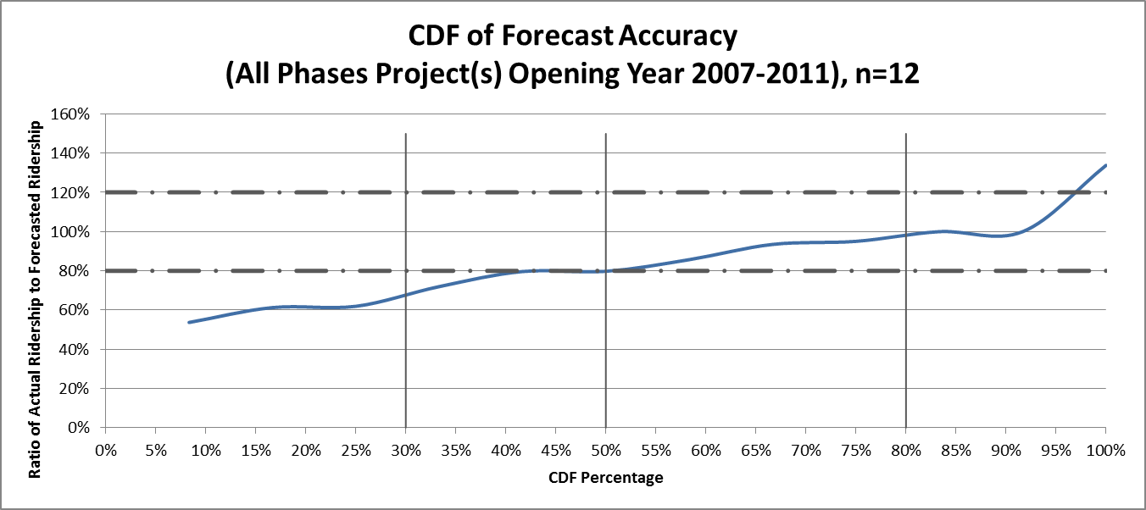
Mean = 0.85
Median = 0.83
Std. Dev = 0.22
Variance = 0.05

Slide 25
Reference Class #2
Light Rail Transit (LRT) Projects
Conditions for Application:
Project mode is LRT

Slide 26
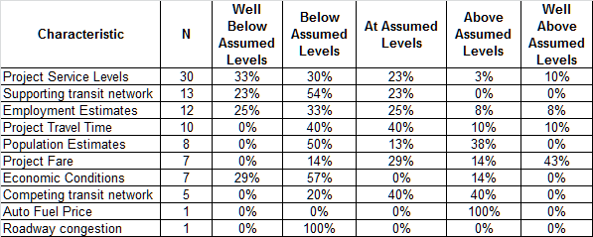
Project Assumption Accuracy Report
for Uncertainty Analyses (n=33)

Slide 27
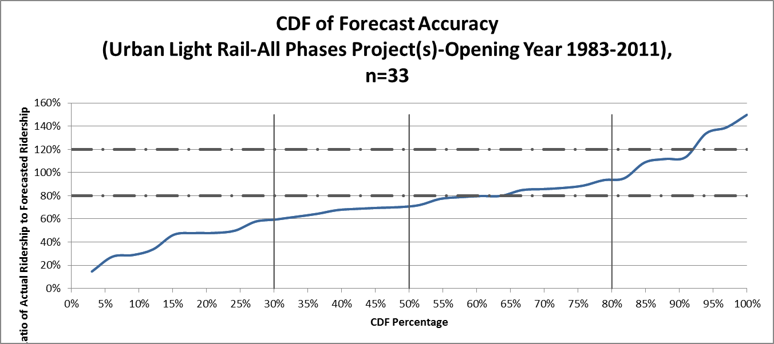
Mean = 0.76
Median = 0.72
Std. Dev = 0.32
Variance = 0.10

Slide 28
Reference Class #3
All Projects
Conditions for Application:
If the conditions for other two classes cannot be met

Slide 29
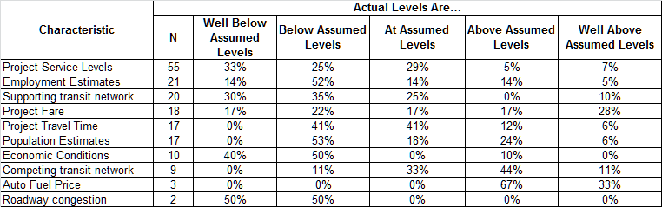
Project Assumption Accuracy Report
for Uncertainty Analyses (n=61)

Slide 30
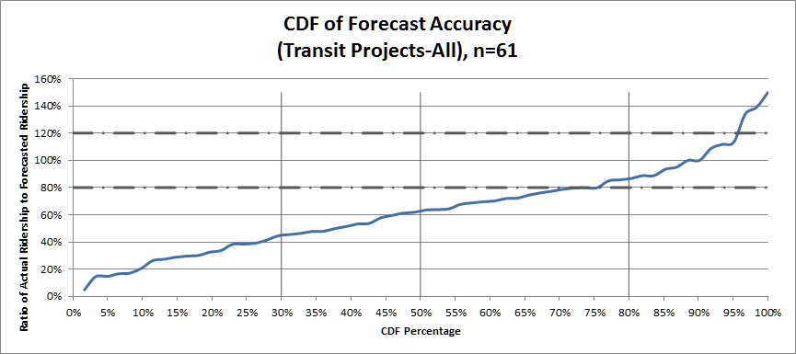
Mean = 0.63
Median = 0.64
Std. Dev = 0.32
Variance = 0.10

