Slide 1
Intra-Household Interactions in Auto-Ownership Decisions
Rajesh Paleti (Old Dominion University)
Chaitanya Paleti (CDM Smith)
Hsi-Hwa Hu (Southern California Association of Governments)
Guoxiong Huang (Southern California Association of Governments)
5/17/2015

Slide 2
Introduction
Auto-ownership → Important decision that influences all activity and travel choices
Serves as a critical input to almost all model components in Travel Demand Models (TDMs)
  Activity participation decisions → Shopping, Social, Discretionary
  Activity scheduling choices → Mode, Departure time, activity duration
Treated as a medium-to-long term decision

Slide 3
Traditional Modeling Methods-Modified
Number of cars owned → Household level decision
Auto Ownership Modeling Framework
Ordered Response Models |  | Unordered Choice Models
Auto ownership Propensity is mapped using threshold parameters |  | Households choose to own car ownership levels that maximizes their utility
Ex: Ordered probit or Ordered logit models |  | Ex: Multinomial logit model (MNL)
Order of the choices – Most important |  | Order of the choice – unimportant
>
Until late 1990s
Earlier comparisons between the two frameworks favored the unordered framework over ordered models (Bhatt and Pulugurta, 1998)
Recent evidence suggests generalized ordered response models are as good as comparable unordered models(Anowar et. al., 2014)
¹Bhat, C.R. and V. Pulugurta (1998) Comparison of Two Alternative Behavioral Mechanisms for Car Ownership Decisions. Transportation Research Part B, 32(1), 61-75.
²Anowar S., N. Eluru, and L. Miranda-Moreno (2014) Alternative Modeling Approaches Used for Examining Automobile Ownership: A Comprehensive Review. Transport Reviews, 34 (4), 441-473.

Slide 4
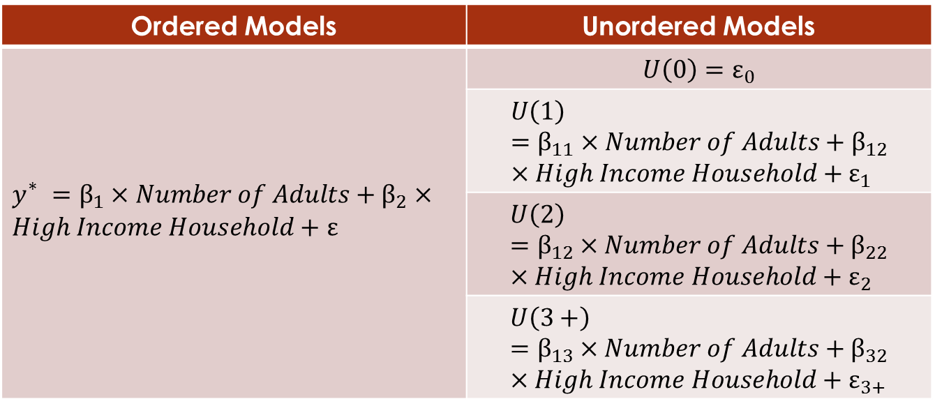
Traditional Modeling Methods …
Irrespective of the modeling framework (ordered or unordered), single household level propensity or utility expression was used
Ordered Models | Unordered Models
$y_{}^{∗}=β_{1}×Number of Adults+β_{2}×High Income Household+$ $ε$ | $$U\left(0\right)=ε_{0}$$
 | $$U\left(1\right)=β_{11}×Number of Adults+β_{12}×High Income Household+ε_{1}$$
 | $$U\left(2\right)=β_{12}×Number of Adults+β_{22}×High Income Household+ε_{2}$$
 | $$U\left(3+\right)=β_{13}×Number of Adults+β_{32}×High Income Household+ε_{3+}$$
Unitary Approach: Interactions – typically captured only using household composition variables (# workers, # retirees, presence of children etc)

Slide 5

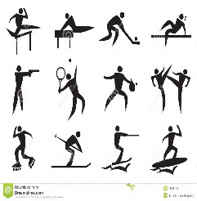





Intra-Household Interactions
Do not account for power structures and bargaining processes in households
  Employed household members most likely wield more control on household level choices
Different household members most likely negotiate and arrive at a consensus
Images :
http://thefeministwire.com/2012/04/gender-equity-still-requires-a-focus-on-the-second-shift/http://www.dreamstime.com/

Slide 6
Objectives
The primary objective of the current study is to capture intra-household interactions in household auto ownership decisions
Uncover power structures and factors that determine the relative influence of household members on auto ownership choices
Examine the data fit and policy sensitivity implications of the proposed model in comparison to traditional models

Slide 7
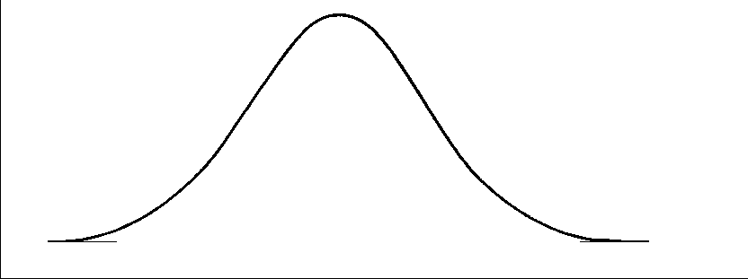

Unitary Model
$y^{∗}=V^{}+ε^{}$
$P\left(r\right)=P\left(ψ_{r−1}<y_{}^{∗}<ψ_{r}\right)$= $P\left(ψ_{r−1}<V^{}+ε^{}<ψ_{r}\right)$; r Є R
$ψ_{−1}=−∞$ and $ψ_{R+1}=∞$
Propensity Equation
Probability Equation
Limits of Thresholds
Translation of Propensity into Auto Ownership Levels
Auto Ownership Propensity

Slide 8
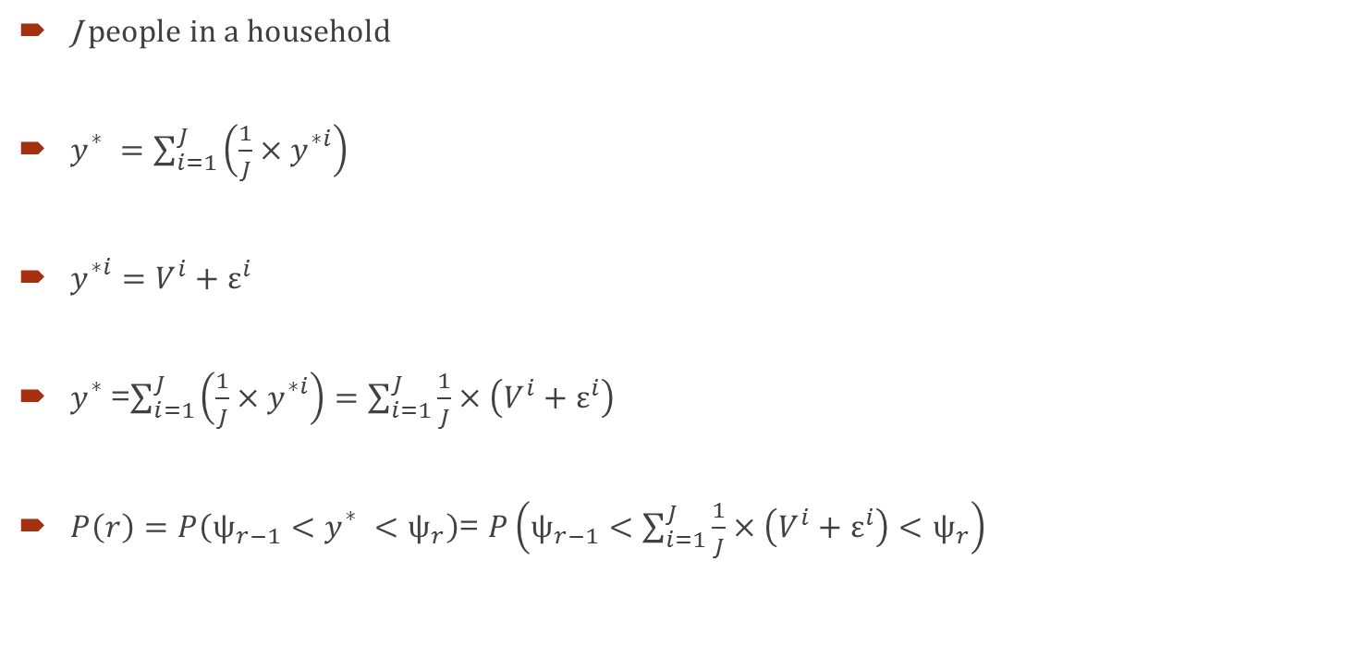
Compromise Type Interactions Model
J people in a household
$y_{}^{∗}=\sum_{i=1}^{J}{\left({\frac{1}{J}×y}_{}^{∗i}\right)}$
$y_{}^{∗i}=V^{i}+ε^{i}$
$y_{}^{∗}$=$\sum_{i=1}^{J}{\left({\frac{1}{J}×y}_{}^{∗i}\right)}=\sum_{i=1}^{J}{\frac{1}{J}×\left(V^{i}+ε^{i}\right)}$
$P\left(r\right)=P\left(ψ_{r−1}<y_{}^{∗}<ψ_{r}\right)$= $P\left(ψ_{r−1}<\sum_{i=1}^{J}{\frac{1}{J}×\left(V^{i}+ε^{i}\right)}<ψ_{r}\right)$
Household Propensity
HH Individual’s propensity
Household propensity
Probability Equation

Slide 9
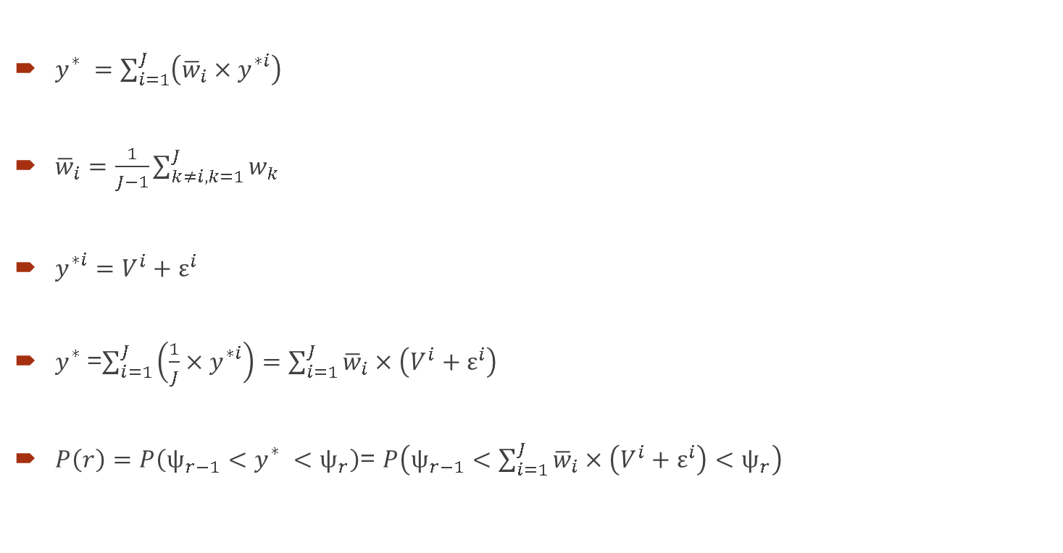
Capitulation Type Interactions (Altruistic) Model
$y_{}^{∗}=\sum_{i=1}^{J}{\left({\overline{w}}_{i}{×y}_{}^{∗i}\right)}$
${\overline{w}}_{i}=\frac{1}{J−1}\sum_{k≠i,k=1}^{J}{w_{k}}$
$y_{}^{∗i}=V^{i}+ε^{i}$
$y_{}^{∗}$=$\sum_{i=1}^{J}{\left({\frac{1}{J}×y}_{}^{∗i}\right)}=\sum_{i=1}^{J}{{\overline{w}}_{i}×\left(V^{i}+ε^{i}\right)}$
$P\left(r\right)=P\left(ψ_{r−1}<y_{}^{∗}<ψ_{r}\right)$= $P\left(ψ_{r−1}<\sum_{i=1}^{J}{{\overline{w}}_{i}×\left(V^{i}+ε^{i}\right)}<ψ_{r}\right)$
Household propensity
Weights for each HH Individual
Individual’s propensity
Household Propensity
Probability Equation

Slide 10
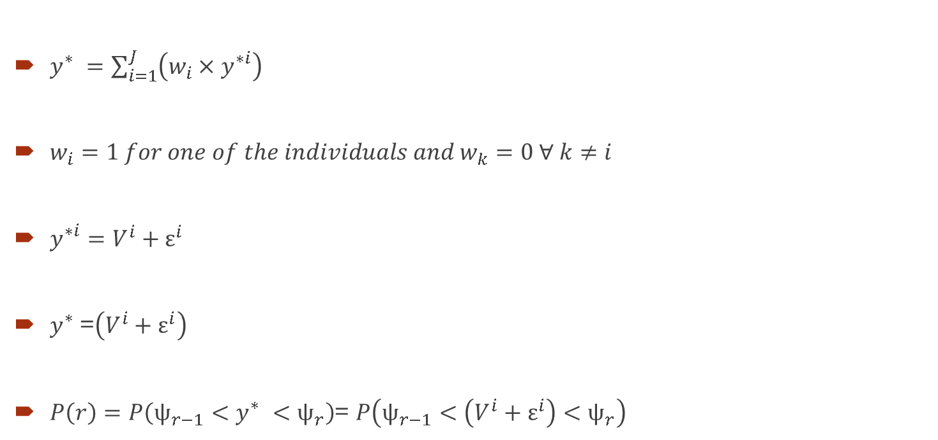
Autocratic Type Interactions Model
$y_{}^{∗}=\sum_{i=1}^{J}{\left(w_{i}{×y}_{}^{∗i}\right)}$
$w_{i}=1 for one of the individuals and{ w}_{k}=0 ∀ k≠i$
$y_{}^{∗i}=V^{i}+ε^{i}$
$y_{}^{∗}$=$\left(V^{i}+ε^{i}\right)$
$P\left(r\right)=P\left(ψ_{r−1}<y_{}^{∗}<ψ_{r}\right)$= $P\left(ψ_{r−1}<\left(V^{i}+ε^{i}\right)<ψ_{r}\right)$
Household propensity
Individual’s propensity
Household Propensity
Probability Equation

Slide 11
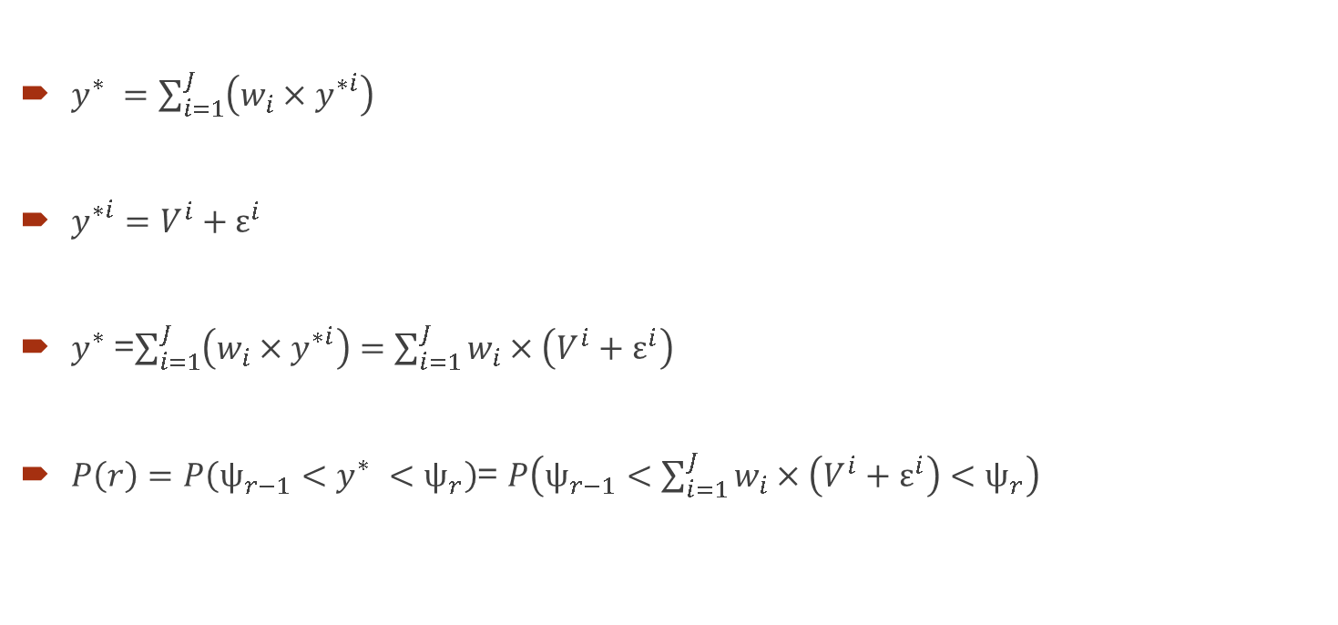
Weighted Propensities
$y_{}^{∗}=\sum_{i=1}^{J}{\left(w_{i}{×y}_{}^{∗i}\right)}$
$y_{}^{∗i}=V^{i}+ε^{i}$
$y_{}^{∗}$=$\sum_{i=1}^{J}{\left({w_{i}×y}_{}^{∗i}\right)}=\sum_{i=1}^{J}{w_{i}×\left(V^{i}+ε^{i}\right)}$
$P\left(r\right)=P\left(ψ_{r−1}<y_{}^{∗}<ψ_{r}\right)$= $P\left(ψ_{r−1}<\sum_{i=1}^{J}{w_{i}×\left(V^{i}+ε^{i}\right)}<ψ_{r}\right)$
Household propensity
Individual’s propensity
Household Propensity
Probability Equation

Slide 12
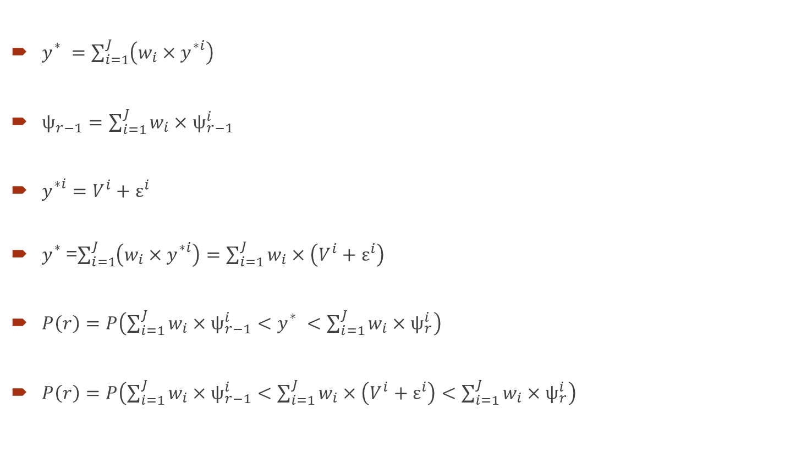
Weighted Thresholds & Propensities
$y_{}^{∗}=\sum_{i=1}^{J}{\left(w_{i}{×y}_{}^{∗i}\right)}$
$ψ_{r−1}^{}=\sum_{i=1}^{J}{w_{i}×ψ_{r−1}^{i}}$
$y_{}^{∗i}=V^{i}+ε^{i}$
$y_{}^{∗}$=$\sum_{i=1}^{J}{\left({w_{i}×y}_{}^{∗i}\right)}=\sum_{i=1}^{J}{w_{i}×\left(V^{i}+ε^{i}\right)}$
$P\left(r\right)=P\left(\sum_{i=1}^{J}{w_{i}×ψ_{r−1}^{i}}<y_{}^{∗}<\sum_{i=1}^{J}{w_{i}×ψ_{r}^{i}}\right)$
$P\left(r\right)=P\left(\sum_{i=1}^{J}{w_{i}×ψ_{r−1}^{i}}<\sum_{i=1}^{J}{w_{i}×\left(V^{i}+ε^{i}\right)}<\sum_{i=1}^{J}{w_{i}×ψ_{r}^{i}}\right)$
Household propensity
Weighted Thresholds
Individual’s propensity
Household Propensity
Probability Equation
Probability Equation

Slide 13
Data
Southern California Association of Governments (SCAG) Household Travel Survey Data
Six County Region: LA, Orange, Ventura, San Bernardino, Imperial, Riverside
26,529 households

Slide 14
Empirical Results (Weighted Thresholds & Propensities)
 | Variable | Coeff | Std. error | t-stats | P value
Threshold 1 | UNO | -4.6074 | 4.2327 | -1.089 | 0.2764
Threshold 2 | UNO | 0.8957 | 0.015 | 59.522 | 0
 | Medium Income Household | 0.1443 | 0.0271 | 5.321 | 0
 | Upper Medium Income Household | 0.1892 | 0.0242 | 7.806 | 0
 | High Income Household | 0.2686 | 0.0447 | 6.003 | 0
 | HH having more than one person w.r.t. single auto ownership alternative | -0.5657 | 0.0147 | -38.412 | 0
Threshold 3 | UNO | 0.6213 | 0.0231 | 26.918 | 0
 | Medium Income Household | 0.1787 | 0.0314 | 5.686 | 0
 | Upper Medium Income Household | 0.1832 | 0.0252 | 7.264 | 0
 | High Income Household | 0.2858 | 0.0262 | 10.916 | 0
 | HH having more than two person w.r.t. two auto ownership alternative | -0.498 | 0.0167 | -29.87 | 0
 | HH having one person w.r.t.two auto ownership alternative | -0.8015 | 0.0392 | -20.45 | 0
Threshold 4 | UNO | 5.8397 | 0.6691 | 8.728 | 0
 | Medium Income Household | 0.0723 | 0.0692 | 1.046 | 0.2957
 | Upper Medium Income Household | 0.0903 | 0.0548 | 1.648 | 0.0993
 | High Income Household | 0.0828 | 0.0565 | 1.466 | 0.1427
 | HH having more than three person w.r.t.three auto ownership alternative | -0.3936 | 0.0322 | -12.208 | 0
 | HH having less than three persons w.r.t.three auto ownership alternative | -0.6201 | 0.0354 | -17.543 | 0
 | HH individual has bachelors degree; yes=1 and no=0 | 0.1325 | 0.0491 | 2.699 | 0.007
 | HH individual has a graduate degree; yes=1 and no=0 | 0.1776 | 0.057 | 3.118 | 0.0018
 | HH individual is female; yes=1 and no=0 | 0.1574 | 0.0767 | 2.052 | 0.0402
 | HH individual is over 16 years; yes=1 and no=0 | -5.689 | 0.6712 | -8.476 | 0
 | HH individuals a full-time worker; yes=1 and no=0 | 0.1135 | 0.0493 | 2.304 | 0.0212
Significant Variables-1
Income Level of Households
Significant Variables-2
Sufficiency Variables
Alternate specific
Significant Variables-3
HH Individual Characteristics

Slide 15
Empirical Results (Weighted Thresholds & Propensities) …
 | Variable | Coeff | Std. error | t-stats | P value
Propensity | UNO | 1 | . | . | .
 | Number of adutls aged >=16 years | 0.499 | 0.0156 | 31.952 | 0
 | Number of Retired People | -0.2696 | 0.0385 | -7.002 | 0
 | Number of Driving Age children | -0.2746 | 0.0254 | -10.803 | 0
 | Average Commute Distance | 0.1572 | 0.0565 | 2.784 | 0.0054
 | HH individual is over 16 years; yes=1 and no=0 | -0.4601 | 0.0774 | -5.948 | 0
 | HH individualis a full-time worker; yes=1 and no=0 | 0.5276 | 0.0348 | 15.156 | 0
 | HH individualis a part-time worker; yes=1 and no=0 | 0.4837 | 0.0397 | 12.183 | 0
 | HH individualis a university student; yes=1 and no=1 | 0.266 | 0.0741 | 3.592 | 0.0003
 | HH individual is retired; yes=1 and no=0 | 0.5308 | 0.0699 | 7.596 | 0
 | Age of HH individual is over 80 years; yes=1 and no=0 | -0.4585 | 0.0385 | -11.919 | 0
 | Medium Income Household | 0.669 | 0.0452 | 14.79 | 0
 | Upper Medium Income Household | 0.9968 | 0.0451 | 22.126 | 0
 | High Income Household | 1.5117 | 0.0957 | 15.801 | 0
 | Single family detached household | 0.3166 | 0.0228 | 13.862 | 0
 | Single family attached household | 0.1389 | 0.0282 | 4.925 | 0
 | HH individual has highschool graduate; yes=1 and no=0 | 0.3926 | 0.0378 | 10.384 | 0
 | HH individual has associate graduate degree; yes=1 and no=0 | 0.597 | 0.0373 | 16.001 | 0
 | HH individual has bachelors degree; yes=1 and no=0 | 0.5683 | 0.0397 | 14.315 | 0
 | HH individual has a graduate degree; yes=1 and no=0 | 0.4745 | 0.0416 | 11.417 | 0
 | Owner-occupied household | 0.4609 | 0.0209 | 22.012 | 0
 | Household density (# HHs/acre) | -0.015 | 0.0018 | -8.167 | 0
 | % of TAZ area are in non-freeway HQTA (high-quality transit area) | -0.0999 | 0.0212 | -4.719 | 0
 | Total Bus Stop Density | -0.115 | 0.0299 | -3.848 | 0.0001
 | Transit Accessibity | -1.2549 | 0.2228 | -5.631 | 0
 | HH individual is female; yes=1 and no=0 | -0.3005 | 0.0263 | -11.436 | 0
 | HH individual has multiple jobs; yes=1 and no=0 | 0.2101 | 0.0444 | 4.731 | 0
 | HH individual has work flexible schedule; yes=1 and no=0 | 0.0777 | 0.0262 | 2.967 | 0.003
Significant Variables-1
Households Variables
Significant Variables-2
HH Individual Characteristics
Significant Variables-3
Zonal Variables

Slide 16
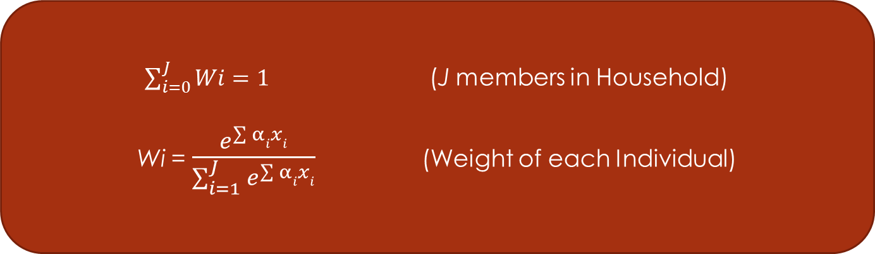
Empirical Results (Weighted Thresholds & Propensities) …
 | Variable | Coeff | Std. error | t-stats | P value
Weights | HH individual is over 16 years; yes=1 and no=0 | 7.2394 | 0.5944 | 12.18 | 0
 | HH individual is retired; yes=1 and no=0 | 0.6811 | 0.2021 | 3.371 | 0.0007
 | Age of HH individual is over 80 years; yes=1 and no=0 | 0.6004 | 0.3006 | 1.997 | 0.0458
 | HH individual is female; yes=1 and no=0 | -0.5418 | 0.0986 | -5.493 | 0
 | HH individual has multiple jobs; yes=1 and no=0 | 0.3516 | 0.1932 | 1.82 | 0.0687
$\sum_{i=0}^{J}{Wi}=1$ (J members in Household)
Wi = $\frac{e^{\sum{α}ixi}}{\sum_{i=1}^{J}{e^{\sum{α}ixi}}}$ (Weight of each Individual)

Slide 17
Model Performance
 | ORP | GORP | Compensatory | Capitulary | Weighted | Weighted Thresholds
Log-Likelihood | -25677.03 | -24236.70 | -24208.67 | -24200.34 | -24132.16 | -24105.92
Number of Parameters (K) | 28 | 39 | 45 | 50 | 50 | 55
Bayesian Information Criterion (BIC)=-2*LL+K*LN(N) | 51639.7 | 48870.6 | 48875.7 | 48910.0 | 48773.6 | 48772.1
The model with the lowest BIC is preferred

Slide 18
Conclusion
Ordered Response Model to capture intra-household interactions
  Weighted thresholds
  Weighted propensity equations
  Average weighted propensity equation to predict auto ownership
Captures relative influence of household members
Significant implications to policy sensitivity

Slide 19
Thank You
Contact Information
Chaitanya Paleti
Transportation Planner
CDM Smith
Raleigh, NC
paletisivasaic@cdmsmith.com
Rajesh Paleti
Assistant Professor
Old Dominion University
Norfolk, VA
rpaleti@odu.edu

