Slide 1
A Parcel Level Demographic Forecasting Process Integrating Land Use and Transportation
Tom Williams, AICP, TTI
Geena Maskey, CAMPO

Slide 2
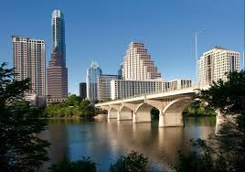
Success in Small Area Demographics for a Large Region
Need a System that Combines:
  Sound Technical Process
  Engage Local Planners
Technical Process to put Reasonable “Fences” around Estimates
Engagement of Local
Planners that Impact
Small Areas

Slide 3
Austin Started in 2006…
Decide to Make it Better
Test and Experiment
Engage Local Planners
Use and Show Results
Design a Technical Method
Dedicate Resources to LU Forecasting
Data and Lots of It
Question the Process

Slide 4
CAMPO Parcel Level Process
CAMPO Process uses conceptual “Goal Densities”
  “Ultimate Density”, “Expected Growth/Density”
Density is a subjective idea with specific measurement
  Smaller cities have different idea of density/growth than larger cities
  Not just New Growth – Must Consider Redevelopment

Slide 5
CAMPO Demographic Modeling
Parcel GIS
Determine
Developable
Space
Sum to TAZs
Calculate
Attractiveness
Input Goal
Densities
Allocate
Growth to Grids
Input annual
Control
Total Growth

Slide 6
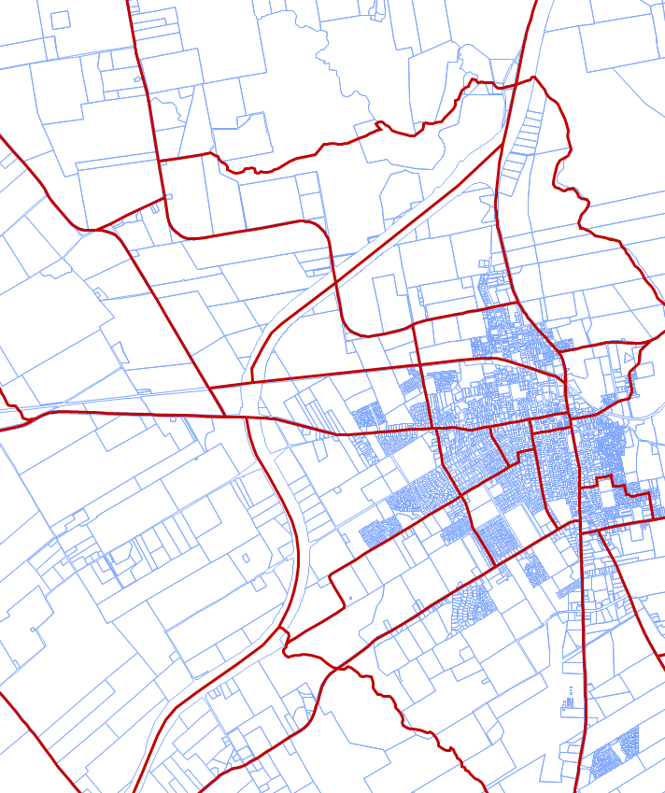
Steps in the Process
Starts with Control Totals by County
GIS - Permitted uses from land use plans, etc.
Ranking and Distribution of Attractiveness for Each Parcel
Definition of Goal Densities
Allocation by Relative Accessibility Ratings

Slide 7
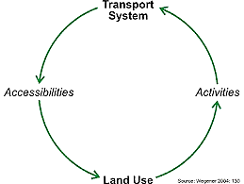
Link Demographics to Transportation
Roadway and Transit Skims
2010 Skims for 2020 Allocation
2020 Skims for 2040 Allocation
Key: Not Presume growth prior to testing network capacity

Slide 8
Bin Distribution
Distributed across larger “bins” according to a simple distribution curve
Proxy for variables not explicitly included
  Schools
  Housing cost
  Urban/rural preferences
“Spread variable”
for allocation

Slide 9
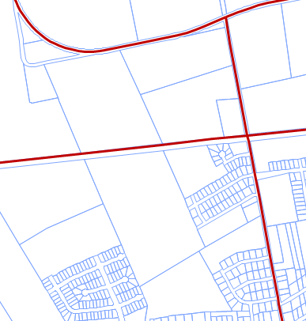
Cannot Have it All…
For some parcels, complete knowledge, for others no knowledge of plans
Need a System that Can Handle Both Situations

Slide 10

Grumpy About Parcels
Parcels are real, TAZs are not
Density Ineffective for
Allocation to Small Parcels
  Created Combined Method, using Explicit Maximums Units/Parcel
  Mostly Housing Subdivisions, where Maximum is 1 Unit per Parcel
Allowed Direct Input for Known Developments

Slide 11

Linking Land Use and Regional Parcel Demographic Forecasting
How Was the Model Implemented?

Slide 12

Data Gathering
Met with City Planners, Engineers, Administrators in Local Agencies
6 Workshops for 6 Counties
Request from MPO TAC
Data Requested
  Comprehensive Plans
  Land Use Maps
  GIS Layers
  Scans of PDFs, Paper maps
  Tagged Parcels with Land Use Codes

Slide 13

Data Preparation
Mostly 2035
City of Austin: Good Participation for Goal Densities
Reviewed by CAMPO Staff using Google Earth
Finding People Knowledgeable of Local Areas
  On MPO Staff
  Other
  Anecdotal OK

Slide 14

Base Parcel GIS Line Work
Central Appraisal District (CAD) Parcel GIS for Line Work
Each County (6) Merged to one GIS Layer
Split Parcels on County Lines
Added other Layers
  Natural Resources
  Transportation
Need Full Time GIS Analyst

Slide 15
2010 Data Reconciliation
Census Demographic Not in Parcels
Disaggregated 2010 Census Data from Block to Parcel
  Used a GIS Python Script (CDMSmith)
Texas Workforce Commission (TWC) for employment
  Point Data Overlay to Parcels
Regional COG (CapCOG) Vacant Land Inventory to flag “Ag-Open” as un-developed

Slide 16


Other Data Sources
Austin “Upcoming Future Projects” list of Near-term/Pending Development
Williamson County - Municipal Utility Districts, Subdivision GIS
Chamber of Commerce Employment GIS

Slide 17

Keys to Success with Parcels
Must Have Robust GIS!
Interaction with MPO Committees
  Hearing Discussions and Comments
  Educating on Process
  Going from Subjective to Objective Process
  Curiosity, Doubt, Concern
Continuing Staff Focus
  Develop Knowledge of Region
  Understanding of Local City Policies/Plans

Slide 18


Keys to Success
Historically: “Trends”
Sprawl vs. Central City
  Very Disparate Viewpoints
Translate between Various Levels of Detail to “Goal Density”
Must Have Reasonable Goal Densities for Unincorporated Areas Also
More Participation = Better Result

Slide 19

Potential Pitfalls
Participation – Some Proactive w/Land Use Planning, Others Not
  Some Cities Very Specific
  Use Anectdotal Knowledge to Supplement
Since Detailed, Impression is that Model is Perfect
Have to get Known Parcels Correct or Entire Process is Discredited
Difficult with 660,000 Parcels in 6 Counties

Slide 20

Vaguely Right vs. Exactly Wrong
“Goal Density” Easier for Households than Employment
Larger City Vision of “High Density” Different from Smaller
Focus on Translating Various Inputs to Common Measures
Must make Some Assumptions!

