Slide 1
Implementing a Blended Model System to Forecast Transportation and Land Use Changes at Bob Hope Airport
15th TRB National Transportation Planning Applications Conference
May 19, 2015

Slide 2
Acknowledgements
Burbank-Glendale-Pasadena Airport Authority
Pat Coleman, co-author
Surface Transportation and Uniform Relocation Assistance Act of 1987

Slide 3
Overview
Project Description
Blended Model Process
Alternatives Evaluated
Results

Slide 4
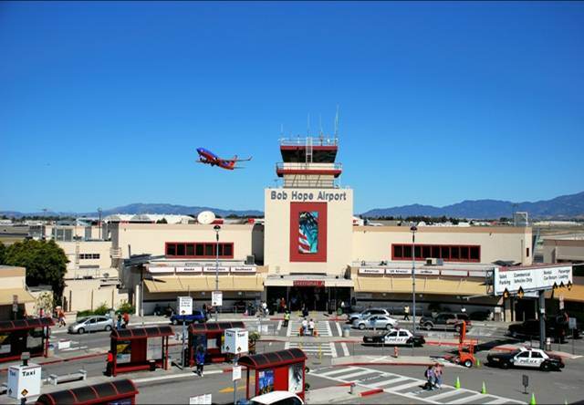
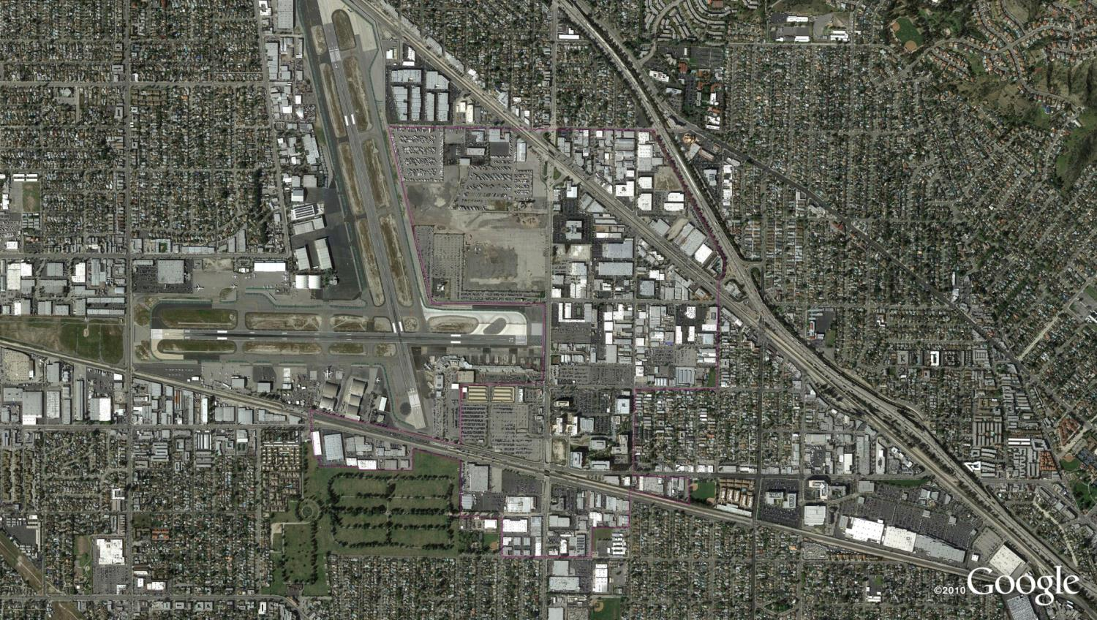
The Challenge: How to Model Airport “Transit Oriented Development”
Notes:
BUR is x miles from downtown Los Angeles, relatively densely populated part of the region (SFV), near Pasadena
Served by commuter rail, soon to be served by a second line
New RITC

Slide 5
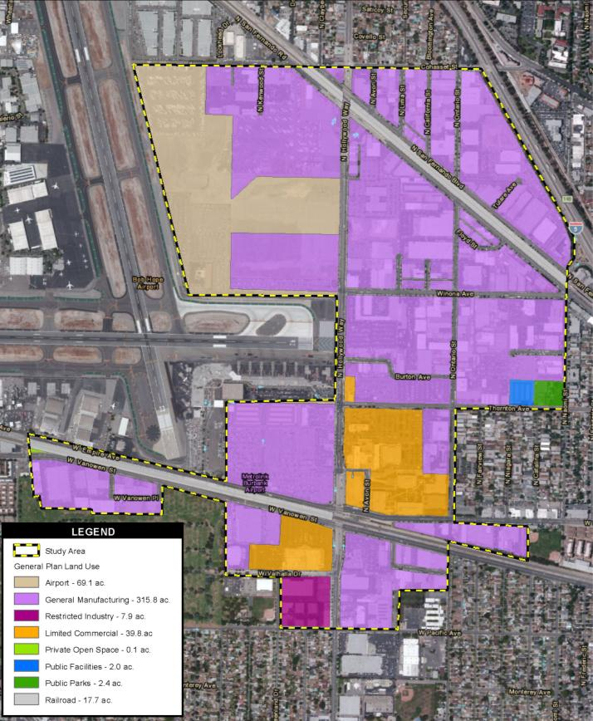
Ongoing and Proposed Changes in Land Use
Historic Lockheed Facility
Industrial uses being repurposed to new media
>50% increase in jobs from 2002 to 2010

Slide 6
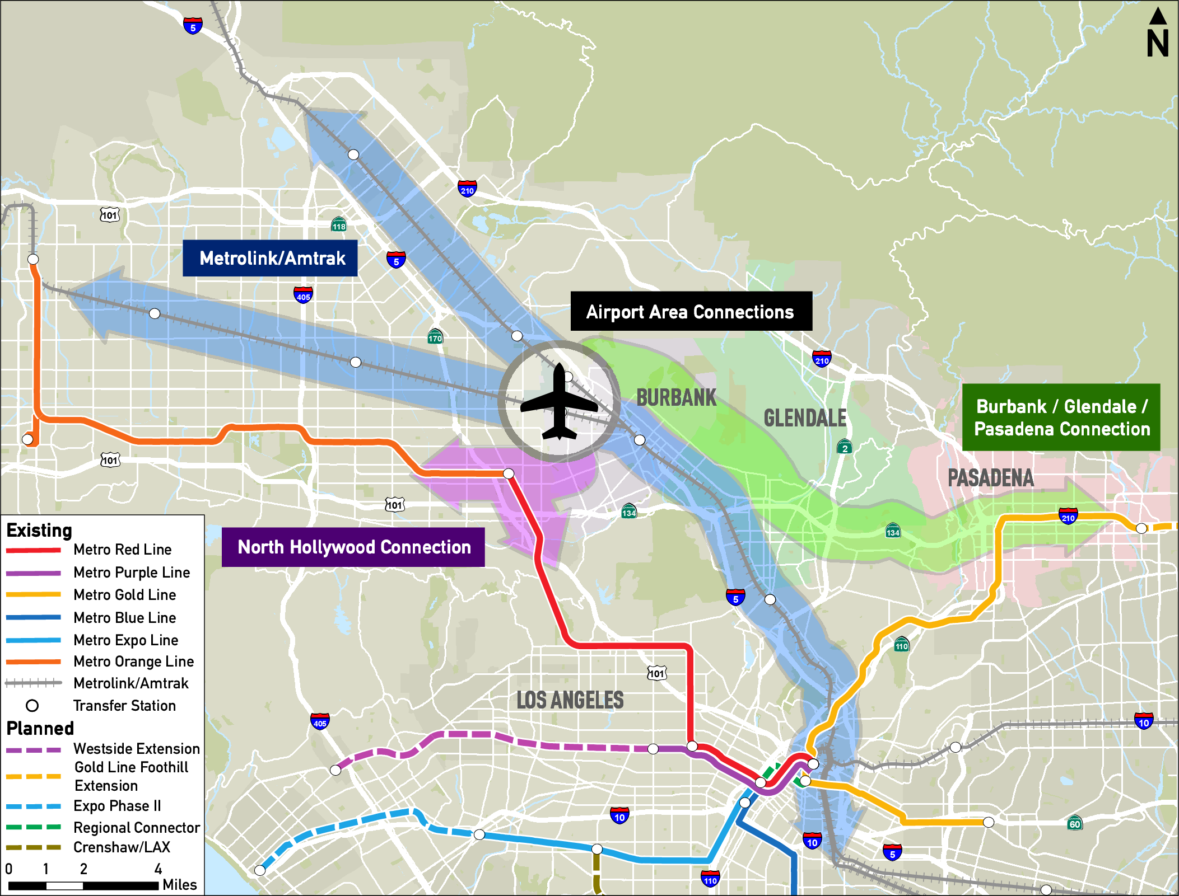
Potential Changes in Transit Network

Slide 7
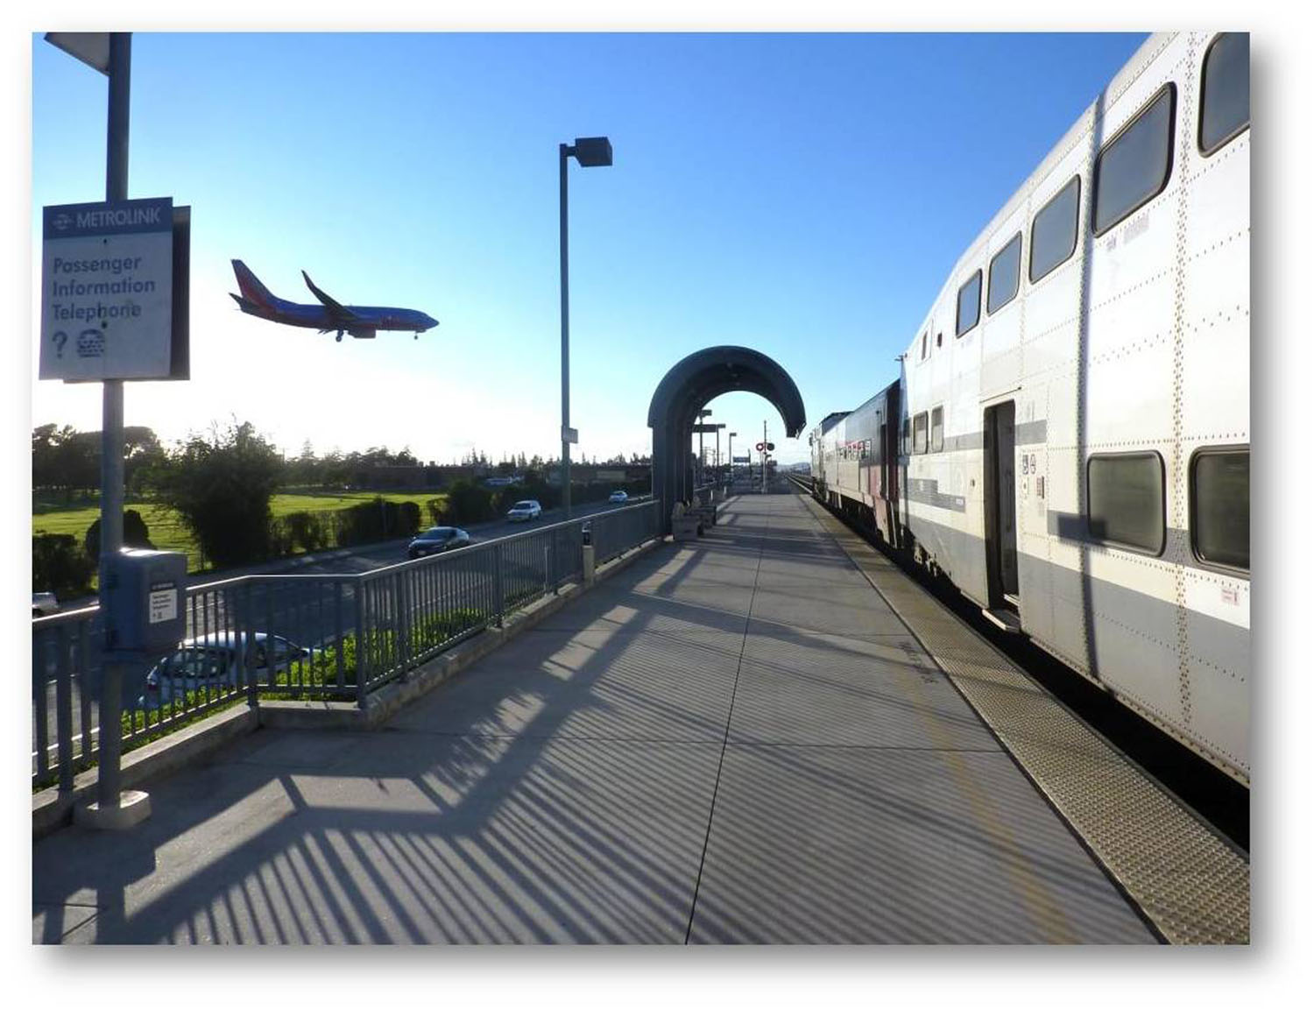
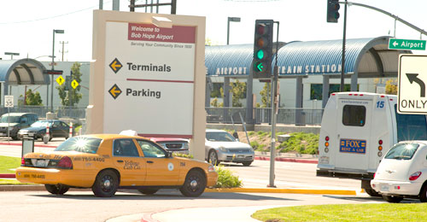
Changes in Airport Mode of Access

Slide 8
Blended Model Process
Land Use Changes → City of Burbank Model
Transit Network Changes → LA Metro Model
Mode of Access Changes → Air Passenger Model

Slide 9
Burbank Model
TransCAD model windowed from regional model
  Includes the City of Burbank and neighboring areas with detailed zone structure
  Land use based trip generation
  Gravity trip distribution
  Capacity constrained equilibrium traffic assignment process
  No transit component

Slide 10
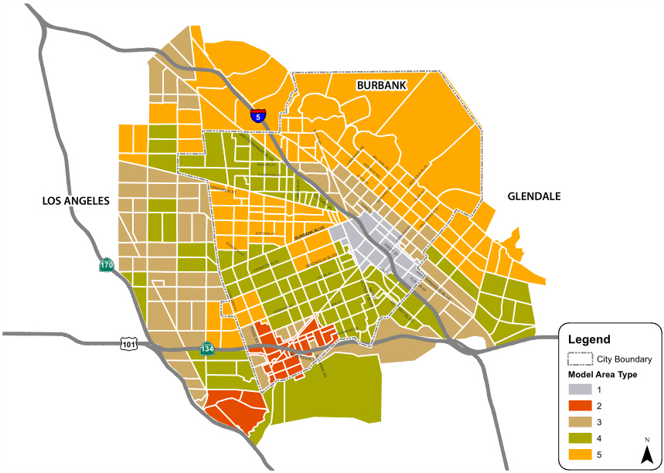
Burbank Model

Slide 11
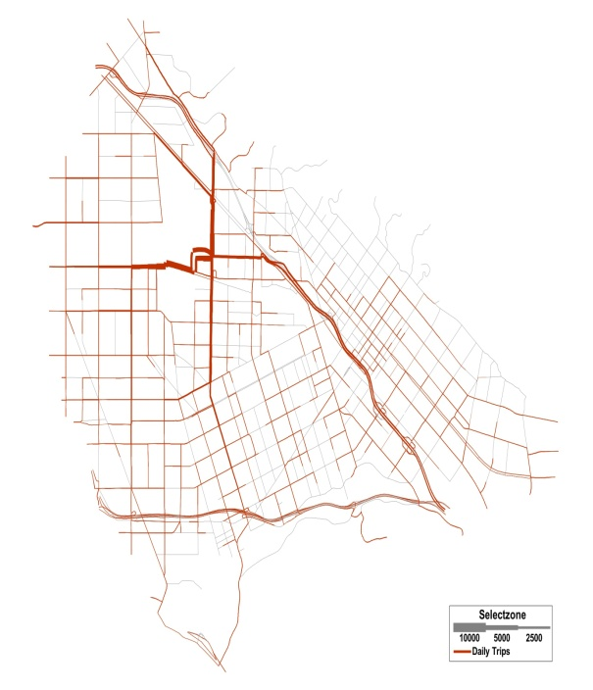
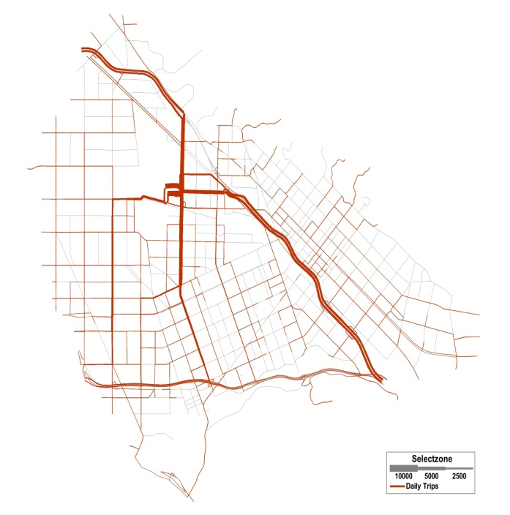
Burbank Model
Synthetic generation and distribution of auto trips at BUR replaced by a survey-based trip table
Synthetic
Survey

Slide 12
LA Metro Model
Tranplan model
  Detailed transit network in and around Los Angeles County
  Vetted by FTA for use in forecasts supporting Section 5309 New Starts applications

Slide 13
Air Passenger Model
Runs in parallel with the “regular” Metro model
Originally used to represent person travel to and from LAX
Calibrated to market and conditions at BUR based on extensive data collection

Slide 14
Blended Model Process
For each scenario, incremental auto trips calculated by APM and Metro mode choice model.
Delta applied to the City model just prior to highway assignment.
Air Passenger Model
Enplane-ments, Ground Access by Mode
Metro Model
City of Burbank TDF Model
Detailed Area Highway Assignments/Link Volumes
Transit Assignments
Change in Auto Trips

Slide 15
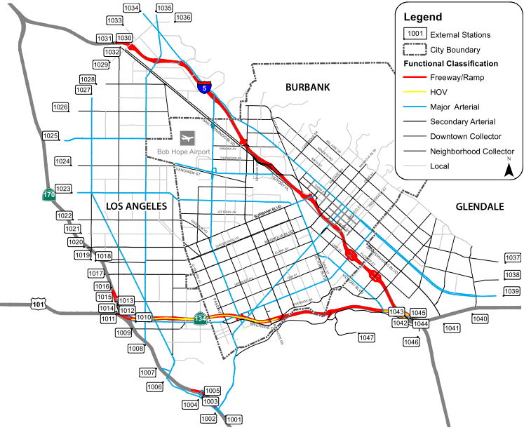
Blended Model Process
Metro model zones outside the study area aggregated, and matched to external zones of the City model, based on the routes that trips from those zones would take to reach the Airport.

Slide 16
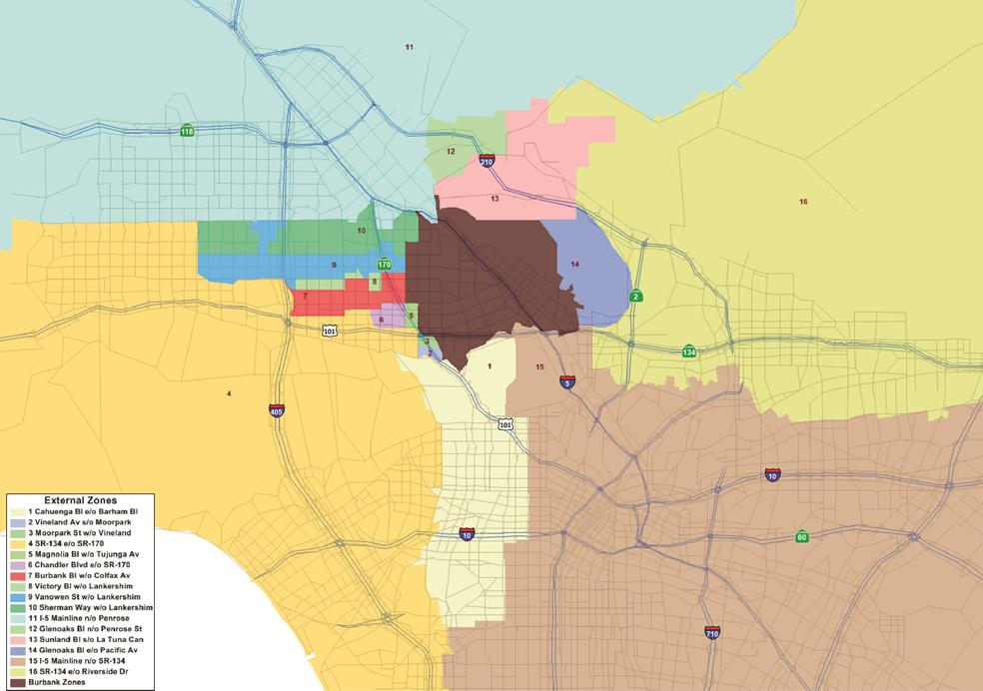
Blended Model Process

Slide 17
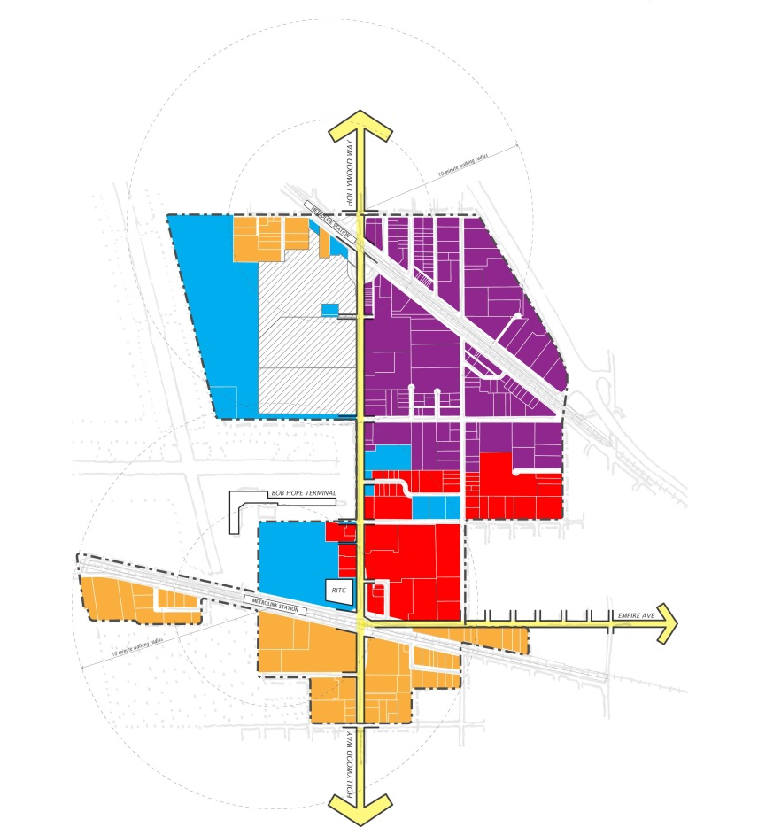
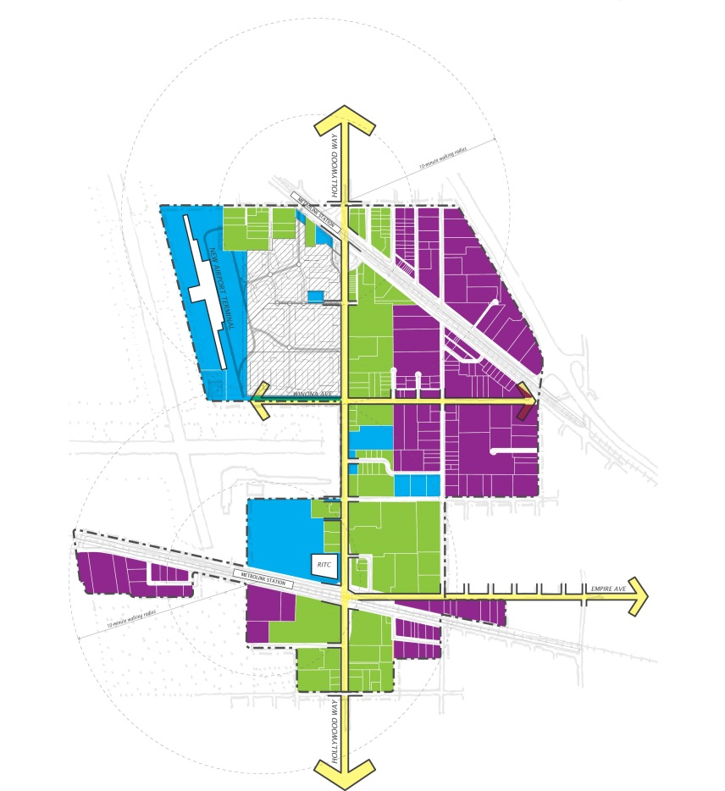
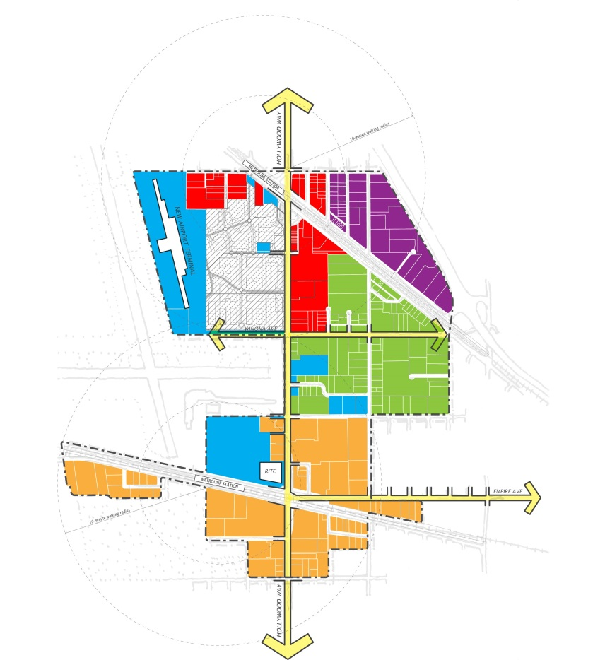
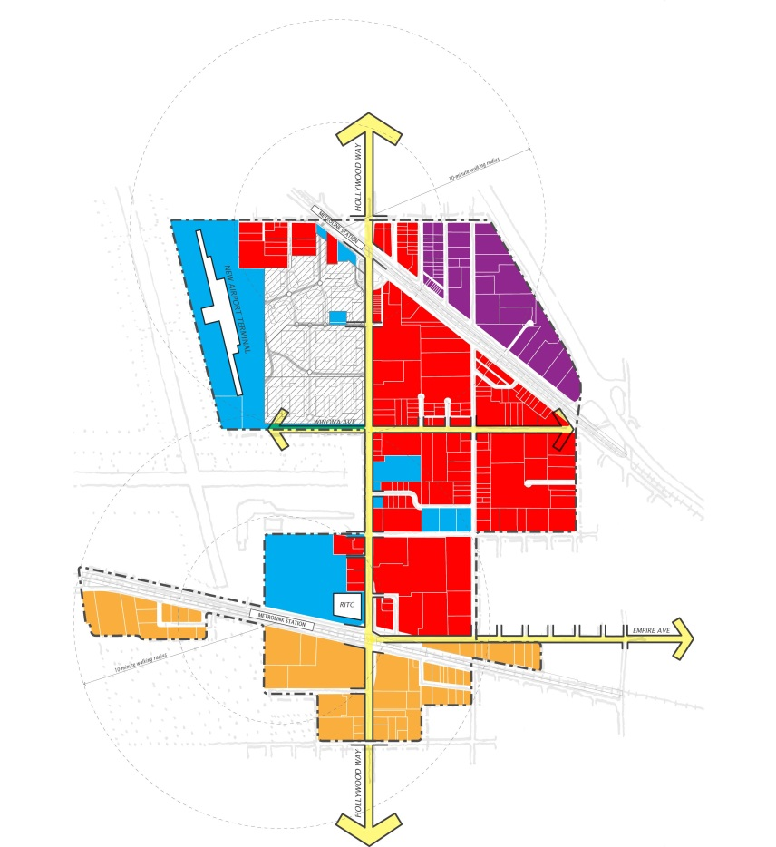
Land Use Alternatives
ALT 2
Flex Corridor
ALT 3
Flex District
ALT 1
Industrial
ALT 4
Tech

Slide 18
Transportation Alternatives
 | Alt 1 | Alt 2 | Alt 3 | Alt 4
North Hollywood | Local Bus | Rapid Bus | BRT | Subway
Pasadena | Shuttle | Express Bus | Express Bus | LRT

Slide 19
2035 Transit Boardings on routes serving the Area
 | Alt 1 | Alt 2 | Alt 3 | Alt 4
Bus | 77,174 | 76,151 | 78,881 | 65,183
BRT | 66,063 | 75,964 | 79,033 | 68,531
LRT | 0 | 0 | 0 | 25,237
Subway | 113,008 | 113,516 | 113,164 | 109,900
Total | 256,245 | 265,631 | 271,078 | 268,851

Slide 20
2035 Mode Share to Airport
 | Alt 1 | Alt 2 | Alt 3 | Alt 4
Drop-off | 38.8% | 39.1% | 38.7% | 37.9%
Drive | 29.8% | 29.9% | 29.8% | 29.5%
Transit | 7.4% | 7.0% | 7.6% | 9.2%
Other | 24.0% | 24.1% | 23.8% | 23.4%
(Current transit share to airport is about 2%.)

Slide 21
Conclusions
“Blended” model consisting of city highway model, regional transit model, and mode of access model used to forecast impacts of land use and network change at/near an airport
Expanded BRT and bus service provide greatest ridership in the area (new land uses)
Subway and LRT increase transit share as mode of access to the airport

Slide 22
Questions?

Slide 23
Validation Approach
Validate Burbank and Metro models to study area conditions
Calibrate Air Passenger Model to BUR travel markets and modes of arrival

Slide 24
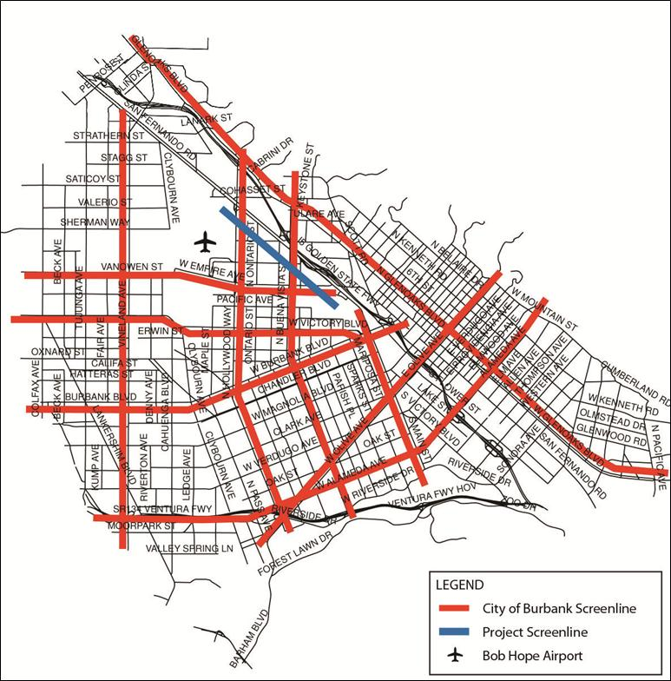
Burbank Model Validation
The City of Burbank model was validated with 2010 traffic volumes counts along 10 screenlines
Additional screenline between BUR and I-5

Slide 25
Metro Model Validation
Route level validation
Metro routes 94, 165, 222, and 794
Burbank Bus routes 2 (Empire to Downtown) and 3 (NoHo to Empire)
Metrolink/Amtrak trains

Slide 26
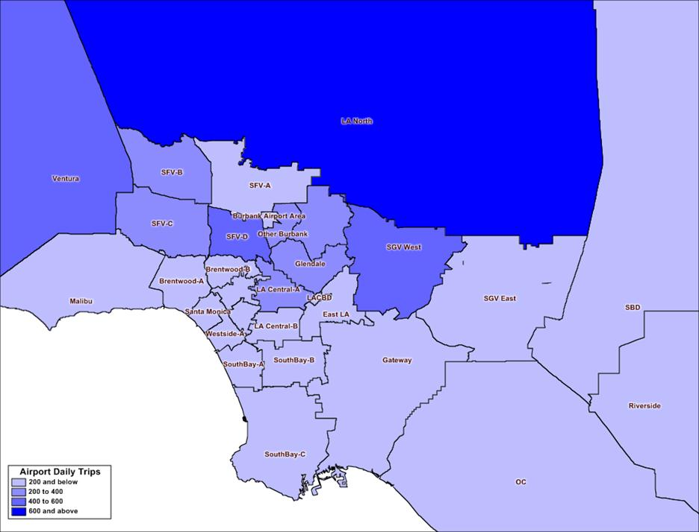
Air Passenger Model Calibration/Validation
Trip Tables by purpose developed using 2012 air passenger survey data

Slide 27
Air Passenger Model Calibration/Validation
Calibration target values from 2012 BUR air passenger survey

