Slide 1
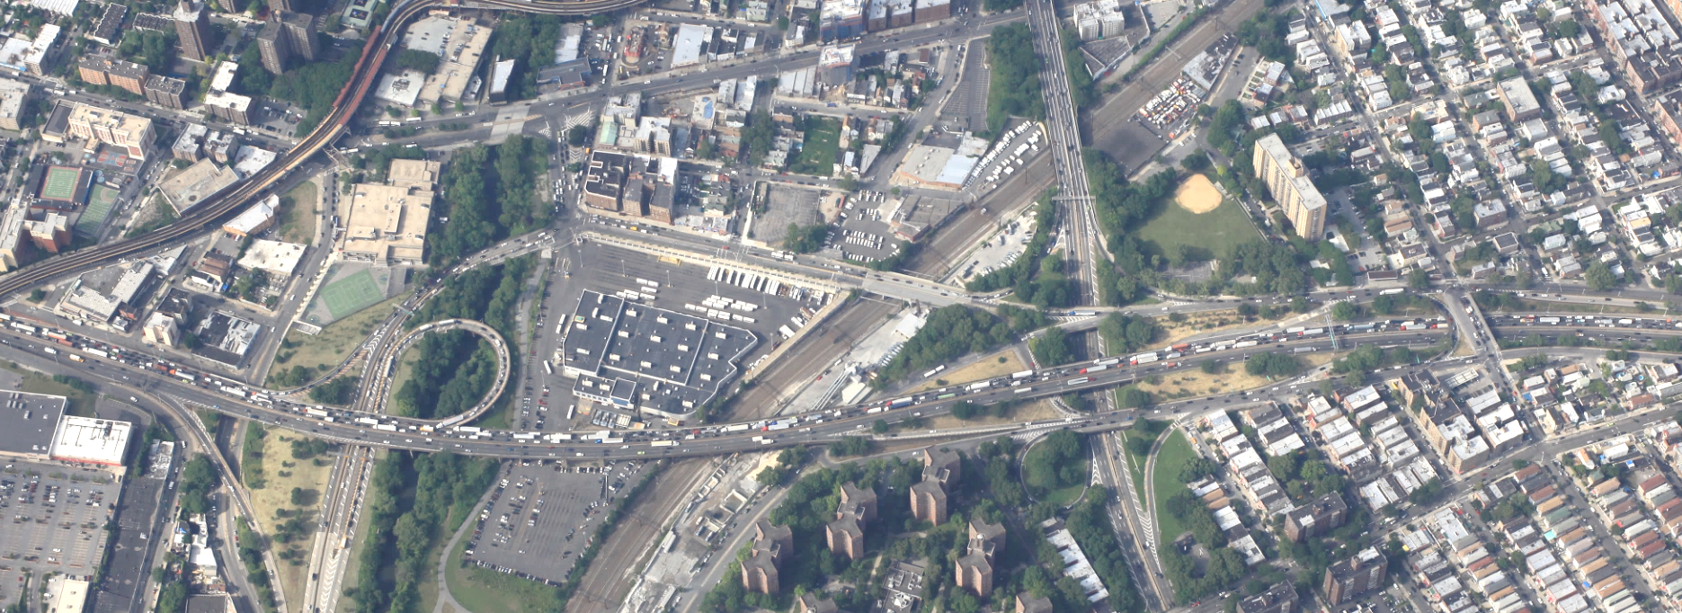
Integrated Macro-Micro Highway Demand/Operational Analysis Case Study: Cross Bronx Expressway Corridor, Bronx, NY
Presented at the 15th TRB Transportation Planning Applications Conference
Authors: Bernard Alpern, Paul Balmacund, AECOM

Slide 2
Presentation Overview
Introduction/Purpose of Analysis
Approach
Macro-level Modeling
Micro-level Modeling
Results

Slide 3
The Cross Bronx Expressway is a Highly Congested Highway
Inrix

Slide 4
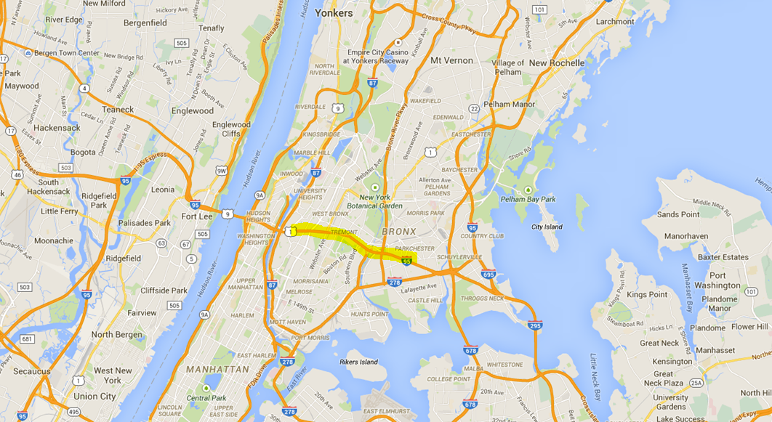
Cross Bronx Expressway in a Regional Context
NEW ENGLAND
NEW JERSEY, WEST & SOUTH
LONG ISLAND

Slide 5
Introduction/Purpose of Analysis
Planning-level Study performed for NYS DOT
Cross Bronx Expressway:
- CBE only has Partial, Discontinuous Service Roads
- Lack of Alternative, Efficient E-W Routes for Local Travel
Concept:
- Create a continuous E-W “Connector Road” alongside the CBE
- Reconnect N-S Streets that were made discontinuous at time of the CBE construction
- Improve Local Traffic Circulation
- Involves the Construction of New Streets and the Use of Existing Streets
Estimate Travel Demand and Traffic Operational Feasibility, and Benefits

Slide 6
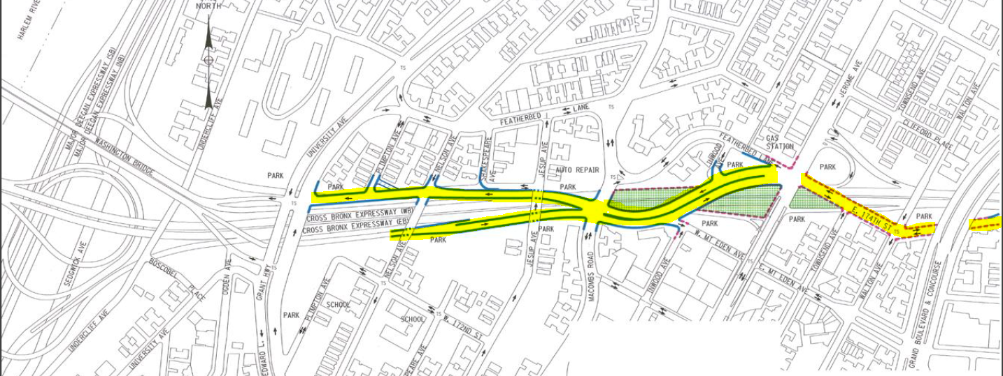
Limits and Configuration of Connector Road in CBE Corridor
Hugh Grant
Circle
University
Ave
Configuration Details of Segment 1 of CBE Connector Road
University
Ave
Grand
Concourse

Slide 7
Modeling Approach
Use a combination of “macro-level” static assignment model and microsimulation
Macro-level model used to project growth, trip re-routing, and as the source for “seed” trip matrices to the microsimulation model
Microsimulation model used to test operational feasibility of proposed Connector Road, and to identify locations for further analysis
Both macro and microsimulation models were calibrated to measured traffic conditions

Slide 8
Modeling Challenges for the CBE Corridor
Extremely-Congested and Constrained Corridor during lengthy AM and PM peak-periods
Several Major and extremely Complex Interchanges are located along the Corridor, with very substandard geometric features
Very aggressive driving behavior in the Corridor
Microsimulation must correctly reflect impacts of these factors on capacity

Slide 9
Macro-Level Static Assignment Model
Subarea network and Auto/Truck trip-tables extraction from NYMTC MPO Best Practices Regional Model
Modeled Periods: 6-10 a.m., 4-8 p.m. Weekdays
Successfully calibrated to Y2009 CBE Mainline and
Ramp peak-period volumes

Slide 10
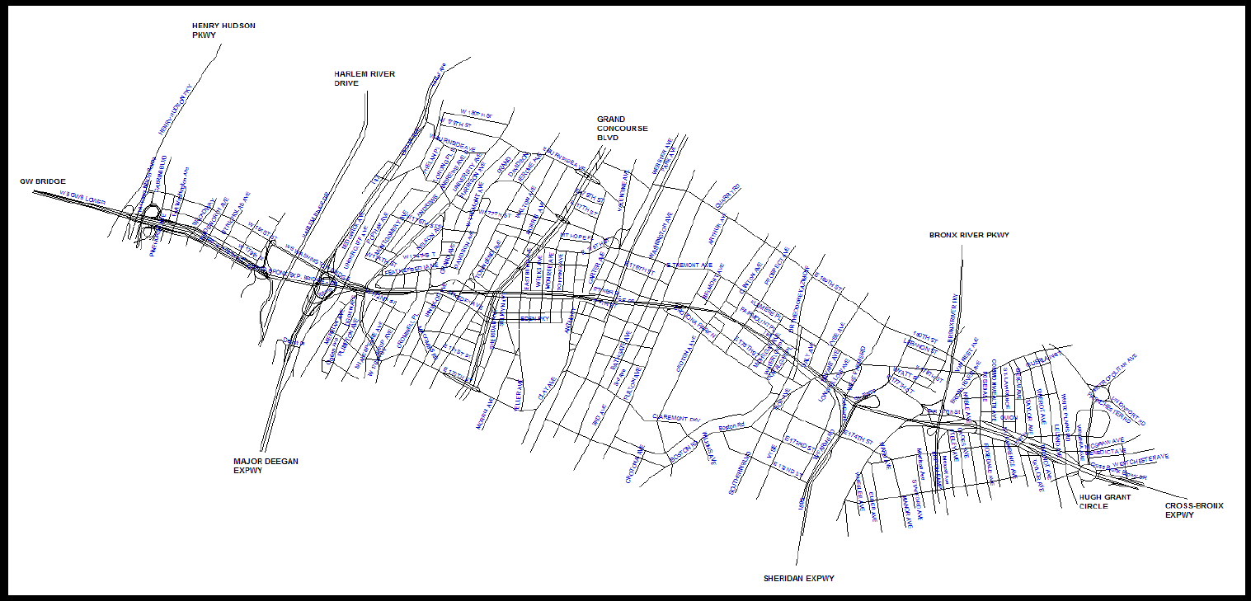
Macro-Level Static Assignment Model Network
NORTH

Slide 11
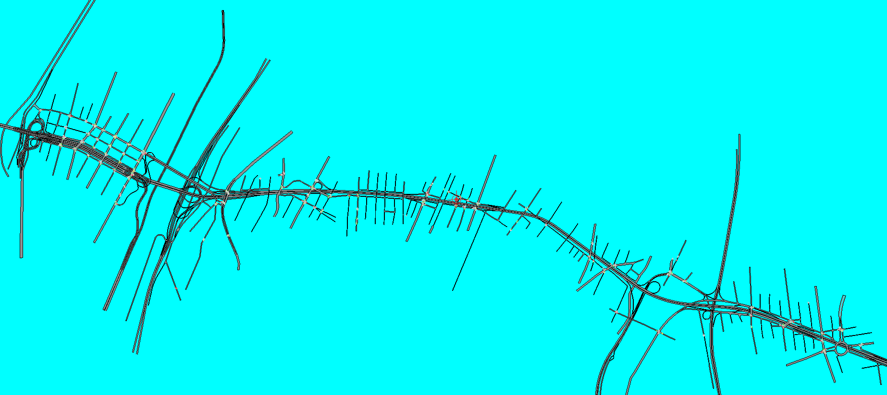
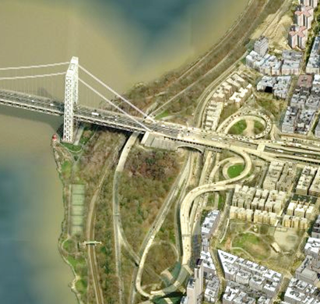
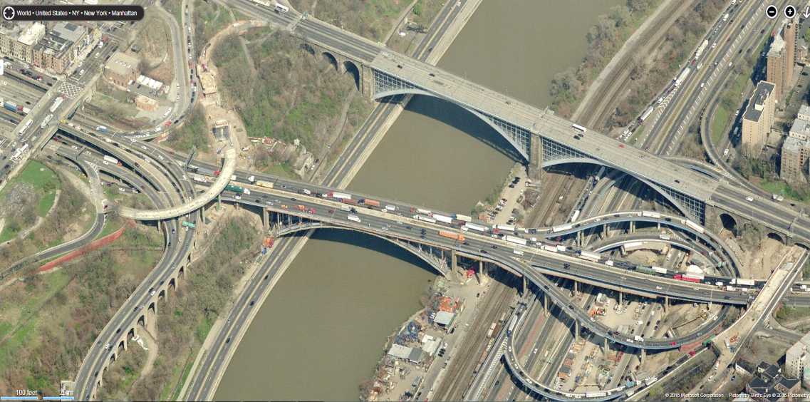
Microsimulation Network
Henry Hudson
Parkway
Harlem River Drive
I-87
Major Deegan Expwy
NORTH
Bronx River
Parkway
I-895
Sheridan
Expwy
George Washington Bridge
Washington
Bridge
Hamilton
Bridge

Slide 12
Microsimulation Network
Henry Hudson
Parkway
Harlem River Drive
I-87
Major Deegan Expwy
NORTH
Bronx River
Parkway
I-895
Sheridan
Expwy

Slide 13
Microsimulation Model
CBE, Connector Road, Street intersections
Modeled periods: 6-10 a.m., 4-8 p.m. weekdays
Successfully calibrated to 2009 volumes, travel-times, queues, following FHWA/WISDOT guidelines.

Slide 14
Microsimulation Model – Travel Time Calibration
AM Peak
PM Peak

Slide 15
Traffic Growth to Year 2035
Traffic growth for the Macro-level model was derived from the regional model
Traffic Growth for the Microsimulation model was derived from the Macro-level model
Due to extreme peak-period capacity constraints on the CBE, the growth in CBE traffic derived from the regional model needed to be moderated.
A uniform growth rate (for each peak period) based on both projected CBE and local travel growth was applied to all origin zones to create the AM and PM peak-period trip tables for assignment to the Microsimulation network

Slide 16
Results – CBE Mainline

Slide 17
Results – Connector Road

Slide 18
Recap
Connector Road improves east-west mobility
Connector Road provides for improved traffic circulation and connectivity
A number of locations were identified for further analysis in the microsimulation to assure that the Connector Road will work operationally
Successful calibration – “if you can model this corridor, you can model any corridor”

