Slide 1
Presentation at 15th TRB Planning Application
Conference, Atlantic City, NJ, 5/17~21, 2015
Integrating Dynamic Traffic Assignment and Agent-Based Travel Behavior Models for Cumulative Land Development Impact Analysis
Lei Zhang¹, Zheng Zhu², Chenfeng Xiong²,
Xiqun Chen³, and Xiang He²
Associate Professor and Director of the National Transportation Center;
2. Graduate Student; 3. Research Scientist;
Department of Civil and Environmental Engineering
University of Maryland
Contact: 301-405-2881; lei@umd.edu

Slide 2
Background
        Research Objectives
        Integrate agent-based behavior model (AgBM) with dynamic traffic assignment (DTA) to capture individual behavior changes and traffic dynamics
        Real-World Application:
        Cumulative land development impact study along the I-270 and MD 355 corridor in Montgomery, Maryland

Slide 3
Overview of Model Integration

Slide 4
Application in Maryland

Slide 5
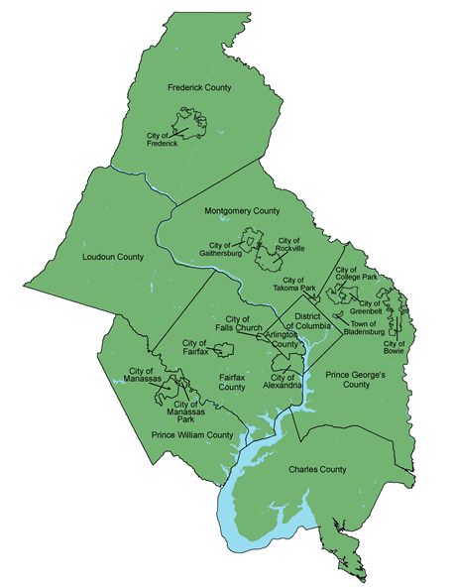
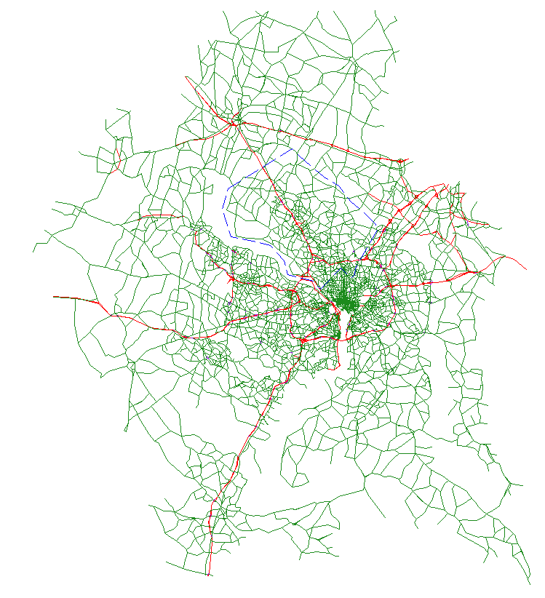
Study Area
Legend
Freeway
Arterial
Subarea
MWCOG Coverage
MWCOG Model in DTAlite

Slide 6
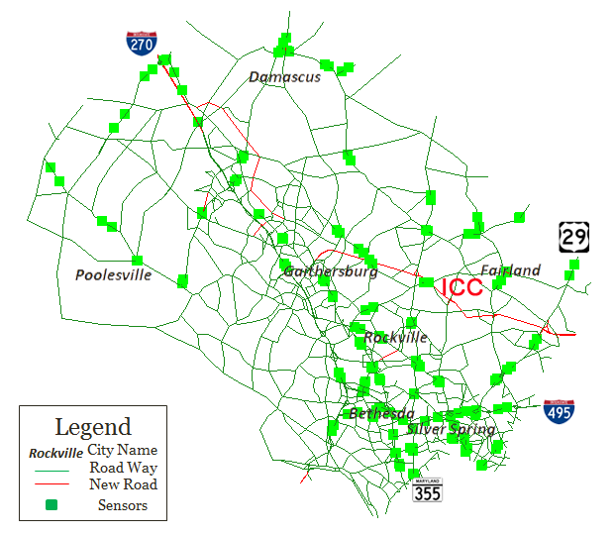
2010 and 2030 Networks
 | 2010 | 2030
Network Mileage | 2606 | 2686
# of inter-sections | 789 | 802
# of trips (million) | 2.86 | 3.28

Slide 7
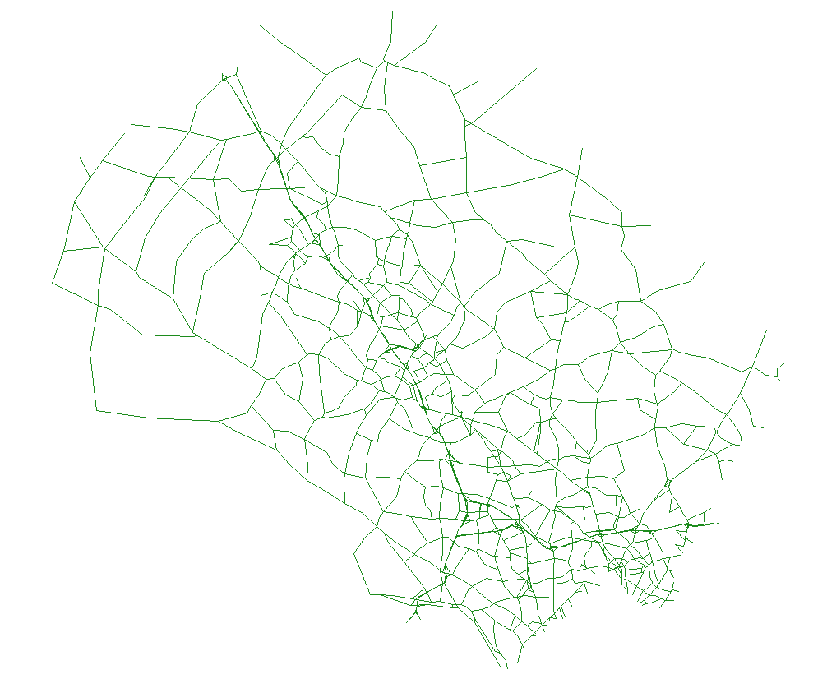




New Sector Plans along I-270
WASHINGTON GROVE
SHADY GROVE
Gaithersburg
Rockville
GREAT SENECA
SCIENCE CORRIDOR
Legend
Sector Plans
City Names
Road Way
Silver Spring
SHADY GROVE
Bethesda
Rockville
WHITE FLINT
GROSVENOR

Slide 8
Population Change 2010-2030
Total POP:
2010: 1,152,132
2030: 1,366,428
Silver Spring

Slide 9
Employment Change 2010-2030
Total EMP:
2010 636,210
2030 785,083

Slide 10
Land Development Scenarios
        2010 Base Case Scenario
        2010 scenario without any sector plan development
        2030 Scenario
        2030 scenario with all sector plan developments
        Only considers routing and traffic congestion changes
        2030 Scenario After Behavior Switch
        2030 scenario with all sector plan developments
        Consider traffic congestion and all behavior changes

Slide 11
Overall Development Impact
        Cumulative Development Impact of All Sector Plans along the I-270/MD 355 Corridor
Year | 2010 Base Case | 2030 w. Development | 2030 After Switch
Num. of Trips | 426,958 | 493,308 | 493,308
Avg. Travel Time (min) | 20.1 | 26.7 (33%) | 24.5 (22%)
Avg. Travel Time Index | 1.78 | 2.22 (25%) | 2.05 (15%)
Avg. Speed (mph) | 36.2 | 32.0 (-12%) | 34.0 (-6%)

Slide 12
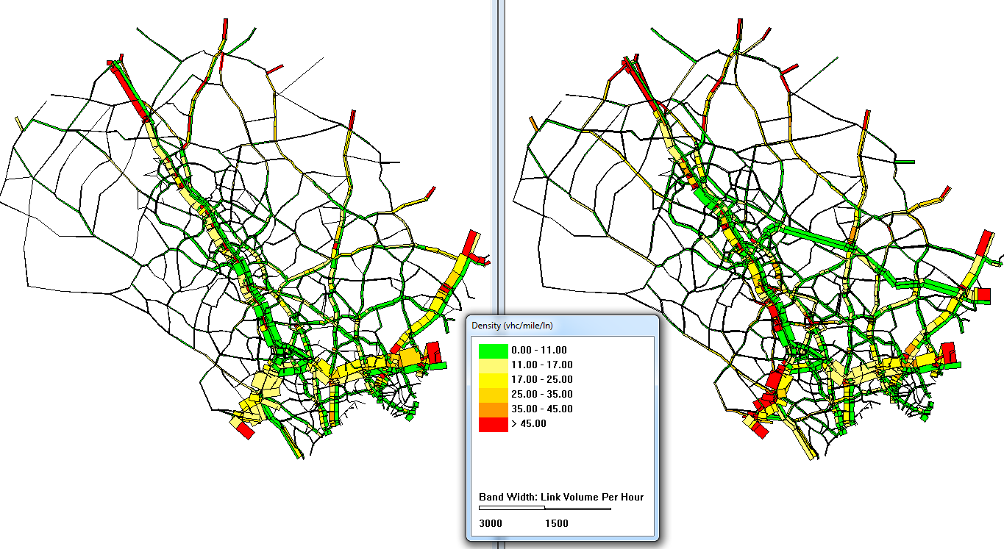

Traffic Congestion Comparison
2010 AM Density
2030 AM Density
National Transportation Center @Maryland || www.ntc.umd.edu || www.tep.umd.edu

Slide 13
Peak Spreading Impact
The Duration of the AM Peak Period will Increase by 45 Minutes.
National Transportation Center @Maryland || www.ntc.umd.edu || www.tep.umd.edu

Slide 14
I-270 SB Travel Time by TOD
National Transportation Center @Maryland || www.ntc.umd.edu || www.tep.umd.edu

Slide 15
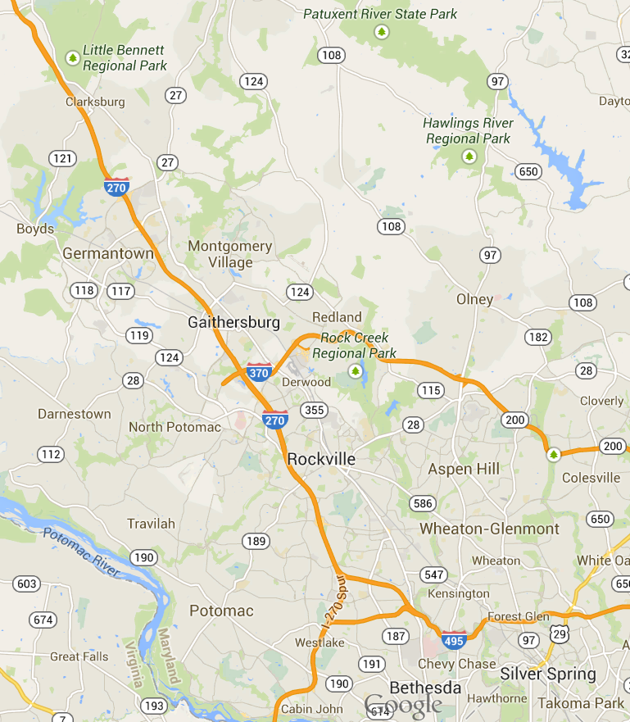
Changes in Destinations/Routes
Diverting from I-270 and MD 355 to ICC and I-495 (Southbound Traffic, AM Peak)
1: ICC
Legend
Through traffic
Diverting traffic
Unit: 1000 trips | 2010 | 2030 | Change
I-270 Thru | 32.7 | 36.1 | 10%
MD355 Thru | 4.5 | 6.0 | 32%
I-270 Divert | 4.3 | 9.7 | 123%
MD355 Divert | 1.1 | 2.9 | 170%
2: I-495
Legend
Through traffic
Diverting traffic
 | 2010 | 2030 | Change
I-270 Thru | 25.2 | 25.8 | 2%
MD355 Thru | 9.3 | 10.5 | 12%
I-270 Divert | 14.0 | 13.0 | 7%
MD355 Divert | 0.4 | 0.6 | 56%
National Transportation Center @Maryland || www.ntc.umd.edu || www.tep.umd.edu

Slide 16
Summary
        An integrated modeling tool for individual or cumulative land development impact analysis (and ICM, ATM, and TSM&O applications)
        Builds on 4-step travel demand, agent-based travel behavior, and dynamic traffic assignment models
        Considers local and regional traffic impact
        Shows traffic impact by intersection, by corridor, by subarea, and by time of day (min-by-min)
        Incorporates behavior responses such as routing change, traffic redistribution, peak spreading, and modal shifts
        Visualizes results with easy-to-understand graphs and animation

Slide 17
Thank You!
Questions, Comments, and Suggestions are Welcome. Please Contact:
Lei Zhang, Ph.D.
Associate Professor
Director, National Transportation Center
Department of Civil and Environmental Engineering
1173 Glenn Martin Hall, University of Maryland
College Park, MD 20742
Email: lei@umd.edu
Phone: 301-405-2881
Web: http://www.lei.umd.edu
Center: http://www.ntc.umd.edu

