Slide 1
Enhancement and Validation of a Managed-Lane Subarea Network Tolling Forecast Model
Stephen Tuttle (RSG), Jeff Frkonja (Portland Metro),
Jack Klodzinski (FTE), Lihe Wang (FTE)
May 19, 2005

Slide 2
Presentation Overview
  ELTOD Model
    Purpose
    Structure
  Validation Effort
    Validation Data and Targets
    Data Challenges and Solutions
    Results
  Discussion
    Lessons Learned

Slide 3
ELTOD Model

Slide 4
Model Purpose
(1) TRAVEL DEMAND MODEL
  Daily or Period
  Regional
Daily or Period Subarea Demand
(2) TIME OF DAY MODEL
  24 one-hour periods
  Corridor Subarea
Express Lane Volumes
& Toll Rates
(3) REVENUE MODEL
  Traffic/Revenue Factors
  Corridor Revenue Estimates
Corridor Revenue Estimates
(4) NEXT STEPS
  Evaluate Alternatives
  Go to Next Study Level

Slide 5
Model Features
Key Inputs
  Subarea network from regional TDM
    Import via GIS
  Demand matrices from regional TDM
    Daily or Period
  Diurnal demand distribution
    Observed from Counts
Solution
  Toll choice + Network simulation iterates to User Equilibrium
  Binary Logit model: f(toll, time savings, unreliability,…)
Outputs
  Link Volumes, Toll Rates, Revenue

Slide 6
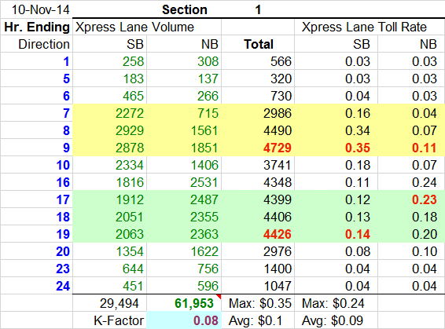
Example Output
Output is recorded and displayed in Excel worksheets
some rows were hidden

Slide 7
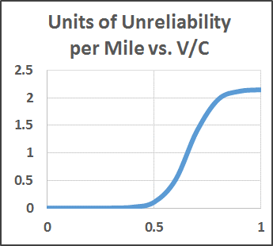
Key Choice Model Parameters
Term | Coefficient: I-95 SP/RP (2011)
Cost (per dollar) | -.61
Time (per minute) | -.11
Unreliability (per unit/mile) | -.12
Unreliability Measure
  Uncertainty of travel time
  Function of V/C & Distance
Ratio | Value (2011)
VOT | $ 11.03/hour
VOR | $ .20/unit/mile

Slide 8
Highlights and Limitations
Highlights
  Quick response
  Dynamic pricing
  Adjustable pricing policy
  Unreliability component
  Cube implementation (new)
Limitations (may change)
  No distributed VOT or VOR
  Binary path choice
  Static assignment

Slide 9
Validation

Slide 10
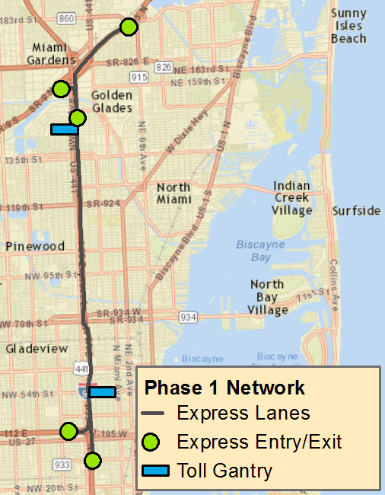
I-95 Express: Miami
Phases
  Phase 1 (2010)
  Phases 2, 3
Access
  Limited (trips > 8 miles)
  Transponder to pay toll
  Free to registered Carpools, Hybrid Vehicles, Buses, etc.
Lanes
  HOT lanes (1-2)
  General purpose (3-5)

Slide 11
Validation Targets
Focus
  Outputs used in revenue model
  Values at toll gantries
  Congested periods
Validation Targets
  Express lane volumes
  Split of Express & General Purpose volumes
  Toll rates
  Revenue
Validation Period
  April 4, 2011 – April 8, 2011 (Mon-Fri)

Slide 12
Validation Data
Traffic Count & Toll Data
  STEWARD count database
    Hourly EL & GP mainline volumes (many links, not all)
    No ramp volumes
  FDOT counts
    Daily ramp volumes (many ramps, not all)
  FTE toll transaction data
    Hourly EL & GP volumes at gantries
    Hourly Toll Rates

Slide 13
Validation Data
OD Data Sources
  SERPM Matrices
    AM, PM, OP
  Bluetooth OD Data
    Hourly flows (Incomplete coverage of subarea)

Slide 14
Data Challenges: Traffic Counts
Screenline Volumes at Toll Gantries
  Required accurate screenline volumes at toll gantries
  Matrices from regional TDM were a bit coarse
  Used ODME to refine TDM matrices
ODME
  Obtained STEWARD, FDOT, and FTE traffic data
  Some data challenges
    Detectors in series differed by +/- 20,000
    Same detector gave different estimates over time
  Removed clear outliers
  Trusted ODME to find right “average”

Slide 15
Data Challenges: Traffic Counts
Screenline Volume Estimates at Toll Gantries
  ODME Flows and Averaging Counts gave comparable estimates
  ODME Flows gave larger estimates than Regional Matrix Flows
Estimation Method | Southbound | Northbound
Use Regional Matrix Flows | 120,000 | 114,000
Use ODME Flows | 143,000 | 125,000
Average Counts near Gantry | 139,000 | 128,000
Select Min Count near Gantry | 120,000 | 119,000
Select Max Count near Gantry | 148,000 | 138,000

Slide 16
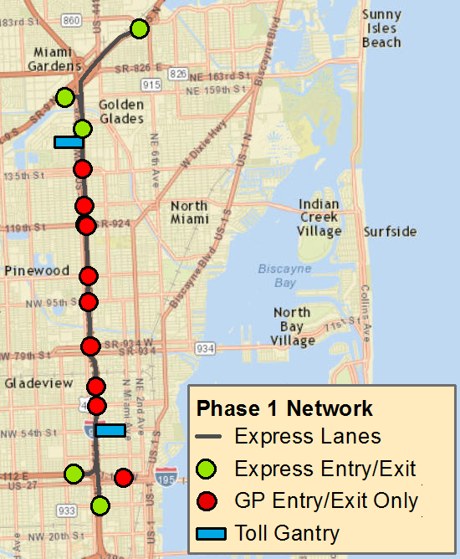
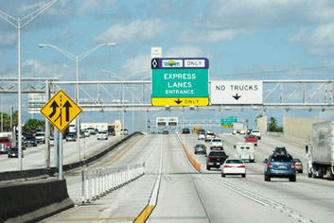
Data Challenges: Toll Lane Eligibility
EL/GP volume split does not imply “toll choice”
  EL serves long-distance trips
  GP serves long-distance and short-distance trips

Slide 17
Data Challenges: Toll Lane Eligibility
Toll Lane Eligibility, cont.
  Inaccurate Toll-Eligible Demand → Poor model calibration
  EL Volume = Toll-Eligible Demand * ML Share
Case | Observed EL Volume | Eligible Demand (matrix data) | Calibrated ML Share
(Base) | 1000 | 2000 | 50%
Eligible Demand Low by 300 | 1000 | 1700 | 59%
Eligible Demand High by 300 | 1000 | 2300 | 43%

Slide 18
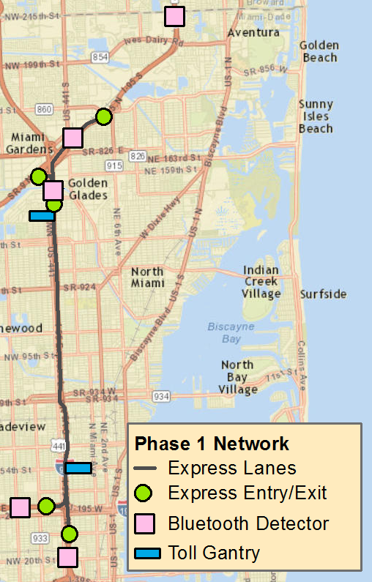
Solution: Bluetooth Study
Bluetooth Study
  2012 Bluetooth Study (RSG)
  Five detector locations
  Estimate of Toll-Eligible Demand
    NO estimate of full-subarea matrix
Adjusting ODME Matrices
  Factored matrices to match Bluetooth Toll-Eligible Demand
  Factored matrices to restore original screenline volumes

Slide 19
Toll-Eligible Demand
Estimates of Toll-Eligible Demand
  Bluetooth Data gave significantly different PM estimates than ODME
  Bluetooth Data gave greater estimates than Regional Matrices
Period | Direction | Original ODME | Bluetooth-Adjusted | Change
PM | SB | 12,300 | 10,500 | -15%
PM | NB | 11,700 | 14,400 | +23%
AM | SB | 13,600 | 13,400 | -1%
AM | NB | 7,000 | 7,600 | +9%

Slide 20
Calibration
Calibration
  Adjusted toll constants (AM, PM, OP)
    Lowered Magnitude
Constant | I-95 SP/RP (2011) | Updated Model
AM | -1 | 0
MD | -1.6 | -1
PM | -1 | 0
Night | -1.6 | -1

Slide 21
Validation Results
Validation
  Output and targets agreed reasonably well
  Investigated why output and targets occasionally differed
    Actual toll is a function of all prior V/C (model uses current V/C)
    Period definitions could be reworked (a new version of ELTOD supports hour-specific toll constants)

Slide 22
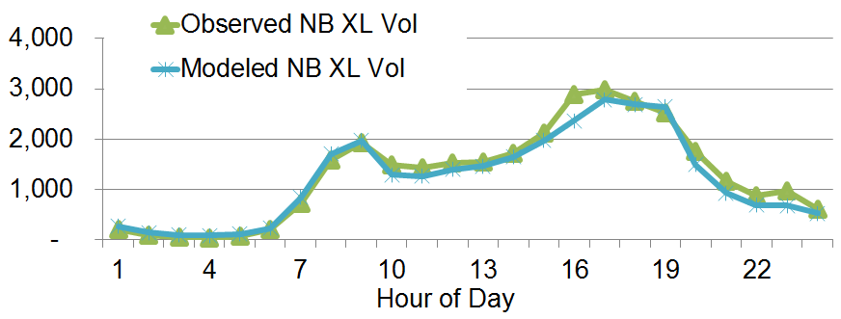
Results: XL Volumes
Results & Conclusions
  Volumes agreed reasonably well
  PM peak period could be extended (or use hour-specific constants)

Slide 23
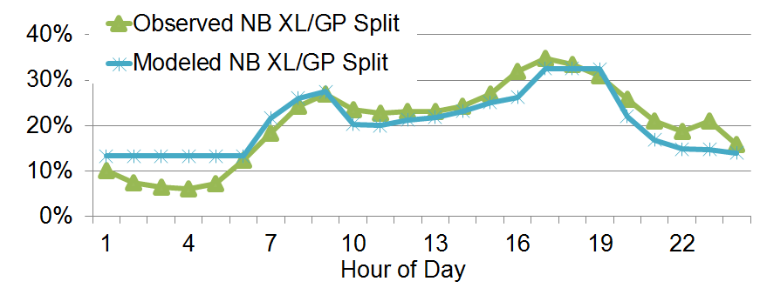
Results: XL & GP Splits
Results & Conclusions
  Splits agreed during congested periods
  Toll constant may be too high from 1-5 AM

Slide 24
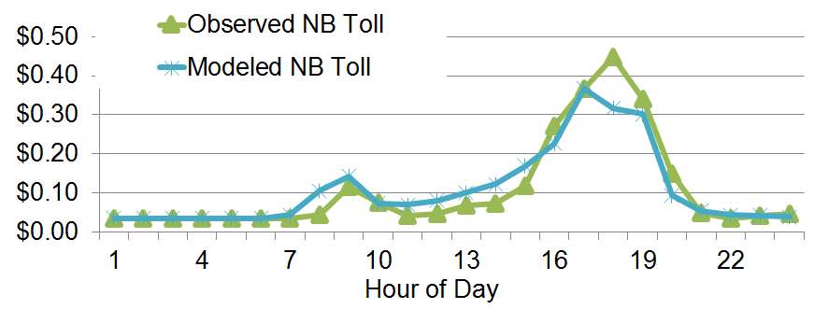
Results: Toll Rates
Results & Conclusions
  Toll rates agreed except during one PM hour
  Actual toll is a function of all prior V/C, not current V/C

Slide 25
Discussion

Slide 26
Observations & Lessons Learned
The Usual Stuff
  Traffic count data may be inconsistent
    Professional judgment required
    ODME methods may help
  May need to refine Regional TDM output
Validating Managed-Lane Choice Model
  Need good estimates of Toll-Eligible Demand
    Traffic counts are not enough (if access is limited)
    ODME seed matrices may be flawed
    Continue to improve methods for collecting OD travel data

Slide 27
Thank You!
Stephen Tuttle
Stephen.Tuttle@rsginc.com
www.rsginc.com

