Slide 1

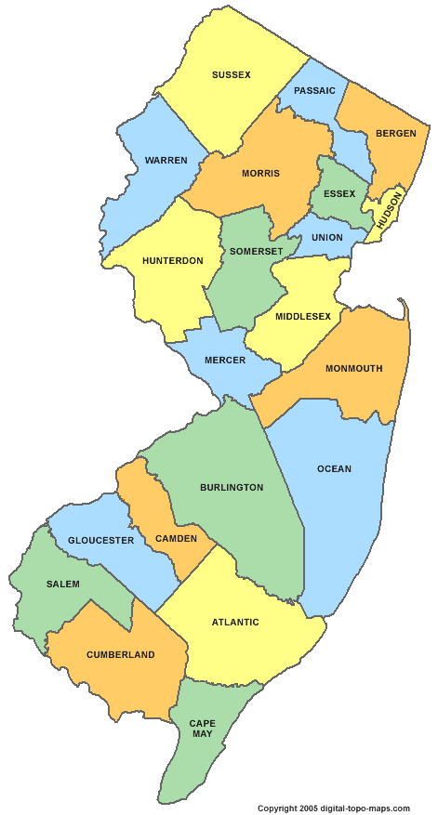


A New Regional Planning Paradigm:
Regional Performance-Based Planning
South Jersey Transportation
Planning Organization
Notes:
This presentation is titled:
A New Regional Planning Paradigm:
Regional Performance-Based Planning
Dave and I are from SJTPO – We are the MPO for the lower four counties of New Jersey.
Our area roughly spans from the Delaware Bridge to Atlantic City and down to Cape May.

Slide 2
MAP-21: Performance Elements
2
Notes:
FHWA is currently implementing Transportation Performance Management.
Transportation Performance Management represents the opportunity to
-prioritize needs,
-align resources, and to
optimize system performance
in a collaborative manner.
This transition supports the recent legislation known as MAP-21.
Map-21 has generated six elements for performance-based planning.
But it is important that the elements are interconnected.
This is achieved by making sure our goals weave their way through the entire process.
The goals (safety) generate specific objectives (reduce fatalities),
which in turn generate related measures (number of fatalities),
which require specific data and analysis techniques (crash data),
generate strategies to meet the objectives (education and road improvements).
So all the parts of the process are there for a reason.

Slide 3
Performance-Based Planning Process
RTP 2040 (2012)
Planning Cycle-End Activity
Mid-Planning Cycle Activity
Project & Program
Life Cycle
Activity
3
Notes:
Where do performance measures impact the planning process?
PBP&P is interwoven though the entire planning cycle.
This is an overview of our planning cycle,
We begin with the previous plan.
There are mid- planning cycle activities, and
End of the planning cycle activities
Also, projects and programs have their own life cycle;
So certain activities occur during that time frame.
We will now zoom in on the mid-planning cycle activity,
And will be there for the next several slides.

Slide 4
Mid-Cycle Planning Activity
Management Systems
Performance Measures
Targets
Performance Report
System-Wide Evaluation
Development Process for:
TIP
UPWP
3
Notes:
This is more detailed view of the Mid-Cycle activities
Much of the performance-based planning activity occurs in
what we call the Management Systems.
The management systems house the performance-based planning elements
such as the performance measures, targets, and reporting.
Important Notes about PMs and Targets:
1-They are produced through a collaborative effort.
(Federal, State, MPOs, & MPO partners)
2-Through-out the process, there is interconnectedness and goal integration.
Performance measures have a direct link back to the previous RTP
(Vision, Goals, Objectives)
Performance measures have a direct link forward to strategies and evaluation.
About Evaluation:
A Performance Report is generated mid-cycle by the management systems. (we will see some examples)
This is system-wide, and it presents opportunities for fine-tuning our strategies.
-------
Also during Mid-Cycle
Performance-Based Planning can impact important MPO products:
They can be used in the development of the TIP and the UPWP.
The potential projects, and programs can be prioritized based on their anticipated performance.

Slide 5
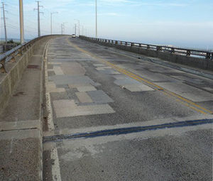
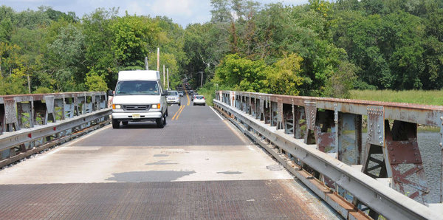
PBP&P Process – Management Systems
Bridge
Pavement
Freight
(Road & Rail)
Transit
Safety
Roadside Assets
Non-Motorized
Congestion
6
Notes:
Top-left: 34th Street bridge in Ocean City
Bottom-left: Centerton Road Bridge over Rancocas Creek in Mt. Laurel
About Management Systems
Currently we have several management systems:
Each concentrates on one aspect of transportation planning.
They each have different data needs, data sources and analysis techniques.
We rely on a combination of data sources including the DOT, and counties.
Example – Bridge Management System
This system includes data from the NBI database.
The DB is the result of the bridge inspections and it contains over 100 fields.
One PM is Sufficiency Rating; this is a combination of 19 data fields.
Including the condition of the deck, the super structure and the substructure.
We will see some more examples of PMs from different systems.

Slide 6
Performance Measures: Characteristics
Origin of:
Federal | State | MPO
Prescribed | Shared | Developed
Uses of:
Prioritize | vs. | Evaluate
Infrastructure | vs. | Human-Centric (Citizen Impact)
Process | vs. | System
System | vs. | Project
4
Notes:
There are different origins, uses, and types of performance measures.

Slide 7
PMs Characteristics (cont.)
Types of:
Outcome: | Ideal, Results-oriented, Recommended where possible | External reporting
Output: | Proactive steps; Agency production, Tools implemented | Internal, Man. sys. reporting
5
Notes:
Outcome vs. Output
Ideally the Federal government want us to use the outcome type.
However, when not possible, the outcome type will be used.
Output can also be helpful for internal reporting.

Slide 8
PMs Characteristics (cont.)
Types of:
Direct: | Agency has material control over relevant policy and outcome.
Indirect: | Agency has some influence over relevant policy and outcome.
None | Used for reporting only, document region's needs.
5
Notes:
Some things the MPO has control over, many things we do not.
There could still be a benefit from maintaining PMs even if we have little control.
Somebody has to be aware of the conditions before improvements can be made.

Slide 9
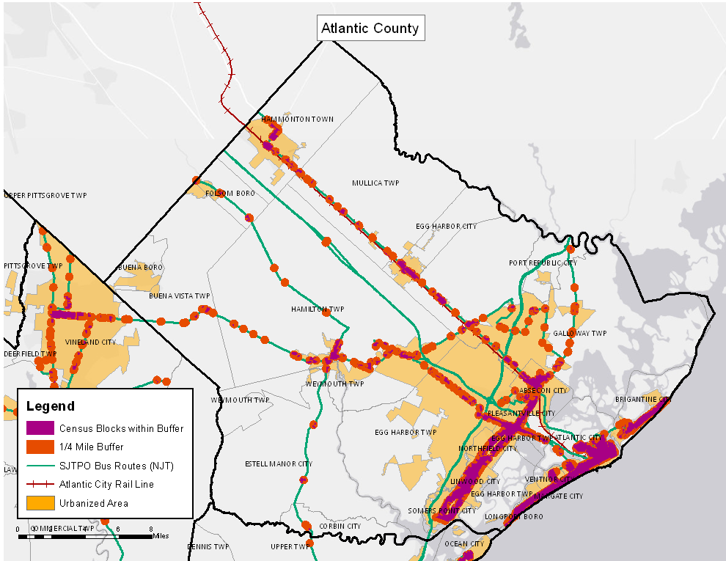
Performance-Based Planning Report
Promote Transportation Choices for the Movement of People and Goods
Additional
Analysis
(Management
System Type)
Transit
Accessibility
8
Notes:
DH:
(This section is not meant to be a presentation of the report; rather it is for visualization when discussing the PMs.)
(Discus nature of theses performance measures and the challenges of collecting data.)
From the mid-cycle activity:
These slides are from the performance report
This performance measures is directly tied into our goal of transportation choices.
In addition to transit route users, or route miles, we looked at accessibility.
We looked at the census block population that lives within a ¼ mile buffer of transit routes.

Slide 10
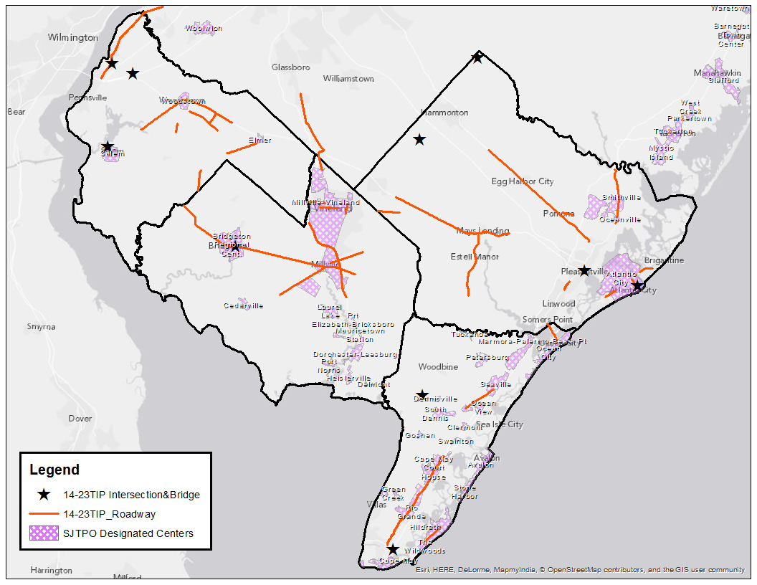
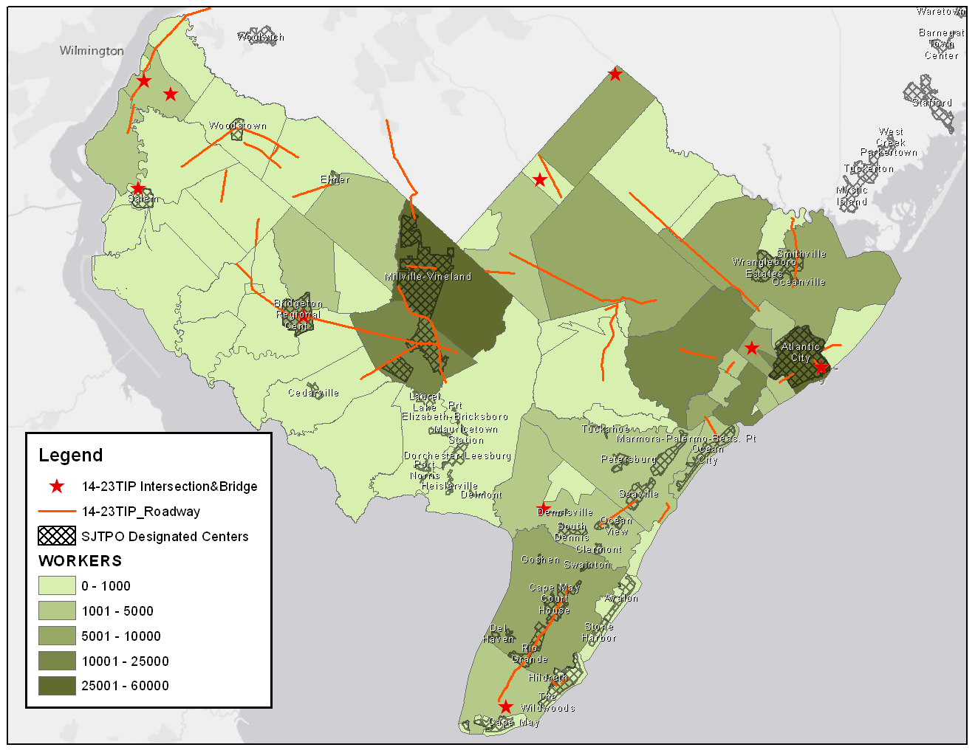
Performance-Based Planning Report
Support the Regional Economy
Are TIP projects Benefiting Employment and Retail Centers?
Designated Centers
Workers by Muni..
9
Notes:
DH
Discus PM and data issues related to this goal – management system.
From the mid-cycle activity
These slides are from the performance report
This performance measures is directly tied into our goal of transportation choices.
We did additional spatial analysis comparing the TIP projects to designated centers
Are we supporting the preservation of infrastructure in designated economic centers?
Also we compared the TIP placement to the regional concentration of workers.
Concentration of workers is just another way of identifying a zone that is important to economic sustainability.

Slide 11
Performance-Based Planning Report
Status: No
Figure 17: Annual Vehicle-Miles Travelled (in millions) by County, 2000-2012
Environment
Air Quality
VOC and NOx
14
Notes:
DH
Data is from the following sources: SJTPO Model, MOVES, PPSuite
These are end result (outcome) performance measures
VOC and NOx MO Source Emissions in Tons per Day (TPD) SJTPO Region, 2005-2015

Slide 12
Performance-Based Planning Report
Improve Transportation Safety
Traffic Fatalities
Prescribed Measure
Fatalities/100 Million VMT (5-Year Rolling Average)
10
Notes:
DH
Related to our goals of safety
Have fatalities continued to decrease?
This is prescribed by the PM Development process (Federal State MPOs)
(Measure came from proposed safety performance rule released March 2014.)
It is outcome
It is human-centric – what is the impact on people?
We do not have direct control over this. Many factors contribute to safety including technology.
We do analysis directed at specific project locations – before and after studies.
We also can track our output related to safety: number of road safety audits, education, assets installed, etc.
Discuss Data Source: Plan4Safety

Slide 13
Performance-Based Planning Report
Status: No
Figure 17: Annual Vehicle-Miles Travelled (in millions) by County, 2000-2012
Mitigate Traffic Congestion
Are We Driving Less?
Annual Vehicle Miles Travelled (Millions) by County
11
Notes:
Mitigate Traffic Congestion
Annual Vehicle Miles Travelled (Millions) by County
Overall VMT has remained steady during the 5-year period from 2008 to 2012.
Data Source: DOT Highway Performance Monitoring System
Indirect PM: Volume depends on many factors: Does not change as only a function of Travel Demand efforts.
Conflicting Goals: Some want more volume (sign of economic activity)

Slide 14
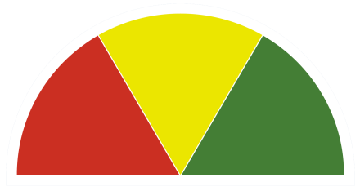
Performance-Based Planning Report
Status: No
Figure 17: Annual Vehicle-Miles Travelled (in millions) by County, 2000-2012
Mitigate Traffic Congestion
Are There Fewer Vehicle Hours of Delay?
Status: New Data Source;
Baseline Established
Roadway | County | Miles | Est. vehicle-hours of delay in 2013
GSP | AT, CMAY | 49.5 | 111,441
ACE | AT | 27.5 | 64,851
NJTP | SA | 9.5 | 40,344
I-295 | SA | 9.5 | 13,146
NJ-55 | CUMB | 18.5 | 5,339
12
Notes:
Congestion
Are There Fewer Vehicle Hours of Delay?
There is not enough historical data to determine progress towards this goal.
These data will serve as baseline data for future comparison.
Note: Deleted “Add. Roads” row—”Data begins July 2013”

Slide 15
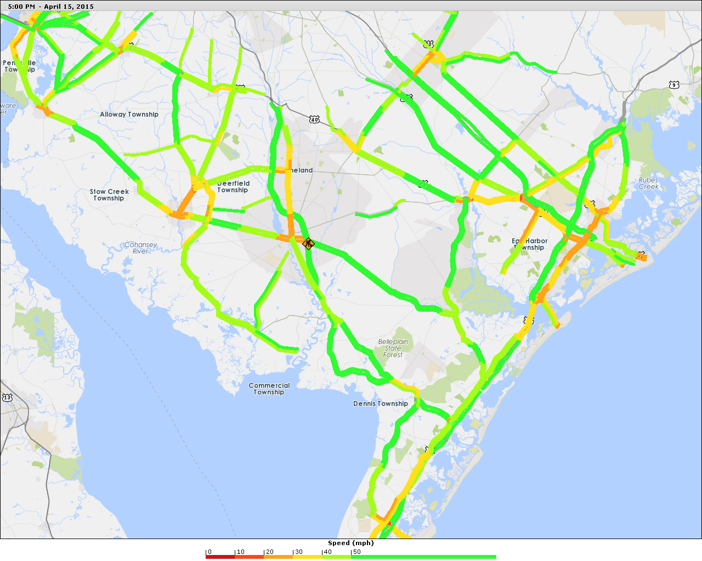
Performance-Based Planning Report
New Data Source Vehicle Probe Project (VPP)
13
Notes:
Data source: New source VPP Vehicle Probe Project.
Identifies the travel speed through road segments.
Data is archived and available for analysis.
Delay is calculated by using the free flow for a segment vs. the observed speed.
Outcome measure: This is what people care about.
Human-centric: This reflects the impact on people.
Alternative: Reliability
People care about reliability even more.
They can plan around a slow moving route; but the surprise bottlenecks are costly.
Reliability compares the expected travel speed to the actual.

Slide 16
Performance-Based Planning Process
RTP 2040 (2012)
Planning Cycle-End Activity
Mid-Planning Cycle Activity
Project & Program
Life Cycle
Activity
3
Notes:
Again, an overview of the process
Zoom-in on the connection between the mid-cycle and the life cycle

Slide 17
Prioritizing & Evaluation (PMs)
Mid Cycle Activity
TIP Projects
Programs
UPWP
Education
Assignments
Subregional
Studies
Life Cycle Activity
Evaluate:
Performance or impact
at completion
Prioritizing based on probable performance
16
Notes:
We saw that the Performance Report gave us an “after the fact” system-wide evaluation
Now we will talk about applying PMs to individual strategies.
This can be done during the selection process and during the evaluation process.
TIP and UPWP development involves selecting individual strategies.
Examples are road projects, programs, and staff activities.
Cost / benefit is already used for selection where possible. This is a form of performance measure.
Other PMs could be added to the selection process, for example:
What impact will an ITS project have on the travel time through a corridor?
How will preventative maintenance impact average road condition?
How will safety education outreach impact teenage driving performance?
Strategies, in the form of project, program, and staff activities, should also be evaluated “after the fact”
or at the end of their life cycle.
Here again performance measures can employed in the same manner.

Slide 18
Performance-Based Planning Process
RTP 2040 (2012)
Planning Cycle-End Activity
Mid-Planning Cycle Activity
Project & Program
Life Cycle
Activity
3
Notes:
Again the overview-will now talk about our cycle end

Slide 19
PBP&P: Planning Cycle-End
RTP 2040 (Update 2016)
Process Evaluation
Strategy Evaluation: System-Wide
3
Notes:
DH
Where do performance measures impact the planning process?
Federal and State generated PMs.
Planning Cycle-End:
Performance report (system-wide) will be used to fine tune next plan cycle.
The system-wide performance is considered.
Infrastructure and system performance should not be looked at alone.
The planning process itself should be evaluated, not just the transportation system.
I is also important to focus on the transportation system’s impact on people.
Thinking on the human scale is vital when developing and analyzing performance indicators.
-------------------------------------------------------------------------------------------------------------

Slide 20
Regional Transportation Plan
STUDIES
HSTP
MANAGE. SYS.
CMP
TDM
PROJECT-BASED
OTHER
PAVEMENT
BRIDGE
SAFETY
GHG
CONFORMITY
FINANCIAL
RTP
SCENARIOS
VISION
DEMOGRAPHICS
17
Notes:
DH
At Cycle-End the performance report will be incorporated into the RTP process.
This will allow for another round of system-wide analysis.
It will also allow for evaluation of the planning process itself.
PROJ=PROJECT
TDM=Bike/Ped, Transit, etc.

Slide 21
Scenario Testing: Projects and Programs
Socio- Economic Inputs | Scenarios | One | Two
 | Economic | Steady | Moderate
 | Demo. | Steady | Moderate
 | Funding Level | Steady | Steady
Policy Level Inputs | Preservation- Focus | Bundle 1.1 | Bundle 1.1
 | Transit-Focus | Bundle 2 .1 | Bundle 2.1
18
Notes:
Inside the end-of cycle, and inside the RTP process is the scenario testing process.
Scenario testing will also use PMs.
Strategies will be tested against different scenarios.
Three steps
1-Create the scenarios
2-Create the strategies
3-Perform a sensitivity analysis
1-Scenarios (Socio-Economic) can be constructed with different factors:
Economic Activity: No Growth, or Growth
Funding Level: Steady, or Slight Increase
2-Strategies (Policy) can be constructed with different emphasis in spending categories
Strategy 1.1 fore example could be a Preservation Focus.
Preservation means placing a heavy weight on roads and bridge maintenance.
Other strategies may heavily weight transit or ITS.
--------------------------------------------------------------------
3-Finally a sensitivity analysis is done.
Strategies are evaluated against different scenarios, using performance measures.
Tools Include:
1-TELUS allows input for spending categories.
2-The SJTPO Travel Demand Model is one analysis tool.
For example what is the impact on travel time or delay with an ITS focus?
3-Another tool is the road management system tool.
This can project road conditions under various funding levels.
Other similar tools are being sought.

Slide 22
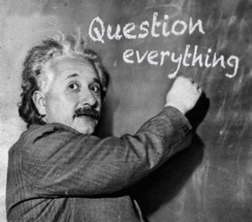
Questions
19

Slide 23

Thank you!
Bill Schiavi, AICP, CPA
email: bschiavi@sjtpo.org
David Heller, AICP/PP
email: dheller@sjtpo.org
Phone: (856)-794-1941
20
Notes:
Goal of this entire process: achieve optimal performance

