Slide 1

Dynamic Traffic Assignment Approaches for Statewide Transportation Planning And Operations: Maryland Case
S. Erdogan¹, K. Patnam², X. Zhou³, F.D. Ducca⁴, S. Mahapatra⁵, Z. Deng⁶, J. Liu⁷
^{1, 4, 6} University of Maryland, National Center for Smart Growth Research and Education
² AECOM, Arlington, VA
^{3, 7} Arizona State University, School of Sustainable Engineering and the Built Environment
15th TRB National Transportation Planning Applications Conference
May 19, 2015, Atlantic City, New Jersey

Slide 2
Motivation- Why Statewide DTA
Time of day issues
Congestion, queue buildup and dissipation
Long distance trips which span multiple time periods
Refined input for sub-area / corridor analysis
Scenario analysis capability

Slide 3
Two Methods
Analytical Approach – TRANSIMS
  VDF for link MOEs
Simulation-based Approach – DTALite
  VDF, Point/Spatial-Queue, or Newell’s Kinematic Wave Model for link MOEs

Slide 4
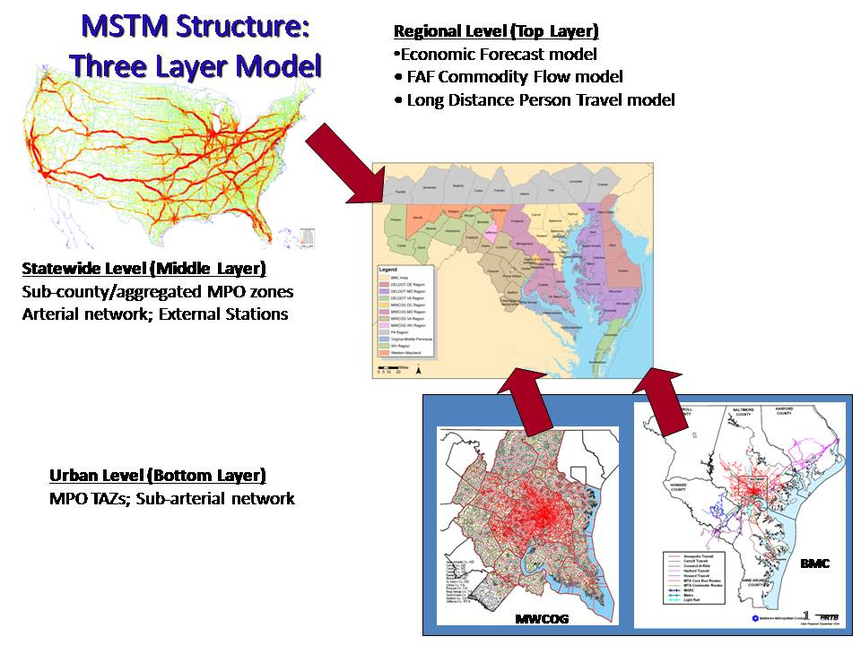
Input Data
Given MSTM CUBE Model
Network:
  MTSM 2007 network
    ~167,000 links, ~68,000 nodes, 1739 zones
Demand:
  MSTM 2007 demand input by
    6 purposes, 5 incomes categories, 4 TOD
  2007 HTS survey for diurnal distributions
Generate Nationwide and Subarea Models

Slide 5
ANALYTIC APPROACH:TRANSIMS

Slide 6
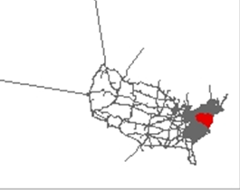

MSTM TRANSIMS Models
Level 1
Nationwide
68,243 Nodes
87,785 Links
1,739 Zones
Level 2
Statewide
  21,748 Nodes
  31,116 Links
  1,811 Zones
TRANSIMS Version 6 Router Applications
AON Routing /
En-route Diversion
Paths
Speeds/Flows
Demand
Network
Speeds/Flows*
Paths*
Dynamic Traffic Routing
Convergence
Paths
Speeds/Flows+
* = Optional
In-memory iterations
Dynamic User Equilibrium
Paths+
Speeds/Flows+
6
+ = Converged

Slide 7
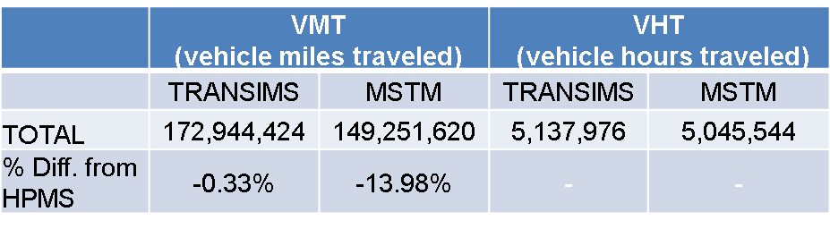
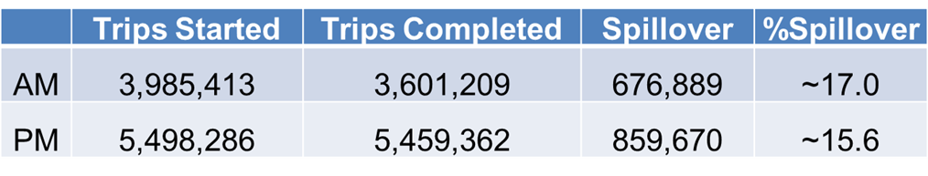
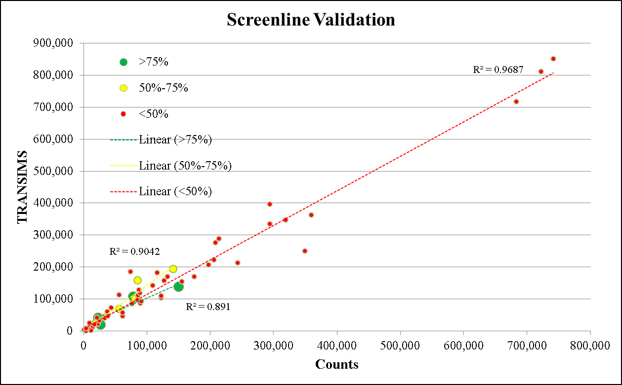
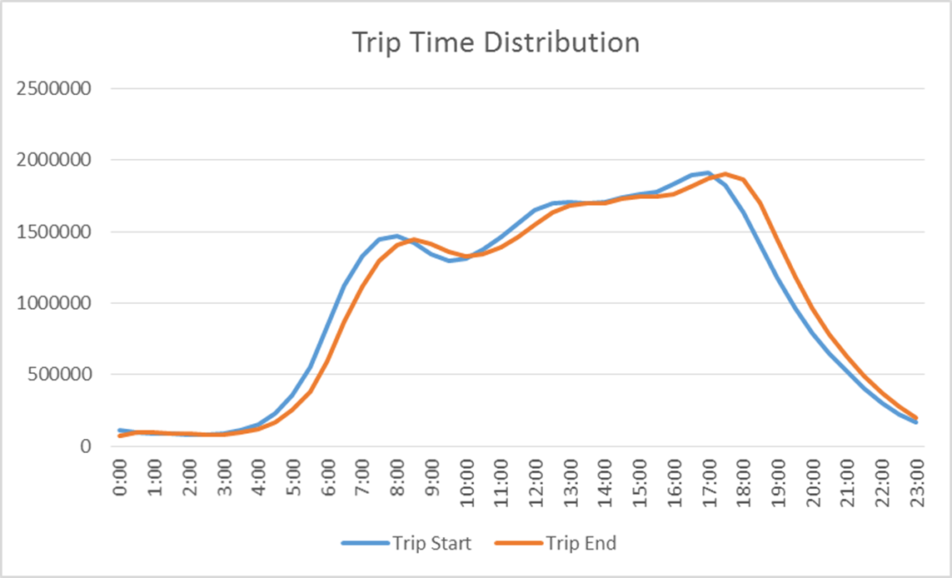
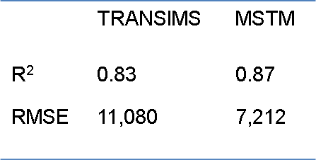
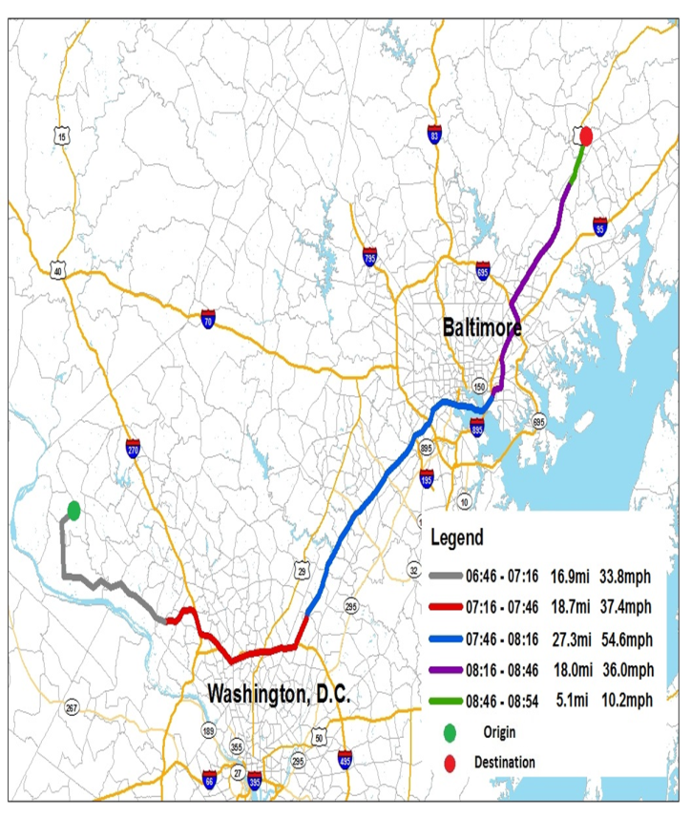
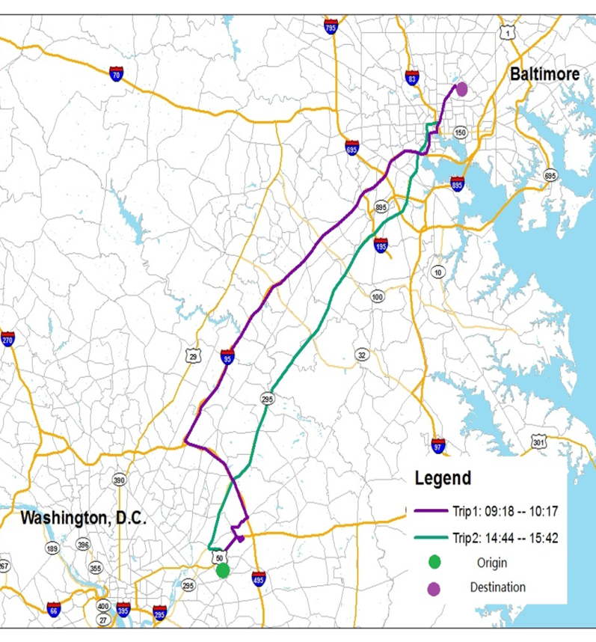
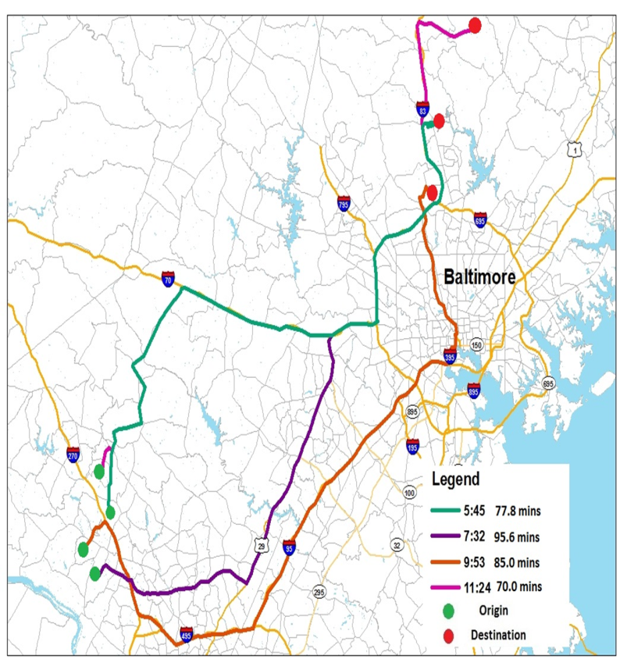

Slide 8
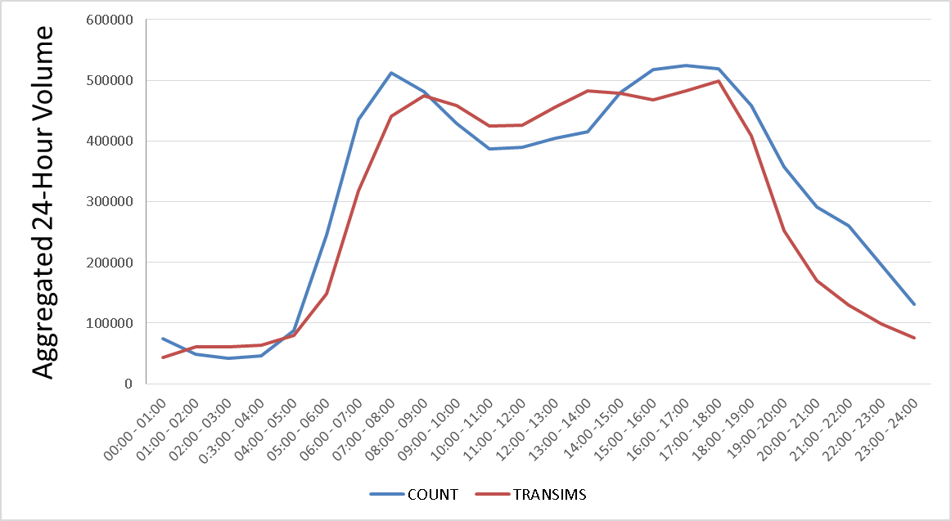
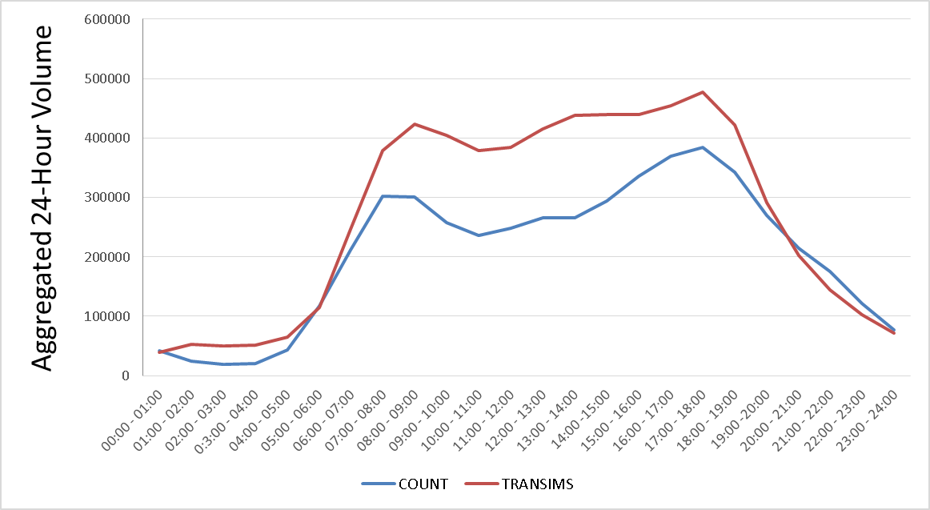
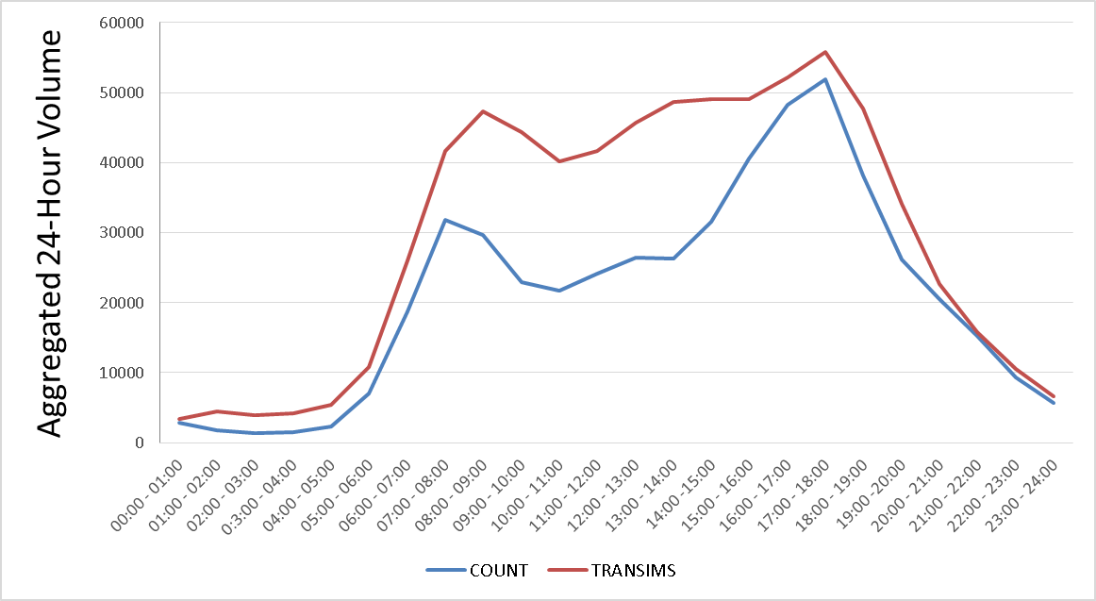
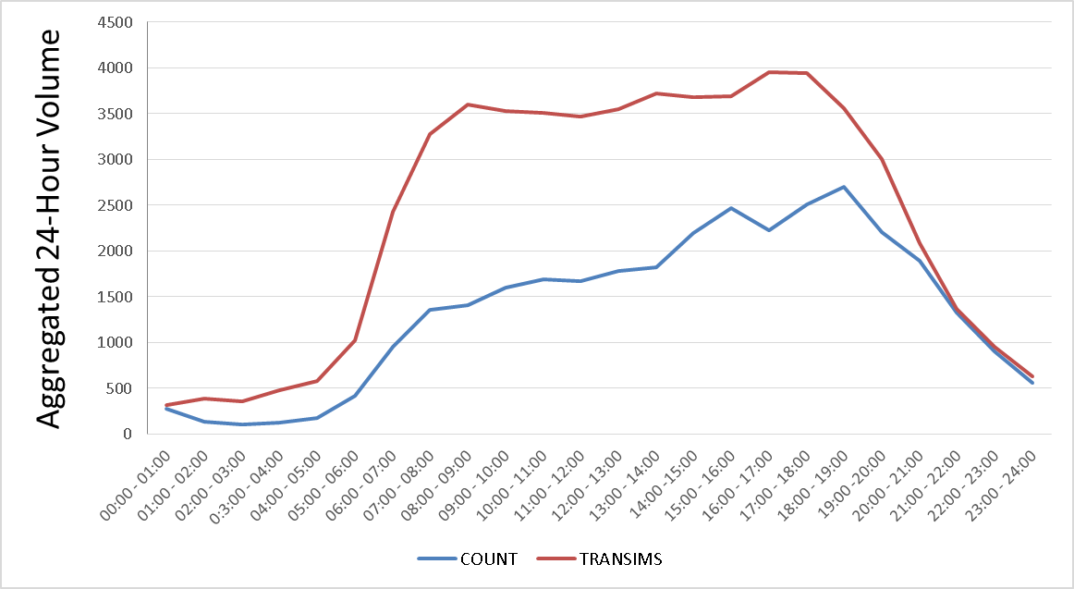
Validation –Link Level
Freeway
Major Arterial
Minor Arterial
Local

Slide 9
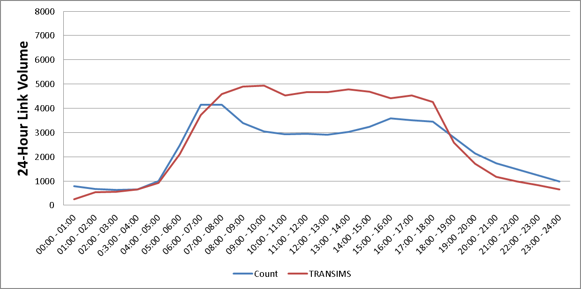
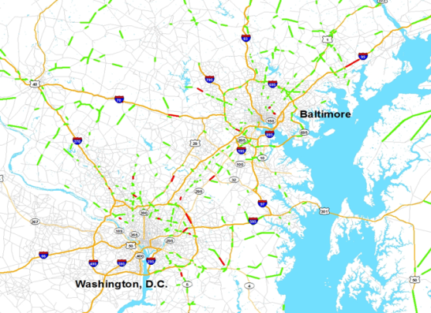
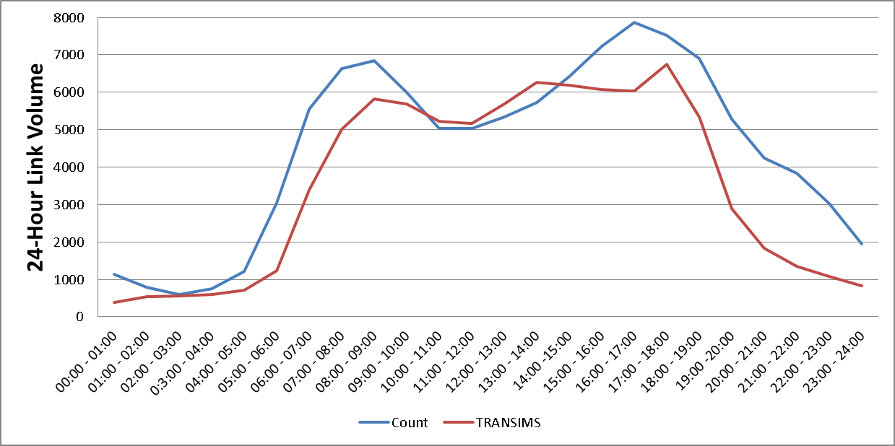
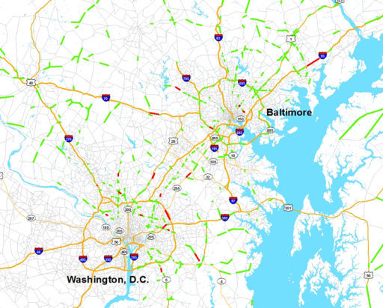
I-95 S between MD-24 and MD-543
I-95 S between MD-24 and MD-543
Volume (vph)
Capital Beltway–Inner Loop between MD-295 and MD-450
Volume (vph)

Slide 10
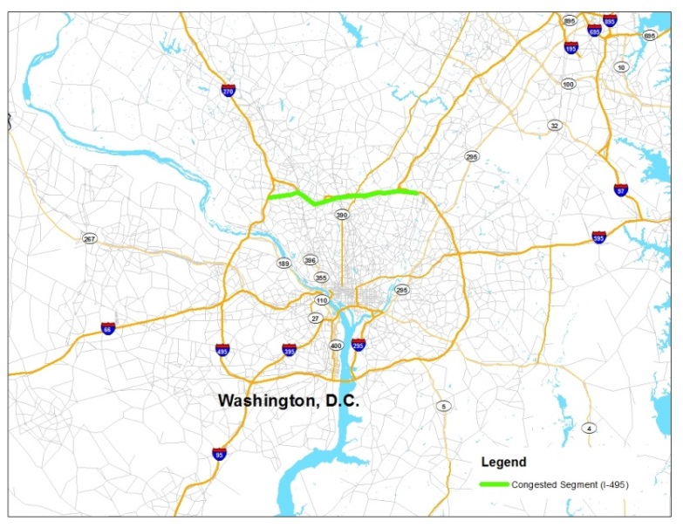
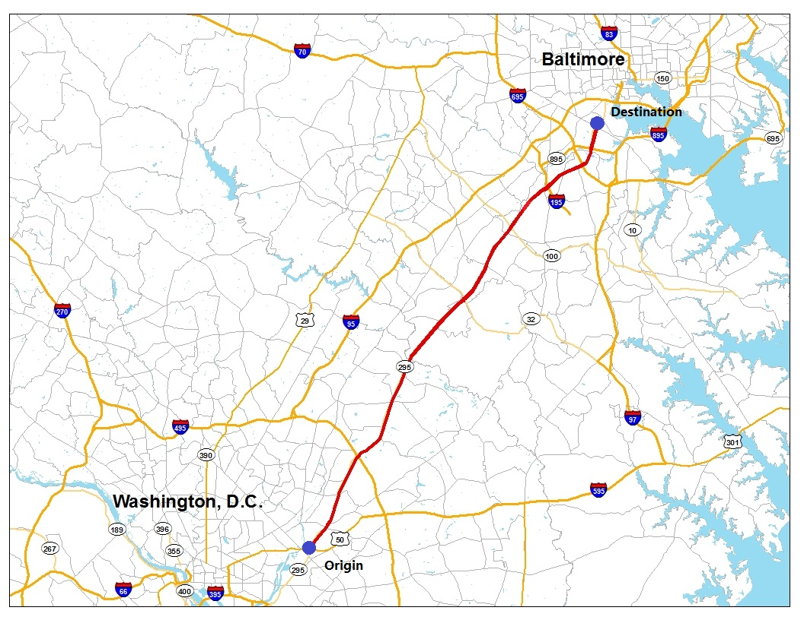
Time-Dependent Performance Measures
Congested Segment
Change in Average Travel Time by Departure Time

Slide 11
Simulation-based APPROACH:DTA-Lite

Slide 12
MSTM DTA-Lite Model
Dynamic traffic assignment:
Calibrate model parameters – e.g. flow capacity, jam density (for congestion propagation)
Traffic count-based dynamic OD demand calibration
Validate to screenlines, major corridors, ground counts by facility type

Slide 13
Preliminary Daily Link Volume Comparison
Daily link volume
DTALite-BPR vs. MSTM
Daily link volume DTALite-PQM vs. MSTM

Slide 14
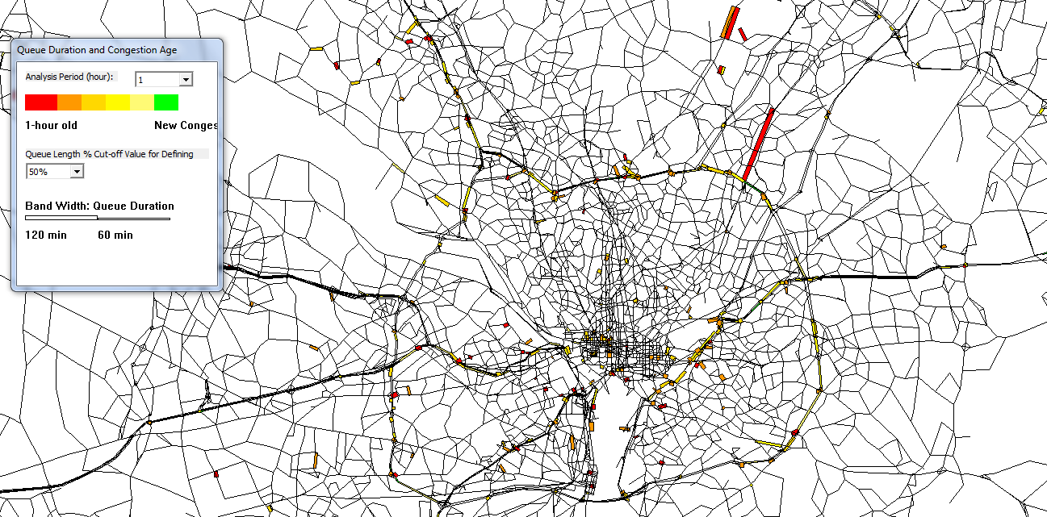
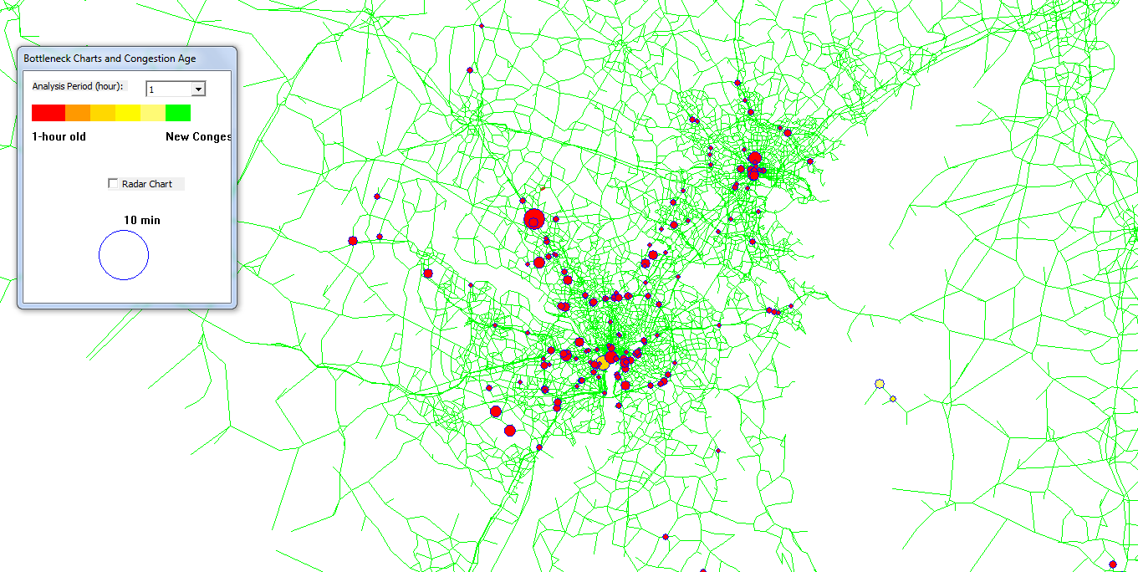
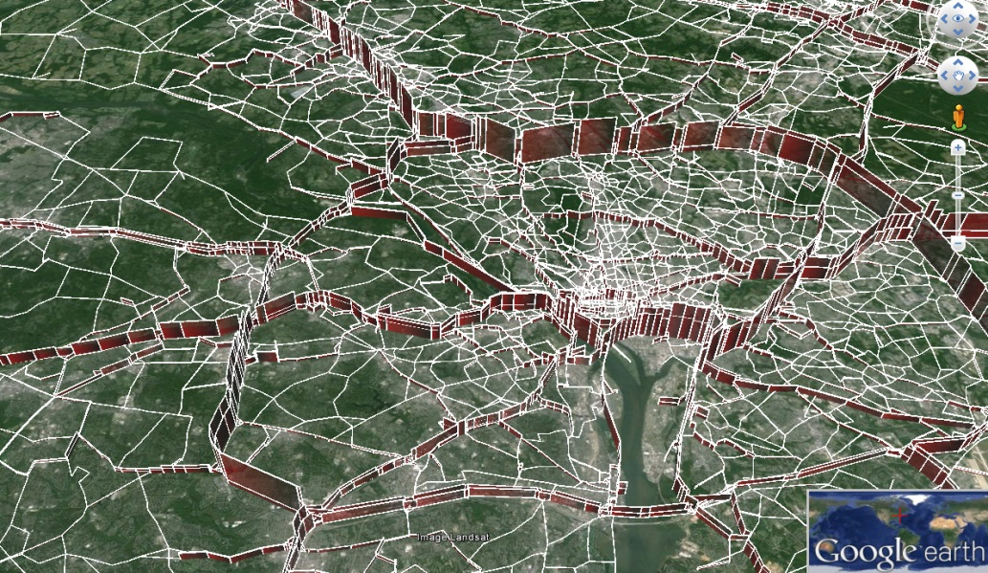
Visualization Examples
Queue Duration
Bottleneck
3D Volume

Slide 15
Highlights
Tight integration with CUBE
  Allow BPR function, point/spatial queue and simplified kinematic wave model in traffic simulation
  Direct interface for reading CUBE shape files and demand file
Tight integration with sensor data
  Built-in OD demand calibration model that accepts sensor density, flow, and speed data
Future work
  Calibration of road capacity and dynamic OD demand matrix
  Tolling scenarios for detour management
  Activity based model + DTA integration, more behavior-driven model for evaluating emerging traffic management scenarios
  Automated evaluation tool for a large number of road capacity improvement strategies
  Google Transit capability to add transit capability

Slide 16
THANKS!
Q &A
For more information:
http://www.smartgrowth.umd.edu/
E-mail :
fducca@umd.edu Fredrick W. Ducca, TPRG Director
serdogan@umd.edu Sevgi Erdogan, Research Associate
Address:
Suite 1112, Preinkert Field House
University of Maryland
College Park, Maryland 20742
301.405.6788

