Slide 1

David B. Roden, Senior Consulting Manager
2015 TRB Transportation Planning Applications Conference
Analysis of Transportation Projects in Northern Virginia
May 19th, 2015

Slide 2
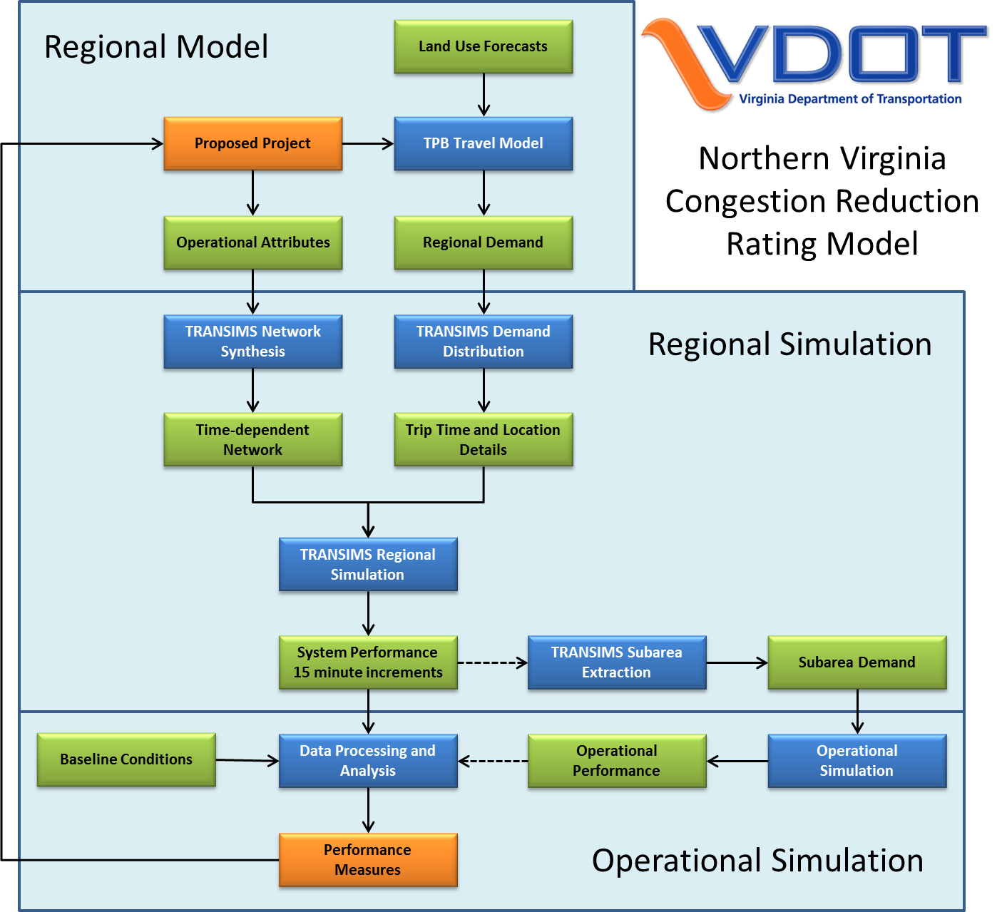
Notes:
^{Add relevant clients to lists.}

Slide 3
Detailed Rating Overview
MWCOG regional model establishes regional travel demand
  Fixed regional population and employment by zone
  Fixed regional trips by mode and origin-destination zone
Based on TRANSIMS dynamic assignments for 2020 and 2040
Focused on the primary impact areas of each project
Scored based on the project that performed the best in each performance measure
Rated based on stakeholder performance measure weights
Project costs were not considered in the rating, but used to select projects for funding

Slide 4
TRANSIMS Dynamic User Equilibrium
Build minimum-impedance paths for individual travelers using 15 minute link travel times and turn delays
Dynamically assign trips to the network
Update 15 minute link travel times and turning delays
Compare the current link travel times and trip travel times to previous iteration values
If the difference is significant (link gap and trip gap), select travelers to update
Average travel times between iterations and between time periods to dampen oscillation effects
Re-build paths for selected travelers and combine with existing paths for other travelers
Notes:
^{Add relevant clients to lists.}

Slide 5
Dynamic User Equilibrium Process
Time-dependent Network
Trip Time and Location Details
Link Volume Delay and Intersection Control Delay
Build Paths
Average Travel Times
15 minute Link Flows and Travel Times
Travel Path and Travel Time for each Traveler
Select Travelers
Link Gap Analysis
Trip Gap Analysis
no
Converged?
yes
15 minute Link and Turn Performance
Travel Plan for each Traveler
Notes:
^{Add relevant clients to lists.}

Slide 6
Convergence Refinement Iterations
Free Flow Conditions
Trips by Time of Day and Mode
Progressively Tighter Convergence
Router (DUE1)
15 minute Link Travel Times and Turn Delays
Travel Paths or Problems
Router (DUE2)
15 minute Link Travel Times and Turn Delays
Travel Paths or Problems
…. up to 7 times
Router (DUE7)

Slide 7
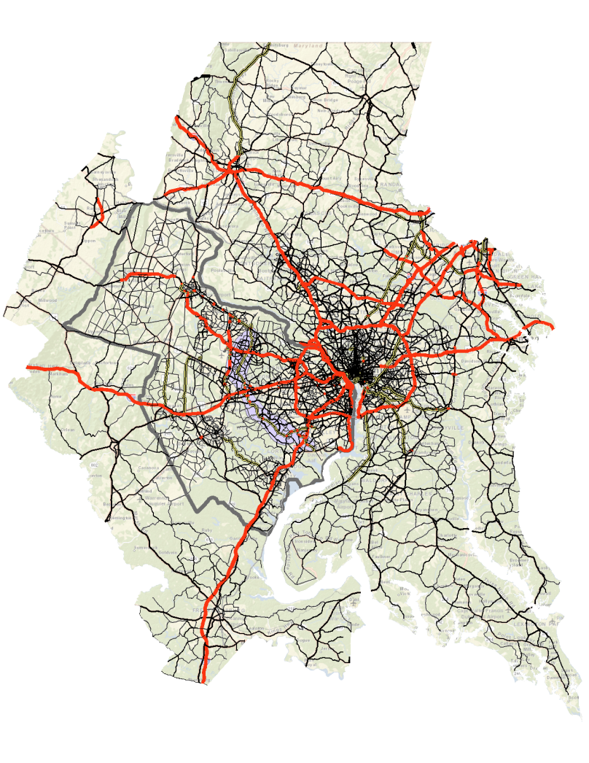
Regional DUE Model
Vehicle Demand
  2020 = 17.4 million
  2040 = 20.1 million
Convergence Process

Slide 8
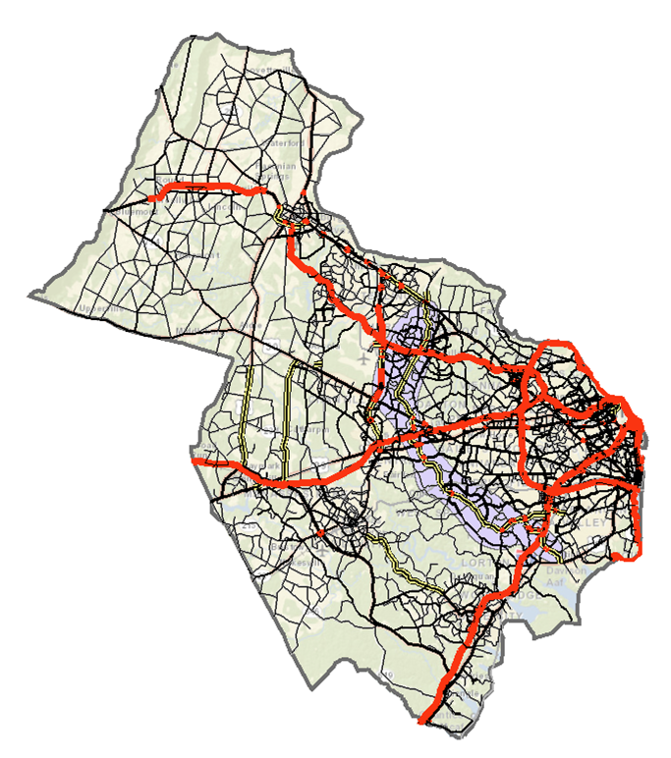
Northern Virginia DUE Model
Vehicle Demand
  2020 = 6.77 million
  2040 = 7.93 million
Convergence Process

Slide 9
Impact Area Definition
  Impact areas were used for the detailed ratings to minimize any distortions in the performance measures related to random effects that are unrelated to the project improvement
  2020 and 2040 TPB model results were used to estimate the impact area for each project
    Change in peak period volume > 250 vehicles or 20% (100+ vehicles)
    The area was defined using TAZ boundaries
  The impact areas were modified for the detailed analysis to more effectively capture links and alternate routes that could potentially be effected by project-related changes
Notes:
^{Add relevant clients to lists.}

Slide 10
Impact Area Applications
The final assignment with and without the project was conducted using any link within or crossing the impact area boundary
All trips to and from the impact area plus all trips traveling through the impact area in the Northern Virginia baseline simulation are included in the project analysis
The project ratings are based on changes in the performance measures for any link within or crossing the impact area boundary

Slide 11
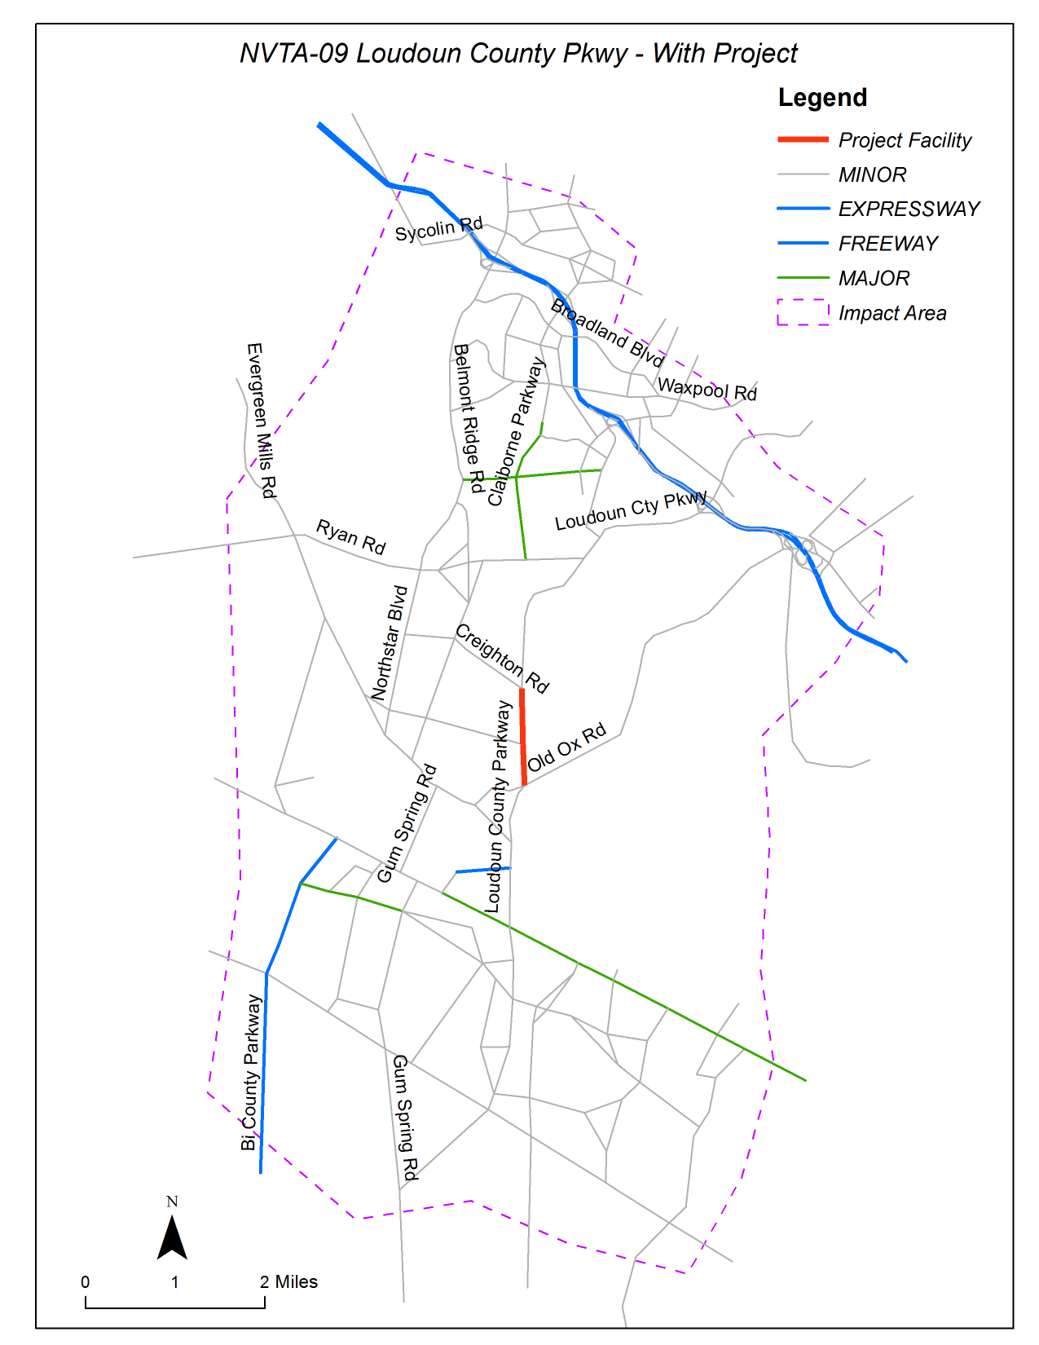
Project Specific Subarea DUE Model
Vehicle Demand
  2020 = 0.09 to 1.97 million
  2040 = 0.12 to 2.25 million
Convergence Process
Typical Gap Ranges

Slide 12
Volume Changes

Slide 13
Volume and Speed Profiles

Slide 14
Performance Measure Summary
  Transit Crowding = reduction in the number of transit route miles experiencing crowded conditions (local bus > 1.0; express bus and commuter rail > 0.9; Metrorail > 100 passengers/car).
  Congestion Duration = reduction in the number of hours of the day auto and transit passengers experience heavily congested travel conditions.
  Person Hours of Delay = reduction in the number of person hours of travel time above free flow travel time.
  Person Hours of Congested Travel in Automobiles = reduction in the number of person hours of travel in automobiles and trucks on heavily congested facilities.
  Person Hours of Congested Travel in Transit Vehicles = reduction in the number of person hours of travel in buses and trains on heavily congested facilities or in crowded vehicles.
  Accessibility to Jobs = increase in the number of jobs that can be reached from each household based on a 45 minute travel time by automobile and a 60 minute travel time by transit.
  Emergency Mobility = increase in the person hours of travel time resulting from a 10 percent increase in peak hour trip making.
Notes:
^{Add relevant clients to lists.}

Slide 15
Transit Impact Analysis Process
Regional transit trips loaded to regional transit routes
  2020 = 1.3 million transit trips
  2040 = 1.5 million transit trips
  Transit ridership and vehicles on links in each 15 minute period
  Add to auto persons and vehicles by link and 15 minute period with and without the project
  Total used to calculate changes in person hours of delay and congested person hours in transit

Slide 16
Emergency Mobility Process
10% of the Northern Virginia subarea trips that started between 6:00 PM and 8:00 PM were rescheduled to start between 5:00 PM and 6:00 PM
  The specific start time between 5-6 was proportional to the original start time offset between 6-8
The trips were traced to each project impact area boundary and then assigned to the subarea network with and without the project
Changes in PM Peak Period person hours of delay were used as the performance measure

Slide 17
Access to Jobs
15 minute link travel times for all regional links were constructed with and without each project
  Travel times for links outside of each project impact area came from the Northern Virginia DUE process
  Travel times for links outside of Northern Virginia came from the regional DUE process
Minimum impedance paths were built between each Northern Virginia TAZ to all regional TAZs
  3 activity locations were selected near each TAZ centroid
  Paths were built between each activity location using 3 trip start times (7:30, 8:00, 8:30) and the travel times were averaged
  If the travel time <= 45 minutes, the jobs at the destination were multiplied by the households at the origin
  The sum was divided by the total households in Northern Virginia → average number of jobs accessible in 45 minutes

Slide 18
Evaluation Performance Measure Weights
Notes:
^{Add relevant clients to lists.}

Slide 19
Evaluation and Rating Process
Absolute Change in each Performance Measure (MOE) for each Project
Absolute Change in each
Performance Measure
(MOE) for each Project
Travel Demand and Simulation Models
Based on 100 points for the project with the greatest benefit in each MOE (with and without the project)
Assign a Score (0-100) to each MOE
Apply Weights to the MOE Scores
Stakeholder Input
Sum Weighted MOE Scores = Project Rating

Slide 20
Projects Sorted by 2020+2040 Ratings

Slide 21
Projects Sorted by Congestion Rating / Cost

Slide 22
NVTA Project Selection Process
NVTA assigned 35% of their project selection score to congestion reduction
  The 2040 Project Ratings were used for highway projects
  A qualitative process assigned high, medium or low congestion reduction potential to transit projects
Other measures (high/medium/low)
  Consistent with TransAction 2040 goals (25%)
    Activity centers, regional connectivity, multi-modal, improve operations, cost sharing
  Project readiness (advanced phase of development) (25%)
  Urgency (existing LOS deficiencies for all modes) (5%)
  Reduce VMT (transit, PNR, HOV, pedestrian/bicycle trails) (5%)
  Safety (5%)

Slide 23
Sorted NVTA Project Scores

