Slide 1
Speed Postprocessing for MOVES
Lessons from NCHRP 25-38
Transportation Planning Applications 2015
Chris Porter
May 20, 2015
Notes:
I’m going to talk about some interesting findings looking at developing speed distributions for MOVES inputs.

Slide 2
Key Messages
Speed distributions are an important MOVES input
A cornucopia of observed speed data is becoming available – BUT
We often need to use modeled speeds for consistency between base and future year assumptions
Models don’t do a good job of predicting speeds
We can improve our current models through…
  Postprocessed speed estimates
  Adjustments to free-flow speeds
Really good speed estimates will require better models

Slide 3
NCHRP 25-38
Input Guidelines for MOVES
Objective
  Produce guidelines for transportation practitioners on methods, procedures, and datasets needed to develop and obtain transportation-related regional- and project-level inputs for using MOVES
Products
  Resource document on developing MOVES inputs
  Sample data and examples
  Tools for processing data
  Final report documenting research approach
Notes:
This presentation is based on research for NCHRP 25-38.
For those of you who are not emissions modelers, MOVES is EPA’s approved motor vehicle emission factor model. It is used for national, state, and local emissions inventory development, including SIPs, conformity analysis (regional and hot-spot), GHG and MSAT analysis. It can be applied at a regional or project scale, and can produce a total emissions inventory, or an emissions rate (g/mi).
This project developed guidelines to help agencies develop locally-based MOVES inputs.
As part of the research for this project we looked at methods for developing data on speed distributions. In this presentation we’ll focus on speed distributions for regional analysis – rather than link speeds for project level analysis.

Slide 4
Summary of MOVES Inputs Falling in Different Sensitivity Ranges
MOVES Input | VOC | NO_{X} | PM
Temperature
Humidity
Speed
Age
VMT
Population
Ramp Fraction
Source Type Detail for Road Type Dist
Source Type Detail for Speed Dist
Month VMT Fraction
Hour VMT Fraction
Very Substantial
Very Substantial
Very Substantial
Modest
Substantial
Modest
Very Substantial
Very Substantial
Very Substantial
Very Substantial
Substantial
Substantial
Substantial
Very Substantial
Very Substantial
Substantial
Substantial
Substantial
Modest
Modest
Substantial
Modest
Modest
Moderate
Modest
Modest
Moderate
Modest
Modest
Modest
Modest
Modest
Modest
Notes:
As part of this research we looked at sensitivity of MOVES outputs to the various inputs.
Speed is one of the inputs to which MOVES is very sensitive. “Very Substantial” means at least a 50% impact on emissions within a range of real-world conditions for the input. So it’s important to develop accurate speed distributions.

Slide 5
Speed-Emissions Relationship
Urban Unrestricted Access Roadways
Notes:
This chart illustrates why – it shows how emissions relate to (link level) speed. Emissions are much higher at low speeds.
Above 35-40 mph, VOC and PM emissions are still sensitive to speed – NOx and CO2 less so.
Based on data for Hillsborough County, FL, 2006, 7:00 – 7:59 am
Relationships for other roadway types are similar

Slide 6
MOVES Speed Sensitivity Analysis
Comparison Made | Source | VOC | NO_{X} | PM
Average speed distribution (overall distribution based on varying congestion levels, worst case road types shown) | (1) | PC: -15% to +83% CT: -29% to +120% | PC: -5% to +20% CT: -8% to +57% | PC: -12% to +43% CT: -20% to +53%
Average speed distribution (reduce HD vehicle speed by 5 mph) | (2) | +1% | +2% | +6%
Average speed distribution (decrease average speed from 90th to 10th percentile based on NEI submittals) | (3) | +8% | +10% | +16%
PC = Passenger Car; CT = Combination Truck; HD = Heavy Duty; NEI = National Emissions Inventory
1. Noel, G., and R. Wayson, 2012, MOVES2010a Regional Level Sensitivity Analysis, Volpe National Transportation Systems Center, prepared for Federal Highway Administration, DOT-VNTSC-FHWA-12-05.
2. Cambridge Systematics and Eastern Research Group, 2015, Input Guidelines for Motor Vehicle Emissions Simulator Model: Practitioners’ Handbook, NCHRP Web-Only Document 210.
3. Koupal, J., et al., 2013, Study of MOVES Information for the National Emission Inventory: Final Report, Eastern Research Group, prepared for Coordinating Research Council, CRC Report # A-84.
Notes:
The average speed distribution can have a substantial effect on emissions. For example, the Volpe/FHWA sensitivity analysis (Noel and Wayson, 2012) tested speed distributions for urban Interstates corresponding to different levels of service and found a variation of up to 33 percent for passenger car VOC emissions and up to 49 percent for combination truck VOC emissions, compared to the national default speed distribution for this road type. PM emissions varied by up to 16 percent for passenger cars and 53 percent for combination trucks.
Car and truck speeds can differ. A sensitivity analysis performed for this research found that reducing the average speed of trucks by 5 mph compared to the MOVES default distribution (for all road types) increased emissions by just a few percent. A CA study found a 10 mph difference on some freeways, so impacts could be higher.
An 8 to 16% variation was found on different states’ speed distributions based on 2011 NEI submittals.

Slide 7
Example Average Speed Distribution Input
sourcetypeID | roadtypeID | hourdayID | avgSpeedBinID | avgSpeedFraction
11 | 2 | 185 | 1 | 0.0000000
11 | 2 | 185 | 2 | 0.0000000
11 | 2 | 185 | 3 | 0.0000000
11 | 2 | 185 | 4 | 0.0000000
11 | 2 | 185 | 5 | 0.0000000
11 | 2 | 185 | 6 | 0.0000000
11 | 2 | 185 | 7 | 0.0212651
11 | 2 | 185 | 8 | 0.0027255
11 | 2 | 185 | 9 | 0.0000000
11 | 2 | 185 | 10 | 0.0000000
11 | 2 | 185 | 11 | 0.0000000
11 | 2 | 185 | 12 | 0.0000000
11 | 2 | 185 | 13 | 0.3890143
11 | 2 | 185 | 14 | 0.0590208
11 | 2 | 185 | 15 | 0.5279743
11 | 2 | 185 | 16 | 0.0000000
x 13 source types x 4 road types x 24 hours of day x weekday versus weekend
Notes:
The “speed distribution” input is a set of 16 fractions that sum to 1, which represents the distribution of vehicle-hours traveled among 16 speed bins
MOVES requests input for 13 source (vehicle) types, 4 road types (restricted/unrestricted access x urban + rural), each hour of the day, and weekday vs. weekend.
Planners rarely have data at this level of detail, so a lot of bins typically have the same distribution.

Slide 8
Speed Data Sources
Base Year/Historical
Forecast Year
MOVES embedded
Field surveys
Public agency ITS systems
Private vendor from GPS/cellphones
Stand-alone volume-delay functions
Travel demand forecasting model
TDFM speed postprocessing
Notes:
These are some sources of speed data.
We are seeing more and more options for current speeds
Forecasting speed still requires models

Slide 9
Speed Inputs for MOVES
EPA Guidance
States expected to develop local estimates for SIP
and conformity analysis
Recommended approach is to postprocess the output from a local travel demand network model
Use of peak and off-peak speed distributions, rather than a distinct distribution for each hour, is acceptable
Postprocessed speeds estimated in the validation year should be compared with speeds empirically observed
Notes:
EPA recommends postprocessing travel demand model speeds
Why use a TDM?
Future year estimates “must be logically related to the current year methodology and estimates”
Models account for effect of growth in VMT and transportation network improvements

Slide 10
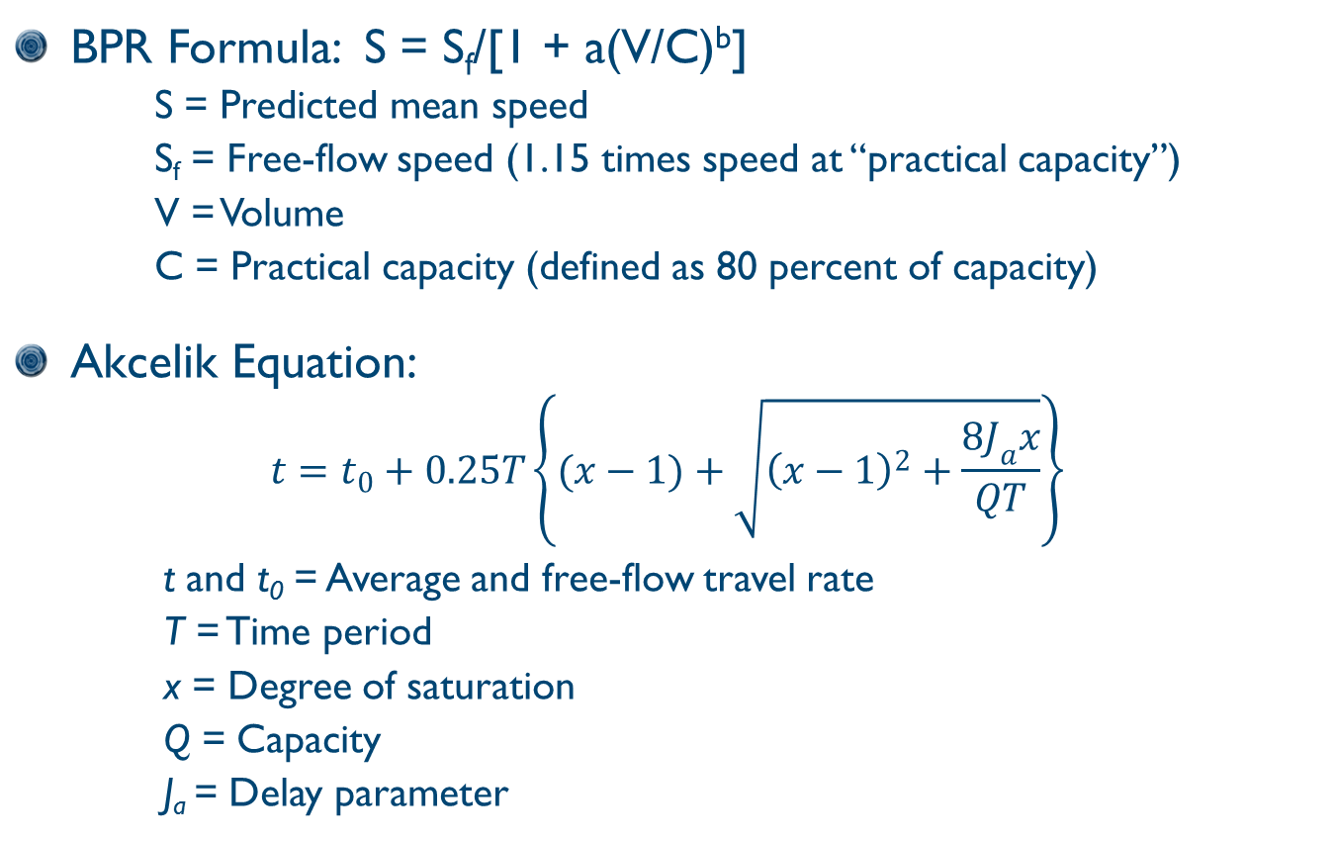
Volume-Delay Functions
BPR Formula: S = S_{f}/[1 + a(V/C)^{b}]
    S = Predicted mean speed
    S_{f} = Free-flow speed (1.15 times speed at “practical capacity”)
    V = Volume
    C = Practical capacity (defined as 80 percent of capacity)
Akcelik Equation:
$$t=t_{0}+0.25T\left\{(x−1)+\sqrt{{\left(x−1\right)}^{2}+\frac{8J_{a}x}{QT}}\right\}$$
        t and t₀ = Average and free-flow travel rate
        T = Time period
        x = Degree of saturation
        Q = Capacity
        J_{a} = Delay parameter
Notes:
The Bureau of Public Roads formula is most commonly used to translate volume, capacity, and free-flow speed by link into actual speed
Coefficients a and b can be varied to give a better fit
Alternatives have been proposed, such as the Akcelik equation

Slide 11
What’s Wrong with Typical TDFM Speed Estimates?
Models are calibrated to match traffic counts – not speeds
Impedances reflect “planning time” not actual travel time
Typically based on v/c ratios for only 1 to 4 time periods per day
Usually a simple function of link-level V/C ratios – no explicit modeling of intersection delay or spillback from downstream bottlenecks
Time-of-day shifting/peak-spreading usually not incorporated
Notes:
Our speed estimation methods have inherent limitations
We are talking about state-of-practice 4-step, tour, and activity based models here, not-state of art like DTA/microsimulation

Slide 12
Postprocessing Speed Estimates
Why and How?
Why
  Apply different parameters to more closely match real-world speed distributions
  Develop hour-by-hour speed distributions based on hourly volume estimates
Steps
  Allocate link-level VMT for each modeled time period by hour based on hour fractions from traffic counts or MOVES defaults
  Recompute link-level speeds for each set of hourly volumes
  Summarize speeds (VHT-weighted) across all links in the model for each hour of the day, for each MOVES road type, to obtain speed distributions
Notes:
We can’t fix all of the problems noted on the previous slide, but we can at least partially fix some of them

Slide 13
Comparison of Speed Data from Multiple Sources
Atlanta
  Travel demand model output, including unprocessed
  and postprocessed by ARC
  ITS data from Georgia DOT (freeways only)
  GPS travel survey data
  NAVTEQ
Jacksonville
  Travel demand model output
  ITS data from the Florida DOT (freeways only)
  INRIX/Here
Notes:
Compared TDFM’s, post-processed in different ways, with “ground truth” data – ITS (freeways only) and GPS travel survey (Atlanta only, but all road types)
ITS speeds are from video or loop detectors, 5-minute intervals over entire year (2011-2012?). Weighted by traffic volumes.
Attempted to use data purchased from NAVTEQ, INRIX – but too labor intensive to match TMC network with model networks so we could weight by volumes
(Note – we are currently doing that for the entire state of Florida)

Slide 14
Average Speed
Jacksonville Freeways
Notes:
Jacksonville model uses the BPR curves with custom (locally calibrated) coefficients
Postprocessing was applied to Jax model to recalculate v/c and speed on an hourly basis
Greatly improves average speed, but still does not completely match ITS

Slide 15
Speed Distribution
Jacksonville Freeways, AM Peak
Notes:
Average speed is not a great statistic for emissions modeling purposes, since speed-emissions relationship is nonlinear
Here we look at a speed distribution
Postprocessing shifts speeds from lower values to higher values compared to straight TDFM output
Underpredicts low speeds, overpredicts at 65 mph (free flow), underpredicts high speeds compared to ITS data
Average is closer to ITS

Slide 16
Average Speed
Atlanta Freeways
Notes:
Postproc 1 is an old custom VDF that ARC no longer uses
Postproc 2 is using BPR curve with JAX coefficients
Postproc 2 is much closer to ITS speeds
Note that GPS speeds are even higher than ITS. Don’t know why. Temporal sampling error in GPS? Spatial sampling error in ITS? Changes between sampling periods? Temporal disaggregation of values?

Slide 17
Speed Distribution
Atlanta Freeways, AM Peak
Fraction of VHT by Speed
Notes:
In Atlanta, using Jax BPR coefficients brings curve closer to ITS than standard BPR coefficients, although doesn’t solve underprediction at low speeds.
Note GPS readings in higher speed bins.

Slide 18
Average Speed
Atlanta Arterials
Notes:
Postprocessing also improves arterial data, but still lower than GPS observed speeds.

Slide 19
Effect of Time Interval Disaggregation
Fraction of VHT by Speed Bin
Jacksonville – AM Peak
Atlanta – AM Peak
Speed (mph)
Low-Speed Operation
Notes:
The time interval of aggregation makes a difference.
Models are V/C averaged over hourly period
ITS data are collected at 5-minute intervals. “Averaged” is average speed over 15 min (?) before aggregating into speed bins. Note that you lose a lot of low speed activity. Short periods of high congestion that don’t show up in 15 min or hourly statistics. Also lose some high speed data. Looks closer to a BPR curve output.

Slide 20
Effect of Speed Distribution on Emissions
Percent of Modeled Emissions versus ITS Speed Distribution
Restricted Access Roads, AM Peak
Jacksonville
Atlanta
Speed Distribution
VOC
NO_{X}
CO₂e
PM_{2.5} (trucks)
Notes:
How much effect to speed distributions have on emissions?
In Jax, not postprocessing your TDFM output would lead to ~10-40% overestimate of emissions in AM peak (compared to ITS), with biggest impact for VOC.
Postprocessing leads to a ~5-15% underestimate.
In Atlanta, the old VDF’s (no longer used) give significant overestimates. Postprocessing with BPR and Jax coefficients comes in pretty close to ITS or GPS - <5% error.

Slide 21
Comparison of Volume-Delay Functions
Notes:
This takes a closer look at alternative VDFs.
BPR, Jax, MTC are the BPR equation with different coefficients.
The moderate speeds shown even at V/C well over 1.0 account for the limitation of the model in capturing time-dependent effects
Akcelik equation is designed to show a sharp dropoff in speed as V/C exceeds 1.0
(This may be more realistic from a real-world perspective, but does it give a better speed distribution?)
There are other equations (e.g., old Atlanta curves, DVRPC equation) that show more dropoff at V/C < 1.0

Slide 22
VDF Impact on Speed Distribution
Fraction of VHT by Speed Bin, Atlanta Freeways, 7:00 to 8:00 a.m.
(old)
Notes:
The dark line is the ITS observed speeds
None of the equations match all that closely
BPR overpredicts in the middle ranges
Akcelik is pretty good at moderate to high speeds but overpredicts at low speeds
None capture speeds in the 70+ range. And if you made FF higher so they did, they would underpredict 60-65 mph speeds.
The emissions curves are pretty flat at that part of the speed curve, so it may not matter that much. Although there have been questions about MOVES’ accuracy at higher (70+ mph) speeds

Slide 23
Conclusions
Postprocess your TDFM speeds
  At the very least, base on hourly V/C ratios
  Don’t use default BPR coefficients
No VDF gives a great match with observed speed data
  May underpredict or overpredict low-speed operation
  VDFs show a peak at the free-flow speed but miss higher
  speed bins

Slide 24
Conclusions (continued)
Calibrate speed *distributions* against observed data?
  If we do this for present conditions, will it hold up in the future?
Aggregation interval of observed data makes a BIG impact
  What do we mean by “speed distribution”?
  Look carefully at cellphone/GPS data – what are we getting?
We won’t get really good speed predictions until we have models that accurately represent real-world traffic flow phenomenon

