Slide 1
Five-year CTPP Data Product
14th Transportation Planning Applications Conference
Liang Long
Columbus, OH
May 5, 2013

Slide 2

What I Will Cover
CTPP Products Using ACS
  CTPP 2006-2010
  CTPP 2006-2008
  Transportation Profiles
  CTPP Related Research
  CTPP Resources

Slide 3
CTPP Data Sources
The ACS replaced the Decennial Census “long form” and requires accumulation of data over multiple years for small area tabulation
CTPP uses data from the U.S. Census Bureau American Community Survey (ACS)
Notes:
As most of you know Decennial Census long form replaced ACS a couple of years ago.
2000 Decennial census long form was the last one.
Because of the change on the census bureau side, the CTPP, which is based on the long form has to change to the asc as well.

Slide 4
Similarities and Differences between
ACS and Decennial Census Long Form
ACS content is similar to the 2000 Census long form, but the design and methodology differ (long form no longer exists)
ACS questions related to commuting are the same as those on the 2000 Census long form
ACS samples about 3 million households per year and five-year estimates based on about 11 million housing units verses 18 million in Census 2000 long form
ACS estimates have higher sampling error than Census 2000 long form

Slide 5
Differences between Standard ACS and CTPP
CTPP has journey to work flow data
Workplace tables down to the small geographies
CTPP has lots of unique tabs at residence and workplace, e.g., household income by means of transportation
CTPP will be available at TAZ and TAD level
Notes:
Census Bureau's regular workplaces geocoding only goes down to county and place.
An imputation routine called "extended workplace allocation“ is currently being developed for the CTPP.
The concept for adding TADs is that the ACS 3-year tabulation is limited to geographic areas with 20,000 population or over. In the future, the TAD could potentially be used as an ACS 3-year tabulation geography.

Slide 6
Key CTPP Data Products
  CTPP five-year data products
  CTPP three-year data products
  Transportation profiles

Slide 7
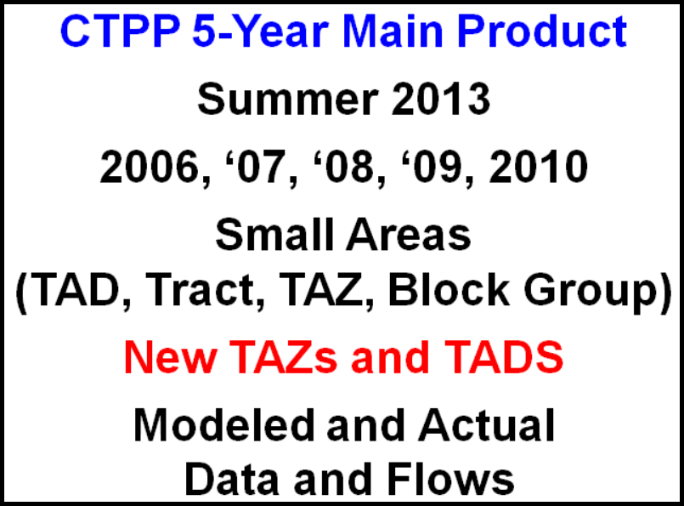
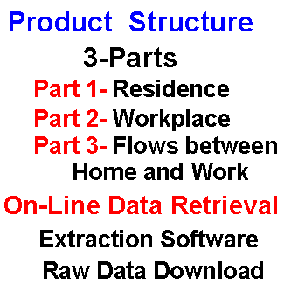
5-year CTPP Data Product
(2006-2010 CTPP)
Requires Disclosure Proofing
7

Slide 8
CTPP 2006-2010 Schedule
May 1st, 2013 – the first 35 states’ datasets (Alabama through North Dakota, in alphabetical order) have been delivered from the Census Bureau to the software vendor
May 24th, 2013 – full delivery of the CTPP raw data from the Census Bureau to the software vendor
June 25th, 2013 - Beta test version of the software product
August, 2013 – Data release with the access software

Slide 9
5-year CTPP Geography
States and MPOs finished creating their custom geography (TAZs and TADs) to be used for the 5-year data product in 2011
TAZ Traffic Analysis Zone | Traditional Size
TAD Transportation Analysis District | 20,000 population
Who did TAZs? TADS?
TAZs and TADs for 2006-2010 are available
ftp://ftp2.census.gov/geo/tiger/TIGER2010/TAZ/2010/
ftp://ftp2.census.gov/geo/tiger/TIGER2010/TAD/
9
Notes:
Traffic Analysis Zone (TAZ) and Traffic Analysis District (TAD) boundaries delineated for 2006-2010 CTPP are available now in the Census Bureau FTP site. Shapefiles are provided be opened in ArcGIS. Please note no CTPP data are contained in the TAZ/TAD files

Slide 10
5-year Geography and Flows
Asymmetrical Flows (in red)
Small Areas defined by MPOs in MPO areas and States Elsewhere
Tracts are Defaults for Small Areas
Default TADs defined by AASHTO
UZA tables for Part 1 ONLY
Notes:
urban clusters will be a messy geography to include in the 5-year package because they are block based, and tend to span several different non-nesting geographic entities.
Urbanized Areas are a more appropriate choice for inclusion in the CTPP tab, bringing me to the second point discussed. The Census Bureau does not calculate place of work urbanized areas, so urbanized areas could be included in Part1 (residence), but not part 2 (place of work). It could be included in a flow (Part 3) as long as the flow starts with urbanized areas on the residence end, and ends with another geography for which place of work is calculated (I guess we're calling these assymetric flows).

Slide 11
Modeled and Actual Flows
Set A and Set B Tables
Set A: Non-Disclosure proofed microdata
Set B: Disclosure proofed microdata
When using both, row and column totals won’t match for the same population and geographies
NCHRP 08-79
Producing Transportation Data Products from the ACS that Comply With Disclosure Rules
Notes:
(Set B tables which use the perturbed microdata are not subject to the suppression rules.)
11

Slide 12

3-year CTPP Data Product
(2006-2008 CTPP)
CTPP 3-Year
January 2011
2006, 2007, 2008
20,000 Pop. Areas
(County, Place, PUMAs)
Actual Flows
http://ctpp.transportation.org/Pages/3yrdas.aspx

Slide 13
(2006-2008 CTPP) Product Design
2008 Geography
Product Structure
3-Parts
Part 1- Place of Residence
Part 2- Place of Work
Part 3- Flows between
Home and Work
On-Line Data Retrieval
Extraction Software ~ Raw Data Download
Nation (US Total)
State
State-County
State-County-MCD
State-Place
State-PUMA (red = 2000 geo.)
State-POW PUMA
Metropolitan Statistical Area
MSA – EACH Principal City
http://ctpp.transportation.org/Documents/CTPP_custom_tabulations_based_on_3yracs2006_2008.xls

Slide 14
(2006-2008 CTPP) Product Summary
Highlights | Low Lights
Based on CTPP2000 Tables Many NEW Univariate Tables More Age Tables Streamlined Race Tables More HH and HH Lifecycle Tables More English Proficiency Tables Way more Flows Tables | Incomplete Coverage Rounded Reduced Number of Crosstabs with Mode -- Travel time -- Household income -- Vehicle availability -- Age -- Time leaving home Tables will have Suppression -- Means based on 3 values -- 3 records in Flow Large MOEs (@ 90%)

Slide 15
Differences between CTPP 2006-2008 and CTPP 2006-2010
No population thresholds and available in small geographies including TAZs
Modeled and Actual Data flows
Transportation Analysis District (TAD) is newly defined geography
Two more tables crossed Means of Transportation (Minority Status and Number of Workers)

Slide 16


CTPP Data Profiles
Why do them? What good are they?
Foundation Building
Snapshot of Area
Quickly compare Between Areas
Begin to Understand Changes
Good introduction to the data
Easy to do!

Slide 17
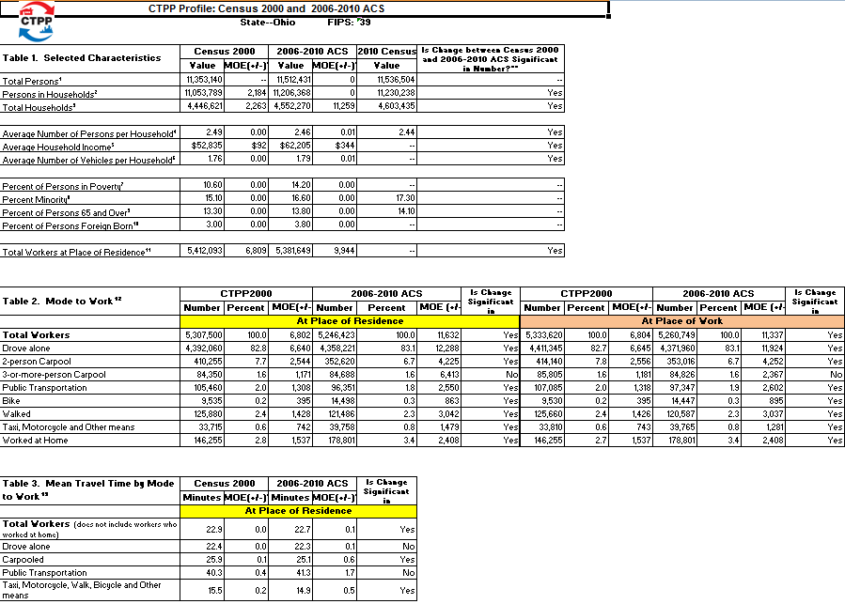
Insert other examples of profile pages

Slide 18
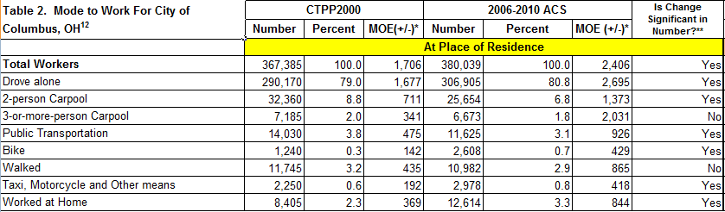
Transportation Profiles
Check out the Profiles for your area http://ctpp.transportation.org
Need to Brush up on significance testing
http://www.edthefed.com/presentations/significance%20testing.ppt

Slide 19
CTPP Related Research
Commuting in America 2013 (On-going)
Feasibility of a Microdata Analysis System (On-going)
Assess the Utility of the CTPP 5-year Data (In the process of selecting a contractor)
  Small Area Employment (proposal submitted to NCHRP 8-36)
  Data Visualization (proposal submitted to NCHRP 08-36)
Notes:
offer more flexibility to the user

Slide 20
CTPP Resources

Slide 21
E-Learning Modules
The American Community Survey
CTPP Data tabulations based on ACS
Changes in CTPP: Census Long Form vs. ACS
Geography in CTPP
Understanding Margin of Error
Disclosure Proofing of ACS Data in CTPP (Coming Soon)
http://ctpp.transportation.org/Pages/elearningmodules.aspx

Slide 22
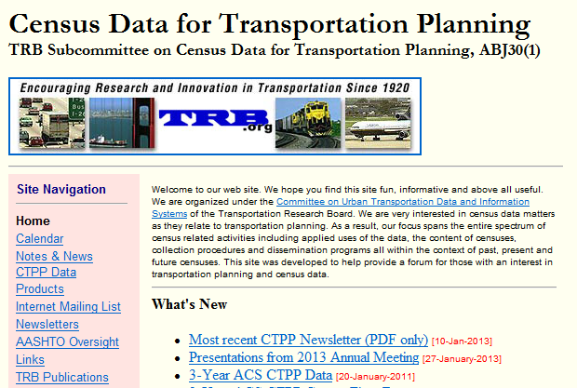
CTPP List Serve
http://trbcensus.com

Slide 23
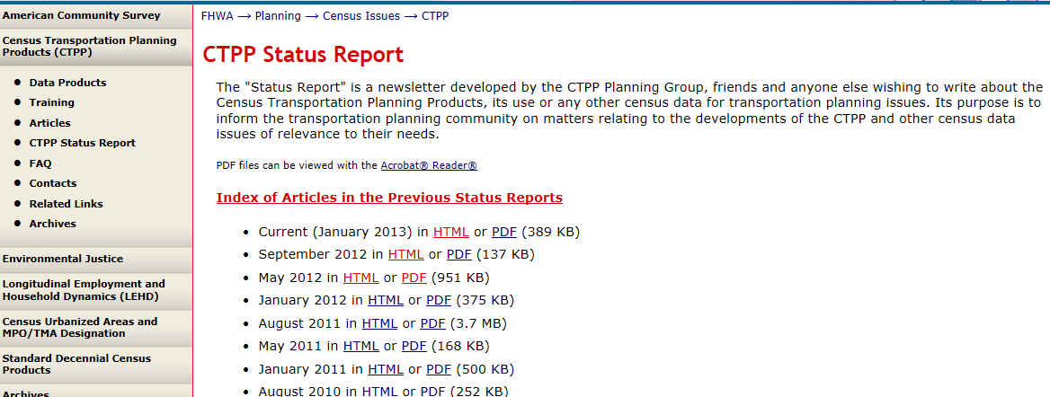
“Status Report” Newsletter
http://www.fhwa.dot.gov/ctpp/status.htm
http://www.trbcensus.com/newsletters.html

Slide 24

Special Staff and Contacts
Penelope Weinberger
CTPP Program Manager, AASHTO
444 North Capitol Street NE Ste 249
Washington, DC 20001
(202) 624-3556
pweinberger@aashto.org
http://ctpp.transportation.org
Liang Long
CTPP Technical Support
(202) 366-6971
liang.long@dot.gov

