Slide 1
Transportation Secure Data Center
Elaine Murakami
FHWA Office of Planning
Washington, DC
Notes:
The TSDC is operated by Department of Energy’s National Renewable Energy Laboratory. The major support has come from FHWA Office of Planning, with additional support from the Office of Operations, and the DOE Vehicle Technologies Program.
NREL had experience is setting up a secure data center with automanufacturers. Also, they were very motivated to get better access to the GPS datasets themselves for EV and PHEV research. One advantage of using NREL is that as a “research laboratory” they are not subject to FOIA requests.

Slide 2
Agenda
Motivations
Different approach to traditional research centers
Datasets currently available, examples of analyses
Processing steps taken by NREL
Data access using VMWare

Slide 3
Transportation Secure Data Center (TSDC)
Goal: Securely archive and provide public access to detailed transportation data
  Transportation research has numerous topics of interest, many of which can be explored using GPS devices placed in a vehicle or on a person
  Publicly-available GPS-based data sets are rare
    Data sets are expensive to collect, and difficult to interpret
    Sharing transportation data places participants privacy at risk limiting its distribution

Slide 4

Comparisons to a traditional research data center
Transportation Secure Data Center at NREL | Traditional Research Data Centers
Differences
Virtual access, access at your desktop | Requires travel to a specific location
Similarities
Submit proposal
Cannot copy the original data
Results reviewed before allowed to remove
Notes:
For example, the Census Bureau Research Data Center program has 15 locations across the United States. Their system often takes 6 to 9 months before approval is granted to access the data. You MUST travel to the RDC location to access the data.

Slide 5
Benefits of the TSDC
Benefits to Data Providers | Benefits to Data Users
You do not have to distribute copies of your data and worry about maintaining the privacy of respondents
The data are converted into a standard format with other GPS travel behavior datasets | The data are converted into a standard format with other GPS travel behavior datasets
The data are archived and will not be lost if staff turnover occurs | The benefits of the data extend beyond the original purpose of data collection, making research more cost effective
 | Recent transferability research suggests the value of accumulating travel records from many locations to benefit local models.

Slide 6
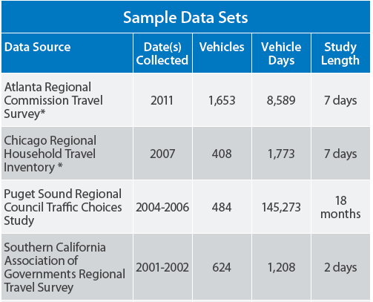
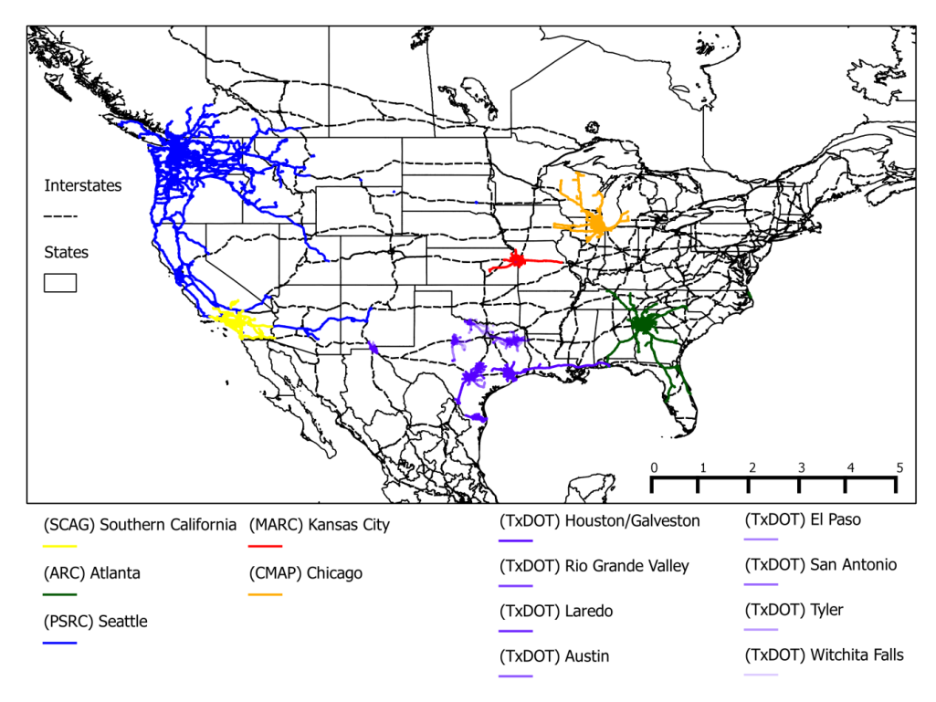
Some of the Data Available through the Secure Controlled Access Portal

Slide 7
You are limited only by your imagination
Notes:
And maybe by your programming and GIS capabilities!

Slide 8
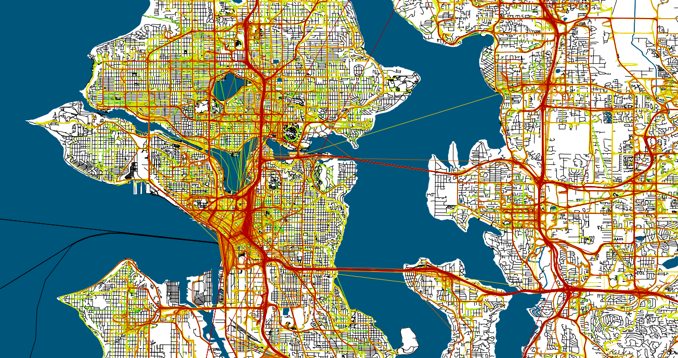
Seattle - Puget Sound Traffic Choices (FHWA value pricing project, by PSRC
Average Speed
Vehicles
GPS recording at X per minute; insufficient for drive cycle processing, but still useful for spatial analyses
447 vehicles
Sampling occurred between November 2004 & April 2006
18 month samples
0-10 mph
10-20 mph
20-30 mph
30-40 mph
40- mph
Notes:
Colors are inverted! I told the NREL staff that it was clear that they were not transportation planners, because they picked RED for the fastest speed.

Slide 9
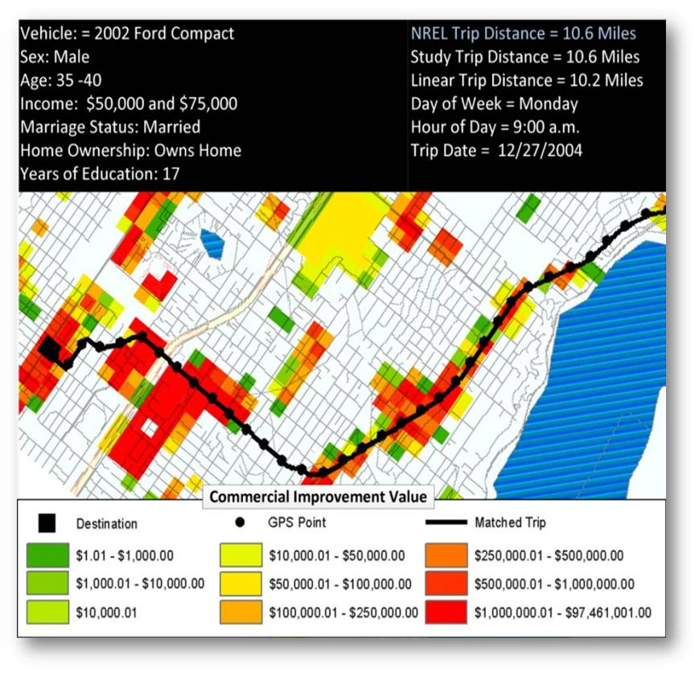
Puget Sound Traffic Choices w/UrbanSim
Notes:
This shows that individual trip can be plotted against the land values from the UrbanSim file.

Slide 10
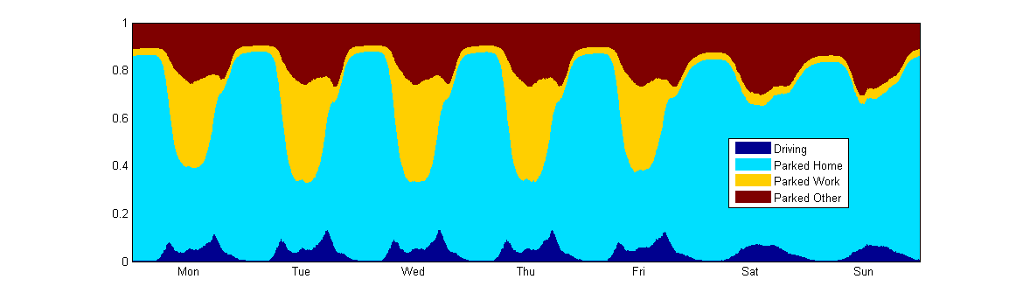
Puget Sound Traffic Choices: average week, location of vehicle
Notes:
This shows accumulated data over multiple weeks, and shows the average.

Slide 11
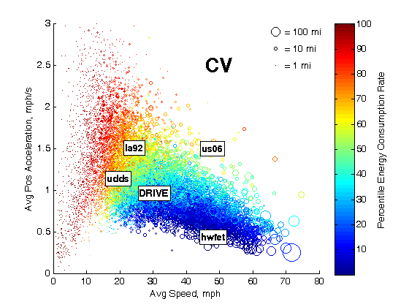
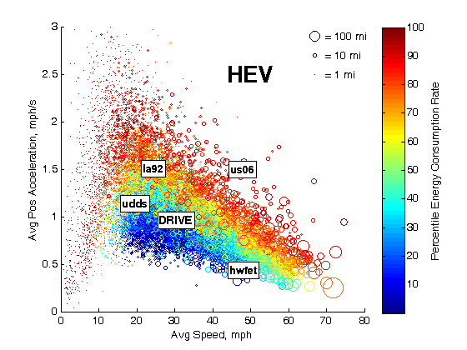
Using Real World Driving behavior to estimate energy efficiency
Notes:
Here is an example from NREL research where they combined the data from all the GPS vehicle datasets that they had on-hand.
Data for all 13,622 trips from 2,154 vehicle records are shown. Left side: conventional vehicles, and Right side shows Hybrid.
Low-speed trips coincide with short-distance travel and high acceleration and vice versa due to:
Behavioral norms (lack of driver-requested high-acceleration events during high speed travel)
Technical realities (inability of most vehicles to deliver high acceleration at high speed).
The optimal CV drive cycle occupies the intersection of HWFET.
Regenerative braking of HEVs pushes the optimal HEV drive cycle toward lower speed, low acceleration cycles.
This applies to PHEVs and BEVs too, as their plots are very similar to the HEV plot.

Slide 12
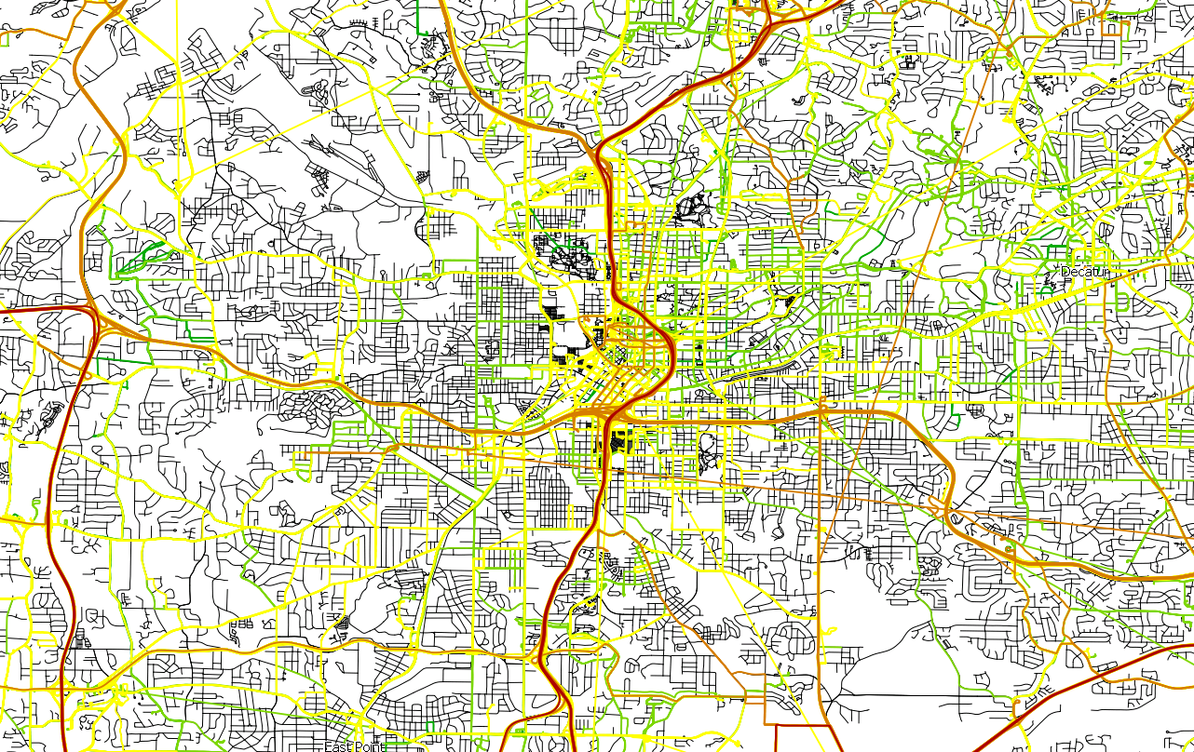
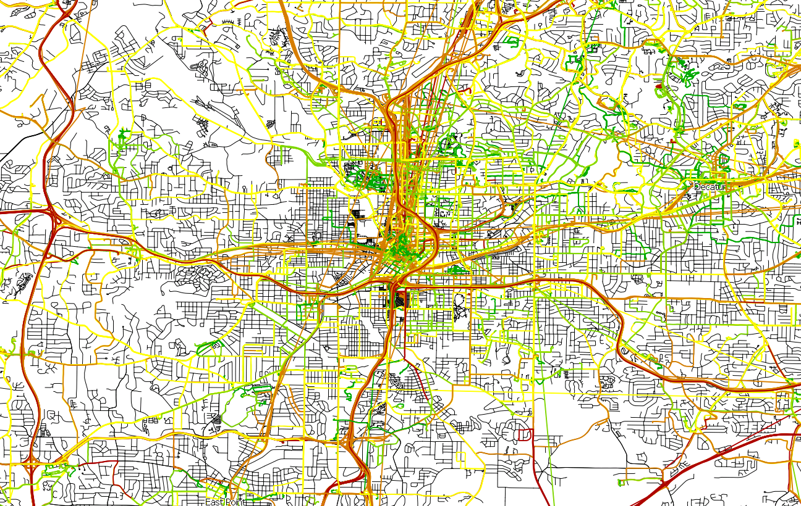
Atlanta – Atlanta Regional Commission (ARC)
Vehicles
Average Speed
Persons
0-10 mph
10-20 mph
20-30 mph
30-40 mph
40- mph
1653 vehicles
Sampling occurred between March 2011 & October 2011
7 Day samples
797 persons
Sampling occurred between March 2011 & September 2011
7 Day samples
Notes:
This is one of the newer datasets with 7 days of data.

Slide 13
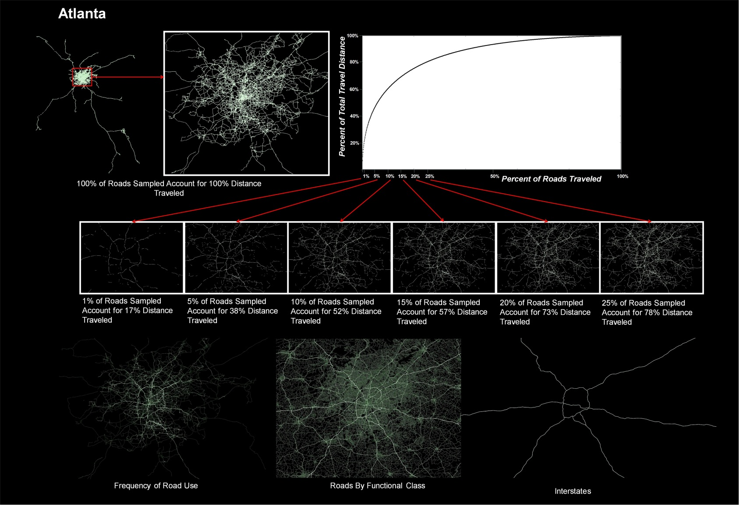
Linking travel to roadway func class:
Roadway electrification study at NREL
DRAFT only
Notes:
This is a current project at NREL to look at how much roadway would need to be electrified and how much vehicle travel would be captured, and therefore, impact on EV re-generation and ability to extend the driving range. This shows that if 10% of the roadway were electrified, it would capture over 50% of the distance traveled. (DRAFT numbers!)

Slide 14
Lexington KY GPS Pilot 1995-1996
Highway Func Class | % of Hwy Miles | Miles Traveled | AM Peak 7-9 a.m. | PM Peak 4-6 p.m. | Off Peak
Freeway | 4.27% | 2.87% | 0.67% | 2.69% | 3.36%
Arterial Hwy | 2.01% | 10.45% | 16.79% | 10.65% | 9.03%
Major Arterial | 7.19% | 32.78% | 29.10% | 31.29% | 33.97%
Minor Arterial | 16.91% | 29.54% | 30.76% | 28.15% | 29.64%
Collector | 8.31% | 8.85% | 8.33% | 9.64% | 8.72%
Local thru | 61.30% | 15.50% | 14.31% | 17.52% | 15.27%
Notes:
Final report, Page 6-9
This project was completed when SA was ON, making mapmatching more difficult.

Slide 15

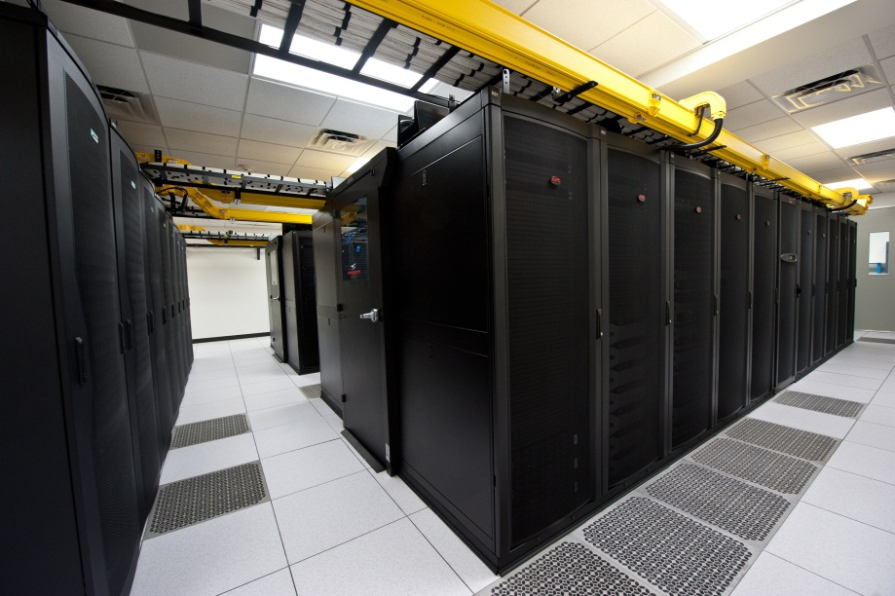
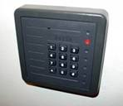

Security - Procedures
Establish MOU agreement with data provider
  Receive data via mail or secure FTP
Load onto secure raw data handling server
  Building badge access
  On-site security force
  Room key access
  Limited to data center staff
Maintain data backups
  Data mirrored on large storage array
  Regular tape back-up
  Fire/disaster protection for copies
NREL Data Center Storage Arrays

Slide 16
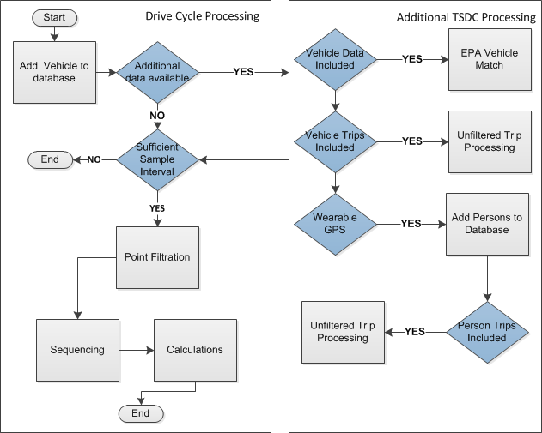
Data Processing
Two groups of processing routines are available to handle data sets
Six questions to determine how to handle the study:
  Is the vehicle GPS sample interval greater than 0.25Hz?
  Is study data provided?
    Yes - Ask the remaining questions
    No - Continue with drive cycle processing
  Is vehicle configuration indicated?
  Is trip level data analysis available in the original study?
  Does the study include a wearable GPS component?
  If a wearable GPS component is included is trip level data available?
If vehicle GPS data is above 0.25 Hz it is always fed through drive cycle processing
The study data is handled separately but a link is maintained between NREL results and the original study results

Slide 17
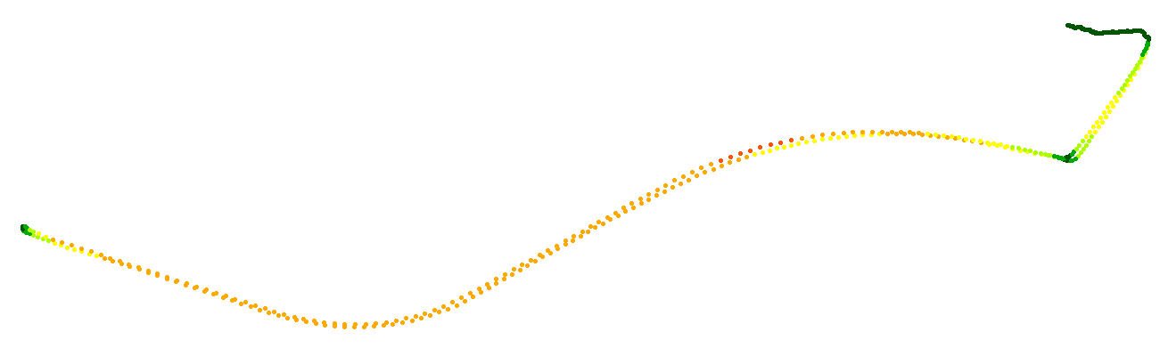
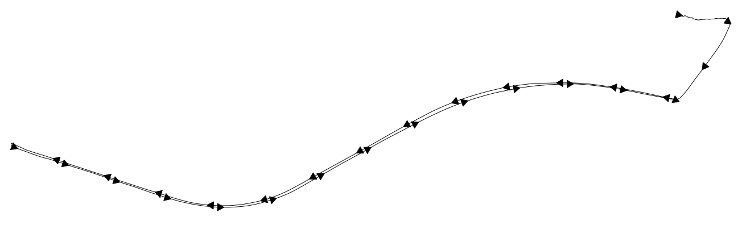
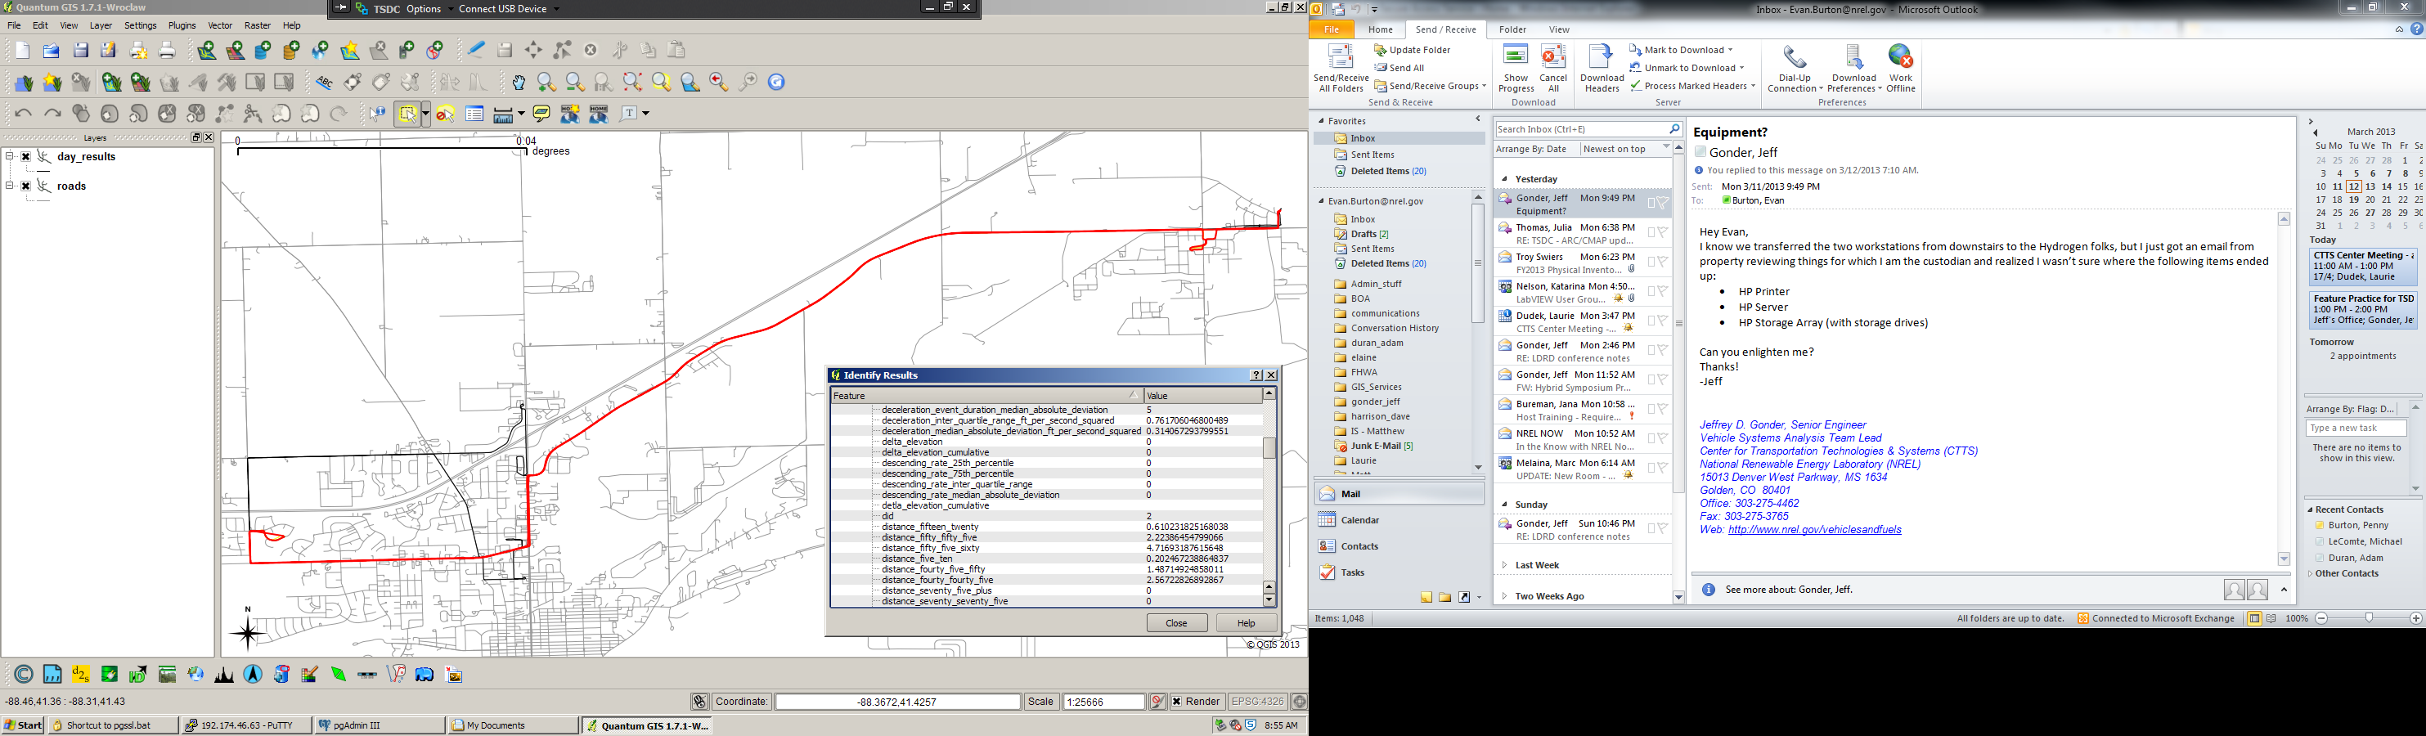
Drive Cycle Processing: Calculations - Results
Calculations
  250+ variables characterizing the vehicle operation over the sequence are generated for each sequence
Filtered point data are used to build trip lines based on the sequences identified
Calculation results are appended to the feature
GPS SPEED/LOCATION TRACE
0-15 mph
15-30 mph
30-45 mph
45-60 mph
60-75 mph
MICRO-TRIP LINE SEGMENT
Line Drawn From Points – Order assigned using time

Slide 18
Additional TSDC Processing
EPA Vehicle Match – Links vehicle configuration data to the EPA database and adds vehicle class(type)
Person Database Update – Assigns an NREL identifier number to each person
Unfiltered Trip Processing - Uses original trip data (start/end times) to sequence raw point data
  Applied to both wearable and vehicle trip data when available
  Outputs statistics indicating the quality of the data, and builds a line representing the path of travel
  Operates on the unfiltered data only

Slide 19
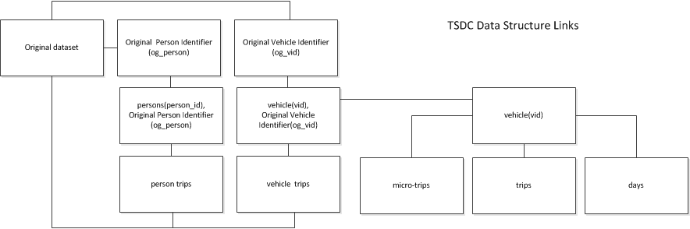
Maintaining the Link
A link is maintained between NREL results and the original study data
  All studies use either a single column or at most 2 columns to indicate a vehicle or person
  NREL assigns a single unique integer for all vehicles and records the original study’s vehicle identifiers as a single column in the vehicle tables (applies to persons as well)
Atlanta Example:
  sampno - is the household identifier (800042)
  vehno - is the unique vehicle identifier relative to the household (2)
  Original vehicle identifier assigned as (800042_2) NREL vehicle identifier assigned (54)

Slide 20


TSDC Master Database
All study data is loaded in a single database
Smaller databases are created for each study and transferred to the TSDC access areas
Study data often includes:
  Wearable GPS add-ons
  Survey data
  Results for the full study
 | PSRC | SCAG | TXDOT | MARC | ARC | CMAP
>0.25 |  | X | X | X | X | X
Vehicle Configuration | X | X | X |  | X
Vehicle trips | X | X |  | X | X | X
Wearable |  |  |  |  | X | X
Wearable trips |  |  |  |  | X | X
MOU | X | X | X |  | X | X

Slide 21
TSDC – Data Access
The TSDC processes data sets and provides access through two areas
  Cleansed Download Data Area: A website where anonymized versions of the processed and original data sets are available to the public
    Spatial reference and personally identifying information (PII) are removed
    www.nrel.gov/tsdc
  Secure Portal for Controlled Access: Remote connection to a virtual machine at NREL where users can log on to work with full data sets after completing a simple application process
    Controls within the secure environment prevent data removal (e.g., no local drive sharing or external internet connection)
    Software tools provided for working with the data
    Users may receive aggregated results from their analyses

Slide 22
TSDC Virtual Machine
Virtual Desktop Environment – The desktop appears in a window on your personal computer
  Allows users to work with the data from a remote location like they were using a computer onsite at NREL
  No data can be removed from the environment without being transferred through the administrator
    No internet access
    Clipboard is shut off

Slide 23
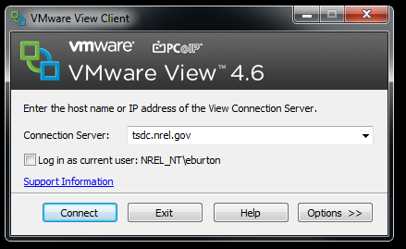

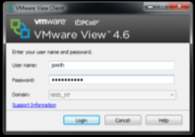
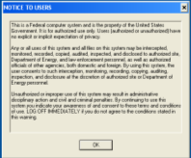
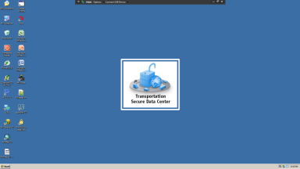
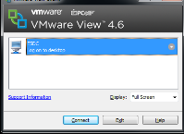
Controlled Access: Log In (Video)
Open the VMware View Client
  A download of the software is available for the user at http://tsdc.nrel.gov/
The connection server is:
  tsdc.nrel.gov
Input the username/password provided by NREL

Slide 24
ACTION steps
Submit YOUR GPS data into the archive
Use data in the archive to understand what you can do with GPS data for your area BEFORE you spend money on a GPS travel survey
Use the archive to support transportation, land use, energy, and emissions research

Slide 25
Thank you! For more information:
Elaine Murakami, FHWA Office of Planning
  Elaine.murakami@dot.gov
  206-220-4460
Jeff Gonder, National Renewable Energy Lab
  Jeff_gonder@nrel.gov
  303-275-4462

Slide 26
Extra slides

Slide 27
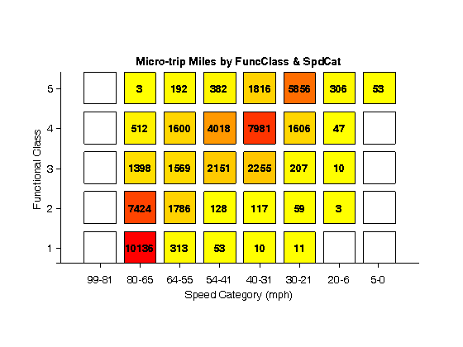
Notes:
Here is another example showing the results of matching the GPS points to the roadway network and examining by functional class and speed category. WHAT DATA were used for this graphic?

Slide 28
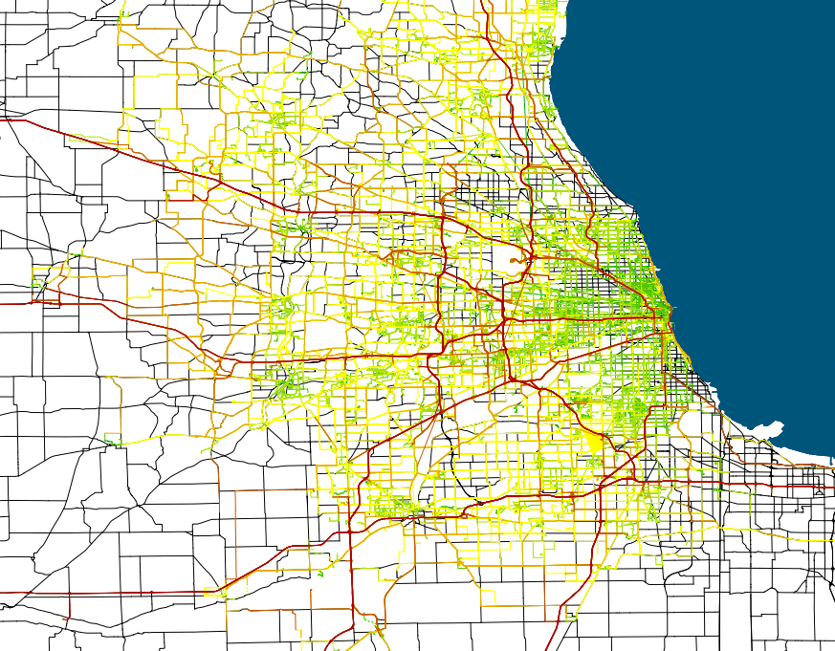
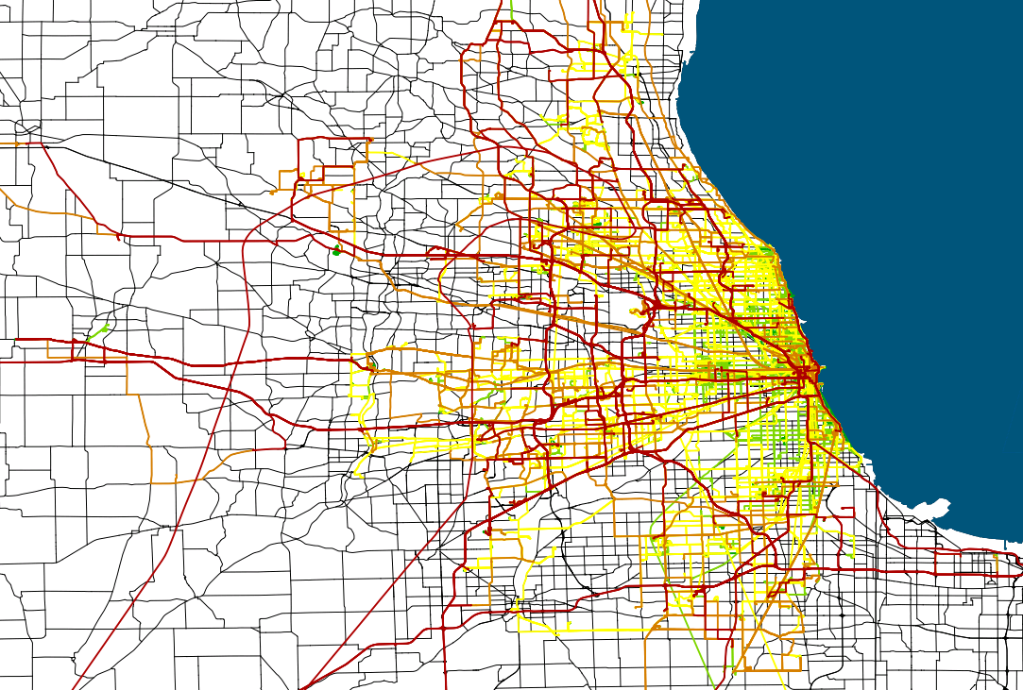
Chicago – Chicago Metropolitan Agency for Planning
Vehicles
Average Speed
Persons
0-10 mph
10-20 mph
20-30 mph
30-40 mph
40- mph
209 Persons
Sampling occurred between September 2007 & January 2008
7 Day samples
408 vehicles
Sampling occurred between March 2007 & November 2007
7 Day samples

Slide 29
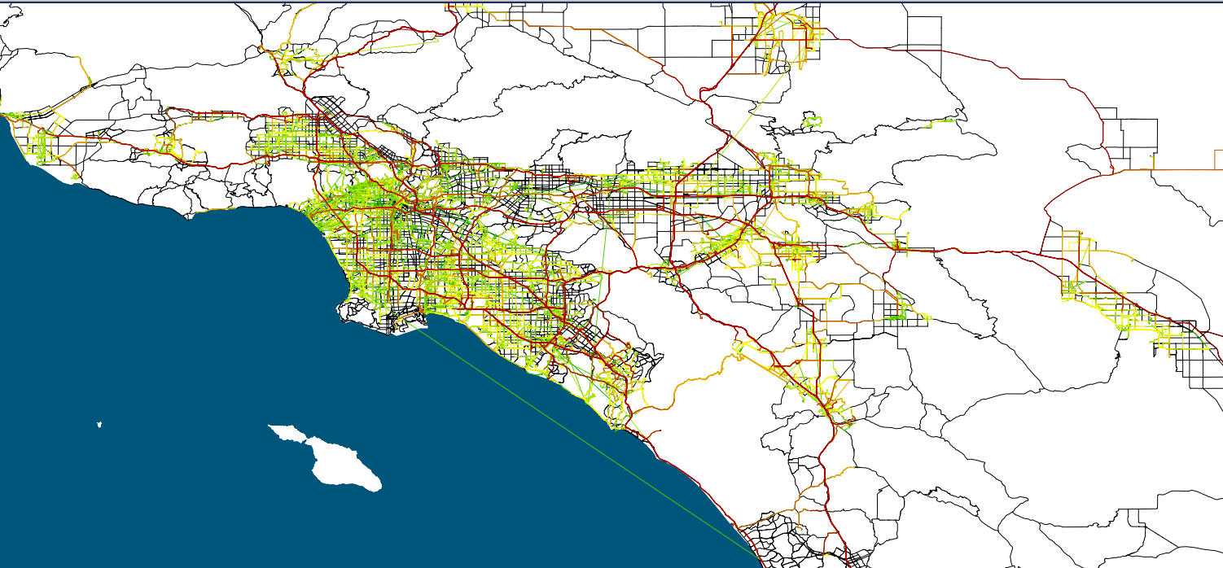
Los Angeles – Southern California Association of Governments
Vehicles
Average Speed
626 vehicles
Sampling occurred between June 2001 & March 2002
2 day samples
0-10 mph
10-20 mph
20-30 mph
30-40 mph
40- mph

