Slide 1
Linking Land Use &
Travel in Ohio
14th TRB National Transportation Planning Applications Conference
May 5-9, 2013, Columbus, Ohio
Dr. Gulsah Akar¹, Dr. Steven I. Gordon² & Yuan Zhang²
¹City & Regional Planning, OSU
²Ohio Supercomputer Center
Study funded by Ohio Department of Transportation

Slide 2
Linking Land Use & Travel in Ohio
Focus on links between land use, transportation infrastructure & travel behavior.
Develop a user-friendly modeling tool to develop forecasts based on different land use, transportation and policy scenarios.
Enhance the existing Land Allocation model developed by MORPC.
  Land allocation model gives forecasts of future land development under different scenarios.
Add a transportation component to be able to forecast the implications of future land use and infrastructure decisions on the resulting travel patterns.

Slide 3
Why look at household travel?
Household travel accounts for the vast majority (over 80 percent) of miles traveled on the Nation’s roadways and three-quarters of the CO₂ emissions from mobile sources (Federal Highway Administration, 2009).
The carbon footprint of daily travel=
  f (types of vehicles, fuel efficiency, number of miles traveled).
There is need to improve our understanding of the links between the land use, transportation policies and individual/household travel behavior to develop sound policies and investment decisions.
Notes:
The carbon footprint of daily travel for an individual household is based on the types of vehicles that household owns, the fuel efficiency, and the number of miles traveled. Although there are many technological innovations with the potential to reduce transportation emissions from passenger vehicles, several researchers agree that the technological innovations alone will not be enough to reach targeted reductions in emissions, as the projected increase in vehicle miles traveled will outpace the advances in fuel economy and lower carbon fuels (Ewing et al. 2008; Rajan 2006; Schipper 2010).
Land use and transportation policies will play a major role in reducing the GHG emissions and shaping the travel patterns in the future.

Slide 4
Transportation

Slide 5
Approach
Given a land use scenario:
  How many auto-trips will be generated?
  What will be the mean trip length?
  What will be the resulting VMT?
Data: Household travel surveys across OH.
  Approximately 23,000 households
  Over 200,000 trips
Two transportation models
  Auto trip rates at TAZ level
  Auto trip distances at TAZ level

Slide 6
Auto Trip Rates
Estimate auto trip rates at TAZ level as a function of:
  Number of households
  Retail employment
  Industrial employment
  Office employment
  Other employment
  Availability of transit
Dependent variable: Number of auto trips generated at each TAZ.
  Outputs of the Statewide Travel Demand Model
Notes:
The linear regression model uses outputs from the statewide travel model along with population and employment numbers and access to transit..

Slide 7
Auto Trip rate – Metro Areas
Dependent variable = auto trips | Coef. | t
Households | 8.539657 | 149.9
Retail | 9.387037 | 48.01
Industrial | 1.718093 | 19.14
Office | 1.175991 | 8.22
Other | 1.24332 | 10.3
Retail X transit | -2.1076 | -9.01
Office X transit | -0.28477 | -1.73
Other X transit | -0.55948 | -4.2
N= 2523, Adjusted R²= 0.97

Slide 8
Auto Trip Rate – Rural & Non-metro
Dependent variable = auto trips | Coef. | t
Households | 7.733091 | 75.5
Retail | 10.98458 | 47.48
Industrial | 2.258675 | 17.59
Office | 3.825136 | 18.34
Other | 2.323226 | 14.36
N= 1137, Adjusted R²= 0.98

Slide 9
Trip Distances
Dependent variable: ln (trip distance)
Function of
  TAZ characteristics (employment & population).
  Household characteristics at the TAZ level
  Job – Household index.
    Measures balance between employment and households. Ranges from 0 to 1. It is equal to 0 if only households or employment present, to 1, when there is a perfect mix. In this coming model we assume 1 job per household as perfect mix.

Slide 10
Trip distance model ( ln (distance) )
 | Coef. | t
Hh size | 0.0860 | 1.87
Income (in 10k) | -0.0566 | -6.22
Vehicles per hh | 0.3711 | 8.04
Retail density | -0.00004 | -2.83
Industrial/ office/ other density | 0.00001 | 5.06
Hh density | -0.0002 | -12.06
JOB_HH index in 20 minutes | -0.2199 | -2.39
Youngstown | -0.2784 | -6.97
Toledo | -0.1916 | -5.04
Steubenville | -0.1199 | -1.92
Springfield | -0.1599 | -2.69
Rural | -0.1631 | -6.52
Mansfield | -0.2107 | -3.48
Lima | -0.1887 | -2.75
Dayton | -0.0954 | -3.1
Canton | -0.2343 | -5.44
Akron | -0.0561 | -1.6
Constant | 1.6279 | 13.26
N= 2878,
Adjusted R²= 0.2

Slide 11
Land Allocation Model

Slide 12
Based on MORPC Model
Allocate population and employment to parts of seven county region
  Region divided into 40 acre cells
  Cells characterized by current land use and factors that would influence future development
  Factors used to create score that dictates which cells would develop first
  Development capped by regional growth control forecast

Slide 13
MORPC Land Use Model Flow Chart
buildout rate for each land use type
for each grid (40 acres)
Base year HH&Job
Future land use type
Projecting “Full Built” HH&Job
assignment.s
Base year HH&Job > “Full Built”
Control/“Full Built” for counties/region
Use Base year HH&Job instead of projected “Full Built”
Apply damping factors to get weighted HH&Job between Base year and projected “Full Built”
Relocating factor = 0
Adjusted “Full Built” HH&Job
Deciding develop potential for each grid
Environmental factors
Control total for counties/region
Decide HH&Job retained
Start assignment
Assignment Schema
Choose control level (county or region)
Assign starting from the grid with the highest weighting. Grids with higher weighting are more likely to be fully filled, grids with weighting in the middle range are partially filled. Assign until control total is reached
Choose assignment method
Assign starting from the grid with the highest weighting. Assign until control total is reached
Future HH&Job for each grid
Post processing
ToTAZ.s
Convert grid data to TAZ data

Slide 14
Example Scenarios
Historic growth pattern
  Typical sprawl development
  Low density residential
  Scattered strip commercial
Increased density in CBD and satellite cities
  Assumes both permission to increase density and market trends in that direction because of rising energy costs
  Targets vacant or currently agricultural land uses within incorporated areas in Central Ohio
  Moves them from future low density to medium density residential where suitable

Slide 15
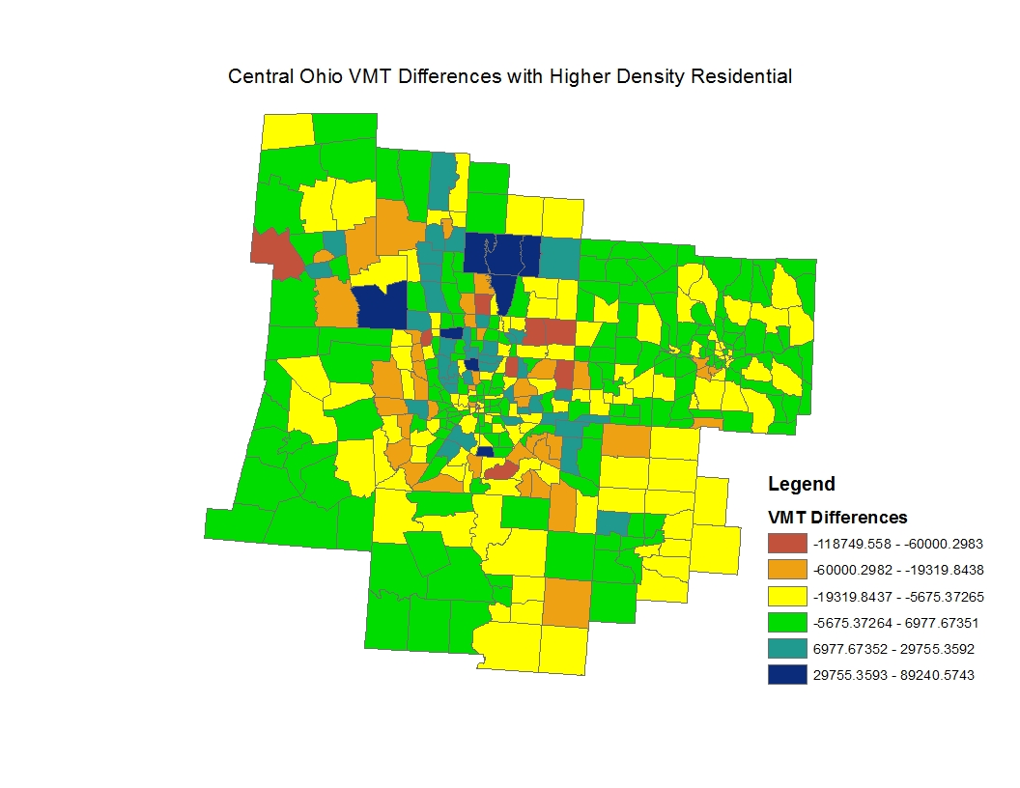
Results for Central Ohio
Scenario Results in Reduction in VMT by over 2.3 million

Slide 16
Mid-Ohio Region –
2000 vs. 2035 comparison (Base Cases)
 | 2000 | 2035 | Change | % change
Num of hh | 707,979.0 | 901,808.000 | 193,829.000 | 27.378
Num of jobs | 867,548.0 | 1,119,444.000 | 251,896.000 | 29.035
Office jobs | 365,221.0 | 451,054.000 | 85,833.000 | 23.502
Retail jobs | 197,758.0 | 257,390.000 | 59,632.000 | 30.154
Industrial jobs | 158,904.0 | 206,063.000 | 47,159.000 | 29.678
Other jobs | 145,665.0 | 184,480.000 | 38,815.000 | 26.647
Number of trips | 8,467,370.6 | 10,857,196.057 | 2,389,825.447 | 28.224
VMT | 56,606,409.7 | 73,443,497.342 | 16,837,087.619 | 29.744
Trip distance | 6.685 | 6.764 | 0.079 | 1.186

Slide 17
Mid Ohio Region –
2035 Base Case vs. Scenario 3
 | 2035 Base | Scenario 3 | Change | % change
Num of hh | 901,808.000 | 937,099.000 | 35,291.000 | 3.913
Num of jobs | 1,119,444.000 | 1,119,019.000 | -425.000 | -0.038
Office jobs | 451,054.000 | 450,665.000 | -389.000 | -0.086
Retail jobs | 257,390.000 | 257,182.000 | -208.000 | -0.081
Industrial jobs | 206,063.000 | 205,581.000 | -482.000 | -0.234
Other jobs | 184,480.000 | 184,541.000 | 61.000 | 0.033
Number of trips | 10,857,196.057 | 11,155,429.323 | 298,233.266 | 2.747
VMT | 73,443,497.342 | 71,131,292.880 | -2,312,204.462 | -3.148
Trip distance | 6.764 | 6.376 | -0.388 | -5.738

Slide 18
Strategies to Deal with Decline
Some areas in Ohio continue to decline in population and employment
  Original model provided allocations based on growth
  Need to devise process for allocating decline
Using past trends as a guide
  Have compiled information on population and employment decline from available data
  Population – block level differences in population and households
  Employment – zip code level data from County Business Patterns by major sector

Slide 19
Defining Indicators of Change
Decline not evenly distributed
  Regions with decline still have some subareas that are growing
  Created indicators of growth or decline from historical data
    Seven categories of change to set the probability for change
    Indicator generated – (3,2,1,0 -1,-2,-3)
    Indicates growth or decline for a target cell as well as the strength of the probability
  Model adjustments
    Choose a cell at random
    Decide whether it will grow or decline
    Allocate an increment of growth or decline
    Check to see whether the new growth or decline has been met
    Continue until entire growth or decline is met

Slide 20
Related Issues
Historic growth or decline may not continue
  Will need to have comparative scenarios that reflect a range of possible futures
  Employment sector decline pattern may also vary over time
    E.G. – manufacturing has begun to recover while retail employment may be leveling off
  Need for more guidelines for model use since the allocation procedure is more complicated
    Must make consistent decisions about future land use, growth or decline, and future land use intensity
    Will incorporate the relevant procedures in our final product

Slide 21
Thanks!
Questions?

Slide 22
Backup slides

Slide 23
Number of Trips by Region
Region | All trips
Youngstown | 9,524
Toledo | 16,384
Steubenville | 8,464
Springfield | 10,324
Rural | 16,807
Mansfield | 10,355
Lima | 9,613
Dayton | 14,595
Canton | 11,132
Akron | 15,265
Central Ohio | 52,003
Cincinnati | 33,841
Cleveland | 13,283
Total | 221,590
*After dropping the ones with missing OD information, number of trips reduces to 207,230.

Slide 24
Mean Trip Rate per Household by Region
Region | All trips
 | # of HH | Mean Trip Rate
Youngstown | 1,111 | 8.57
Toledo | 1,907 | 8.59
Steubenville | 1,043 | 8.12
Springfield | 1,198 | 8.62
Rural | 1,871 | 8.98
Mansfield | 1,130 | 9.16
Lima | 1,100 | 8.74
Dayton | 1,720 | 8.49
Canton | 1,175 | 9.47
Akron | 1,742 | 8.76
Central Ohio | 4,971 | 10.46
Cincinnati | 3,000 | 11.28
Cleveland | 1,120 | 11.86
Total | 23,088 | 9.6

Slide 25
Percentage of Auto vs. Non-Auto Trips
Region | % of Auto Trips | % of Non-Auto Trips
Youngstown | 93.4% | 6.6%
Toledo | 94.0% | 6.0%
Steubenville | 93.3% | 6.7%
Springfield | 93.9% | 6.1%
Rural | 92.9% | 7.1%
Mansfield | 94.5% | 5.5%
Lima | 95.5% | 4.5%
Dayton | 92.8% | 7.2%
Canton | 92.9% | 7.1%
Akron | 92.9% | 7.1%
Central Ohio | 90.2% | 9.8%
Cincinnati | 87.9% | 12.1%
Cleveland | 88.4% | 11.6%
Total | 91.6% | 8.4%

Slide 26
Mean Trip Length by Region (Mile)
Region | Mean Length (All Trips) | Mean Length (HBW Trips)
Youngstown | 6.88 | 10.69
Toledo | 5.67 | 7.76
Steubenville | 7.46 | 11.60
Springfield | 7.42 | 11.24
Rural | 9.54 | 13.69
Mansfield | 7.25 | 9.22
Lima | 5.76 | 7.00
Dayton | 7.01 | 10.20
Canton | 6.77 | 10.71
Akron | 7.23 | 10.78
Central Ohio | 4.94 | 7.37
Cincinnati | 7.02 | 9.53
Cleveland | 6.27 | 6.24
Total | 6.58 | 9.44

Slide 27
  Job – Household index.
    Measures balance between employment and households. Ranges from 0 to 1. It is equal to 0 if only households or employment present, to 1, when there is a perfect mix. In this coming model we assume 1 job per household as perfect mix.
    JOB_HH =
    1 - [ABS (employment - households) / (employment + households)]

