Slide 1

National Public Transit Livability Performance Measures
Jennifer Dill
Marc Schlossberg
Linda Cherrington
Suzie Edrington
Jonathan Brooks
Donald Hayward
Oana McKinney
Neal Downing
Martin Catala

Slide 2
Project Background
Collaborative Research
  Center for Urban Transportation Research @University of South Florida (CUTR)
  Oregon Transportation and Research Education Consortium (OTREC)
  Texas A&M Transportation Institute (TTI)
Research Roles
  Define Rural Measures
  Define Urban Measures
  Develop National Transit Livability Database and Dashboard
Notes:
First I would like to pay tribute to all the people that have contributed to this project.
It was a collaboration between 3 universities.

Slide 3
Project Goals
Develop National Transit Livability Measures
Inform Stakeholders of livability measures
Impact Decision makers
  FTA feedback on outcomes of transit investments
  Transit Agencies aware of livability outcomes
  Communities consider livable goals
Notes:
We want this to part of a process that will grow and improve to include

Slide 4
Livability Principles
Support Existing Communities
Enhance the unique characteristics of all communities by investing in healthy, safe and walkable neighborhoods, whether rural, urban or suburban.
Value Communities and Neighborhoods
Target federal funding toward existing communities – through transit-oriented and land recycling – to revitalize communities, reduce public works costs, and safeguard rural landscapes
Promote Equitable and Affordable Housing
Expand location- and energy-efficient housing choices for people of all ages, incomes, races and ethnicities to increase mobility and lower the combined cost of housing and transportation
Notes:
Challenges presented to the TTI team grounded in not a lot of data
And transit service data incomplete or not compatible with measuring service.

Slide 5
Livability Principles
Enhance Economic Competitiveness
Improve economic competitiveness of neighborhoods by giving people reliable access to employment centers, educational opportunities, services and other basic needs
Provide more transportation Choices
Provide more transportation choices to decrease household transportation costs, reduce our dependence on oil, improve air quality and promote public health
Coordinate and Leverage Federal Policies and Investment
Align federal policies and funding to remove barriers to collaboration, leverage funding and increase the effectiveness of programs to plan for future growth.

Slide 6
Research Results
Development of Transit Livability Measures
  Urban Measures developed
    Identification of variables that influence urban ridership
  Rural Measures developed
    Identification of measures directly impacted by transit and aligned with 6 livability measures.
Findings
  Incomplete Transit Data (fixed route and Demand response)
  BETA dashboard of transit livability
Notes:
High ridership in urban areas are livable.

Slide 7
Challenges
Index Development based on theoretical idea of Livability
National Scale
  Many livability variables and measures are local in nature and not available on a national scale.
Data Challenges
  Lots of data (transit, blocks, streets)
  Lots of analysis (service area buffers)
  Lots of HOLES in transit data
Notes:
Given that Livability is a construct or theory
National issue local data
Tons of data
Total Agencies: 215
States: 34
Total stops: 396643
Total Routes (8821)

Slide 8
Challenge- Development of Index
TTI established straightforward indexing
  Challenge with no external validity
    Any model measuring livability is constrained by the reality that there can be no empirical observation of what livability is.
    Metrics reflect outcomes related to livability principles
  Not punitive
  Informative
  Decile indexing scale 1-10
Notes:
TTI instrumental for developing the index.
Recognizing: There is no external validity of our measures. In other words because livability is a construct or theoretical idea we can not independently validate the measures. This was particularly relevant when developing urban and rural measures.
So the focus was on outcomes AND as they relate to livability principles. and transits ability to impact the measure.
And Outcomes…and you will see when we move to the measures.
Index reports on RELATIVE livability.
Also, did not want to be punitive, rather informative.

Slide 9
Challenge- National Scale Data
Reliable data (accuracy and precision) available at local level
Reasonable alternatives to support development of Index
  Rural transit service data characteristics
    Manually collected
  Land Use and Housing Characteristics
    LEHD Data for commercial activity, and employment locations
  Urban Fixed Route Service Characteristics
    GTFS
    80% of transit trips covered by agencies with GTFS data
Notes:
Rural transit service data characteristics
Transit LOS utilized by TxDOT were used but are not avaialble nationally,(describe span of service, service days counties served)
Manually collected
8 states only
Land Use and housing characteristics
Relied heavily on local parcel level data from tax assesor and property appraiser (again this data doesn’t scale up to a national level)
Fortunately, the US census provides data from the LEHD program to help measure commercial activity and employment locations
Urban fixed route service characteristics.
There are no national transit stop, route and schedule data avaialble. The NTD does not report on service characteristics at this level.
An alternative was using the GTFS dataset (which to one study accounts for nearly 80% of all transit trips made in the US).

Slide 10
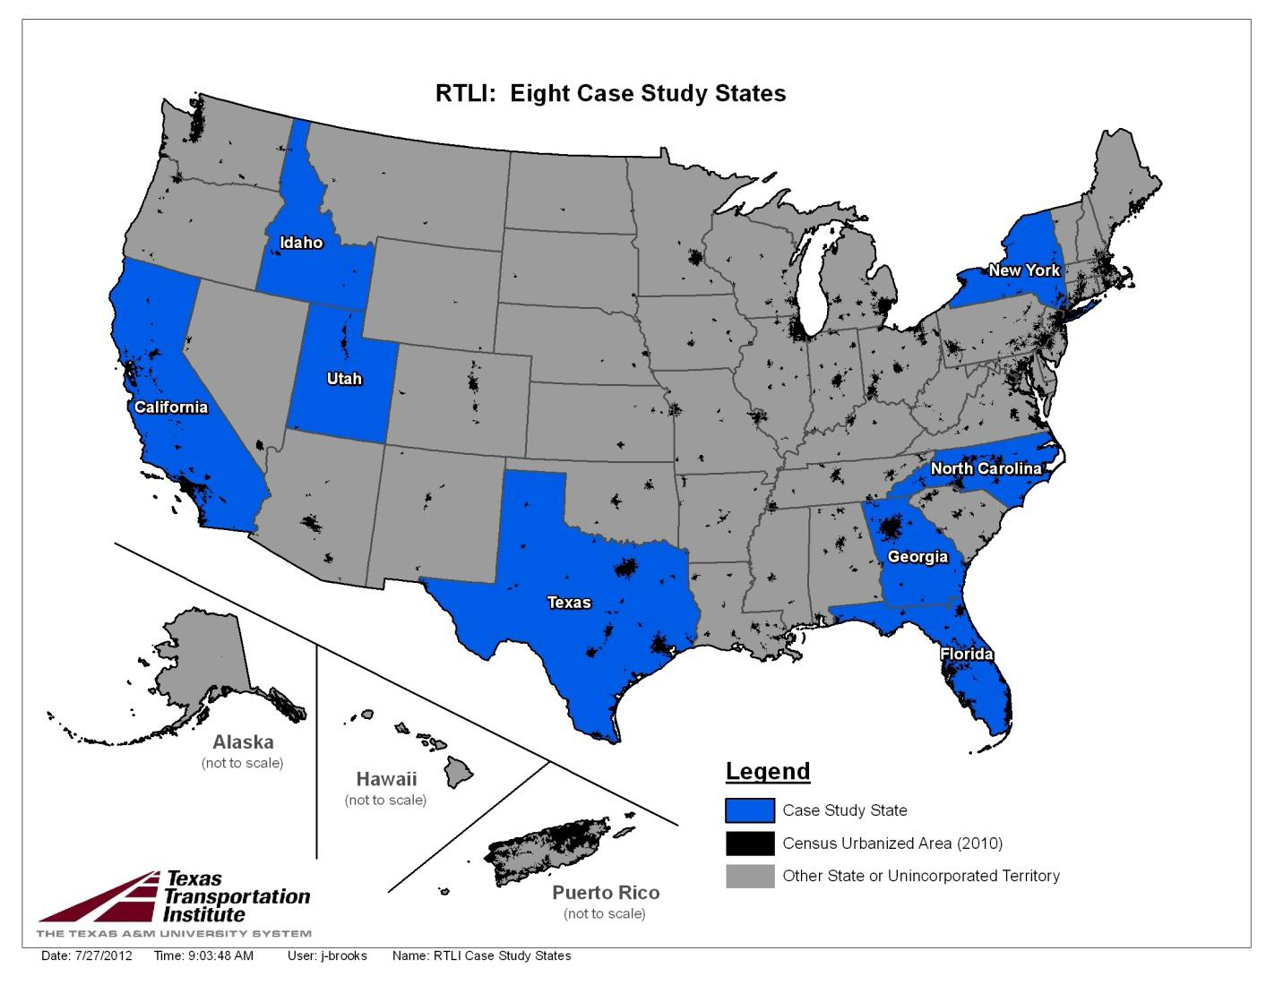
Rural Transit Case Studies

Slide 11
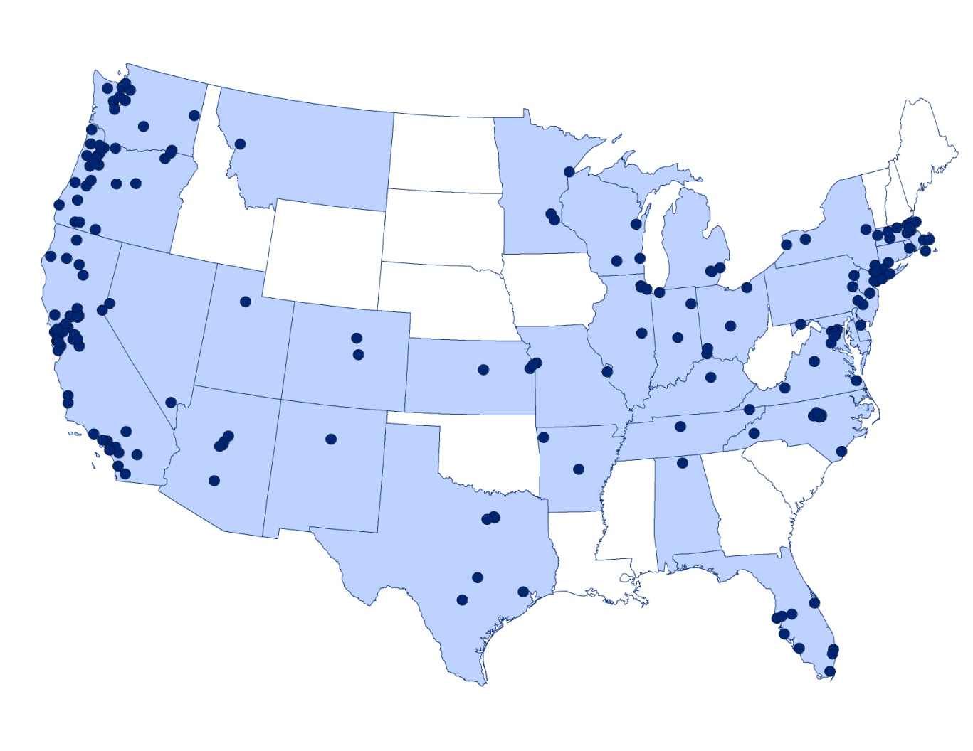
GTFS Agencies
Notes:
This is rapidly changing Atlanta is now there

Slide 12
Challenges - Data
Large Data Sets
  Census Blocks 11,078,297
  Block Groups 217,740 records
  Census Tracts 73,057
  Census Designated Places 19,540
Analysis
  Geographic Analysis
  Service Area Analysis
Notes:
Also our effort were looking to provide multiple scales of livability measures. For example, we want to be able to report on state-wide rankings, regaional rankings and State based Census tract ranckings.
Blocks Used for LEHD analysis
Blockgroups used for Census ACS data
Tracts used for aggregation (displaying on the map
Total Agencies: 215
States: 34
Total stops: 396643
Total Routes (8821)
Block Groups217,740
Census Blocks11,078,297
Census Tracts73,057
Places 29,261
Incorporated Places 19,540
Census Designated Places 9,721

Slide 13
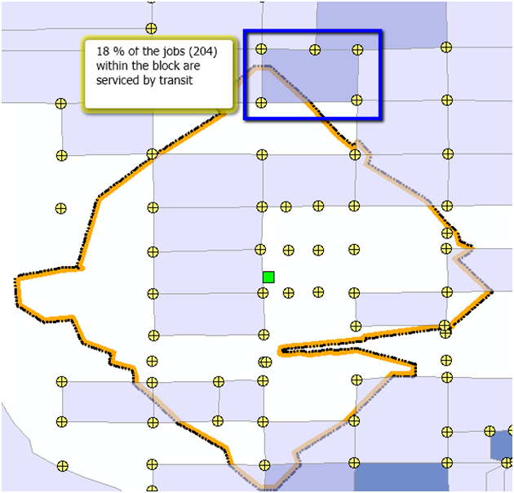
Service Area Analysis
Total Agencies: 215
States: 34
Total stops: 396,643
Total Routes: 8,821

Slide 14
Urban Livability Measures
Support Existing Communities
Percent of Pedestrian Generating Business and Population Served by Transit
Value Communities and Neighborhoods
Intersection Density at Transit Stops
Promote Equitable and Affordable Housing
Percent of Multi-Unit Housing Served by Transit
Notes:
Each of the measures attempts to ask, how well does transit service “livable areas”.
So where are the pedestrian generating businesses? Is transit servicing these area?
Same with intersection density. Does transit service exist in area that are “pedestrian friendly or walkable.
Existing LEHD data contains

Slide 15
Urban Livability Measures
Enhance Economic Competitiveness
Percent of Employment Serviced by Transit
Provide more transportation Choices
Transit Frequency, the number of times serviced by transit
Notes:
Each of the measures attempts to ask, how well does transit service “livable areas”.
So where are the pedestrian generating businesses? Is transit servicing these area?
Same with intersection density. Does transit service exist in area that are “pedestrian friendly or walkable.
Existing LEHD data contains

Slide 16
Rural Livability Measures
Support Existing Communities
Unlinked Passenger Trips Per Rural Developed Land
Value Communities and Neighborhoods
Annual Unlinked Passenger Trips per Transit Needs Population
Promote Equitable and Affordable Housing
Percent of Household Income Not Spent on Transportation
Notes:
Challenges presented to the TTI team grounded in not a lot of data
And transit service data incomplete or not compatible with measuring service.

Slide 17
Rural Livability Measures
Enhance Economic Competitiveness
Active Revenue Vehicles per 1,000 Square Miles of Rural Land Area
Provide more transportation Choices
Percent of Workers that Did Not Drive Alone to Go to Work
Coordinate and Leverage Federal Policies and Investment
Local Operations Funding per Operating Expense

Slide 18
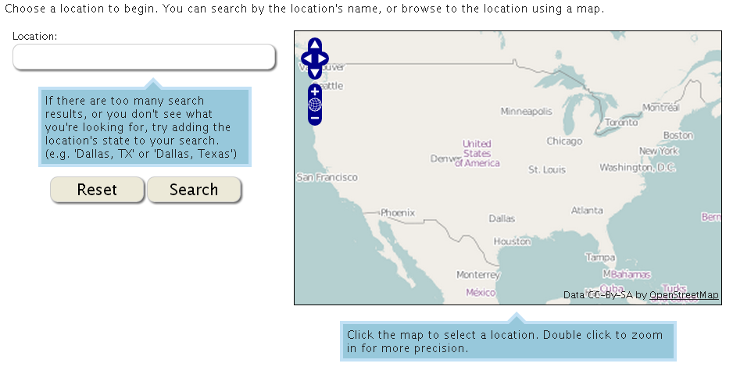
Dashboard (Preview)
http://transitlivability.org/

Slide 19
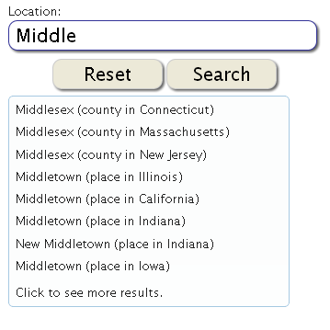
Searching Features
Text Search Features
  Auto complete
  Full List of Search Results
Notes:
Although the data is incomplete, a user can search for the entire US using either the text search or map search function

Slide 20
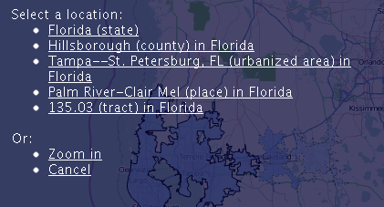
Dashboard Features
Drill down mapping feature

Slide 21
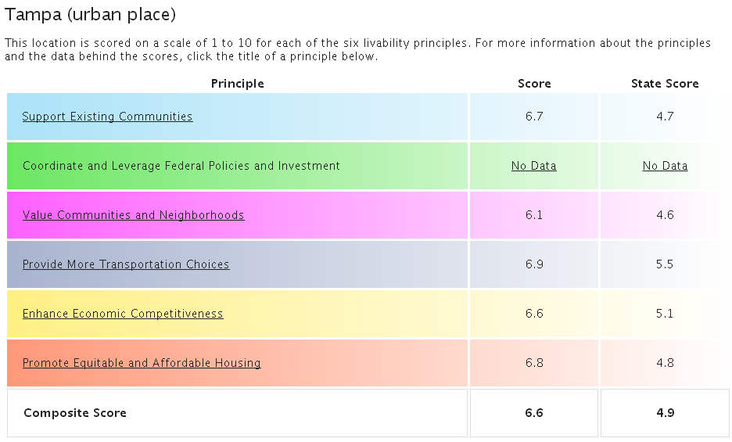
Index “Score”
Notes:
Briefly dicuss ous the index in a second, but first let me show you how we represent the score or ranking.
For each area there is comparison with the state.
Simple ranking of variables and taking the deciles to represent a “relative” score.
We didn’t want the measure to punitive rather informative.
And again, we feature the drill down, to help someone find more information.

Slide 22
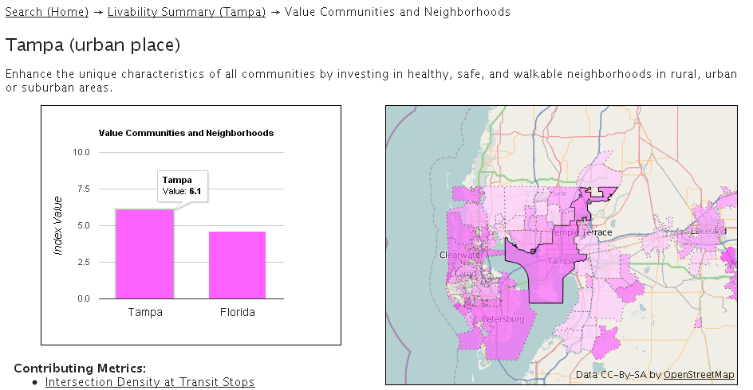
Index Details
Notes:
You can also select adjacent geography, or drill down on the map
Drill down on the data driving the measure

Slide 23
Conclusions
Several missing pieces
  National Fixed Route and Demand Response Data
    Support Livability and Other Federal Initiatives
      Map21
      Transportation for the Nation
    Census Verification of Mode information reported
    Support the National Household Transportation Survey (NHTS)
      Assessment of transit availability of respondents
    National Spatial Data Infrastructure (Federal GIS program)

Slide 24
Conclusions
Step Beyond Index
  More powerful measures
    Transit Travel Time Matrix
    National Accessibility Measures
TransitAccessibility.org

