Slide 1
Project Evaluation Database System for MORPC’s 2012 Metropolitan Transportation Plan (MTP)
May 7, 2013
Nick Gill
Zhuojun Jiang

Slide 2
Transportation Plan Process
public involvement and participation
future population and employment growth distribution
evaluate strategies and projects
assure environmental justice
assure financial balance
estimate future travel demand
adopt. implement through TIP, and continuing work
assure
air quality conformity
goals, objectives, strategies, actions, performance

Slide 3
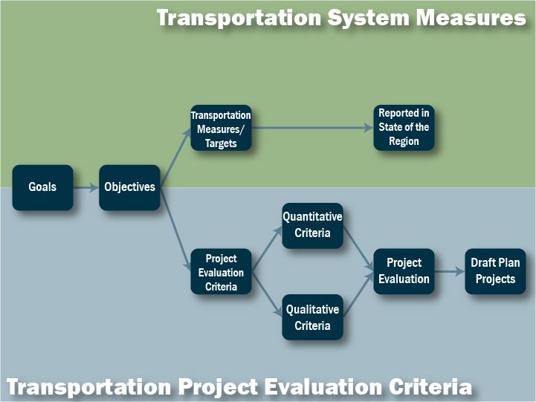
Notes:
Out of the regional goals that were adopted in July 2010, we are doing two separate things for the transportation plan:
1. Creating systemwide or plan-level measures to be used in future versions of our annual report
2. Creating project evaluation criteria, which helps inform what projects will make it in the plan

Slide 5
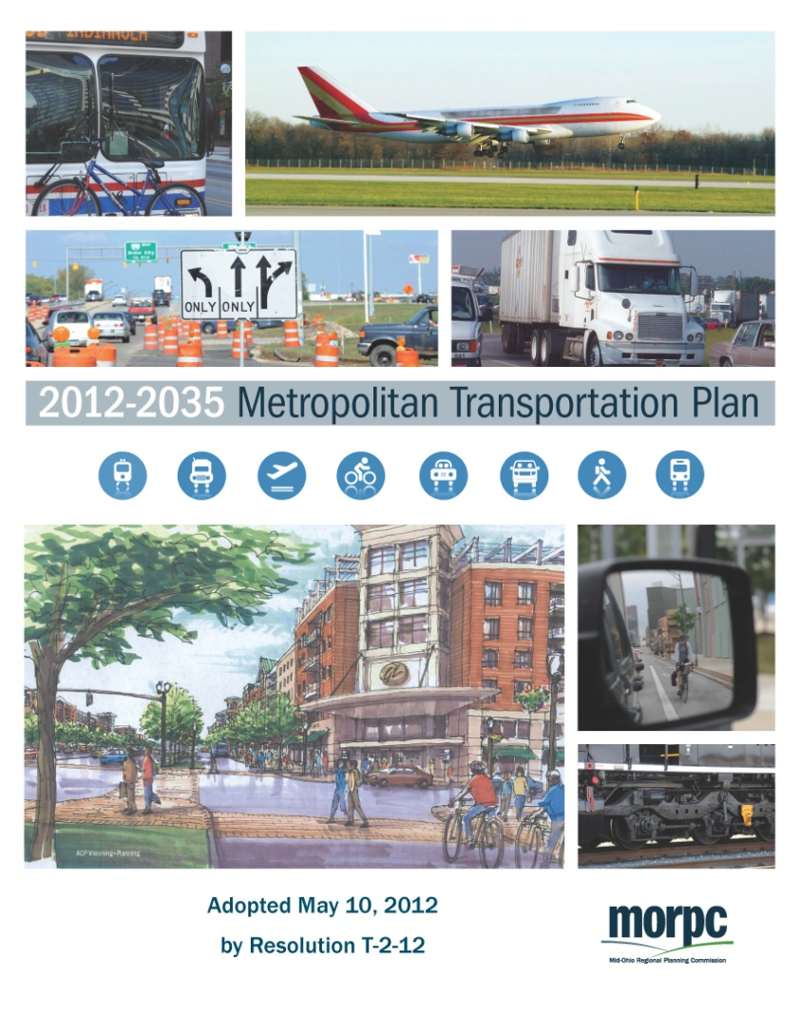
By the Numbers
Goals, Objectives, Measures for MTP
6 Broad Goals
16 System Objectives
25 Measures & 16 Statements
www.morpc.org/tplan
Notes:
The plan began by incorporating 6 broad goals. These goals were intended for use in multiple regional planning efforts – not just the MTP.
Because these goals were so broad, we used the 16 measurable objectives to apply them to the transportation system.
In order to measure progress toward those objectives, we identified 25 measures.

Slide 6
Goal: Attract and Retain Economic Opportunity
Goals, Objectives, Measures for MTP
Key
2 Objectives
Objective
Attract new businesses, expand and retain existing businesses
Attract and retain a skilled workforce
Reduction in congested VMT near project
Miles of bike routes added with the project
Measures from modeling procedures
Measures from GIS procedures
Qualitative statements
Truck density along project
% Project traffic going to intermodal transfer points
Peak period travel time reduction per project user
% Existing truck traffic
Existing non-retail jobs near project
Crash composite ranking
Impact on job growth
Congestion condition for the project area
Forecasted non-retail jobs near project
Transit enhancement

Slide 7
Goal: Preserve and Project Natural Resources
Goals, Objectives, Measures for MTP
3 Objectives
Protect natural habitats
Improve water quality
Reduce air pollution
  List of sensitive land or ecological systems near project
  Whether within a stream buffer
  Reduction in vehicular emissions (PM2.5, VOC, and NOx)

Slide 8
Goal: Promote Reduction in Energy Consumption and Production of Alternative Energies
Goals, Objectives, Measures for MTP
3 Objectives
Demonstrate energy savings through technology & innovation
Increase energy savings through individuals actions
Increase production and use of renewable fuel sources
  Potential project level technology components that save energies
  Project potential to reduce drive-alone travelers
  Project potential to facilitate generation or use of renewable energy

Slide 9
Goal: Increase Collaboration to
Maximize the Return on Public Expenditures
Goals, Objectives, Measures for MTP
3 Objectives
Increase investments in public projects from non-public sources
Increase awareness of regional impact from local decisions
Reduce loss of life and property due to natural and manmade disasters
  Amount of new development near project
  Percent of new development near project
  Mechanisms in place in the project area to enable non-public participation
  Sorting from most to least users by jurisdiction, the number of jurisdictions that contribute 75% of the project users
  Whether a project phase is currently on the TIP
  List of plans/studies the project appears in
  Compatibility of the project with adjacent communities’ plans
  Significance in preventing or minimizing the impact of natural or manmade disasters

Slide 10
Goal: Promote Public Investments to Benefit the Health, Safety and Welfare of People
Goals, Objectives, Measures for MTP
3 Objectives
Increase access to transportation choices
Increase safety of central Ohio residents
Maximize the life of existing infrastructure
  % Project traffic going to multimodal transfer points
  Reduction in congested VMT near project
  Peak travel time reduction per project user
  % project without sidewalks in good condition
  Miles of bike routes added with the project
  Transit enhancement
  Gap filling in existing bikeways, pedestrian, or transit path
  Crash composite ranking
  Bridge rating
  Pavement condition rating
  Project potential to maximize life of transportation system

Slide 11
Goal: Create Sustainable Neighborhoods
Goals, Objectives, Measures for MTP
2 Objectives
Increase neighborhood stability
Facilitate redevelopment and infill
Objective
  % EJ populations of the project users (Minority, Poverty, Elderly, and Disabled)
  % project without sidewalks in good condition
  Miles of bike routes added with the project
  Transit enhancement
  Possible displacement
  Potential negative impacts to EJ populations
  Average population & job density of project users’ origins and destinations in 2010
  Average population & job density of project users’ origins and destinations in 2035
  Average change in population & job density of project users’ origins and destinations from 2010 to 2035
  Proximity to existing development sites

Slide 12
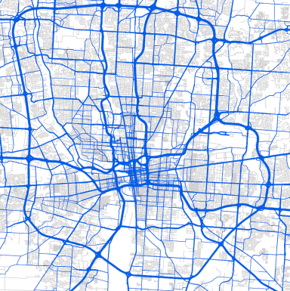
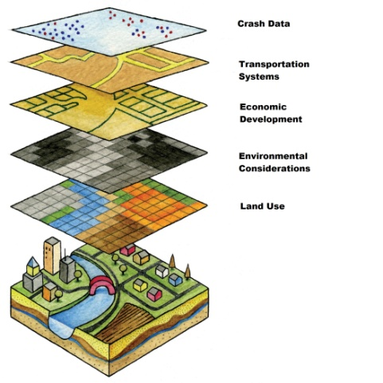


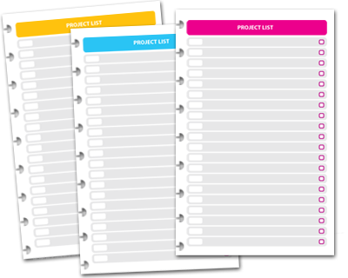
Project Evaluation Database System
Model
GIS
Qualitative
Project Evaluation Database System
(Microsoft Access)
Project List with Scores
Candidate Projects

Slide 13
Transportation Plan Project Types
Project Evaluation Database System
Major Widening – Freeways
New Freeways
Converting to Freeway
Interchange Expansion
New Interchange
Major Widening – Arterials
New Roadway
Minor Widening/Safety
Intersection Modification
Transit
Bike/Pedestrian (stand alone)
Management and Operations/ITS
Railroad Related
Other
*Specific project to expand the transportation system are listed
*Specific maintenance projects are not listed

Slide 14
Project Evaluation Database System
6 Broad Goals
16 System Objectives
25 Measures & 16 Statements
Evaluated 769 candidate projects
  40 freeway projects
  47 interchange projects
  299 major widening/new roadways projects
  296 minor widening/intersection projects
  70 bike/pedestrian projects
  17 other projects

Slide 15
Modeling Procedures
Project Evaluation Database System
Take advantage of MORPC’s tour-based travel demand model
No-Build (base) vs. Build (individual project) scenarios
Traffic assignments with tighter convergence criteria (gap=0.00001)
Derive project users through select-link analysis
Determine disadvantaged population users by linking disaggregate model results to PUMS data
Produce congestion/travel time measures
Produce vehicle emissions through standard AQ analysis procedures
Produce OD-related measures for project users

Slide 16
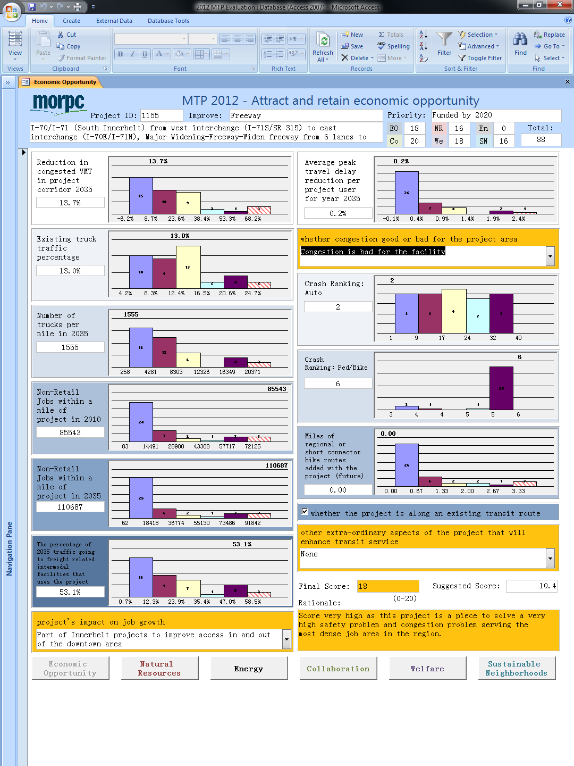
Project Evaluation Database System
Manual Process by 3 Staff
Batch Process by 9 Model Computers
Start
Code Build Networks
Identify Project Links
682 “codable”
candidate projects
Select Link/Traffic Assignments
Build-network for each candidate project
Individual Project
Determine Project Users
Sufficient batch of Build Networks?
Produce Measures
No
Yes
More Build Networks?
Yes
No
Stop

Slide 17
GIS Procedures
Project Evaluation Database System
Take advantage of a variety of GIS layers available to MORPC (land use, transportation systems, crash data, traffic data, stream, ecological systems, etc)
Create buffers around projects
Spatial join with different GIS layers
Produce GIS measures by using pre-determined formula

Slide 18
Qualitative Statements
Project Evaluation Database System
Take advantage of specific studies/plans and staff knowledge/judgments
Developed by MORPC staff
Reviewed by working group

Slide 19
Evaluating the Candidate Projects
Project Evaluation Database System
6 Goals
Criteria for each goal become data/info to subjectively score each goal on 0-20 scale
Quantifiable data compared to histogram of values of similar/same project types
Also consider qualitative statements related to achieving goal (improving an objective measure)
Scores for each goal summed to determine total project score

Slide 20
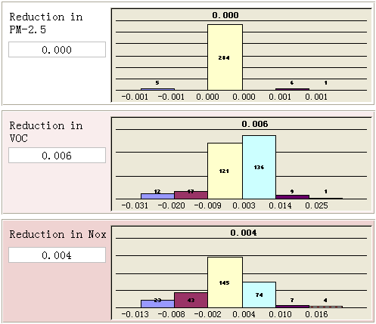
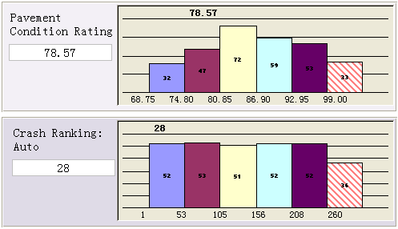

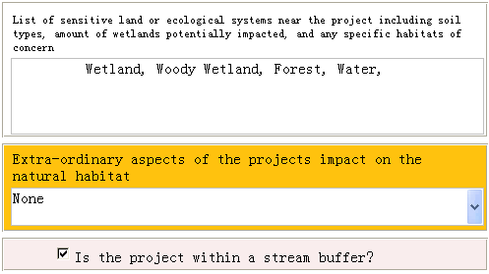
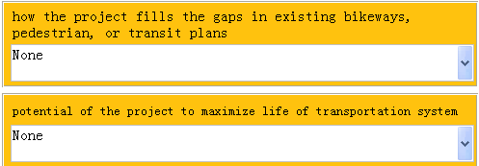
Example Criteria Score (1)
Project Evaluation Database System

Slide 21
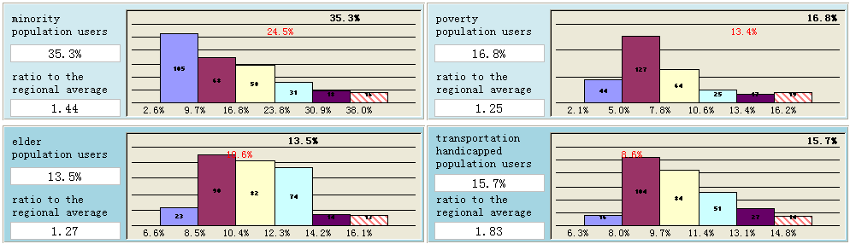
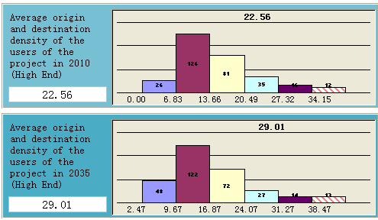
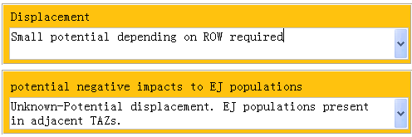
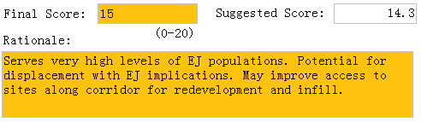
Example Criteria Score (2)
Project Evaluation Database System

Slide 22
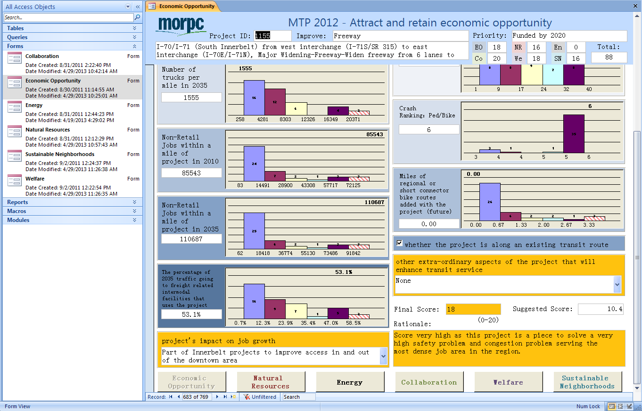
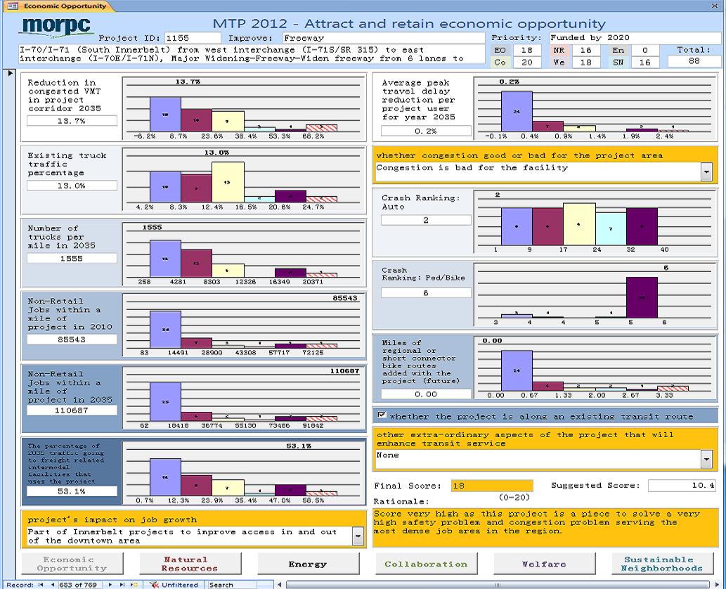
Project Evaluation Database System

Slide 23
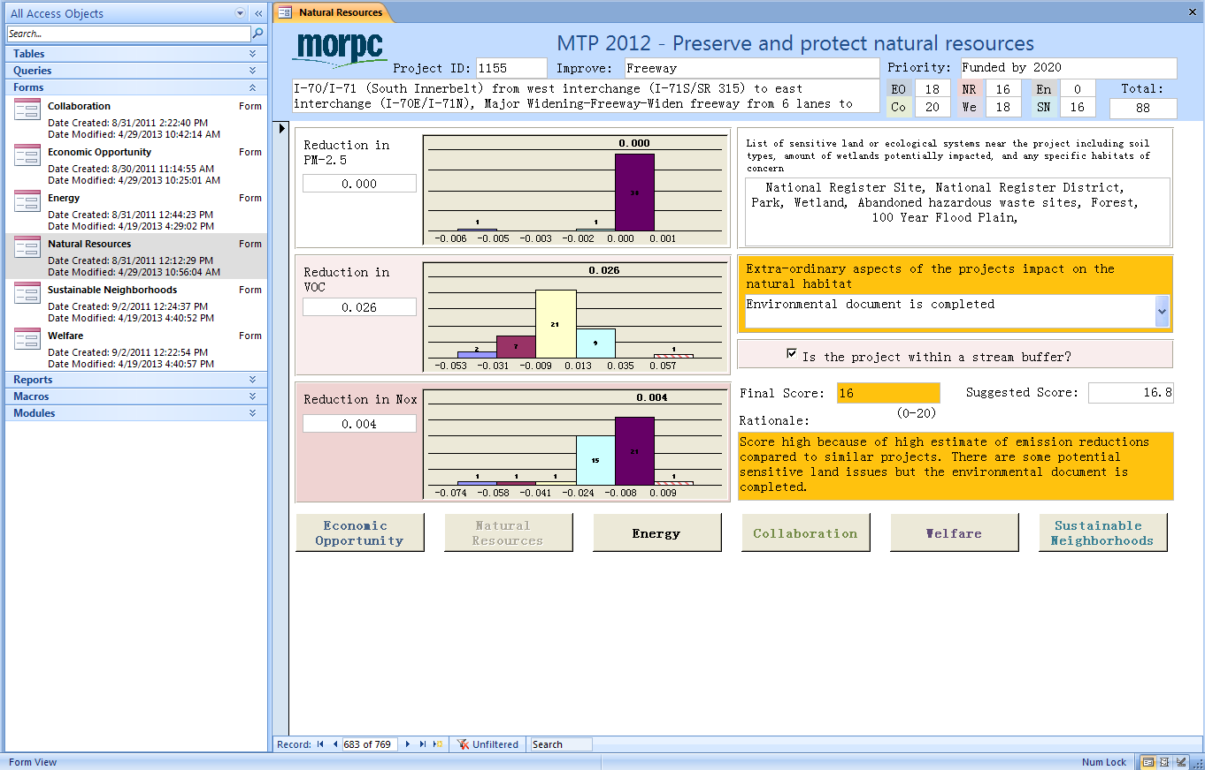
Project Evaluation Database System

Slide 24
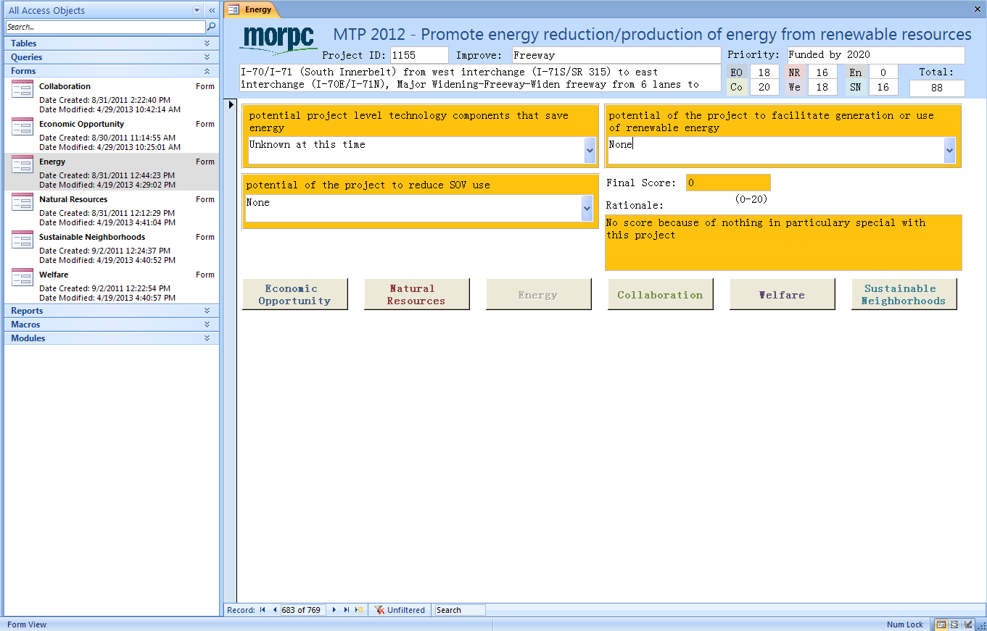
Project Evaluation Database System

Slide 25
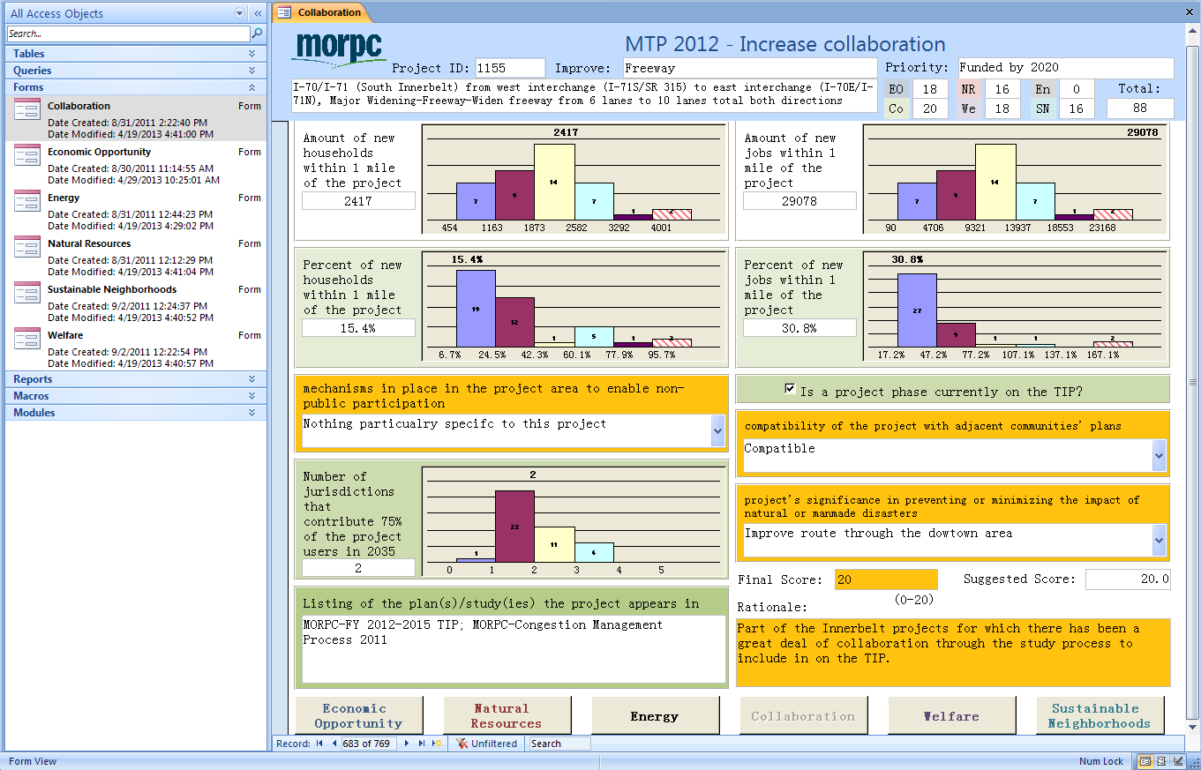
Project Evaluation Database System

Slide 26
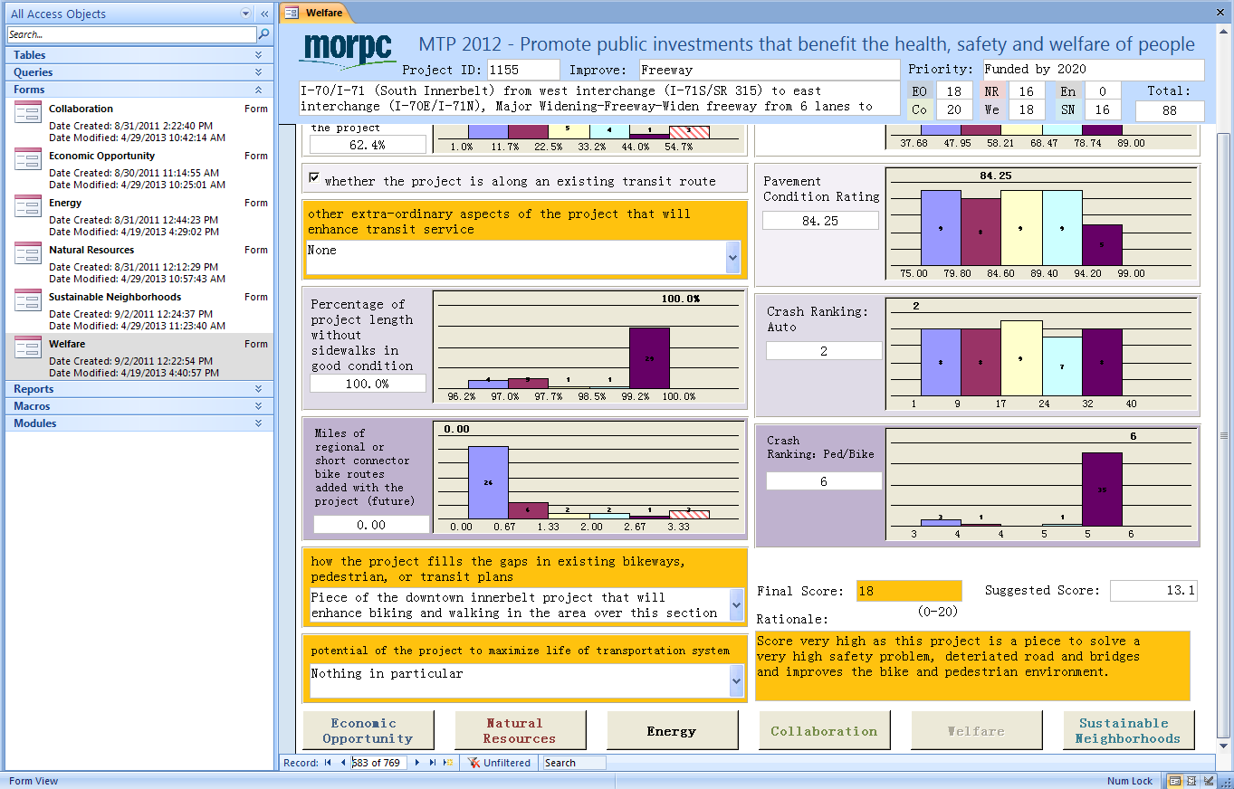
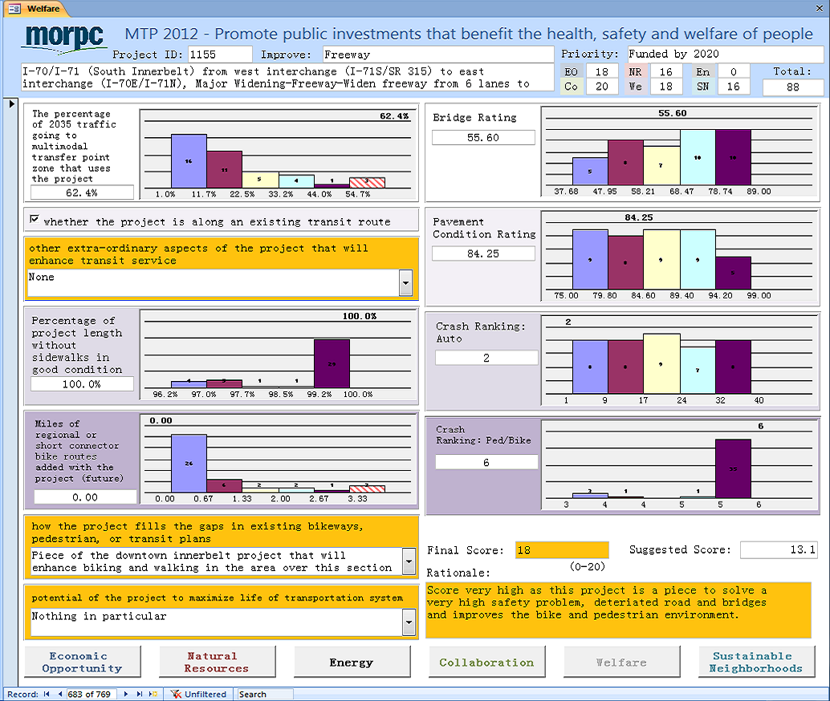
Project Evaluation Database System

Slide 27
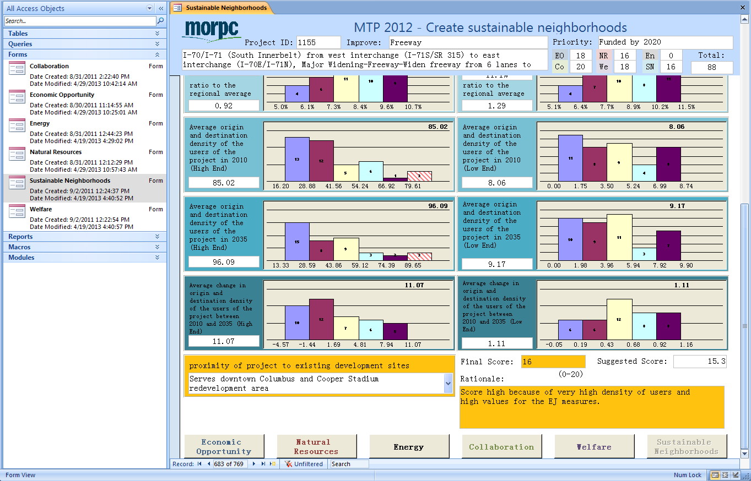
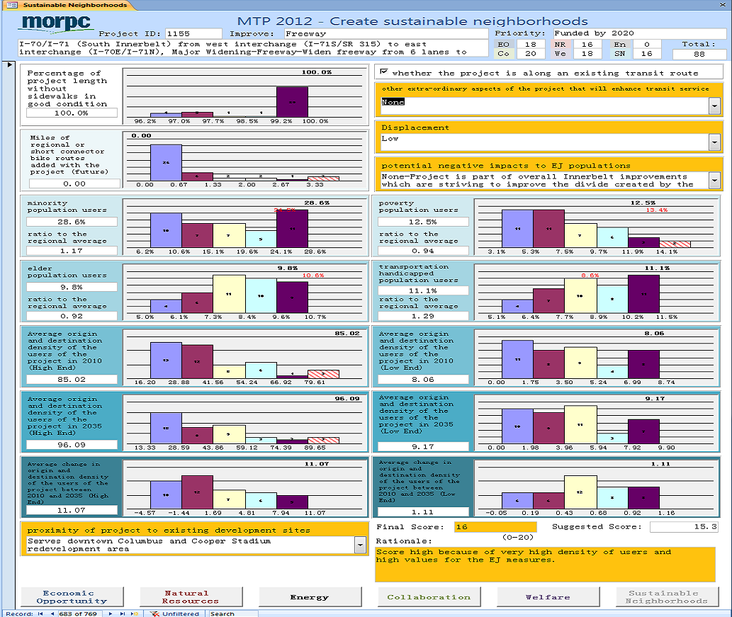
Project Evaluation Database System

Slide 28
Projects Stats and Staff Involved
Project Evaluation Database System
Evaluated 769 candidate projects
  40 freeway projects
  47 interchange projects
  299 major widening/new roadways projects
  296 minor widening/intersection projects
  70 bike/pedestrian projects
  17 other projects
6 staff involved for project evaluation
  each focusing on a specific goal
  Rotating review for second opinions

Slide 29
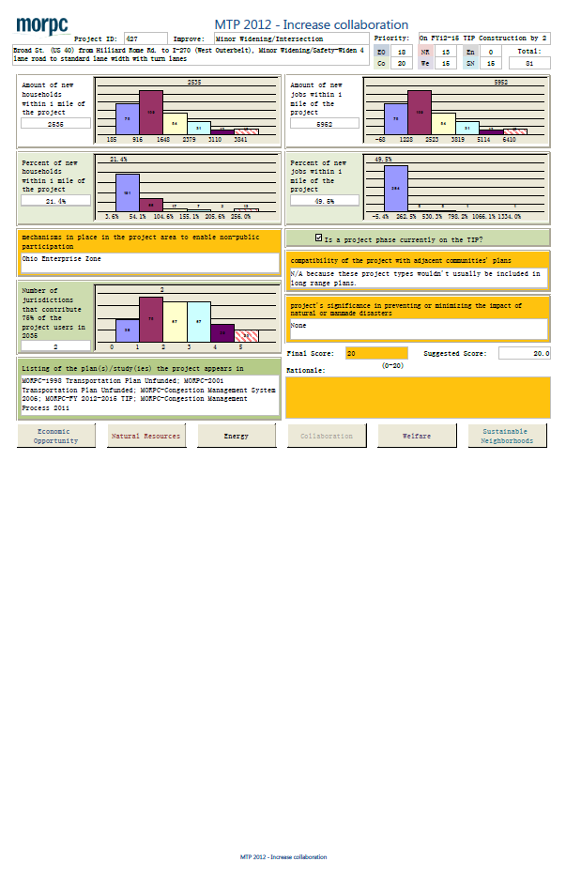
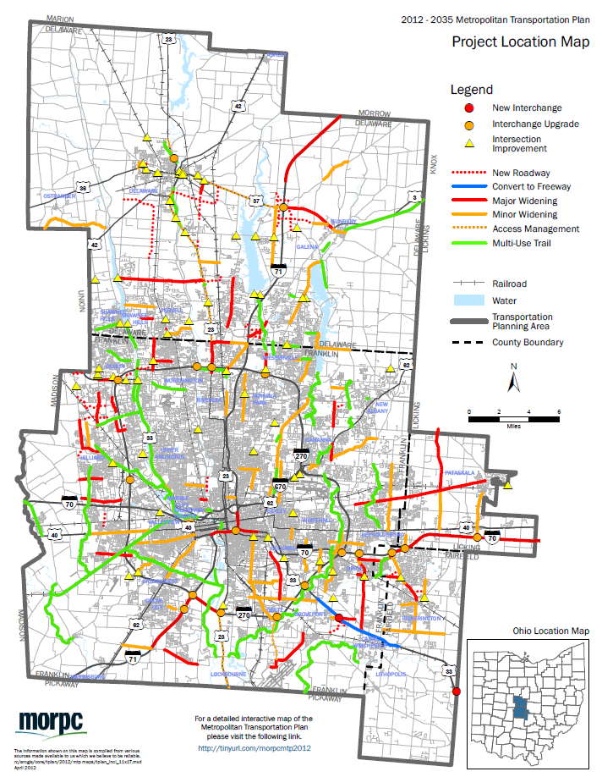
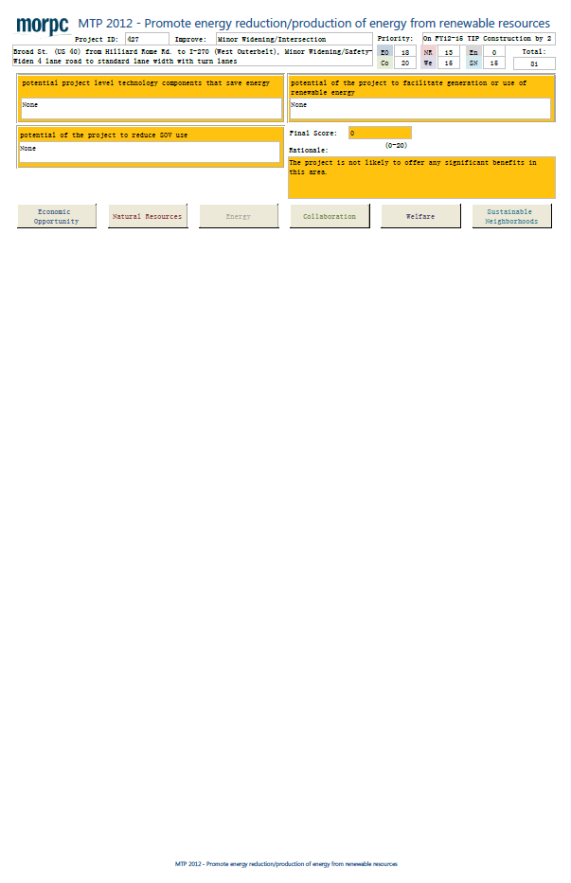
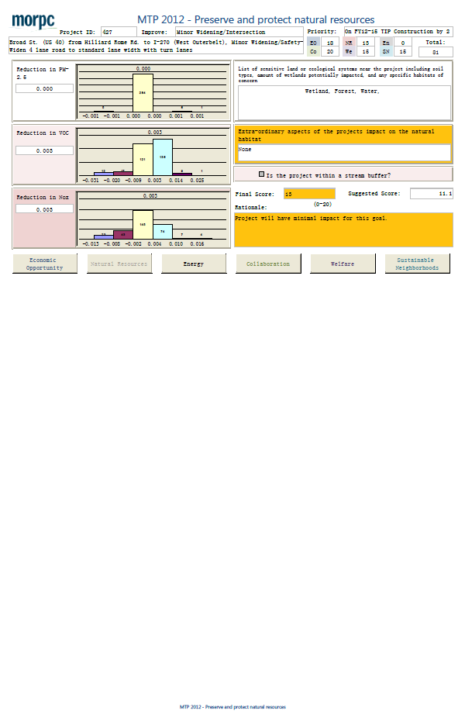
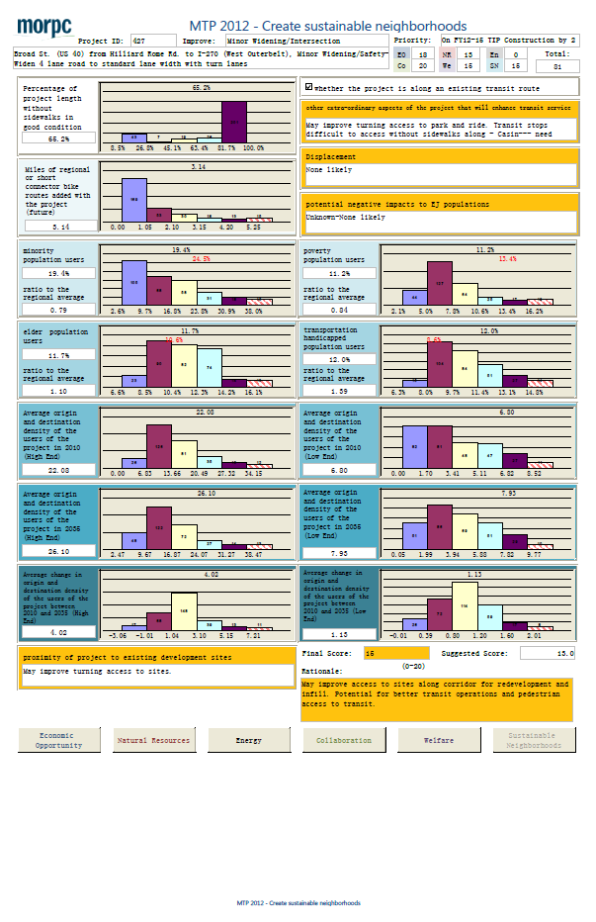
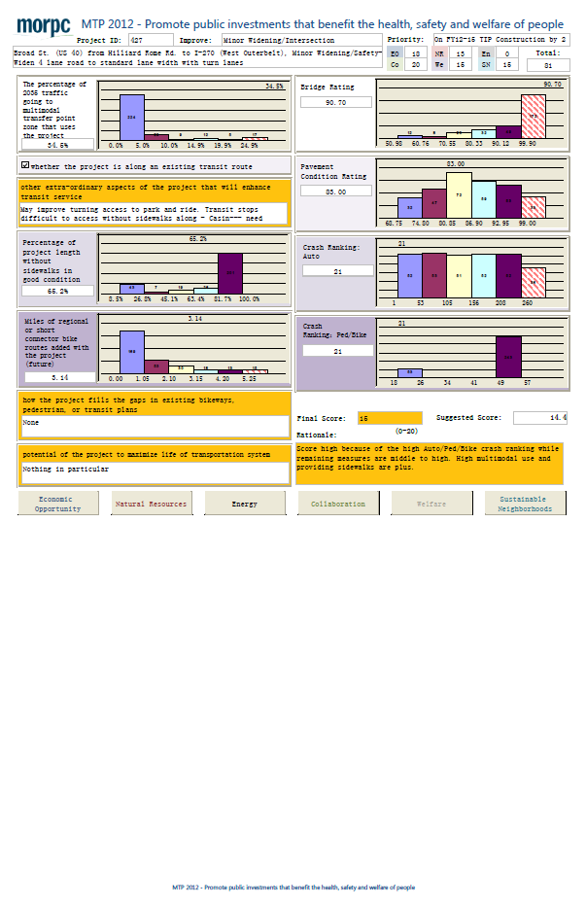
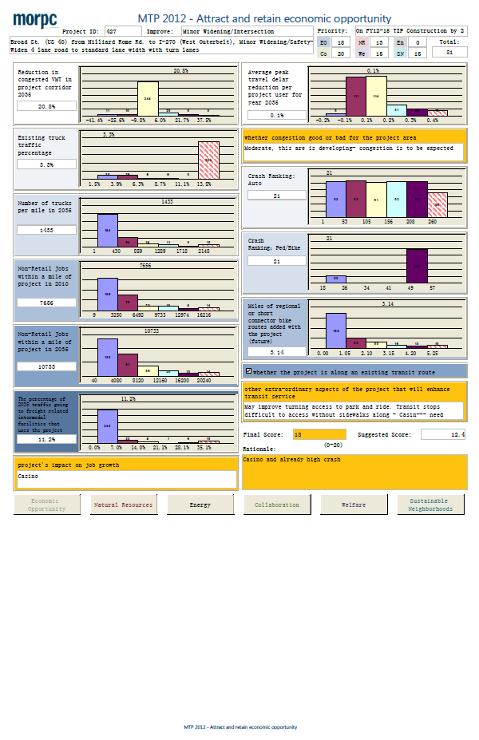
Project Score Details – Fact Sheets
Project Evaluation Database System

Slide 30
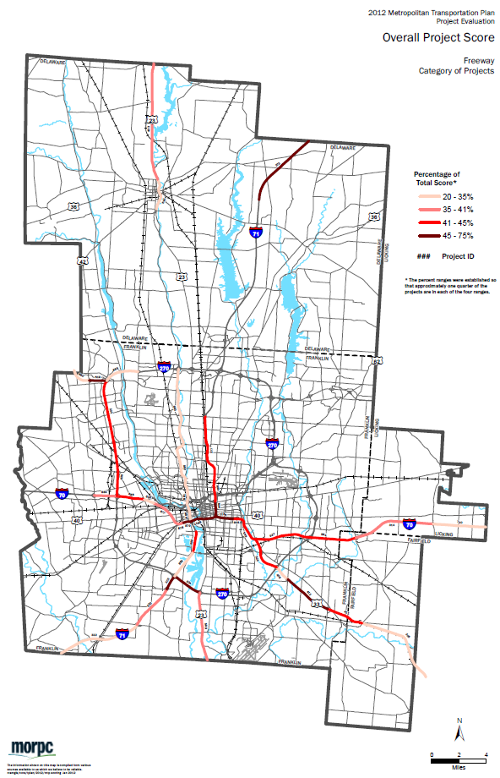
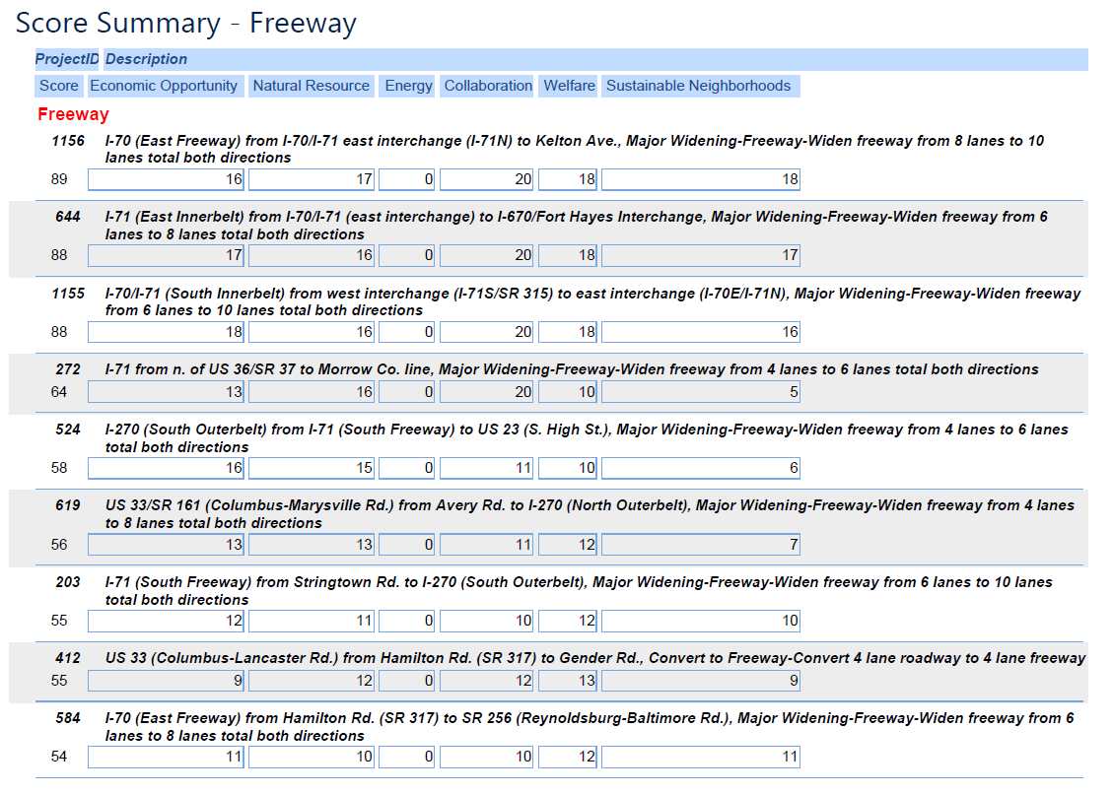
Final Score Report – Freeway Example
Project Evaluation Database System

Slide 31
Conclusions
Project Evaluation Database System
Streamlined project evaluation process
Successful tool of project evaluation for 2012 MTP
Similar database systems for future MTPs
  Fair
  Transparent
  Rigorous
However, still just a tool. MTP ultimately is result of the planning process which includes public involvement and other factors.

Slide 32
Questions??
Nick Gill – ngill@morpc.org, 614-233-4151
Zhuojun Jiang, zjiang@morpc.org, 614-233-4147
www.morpc.org/tplan
Specifically-Appendix B

