Slide 1
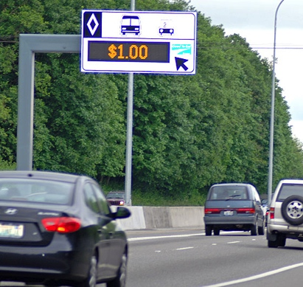
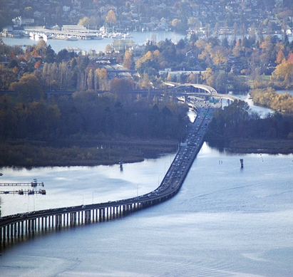
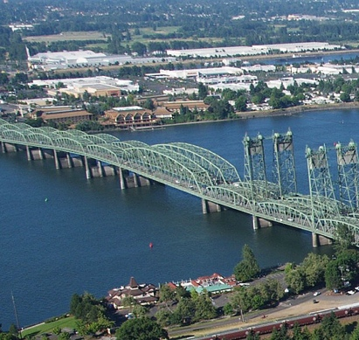
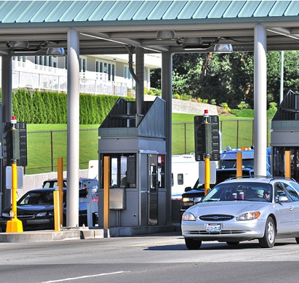
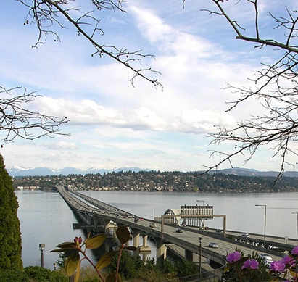
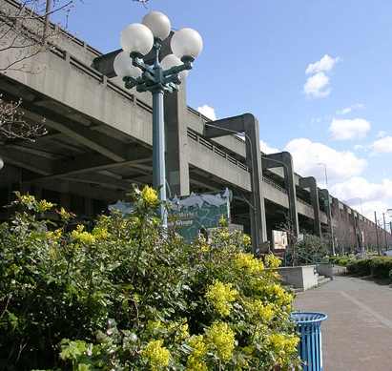
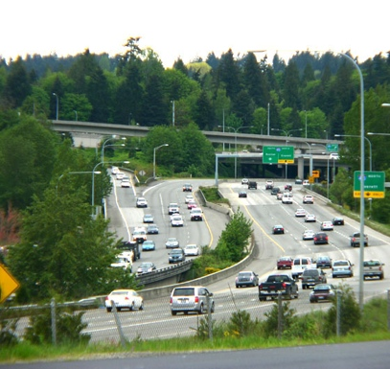
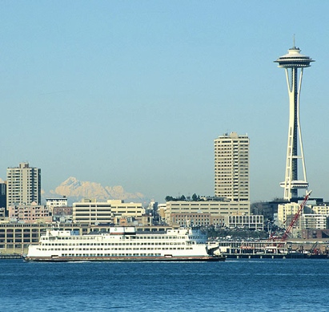
Combining Macro Scopic and Meso Scopic Models in Toll and Traffic Revenue Forecasting
SR 167 Corridor Completion Comprehensive Tolling Study
Ming-Bang Shyu, Natarajan Janarthanan & Shuming Yan
Lynn Peterson
Secretary of Transportation
14th TRB Transportation Planning Applications Conference
Columbus, Ohio
May 5th 2013

Slide 2
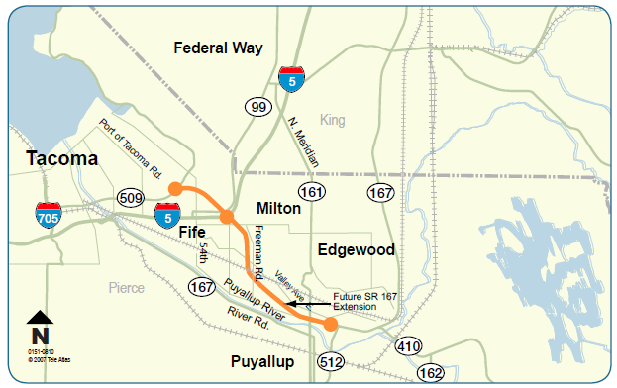
Project Background
Planning started over 40 year ago
EIS was completed in 2006
FHWA signed ROD in 2007
Fills a missing link
Adds connection to Port of Tacoma
Moves freight faster

Slide 3
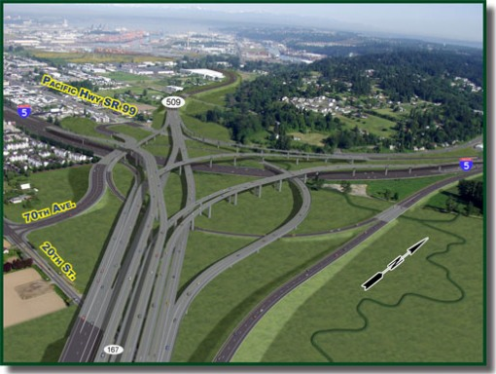
The SR 167 Extension

Slide 4
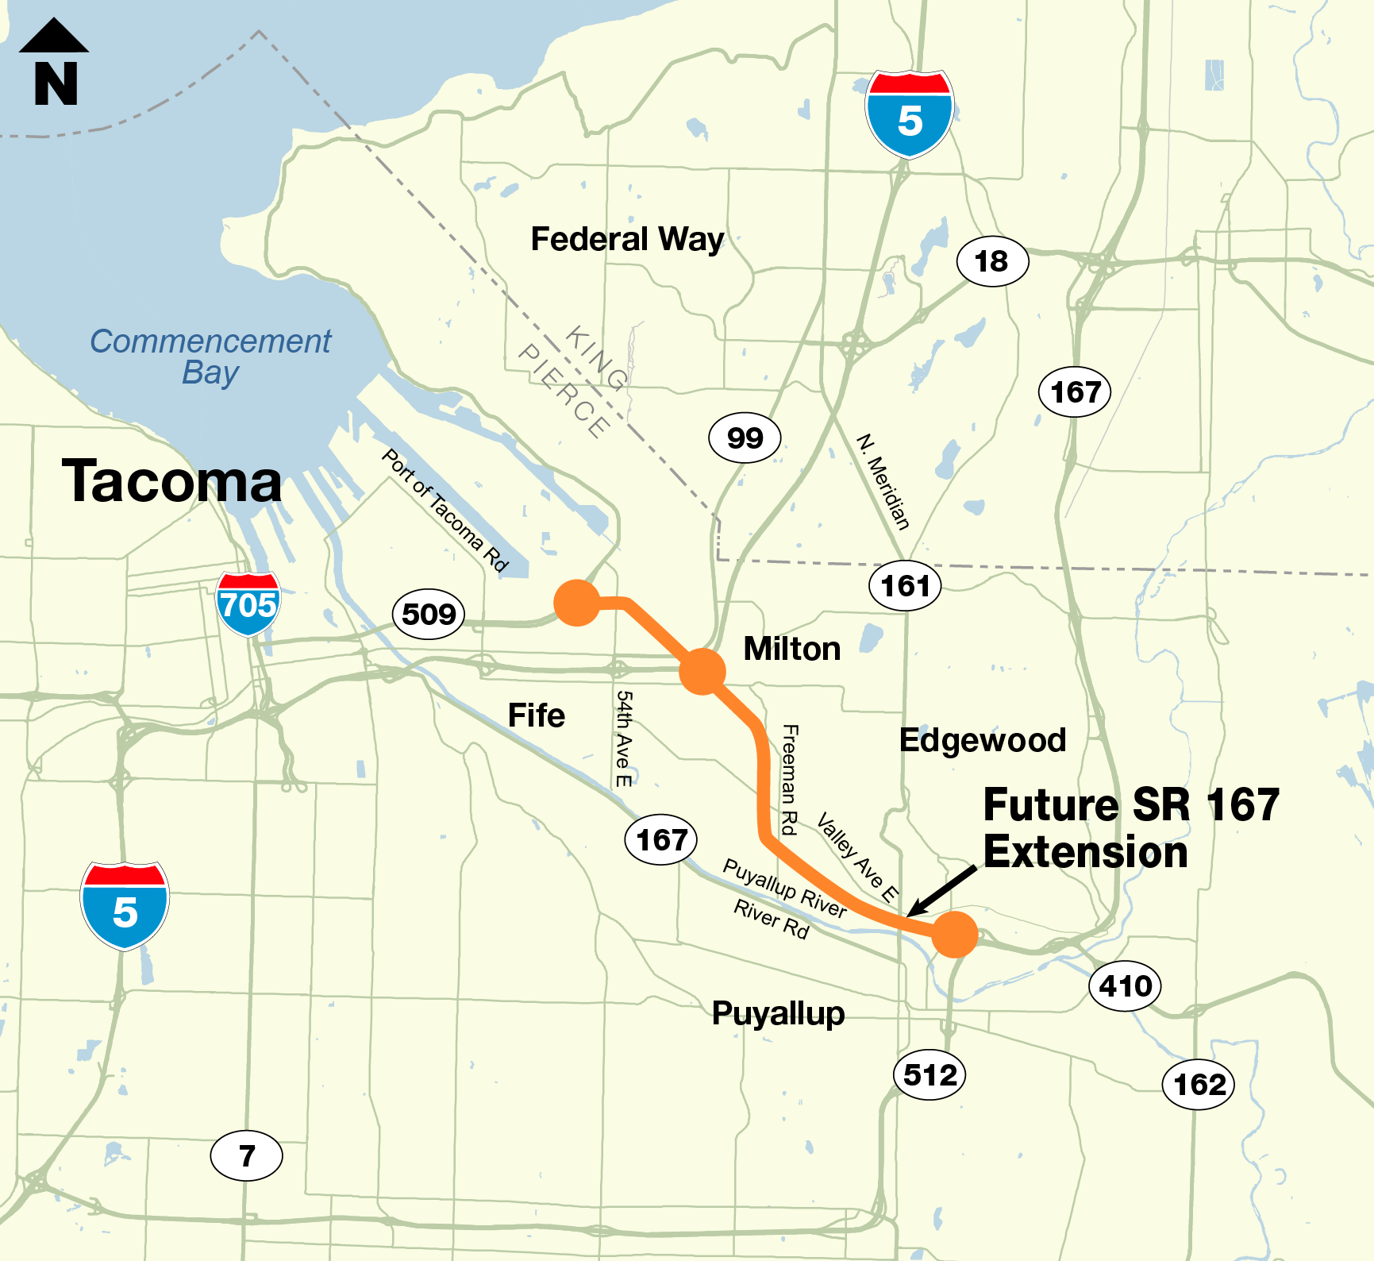
SR 167 Extension: Current Status
What we have accomplished so far
Record of Decision on EIS granted
Purchased 70% of needed right of way
Tolling feasibility study completed
Where we are now
Comprehensive Tolling Study analyzing
tolling options to close funding gap
Identifying staging scenarios to decrease initial capital costs
What we need to complete the project
Funding for remaining right of way, design and construction ($1.5 B)
Purchase remaining 30% of right of way (100 parcels = $165 M)
Complete design, acquire permits, build project
  Staging the project to reduce up front capital costs is highly likely
Notes:
WSDOT transportation vision slide

Slide 5
Different Types of Tolling Studies
Feasibility Study – Is there merit to toll the corridor and use the tolling revenue to help finance the project?
Comprehensive Study - How much revenue can be expected from tolling? What are the impacts? What does the public think about it?
Investment Grade Study – What will the interest rate be? What is the debt payment plan? What are the risks and mitigations?
Notes:
SY

Slide 6
Toll Study Process
Concept of Operations
• Toll rate structure
• Cost to implement tolls
Project Specifications
• Project scope and cost
• Expenditure cash flow
Traffic Modeling
• Maximize Revenue
• Minimize Diversion
Iterative
Process
Financial Modeling
• Toll funding contribution to project
• Matches timing of sources and uses
Revenue Modeling
• Annual gross toll revenue stream
• O&M costs paid by tolls

Slide 7
SR 167 Comprehensive Tolling Study
Analysis assumptions:
Toll rates are set for maximum revenue generation
All vehicles except transit pay tolls
Toll rates vary by time of day based on congestion levels
Trucks pay higher tolls
Toll financial capacity analysis was based on current market conditions

Slide 8
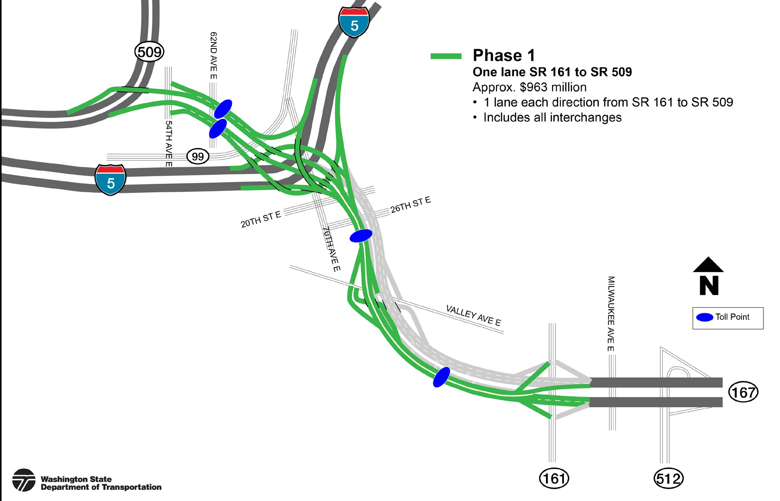
Phase 1 Conceptual Scope

Slide 9
Potential Trips Diversions
Legend
SR 167 Extension
Potential Diversion Route

Slide 10
Traditional Macro Scopic Model Approach
Social-Economic Data – Households and Employments
Trip Generation
Trip Distribution
Mode split
Trip Assignment

Slide 11
Model Resolution
Macro Scopic Travel Demand Model
  Static model;
  Instantaneous travel time methodology
  Regional wide analysis
  Output: Demand volumes
Meso Scopic Dynamic Traffic Assignment (DTA) Model
  Time dependent DTA model
  Experienced travel time methodology
  Regional wide or corridor analysis
  Output: Throughputs
Micro Scopic Simulation Model
  Individual vehicle simulation
  Intersection or corridor operation analysis
  Output: Throughputs

Slide 12
General Approaches for Model Validation/Calibration
 | Macro Scopic Static Assignment Model | Meso Scopic DTA Model
Validation | Counts | Counts
 |  | Travel times / speeds /queues
 | Network measures (VMT, VHT etc) | Network measures (VMT, VHT etc)
 | Traveling paths | Traveling paths
Calibration | Link/node properties | Link/node/movement properties
 | Turn penalties | Driver behavior properties (response time, follow up time, gap acceptance)
 |  | Intersection control properties
 | Demand adjustment | Demand adjustment

Slide 13
Why We used the Meso Scopic DTA Model
Flow-Density-Speed relationship;
Car-following and lane changing theories;
Detailed network;
Intersection delay taken into account;
System dynamic traffic profile;
Lane based simulation.
More realistic traffic operation and assignment
Better traffic forecast

Slide 14
Meso Scopic DTA Model Development Process
Future Base Travel Demand Model - 2030 PM
Data Collection
Intersection geometry
Traffic profile
Intersection controls
Sub Area Network
Future Base Year DTA Model
Future DTA model with SR 167 Extension and the optimal toll rates
Future DTA model with SR 167 Extension – test different toll rates

Slide 15
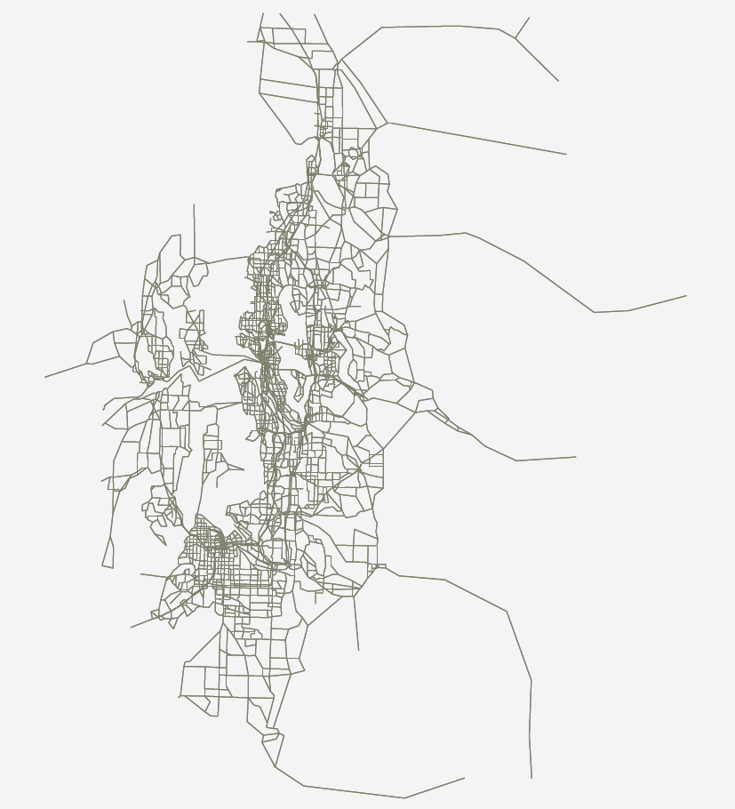
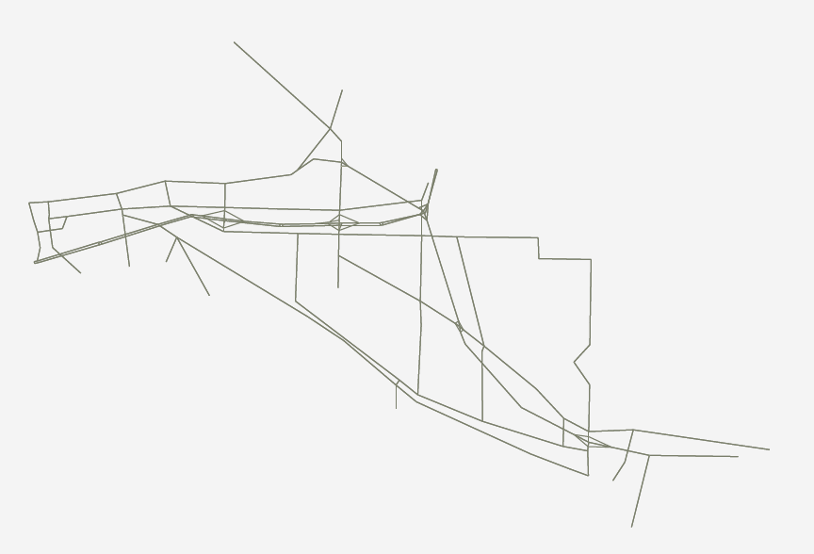
Meso Scopic DTA Model Development – SR 167 Subarea
Regional Macro Scopic Model
Subarea
Macro Scopic
Travel Demand Model
SR 509
I-705
I-5
River Rd
SR 161

Slide 16
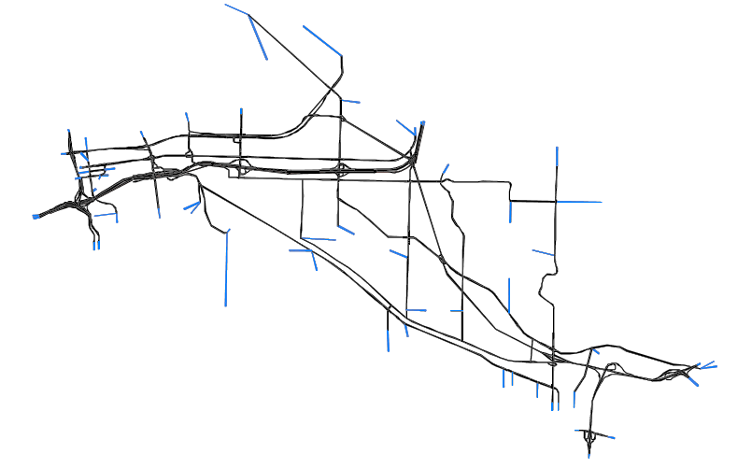
Meso Scopic DTA Model Development – SR 167 Subarea
Subarea Meso Scopic DTA Model
Network Refinements
realistic geometry coding
58 Intersections
signal plans and stop controls
Demand Loadings
11 modes; 24 time intervals each

Slide 17
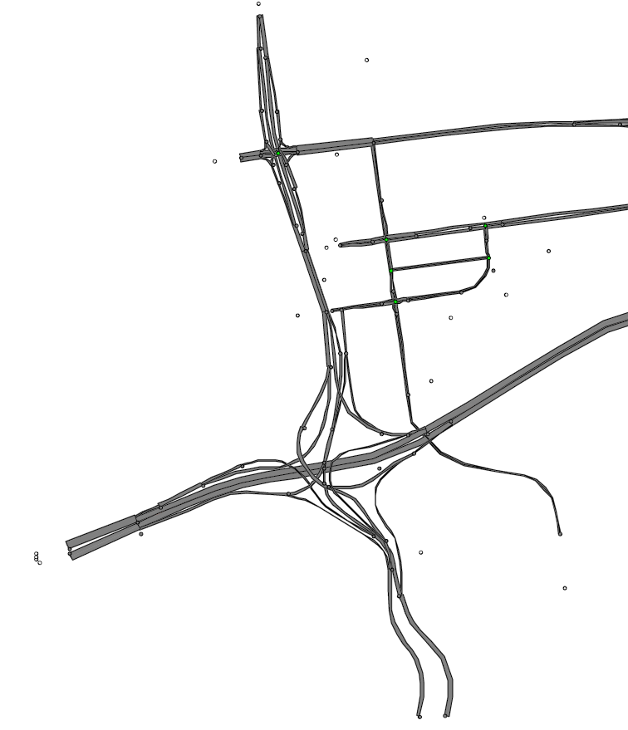

Meso Scopic DTA Model Development – Network Refinement
Meso Scopic DTA Model
- Detailed geometry for every intersection / interchange were coded.
Macro Scopic Model
SR 509
SR 509
I-705
I-705
I-5
I-5

Slide 18

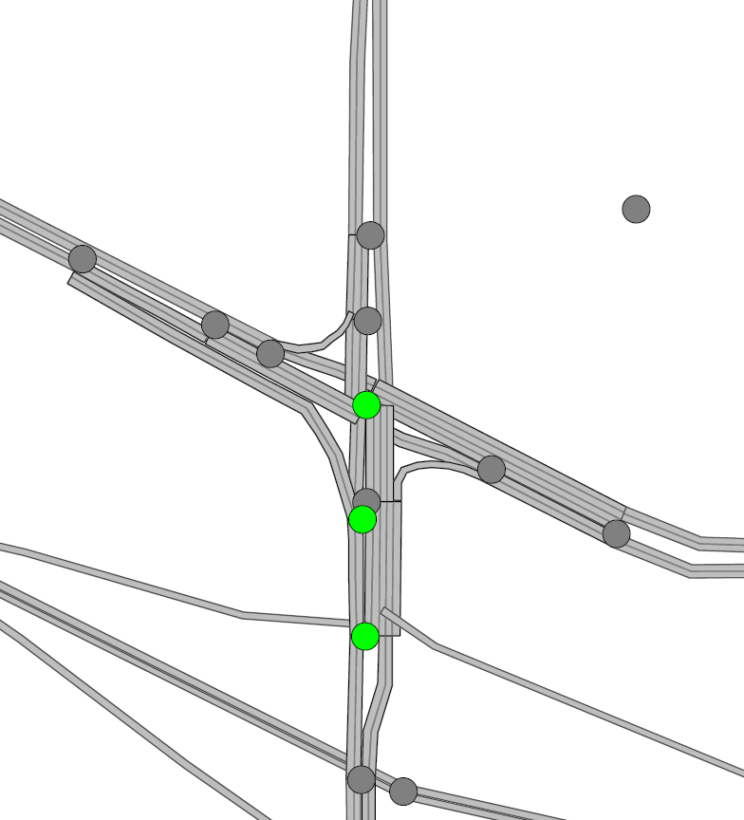
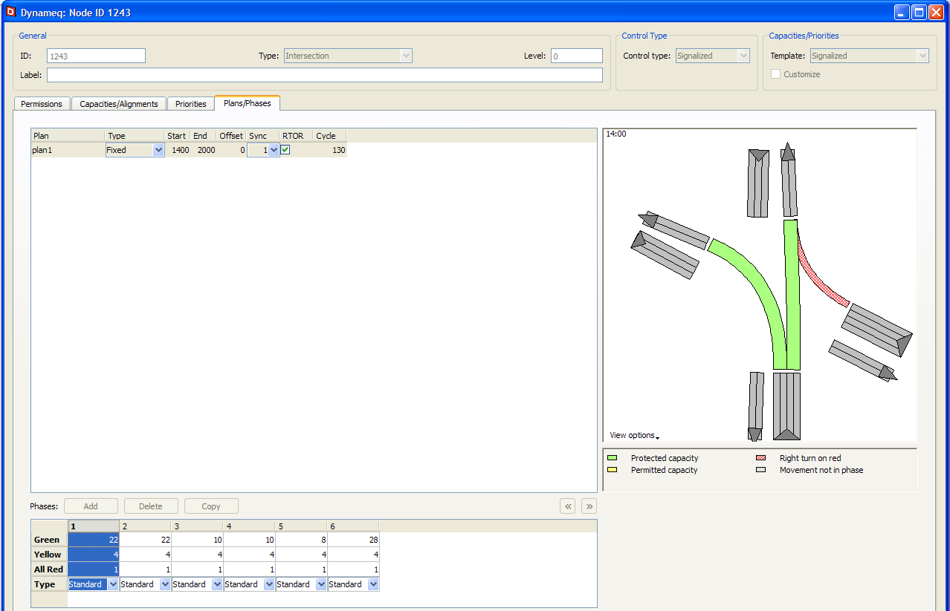
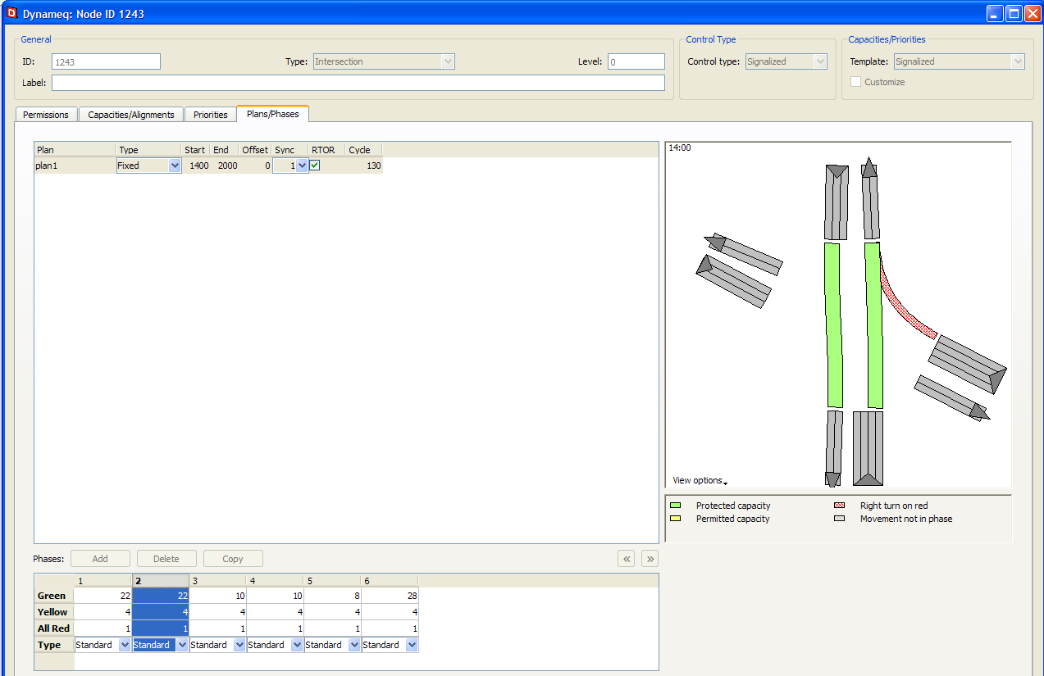
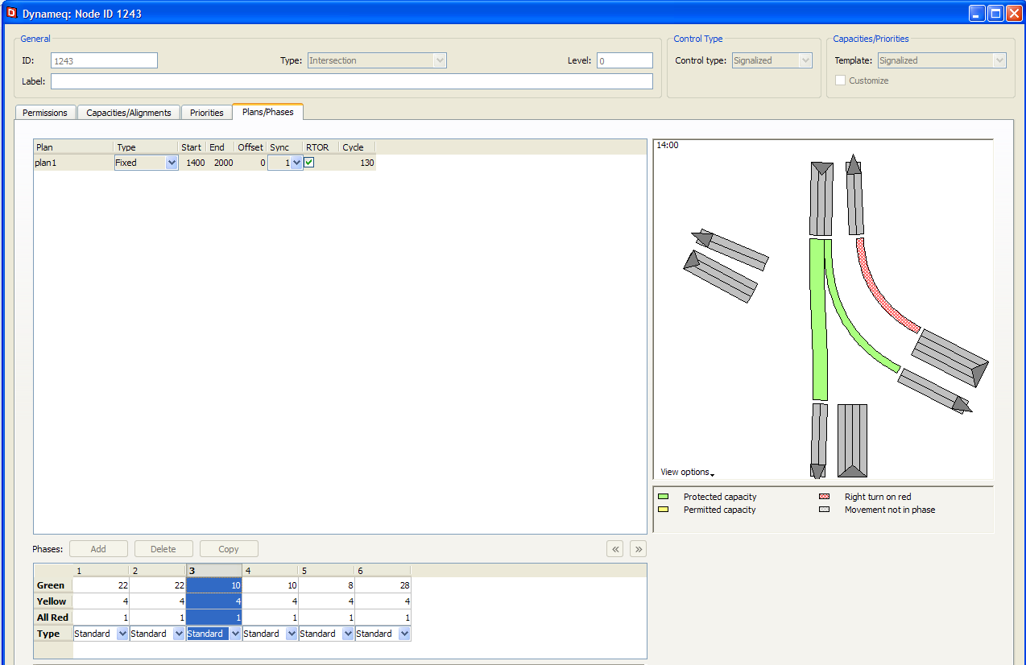
Meso Scopic DTA Model Development – Intersection Control
In order to capture the intersection delay during the traffic assignment, 58 signalized and unsignalized intersections were coded in the subarea network.
Macro Scopic Model
Meso Scopic DTA Model
SR 161
SR 161
Valley Ave
Valley Ave

Slide 19
Meso Scopic DTA Model Development – Demand Loading
Refinement
For traffic dynamic, existing traffic profile were considered.
11 modes total and 24 15-min matrices for each mode were generated.
Meso Scopic DTA model loading
Static Macro model loading

Slide 20
Toll rate, traffic and revenue relationship
Notes:
The X axis represents toll rate, the Y axis shows traffic volume. The red line depicts traffic volume, the green line depicts revenue.
As the toll rate increases initially, the revenue increases, but the traffic volume decreases. As the rate increases to a certain point, the traffic volume drops so much that yield lower revenue.
Two way of tolling, toll to generate max revenue, or toll to maximize corridor and system performance.

Slide 21
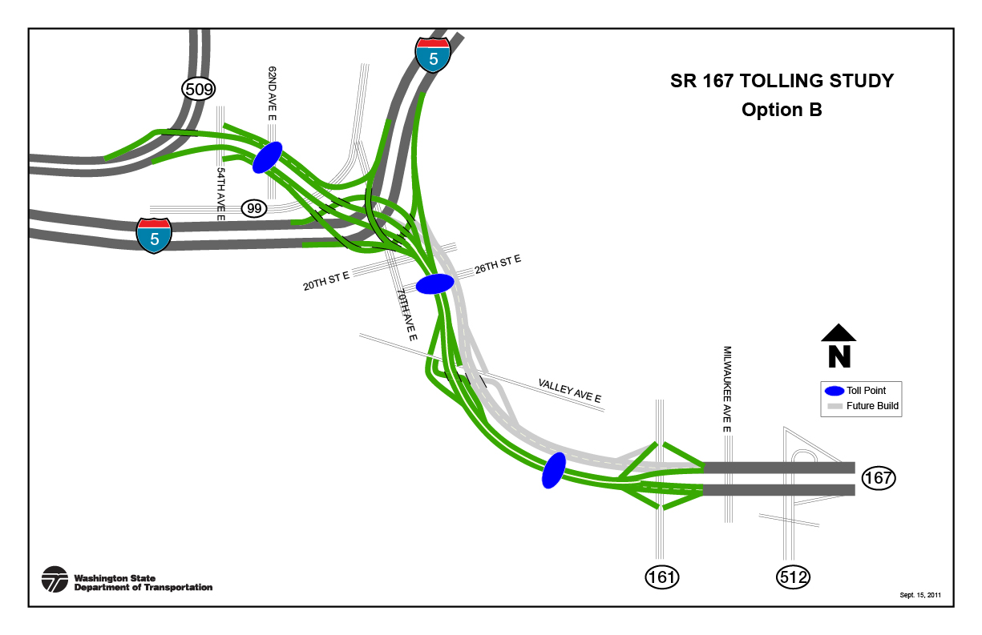
Toll Rates Used in Model (AM Peak)
Auto toll rates in AM peak period 6:00 – 9:00 AM (in 2010 $)
Medium truck rates are 1.5 times of auto; Heavy truck rates are 2 times of auto.
Macro | 0.50
Meso | 0.50
Macro | 0.75
Meso | 0.75
Macro | 1.15
Meso | 0.95
Macro | 0.75
Meso | 0.75
Macro | 1.15
Meso | 1.35
Macro | 0.75
Meso | 0.75

Slide 22
Toll Rates Used in Model (PM Peak)
Auto toll rates in PM peak period 3:00 – 6:00 PM (in 2010 $)
Medium truck rates are 1.5 times of auto; Heavy truck rates are 2 times of auto.
Macro | 1.00
Meso | 1.00
Macro | 0.55
Meso | 0.55
Macro | 0.90
Meso | 0.90
Macro | 1.50
Meso | 1.10
Macro | 0.90
Meso | 0.90
Macro | 1.50
Meso | 1.90

Slide 23
Model Results – 2030 Volumes (AM Peak)
AM Peak Period 6:00 – 9:00 AM
Macro | 610
Meso | 880
Macro | 630
Meso | 2240
Macro | 2860
Meso | 2640
Macro | 900
Meso | 1190
Macro | 2230
Meso | 4200
Macro | 790
Meso | 1410

Slide 24
Model Results – 2030 Volumes (PM Peak)
PM peak period 3:00 – 6:00 PM
Macro | 1310
Meso | 1030
Macro | 480
Meso | 1710
Macro | 1330
Meso | 2090
Macro | 2270
Meso | 3050
Macro | 770
Meso | 1960
Macro | 2060
Meso | 4780

Slide 25
Key Findings from Meso Scopic Model
  It was a valuable and informative exercise
  Higher extension usage when intersection delays are considered
  AM peak period volumes and revenue increase about 1/2 in meso scopic model
  PM peak period volumes and revenue increase about 2/3 in meso scopic model
  A possible bottleneck was revealed: SR 167 extension to NB I-5 in AM peak period

Slide 26
Study findings:
Among the six options studied, tolling is expected to generate the revenue to pay for the on-going facility maintenance, operations and toll collection costs, but would generate only limited funding for construction.
Tolling would help manage traffic demand and make a phased approach (or incremental project implementation) more viable from both a traffic operations and financial standpoint.
Without future improvements on I-5 to accommodate traffic growth, congestion on I-5 is expected to grow which in turn, would constrain SR 167 extension usage and negatively affect the toll revenue.

Slide 27
Thank you!!
Contact Information:
Ming-Bang Shyu | Senior Traffic & Toll Modeler | Urban Planning Office, WSDOT | shyumb@wsdot.wa.gov 206-4641290
Shuming Yan | Deputy Director | Urban Planning Office, WSDOT | YanS@wsdot.wa.gov 206-4641276
Natarajan Janarthanan | Modeling Manger | Urban Planning Office, WSDOT | JanartN@wsdot.wa.gov 206-4641274
Notes:
KJD

