Slide 1
Model Calibration & Estimation Input Data Validation Checks…
So, How Do You Know Those Travel Times Are Reasonable, Anyway?
14th TRB Planning Applications Conference
David Kurth
May 7, 2013

Slide 2
Co-authors & Contributors
Cambridge Systematics
Marty Milkovits
Dan Tempesta
Jason Lemp
Anurag Komanduri
Ramesh Thammiraju
AECOM
Pat Coleman

Slide 3
Presentation Overview
Quick review of Travel Model Validation and Reasonableness Checking Manual – Second Edition
Aggregate & disaggregate validation checks of input model skims
Updates / New Techniques for Disaggregate Checks
Transit prediction success with transit multipath builders
SEMCOG
Transit route profiles
Minneapolis-St. Paul & Denver
Highway travel skims
Houston & Denver

Slide 4
Validation of Input Data
Important for Trip-Based and Activity/Tour-Based Models
In a word – GIGO
Appropriate Approaches
Aggregate Models → Aggregate Checks
Larger outliers that impact model calibration
Disaggregate Models → Aggregate & Disaggregate Checks
Larger outliers that skew models
Individual outliers that impact coefficient estimates & statistics

Slide 5
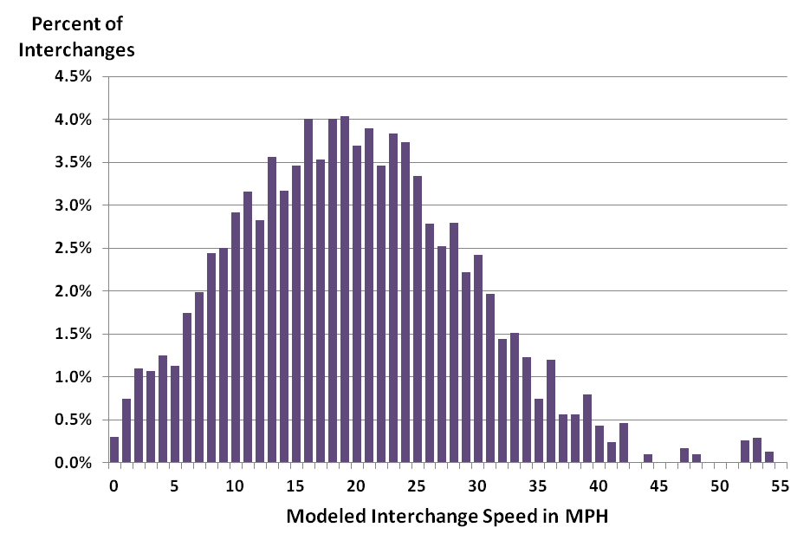
Travel Model Validation and Reasonableness Checking Manual – Second Edition
Highway Network Path Building Aggregate Checks
Speed interchange frequency distributions

Slide 6
Travel Model Validation and Reasonableness Checking Manual – Second Edition
Highway Network Path Building Aggregate Checks
Speed interchange frequency distributions
Travel time plots

Slide 7
Travel Model Validation and Reasonableness Checking Manual – Second Edition
Highway Network Path Building Disaggregate Checks
“no applicable disaggregate checks of highway network skim data…”

Slide 8
Travel Model Validation and Reasonableness Checking Manual – Second Edition
Highway Network Path Building Disaggregate Checks
“no applicable disaggregate checks of highway network skim data…”
…will be addressed in this presentation.

Slide 9
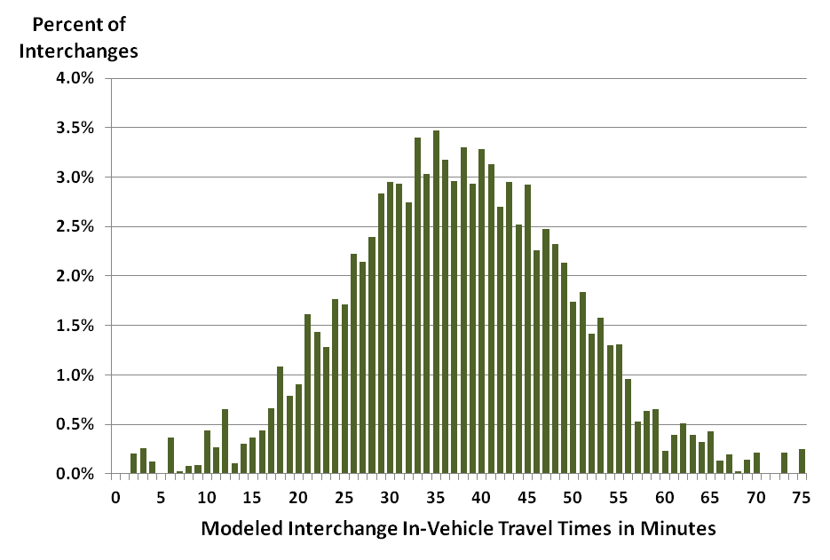
Travel Model Validation and Reasonableness Checking Manual – Second Edition
Transit Network Path Building Aggregate Checks
Trip length frequency distributions
In-vehicle time
Out-of-vehicle time
Number of transfers
Costs

Slide 10
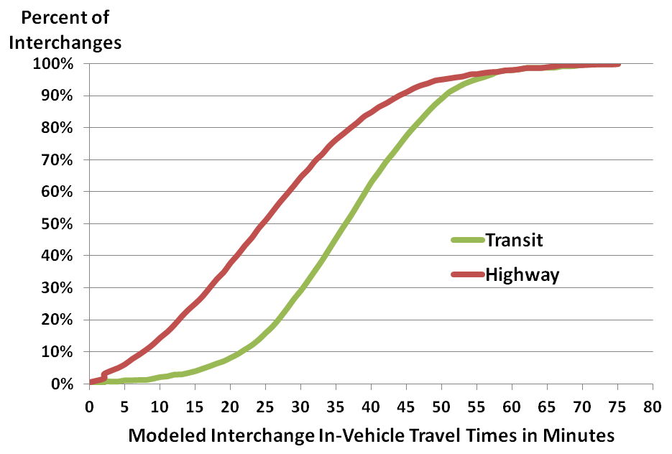
Travel Model Validation and Reasonableness Checking Manual – Second Edition
Transit Network Path Building Aggregate Checks
Trip length frequency distributions
In-vehicle time
Out-of-vehicle time
Number of transfers
Costs
Comparison to auto travel times

Slide 11
Travel Model Validation and Reasonableness Checking Manual – Second Edition
Transit Network Path Building Aggregate Checks
Trip length frequency distributions
In-vehicle time
Out-of-vehicle time
Number of transfers
Costs
Comparison to auto travel times
Assign observed transit trips and compare modeled to observed boardings by route
Line | Observed Boardings | Assigned Boardings | Difference | Percent Difference
1 | 913 | 698 | -215 | -24%
2 | 645 | 723 | 78 | 12%
3 | 7,944 | 7,510 | -434 | -5%
4 | 1,414 | 1,587 | 173 | 12%
5 | 4,208 | 4,271 | 63 | 1%
6 | 1,172 | 1,001 | -171 | -15%
7 | 12,466 | 13,067 | 601 | 5%
… | … | … | … | …
Total | 149,562 | 144,285 | -5,277 | -4%

Slide 12
Travel Model Validation and Reasonableness Checking Manual – Second Edition
Transit Network Path Building Disaggregate Checks
Prediction-success tables comparing modeled to reported boardings
 |  | Modeled |  |  |  |  | Summary
 |  | 0 | 1 | 2 | 3 | 4 | Path Match | Percent
Reported | 1 | 0.2% | 24.9% | 9.0% | 0.7% | 0.0% | 0 Modeled Paths | 1.0%
 | 2 | 0.5% | 12.2% | 31.2% | 6.9% | 0.0% | Reported > Modeled | 22.6%
 | 3 | 0.4% | 2.8% | 7.6% | 3.5% | 0.2% | Reported < Modeled | 16.9%
 | 4 | 0.0% | 0.0% | 0.0% | 0.0% | 0.0% | Reported = Modeled | 59.5%

Slide 13
Prediction-Success with Transit Multipath Builders – SEMCOG
Issue
Transit path-builders construct multiple paths
Average number of boardings per interchange reported
Respondents report integer number of boardings
So, when the model shows 1.53 average boardings for a respondent reporting 1 boarding…

Slide 14
Prediction-Success with Transit Multipath Builders – SEMCOG
Issue
Transit path-builders construct multiple paths
Average number of boardings per interchange reported
Respondents report integer number of boardings
So, when the model shows 1.53 average boardings for a respondent reporting 1 boarding…
…is that success or failure?

Slide 15
Prediction-Success with Transit Multipath Builders – SEMCOG
2010 On-board Survey Boardings by Access Mode
Observed Prevalence of Multiple Paths
Boardings | Walk Access | Drive Access
1 | 5,802 | 960
2 | 4,797 | 257
3 | 1,262 | 46
4 | 203 | 9
Total | 12,064 | 1,272
Boardings / Linked Trip | 1.4 | 1.2
 | Walk Access | Drive Access
Interchanges with 3 or more observations | 244 | 14
Interchanges with respondents reporting different numbers of boardings
Number | 79 | 0
Percent | 32% | 0%

Slide 16
Prediction-Success with Transit Multipath Builders – SEMCOG
Prediction-Success Tables Must Allow for:
Multiple paths
Different numbers of transfers
Prediction-Success Implementation Procedure
Build true/false tables
Build paths multiple times with “Maximum Number of Transfers” set to 0, 1, 2, or 3

Slide 17
Prediction-Success with Transit Multipath Builders – SEMCOG
Prediction-Success Implementation Procedure
Initial paths
Maximum Number of Transfers = 0
If path exists, “one-boarding” matrix cell = “True”; else “False”
Save average number of transfers for each matrix cell
Second set of paths
Maximum Number of Transfers = 1
If path exists and average number of boardings > value for “one-boarding” matrix
Mark “two-boarding” matrix cell = “True” and save average number of transfers
Repeat above for Maximum Number of Transfers = 2, 3
If no paths for Maximum Number of Transfers = 3
“No transit” = True

Slide 18
Prediction-Success with Transit Multipath Builders – SEMCOG
Prediction-Success Implementation Procedure (continued)
For each on-board survey observation
Set prediction-success to true if the reported number of transfers matched one of the true/false tables
SEMCOG Results
 |  | Modeled |  |  |  |  | Summary
 |  | 0 | 1 | 2 | 3 | 4 | Path Match | Percent
Reported | 1 | 0.8% | 41.2% | 5.9% | 0.2% | 0.0% | 0 Modeled Paths | 2.4%
 | 2 | 1.0% | 8.6% | 29.4% | 0.7% | 0.0% | Reported > Modeled | 17.3%
 | 3 | 0.5% | 3.2% | 3.9% | 2.8% | 0.0% | Reported < Modeled | 6.9%
 | 4 | 0.1% | 0.7% | 0.7% | 0.1% | 0.1% | Reported = Modeled | 73.4%

Slide 19
Prediction-Success with Transit Multipath Builders – SEMCOG
Key Findings / Changes
Finding | Found During Aggregate Validation | Found During Disaggregate Validation
Illogical walk egress distances in survey data | No | Yes
Maximum walk egress distance | Not determined | 36 Minutes
Transfer penalty | 6 minutes | 3 minutes

Slide 20
Transit Route Profiles – Minneapolis-St. Paul
Use the correct data to check model accuracy
Supply Side Inputs – Transit Networks
Accurate service frequency and stop spacing impact model outputs
Custom database built by MetCouncil – NCompass
Most up-to-date transit network information
Updated regularly
Demand Side Inputs – On-board Survey Data
Proper geocoding
Proper survey expansion

Slide 21
On-board Survey Geocoding – Minneapolis-St. Paul
Geocoding of 4 locations – “O-B-A-D”
O-D most critical for model validation tests
16,500+ surveys = ~65,000 locations
Three rounds of geocoding
ArcGIS, TransCAD, Google API
Test for “accuracy” – mostly commonsense rules!
Walk to transit < 1 mile from bus route (access and egress)
Boarding and alighting locations “close” to bus route
Manual cleaning for records that “fail” criteria = better input data

Slide 22
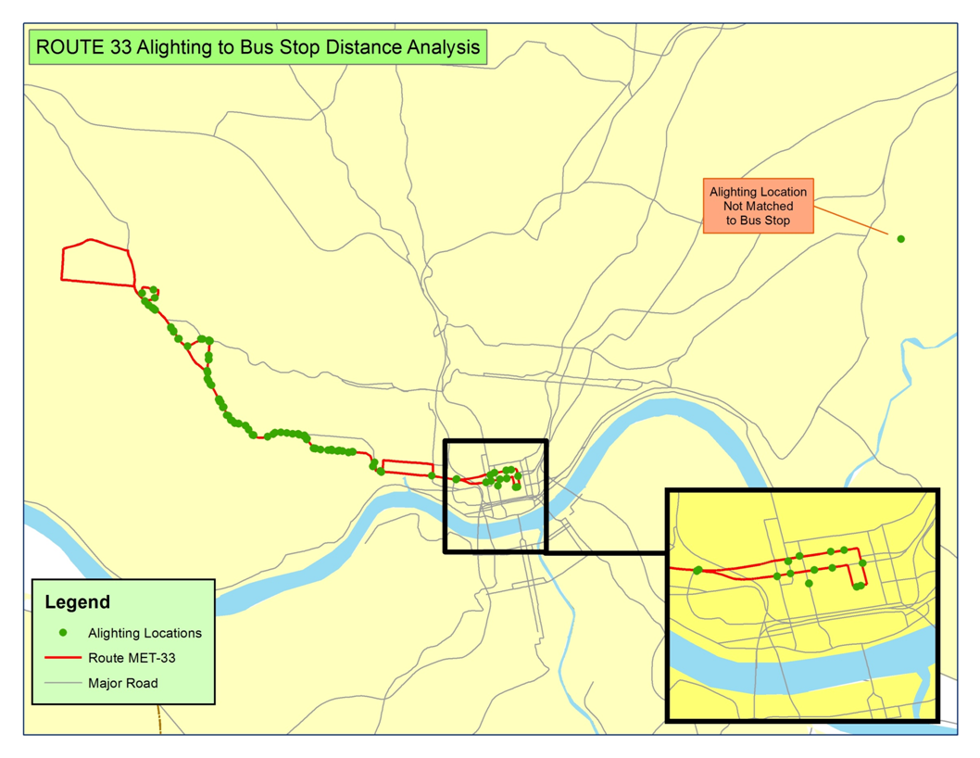
On-board Survey Geocoding – Example from OKI On-Board Survey

Slide 23
On-board Survey Weighting – Minneapolis-St. Paul
Proper expansion impacts accuracy
Collected detailed boarding-alighting count data
Supplements on-board survey data
Same bus trips as on-board survey
Performed disaggregate weighting procedures
Step 1 – control for non-participants (route-direction-ToD)
Step 2 – control for non-surveyed trips (sampling)
Step 3 – control for “boarding-alighting” patterns (geo) IMPORTANT!
Step 4 – control for transfers (linked trip factors)

Slide 24
On-board Survey Weighting – Minneapolis-St. Paul
Time of Day | Boarding Superdistrict | Count Distribution | Pre-Geographic Expansion Distribution | Post-Geographic Expansion Distribution
AM Peak Period (6–9 AM) | 101 | 10.8% | 12.2% | 12.4%
 | 102 | 13.2% | 17.7% | 13.0%
 | 103 | 0.7% | 0.2% | 0.5%
 | 104 | 18.1% | 21.4% | 17.9%
 | 201 | 4.1% | 6.2% | 3.9%
 | 202 | 0.8% | 0.8% | 0.8%
 | 301 | 18.0% | 18.4% | 18.2%
 | 401 | 34.0% | 22.4% | 32.9%
 | 701 | 0.4% | 0.7% | 0.4%

Slide 25
Transit Route Profiles – Minneapolis-St. Paul & Denver
Validation procedure includes
Prediction-success tables
Matching route profiles by line
Other data considerations
Availability of data from Automated Passenger Counters (APCs)
Transit on-to-off surveys being recommended by FTA
Possibly most useful for corridor studies

Slide 26
Transit Route Profiles – Minneapolis-St. Paul & Denver
Minneapolis-St. Paul On-Board Survey
Denver West Line Light Rail “Before Survey”
Before survey for FTA New Starts project (opened April 26, 2013)
Included collection of boarding TO alighting counts by stop group
Denver Colfax Corridor Alternatives Analysis
Corridor study with “traditional” on-board survey expanded to boardings by time-of-day and direction by line (2008)
Detailed APC data

Slide 27
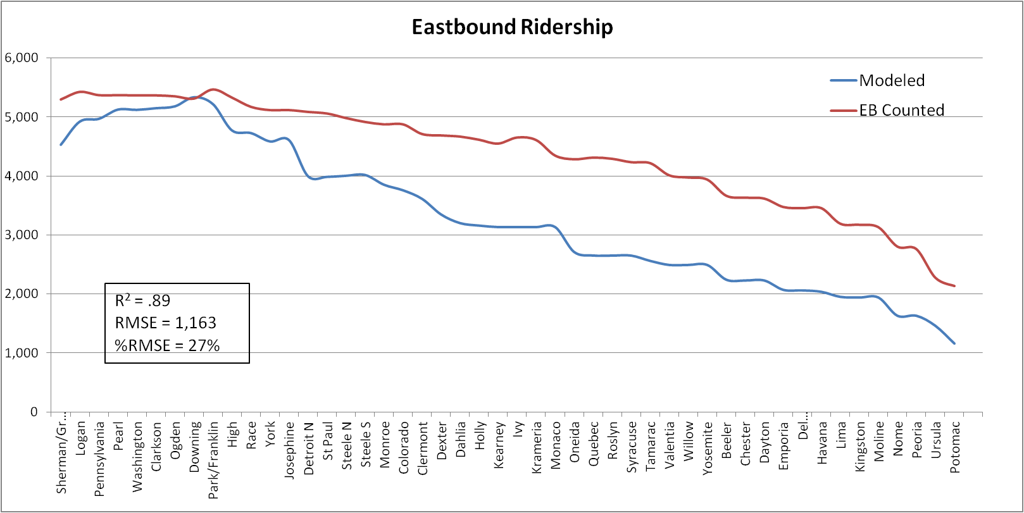
Transit Route Profiles – Minneapolis-St. Paul & Denver

Slide 28
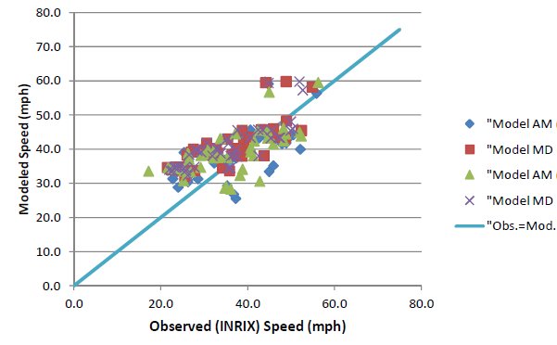
Highway Travel Times – Houston
Background
Work performed for development of H-GAC Activity-Based Model
Highway network validated using aggregate methods
Comparison of modeled to observed speeds

Slide 29
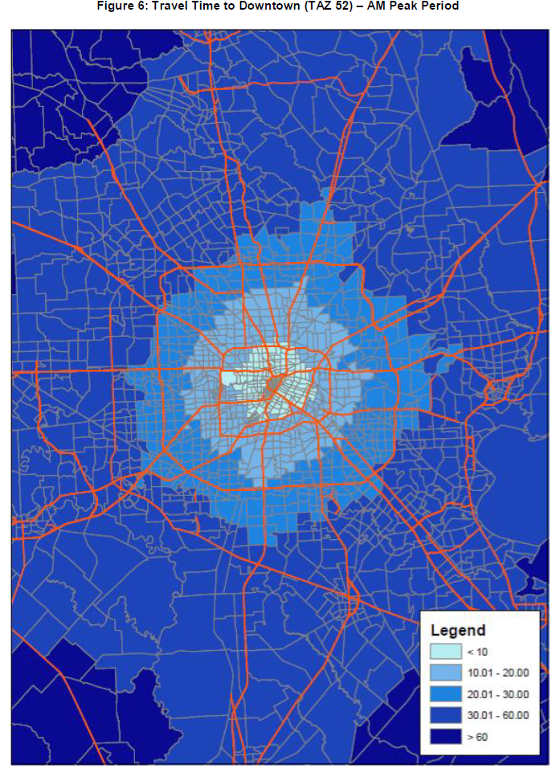
Highway Travel Times – Houston
Background
Work performed for development of H-GAC Activity-Based Model
Highway network validated using aggregate methods
Comparison of modeled to observed speeds
Travel time plots

Slide 30
Highway Travel Times – Houston
Issues for Activity-Based Model Development
Network speeds were reasonable
Selected interchange travel times were reasonable
But, what about the 1000s of “unchecked” interchanges?

Slide 31
Highway Travel Times – Houston
Issues for Activity-Based Model Development
Network speeds were reasonable
Selected interchange travel times were reasonable
But, what about the 1000s of “unchecked” interchanges?
Approach to investigate the 1000s of unchecked interchanges
Compare modeled (skimmed) travel times to reported travel times

Slide 32
Highway Travel Times – Houston
Analysis Procedure
Post modeled TAZ → TAZ time on auto driver records from household survey
added terminal times to modeled times
Calculated travel time difference for each auto driver record
Summarized and plotted travel time differences in histograms

Slide 33
Highway Travel Times – Houston
Expectations
Normal-like distribution
Mean & median ≈ 0
Little skew
Variation due to:
Clock face reporting
Normal variation in observed traffic
E.g. survey respondent delayed on travel day by congestion due to traffic accident
It’s a model – we will be never “perfect”
Image s downloaded from http://www.dreamstime.com/royalty-free-stock-photo-histogram-normal-distribution-image13721055

Slide 34
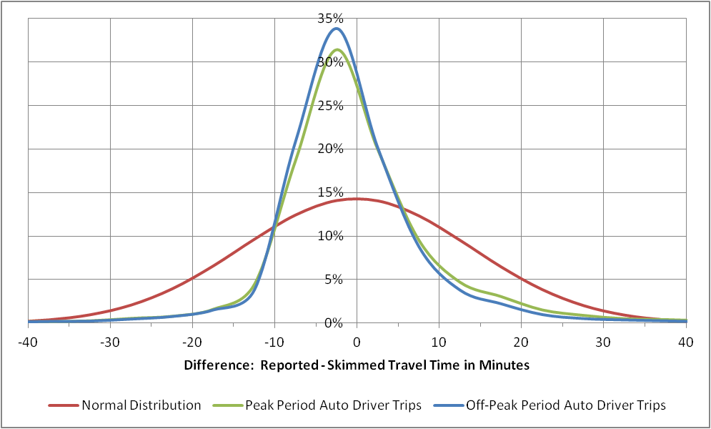
Highway Travel Times – Houston

Slide 35
Highway Travel Times – Houston
Implications of results
Skimmed travel times tend to overestimate reported times → modeled speeds too slow
No huge outliers identified
Other findings
Analysis of results useful in identifying outliers
Observations with obvious reporting problems
Removed from model estimation dataset
Adjusted terminal times
Mean = -0.11 minutes
SD = 13.9 minutes
Median = -1.9 minutes
Reported time < skimmed = 60.7%
Reported time >= skimmed = 39.3%

Slide 36
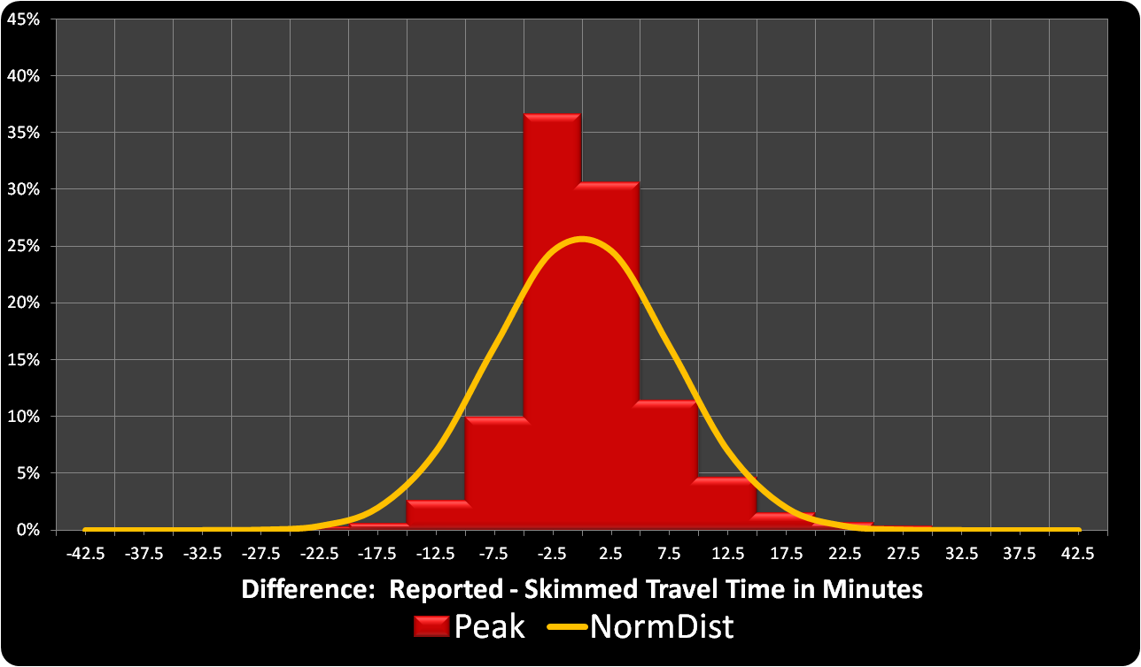
Highway Travel Times – Denver

Slide 37
Highway Travel Times – Denver
Implications of results
Skimmed travel times tend to underestimate reported times → modeled speeds too fast
No huge outliers identified
Other findings
Analysis of results useful in identifying outliers
Observations with obvious reporting problems
Removed from model estimation dataset
Adjusted terminal times
Mean = 0.8 minutes
SD = 7.6 minutes
Median = -0.2 minutes
Reported time < skimmed = 50.2%
Reported time >= skimmed = 49.8%

Slide 38
Summary
Demonstrated Several New Validation Checks
Disaggregate or semi-disaggregate in nature
Easy to apply
Provide information regarding quality of observed data being used for activity-based model estimation
Removal of outliers from estimation data sets

