Slide 1
Traffic and Revenue Forecasting for the Ohio Turnpike Asset Evaluation
TRB Planning Applications Conference
Columbus, OH
May 7, 2013
Presented by:
Gregory D. Erhardt, Parsons Brinckerhoff
With:
Tara Weidner, Oregon Department of Transportation
Fintan Geraghty, Parsons Brinckerhoff
Brad Ship, Parsons Brinckerhoff
Howard Wood, Parsons Brinckerhoff
Alistair Sawers, Parsons Brinckerhoff
Youssef Dehghani, Parsons Brinckerhoff

Slide 2
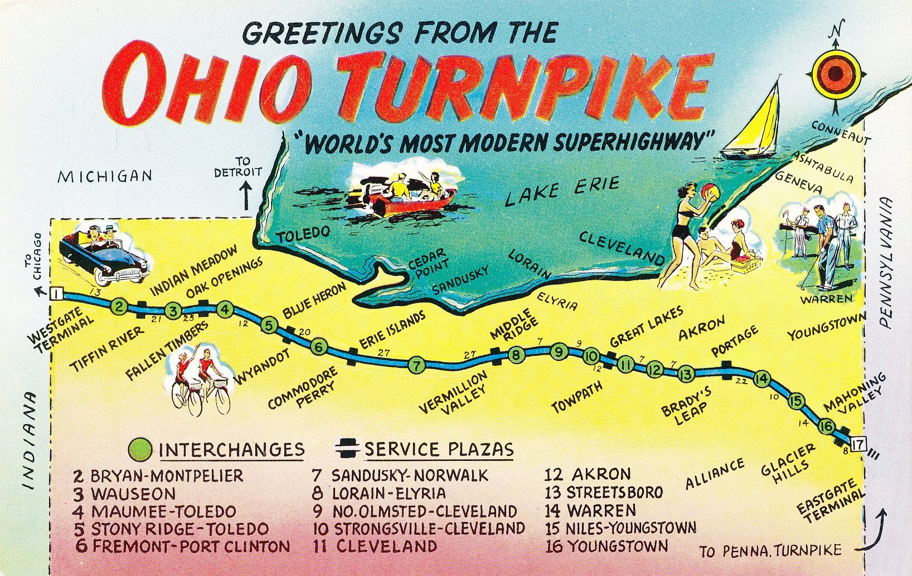
Ohio Turnpike
Source: Ohio Natural Color Card Co

Slide 3
Ohio Turnpike
241 mile toll facility across northern Ohio
Largely inter-city route listed as I-80/I-90
~$250 million in revenue in 2012
Trucks are 20% of VMT, but half of revenue
Long history of historic data, including toll increases and decreases
Operated by the Ohio Turnpike Commission (OTC)
Statewide shortfall of transportation funds

Slide 4
Options
Status Quo with Increased Bonding Capacity
OTC retains governance
But allowed to borrow against future revenue growth
Public Option
Closely align OTC with Ohio DOT
Potential operating cost savings
Option to issue new bonds to fund highway projects elsewhere
Public Private Option
Up to 50 year lease to concessionaire
Toll rates and maintenance investments written into contract
State gets up-front cash or share of revenue
Source: Ohio Turnpike Opportunity Analysis: Final Report

Slide 5
Assumed toll rates
Source: Ohio Turnpike Opportunity Analysis: Final Report

Slide 6
Outline
Part 1: Methods and Data
Statewide model
Rapid response model
Backcast validation
Part 2: Planning Questions
How much revenue can be generated?
How much diversion will occur onto state highways?
What about local residents paying the toll on a daily basis?
What risks are associated with these forecasts?

Slide 7
Methods
Let’s get started!

Slide 8
Forecasting Approach
Statewide Model
Initial diversion curves
Calibration
Baseline traffic growth in 5-year increments
Average weekday conditions
Composition of traffic
Origins and destinations
Diversion to parallel routes
Rapid Response Model
Annual revenue stream
CPI adjustment
ETC vs. cash
Local exclusions
Tests of many small changes

Slide 9
Diversion Curves

Slide 10
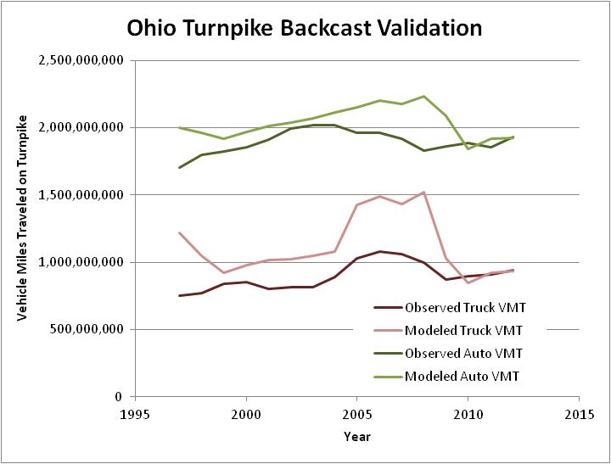
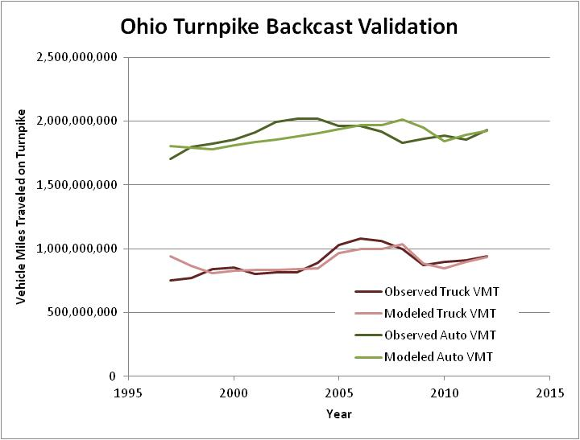
Backcast Validation
Value of Time too low:
$17/hr for autos
$30/hr trucks (class 5)
Value of Time just right:
$22/hr for autos
$40/hr trucks (class 5)
1997-2012 Backcast of Ohio Turnpike VMT

Slide 11
Calibrated Values of Time
Source: Ohio Turnpike Opportunity Analysis: Final Report
ETC value of time 10% higher

Slide 12
How much revenue can be generated?
It depends on the toll rates…

Slide 13
Resulting Revenue
Present value of upfront proceeds and operating cash flow:
Status Quo: $1.4 billion
Public Option: $2.1-$2.5 billion
Public-Private Option: $3.3-4.0 billion
Source: Ohio Turnpike Opportunity Analysis: Final Report

Slide 14
How much diversion will occur onto state highways?
2-lane facilities are less able to handle accommodate heavy trucks

Slide 15
Diversion Analysis
Source: Ohio Turnpike Opportunity Analysis: Final Report

Slide 16
Diversion Analysis
Source: Ohio Turnpike Opportunity Analysis: Final Report

Slide 17
Diversion Analysis
Source: Ohio Turnpike Opportunity Analysis: Final Report

Slide 18
What about local residents paying the toll on a daily basis?
Including a local exclusion from tolls?
Should the money get spent in northern Ohio or throughout the state?

Slide 19
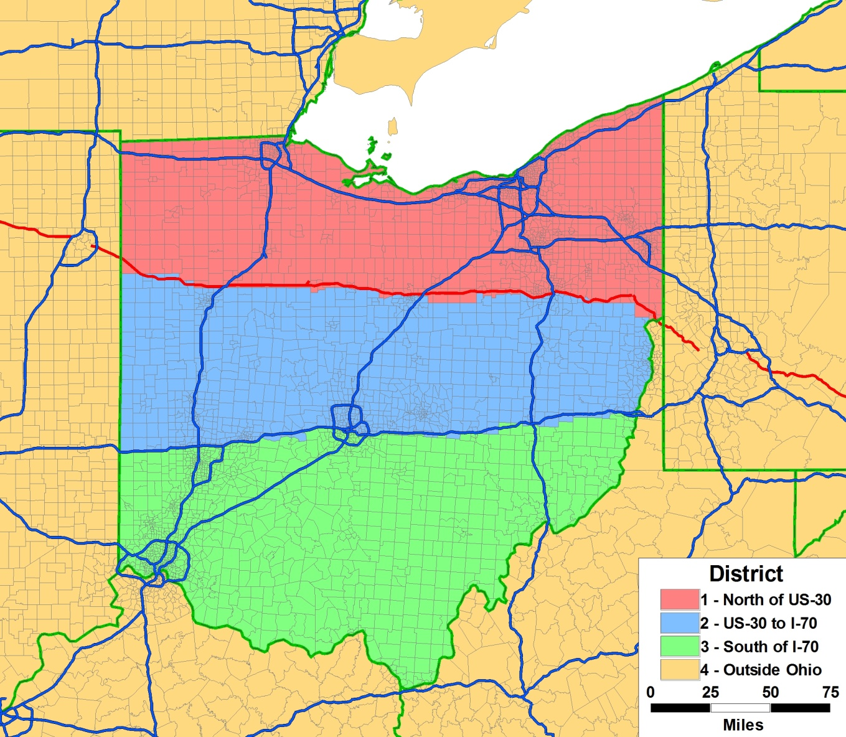
Traffic by Origin and Destination
Trucks
69% through trips
17% with O or D north of US 30
7% travel just one segment
Autos
31% through trips
51% with O or D north of US 30
24% travel just one segment
Source: Ohio Turnpike Opportunity Analysis: Final Report

Slide 20
What risks are associated with these forecasts?
How sure are we that we can cover the bonds?

Slide 21
Travel Markets
Autos
Short-Distance Resident Trips (SDT)
Long-Distance Resident Trips (LDT)
Visitor Trips (VM)
Through Trips (EE)
Trucks
Short-Distance Trips (DCOM)
Long-Distance Trips (ACOM)
Through Trips (ACOM)
37% of traffic
10% of traffic
20% of traffic
11% of traffic
22% of traffic
100%
Source: Ohio Turnpike Opportunity Analysis: Final Report

Slide 22
Sensitivity Tests
0.5X and 2.0X employment growth in Ohio and surrounding counties
0.5X and 2.0X household growth in Ohio and surrounding counties
0.5X and 2.0X growth in auto through trips on the Turnpike
0.5X and 2.0X growth in commodity flows to/from locations outside Ohio (which drive the long-haul trucks)
Source: Ohio Turnpike Opportunity Analysis: Final Report

Slide 23
Sensitivity Test Results
Public-Private option assumes a higher willingness to take on risk
Source: Ohio Turnpike Opportunity Analysis: Final Report

Slide 24
Conclusions
What did we learn?

Slide 25
Conclusions – Methods
Statewide model and rapid response model complement each other
Backcast validation allowed refinement of values of time and overall forecasting methodology
Risk analysis confirms:
Significance of long-distance flows
Exposure to national economic and freight trends

Slide 26
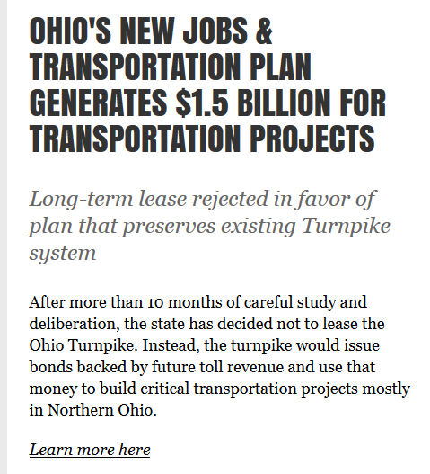
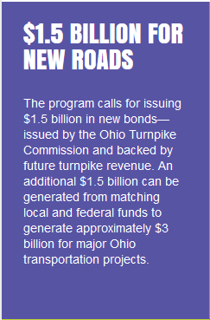
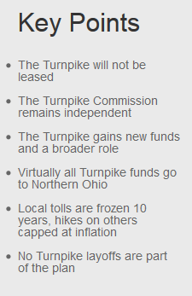
Conclusions – Planning Questions
Source: http://www.ohturnpikeanalysis.com/

Slide 27
Acknowledgements
Many thanks to:
KPMG Team
Ohio DOT
Ohio Turnpike Commission
References
Ohio Turnpike Opportunity Analysis: Final Report. Prepared for the State of Ohio by KPMG Corporate Finance LLC, December 12, 2012
Accessed at http://www.ohturnpikeanalysis.com/

Slide 28
Questions?
Greg Erhardt
Parsons Brinckerhoff
415-307-6974
erhardt@pbworld.com

