Slide 1


Comparative Analysis of Random-digit-dialing and Address-based Household Travel Surveys
Sanghoon Son and Asad Khattak
(Old Dominion University)
Paul Agnello and Ju-Yin Chen
(Virginia Department of Transportation)
14th TRB National Transportation Planning Applications Conference, Columbus, OH, 2013
Notes:
Cell phone=>Mobile phone

Slide 2
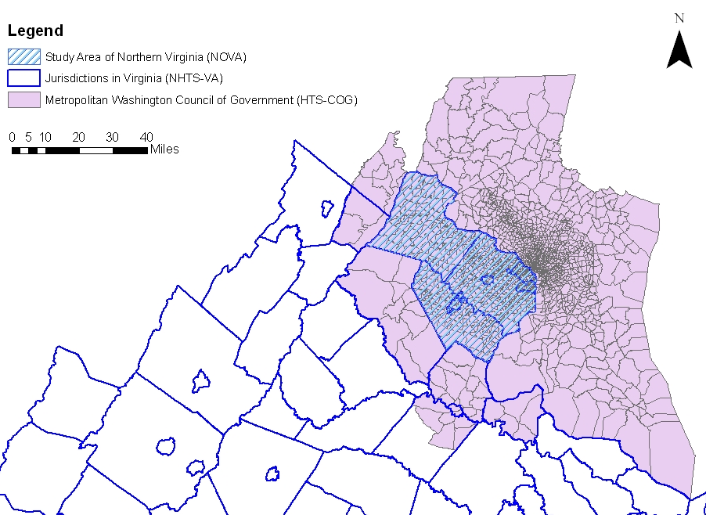
Background
1. 2009 National Household Travel Survey Virginia Add-on (NHTS-VA)
2. 2008 National Capitol Region Household Travel Survey (NCRHTS)
Washington D.C.
N=11,436
Virginia
N=15,231
Study Area

Slide 3
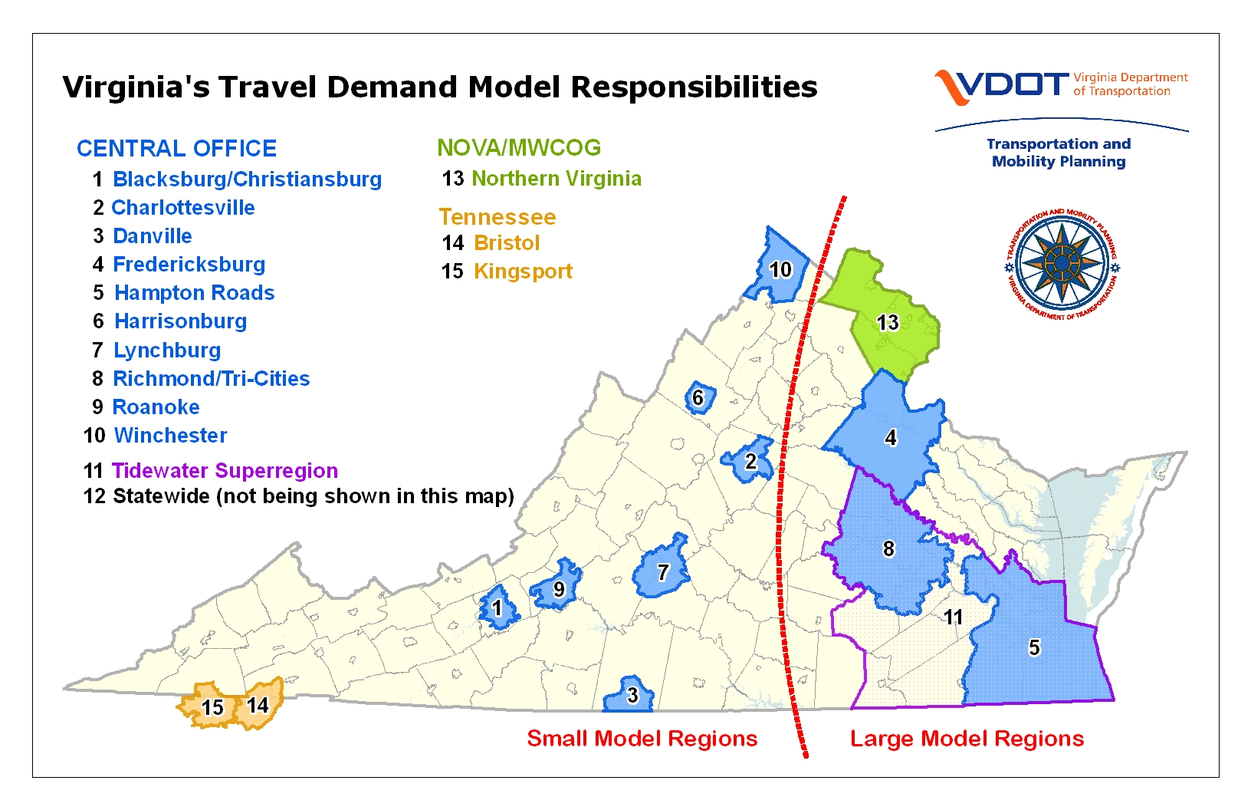
Virginia Travel Demand Models
Most NHTS-VA surveys conducted in Blue Model Regions

Slide 4
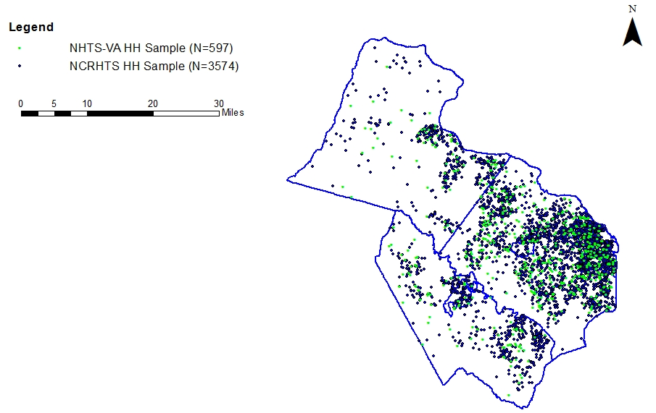
Survey Sample Size Comparison
Northern Virginia
NHTS-VA (N=597)
NCRHTS (N=3,581)

Slide 5
Comparison of two surveys
 | NHTS-VA | NCRHTS
Area | State of Virginia | National Capital Region
Period | March 2008 – May 2009 | February 2007 - April 2008
Sampling | Landline telephone RDD | Residential mailing address
Stratification | 13 strata by MPO | 43 strata by jurisdiction & density
Contact | Telephone | Multimode (Mail +Telephone)
Interview | Computer assisted telephone interview | Computer assisted telephone interview
Incentive | Household ($5); travel dairy ($2) | Household with no landline phone ($50)
Target age | Age 5+ | All ages
Travel day | Monday to Sunday (start at 4 AM) | Monday to Friday (start at 3 AM)
Instrument | Comprehensive and long | Concise and short
Response rate | 28% | 8%

Slide 6
Address-based sampling
Address-based sampling (ADD)
  Includes mobile phone only households
  Using address database: Delivery Sequence File
  Covering 98% US Postal Service delivery points
  Advantage: wider coverage/easy to use external data
  Disadvantage: long turnaround time/low response rate
  Recent ADD travel surveys:
    National Capital Region (2008)
    Greater Cincinnati Region (2009)
    New York Metropolitan Area (2010)
Notes:
Covering 98% US Postal Service delivery points (Iannacchione et al. , 2003)

Slide 7
Objectives
Compare sample representativeness
  NHTS-VA: landline telephone households (RDD survey)
  NCRHTS: landline + mobile phone only households (ADD survey)
  Focus on socio-demographics
Compare travel behavior measurement
  NHTS-VA: comprehensive and long
  NCRHTS: concise, short, and based on TDM
  Focus on trip rates by mode
Notes:
Research questions are:

Slide 8
Socio-demographics: person level
NCRHTS → more younger individuals (aged 19-34) and Hispanics/Mexican (a.k.a. hard-to-reach groups)
Variable | Category | NHTS-VA (N=597) | NCRHTS (N=3581) | 2010 Census
Gender | Male | 48.5 | 52.7 | 49.3
 | Female | 51.5 | 47.3 | 50.7
Age group | 5-18 | 20.1 | 16.1 | 21.1
 | 19-34 | 10.7 | 17.9 | 24.0
 | 35-44 | 14.4 | 17.3 | 17.4
 | 45-54 | 20.7 | 17.8 | 16.5
 | 55-64 | 16.1 | 17.1 | 11.7
 | 65+ | 18.0 | 13.8 | 9.3
Race/ethnicity | White | 84.7 | 81.0 | 63.5
 | African American | 6.2 | 5.6 | 11.7
 | Asian Only | 7.2 | 5.6 | 13.5
 | Hispanic/Mexican | 0.8 | 5.2 | 6.6
 | Others | 1.1 | 2.6 | 4.7
Notes:
Landline telephone = RDD
Pooled sample = ADD

Slide 9
Socio-demographics: household level
NCRHTS → over-representation of single-person households
Variable | Category | NHTS-VA (N=597) | NCRHTS. (N=3581) | 2010 Census
Household size | 1 | 19.3 | 34.4 | 25.3
 | 2 | 38.4 | 35.9 | 30.3
 | 3 | 17.4 | 13.1 | 16.7
 | 4 | 15.7 | 11.4 | 15.5
 | 5+ | 9.2 | 5.2 | 12.2
Household vehicle | 0 | 2.6 | 3.6 | -
 | 1 | 22.9 | 37.1 | -
 | 2 | 48.2 | 42.6 | -
 | 3+ | 26.3 | 16.7 | -
Housing type | Single family detached | 66.8 | 49.9 | -
 | Single family attached | 16.9 | 21.4 | -
 | Multi-Family | 16.3 | 28.7 | -
Notes:
Landline telephone = RDD
Pooled sample = ADD

Slide 10
Travel behavior: descriptive analysis
NCRHTS → fewer auto & walk+bike trips, but more transit trips
Household | NHTS-VA (N=429) |  | NCRHTS (N=2,469)
 | Mean | Stdv. | Mean | Stdv.
Total trip rate | 8.87 | 6.28 | 7.80 | 6.09
Auto | 7.10 | 5.40 | 6.56 | 5.62
Transit | 0.23 | 0.77 | 0.35 | 0.86
Walk + bike | 1.22 | 2.07 | 0.58 | 1.53
Person | NHTS-VA (N=954) |  | NCRHTS (N=5,350)
 | Mean | Stdv. | Mean | Stdv.
Total trip rate | 3.99 | 2.54 | 3.60 | 2.52
Auto | 3.19 | 2.46 | 3.03 | 2.57
Transit | 0.10 | 0.47 | 0.16 | 0.56
Walk + bike | 0.55 | 1.12 | 0.27 | 0.83

Slide 11
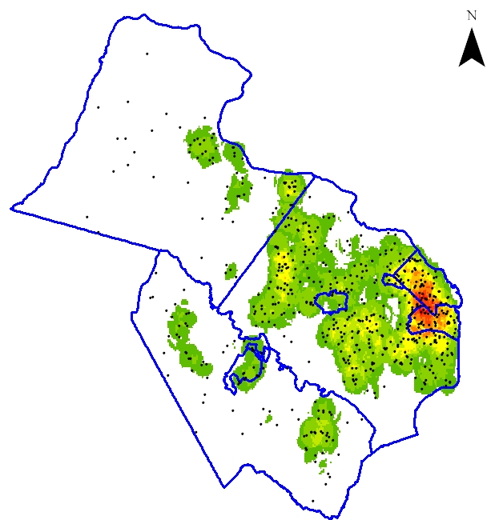
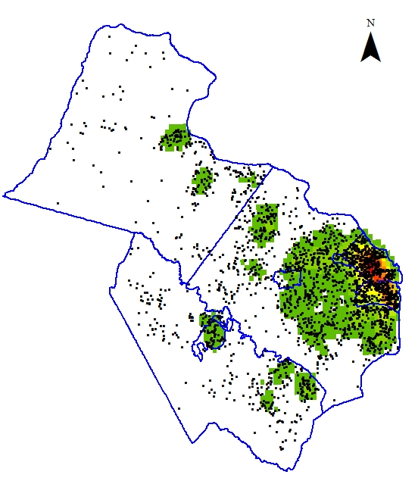
Travel behavior: spatial distribution
NHTS-VA & NCRHTS → fairly similar (concentrated near Washington D.C.)
NHTS-VA
(N=429)
NCRHTS
(N=2,469)

Slide 12
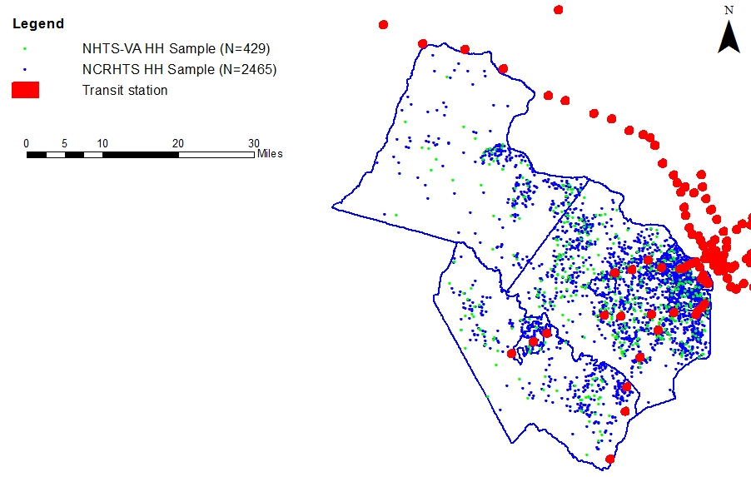
Travel behavior: transit accessibility
NHTS-VA & NCRHTS → transit accessibility varies by area

Slide 13
Travel behavior: statistical modeling
Negative binomial regression models control for:
  Household socio-demographics (e.g., household size)
  Household spatial distribution and transit accessibility
NCRHTS
  Fewer walk+bike (60%) trips and total (10%) trips
  Concise and short instrument → not necessarily better
Dep. Indep. | Auto trips |  |  | Transit trips |  |  | Walk+bike trips
 | Beta | IRR | p-val. | Beta | IRR | p-val. | Beta | IRR | p-val.
NCRHTS | -.033 | .968 | .373 | -.354 | .702 | .359 | -.933 | .393 | .001
Note: IRR=Incident Rate Ratio

Slide 14
Conclusions and lessons learned
Address-based sampling (ADD) survey
  Included mobile phone only households → more representative sample
Concise and short survey instrument
  Captured fewer trips → not necessarily better at measuring travel behavior
Lessons learned
  ADD surveys reduce non-coverage → next NHTS & regional surveys
  ADD + fine-tuned survey method → more representative sample
  Attitudinal questions + diary instruction → better survey instrument

Slide 15
Thank you
Q & A

