Slide 1
An Empirical Comparison of Microscopic and Mesoscopic Traffic Simulation Paradigms
Ramachandran Balakrishna
Daniel Morgan
Qi Yang
Caliper Corporation
14th TRB National Transportation Planning Applications Conference Columbus, OH • 8th May, 2013

Slide 2
Outline
Motivation
Dynamic Traffic Assignment
Challenges for model comparison
Methodology
TransModeler overview
Case study: Phoenix, AZ
Conclusion

Slide 3
Motivation
Dynamic Traffic Assignment (DTA)
  Demand: short departure time intervals (5-15 min)
  Supply: microscopic, mesoscopic, analytical, etc.
Microscopic (micro) vs. mesoscopic (meso)
  Micro: Detailed driving behavior, network response
  Meso: Aggregate/approximate traffic dynamics, control, queues
Need for objective comparison of micro, meso DTAs
  Emissions modeling, etc. require micro fidelity
    However, DTA often used interchangeably with meso
  Hardware, software advances facilitate micro DTA

Slide 4
Dynamic Traffic Assignment (1/2)
General DTA framework
[Source: Ben-Akiva, Koutsopoulos, Antoniou and Balakrishna (2010) “Traffic Simulation with DynaMIT”. In Barcelo (ed.) “Fundamentals of Traffic Simulation”, Springer.]

Slide 5
Dynamic Traffic Assignment (2/2)
Network loading (supply)
  Microscopic
    Small time steps (0.1 second)
    Car following, lane changing, reaction times
    Explicit models of traffic control, lane utilization
    Routing utilizes lanes, intersection geometry and delays
    Outputs: Detailed trajectories, realized capacities
  Mesoscopic
    Large time steps (several minutes)
    Macroscopic traffic dynamics e.g. speed-density functions
    Approximate models of signals, lanes, capacities
    Routing based on link-node representation
    Outputs: Aggregate link performance

Slide 6
Challenges for Model Comparison (1/2)
Traffic simulation tools differ significantly
  Software architecture
    Data structures, loop implementation, procedures
  Modeling features, assumptions, simplifications
    Vehicle and user classes, value of time (VOT)
    Network representation
      Lanes, lane groups, turn bays
    Shortest path, vehicle propagation algorithms
  Default parameters
  Visualization and output generation

Slide 7
Challenges for Model Comparison (2/2)
  Literature review indicates diverse tool-dataset combinations
  Comparison of existing studies is difficult
    Need for calibration to common traffic data
    Unclear methodologies for prior calibration
    Differing performance measures, thresholds
  Often impossible to replicate datasets across tools
    Limited documentation of algorithms, assumptions
    Missing data
      Example: “stick” network, missing lane geometry info
    Incompatible modeling assumptions
      Example: single VOT, restricted signal timing plans

Slide 8
Methodology
Eliminate errors due to tool differences
  Common platform for micro and meso
    Shared software architecture
    Consistent network representation logic
    Identical input formats
    Directly comparable outputs
  Common dataset
    Highway network
    OD matrices, vehicle classes
    Historical travel times, turn delays
  Common model settings
    Route choice model parameters, turn penalties, etc.

Slide 9
TransModeler Overview
Scalable micro, meso, hybrid simulation
Built-in Geographic Information System
  Network accuracy, model fidelity, charting
Explicit handling of complex traffic control
Intelligent Transportation Systems (ITS)
  High Occupancy Vehicle/Toll (HOV/HOT)
  Electronic tolls (ETC)
  Variable/Changeable Message Signs (VMS/CMS)
Dynamic Traffic Assignment (DTA)

Slide 10


Slide 11
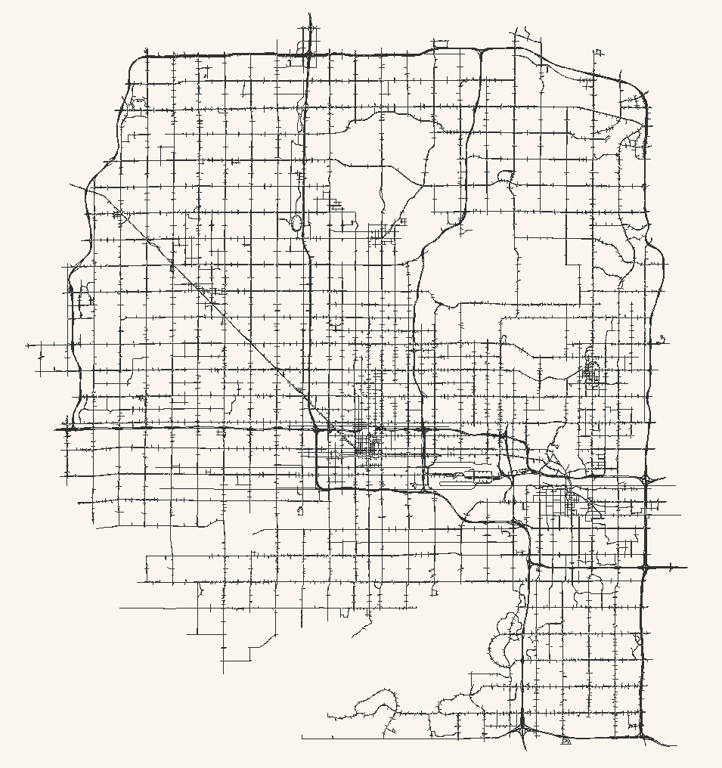
Case Study: Phoenix, AZ (1/5)
Central Phoenix
  Maricopa Association of Governments (MAG)
Spatial extent
  530 sq. miles; 890 zones
  17,000 nodes
  23,000 links; 35,000 segments
  1,800 signalized intersections
AM peak period
  6:00-9:00 AM
  812,000 trips

Slide 12
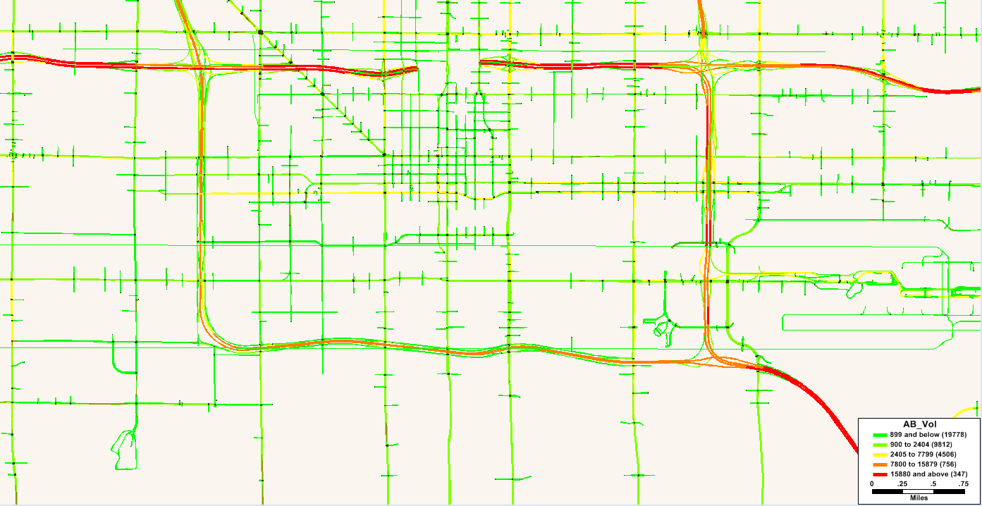
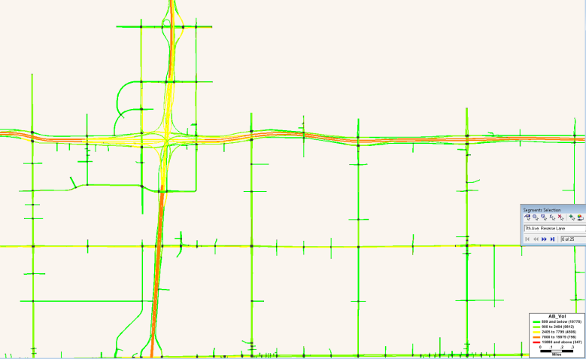
Case Study: Phoenix, AZ (2/5)
Micro model calibrated to match dynamic traffic count data
  Time-varying demand
  Congested travel times
  Turn delays
Validated against INRIX speeds
Calibration and validation in subsequent presentation

Slide 13
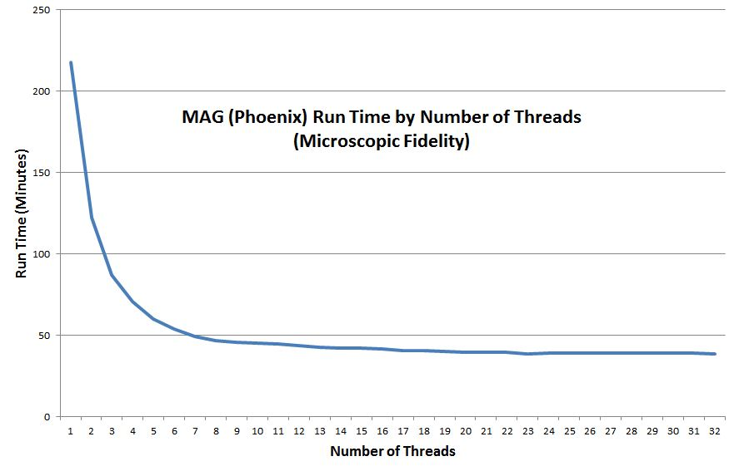
Case Study: Phoenix, AZ (3/5)
Micro fidelity run times
  3.1 GHz Intel Xeon Dual Core 64-Bit CPU, 64 GB RAM
  Averages from five replications

Slide 14
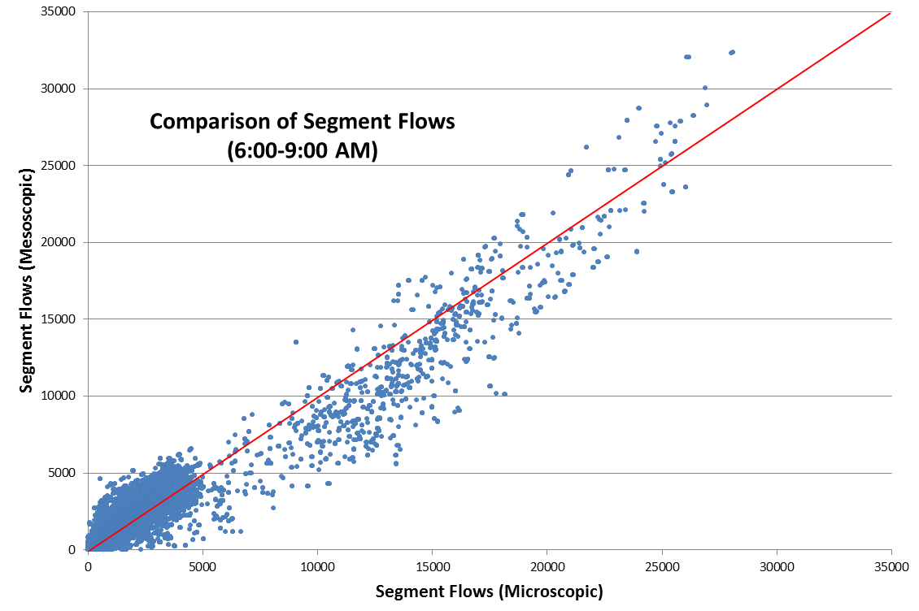
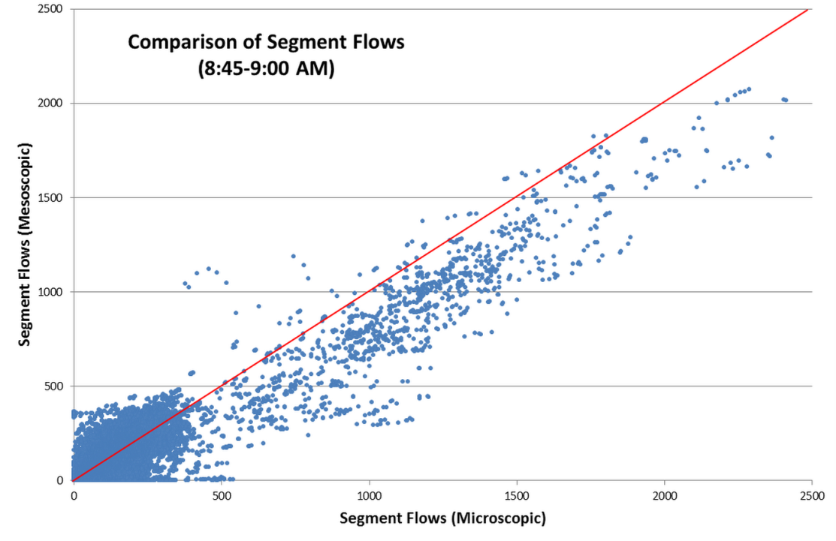
Case Study: Phoenix, AZ (4/5)
Comparison of segment flows
  Default node delay calculations in meso
  Indicates need for further capacity calibration in meso

Slide 15
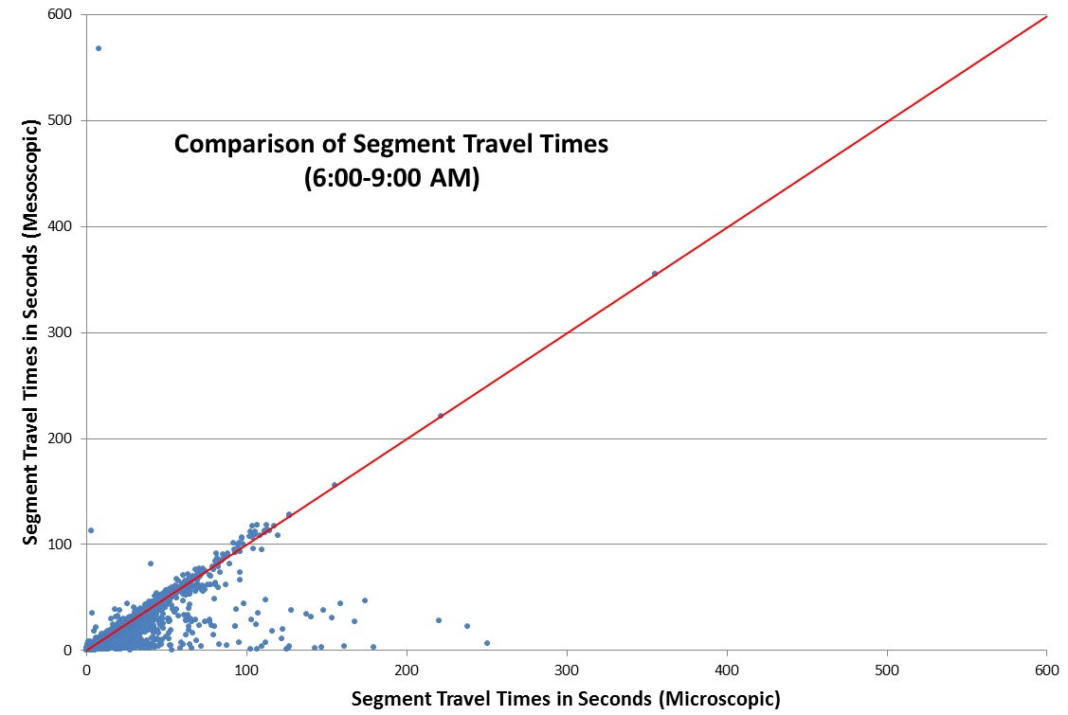
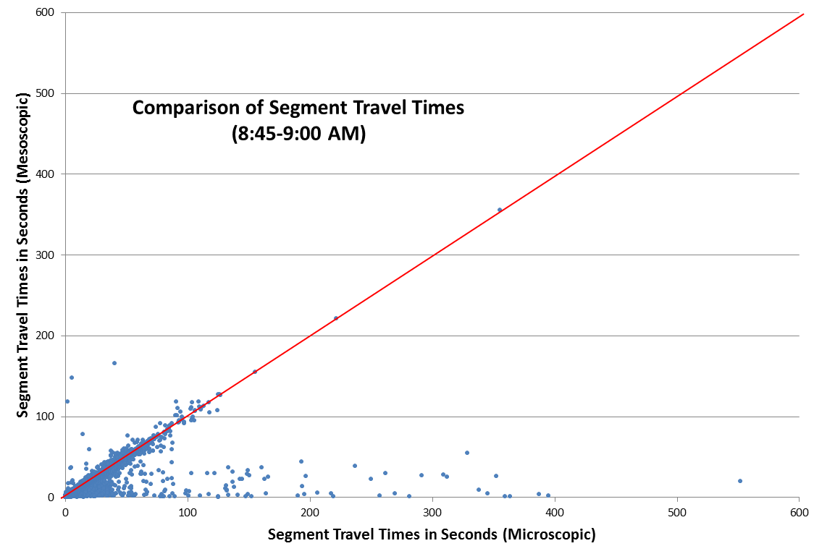
Case Study: Phoenix, AZ (5/5)
Comparison of segment travel times
  While meso is close, micro provides output fidelity

Slide 16
Conclusion
TransModeler
  Objective platform for comparing fidelities
Microscopic fidelity
  Feasible for planning applications
    Practical run times on desktop hardware
    Provides detail for modeling emissions, tolls, etc.
  Additional calibration burden for meso
    Needs more work to bring supply closer to reality
Next steps: more tests
  Compare queue lengths, point-to-point travel times
  Test different meso delay models
  Quantify variance from multiple runs

