Slide 1
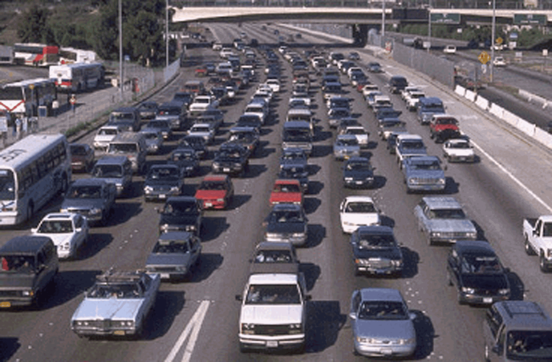
Development and Implementation of Congestion Pricing Triggers on Toll Roads to Manage Congestion
Yagnesh Jarmarwala Phani Jammalamadaka Michael Copeland
Maneesh Mahlawat
14th TRB National Transportation Planning Applications Conference
May 7, 2013
TRB National Planning Applications Conference

Slide 2
Overview
Background
Congestion pricing/capacity expansion triggers
Implementation process
Test scenarios/results
Summary

Slide 3
Background on Roadway Congestion

Slide 4
State of Roadway Congestion
Yearly delay per auto traveler
  14 hours (1982)
  34 hours (2010)
Congestion cost
per auto traveler
(2010 $)
  $310 (1982)
  $713 (2010)
  In most urban areas,
  congestion is expected
  to worsen.
*
*Ratio of the peak and off-peak travel times
Sources:
- 2010, 2011 Annual Mobility Report, Texas Transportation Institute Report
- David T. Hartgen and M. Gregory Fields, Building Roads to Reduce Traffic Congestion in America's Cities, Reason Foundation.
Notes:
1982 – yearly delay per auto traveler was 14 hours
2010 – yearly delay per auto traveler is 34 hours almost 2.5 times in comparison to 1982
The congestion cost per auto traveler has also doubled from 1982. In most urban areas congestion is expected to worsen.
Peak travel period in congested hours more than doubled from 1982 to 2007
Average annual delay per traveler is maximum in Los Angeles and Washington DC in 2007 but other urban areas are also experiencing annual delay greater than 40 hours per traveller.
Travel time index is expected to get worse for most urban areas by 2030.

Slide 5
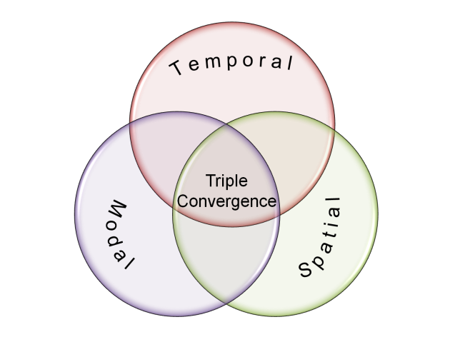
Why Congestion Pricing?
Increased roadway demand
  Alternative demand management strategies
Challenges to increasing roadway capacity
  Funding
  Air quality impacts
  Right of way, etc.
Increased roadway capacity results in “Triple Convergence”
  Temporal
  Spatial
  Modal
Congestion pricing is one of the tools available to address triple convergence
Source: Anthony Downs. Stuck in Traffic (1992), pp. 27-29
Notes:
The Texas Transportation Institute has estimated that rush-hour travelers in major metropolitan areas spent 3.6 billion hours in traffic jams in 2000--at a cost of about $67.5 billion. It is unlikely that the United States could ever "build its way out of congestion," even with massive increases in spending on highways. The reason is that greater road capacity--which initially permits greater speeds--tends to attract motorists who previously used other roads, traveled at off-peak times, took public transit, or moved farther out in the suburbs. Soon the road, despite its larger size, becomes as congested as it was before.

Slide 6
Roadway Congestion Pricing
A traffic demand management tool
Could eliminate discretionary trips and shift peak period trips to off-peak periods, alternative routes or other modes
Could assist with meeting air quality compliance goals
Types:
  Traditional toll facilities
  Managed lane facilities
  Cordon tolling
Could be very prevalent tool in future
Congestion pricing based triggers can aid in meeting national performance goals (MAP-21)
Notes:
In this presentation we will be focusing on Traditional toll rods. Typically these facilities have fixed toll rate and no congestion pricing or variable pricing

Slide 7
Where congestion pricing is successfully implemented?
Airline industry , airports, parking
Cell phone industry
Shipping and logistics industry
Utilities like electricity industry
Movie theaters
Museums, hotels and resorts
Congestion pricing can be feasible on toll roads

Slide 8
What are types of congestion pricing on roadways?
Facility specific
  Traditional toll facilities
  Managed lane facilities
  Cordon tolling
Pricing specific
  Static pricing
  Dynamic pricing
Congestion pricing could be a prevalent tool in future

Slide 9
Congestion pricing & Capacity expansion triggers

Slide 10
Trigger Mechanism
Notes:
Determine triggers for implementation of
Congestion pricing
Capacity expansion
Performance measures
Average speed/delay
Traffic density
Level of service
Traffic flow rate
Queue length
Emissions
Reliability
Revenue, etc.
Length of the roadway to be considered
Duration to be considered

Slide 11
Congestion Pricing Triggers
Sample triggers and pricing regimes
    First pricing trigger (FPT)
      10 mph below posted speed over a two hour period on a 5 mile section
    Second pricing trigger (SPT)
      20 mph below posted speed over a two hour period on a 5 mile section
    Preliminary congestion pricing regime (P-CPR)
      Implemented after FPT
    Aggressive congestion pricing regime (A-CPR)
      Implemented after SPT, after PCPR is already in place
    Capacity expansion trigger (CET)
      20 mph below posted speed over a two hour period on a 5 mile section after the ACPR is implemented

Slide 12
Congestion Pricing Triggers
Notes:
Speed is moving average based on duration of 3 months (for eg)

Slide 13
Implementation process

Slide 14
Stakeholders

Slide 15
Congestion Pricing Planning

Slide 16
Congestion Pricing Implementation

Slide 17
Test Scenarios/Model Results

Slide 18
Test Model
1,029 Zones
7,476 Links
Urban area highway model
Traditional toll facility system
  Toll facility 1
    Segments 1,2,3
  Toll facility 2
    Segments 4,5
Time periods analyzed
  AM Shoulder 1 (1 hour)
  AM Peak (1 hour)
  AM Shoulder 2 (1/2 hour)
Notes:
Multidimensionality of congestion pricing process which involves congestion price levels (tolls), response to tolls (behavior TT) two states people changing travel time or shift from toll to other mode.
Test was to analyze performance of the facility and hence the capacity needs of the facility.
Strategically chosen so the section ends are major cross streets or freeways. The section lengths are not too large or not too small.

Slide 19
Modeling Methodology
AM period traffic assignments
Binary choice (toll path vs. non-toll path) model
  Embedded in equilibrium assignment
Probability of toll road usage dependent on
  Toll rates
  Congestion/travel time savings
  Traveler values of time
  Operating costs

Slide 20
Scenarios Tested
The above alternatives were tested under
No expansion scenario
After expansion of sections 1,4, and 5

Slide 21
AM Peak Delay (Before Expansion)

Slide 22
System Traffic (Before Expansion)

Slide 23
System Revenue (Before Expansion)

Slide 24
AM Peak Speed (Before Expansion)

Slide 25
System AM Peak Speed (Before Expansion)
Notes:
AM speed impact due to changes in trip tables. This is temporal and modal shift in Trips + any generation of new trips
This scenario is tested to analyze the impact that would occur due to the shifting of trips (demand of facility) to other modes or reduction of number of trips made during that time period.
At base toll rate and base TT speed of the system is 35 mph.
Other initiatives by MPO or policies can assist shifting the demand (trips from the facilities)
It might take too high toll rate to increase speed limit back to posted speed limit hence we tested expansion scenario.

Slide 26
AM Peak Speed (After Expansion)
AM Peak Speed (Before Expansion)
Notes:
Performance of speed with increase in toll rates after expansion of section 1 of facility 1 and sections 4 and 5 of facility 2
We see that speed have increased in spite of expansion. When we increase toll rate by 50% most of the speed on facilities shows improvement.
We can notice that section 2 speeds decreases because of the expansion of section 1
In expansion phase PCPR at 50% toll increase and in case of no expansion phase PCPR at 100% toll increase.

Slide 27
System AM Peak Speed (Before Expansion)
System AM Peak Speed (After Expansion)
Notes:
AM speed impact due to changes in trip tables.
At base toll rate and base TT speed of the system is 45 mph. System still needs increase of tolls by 100% to increase the speed equal to posted speed limit.
Other initiatives by MPO or policies can assist shifting the demand (trips from the facilities)

Slide 28
T&R By Facility (Before Expansion)
Notes:
We can see that at 100% toll increase facility 1 shows decline in revenue. It is important to note that toll increases should not occur greater than toll revenue maximum point. Toll sensitivity maximum point and local stakeholders.

Slide 29
T&R By Facility (After Expansion)
Notes:
You will not find high impact of toll rate due to the fact that there is no alternative.
Public resistance to high toll rate, pricing may take you to only one level and not fully accomplish the goals. Hence expansion of the facility might have to occur. It has to be a collaborated effort with local agencies to achieve goals.

Slide 30
Summary

Slide 31
Summary
Need for establishing triggers
  Congestion pricing
  Facility expansions
Trigger criteria
  Performance measures such as average speed, delay, revenue, etc.
  Duration of monitoring
  Roadway section lengths
Implementation process

Slide 32
Summary
Congestion pricing example
  Impacts on a toll system
    Toll rate changes, trip table changes and expansion
    Speeds, delay, transactions and revenue
Future research
  Explore impacts on other performance measures such as density, queue lengths, emissions, etc.
  Revenue neutral congestion pricing strategies
    Impacts of off-peak discounts

