Slide 1

Matching Real-world Conditions: How Do We Calibrate Capacity, OD Demand, and Path Flow in a Mesoscopic Traffic Simulator?
Jeffrey Taylor & Xuesong Zhou
University of Utah
14th TRB National Transportation
Planning Applications Conference
May 8th, 2013
Columbus, Ohio

Slide 2
Motivation: Sharing Lessons Learned
Recent work with network conversion & calibration
  Macro-to-Meso conversion
  Network calibration with multiple data sources
    Volume, travel time, etc.

Slide 3
Motivation: Sharing Lessons Learned
Recent development work on DTALite
  Lightweight open source DTA model
Intimate knowledge of traffic simulation model details
  Shortest path, queuing, merge models, capacity constraints, intersections…
Disclaimer: This discussion is driven by our experience with DTALite, but may also be relevant to other simulation models

Slide 4
Outline
Introduction to DTALite
Understanding Capacity
  Types of capacity
  Network coding and representation
Diagnostic Procedures for Calibration
  Parameters & sensitivity
OD Demand & Path Flow Adjustment
Notes:
Since we are working specifically with DTALite, we’ll provide a brief introduction to DTALite and its traffic simulation model.

Slide 5
Brief Intro to DTALite
Open source DTA model, GUI
code.google.com/p/nexta/
Agent-based simulation
Capacity-constrained model
Traffic simulation models
  BPR, volume-delay functions
  Point Queue
  Spatial Queue (with jam density)
  Newell’s Model
Notes:
DTALite is an open source DTA model. It is an agent-based simulation with capacity constraints. The capacity constraints make calibrating network capacities a very important step in the process of building our models. Additionally, we have multiple traffic simulation models with which to move vehicles through the network. We can use some of these different models for diagnostic purposes, where different models relax different capacity constraints.

Slide 6
Traffic Simulation
Notes:
In general, the traffic simulation assigns vehicles to different paths based upon link travel time. The physical process of moving vehicles works in a two-step process. First, a vehicle is moved across a link during the link pass, and then moved between links at the node during the node pass. Link travel times from the traffic simulator are fed to the shortest path model for path selection. The new paths are then fed back into the traffic simulator in the next iteration.

Slide 7
Traffic Simulation Details
Outflow capacity
Inflow capacity
Storage capacity
Exit Queue
Entrance List
Inflow Capacity
Outflow Capacity
Storage Capacity

Slide 8
Traffic Simulation Details
Node transfer
Node Transfer
Node
Check Outflow Capacity
Check Inflow Capacity
Check Storage Capacity
Notes:
Going into more specifics, let’s take a closer look at the link pass and node pass. The capacity constraints are enforced at both ends of each link. At the beginning of the link, the entrance list keeps track of vehicles entering the link, enforcing the inflow capacity constraint. During the link pass, the vehicles are moved between the entrance list and the exit queue. The exit queue keeps track of vehicles waiting to leave the link, enforcing the outflow capacity constraint. Vehicles are then moved between the exit queue and the entrance list of the next link during the node.

Slide 9
Difficulties in Calibrating Capacity
Different types of capacity
  Inflow capacity, Outflow capacity, Storage capacity
  Simulation parameters
Exit Queue
Entrance List
Inflow Capacity
Outflow Capacity
Storage Capacity
Notes:
As you can see, at the level of detail in this model, capacity is one of the most important parameters requiring calibration. In addition to traditional concepts of capacity in macroscopic models, we have multiple types of capacity, and those capacities are influenced by simulation parameters, network coding, and network representation.

Slide 10
Traffic Flow Model (on the Link)
Newell’s simplified kinematic wave model
  Triangular flow-density relationship
  Free flow speed, jam density, backward wave speed

Slide 11
Traffic Flow Model (on the Link)
Queue propagation
  Inflow capacity = outflow capacity
Inflow Capacity
Outflow Capacity

Slide 12
Difficulties in Calibrating Capacity
Different types of capacity
  Inflow capacity, Outflow capacity, Storage capacity
  Simulation parameters
Network coding and representation
  Geometry
  Merge/diverge
  Intersections
Notes:
Additionally, capacities are utilized differently subject to different conditions. For example, merge points and intersections receive special handling to consider the special effects those locations have on traffic flow.

Slide 13
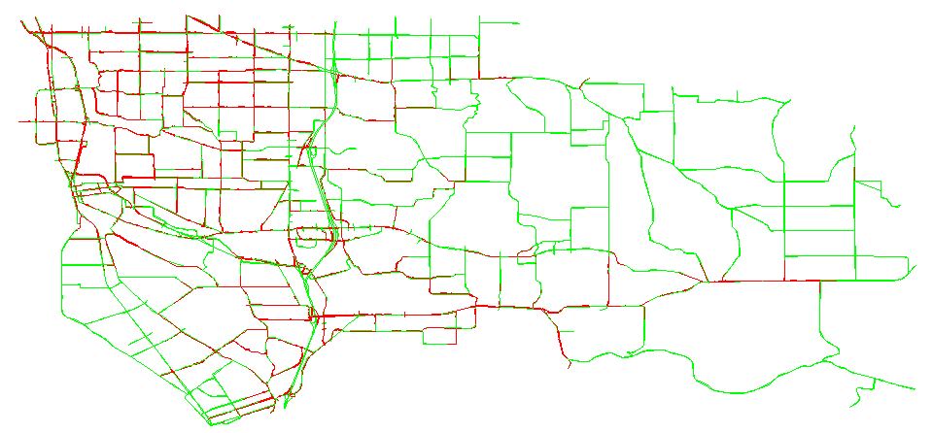
Converting from Macro to Meso
Directly import important network attributes
  Capacity, speed, number of lanes, etc.
First Simulation Run:
Wide-scale Gridlock (Red)
Notes:
In our first example, let’s take a look at a simple macroscopic model that was converted for use with our mesoscopic model. We directly imported the network attributes, including capacity, speed, and the number of lanes. This creates an underlying assumption that the macroscopic capacities are compatible with the capacities in our mesoscopic model. In effect, we are using the macroscopic capacities for the capacity constraints in the DTA model. In our first simulation run, with very few adjustments, we found wide-scale gridlock, shown in red here. As you can see, they were appropriate in some locations in this model, mostly on freeways, but not so much in others. In this case, ramp capacities were causing significant queuing, and were creating more queuing in the arterial street network.

Slide 14
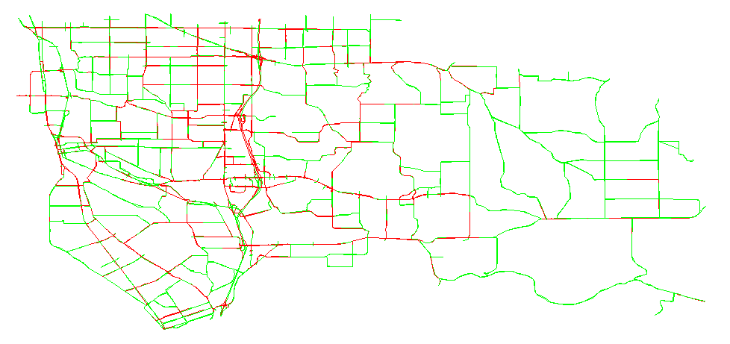
Second Attempt
Increased ramp outflow capacity
  Still experiencing significant queuing

Slide 15
Merge Models
Distribute inflow capacity to upstream links
  Lane & demand-based methods
80%
Node
Available Inflow Capacity
20%

Slide 16
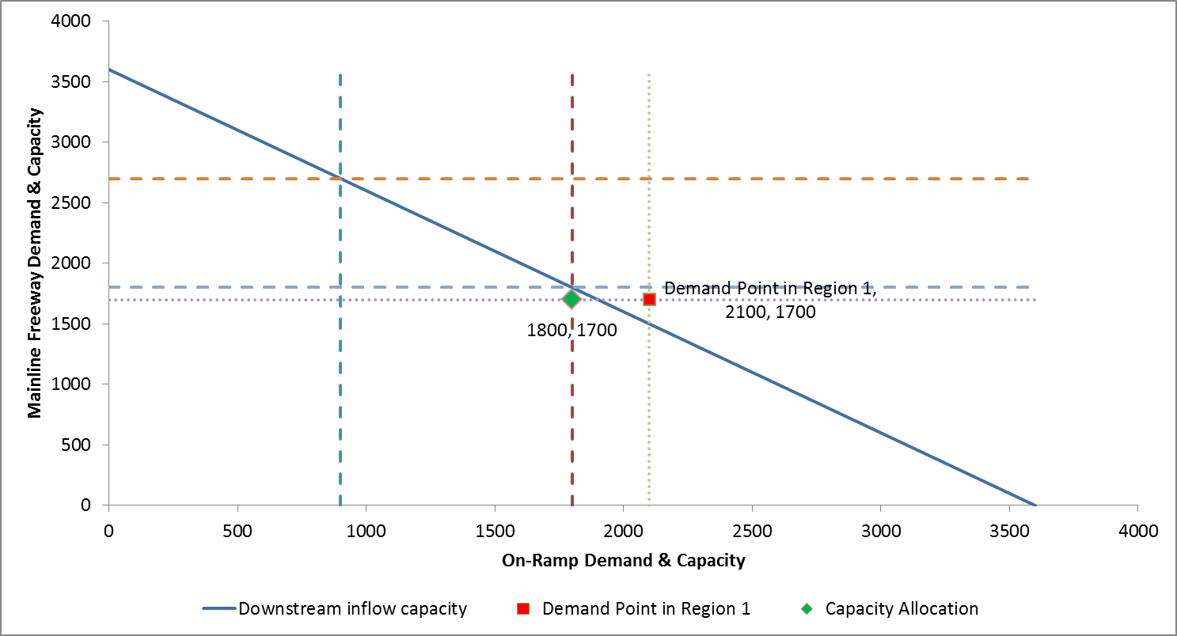
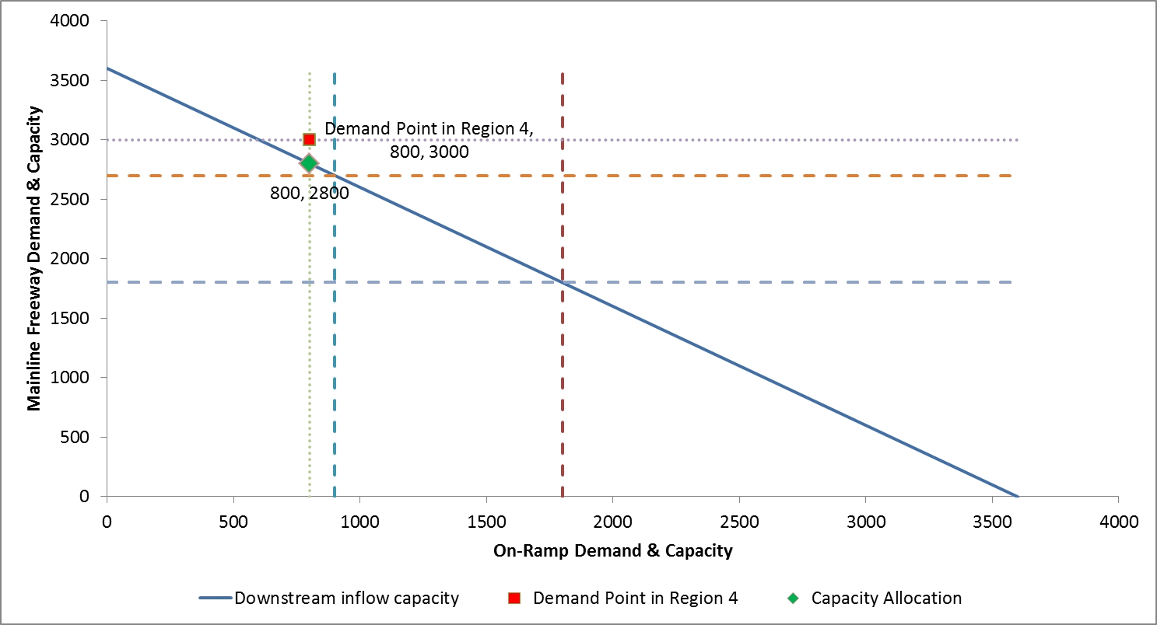
Inflow Capacity Distribution
Dynamic capacity distribution

Slide 17
Diverge Models
Different conditions by lane
First-In-First-Out (FIFO) constraint
  Relaxation to prevent extreme bottlenecks
Node

Slide 18
Inflow/Storage Capacity?

Slide 19
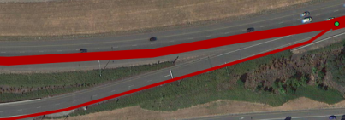
Geometry Details
Two-lane ramp, coded with one lane
  Reasonable outflow capacity
Potential issues
  Underestimated inflow capacity
  Underestimated storage capacity
Notes:
In this example, we find an interesting two-lane on-ramp entering the freeway. It begins as a two-lane facility, and enters the freeway as a one-lane facility. The ramp link was coded with one lane, which accurately represents the outflow capacity at the end of the link. However, since we’re missing a lane over a portion of the link, we’ve underestimated both the inflow capacity and storage capacity.

Slide 20
Traffic Flow Model Sensitivity

Slide 21
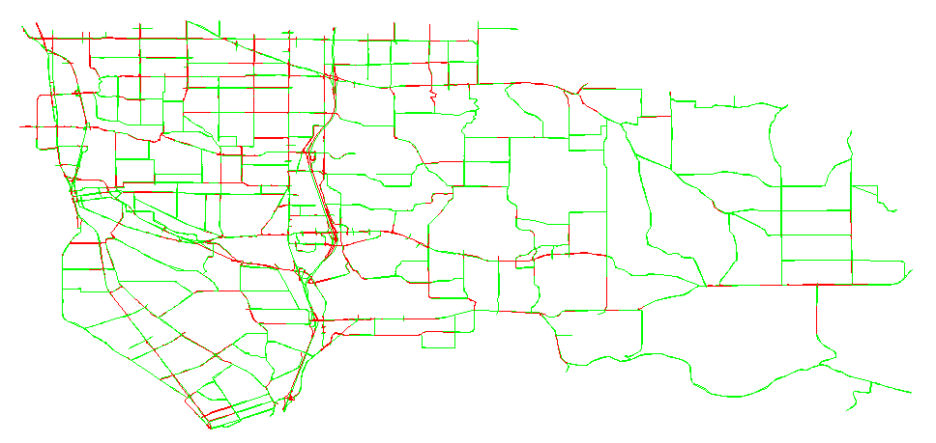
Third Attempt
Reset outflow capacity, adjusted inflow & storage capacity

Slide 22
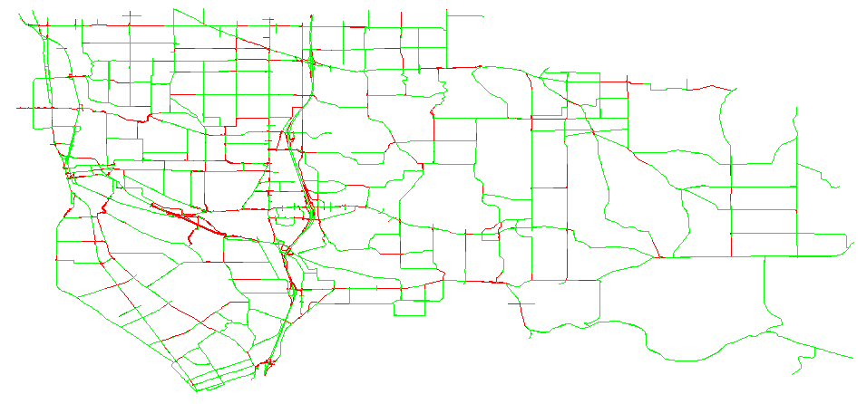
Combined Modifications
Combination of adjusting outflow and storage capacity appears more reasonable

Slide 23
Signalized Intersections
Simplified representation in DTALite
  Effective green time, saturation flow rate, movement-based capacity
  Relaxed inflow constraints
Data sources
  Manual input/adjustment
  Signal timings from another model
  QEM for signal timing estimation

Slide 24
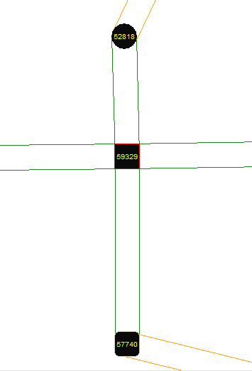
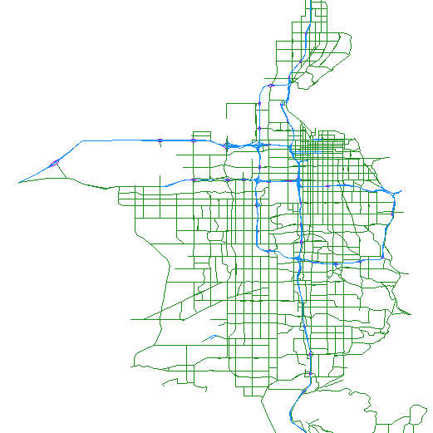
Signalized Intersections
Model sensitivity
  Location dependent
  Related to assignment model?
Initial testing with QEM
  SLC network
  Requires further testing

Slide 25
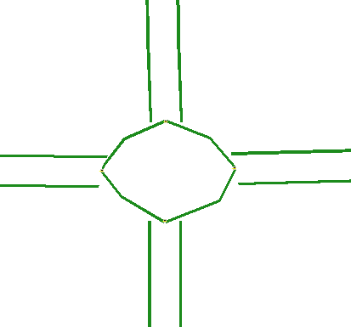
Roundabouts
Link lengths limited by simulation time interval
  Travel time < interval
Difficulties
  Merge priority, delay
  Queue storage

Slide 26
OD Demand Estimation
Combined simulation/estimation model
Gradient-based approach
  Calculate travel time difference from changing one unit of flow
  Dependent upon signals, capacity
Recommendation: Smaller adjustment %

Slide 27
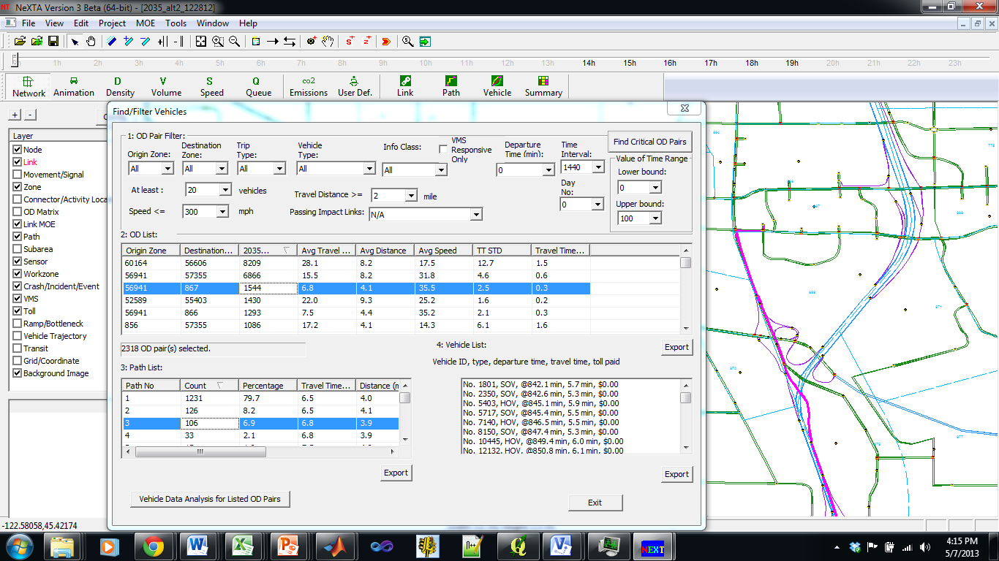
Path Flow Adjustment

Slide 28
Recommendations
Macroscopic capacity may not be appropriate for mesoscopic capacity constraints
Understand the traffic flow model
  Understand limitations, special cases
Adjust capacity before OD demand, path flow
Start with fewer capacity constraints to remove possible unrealistic bottlenecks
  Point queue → Spatial queue → Shock wave → Speed-density relationships

Slide 29
Questions?

