Slide 1
Development of a New Commercial Vehicle Travel Model for Triangle Region
14th TRB Planning Applications Conference, Columbus, Ohio
May 7, 2013
Bing Mei and Joe Huegy
Institute for Transportation Research and Education
North Carolina State University

Slide 2
Outline
2010 commercial vehicle travel survey
Trip data imputation
Trip generation models
Trip destination choice models
Notes:
The topics I am going to cover include the commercial vehicle survey data collected in 2010 in the region, some data imputation work, and followed by trip generation model and destination choice model development work.

Slide 3
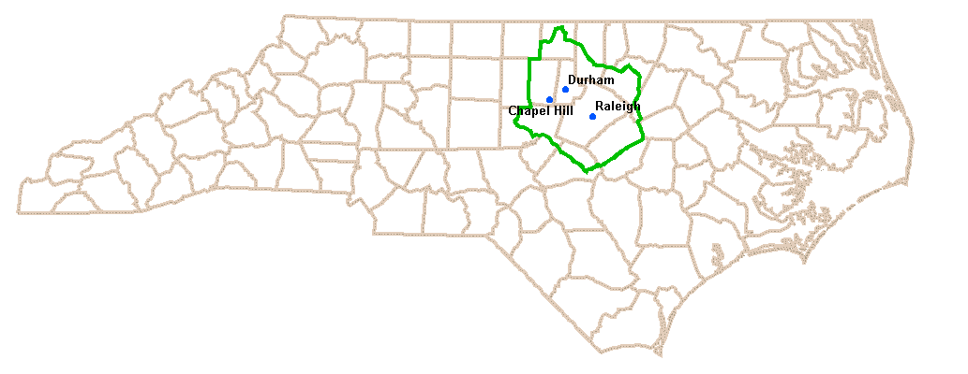
Triangle Region and Model
Population: 1.6 million (2010)
Employment: 0.85 million (2010)
Area: 3,430 miles²
Trip-based model
Traffic Analysis Zones:
  Internal: 2,579 / External: 99
Highway Network in Model:
  7,400 miles
Notes:
Here is a figure showing the location and size of the Triangle region as well as a few statistics about the region and the regional model. The region has three major cities: Raleigh, Durham, and Chapel Hill, along with a few smaller cities and towns. The region has about 1.6 million people and .85 million employees. The Triangle regional model is a trip-based model, cover about 34 hundred square miles.

Slide 4
Survey Data
2010 Triangle Region commercial vehicle activity and travel survey
  Establishment-based survey
  500 business establishments surveyed in the region
  Collected a rich set of data:
    Establishment data: SIC code, number of employees, number of commercial vehicles by type, locations, etc.
    Vehicle data: Vehicle type, number of axles, vehicle weight, beginning and ending odometer readings, etc.
    Activity/trip data: arrival and departure times at each activity location, activity location coordinates, trip purpose, goods delivered, weight of the goods, etc.
Notes:
A commercial vehicle survey was conducted in 2010 and collected data from 500 business establishments in the region. According to the local employer database, there were about 80 thousand employers in 2010. And according to DMV registration records, there were about 13 to 14 thousand businesses owning commercial vehicles in the region. A rich set of data items are collected, including information about business establishments, vehicles, and activities and trips, as you can see from the slide.

Slide 5
Survey Data (cont’d)
Items | Statistics
# establishments that completed CV travel survey | 486
# vehicles garaged at non-residence locations and operated by the establishments completing the survey | 2,793
# vehicles surveyed | 1,489
# vehicles that made trips on assigned survey day | 863
# trips reported | 5,669
# trips recorded in detail in travel diaries | 4,557
Average vehicles per business establishment | 5.75
Average daily trips per vehicle that completed the survey | 3.81
Average daily trips per vehicle that made trips on assigned survey days | 6.57
Notes:
This table shows some summary statistics derived from the survey data. Last three rows show average number of vehicles operated and average number of trips made by the vehicles. Overall they are comparable with other regions in the States.

Slide 6
Survey Data (cont’d)
Trip Purpose | # of Trips | Percentage
Delivery of Goods | 1,416 | 31.1%
Delivery of Services | 1,596 | 35.0%
Pick up Goods | 217 | 4.8%
Pick up Supplies for Services | 52 | 1.1%
Serve People | 137 | 3.0%
Deliver/Retrieve Mail | 75 | 1.6%
Return | 789 | 17.3%
Other | 275 | 6.0%
Total | 4,557 | 100%
Notes:
This table shows trip distribution by trip purpose. The highest ones are delivery of services, accounting for 35%, then delivery of goods, 31%, and return trips, for 17.3%. These trip purposes are collapsed into delivery of goods, delivery of services, and other purposes for model development.

Slide 7
Trip Data Imputation
# of surveyed CVs making 10 or fewer trips (all recorded) | 1,207
# of surveyed CVs making 11+ trips (11th and up unrecorded) | 124
# of trips made in total | 5,071
# of trips recorded | 4,091
# of trips unrecorded | 980
Note: statistics based on 436 internal business establishments
Only first 10 trips recorded for each vehicle
About 20% of trips unrecorded
Affects time-of-day distribution substantially
  Mid-day
  PM peak
Notes:
A few trips were imputed due to the fact that only first 10 trips were able to be recorded in the survey diary. Any additional trips are collapsed as a single number written into a box in the diary. As this table shows, we had 10% of the vehicles made 20% extra, unrecorded trips on the survey days. Also, it was observed from the survey that these vehicles were operated by businesses, of which many operated more than 10 vehicles. But only up to 10 vehicles were picked from each establishment in the survey. With survey data expansion, these unrecorded trips have big impact, especially on time-of-day analysis, as most of the unrecorded trips happen in mid-day and pm peak.

Slide 8
Trip Data Imputation (cont’d)
Ad hoc imputation
  Simple random sampling from recorded trips made by the same vehicle
Imputed trips join originally recorded trips for:
  Time-of-day analysis
  Trip generation model development
  Trip length frequency distribution for destination choice model calibration
  NOT for destination choice model estimation
Notes:
An ad hoc data imputation method was used, which employs simple random sampling from the recorded trips. Travel time and destination stop time are retained and sampled trips are sequenced in the order they are sampled. Then imputed trips were put together with the originally recorded trips for ……. However, the joint data set was not used for destination choice model estimation as the origins and destinations of imputed trips are not real ones. Instead we only use the recorded trips for DC model estimation.

Slide 9
Model Design
Overall Model Design:
  Three vehicle types:
    light commercial vehicle (FHWA Classes 2 and 3)
    single-unit truck (Classes 5, 6 and 7), and
    multi-unit truck (Classes 8, 9, 10, 11, 12, and 13)
  Three trip purposes:
    delivery of goods
    delivery of services, and
    other purposes

Slide 10
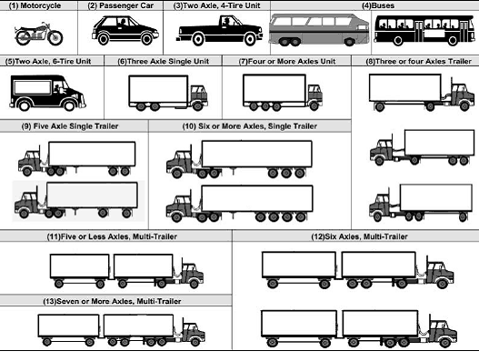
Model Design (cont’d)
FHWA Vehicle Classification

Slide 11
Model Design (cont’d)
  Few observations in survey data set for
    single-unit truck trips with other purposes
    multi-unit truck trips delivering services, and
    multi-unit truck trips with other purposes
  Models estimated (for I-I trips only):
Vehicle Type + Trip Purpose | Number of Trip Records
Light Commercial Vehicle - Delivery of Goods | 487
Light Commercial Vehicle - Delivery of Services | 945
Light Commercial Vehicle – Other Purposes | 202
Single-Unit Truck - Delivery of Goods | 520
Single-Unit Truck - Delivery of Services | 526
Multi-Unit Truck - Delivery of Goods | 241
Total | 2,931

Slide 12
Trip Generation Model
High correlation among explanatory variables
Form new districts for regression based on zonal socioeconomic characteristics
A two-hierarchy methodology
  1st level: population vs. employment
  2nd level: employment ranking by type
Correlation Coefficient | Industrial | Retail | H_Retail | Office | Service | Household
Industrial | 1.00 | 0.84 | 0.82 | 0.81 | 0.74 | 0.77
Retail | - | 1.00 | 0.97 | 0.56 | 0.83 | 0.95
H_Retail | - | - | 1.00 | 0.62 | 0.90 | 0.91
Office | - | - | - | 1.00 | 0.72 | 0.43
Service | - | - | - | - | 1.00 | 0.76
Household | - | - | - | - | - | 1.00

Slide 13
Trip Generation Model
1st level:
  Population dominating
  Population leading
  Balanced
  Employment leading
  Employment dominating
2nd level:
  S50-R30: 1st – Service ~ [50%, 80%); 2nd – Retail ~ [30%, 50%)
  O80-I05: 1st – Office ~ [80%, 100%); 2nd – Industrial ~ [5%, 10%)
Combined:
  Population leading - S50-R30

Slide 14
Trip Generation Model
Correlation | Industrial | Retail | Office | Service | Household
Industrial | 1.00 | -0.03 | 0.002 | 0.03 | -0.10
Retail | - | 1.00 | -0.07 | 0.05 | 0.23
Office | - | - | 1.00 | 0.11 | 0.13
Service | - | - | - | 1.00 | 0.11
Household | - | - | - | - | 1.00
Vehicle-Purpose Category |  | # of Districts
All vehicle types | All purposes | 130
Light-Duty CVs | Delivery of goods | 103
 | Delivery of services | 113
 | Other | 72
Single-Unit Trucks | Delivery of goods | 104
 | Delivery of services | 99
Multi-Unit Trucks | Delivery of goods | 78

Slide 15
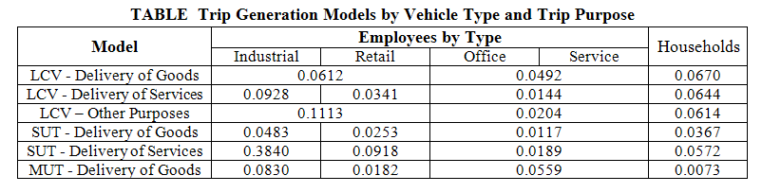
Trip Generation Model
R-squared: 0.16 – 0.59
Explanatory variables with t score >= 1 retained

Slide 16
Destination Choice Model
Explore the feasibility of developing a commercial vehicle trip distribution model with discrete choice model structure and stratified by both vehicle types and trip purposes
Considering the complexity of commercial vehicle travel, test non-impedance variables for inclusion in utility function
    explicit inclusion of socio-economic, geographic, and political-boundary variables in the utility function
    coefficients on those variables estimated using formal statistical processes

Slide 17



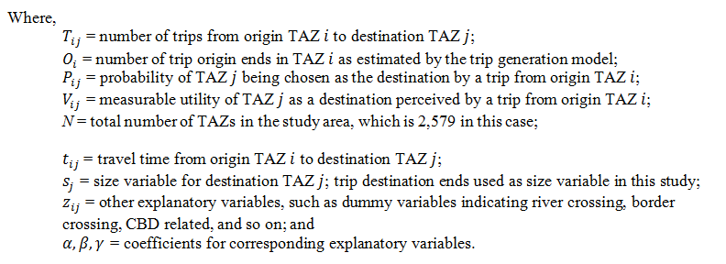
DC Methodology
Model Specification

Slide 18
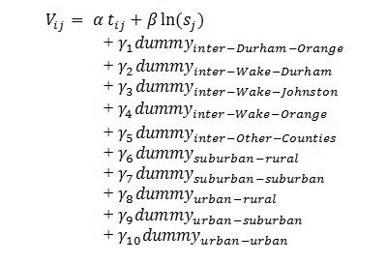
DC Methodology (cont’d)
Utility Function:
inter-county dummies
inter-area-type dummies
    inter-county dummies – capture the strength of inter-county economic interactions
    inter-area-type dummies – survey reveals larger commercial vehicles tended to travel between less developed areas

Slide 19
DC Methodology (cont’d)
Model Estimation with Importance Sampling
  A sample of TAZs used for logit model estimation:
    Independence of Irrelevant Alternatives (IIA) Property
  Importance Sampling with Replacement (ISwR) method (Ben-Akiva and Lerman, 1985)
  Rationale of ISwR:
    The alternatives more likely to be chosen by decision maker have a higher probability of being selected into the sample
  Selection weight

Slide 20
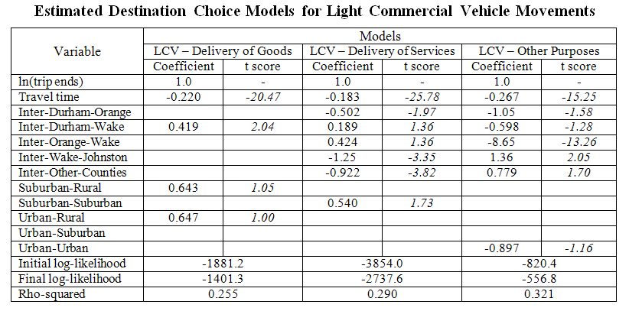
Model Estimation Results

Slide 21
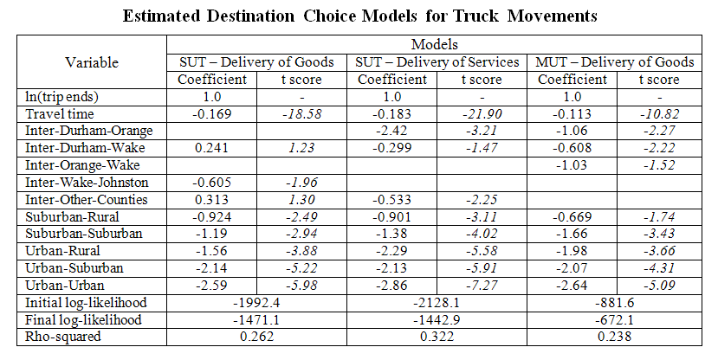
Model Estimation Results (cont’d)

Slide 22
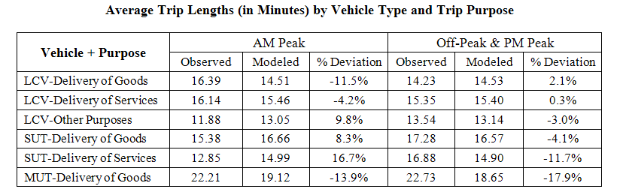
Model Performance Evaluation
Model performance evaluated based on:
  Average trip lengths;
  Trip length frequency distribution; and
  Coincidence ratios

Slide 23
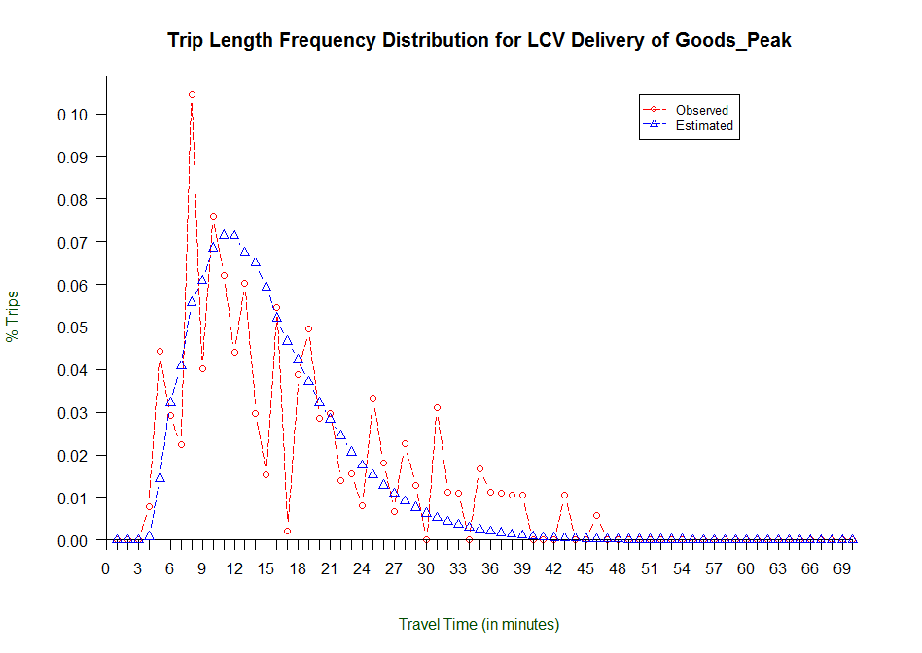
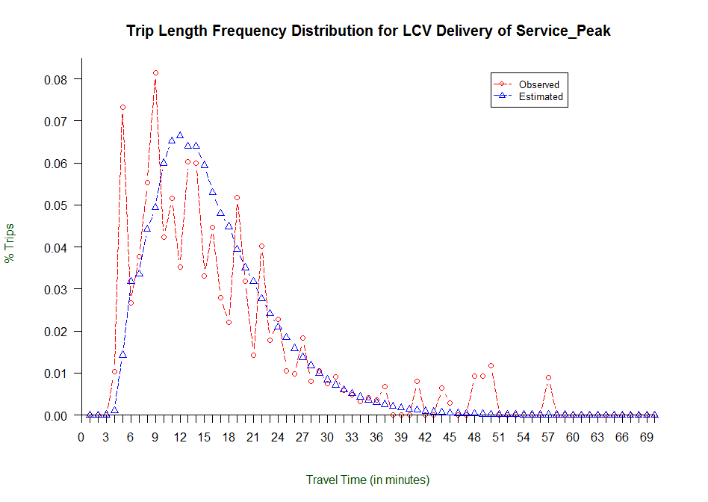
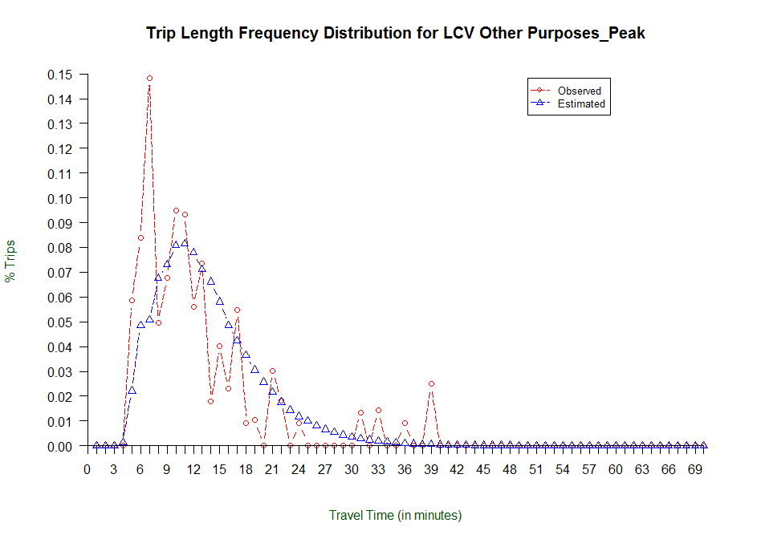
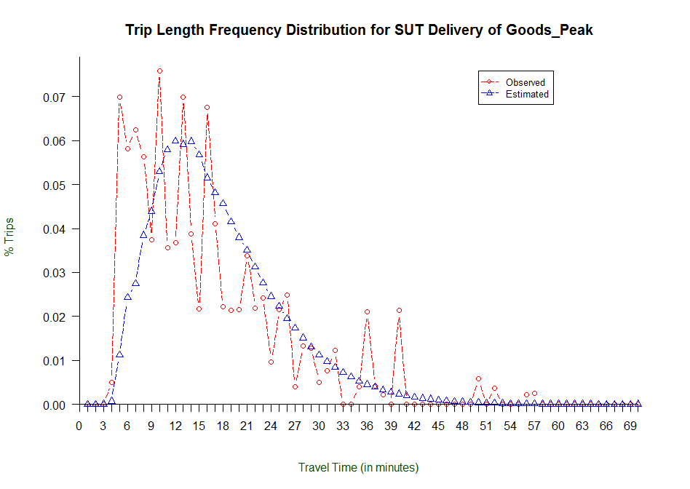
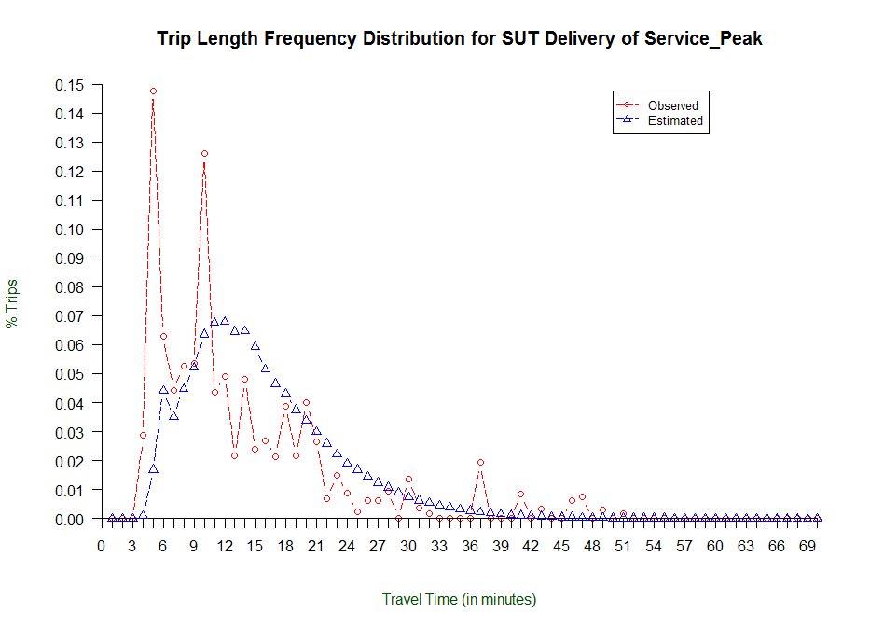
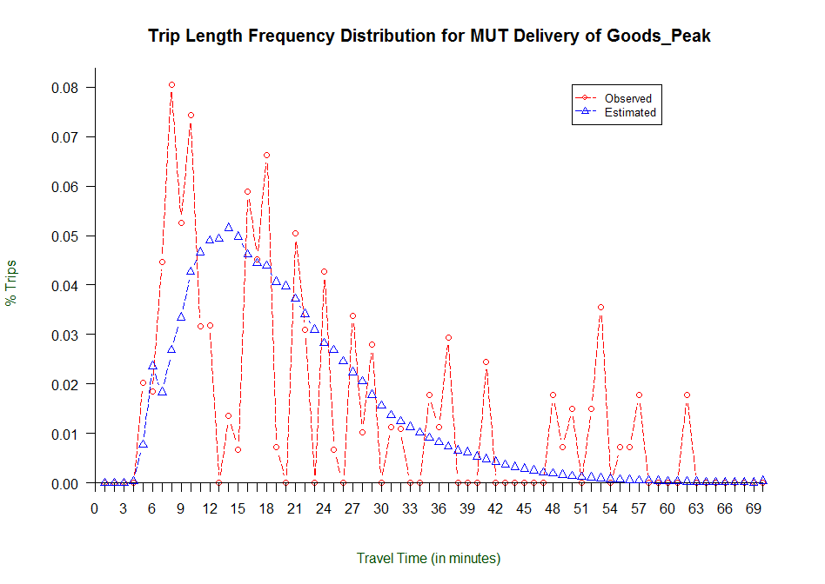
Model Performance Evaluation (2)
Trip Length Frequency Distribution by Vehicle Type and Trip Purpose for AM Peak Period

Slide 24
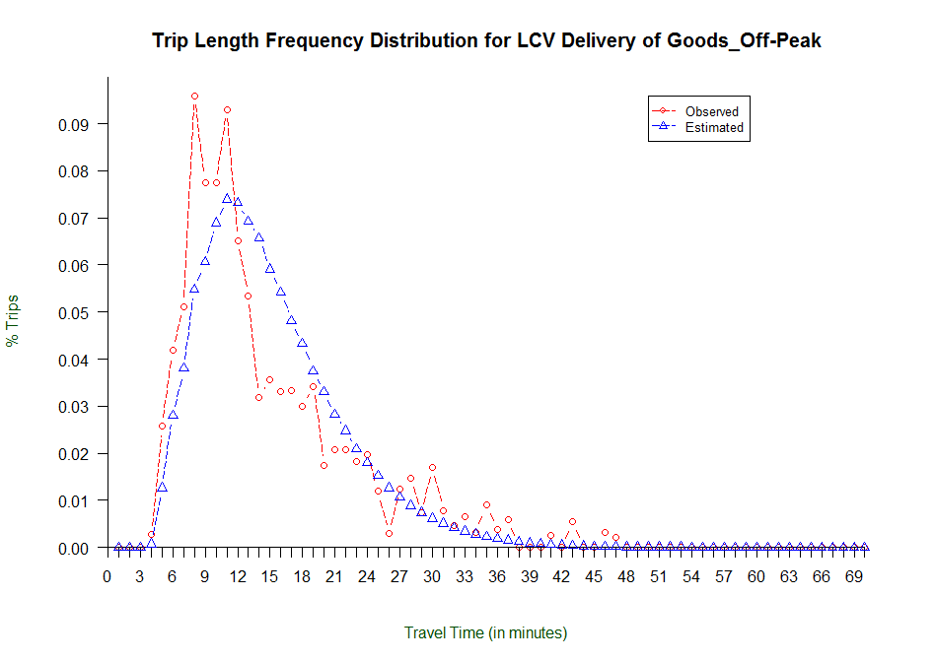
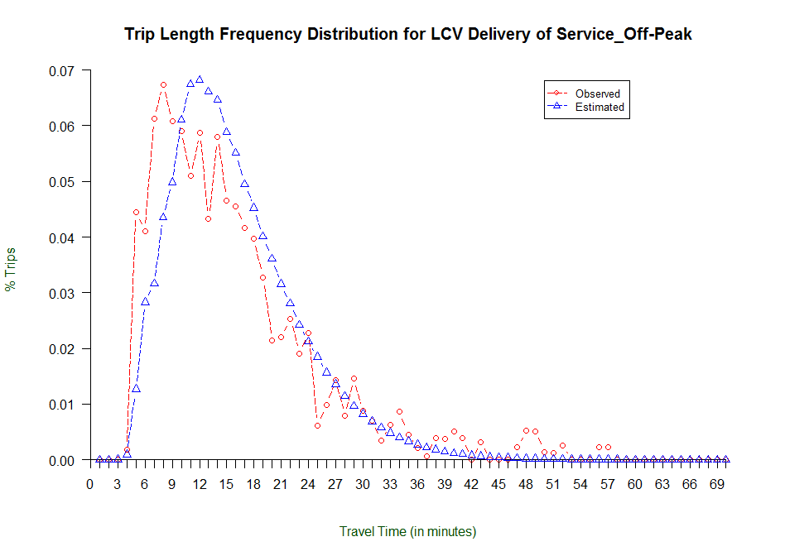
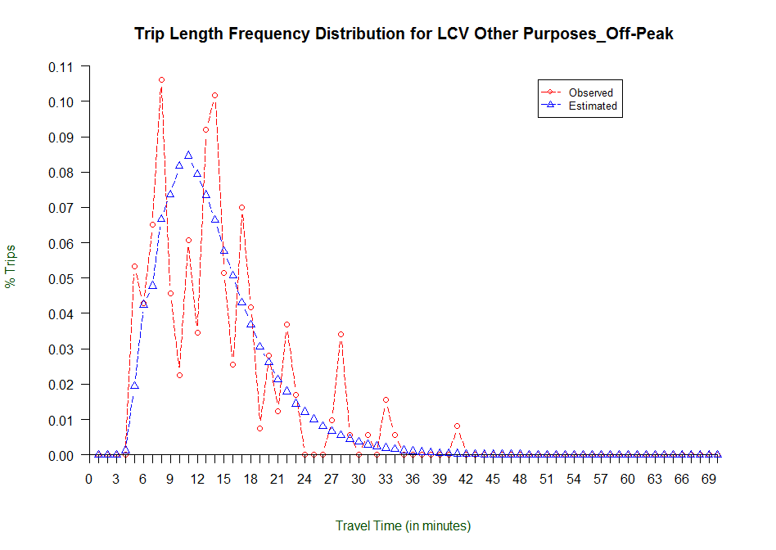
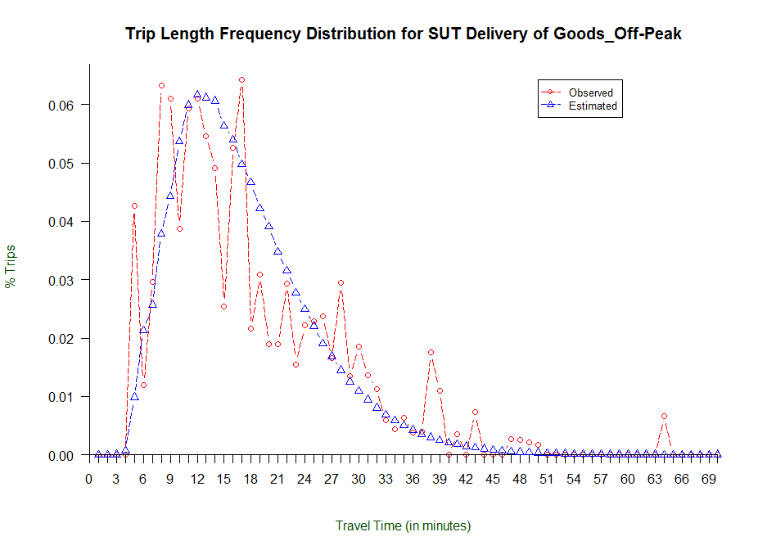
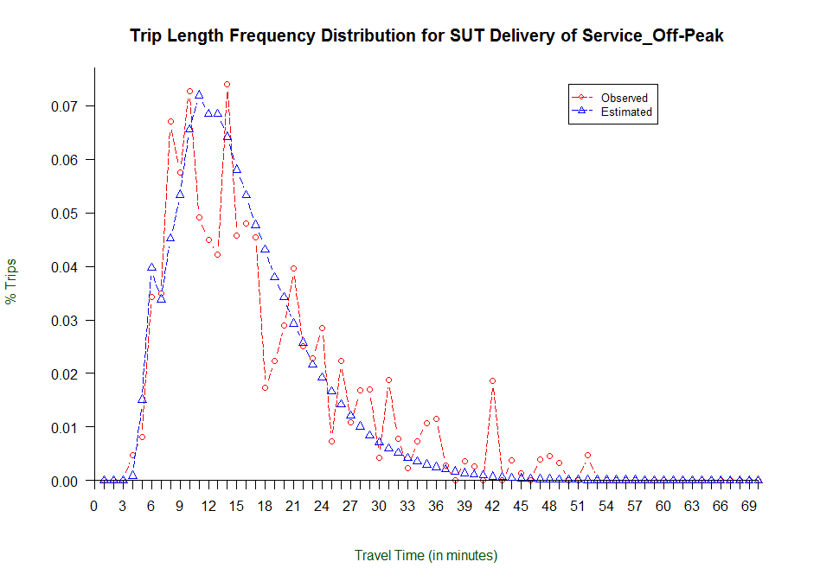
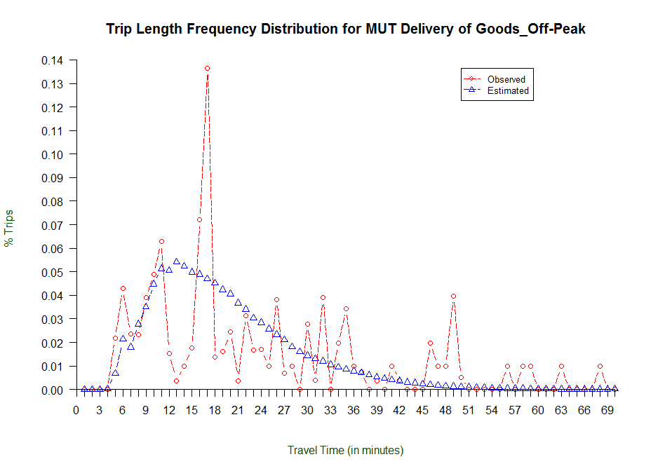
Model Performance Evaluation (3)
Trip Length Frequency Distribution by Vehicle Type and Trip Purpose for PM Peak & Off-Peak

Slide 25

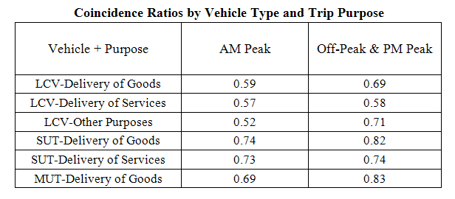

Model Performance Evaluation (4)
Coincidence ratios:
$$CR=\frac{\sum_{i}{min({obs}_{i},{mod}_{i})}}{\sum_{i}{max({obs}_{i},{mod}_{i})}}$$

Slide 26
Summary
Forming districts based on zonal socioeconomic characteristics helps reduce correlation between independent variables for regression
Travel time is still the strongest determining factor for destination choice
Inter-area-type dummy variables are statistically significant in all SUT and MUT sub-models and push more SUT and MUT trips to less developed areas.
Inter-county dummy variables are statistically significant in some sub-models too
Room for improvement in the future:
  Explore the explicit inclusion of economic factors in the model to improve model’s explanatory power;
  Investigate the use of more disaggregated employment categories that are more consistent with NAICS or SIC;
  Explore model stratification by NAICS or SIC sectors.

Slide 27
Thank You!
Contact Info:
Bing Mei, bmei@ncsu.edu, 919-513-7381
Joe Huegy, jbhuegy@ncsu.edu, 919-513-7378

