Slide 1

Comparative Analysis of Traffic and Revenue Risks Associated with Priced Facilities
14th TRB National Transportation Planning Applications Conference
Phani Jammalamadaka
Yagnesh Jarmarwala
Worapong Hirunyanitiwattana
Naveen Mokkapati
May 7, 2013

Slide 2

Outline
Background
Traffic/Transactions and Revenue (T&R) process
Sensitivity analysis
Risk analysis
Discussion on uncertainty in T&R
Case studies
Summary/next steps

Slide 3
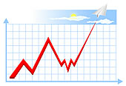
Background
Traffic and revenue (T&R) forecasts - typically point estimates
Bond investors, rating agencies, etc. prefer rigorous sensitivity/risk assessments in toll road T&R forecasts
Risk analysis helps to
  Quantify uncertainties in inputs
  Determine impacts of inputs on output
  Analyze output sensitivities
  Quantify uncertainties of the output
Multi-agency toll project financing negotiations
Evolving risk analysis processes in T&R estimation

Slide 4
Typical T&R Process

Slide 5
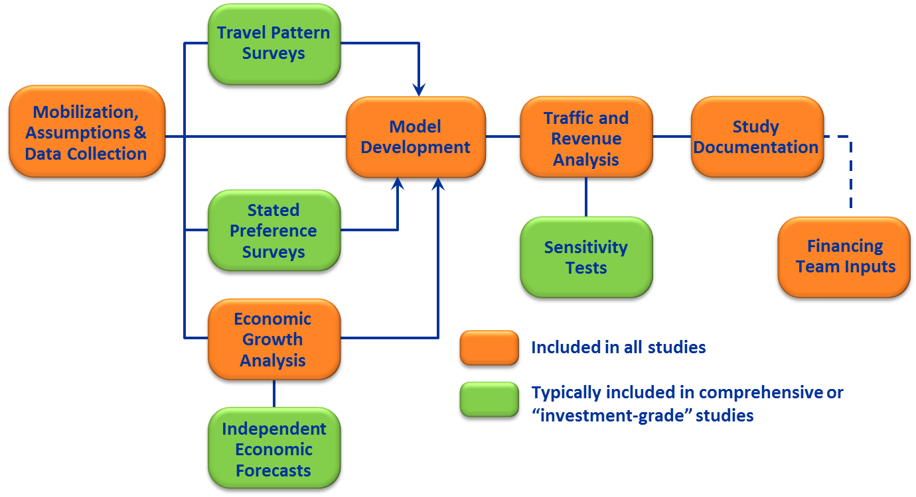
Typical T&R Process

Slide 6
SENSITIVITY AND RISK ANALYSIS

Slide 7
Sensitivity Analysis
Demonstrate impacts of changes to inputs
Determine most and least influential inputs
Test impacts of extreme events
Estimate reasonable high and low
Typically not a time-intensive process
A relatively common and reasonably effective method for accommodating risk in demand and revenue
forecasts is the use of sensitivity analyses or “stress tests” (Kriger et al., 2006)

Slide 8
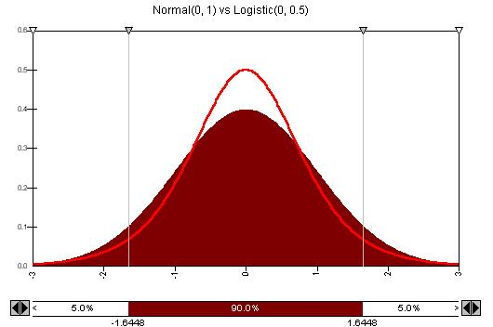
Risk Analysis
Typical Process
  Determine uncertainty distributions of inputs
  Model relationship between inputs and outputs
  Estimate output ranges/probabilities using multiple simulations (Monte Carlo)
Sensitivities/elasticities are a by-product of risk analysis
Challenges (in T&R risk analysis)
  Variables to include in risk analysis and correlations
  Quantification of uncertainty of inputs not easy
  Could lead to misleading conclusions
    Variables used for risk analysis
    Extreme events

Slide 9

Select Uncertainty Factors
Demographics (Population, Employment) | Weather
Value of time (Income) | Accidents
Vehicle operating cost (Gas prices) | Construction activity
Toll rates | Feeder/Competing routes
Trip generation rates | Congestion management policies
Revenue days (Weekend/Weekday traffic) | Travel Demand Modeling Factors
Toll revenue recovery
Truck traffic shares
Toll transponder usage

Slide 10
Uncertainty Propagation Through TDM
According to Zhao and Kockelman (2002)
Uncertainty grows through trip generation, trip distribution and mode choice models
Uncertainty drops at the traffic assignment model
    Final flow uncertainties higher than levels of input uncertainties
More difficult to anticipate flows on uncongested networks

Slide 11
Case study #1

Slide 12
Case Study #1 - Overview
Sub Area Network
Urban area highway model
AM, PM and OP time periods
741 Zones (including 116 External Zones)
4667 Roadway Links
3106 Nodes
816 Zone Connectors
Assumptions
Validated travel demand model
Commuter corridor
High toll transponder participation
Market share based toll diversion algorithm
No congestion pricing
Mostly developed corridor (Brownfield corridor)
Growth in trips to 2030 (1.6% annual growth)
No transportation improvements through 2030
Toll Road
Freeways
Arterials

Slide 13
T&R Risk Analysis Process
Develop Sub area Model
Trip Generation
Trip Distribution
Transaction Probability Analysis
Regression model to forecast daily traffic/transactions
Revenue Probability Analysis
Develop distributions for input variables (Revenue days, Truck shares, Transponder shares, Toll rates)
Monte Carlo simulation (1000 runs) to obtain revenue distribution
Toll Assignment
Develop input distributions (Population, Employment, Value of time, Toll rates, Vehicle operating costs)
Monte Carlo simulation (1000 runs) to obtain traffic/transaction distribution
Regression model to forecast revenue
Modal Split

Slide 14
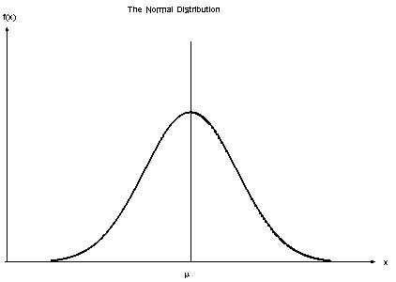
Uncertainties in Input Variables
Transaction Variables
Population (Census vs. Forecast)
Employment (Census vs. Forecast)
VOT (SP Survey, CPI)
Toll Rates, Vehicle Operating Costs (AAA, CPI)
General Uncertainty/Safety Factor
Revenue Variables
Truck Shares (based on observed trends on similar toll facilities)
Revenue Days (based on observed trends on similar toll facilities)
Transponder Shares (based on observed trends on similar toll facilities)
14

Slide 15
Traffic Sensitivity Analysis Summary

Slide 16
Revenue Sensitivity Analysis Summary

Slide 17
T&R Uncertainties
Year | Traffic Distributions
 | Lower Bound (P5) | Mean | Upper Bound (P95)
2011 | 96 | 100 | 104
2030 | 80 | 100 | 122
Year | Revenue Distributions
 | Lower Bound (P5) | Mean | Upper Bound (P95)
2011 | 83 | 100 | 111
2030 | 69 | 100 | 141

Slide 18
Sensitivity & Traffic/Transaction Probabilities
10 year Demographic Lag
P5 of Population
Toll Rates inflation of 5% per year
P95 of Population
Probability
Probability ~ 23%
P5 of VOC
P95 of VOC

Slide 19
Sensitivity & Revenue Probabilities
100% increase in Truck Shares
10% increase in Revenue days
P5 for Toll Rates
P95 for Toll Rates
50% decrease in Revenue Recovery
Probability
Probability ~ 44%
P95 for Revenue days
P5 for Revenue days

Slide 20
Case study #2

Slide 21
Case Study Model #2
Network
Semi-urban area roadway model
Daily model
600+ zones
16000+ Roadway Links
6000+ Nodes
3000+ Zone Connectors
Assumptions
Validated travel demand model
New alternative river crossing
Market share based toll diversion algorithm
No congestion pricing
Greenfield corridor
Toll Bridge
Freeways
Arterials
River

Slide 22
T&R Risk Analysis Process
Regional Demand Model
Trip Generation
Trip Distribution
Transaction Probability Analysis
Regression model to forecast daily traffic/transactions
Revenue Probability Analysis
Develop distributions for input variables (CPI Growth)
Monte Carlo simulation (1000 runs) to obtain revenue distribution by vehicle class
Toll Assignment
Develop input distributions (Households, Value of time, Toll rates, Vehicle operating costs)
Monte Carlo simulation (1000 runs) to obtain traffic/transaction distribution by vehicle class
Regression model to forecast revenue by vehicle class as function of traffic, CPI growth and toll rates
Modal Split

Slide 23
Population Forecast Comparisons

Slide 24
Uncertainties in Input Variables
Transaction and Revenue Variables
Households (Census vs. Forecast, Comparison of Multiple Forecasts)
VOT (SP Survey, CPI)
Toll Rates, Vehicle Operating Costs (AAA, CPI)
General Uncertainty/Safety Factor

Slide 25
Sensitivity Test Results - Traffic
2025
2035

Slide 26
2025 Sensitivity and Transaction Probabilities

Slide 27
2025 Sensitivity and Revenue Probabilities

Slide 28
SUMMARY AND NEXT STEPS

Slide 29
Summary
Quantification of T&R uncertainties very important given the inherent uncertainties/imperfections in inputs and models
Possible ways to quantify T&R uncertainties
  Discrete sensitivity analysis
  Risk analysis to create probability ranges for the outputs
  Combined sensitivity analysis, risk analysis and extreme event impacts (recommended)
Case studies
  Estimation of input variable uncertainties
  Estimation of T&R uncertainties using Monte Carlo simulations
  Sensitivity analyses, including extreme event impacts
  Approaches can vary based on type of facility, data and base models available

Slide 30

Next Steps
Quantification of T&R risks associated with
  Trip rates
  Modal splits
  Trip distribution parameters
  Volume delay functions
  Revenue recovery rates
  Toll facility “ramp-up” factors
  Toll diversion algorithm impacts
  Extent of sub-area model
  Managed lane facilities

Slide 31

Questions?
Phani Jammalamadaka, PE
jammalamadakapr@cdmsmith.com
Yagnesh Jarmarwala, PMP
jarmarwalaym@cdmsmith.com
Worapong Hirunyanitiwattana, PE
hirunyanitiwattanaw@cdmsmith.com
Naveen Mokkapati, PE
mokkapatin@cdmsmith.com

