Slide 1
An Open-Source Data Hub for Improving the Effectiveness of Integrated Modeling Applications
Brandon Nevers (KAI)
Xuesong Zhou, Jeff Taylor (Univ. of Utah)
Prepared for 14th TRB Planning Applications Conference

Slide 2
Outline
Overview and Data Hub Concept
Development Goals
Connections to AMS Data Hub
Test Applications and Key Modeling Steps
Next Steps

Slide 3
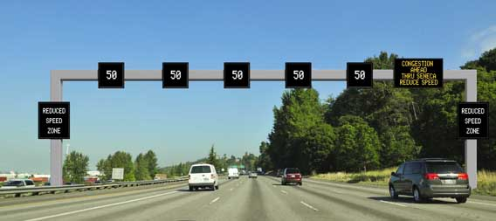
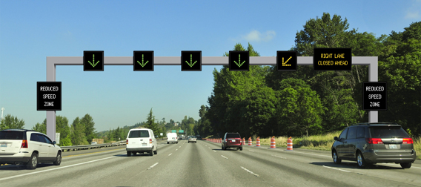
Problem Statement and Need
Transportation decision making is complex; requires consideration of multiple levels of analysis or domains
Improved suite of tools is critical to support USDOT initiatives:
Connected Vehicles
Integrated Corridor Management
Active Transportation Demand Management
Many integrated modeling practices are still ad-hoc

Slide 4
Integrated Modeling Practices
Current Practice Ad Hoc
Field Data
Safety
Emissions
Micro-simulation & HCM Analysis
Dynamic Traffic Assignment
Travel Demand Forecasting
Data Hub

Slide 5
Our Vision
Current Practice Ad Hoc
With AMS Data Hub Systematic
Field Data
Land Use, Safety & Emissions Models
HCM & Signal Timing Models
Micro-simulation Models
Dynamic Traffic Assignment Models
Travel Demand Forecasting Models
Data Hub
Field Data
Land Use, Safety & Emissions Models
HCM & Signal Timing Models
Micro-simulation Models
Dynamic Traffic Assignment Models
Travel Demand Forecasting Models
AMS Data Hub

Slide 6
FHWA Research Project
Project title: Effective Integration of Analysis and Modeling Simulation (AMS) Tools
April 2011 to January 2013
Objectives:
Define a concept of operations
Allow for the effective integration of AMS tools across various domains and scale,
Perform multi-resolution simulation for multiple scenarios

Slide 7
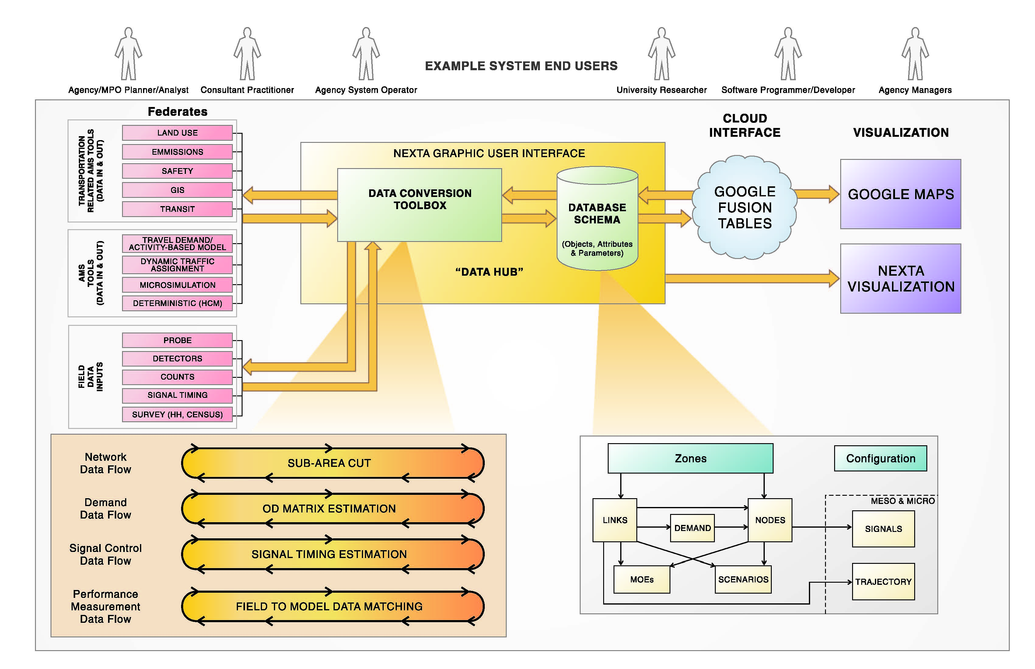
Development Goal 1: Unifying Data Scheme

Slide 8
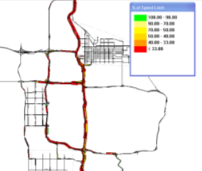
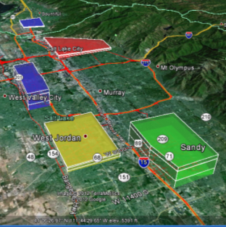
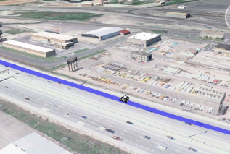
Development Goal 2: Support Cross Resolution Modeling
Mesoscopic simulation
Regional planning model
Microscopic simulation
Height (Z-axis) represents zone-specific population
Color range represents predicted accessibility

Slide 9
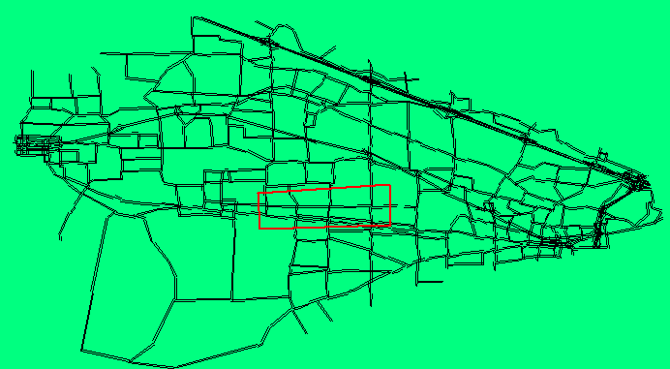
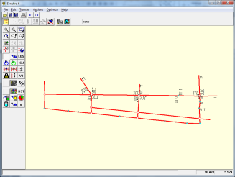
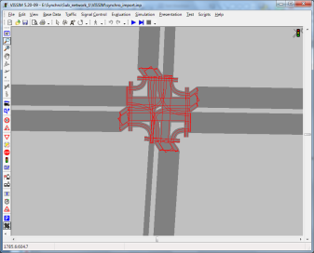
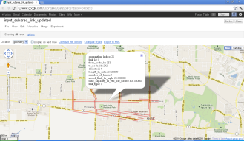
Development Goal 3: Facilitate Data Exchanges between Modeling/Simulation Software Packages
Traffic assignment:
Signal Optimization:
Synchro
Microsimulation:
Vissim
Google Maps Output

Slide 10
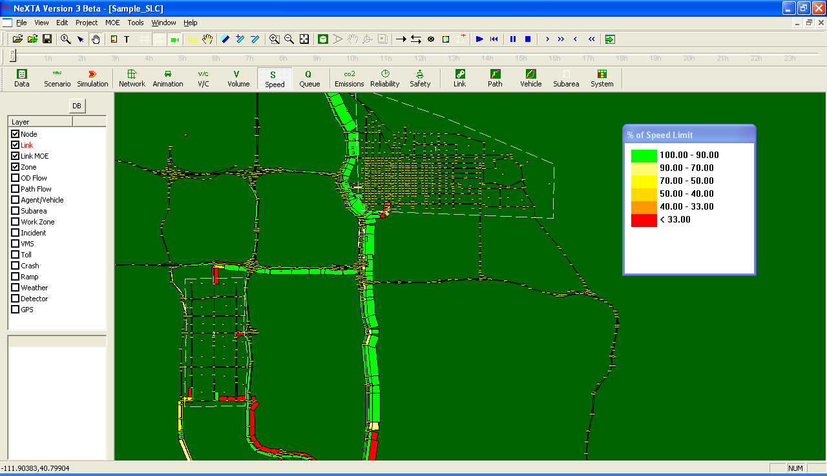
AMS Data Hub Software Prototype: NEXTA
Open Source: Available at Google Code: https://code.google.com/p/nexta/
Windows based applications but with connections to on-line storage (Google Fusion Tables)
Start with GIS with multiple transportation layers
Network, demand, vehicle trajectory, Link MOE, ….
Focus on data processing and visualization

Slide 11
Connection 1:
Regional planning models
TransCAD
CUBE
VISUM
GIS shape files
Multiple demand formats
CSV, Matrix
Automatic identification of signal locations
Subarea cut utility
Export network to Google Maps
Micro-simulation Models
Dynamic Traffic Assignment Models
Travel Demand Forecasting Models
AMS Data Hub
HCM & Signal Timing Models
Land Use, Safety & Emissions Models
Field Data

Slide 12
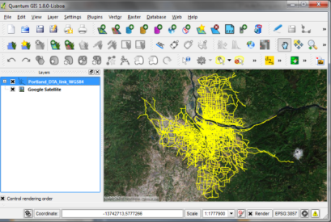
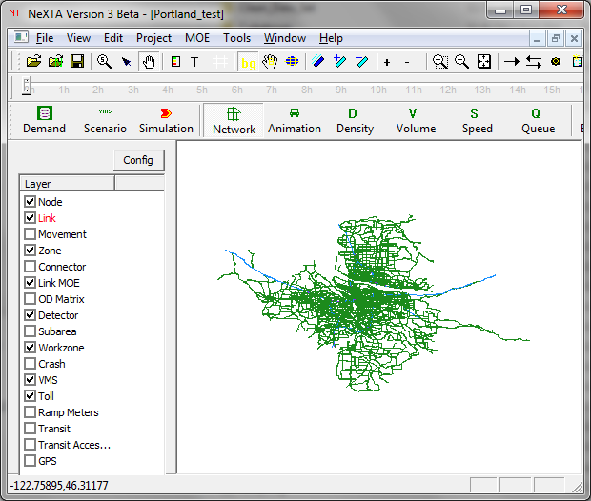
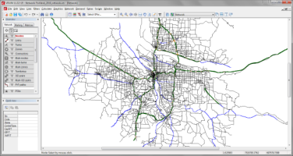
Network Data Importing
Import GIS node/link/zone shape files
Utilize Open-source Geospatial Data Abstraction Library (GDAL) library
Script for mapping planning data set to NEXTA data hub
VISUM
Open-Source Q-GIS

Slide 13
Connection 2:
Import DYNASMART/Dynust data set
Network
Signal Control
Vehicle trajectory
Trajectory-based statistics generation
Select link, path, subarea analysis
95% percentile travel time
Planning index
Field Data
Land Use, Safety & Emissions Models
HCM & Signal Timing Models
Micro-simulation Models
Dynamic Traffic Assignment Models
Travel Demand Forecasting Models
AMS Data Hub

Slide 14
Connection 3:
Import Aimsun vehicle trajectory file
Export synchro data format
Export VISSIM network data format (*.anm)
Extensions:
TRANSIMS
Open-source CORSIM
Field Data
Land Use, Safety & Emissions Models
HCM & Signal Timing Models
Micro-simulation Models
Dynamic Traffic Assignment Models
Travel Demand Forecasting Models
AMS Data Hub

Slide 15
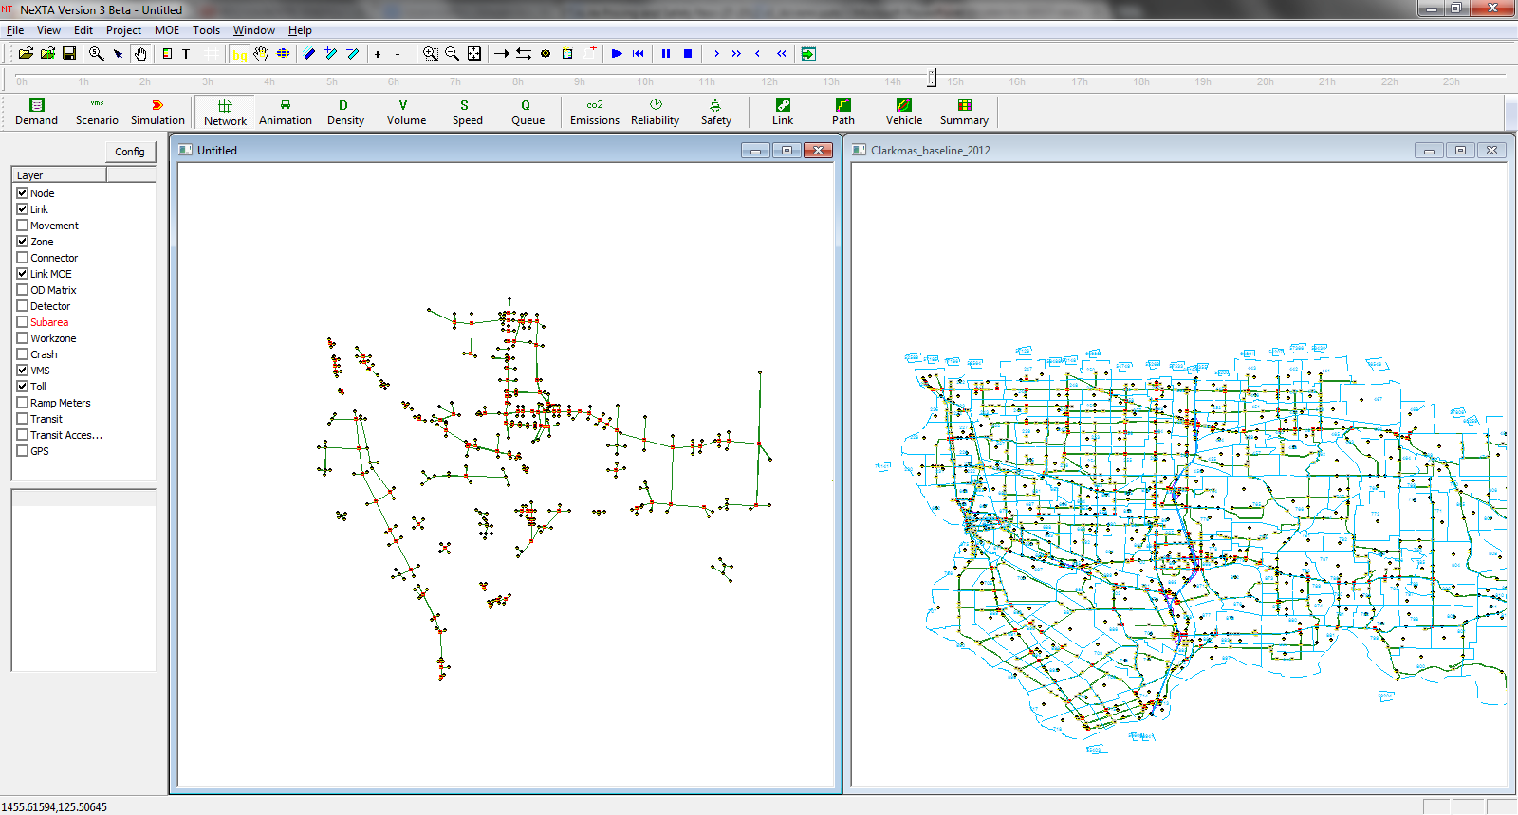
Connection to Synchro and QEM
Import Synchro data directly to NEXTA
Match nodes using two layers
Fetch signal data from Synchro layer for Dynamic Traffic Assignment
Future year study through QEM

Slide 16
Connection 4:
FREEVAL
HCM-based Quick Estimation Method (QEM)
Given turning volume,
Generate signal phasing and timing data
Field Data
Land Use, Safety & Emissions Models
HCM & Signal Timing Models
Micro-simulation Models
Dynamic Traffic Assignment Models
Travel Demand Forecasting Models
AMS Data Hub

Slide 17
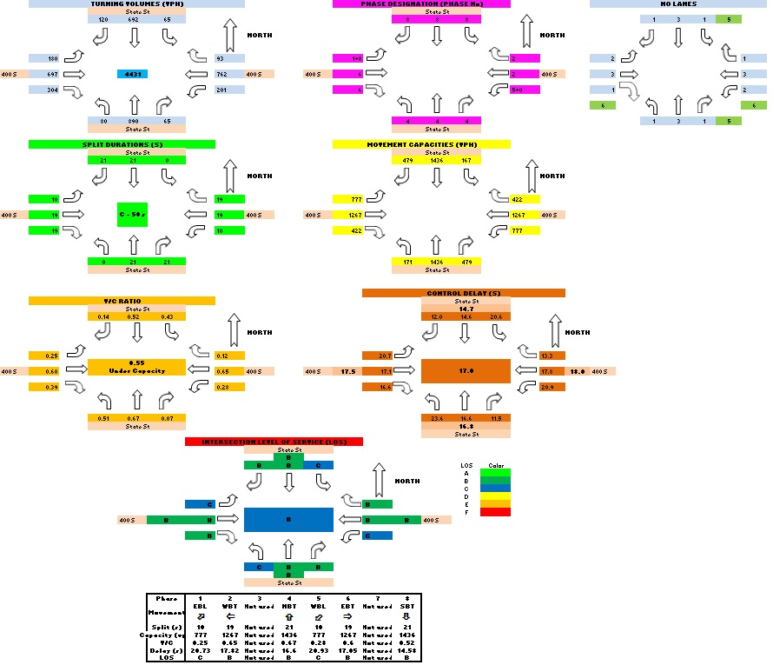
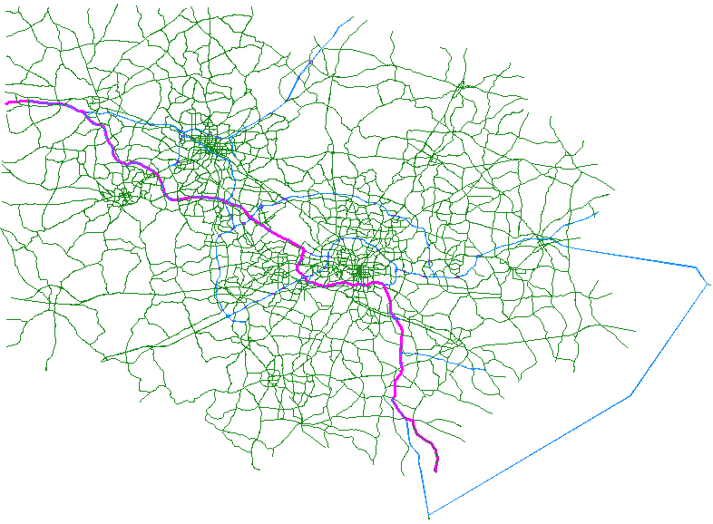
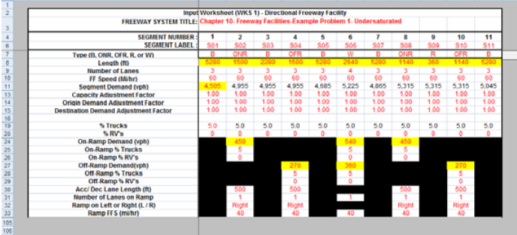
Signal Timing and Capacity Data Hub
NEXTA network data hub
HCM signal data hub
HCM highway capacity hub

Slide 18
Connection 5:
MOVES LITE
Simplified Emission Estimation Method
Safe prediction model
Given AADT, interchange type, link type
Predict crash rates
Different crash types
Field Data
Land Use, Safety & Emissions Models
HCM & Signal Timing Models
Micro-simulation Models
Dynamic Traffic Assignment Models
Travel Demand Forecasting Models
AMS Data Hub

Slide 19
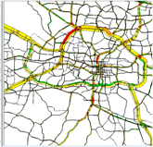
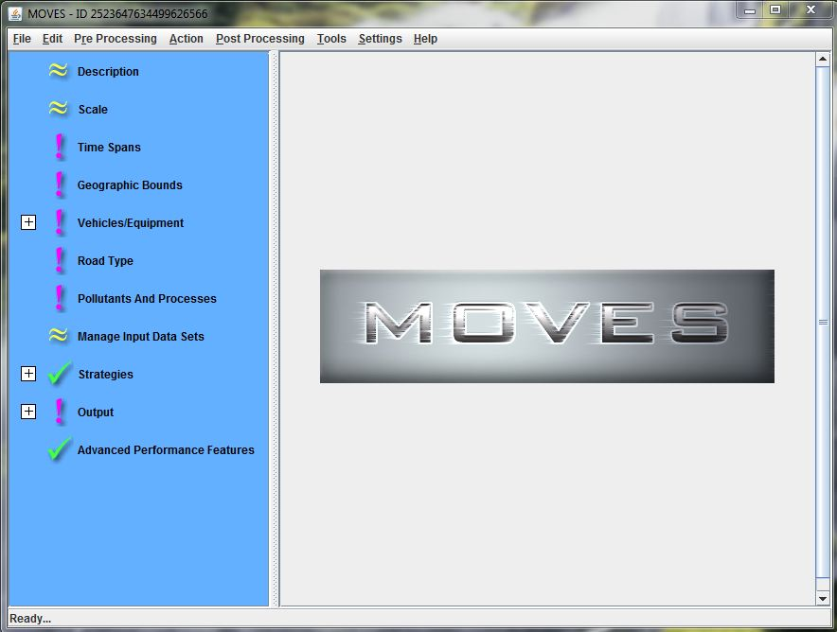
Linking Simulated Vehicle Trajectory with MOVES
Vehicle Fleet
I/M programs
Fuel properties
(others)…
Vehicle Dynamics
MOVES
constant

Slide 20
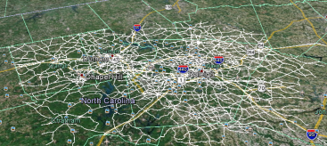
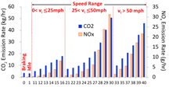
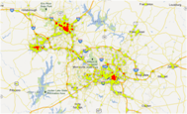
Integrated MOVES Lite and DTALite Packages for Emission Analysis
Emission Result Aggregation
Microscopic Vehicle Trajectory Reconstruction
Emission Estimates
MOVES Lite
Project level
Network level
DTALite
Simplified Emission Estimation Method
Large-scale Dynamic Traffic Assignment & Simulator
Notes:
TRM Network Statistics
Zones = 2,389
Nodes = 9,528
Links = 20,258
Signals = 1,914
AM Trips = 1,064,703
Counties = 8
Households = 490,000
DTALite is an open-source mesoscopic traffic simulator (C++)
Light-weight and agent-based
Enhance DTALite to provide a rigorous and computationally efficient tool to evaluate traffic management strategies
The enhanced tool will enable practitioners to:
Assess corridor and network-wide effects
Conduct numerous alternatives analyses
Evaluate recurring and non-recurring congestion
Calculate performance measures that can be applied in investment-level planning and decision making

Slide 21
Connection 6:
Inrix Sensor data
15-min speed count
GPS data sets
Tomtom dataset from New York
NGSIM data set
Incident data (crash locations)
Google Transit Feed
Extension:
Dynamic OD demand calibration tools
Field Data
Land Use, Safety & Emissions Models
HCM & Signal Timing Models
Micro-simulation Models
Dynamic Traffic Assignment Models
Travel Demand Forecasting Models
AMS Data Hub

Slide 22
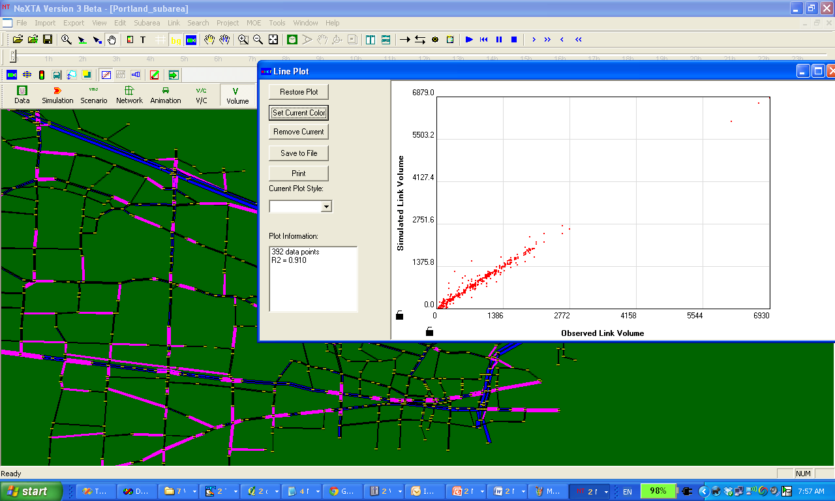
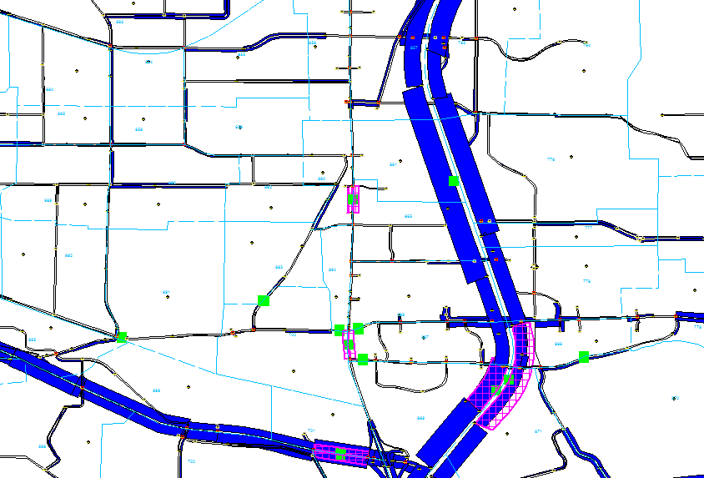
Network Coding/Debugging/Calibration
Reduce editing and debugging efforts
Visualization and validation
Purple band: observed volume vs. Dark blue band: simulated volume

Slide 23
Test Applications
Two test networks selected:
NW 185th Avenue in Portland, Oregon
I-10 in Tucson, Arizona
Primary objective: demonstrate linkages among AMS tools and field data
Model and field data already available to team
Familiar networks
Interested modeling agencies
Portland Metro
Pima Association of Governments

Slide 24
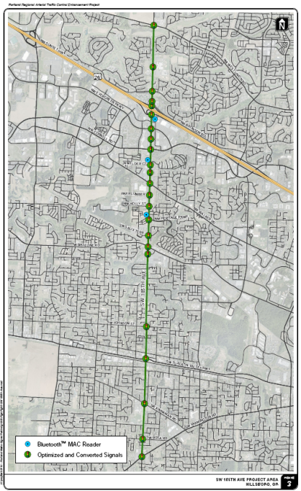
185th Avenue NW Portland, OR
Over 20 signalized intersections
Interchange ramp terminals at US-26
Data Sources
Counts / Volume
Historical count database
Signal Timing
Synchro
Travel Time/Speed
BluetoothTM
AMS Tools
VISUM
DTALite & DynusT
Synchro
VISSIM

Slide 25
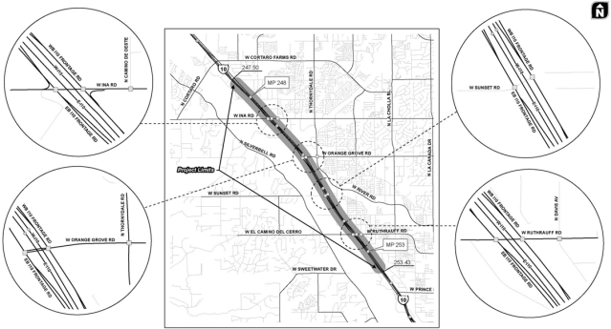
I-10 Freeway Network Tucson, AZ
5 miles of I-10 being reconstructed
4 interchanges; 3 to be closed during reconstruction
Data Sources
AMS Tools
24-Hour Segment Counts
Intersection Turning Movement Counts
I-10 Mainline Speed
TRANSCAD
DTALite & DynusT
Synchro
VISSIM

Slide 26
Key AMS Data Hub Modeling Steps
1. Network Import
2. Subarea Cut
3. Signal Timing Estimation
4. O-D Calibration
5. Data Visualization

Slide 27
1. Network Import/Conversion
Highlighted Features
Supports flexible GIS network coding
Internal error checking (network coding)
Intersection control inference
Benefits
Time savings in quality control and network preparation efforts

Slide 28
2. Subarea Cut
Highlighted Features
Generate subarea OD demand matrix
Convert zone centroids and connectors to side streets
Benefits
Reduced physical effort in preparing subarea networks

Slide 29
3. Signal Timing Estimation
Highlighted Features
HCM-based Quick Estimation Method (QEM)
Evaluate Phasing, Timing, Movement Capacity, Left-turn treatment strategies, etc.
Data Exchange with Synchro and DTA packages
Benefits
Reduced effort in preparing intersection analysis

Slide 30
4. Calibrate O-D Demand Matrices
Highlighted Features
Calibrate subarea OD demand
Utilize time-dependent link counts
Integrated OD adjustment and simulation process
Benefits
Highly efficient assignment engine
Better path flow estimates for microsimulation

Slide 31
Calibrate O-D Demand Matrices

Slide 32
5. Data Management and Visualization
Highlighted Features
Google Fusion Tables (Cloud-based Data Storage)
Google Earth, 2D, 3D, 4D illustration
Flexibility/Interoperability through data format
Benefits
Enhanced visualization capabilities
Simplified data sharing between agencies, public

Slide 33
Estimated Time Saving from AMS Data Hub
Component | Without AMS Data Hub | With AMS Data Hub
Network Import Export, edit, and import network | 8-10 hours | 1-2 hours
Intersection Control Inference Editing control type for all nodes | 6-8 hours | 4-6 hours
Subarea OD Tables Aggregate path flows at boundary | 8-16 hours | < 0.5 hours
Convert Connectors to Side Streets Add new nodes, delete links, etc. | 1-2 hours | < 0.5 hours
Signal Timing with QEM Initial timings for intersections | 6-8 hours | < 0.5 hours
ODME Preparing field data, running ODME | 6-8 hours | 2-3 hours
TOTAL | 35-52 hours | 7-11 hours
80% Savings

Slide 34
Challenges
Network coding
Different applications require different levels of details
Signal data representation
capacity;
turning movement and effective green time
dual ring signal timing
software/hardware in the loop
Software vendor buy-in
existing multi-resolution integration using their own proprietary format
community support (TRB/IEEE)

Slide 35
Next Steps
Receive comments and host webinar with invited user group
Continue model development and testing
Refine and expand connections with signal timing data
Linkage with Activity-Based Model
Expand number of AMS tool interfaces
Provide connection with real-time detector data
Identify and conduct pilot tests

