Slide 1
Impact of Aging Population on Regional Travel Patterns:
The San Diego Experience
14th TRB National Transportation Planning Applications Conference, Columbus OH
May 7th, 2013
Wu Sun, Beth Jarosz & Gregor Schroder
San Diego Association of Governments (SANDAG)
Notes:
Authors include team members from SANDAG and PB.

Slide 2
Background
Population Aging
Activity-Based Travel Demand Model (ABM)
Evaluate Impact of Aging Population on Travel Patterns Using ABM

Slide 3
U.S. Population Aging
 | 1970 | 2010
Younger than 30 | 53% | 41%
Age 65 or older | 10% | 13%
Source: U.S. Census Bureau, decennial census 1970, 1980, 1990, 2000, and 2010
Notes:
As the population ages…
We may care less about our cars. A Gallup poll in 1991 found that 20% of Americans found driving to be a chore. The same response in 2006 got a 40% boost to 28%. When you drill down into the details of the survey, reported enjoyment of driving (likelihood of taking a ride “just because it’s fun”) decreases substantially with age.
We may also drive more safely.
In their 2009 study of aggressive driving behavior, AAA found that at 16, nearly 60% of drivers show aggressive behavior. By age 35, it falls to 35%, and by age 60 is below 27%.
Moreover, safer driving is beginning to show up in accident statistics.
Quoting Transportation Secretary Ray LaHood:
“in 2010 the number of traffic fatalities in America fell to the lowest levels since 1949.
…despite a sharp increase in the number of miles Americans drove last year - 21 billion additional miles. In addition, the rate of road fatalities in the U.S. has also dropped to its lowest level since 1949. Over the last five years, traffic deaths have declined by 25 percent…And the rate of fatalities per million miles traveled fell to 1.09 from 1.13 in 2009.”
LaHood credits this to “the combined efforts of DOT, states, law enforcement, safety organizations, and America's drivers who are taking personal responsibility for their driving habits.”
But I also see a demographic shift at play, much as there was a demographic influence on falling crime rates, beginning in the mid-1990s.
I’ll focus on the transportation and residential location choices of 4 Generation Groups today:
Older Americans (age 65+)
Boomers (45-64)
Gen X (30-44)
Millennials (under age 30) 53% of population in 1970, only 41% today
Note: age ranges are approximations for which most data are available
Sources: http://pewsocialtrends.org/2006/08/01/americans-and-their-cars-is-the-romance-on-the-skids/1/
AAA: http://www.aaafoundation.org/pdf/AggressiveDrivingResearchUpdate2009.pdf
DOT: http://fastlane.dot.gov/2011/04/record-low-traffic-deaths-encourage-continued-road-safety-efforts.html

Slide 4
In 25 years, Boomers will nearly double the population age 65+
Source: U.S. Census Bureau, Projections (2012) ,“Constant International Migration Series”
Notes:
Life-course changes for our growing 65+ population will undoubtedly change the nation’s transportation system needs.
As the population ages…
We may care less about our cars. A Gallup poll in 1991 found that 20% of Americans found driving to be a chore. The same response in 2006 got a 40% boost to 28%. When you drill down into the details of the survey, reported enjoyment of driving (likelihood of taking a ride “just because it’s fun”) decreases substantially with age.
We may also drive more safely.
In their 2009 study of aggressive driving behavior, AAA found that at 16, nearly 60% of drivers show aggressive behavior. By age 35, it falls to 35%, and by age 60 is below 27%.
Moreover, safer driving is beginning to show up in accident statistics.
Quoting Transportation Secretary Ray LaHood:
“in 2010 the number of traffic fatalities in America fell to the lowest levels since 1949.
…despite a sharp increase in the number of miles Americans drove last year - 21 billion additional miles. In addition, the rate of road fatalities in the U.S. has also dropped to its lowest level since 1949. Over the last five years, traffic deaths have declined by 25 percent…And the rate of fatalities per million miles traveled fell to 1.09 from 1.13 in 2009.”
LaHood credits this to “the combined efforts of DOT, states, law enforcement, safety organizations, and America's drivers who are taking personal responsibility for their driving habits.”
But I also see a demographic shift at play, much as there was a demographic influence on falling crime rates, beginning in the mid-1990s.
Sources: http://pewsocialtrends.org/2006/08/01/americans-and-their-cars-is-the-romance-on-the-skids/1/
AAA: http://www.aaafoundation.org/pdf/AggressiveDrivingResearchUpdate2009.pdf
DOT: http://fastlane.dot.gov/2011/04/record-low-traffic-deaths-encourage-continued-road-safety-efforts.html

Slide 5
3 sources of change
Life-course
Generational
Broad social/economic trends
Notes:
I would like to point out that some of the trend by age may be generational (such as the Millennial Generation delaying the age at which they get a drivers license)
Some age-related differences in travel are because of life-course events as income and family structure changes by age. For example, an adult is likely to begin driving a child to school a few years after becoming a parent.
And some future changes in the transportation system will be broad social and economic changes that affect everyone (think: gas prices and new transportation technologies).
In this analysis, we attempt to isolate the life-course changes by holding generational and broad social/economic trends constant between scenarios.

Slide 6
Life-course: disability status by age
Source: U.S. Census Bureau, ACS 2011
Notes:
For example, over the life course, the likelihood of having a disability increases with age.
Under the age of 35, less than 10% of the population reports having a disability.
That rises to ¼ by age 65, and to more than 50% in populations over the age of 75.
This, of course, has an effect on transportation options at older ages.

Slide 7
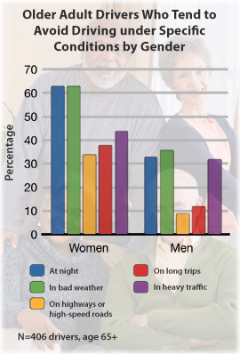
Time of Day: Older Drivers Report Avoiding Certain Driving Conditions
Older drivers likely to avoid driving:
  at night
  in bad weather
  in heavy traffic
Some avoidance of highway driving
Time-shifting of trips to avoid congested periods
Source: U.S. Centers for Disease Control and Prevention, “New Data on Older Drivers,” April 19, 2011
Notes:
In terms of life-course trends, seniors have much different driving behaviors than other cohorts.
<describe driving avoidance behaviors from CDC 2011 report shown on slide>
http://www.cdc.gov/Motorvehiclesafety/Older_Adult_Drivers/

Slide 8
Mode share: Means of Transport to Work by Age (2007-09)
Source: U.S. Census Bureau, ACS 2011
Notes:
As both a reflection of life course events and income, we see variations in commute mode choice by age.
For example, 16-19 year olds are probably working after-school jobs, might not yet have a car and are probably walking or getting a ride with mom, dad, or a friend. Thus, they have the highest walk-to-work share (9%) and carpool share (15%) of any age group.
Workers age 65+ on the other hand, are twice as likely (or more) than any other age group to work from home.

Slide 9
Aggregate System Effects: Average Daily Miles of Travel
Sources: U.S. Department of Transportation, Federal Highway Administration, 1983, 1995, 2001, and 2009 National Household Travel Survey.
Notes:
Note… we see a downward trend in 2009 – likely confounded by the effects of the Great Recession.
But still…
Avg Daily Person Miles – DOUBLED between 1983 and 2009 for 66+
Increased more than 50% for 36-65
Conclusion: Boomers (and older Gen Xers) travel more now than the generation before them, and are likely to continue driving more in their senior years
-> More senior drivers on the roads and more senior riders on transit.

Slide 10
Methodology
Generation of 3 aging scenarios
ABM-A travel forecast model sensitive to socio-demographic changes
Generation of a synthetic population

Slide 11
Generation of Aging Scenarios: Data
2010 Census
2035 Forecast – 3 scenarios
  Base case: derived from SANDAG 2050 Regional Growth Forecast (2010)
  Older population: 2.3% increase in population over age 65, compared with base case, offset by fewer persons age 64 and younger (with most change under age 18)
  Younger population: 2.2% decrease in population over age 65, compared with base case, offset by fewer persons age 64 and younger (with most change under age 18)
Geography:
  San Diego County
  Unit of analysis: approximately 23,000 census block level geographies known as Master Geographic Reference Areas (MGRAs)

Slide 12
Aging Scenarios
Source: SANDAG, 2050 Regional Growth Forecast (2010) and alternate age scenarios

Slide 13
Aging Scenarios

Slide 14
Activity-Based Model (ABM)
Transportation
Policy
Transportation
System
Land Use
Models
ABM
Border
Model
Traffic Assignment
CVM
Special
Models
Environmental
Impact
System
Performance
Economic
Analysis
Notes:
Transportation models:
Activity-based model (ABM)
Commercial vehicle model (CVM)
Land use Model:
Production, Exchange, and Consumption Allocation System (PECAS)
Integrated land use and transportation model

Slide 15
Why ABM?
  Simulate travel behavior individually
  Detailed temporal & spatial resolutions
  Sensitive to socio-demographic changes
  Increased Sensitivity
    Environmental Justice / Social Equity
    Spatial and network changes
    Land use changes
Notes:
TDM: use telecommuting and flexible work hours as examples.
Impact of policies on demographic groups
Transportation demand management policies
High occupancy vehicle (HOV) policies
Congestion pricing/toll policies
Transit fare policies
Environmental policies
Border crossing policies

Slide 16
Treatment of Space
MGRA (gray lines)
21,633 MGRA
4,682 TAZs
MGRA: Master Geographic Reference Area (Grey Lines)
TAZ: Transportation Analysis Zone (Orange Line)

Slide 17
Treatment of Time
  TOD in travel demand modeling
    40 departure half-hours (5AM-24PM) by
    40 arrival half-hours (departure-24PM)
  TOD in traffic assignment
NUMBER | DESCRIPTION | BEGIN TIME | END TIME
1 | Early A.M. | 3:00 A.M. | 5:59 A.M.
2 | A.M. Peak | 6:00 A.M. | 8:59 A.M.
3 | Midday | 9:00 A.M. | 3:29 A.M.
4 | P.M. Peak | 3:30 P.M. | 6:59 P.M.
5 | Evening | 7:00 P.M. | 3:29 A.M.
Notes:
Some early hours are combined, instead of 48 30 min TODs, there are 40 of them.

Slide 18
Treatment of Travel Purposes
TYPE | PURPOSE | Description | CLASSIFICATION
1 | Work | Working outside the home | Mandatory
2 | University | College + | Mandatory
3 | High School | Grades 9-12 | Mandatory
4 | Grade School | Grades K-8 | Mandatory
5 | Escorting | Pick-up/drop-off passengers | Maintenance
6 | Shopping | Shopping away from home | Maintenance
7 | Other Maintenance | Personal business/services | Maintenance
8 | Social/Recreational | Recreation, visiting friends/family | Discretionary
9 | Eat Out | Eating outside of home. | Discretionary
10 | Other Discretionary | Volunteer work, religious activities | Discretionary
Notes:
10 Activity Types, READ 10
Go through descriptions.

Slide 19
Treatment of Travel Modes
Choice
Auto
Drive alone
Shared ride 2
Non-motorized
Walk(9)
Shared ride 3+
GP(1)
Pay(2)
GP(3)
Pay(5)
GP(6)
HOV(7)
Bike(10)
Transit
Walk access
PNR access
Local bus(11)
Express bus(12)
BRT(13)
LRT(14)
Commuter rail(15)
Local bus(16)
Express bus(17)
BRT(18)
LRT(19)
Commuter rail(20)
HOV(4)
Pay(8)
KNR access
Local bus(21)
Express bus(22)
BRT(23)
LRT(24)
Commuter rail(25)
School Bus(26)
Tour Mode
Trip Mode
Notes:
26 Modes.
READ.
Explain some of them are tour modes, some of them are trip modes.

Slide 20
Treatment of Socio-Demographics
Household characteristics
  Household size
  Household income
  Number of workers per household
  Number of children in household
  Dwelling unit type
  Group quarter status
Person characteristics
  Age (0-17, 18-24,25-34, 35-49, 50-64, 65-79, 80+ )
  Gender
  Race
Notes:
Total of 39 controls, 22 household, 17 person
Income: <$30k, $30to60k, $60kto100k, $100to150k, and >=$150k
Single family, multi Family and mobile home
gqInst, gqCollege, gqMilitary, gqNonInstOther
AGE0TO17, AGE18TO24, AGE25TO34,AGE35TO49, AGE50TO64,AGE65TO79, AGE80PLUS
HISPANIC, WHITE, BLACK, NINDIAN, ASIAN, ISLANDER, RACEOTHER, MIXED

Slide 21
Population Synthesizer (PopSyn)
Synthetic population:
  a collection of records that represents household and person characteristics
Foundation of individual behavioral simulation based model such as ABM
Notes:
Total of 39 controls, 22 household, 17 person
Income: <$30k, $30to60k, $60kto100k, $100to150k, and >=$150k
Single family, multi Family and mobile home
gqInst, gqCollege, gqMilitary, gqNonInstOther
AGE0TO17, AGE18TO24, AGE25TO34,AGE35TO49, AGE50TO64,AGE65TO79, AGE80PLUS
HISPANIC, WHITE, BLACK, NINDIAN, ASIAN, ISLANDER, RACEOTHER, MIXED

Slide 22
PopSyn Inputs
Census and ACS PUMS
  Household and person level microdata
Census and ACS summary data
  Source for base year control targets
  Source for base year validation data
SANDAG estimates and forecasts
  Source for future year control targets
  3 aging scenarios
Notes:
Talk a little about Census PUMS, SF1, SF3
Focus on ACS PUMS, and summary tables
ACS summary are estimates of household and pop
Everyone probably is very familiar with Census decennial data. So I will mainly focus on ACS.

Slide 23
PopSyn Outputs
HHID | HH Serial # | GeoType | GeoZone | Version | SourceID
 | …
Household Table
HH Serial # | PUMA | Attributes
PUMS Household Table
PerID | HH Serial # | Attributes
PUMS Person Table
Notes:
Final results are a list of allocated households that can be linked back to PUMS household and person tables
All tables in SQL Server dB
Linked together through HH serial number
Year 2008, 1.07 mil households, 3 mil persons

Slide 24
Results
Mode choice
TOD choice
Tour purposes
Average tour distance/Daily tour distance
VMT (resident households only)

Slide 25
Mode Choice Results:
Individual Tours
Notes:
How do we tell a story from this?
Strange:
Why younger scenario school bus has a lower percentage?

Slide 26
Mode Choice Results:
Joint Tours

Slide 27
TOD Choice Results:
Individual Tours

Slide 28
TOD Choice Results:
Joint Tours

Slide 29
Tours by Tour Purposes

Slide 30
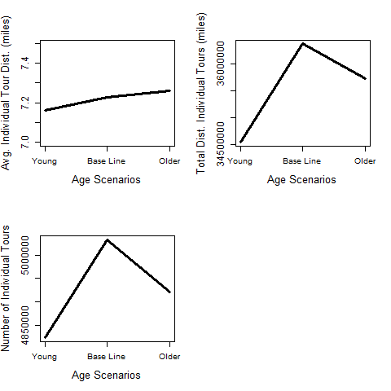
Average Tour Distance:
Individual Tours
Notes:
This slide is ok.
Baseline has the highest total tours.
Older scenario has the longest average tour distance.
Younger scenario has the shortest average tour distance.

Slide 31
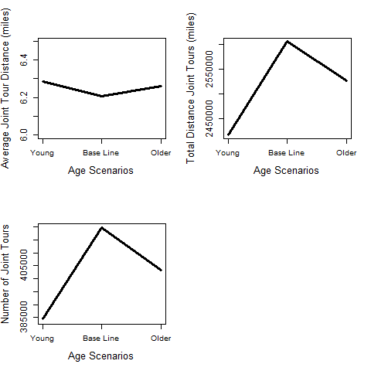
Average Tour Distance:
Joint Tours
Notes:
This slide is ok.
Baseline has the shortest joint tour distance
Younger scenario has the longest joint tour distance.

Slide 32
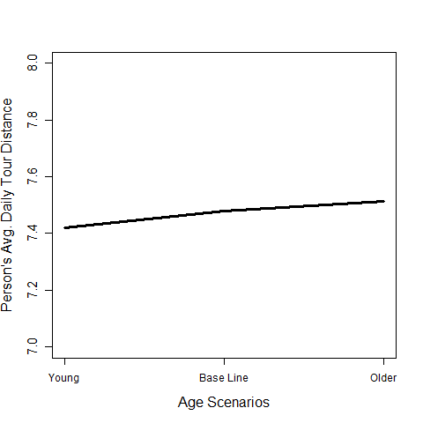
Average Daily Miles of Travel
Notes:
This slide is ok.
Older scenario has the longest daily travel distance-because they have time.

Slide 33
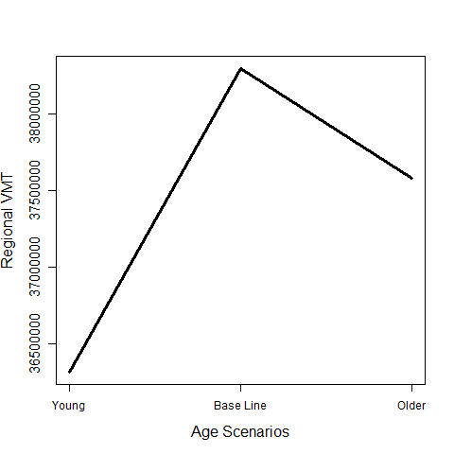
Regional VMT
(Resident Households)

Slide 34
Conclusions
Population aging is a national trend
Impact of population on travel patterns
Evaluate population aging impact on travel using ABM
Say something about analysis results here….

