Slide 1
MPO Modeling Efforts in the Development of an Activity-Based Model (ABM):
The San Diego Experience
14th TRB National Transportation Planning Applications Conference, Columbus OH
May 7th, 2013
Wu Sun, Ziying Ouyang, Rick Curry & Clint Daniels
San Diego Association of Governments (SANDAG)
Notes:
Topic
I am, interesting work 4 years
SANDAG co-authors
PB team

Slide 2
Background
SANDAG ABM development status
Share model development experience
Notes:
Objective of this presentation:
Report the status of development
Share experience from MPO modeling staff perspective
SANDAG ABM
4-year project, 1/2009-1/2013
Calibrated and validated to model base year 2008
Initial sensitivity testing on future scenarios, including sensitivity test on aging scenario, which I will make a presentation later in the afternoon
Transitioning to a new geography and new base year 2010
Share experience from these perspectives:
Agency/Policy Perspective
Technical Perspective
Data Perspective
Administrative perspective

Slide 3
Transportation Model Users
Caltrans
CARB
SANDAG
APCD
Transportation
Model
City of San Diego
MTS
Local Jurisdictions
NCTD
Private Developers
Notes:
What is APCD?

Slide 4
Project Management
Level of SANDAG staff involvement
  Project management only?
  Data collection and processing only?
  Or more?
Project management
Technical advisory
Development and application staff
Notes:
Level of staff involvement:
Model is complicated
Staff to run the model on a daily base in applications, staff need to be able to independently solve problems
NO BLACK BOX, TRANSPARENT BOX, expect SANDAG staff to be actively involved in model development
Management:
Weekly meetings
Documentation:
Code repository, important in debugging
Technical advisory:
A group of national known experts from other MPOs, federal government, professors from local and other universities, and SANDAG planning and upper management staff. Name a few in the audience?
3 advisory meetings
Project is primarily tasked to development staff, but the application staff provided very valuable support, such as network building and data collections. We have regular meetings with application staff via:
Internal modeling meeting
Special workshops
At the end, ABM trainings

Slide 5
SANDAG Staff Responsibilities
Project management
Data collection and processing
Review model estimation, calibration and validation results
Model development
Understand source codes? Yes
Hardware and software configuations? Yes
Notes:
Population Synthesizer
Some model estimations
Sensitivity testing

Slide 6
Important Technical Decisions
Model features & scope of work
Granularity and key model dimensions
  Spatial resolution
  Temporal resolution
  Socio-demographic resolution
Integration with other models
Choose a model platform
Notes:
Important technical decisions to be made in planning stage:
What model features do we must have? What should be included in SOW?
What granularity and its implication on model dimensions?
Integrate ABM with what other models? And, integration at what level?
What model platform do we pick?

Slide 7
Model Features
Detailed spatial & temporal representations
Sensitive to socio-demographic changes
Explicit intra-household interactions
Full set of travel modes
Unique regional features
A set of special market models
Integrates with the commercial travel model
Integrates with the land-use model (PECAS)
Notes:
We decided SANDAG ABM should have these features:
Detailed spatial representation so that we can model transit and non-motorized travel better.
Detailed temporal representation so that we can model time-variant tolling and flexible working hour better, also for future integration with DTA.
Explicit intra-household modeling to account for HOV trips and better constrained scheduling
Unique regional feature-Xborder model
Special market models to have a comprehensive picture of regional trips and VMT:
Visitor
Air passenger
External trip model
Special event model
Integrate with CTM with some shared inputs such as micro-zone based employment data and combined traffic assignment
Integrate with PECAS with iterative data feedback
From PECAS to ABM: micro-zone based socio-demo graphic inputs and marginal controls to population synthesizer.
From ABM to PECAS, aggregated mode choice and destination choice logsums and skims at land use zone level.

Slide 8
Spatial Resolution
MGRA (gray lines)
23002 MGRA
4996 TAZs
MGRA: Master Geographic Reference Area (Grey Lines)
TAZ: Transportation Analysis Zone (Orange Line)
Notes:
Spatial resolution is a double edged sword:
Spatial details improve transit and non-motorized travel modeling and behavioral realism
Spatial details also cause increased:
Model runtime, especially on location choice components
Data availability, especially for future years
Need to discuss with land use modelers to make sure what are forecastable at micro-zone levels
Spatial Details:
MGRAs (SR13-23K)
TAZs: (SR13-4996)

Slide 9
Temporal Resolution
  TOD in travel demand modeling
    40 departure half-hours
    40 arrival half-hours
  TOD in traffic assignment
NUMBER | DESCRIPTION | BEGIN TIME | END TIME
1 | Early A.M. | 3:00 A.M. | 5:59 A.M.
2 | A.M. Peak | 6:00 A.M. | 8:59 A.M.
3 | Midday | 9:00 A.M. | 3:29 A.M.
4 | P.M. Peak | 3:30 P.M. | 6:59 P.M.
5 | Evening | 7:00 P.M. | 3:29 A.M.
Notes:
Again temporal granularity is a double-edged sword:
Temporal details improve:
Behavioral realism
Flexible working schedule and time-dependent toll applications
Emergency evacuation planning application
Consider impacts:
Model runtime, on both the demand side and the supply side (how many TODs in traffic assignment)
Temporal Details:
30 minute time slices, some early hours are combined, instead of 48 30 min TODs, there are 40 of them.
5 TODs in assignment

Slide 10
Socio-Demographic Resolution
Expectations of social equity analysis
Availability and quality of socio-demographic data
Key household characteristics:
  household size, income, number of workers, children presence, dwelling unit type, and group quarter status
Key person characteristics:
  age , gender, race
Notes:
When we made a decision on the socio-demographic resolution, we considered these factors:
SE expectations:
Such as the definition of LIM (low income minority groups) used in Title VI or other SE analysis
Data availability:
Example, initially we wanted to have employment type as a control variable in the population synthesizer. After a discussion with land use modeler, it turns out it would be difficult to produce this control at residential end of micro-zone level. So, we have to drop it.
Key household and person socio-demographic variables (not a complete set used in the model, only the key ones).

Slide 11
Travel Modes
Choice
Auto
Drive alone
Shared ride 2
Non-motorized
Walk(9)
Shared ride 3+
GP(1)
Pay(2)
GP(3)
Pay(5)
GP(6)
HOV(7)
Bike(10)
Transit
Walk access
PNR access
Local bus(11)
Express bus(12)
BRT(13)
LRT(14)
Commuter rail(15)
Local bus(16)
Express bus(17)
BRT(18)
LRT(19)
Commuter rail(20)
HOV(4)
Pay(8)
KNR access
Local bus(21)
Express bus(22)
BRT(23)
LRT(24)
Commuter rail(25)
School Bus(26)
Notes:
26 Modes.
Top level: auto, NM, transit, and school bus
Transit further segmented by line haul and access model

Slide 12
Special Market Models
Cross-border model
Visitor model
Air passenger model
External trip models
Special event model
Notes:
Some of them are simplified disaggregate models:
Xborder, visitor, air passenger
Aggregate models:
EI, EE, and special event (IE is part of the core model, not special market model)

Slide 13
Model Structure
Transportation
Policy
Transportation
System
Land Use
Models
ABM
Border
Model
Traffic Assignment
CTM
Special
Models
Environmental
Impact
System
Performance
Economic
Analysis
Notes:
Transportation models:
Activity-based model (ABM)
Commercial vehicle model (CVM)
Land use Model:
Production, Exchange, and Consumption Allocation System (PECAS)
Integrated land use and transportation model
Integrated with EMFAC model that is used in CA

Slide 14
Model Platform
Understand the difference between various model platforms
Must have model features
Matching with staff skills
Coordinated Travel – Regional Activity Based Modeling Platform (CT-RAMP)
Notes:
Considered all major ABM modeling platforms and investigated the difference among these platforms
Among some other factors, we made our decisions on two factors:
What are the must have model features?
How it handles intra-household interactions?
How could unique regional features such as Xborder model be handled by the platform?
How well it integrate with land use and EMFAC models
Does the skill set of SANDAG staff match the requirements of these model platforms?
Programming language used (SANDAG has a few Java savvy staff, so choosing a Java-based platform could be beneficial to us)
What data processing skills staff need to have to support model development?
PB’s CT-RAMP platform.

Slide 15
Data Collection Issues
What data do we need?
Data collection coordination
Data processing and cleaning
Data geographies
Data privacy issues
Notes:
Data collection and processing is one of the key responsibilities MPO modeling staff undertakes.
It could be boring and overwhelming sometimes, but it is important. The responsiveness of MPO staff to provide high quality data is key to the success of a large scale ABM development, especially we choose to develop almost every single component from scratch.
In the next slide, I will talk about a list of data we needed.
Data collection takes time, many data were collected while we are developing the model, so it should be well coordinated:
Model development schedule and data collection schedule
Coordination between survey and modeling staff
Data geographies have great impact on data collection effort, I have a summary table in the next slide.
Data privacy is an issue that need careful consideration. In CA, SB1268 regulates transportation agencies use personally identifiable data, for example, we had to talk to our legal consuls on how we use FasTrak toll data on I15.

Slide 16
What data do we need?
Travel Surveys | Household travel behavior
 | Transit on-board survey
Network | Highway network
 | Transit network
 | Highway skims
 | Transit skims
 | Transit access/egress
 | Non-motorized impedances
Land Use & | Local employment
 | Local socio demo
 | Local enrollment
 | Build environment
Census/ACS | PUMS
 | Summary files
 | CTPP
Parking | Inventory
 | Behavior survey
FasTrak&Toll | Toll use
 | FasTrak registration
Special Market Surveys | Cross-border survey
 | Visitor survey
 | Air passenger survey
 | Inter-regional travel survey
 | Special even survey
Counts | PeMS data
 | Caltran district 11 counts
 | Arterial counts
Notes:
READ

Slide 17
Data Geographies
Name | Count | Category
Census Block 2000, 2010 | 25,662 | Census
Census Block Group 2000, 2010 | 1,762 | Census
Census Tract 2000, 2010 | 605 | Census
PUMA 2000 | 16 | Census
CTPP TAZ 2000 | 505 | Census
MGRA 12 | 21,633 | SANDAG Transportation Model
MGRA 13 | 23,002 | SANDAG Transportation Model
TAZ 12 | 4,682 | SANDAG Transportation Model
TAZ 13 | 4,996 | SANDAG Transportation Model
Transit access point (TAP) | 2,500 | SANDAG Transportation Model
Pseudo major statistical area | 8 | SANDAG Transportation Model
High school district | 6 | SANDAG Land Use Model
Elementary school district | 24 | SANDAG Land Use Model
Land use zone (LUZ) | 229 | SANDAG Land Use Model
Notes:
Geographies uses in data collection has implications on data collection and cleaning efforts.
Multiple geography: READ
Geography has implications on:
Data consistency.
Aggregation, disaggregation.
Geography change:
Affects all not just model inputs
Model need to be recalibrated and validated
Sometime model itself, sometime unexpected model related issues occur when transition to a new geography.

Slide 18
Survey Data
Name | Year | Agency | Sample Size
Household travel behavior survey | 2006-2007 | SANDAG | 3536 households
Transit on-board survey | 2009 | SANDAG | 28303 trips
Parking inventory survey | 2010 | SANDAG | parking lots and meters
Parking behavior survey | 2010-2011 | SANDAG | 1563 persons
Border crossing survey | 2010 | SANDAG | 1500 persons
Visitor survey | 2011 | SANDAG | 600 persons
Special event survey | 2011 | SANDAG | 1500 persons
Interregional travel survey | 2006 | SANDAG | 1301 persons
Vehicle classification & occupancy survey | 2006 | SANDAG | 671827 vehicles
Taxi passenger survey | 2009 | MTS/SANDAG | 988 persons
Air passenger survey | 2009 | SDIA | 8771 persons
Notes:
11 surveys
3 available before model development started.
6 conducted while model is being developed.
9 of 11 are SANDAG surveys
2 of 11 are surveys conducted by other agencies.

Slide 19
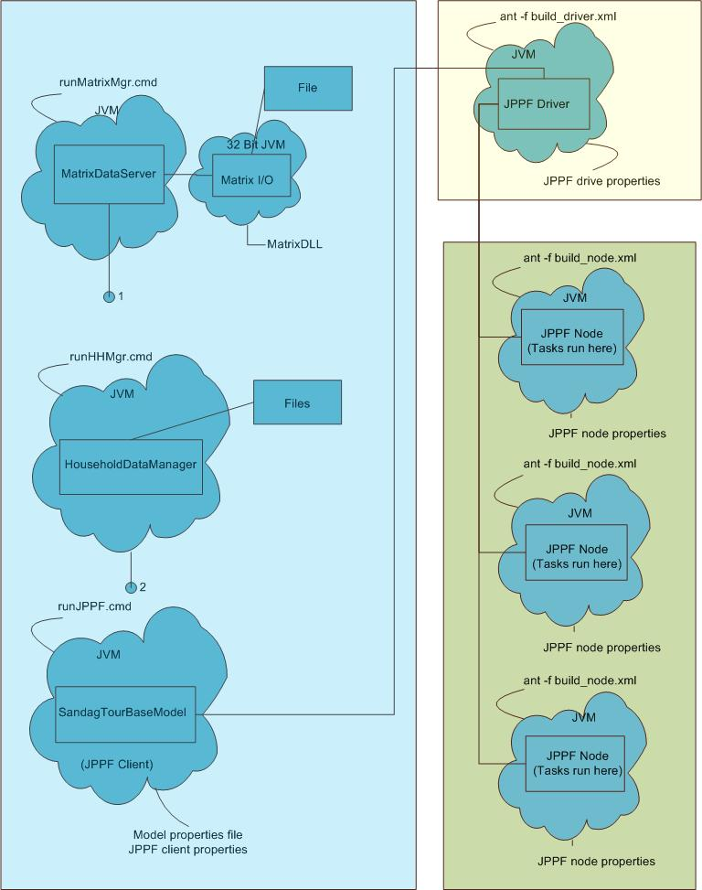
Software Framework
Notes:
Distributed computing framework
JPPF (Java Parallel Processing Framework)
One master node and 2 worker nodes.
Household server sends household packet from master node to worker nodes.
Matrix server.

Slide 20
Model Run Time (I)
What affects model run time?
  Size of household and population
  Network and zones (TAZ and MGRA)
  Household packet size
  Number of threads on all nodes
  RAM: minimum 30GB
Model runtime benchmark
  Base year (2008): ~17hrs
  Future year (2035): ~20hrs
Notes:
MMA
Bi-conjugate assignment
14 vehicle classes
5 TODs
3 global iterations (4 highway assignments)
Convergence criteria 0.0005

Slide 21
Model Run Time (II)
Run time breakdowns
CT-RAMP Core | 5:40
Hwy Assignment | 5:20
Hwy Skimming | 0:50
Transit Assignment | 0:30
Transit Skimming | 0:20
Xborder | 1:15
Visitor | 0:30
Other | 2:15
Total | 16:40
Notes:
Can only reduce CT-RAMP by this much
TransCAD steps: 7 out of 16 and 40 mins spent on TransCAD
Xborder is a bottleneck, 8 times faster now.

Slide 22
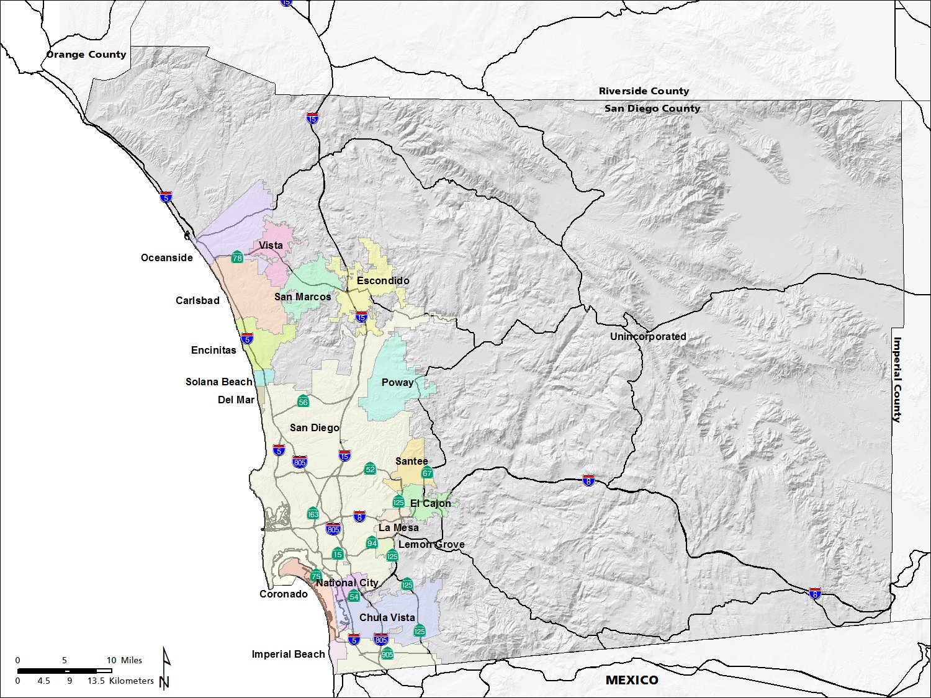
How much do we need to know about the model?
Notes:
When model is in production mode, pressure will be shifting to staff.
A lot of the times the turn around time is short, which requires staff to solve problems mostly in house.
Even with consultant on-call, consultants are not available all the times
Especially important for a newly completed model. Tend to have issues as staff is getting familiar with the model.
Example:
Transition to a new geography and new base year.
We are expected to produced aggregated logsums and skims to land use model.
We encountered various issues to be solved in house.
Beautiful San Diego. Most people in SD live and work in the western portion of the county.
The total population in San Diego is 3,208,466 according to the 2010 US census.
To give you a better idea of how big San Diego County is – it is bigger than the state of Rhode Island.
Camp Pendleton: major West Coast Marine Corps base
Northwest corner of SD County

Slide 23
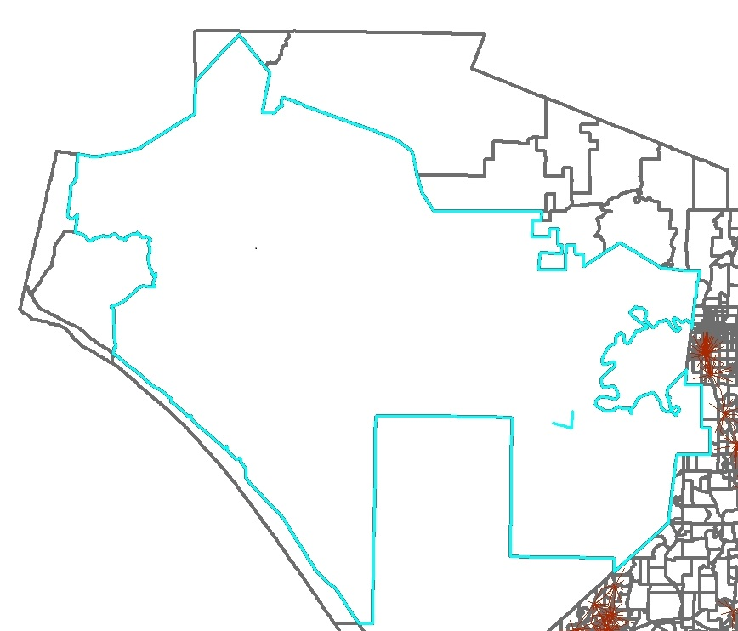
Need to know a lot
Notes:
1) Camp Pendelton is a large MGRA
2) A 30 year old female.
Work tour.
Escort stop, drop kid to school.
Tour mode is chosen: walk to transit tour
MGRA centroid
2 transit TAPs (transit access points, think transit stops)
3) The program keep bombing at intermediate stop location choice step. Finding a stop location (a MGRA) to drop off the kid.
5) For a MGRA to qualify as a stop location alternative, it must satisfy:
There are TAPs walk accessible from this MGRA (Yes)
The MGRA is within walking distance (1 mile threshold) from the trip origin (No)
5)
Too far to walk to other MGRAs.
Intra-MGRA walk distance is based on the size of the MGRA, over 1 mile threshold
6) How did we find out the reasons? DEGUG the source codes.
7) Interesting because it reveals the importance of MPO staff to:
Understand how model works at plumbing level
Understand the input data, such as how walk to taps are calculated, how geography and network changes could potentially affect model result.
Be able to look into the codes and debug, especially within a short turn around time when consultants are not available.

Slide 24
Lessons Learned
Plan well and ahead
Dedicated staff
Good work relationship with consultants
Communicate with stakeholders
Be aware of model run time and implications on future applications
Manage expectations

Slide 25
Questions?
Contact: Wu Sun
Wu.Sun@sandag.org

