Slide 1

Integration of a Parcel-Based Sketch Planning Model with GIS to Measure GHG Emissions
Jung Seo, Hsi-Hwa Hu, Frank Wen, Simon Choi, Lu Lu
Southern California Association of Governments
14th TRB National Transportation Planning Applications Conference
May 5-9, 2013, Columbus, Ohio

Slide 2
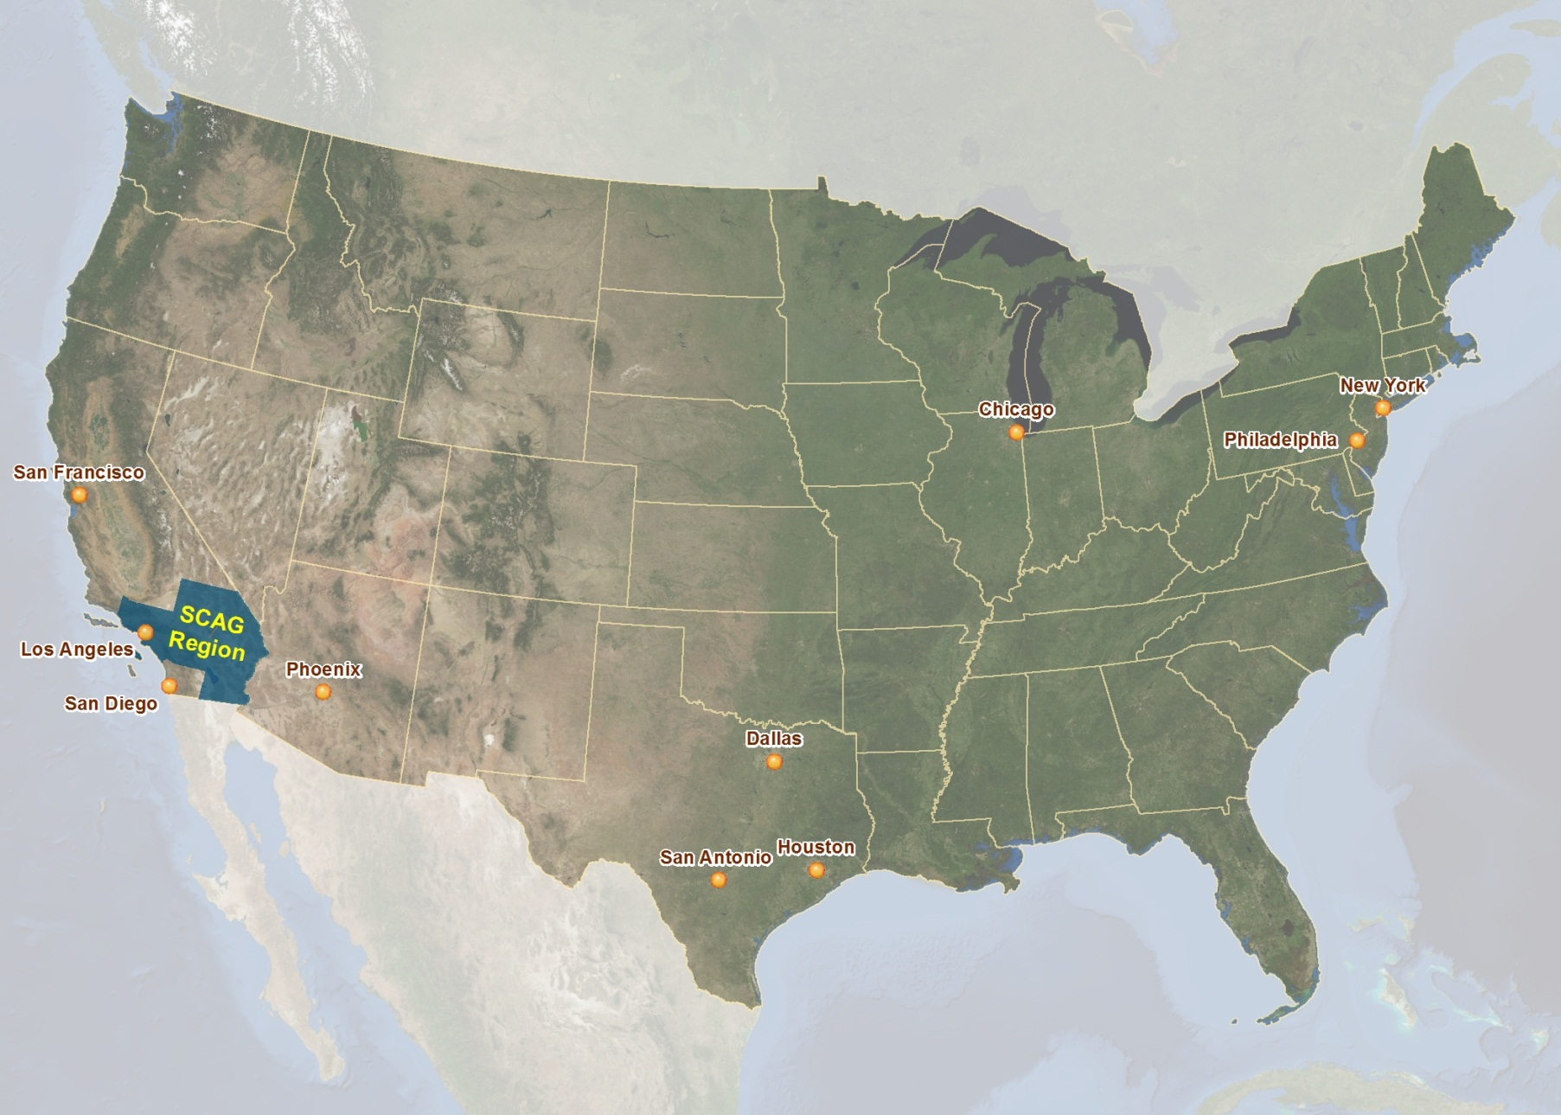
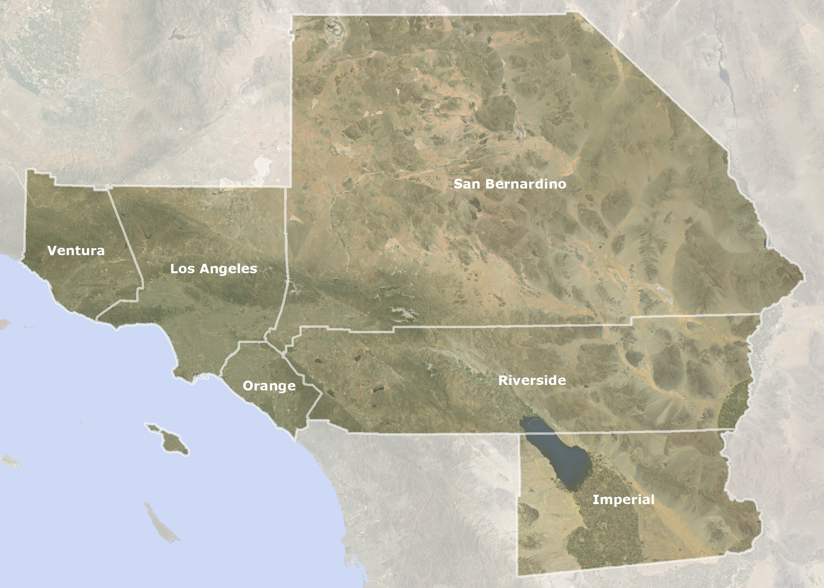
Southern California Association of Governments (SCAG)

Slide 3

SCAG Quick Facts
Nation’s largest Metropolitan Planning Organization (MPO)
6 counties and near 200 cities
18 million people within 38,000+ square miles
GDP in 2012: $890 Billion, 16th largest economy in the world

Slide 4
RTP/SCS and SB 375
Regional Transportation Plan (RTP)
SB 375 - Nation’s first law to control greenhouse gas (GHG)
Sustainable Communities Strategy (SCS)
Reductions in GHG emissions from
automobiles and light duty trucks

Slide 5
Research Objective
Parcel-Based Transportation Model
as a Supplemental Analysis Tool
Analysis of Impact of Land Use Scenario
on Travel Behavior and GHG Emissions.
Estimates of Greenhouse Gas (GHG) Emission using Vehicle Miles of Travel (VMT)

Slide 6
Land Use and Regional Transportation Plan
Transit-Oriented Development (TOD)
➔ Approach to reduce GHG emissions.
TOD land use scenario for SCAG’s 2012 RTP/SCS.
  More housing supply in TOD areas ➔ Reduction in Regional GHG emissions
  High Residential Density, Better Accessibility, Mixed Use,
  Proximity to Major Transit Services

Slide 7
SCAG Parcel-Based Sketch Model
Alternative modeling approach to
TAZ-Based SCAG Regional Travel Demand Model
Supplemental Analysis Tool to estimate of the impact of land use on vehicle use
Estimated by using 2009 National Household Travel Survey (NHTS) data

Slide 8
Modeling Approach

Slide 9
Variable Description
Household Travel Data
Socioeconomic Characteristics
Accessibility
Job-household Ratio

Slide 10
Neighborhood-Based Analysis
(1/4 mile buffer)
Household Density & Employment Density
Walkability
Job Diversity
Bus Stop Density
Urban rail access

Slide 11
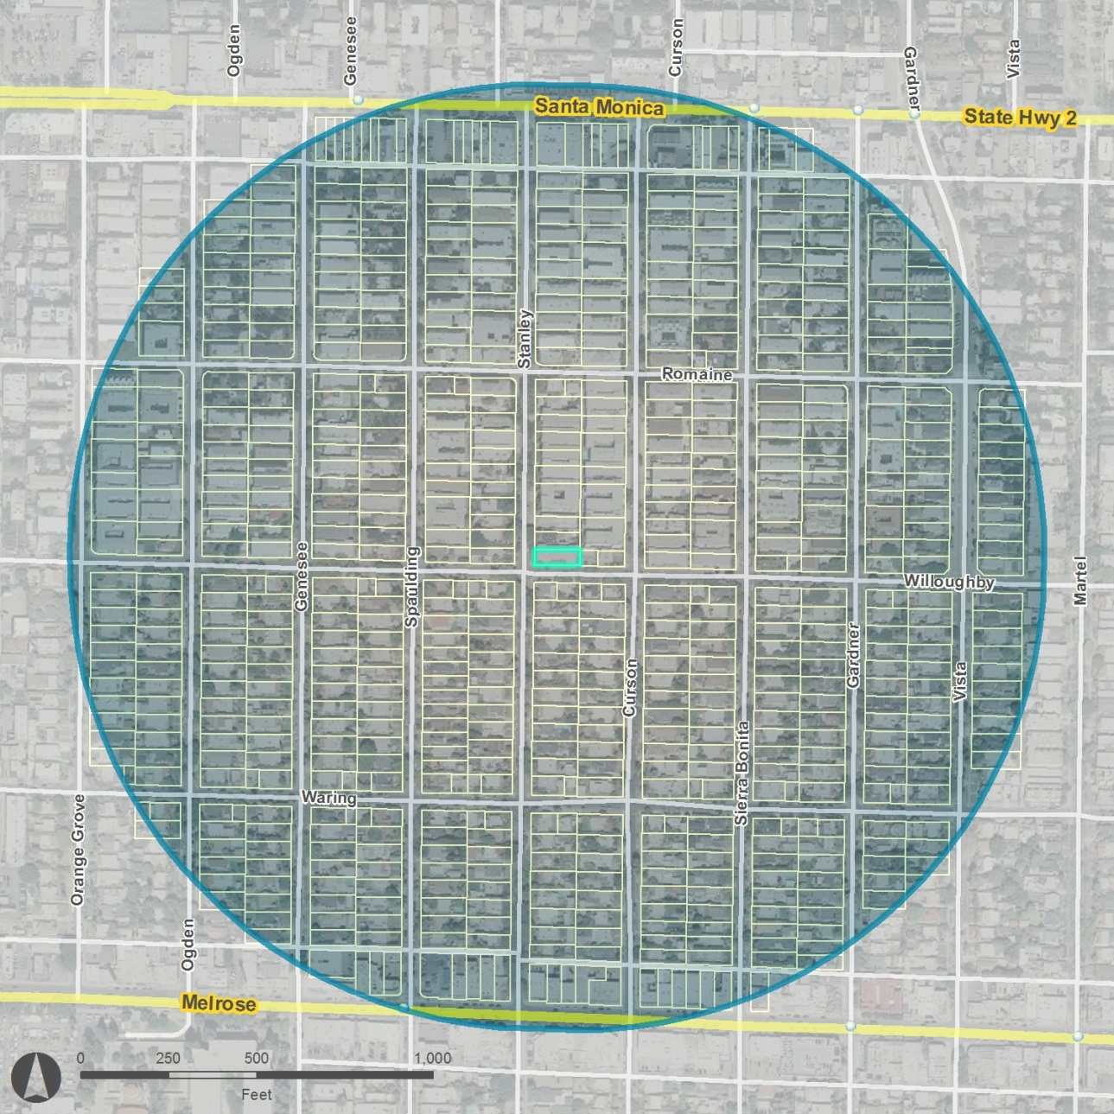
Neighborhood Household Density
( Select Parcels within ¼ Mile from Residential Parcels )
¼ Mile
Parcel ID: 123456

Slide 12
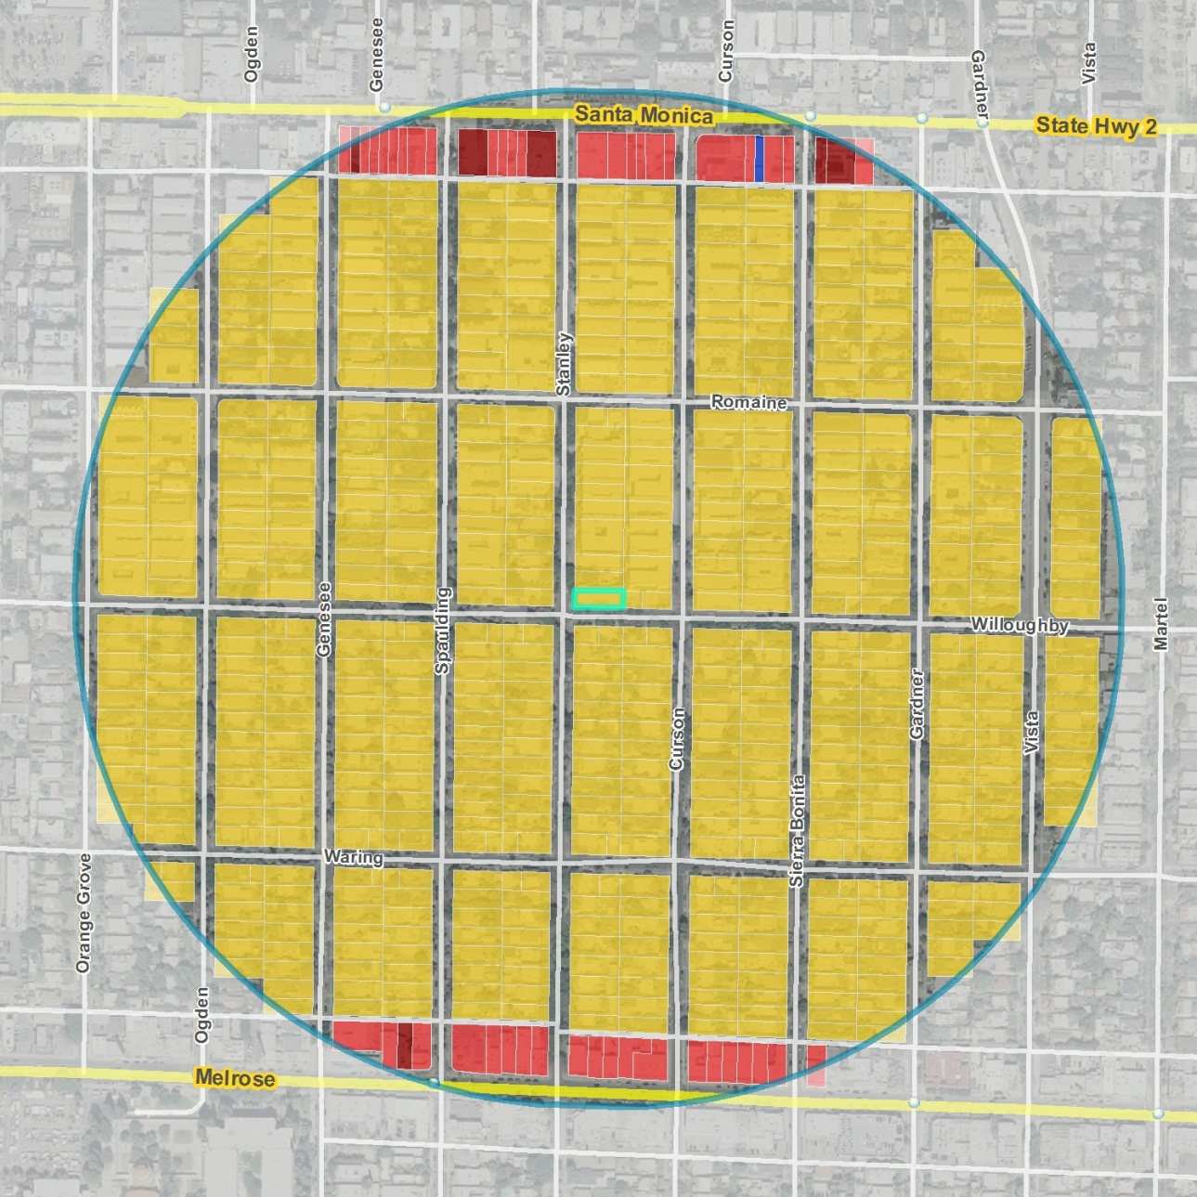
Neighborhood Household Density (cont.)
( Identify Land Uses within ¼ Mile Buffer )
Parcel ID: 123456

Slide 13
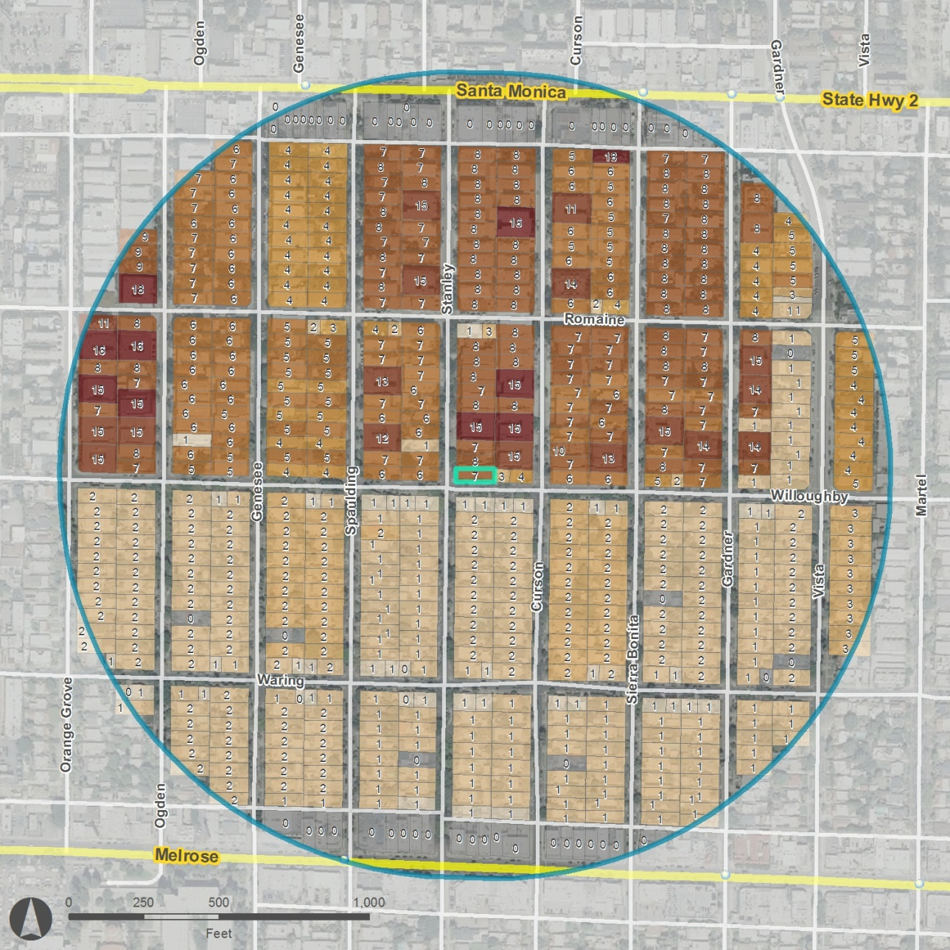
Neighborhood Household Density (cont.)
( Total Number of Households within ¼ Mile Buffer )
Total Households within ¼ Miles of Parcel 123456 :
2,624 HH
Parcel ID: 123456

Slide 14
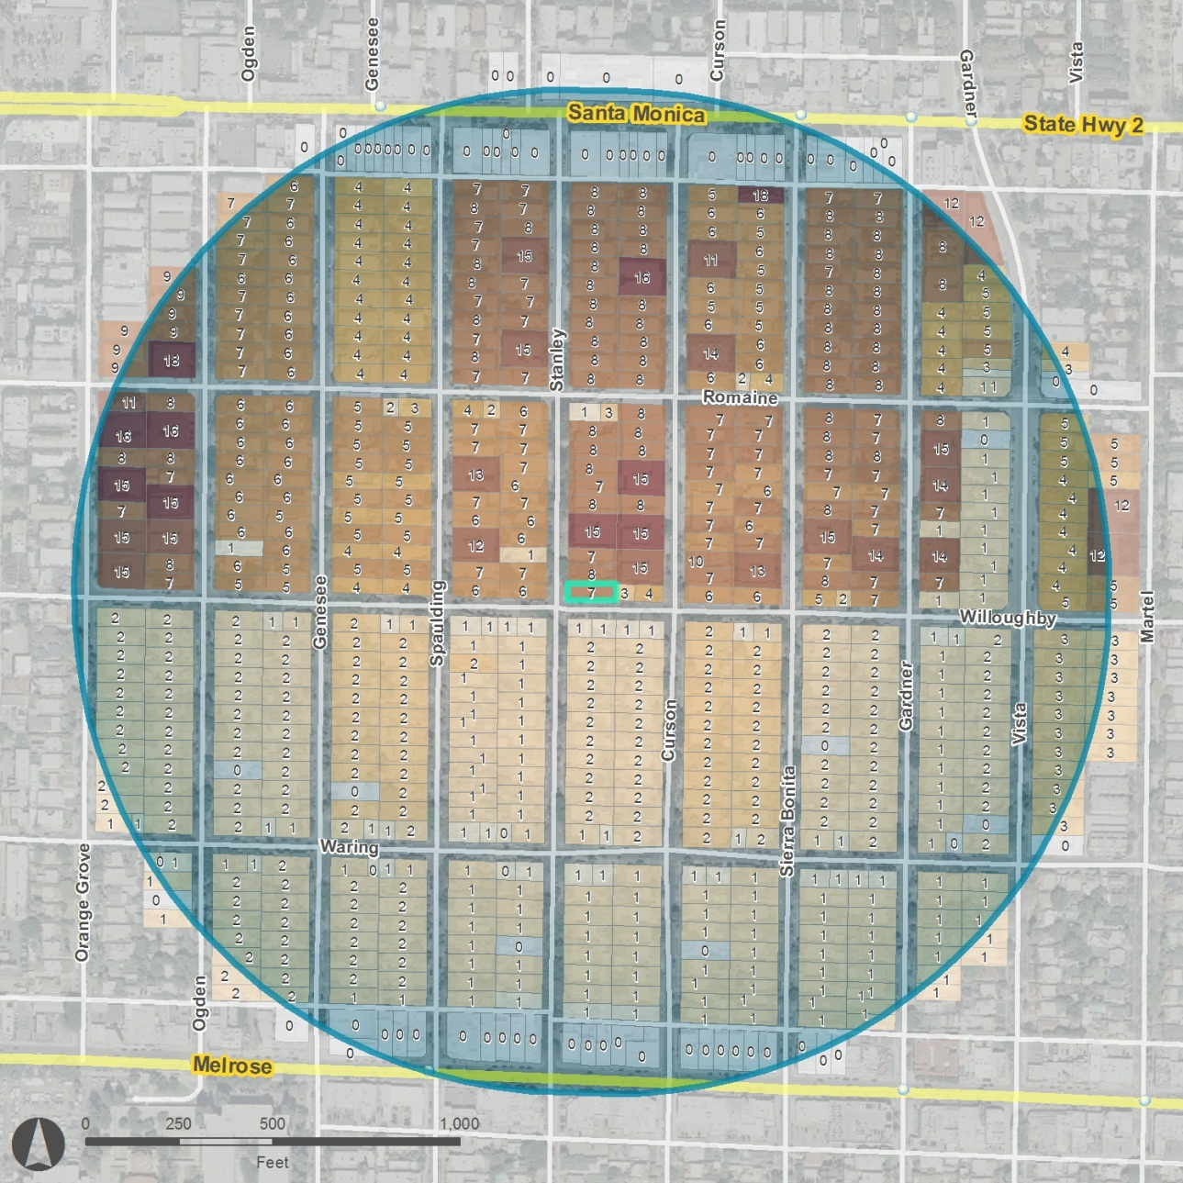
Neighborhood Household Density (cont.)
( Total Households Divided by Area )
Total Households within ¼ Miles Buffer: 2,624 HH
Acreage of ¼ Mile Buffer: 125.7 Acres
Neighborhood Household Density: 20.9
( 2,624 HH / 125.7 Acres )
Parcel ID: 123456

Slide 15
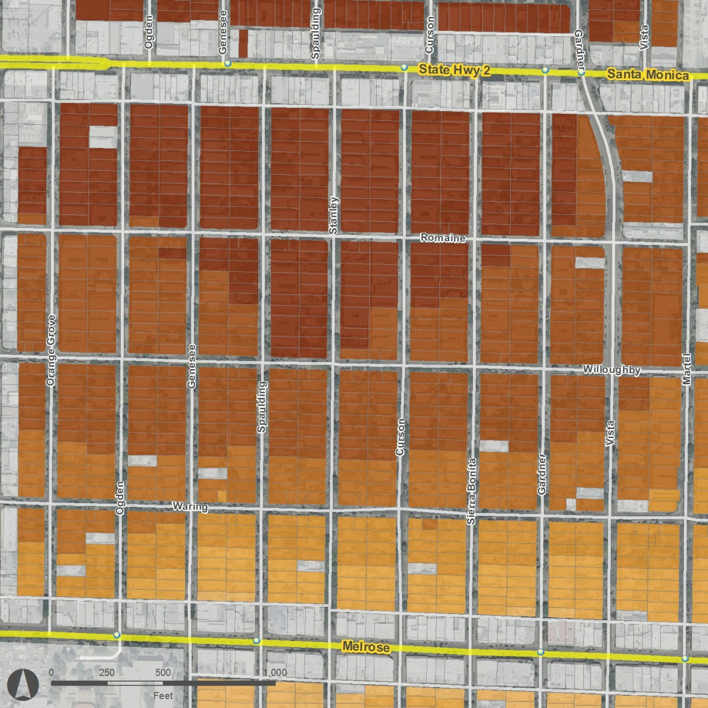
Neighborhood Household Density (cont.)
( Calculate the Household Density for the Entire Parcels )

Slide 16
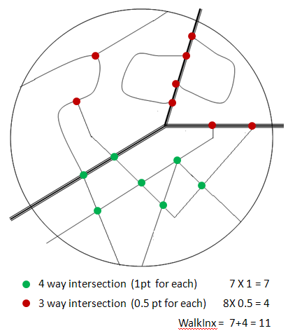
Walkability Index
( Street Connectivity within ¼ Mile Buffer )

Slide 17
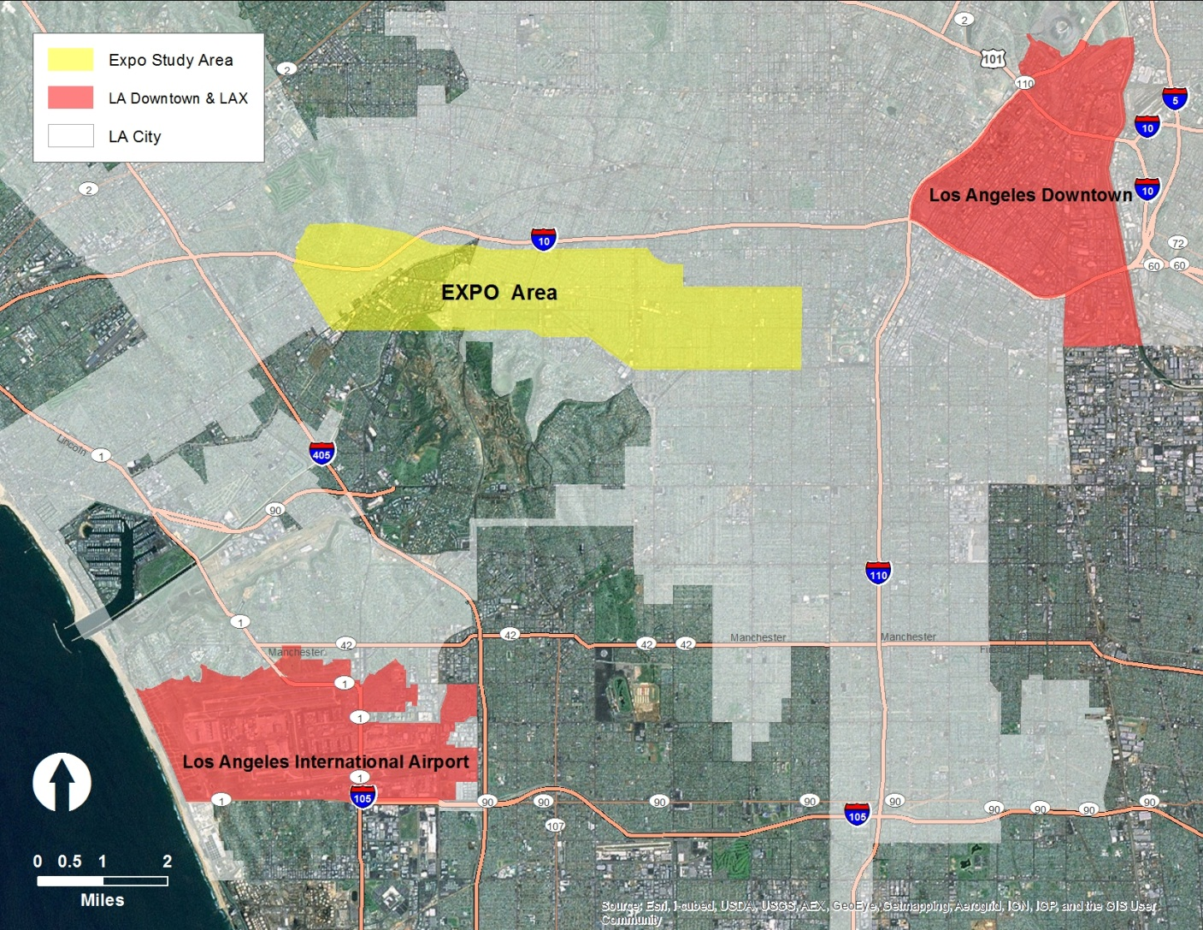
Study Area

Slide 18
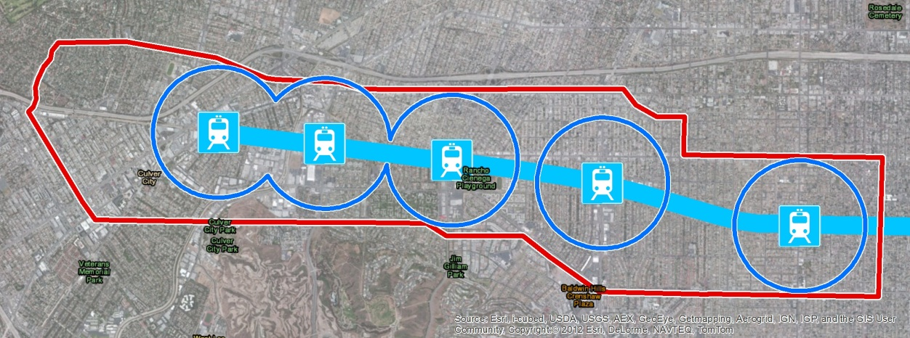
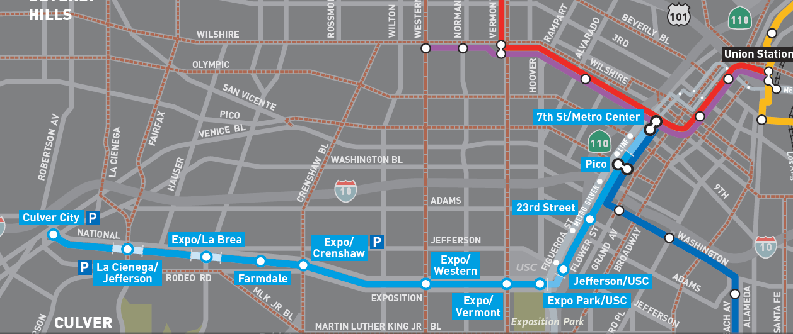
Study Area
Surrounding area of Exposition Line (LRT) Phase I (opened in 2012)
½ mile buffer and bounded by major streets
Analysis:
2008 vs. 2035 Plan (TOD)

Slide 19
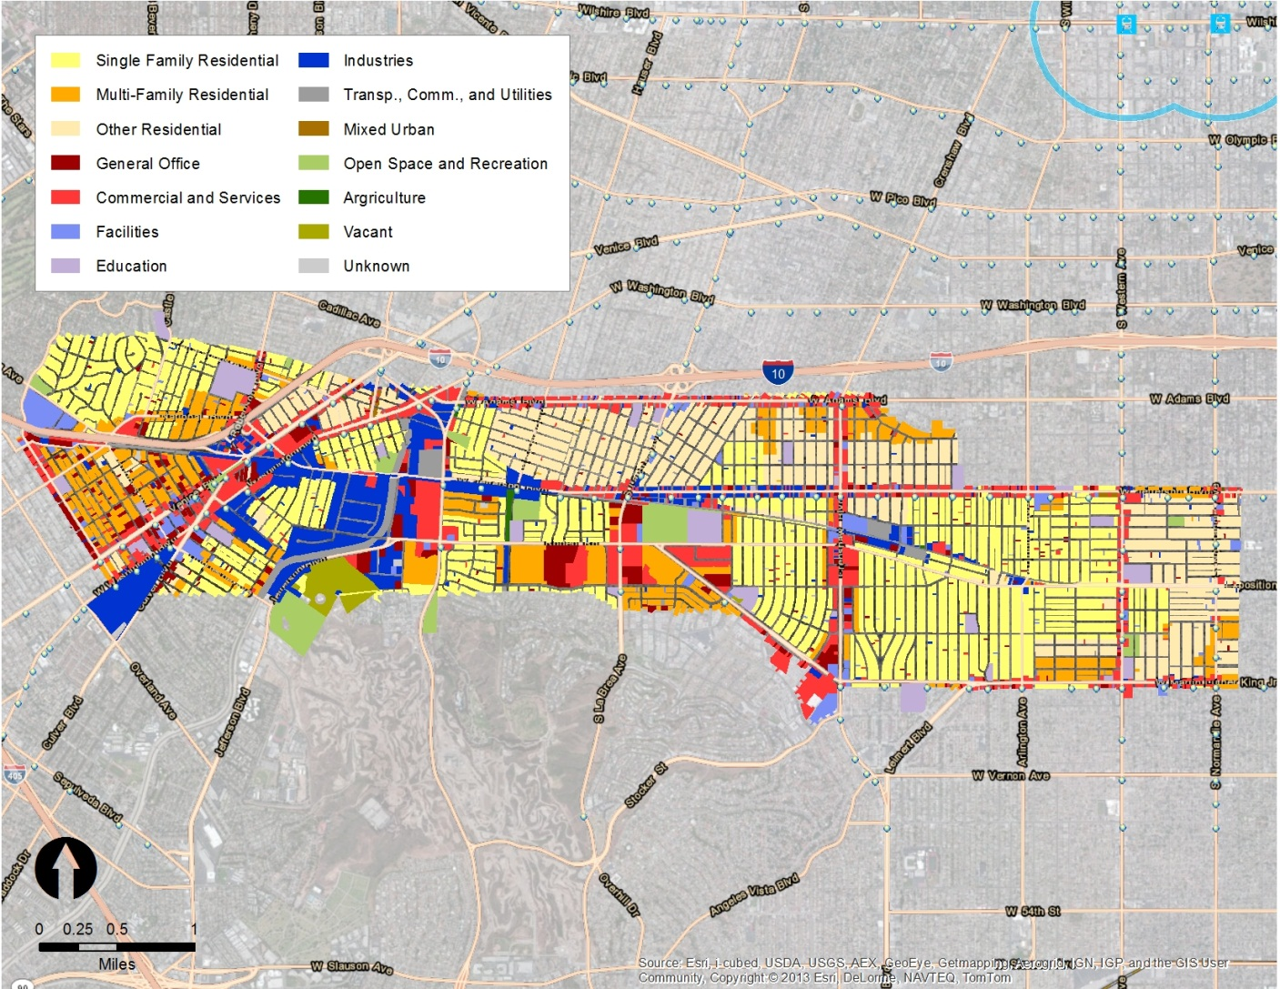
Existing Land Use
( 2008 )

Slide 20
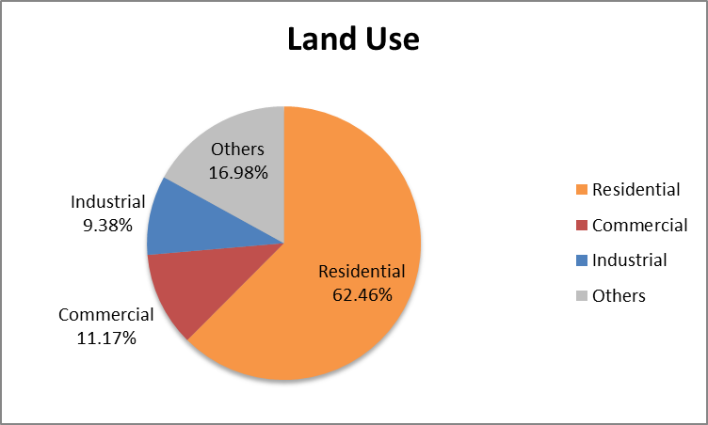
Existing Land Use
( 2008 )

Slide 21
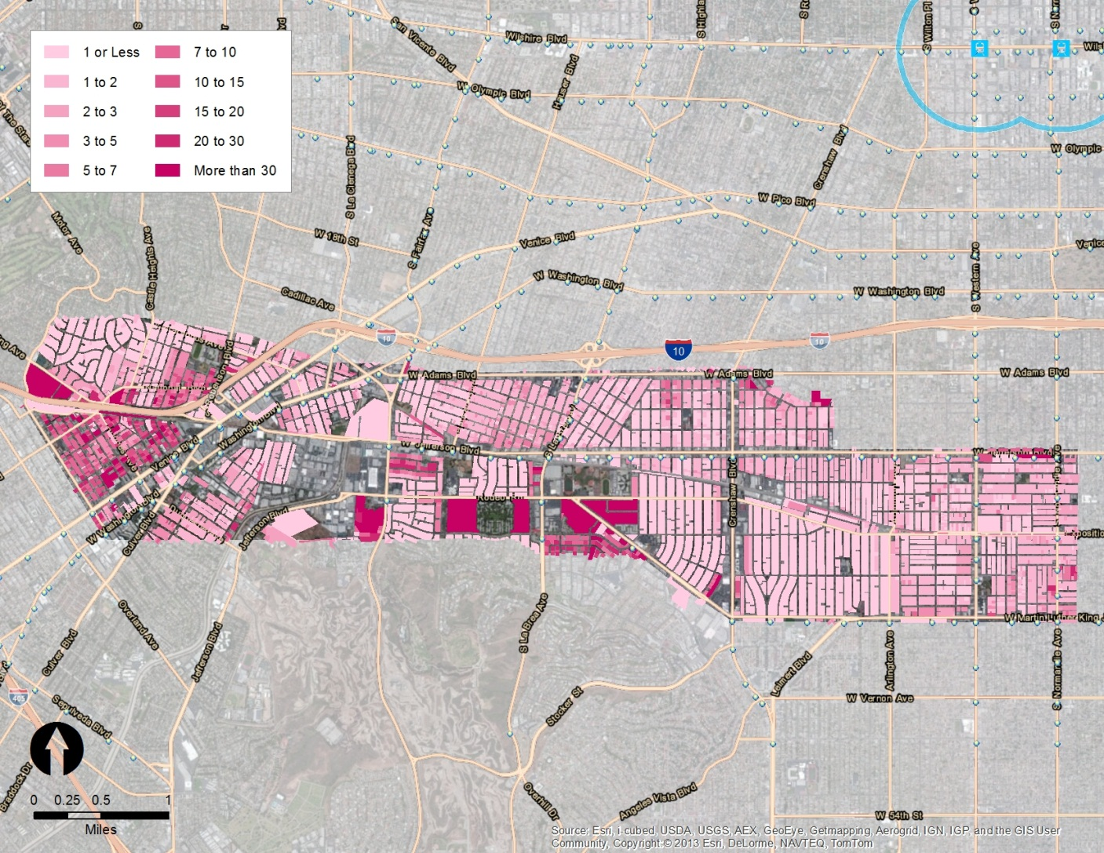
Number of Households
( 2008 )

Slide 22
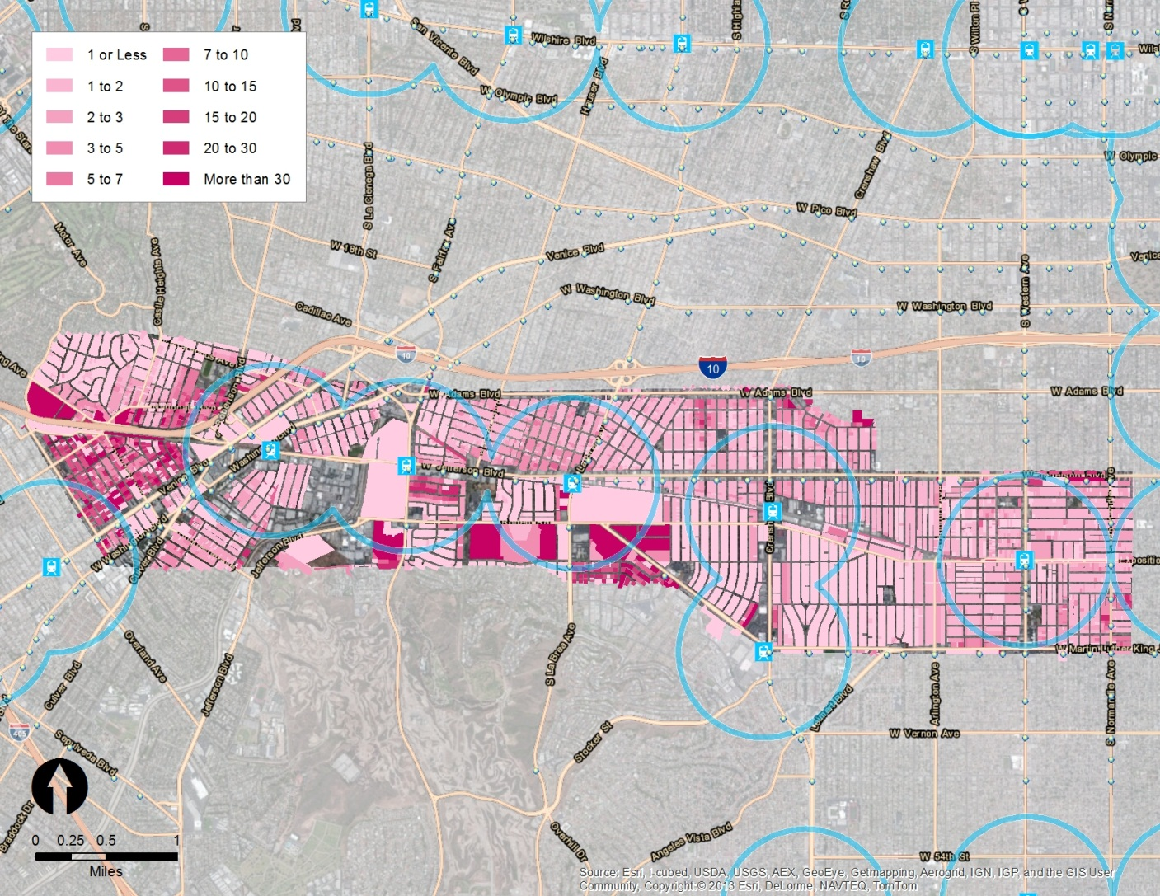
Number of Households
( 2035 Plan )

Slide 23
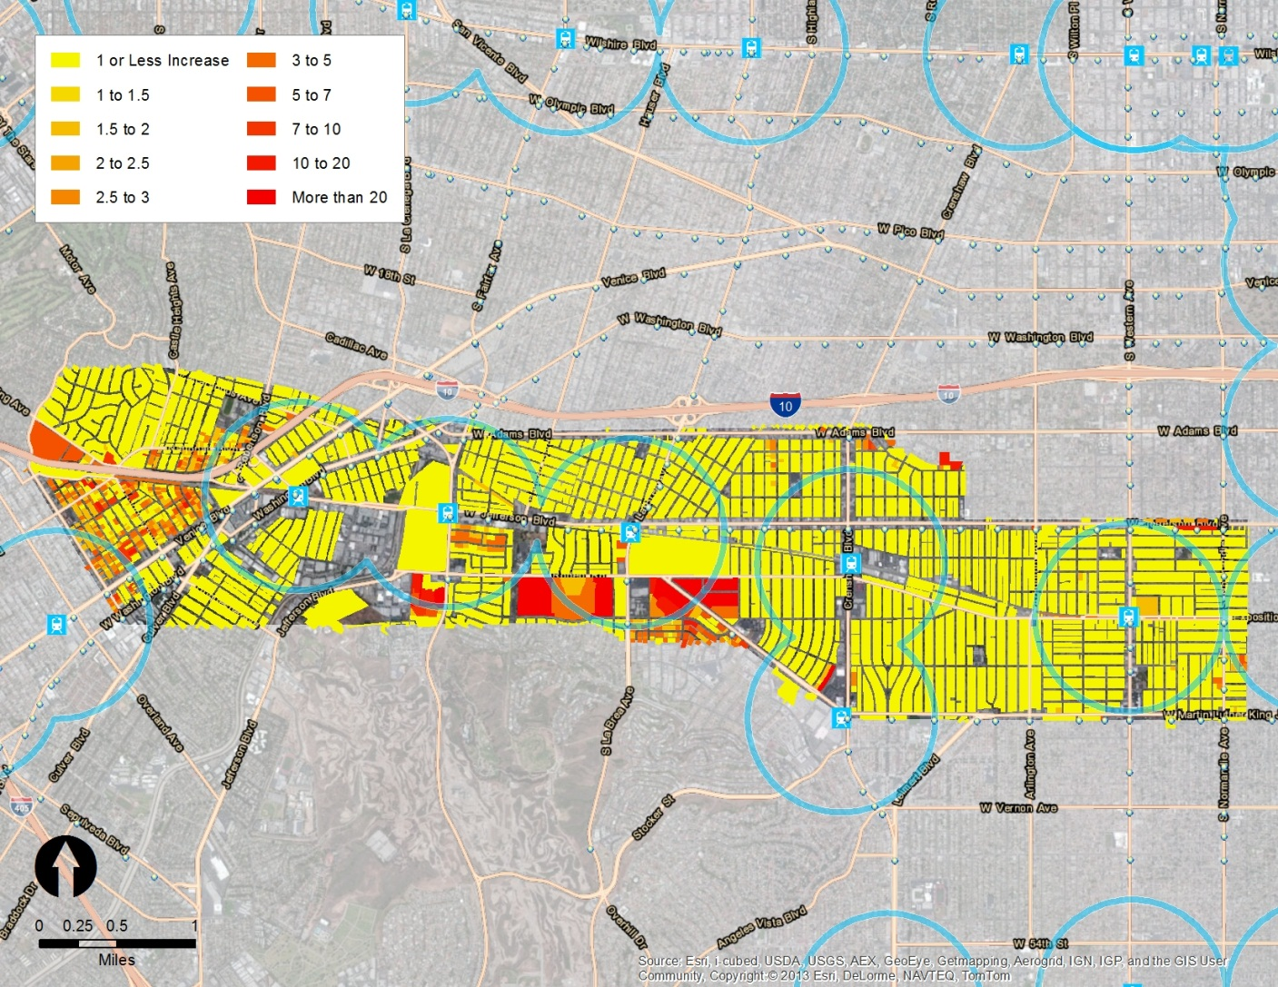
Number of Households
( 2008 to 2035 )

Slide 24
Land Use & Socioeconomic Characteristics
( 2008 vs. 2035 Plan )
Study Area | 2008 | 2035 Plan | % Change
Residential Density | 11.25 | 13.86 | 23%
Job Density | 7.04 | 7.61 | 8%
Household Size | 2.73 | 2.57 | -6%
Household Income | $35,500 | $35,600 | 0.3%
Total Household | 38,119 | 46,479 | 22%

Slide 25
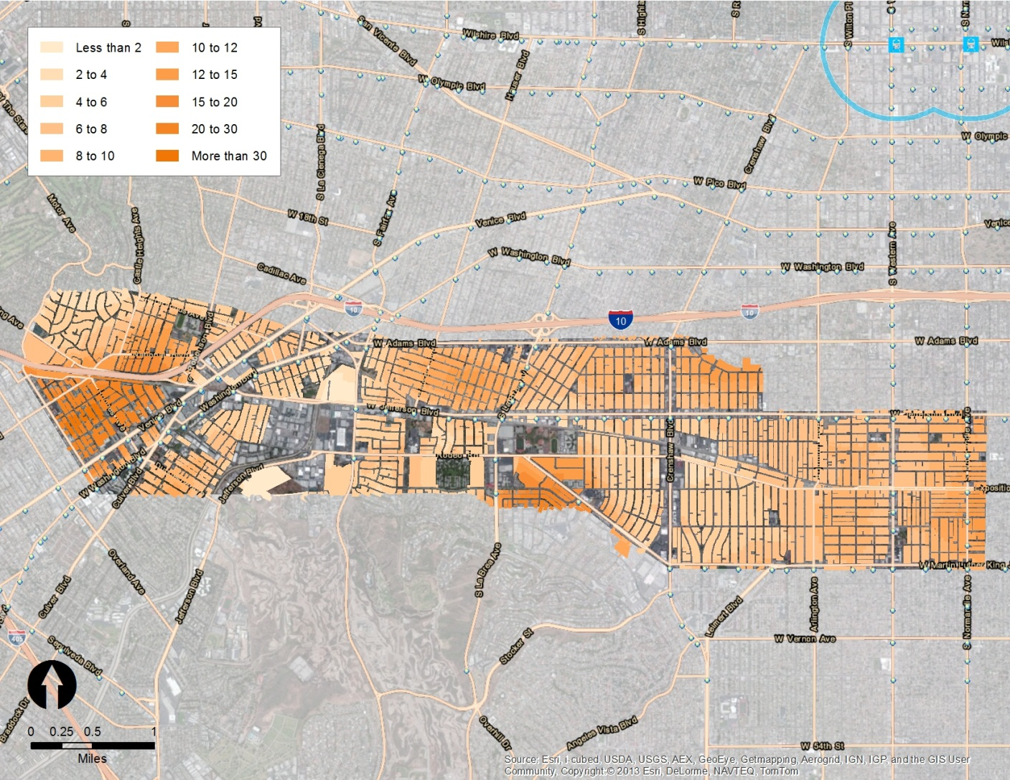
Neighborhood Household Density
( 2008 )

Slide 26
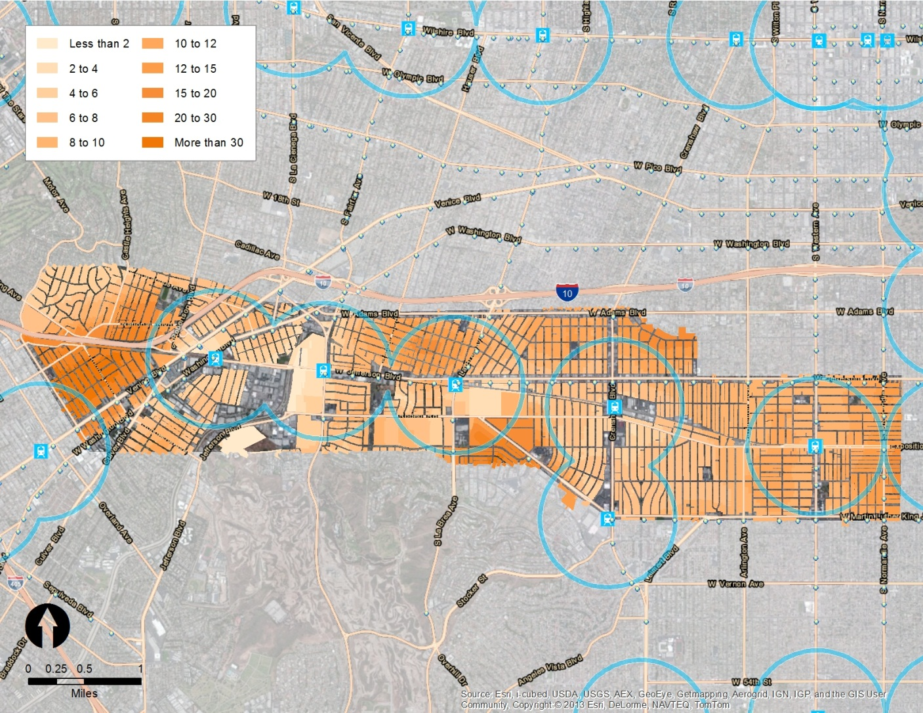
Neighborhood Household Density
( 2035 Plan )

Slide 27
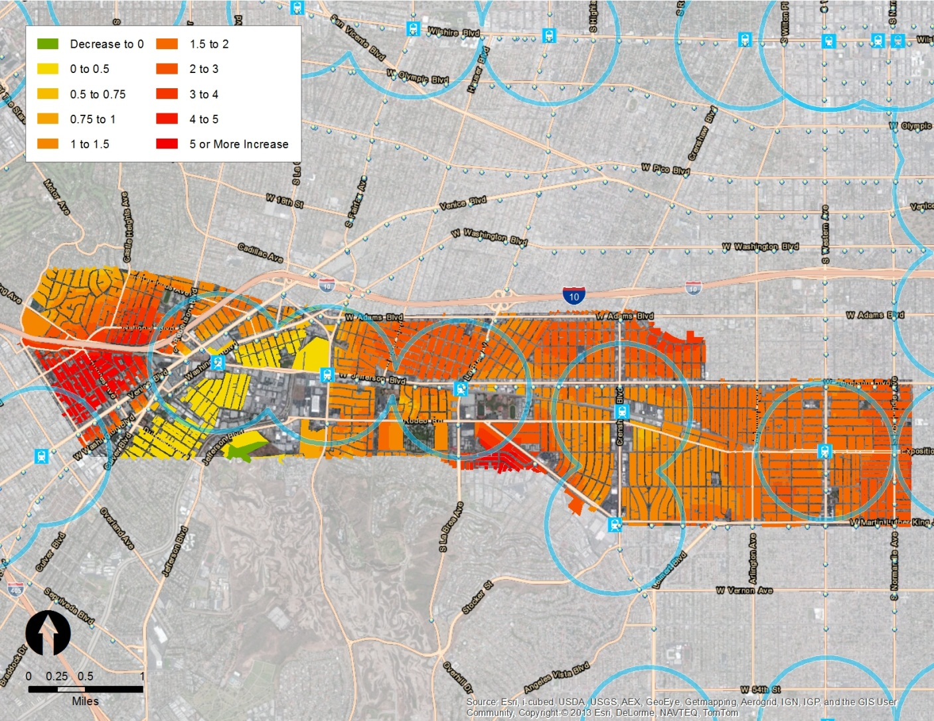
Neighborhood Household Density
( 2008 to 2035 Plan )

Slide 28
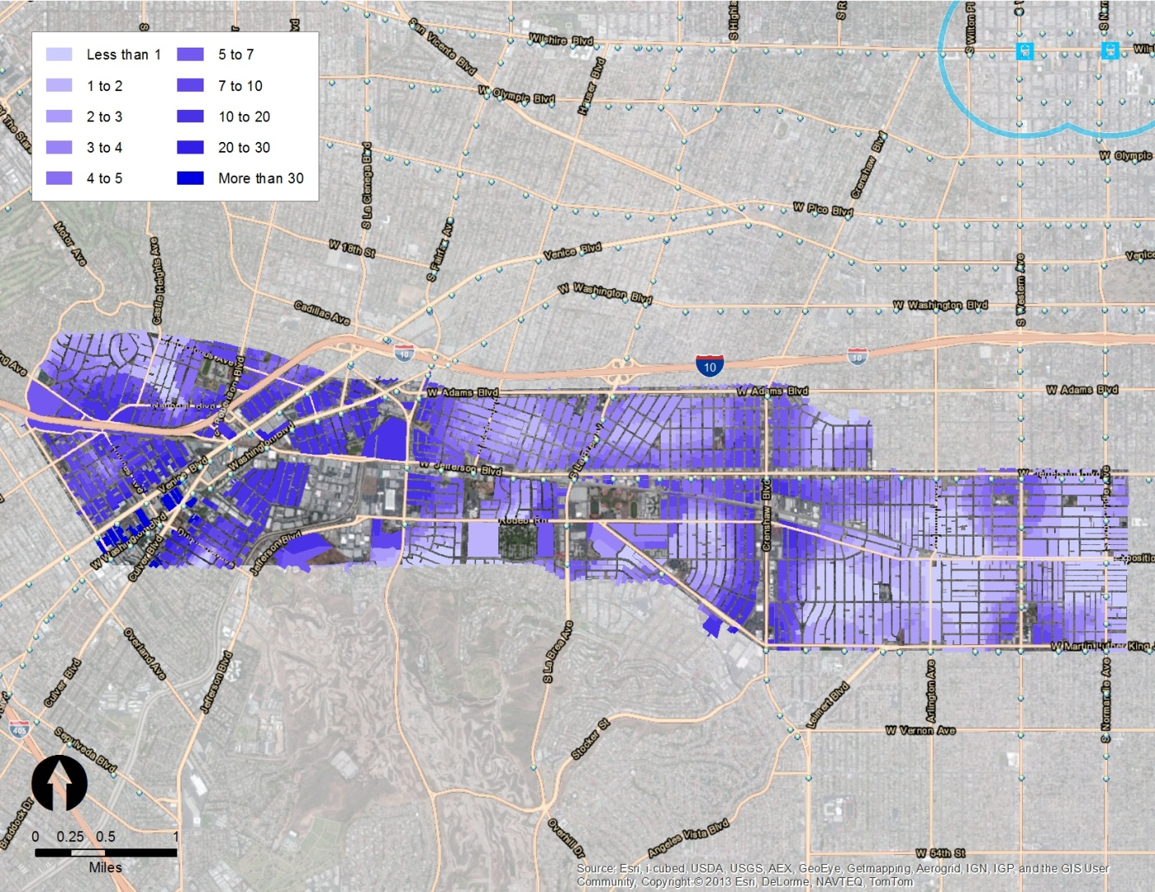
Job Density
( 2008 )

Slide 29
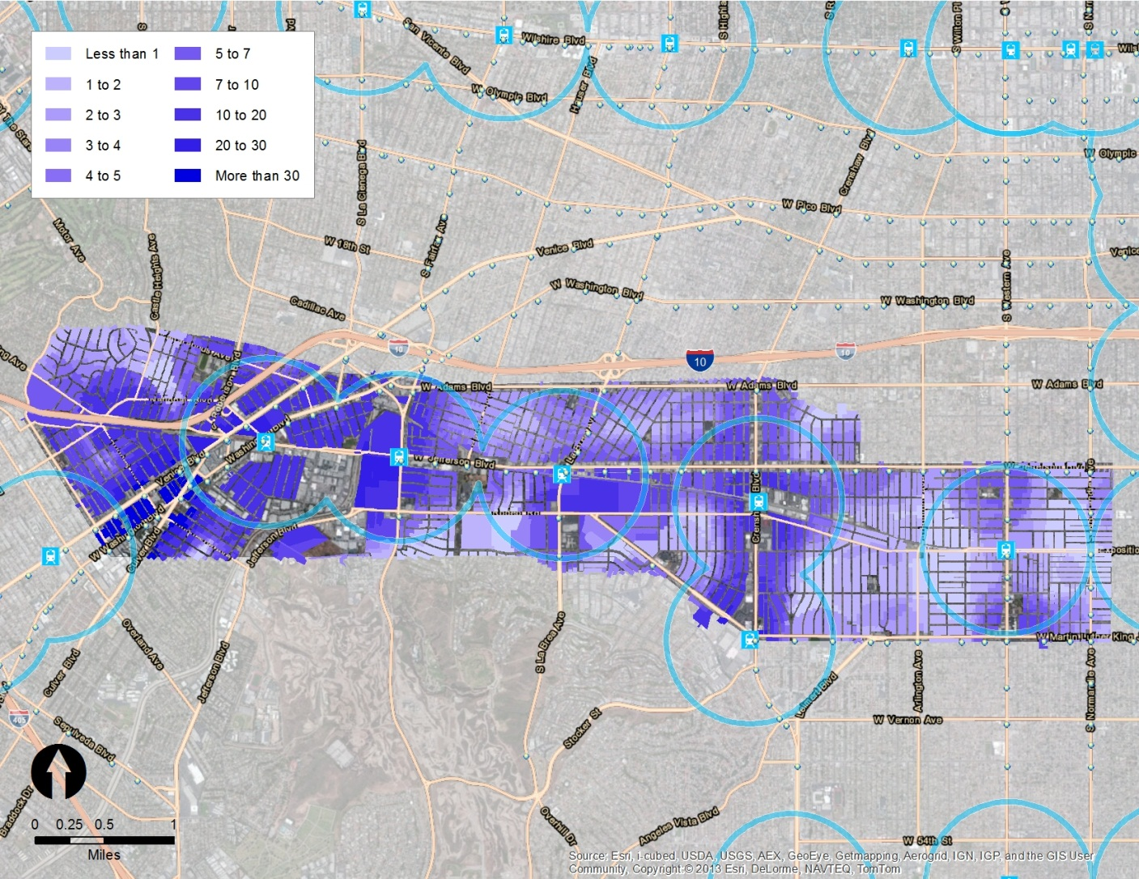
Job Density
( 2035 Plan )

Slide 30
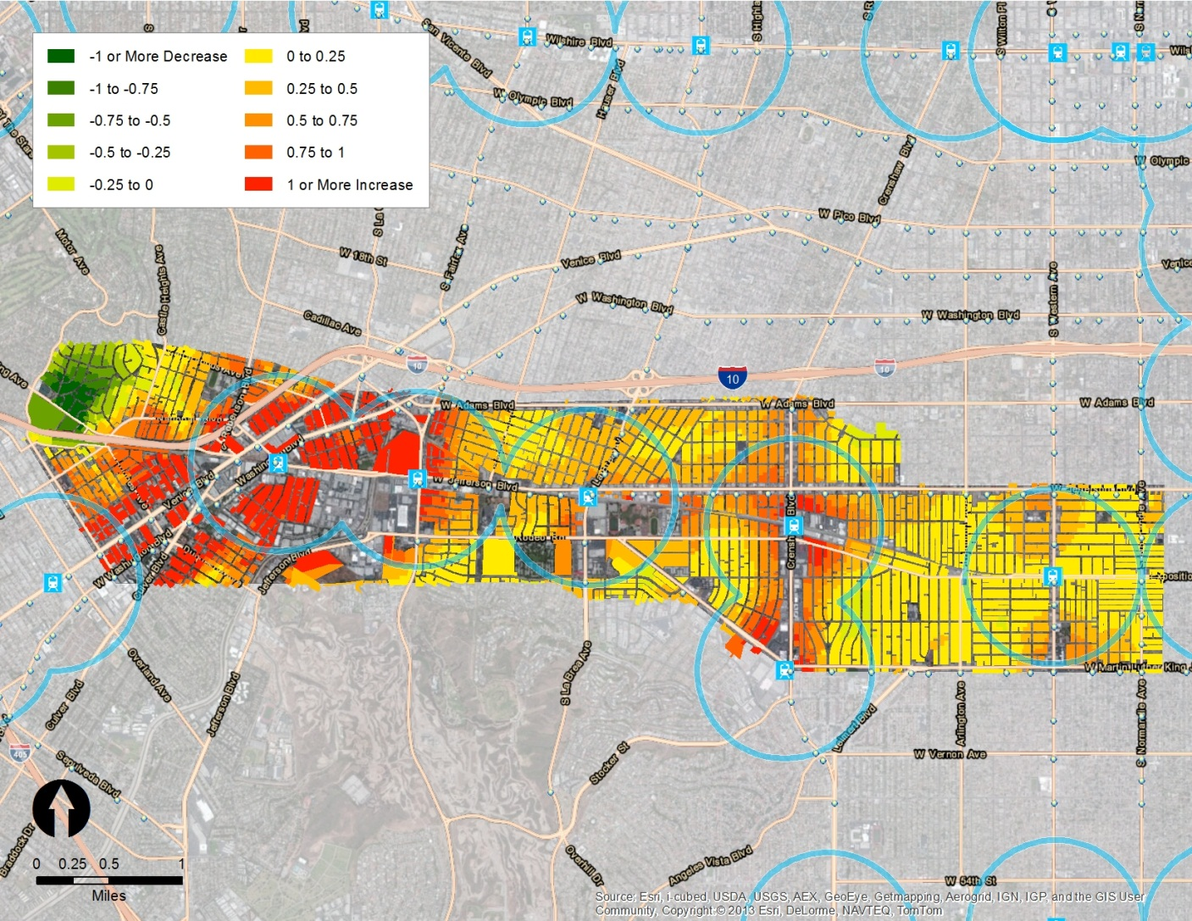
Job Density
( 2008 to 2035 )

Slide 31
Mode Share Change
( 2008 vs. 2035 Plan )
Mode Share | 2008 | 2035 Plan | Diff
Auto (Driver) | 51.4 % | 39.4 % | -12 %
Auto (Passenger) | 18.9 % | 23.2 % | 4.3 %
Transit | 3.9 % | 11.8 % | 7.9 %
Non-Motorized | 23.6 % | 23.9 % | 0.3 %
Other | 2.2 % | 1.6 % | -0.6 %

Slide 32
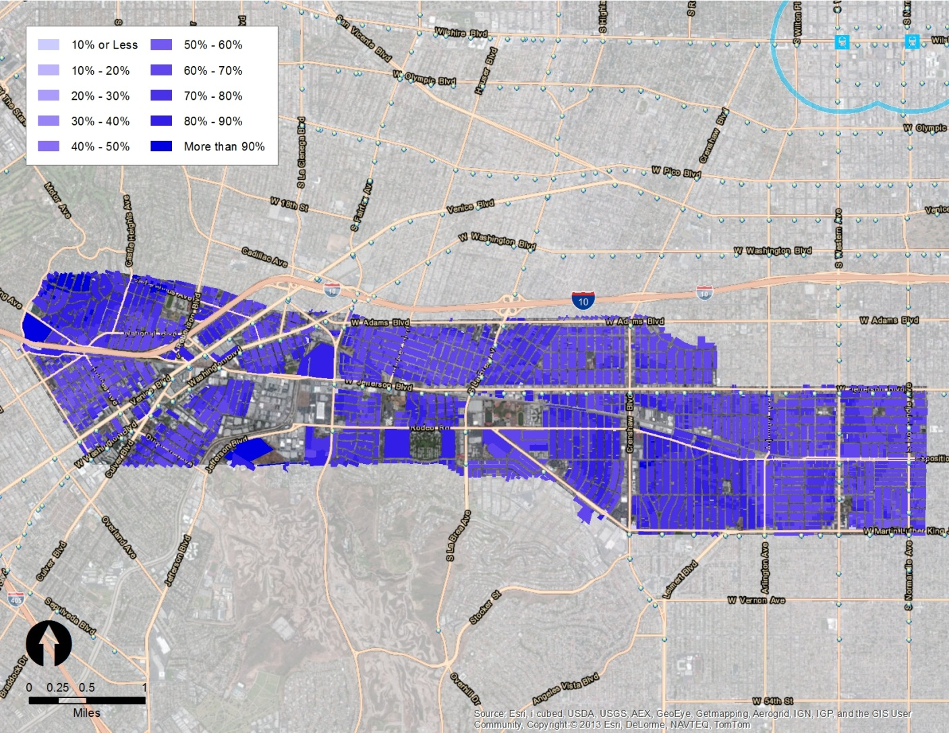
Mode Share – Auto
( 2008 )

Slide 33
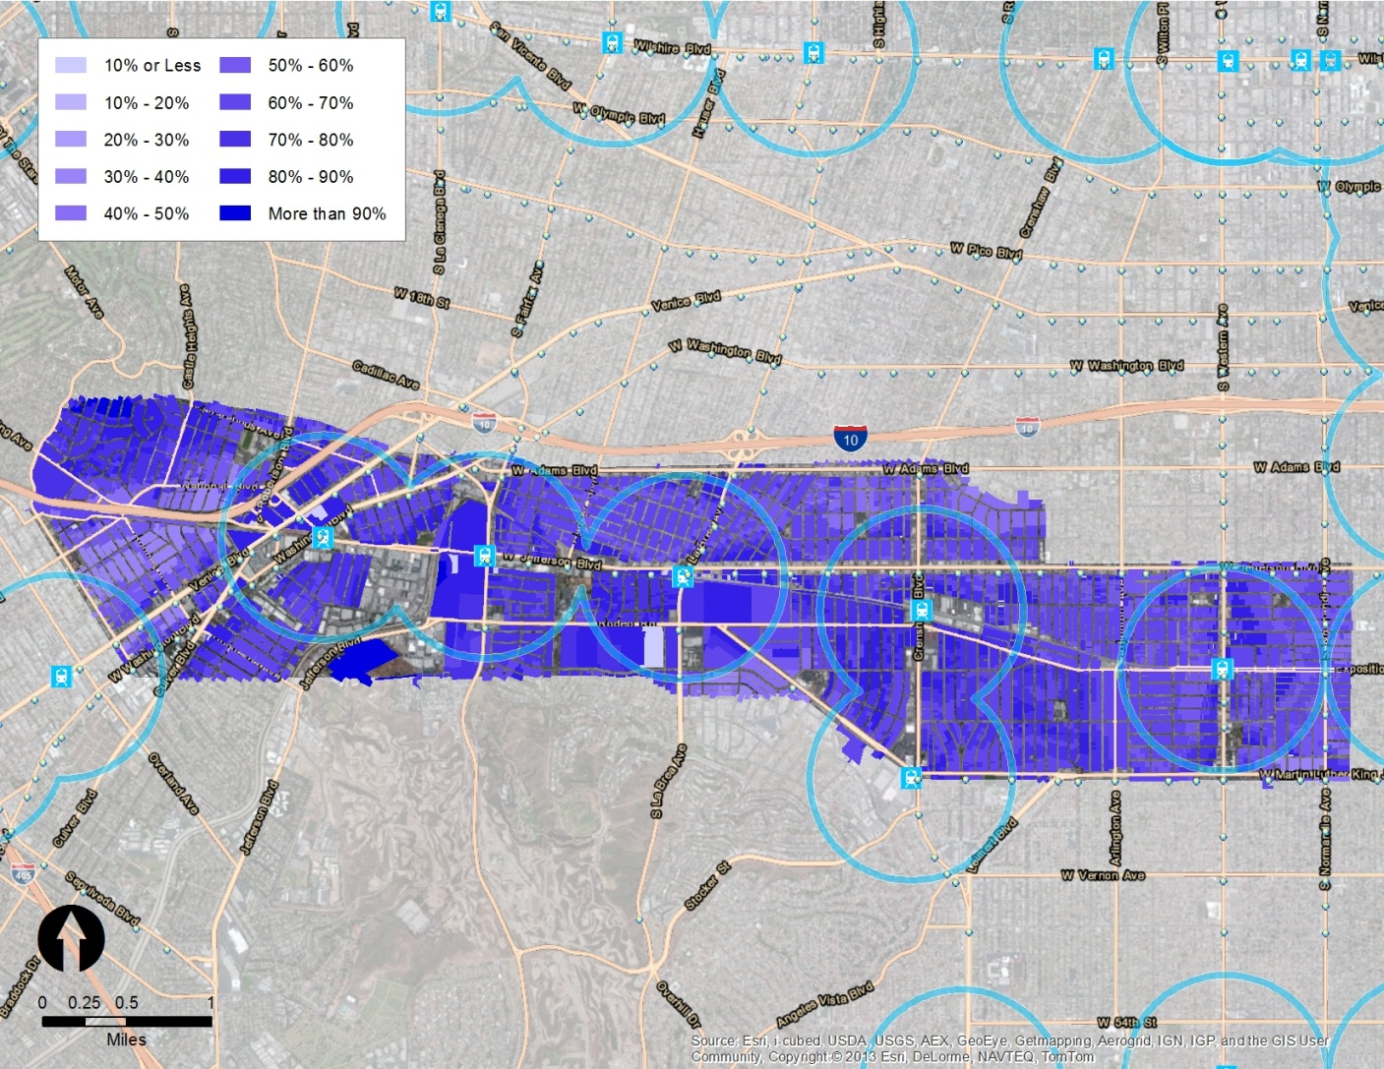
Mode Share – Auto
( 2035 Plan )

Slide 34
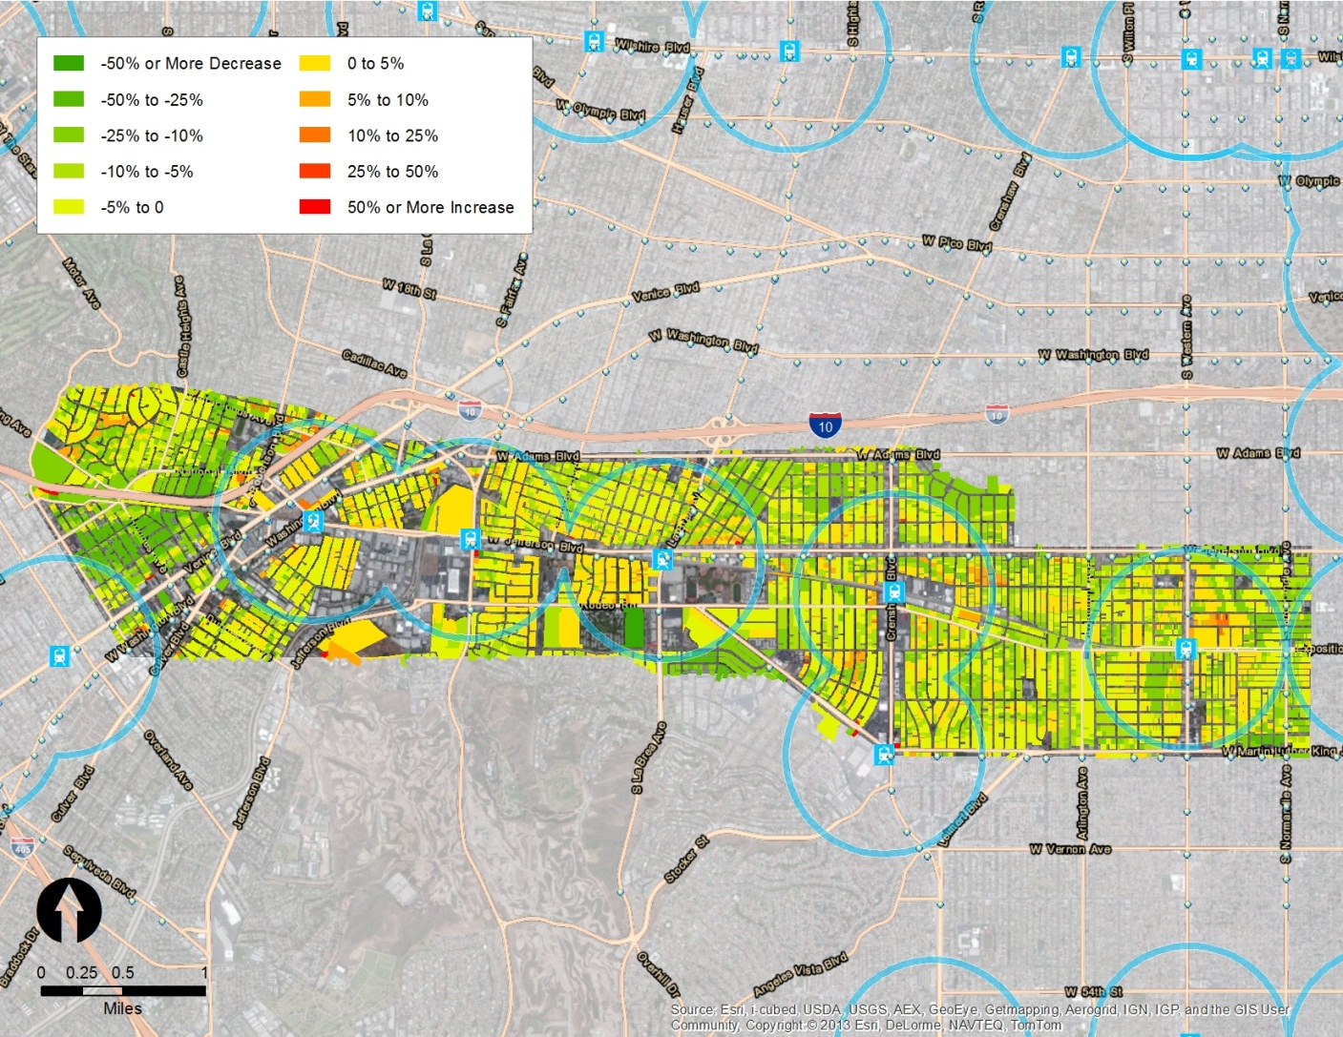
Mode Share – Auto
( 2008 to 2035 )

Slide 35
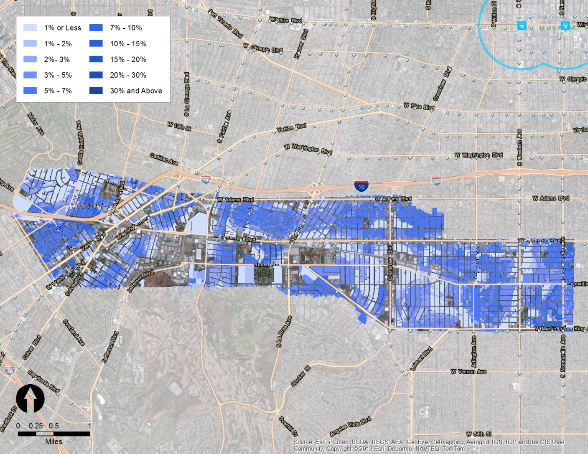
Mode Share – Transit Passenger
( 2008 )

Slide 36
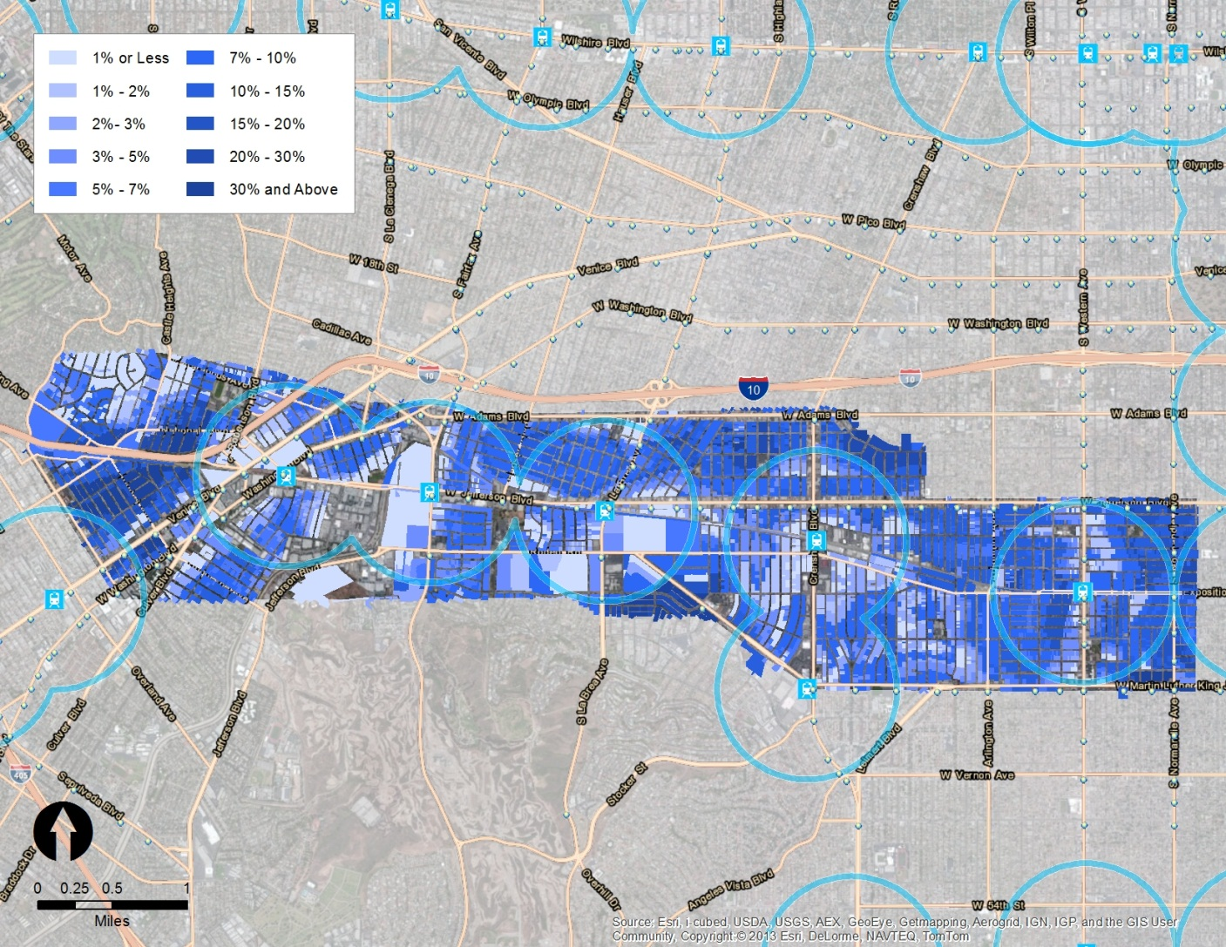
Mode Share – Transit Passenger
( 2035 Plan )

Slide 37
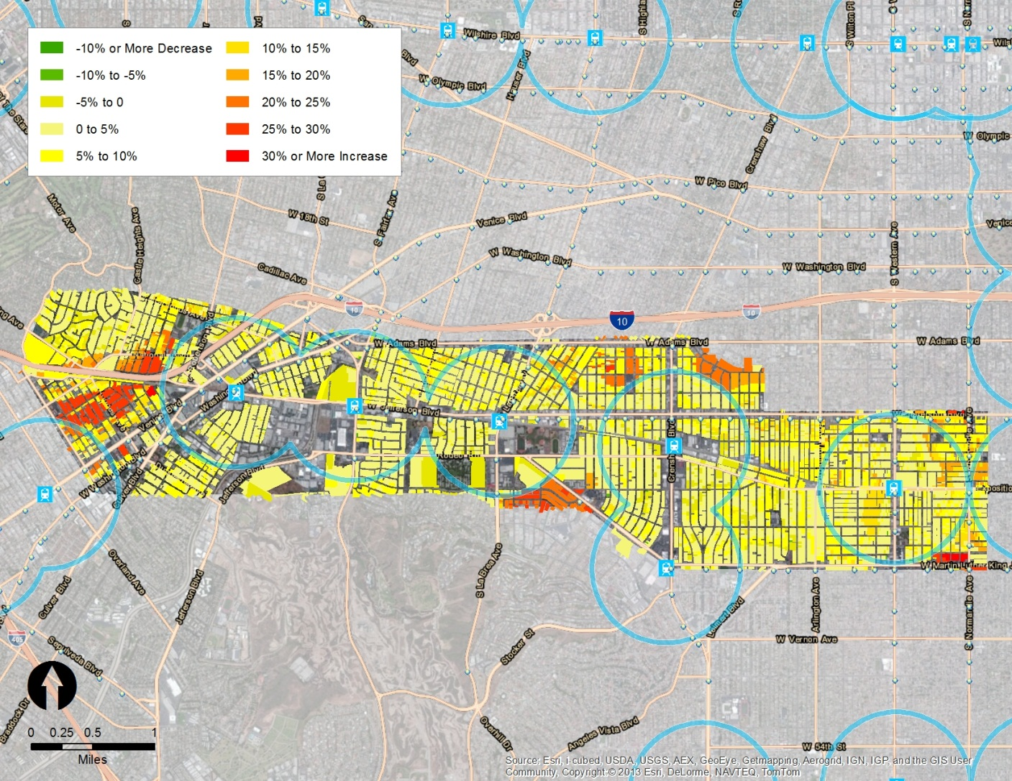
Mode Share – Transit Passenger
( 2008 to 2035)

Slide 38
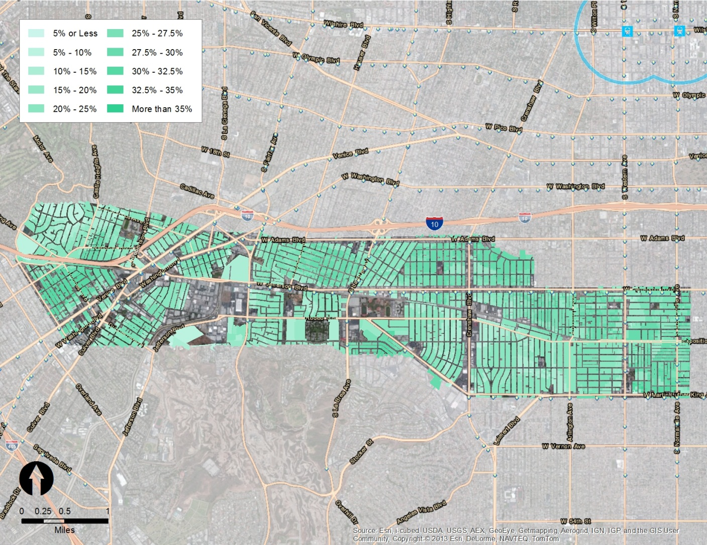
Mode Share – Walking
( 2008 )

Slide 39
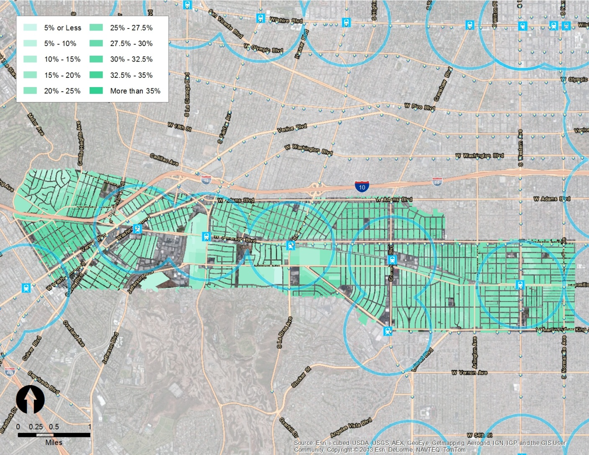
Mode Share – Walking
( 2035 Plan )

Slide 40
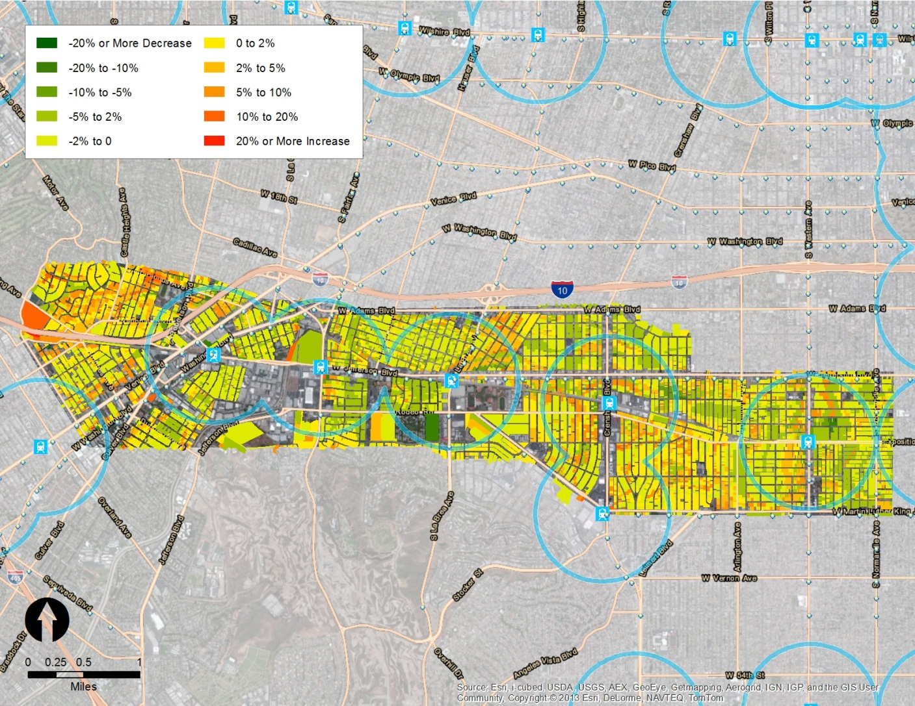
Mode Share – Walking
( 2008 to 2035)

Slide 41
VMT Per Household
( 2008 vs. 2035 Plan )
Study Area | 2008 | 2035 | % Diff
VMT Per Household | 32.1 | 22.5 | -29.9%

Slide 42
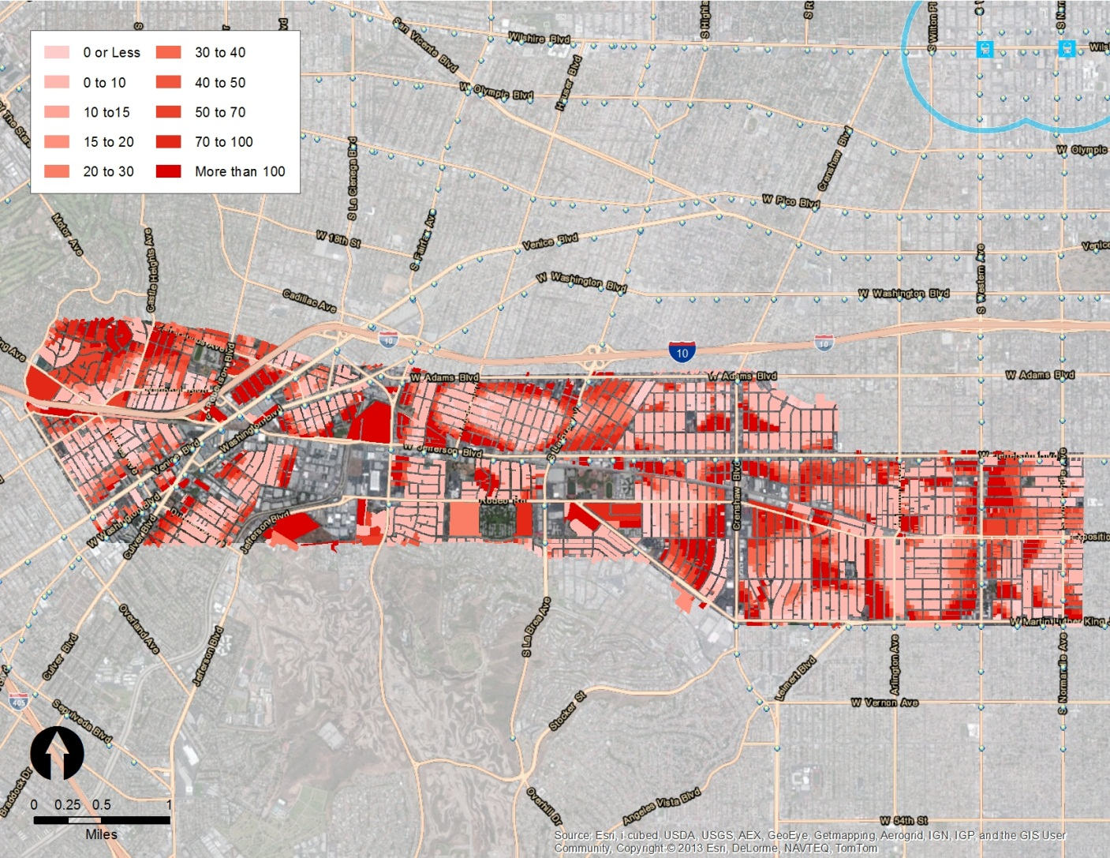
VMT Per Household
( 2008 )

Slide 43
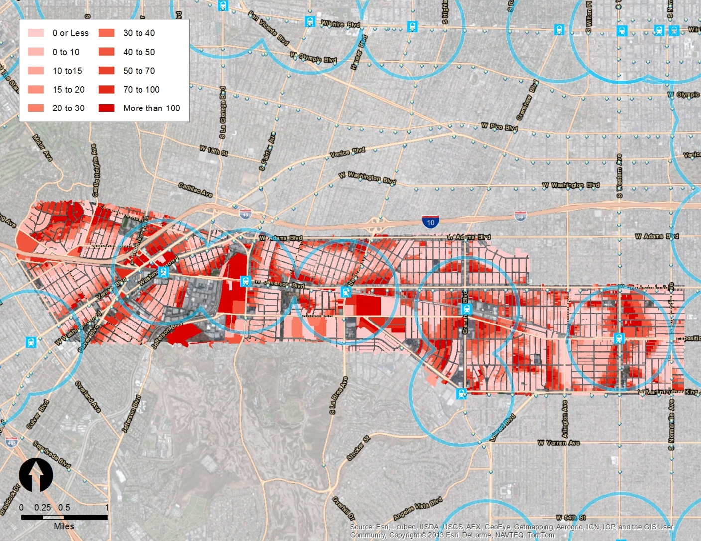
VMT Per Household
( 2035 Plan )

Slide 44
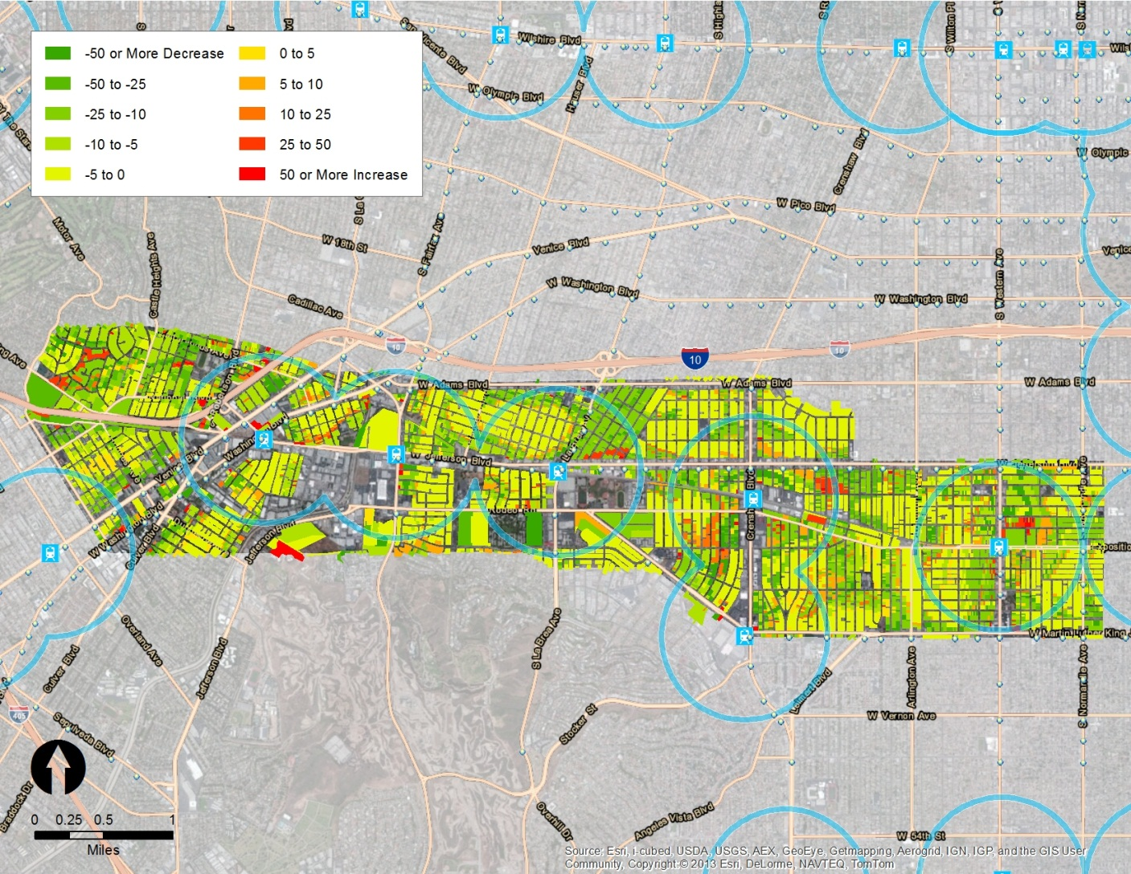
VMT Per Household
( 2008 to 2035 )

Slide 45
Conclusion
Reasonable Model Results
Impacts of Land Use Scenarios on GHG reduction
Land Use Scenarios
Travel Behavior
Vehicle Miles of Travel (VMT)
GHS Emissions

Slide 46

Thank you!
Jung H. Seo
Southern California Association of Governments
seo@scag.ca.gov
www.scag.ca.gov

