Slide 1
Measuring Impossible Behavior
How Do System Performance Metrics Need to Change When Using Modeling Tools with Hard Capacity Limitations
Dan Tischler
14th TRB Planning Applications Conference
May 5th, 2013 • Columbus ,Ohio
Notes:
Provide fair warning about interactivity

Slide 2
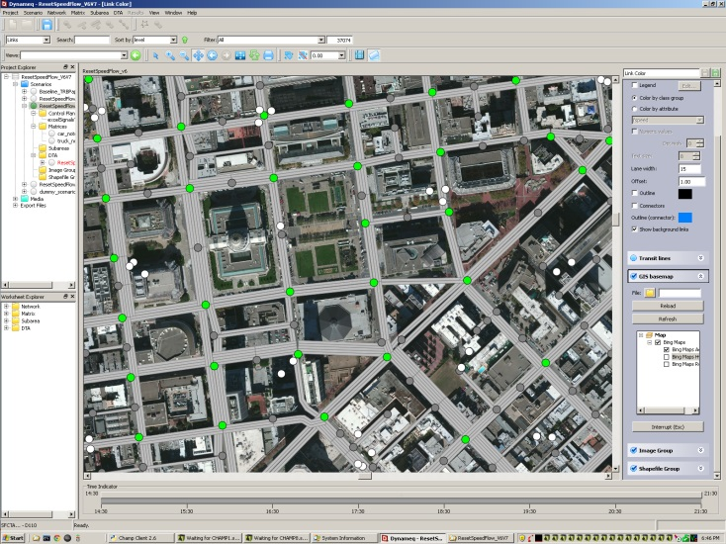
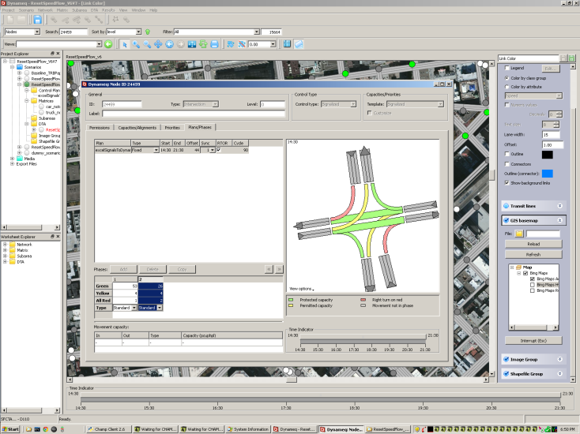
Outline
Background – SF and DTA
The capacity conundrum
DTA-appropriate metrics
Sharing time
Notes:
Start with very brief background because Elizabeth Sall just dicsucssed SFCTA DTA model development

Slide 3
Modeling Framework
Land
Use
Transportation
System
ABM w/ Static
Assignment (CHAMP)
Auto Demand in Subarea
Dynamic Assignment
Model (Dynameq)
Intersection
Volumes
Transit &
Non Motorized
Demand
Roadway Performance
Auto
Demand
Analytical Traffic
Assessment (Synchro)
Microsimulation
(VISSIM)
Roadway Performance
Transit Performance
Notes:
SFCTA has spent several years developing an increasingly sophisticated DTA model covering an increasingly large network. The model is used essentially as a CHAMP post-processor and a lubricant between our ABM and microsimulation. This graphic shows the modeling framework into which our DTA model is incorporated for a typical transportation project study. We do not currently feed DTA skims back into CHAMP.

Slide 4

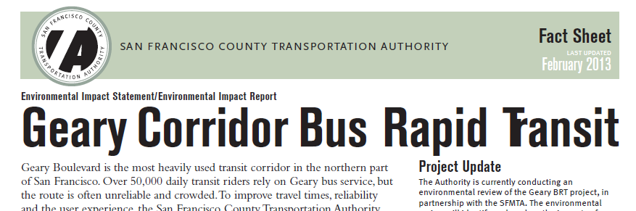


DTA Applications
Freeway replacement
Bus rapid transit
Road closure
HOV ramps and lanes conversion
Congestion pricing (model dev. scenario test)
bettermarketstreetsf.org/
http://www.sfcta.org
presidioparkway.org
Notes:
During the time that we’ve been developing the model we’ve had some opportunities to apply DTA models and learn from the experience. Here are some applications where our DTA model has played some role.

Slide 5
Reflections on Experiences
The good
  More realistic assignment (you can’t jam unrealistic traffic through bottlenecks)
  Backups that impact nearby links are represented
  Traffic patterns/paths change at different times in response to varying traffic conditions
  Understands congestion for individual lanes and intersections
  Dynamic demand, even if we don’t fully use it
Notes:
In some ways very helpful, but in other ways raises questions or is frustrating

Slide 6
Reflections on Experiences
The so-so or not so good
  Demand from ABM may not be appropriate
  Metrics used to interpret results provide different answers
  Travel demand modelers may lack traffic operations experience
Notes:
Travel demand modelers are not necessarily prepared to ask the right questions of models or properly evaluate model performance that have more in common with microsimulation and traffic operations

Slide 7
Outline
Background – SF and DTA
The capacity conundrum
DTA-appropriate metrics
Sharing time
Notes:
Here’s an example of an issue that arises from the difference between constraining and not constraining flow to capacity. This example is hypothetical, but reflects a particular question and challenge we have faced in San Francisco. Bonus points for anyone that can guess the real world example.

Slide 8
Hypothetical Project
HOV
Project
area
CBD
Project to convert one freeway lane to HOV-only
Will traffic diversions from the freeway affect transit?
Arterial roadway
Road-based transit
Connector St
Freeway
Notes:
Imagine a project that is considering adding an HOV lane to freeway. The HOV lane would occupy an existing lane, and no new lanes would be provided, thus the project would reduce highway capacity for single occupant vehicles. One of the questions we have is how the HOV lane would affect traffic on a parallel arterial. The parallel arterial roadway features an important bus route and there is concern that the HOV lane project could worsen operating conditions for the transit line. Besides asking if the HOV lane is effective we also want to know if we need to add a dedicated bus lane to protect transit operations.

Slide 9
Static Model Results
HOV
Project
area
CBD
HOV lane pushes auto trips to the arterial
Transit speeds and reliability worsen
Indicates need for bus-only lane
Congestion
Road-based transit
Diversions
Notes:
First we see what our ABM tells us with static traffic assignment. As might be expected, CHAMP shows that there is a lot of diversion from the highway to the local street. This causes congestion on the arterial and slows the transit line. Our transit line is now less reliable and more expensive to operate.

Slide 10
Dynamic Traffic Assignment Results
HOV
Project
area
CBD
More traffic stays on freeway
Freeway speeds decline
Some diversions go elsewhere
Transit not impacted
Congestion
Road-based transit
Notes:
Next we ask our DTA model. DTA Model: What do YOU think will happen? Well, the DTA model shows a very different story. The dynamic car following-simulation assignment shows very few diversions to our arterial road. Most traffic stays on the freeway or diverts elsewhere. If we summarize travel times and volumes from DTA it looks like our bus line is just fine with the HOV lane project.

Slide 11
DTA Hidden Story
HOV
Project
area
CBD
Bottleneck at signal causes long queues on Connector St
Connector St has short green phase because volumes are currently low
In practice traffic engineers would adjust signal capacity as travel changes
Road-based transit
Bottleneck
Queue
Notes:
If we investigate further we find that a bottleneck caused by a traffic signal meters traffic coming from the freeway. Signal timings are not like fixed infrastructure. In the real world this signal would be routinely re-timed to serve demand so more of the traffic wanting to use the arterial would be able to use it. If we code the DTA model with more green time, we find that the arterial is very congested, transit service is slow and unreliable, and we do need that bus lane after all. If we take the time to investigate queues, diversions, waiting vehicles, backups, and bottlenecks beyond our core area of concentration then DTA can give us a better understanding of project impacts, but if we use our traditional metrics, we get an answer that is less useful than that of the static model.

Slide 12
Circular Feedback
Capacity (signal timing)
Traffic volumes
Policy decisions
Congestion
Notes:
We use the model to try to answer a question, but we have to make policy decisions related to the questions to determine inputs that return our answer. This creates a circular loop and it’s not just hypothetical. We’ve faced this in actual applications. Less green time just means fewer cars, congestion never gets TOO bad and the metrics used in static models don’t tell us all that much.

Slide 13

What Are We Trying to Accomplish?
?
LMFAO music video
via Youtube
Notes:
We are not trying to create more realistic models just for the sake of it. We are trying to become better at answering questions – so that we can provide better information to policy makers

Slide 14
Outline
Background – SF and DTA
The capacity conundrum
DTA-appropriate metrics
Sharing time

Slide 15
Do’s and Don’ts of Interpreting DTA Results
Don’t only…
rely on V/C ratios or volumes alone as a metric
assume that travel times tell the whole story
Do consider…
queuing and its effects on the whole network
bottlenecks (assumptions or real constraints)
alternate routes
travel time and delay outside of the analysis period

Slide 16
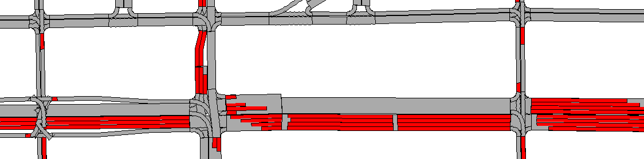
Queuing
Queues blocking intersections = poorly functioning network
Possible measures
  Tot length of all queues
  Blocked intersections
Notes:
This is old hat in microsimulation, but it is relatively new to travel demand modeling. Long queues spilling back from bottleneck intersections or mergers are a key source of urban congestion. Observing queuing patterns should be a key tool to understand DTA model results

Slide 17
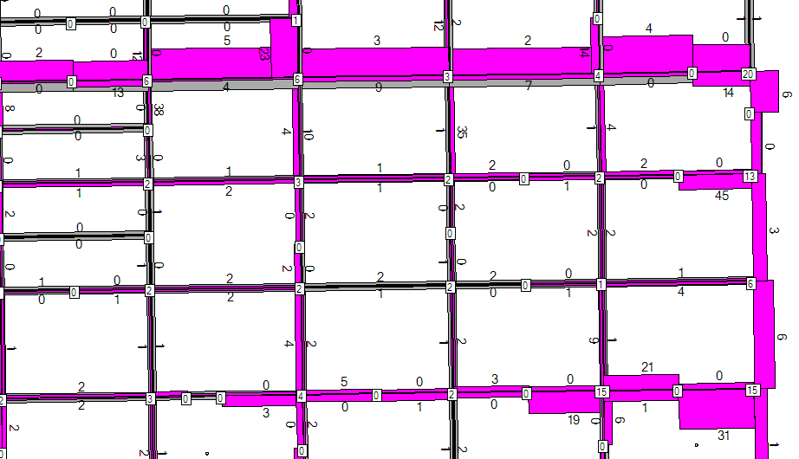
Vehicle Delay
Notes:
Unlike V/C > 1, vehicle delay is not bounded in the real world. Unlike flow rates, delay increases continuously as congestion worsens. Delay can be normalized in various ways. For example: per trip, per person-trip, per mile traveled, absolute, etc. Needs thought in regards to impacts of changing demand on metric results

Slide 18
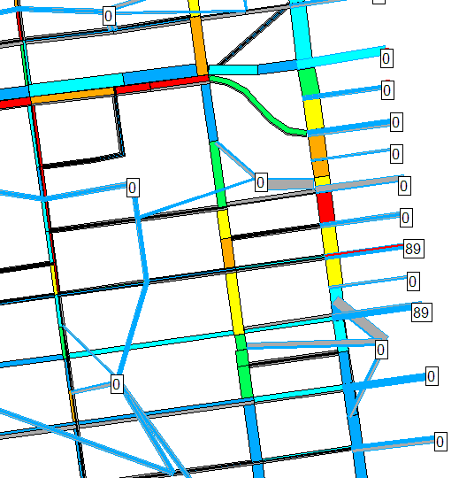
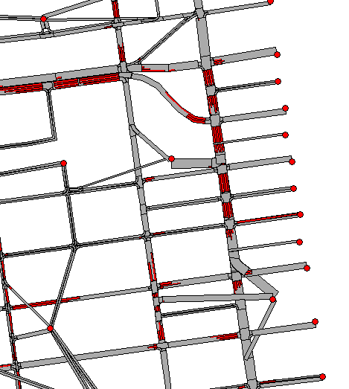
Waiting Vehicles
Notes:
Waiting vehicles represent demand queuing to enter a network where demand near an entry gate exceeds capacity. Waiting vehicles are subject to delay, and may cause spillback impacts on other off-network facilities. An increase in waiting vehicles is an indicator or worsening congestion cased by differences between two scenarios, even if operations within the network are similar. Like vehicle delay and queue formation, waiting vehicles replaces v/c as indicator of demand in excess of supply for network boundary areas, or congested downtown districts.

Slide 19
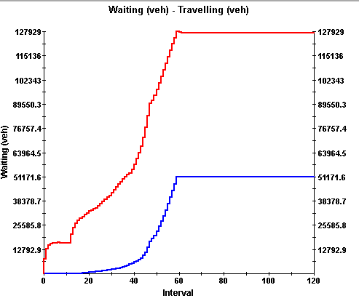
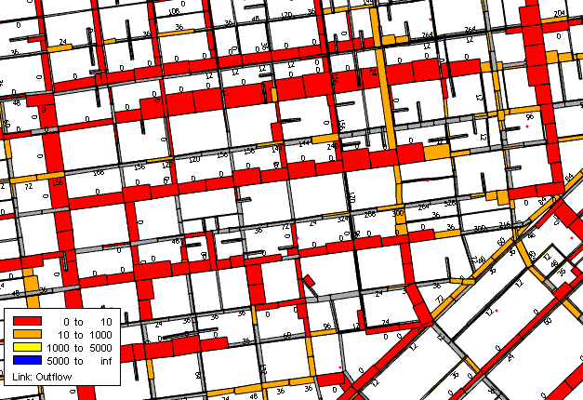
Gridlock
Notes:
Meso-level models tend to be sensitive to congestion. Unrealistic traffic volumes will result in a system breakdown. Simulation gridlock (in a well-calibrated model) is an indicator that demand levels are unrealistic and unlikely to materialize. Information about gridlock can be fed back into the model, but we aren’t there yet. Also it raises the question of how can we calculate the loss of utility for people who are making 2nd choice?

Slide 20
Outline
Background – SF and DTA
The capacity conundrum
DTA-appropriate metrics
Sharing time

Slide 21
Sharing is Caring
Notes:
Since this is the beginning of the conference, my colleagues and I want to try to set in motion as much collaboration and real-time information exchange as possible.
- For agencies that have experience w/ DTA models, what metric or interpretation challenges have you encountered so far, particularly with regards to switching between capacity informed and capacity constrained models?
- How have you addressed these issues?
- What have you found to be the most effective ways of interpreting and communicating the results of DTA models?

Slide 22
Thank you!
Dan Tischler
dan [dot] tischler [at] sfcta [dot] org

