Slide 1
Simplified Data Driven Methods for FTA Small Starts Project Evaluation
Jeffrey Roux (AECOM)
Prasad Pulaguntla (AECOM)
May 8, 2013

Slide 2
Agenda
Richmond Broad Street BRT Project Overview
The Challenge
Approach
Bump on the Road
Project extensions
Lessons Learned
Acknowledge MANY contributions to the study

Slide 3
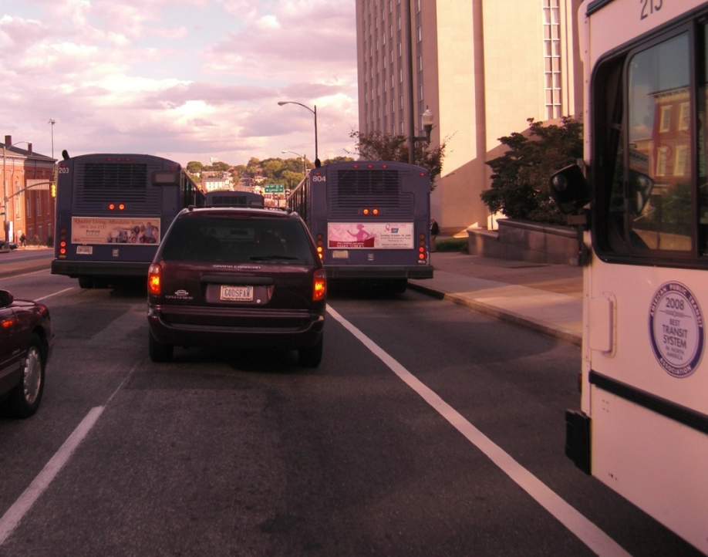
Broad Street Corridor
Broad Street is THE bus corridor in Richmond, VA with 17,000 daily transit trips.
Broad Street serves as main GRTC artery in Downtown
Today: bus bunching, sub-standard lanes and accidents result in a relatively slow and unreliable journey.
Full BRT saves up to 3 min. on local bus trips and 6 min. on BRT/express bus trips

Slide 4
Problem Statement
Existing conditions
  48 buses/direction/peak hour within downtown RIC
  Current service is “local” stopping every block
  Narrow Parking lane (8’) dedicated to buses in peak-period (with poor enforcement)
  Problems
  High bus volumes with multiple routes entering the trunk line lead to bus bunching and low reliability
  Existing narrow downtown bus lanes cause conflicts and accidents
  Conga-line conditions leads to very slow travel times

Slide 5
Goals and Objectives
Provide more attractive transit service
  Improve travel times
  Reduce accidents
  Improve customer experience/amenities
  Improve system efficiency
  Improve reliability
  Improve convenience, efficiency of transfers
  Expand market

Slide 6
Project Tactics
BRT trunk line to provide a higher quality transit service:
  Higher quality, low floor, branded vehicles
  Formal BRT transit stops
    Formal branded shelters
    Off-board fare collection
  Dedicated bus lanes for half of corridor to speed trips
  Traffic signal priority
  Trunk line BRT is 6 min faster to Downtown (vs. express bus without priority treatments) and 14 min faster compared to local bus.
Consolidated bus stops in Downtown for ALL buses
  Downtown operations consolidate to three stops
  Multi-platform boarding
  Local buses are 3 min. faster through Downtown

Slide 7
The Challenge
Prepare patronage forecast & FTA Project Justification materials for Small Starts application
Off the shelf tools (in 2010):
  VDOT Richmond/Tri-Cities Forecasting Model (RTFM):
    Highway focused forecasting model
    Very good representations of highway travel speeds
    Basic transit network and limited mode choice capabilities
  Fall 2009 GRTC On-Board Survey
Approach: Develop data-driven approach from RTFM networks and on-board surveys

Slide 8
Data Driven Approach – Two Elements
Transit Networks:
  Recoded RTFM Transit Networks (CUBE TP+/TRNBUILD)
  Calibrated bus travel times from VDOT peak/off-peak highway travel times (equations of motion)
On-Board Transit Survey – Trip Tables:
  VDRPT surveyed GRTC routes in Fall ’09
  Comprehensive picture of GRTC existing markets
Approach: Measure how existing riders (surveyed) impacted by project and estimate new riders through representation of transit network changes

Slide 9
Transit Network Development
Recoded RTFM Transit Networks to Reflect Nov. ‘09 Service (survey):
  Separate peak/off-peak transit networks:
    Peak (7-9 AM)
    Off-Peak (10-2 PM)
  Correct route routing (including loops through D’town)
  Zone splits in project corridor
  Properly reflect stop locations
  Developed bus speed relationships, using equations of motion based approach:
    AM Peak – Congested highway travel times
    Off-Peak – Free flow highway travel times

Slide 10
Bus Travel Time Validation
Approach: Accurately represent bus travel speeds by pivoting off of RTFM highway speeds
Process built “equation of motion” approach to replicate current scheduled travel times of all buses:
  Used typical bus acceleration/deceleration rates
  Calibrated an average “dwell” times per stop
  Process worked very well as virtually all buses are within 15% or (3-4 min.) of scheduled end-to-end running times

Slide 11
2009 GRTC On-Board Survey
4,500 completed surveys representing 32,900 GRTC boardings:
  Included VCU and non-VCU bus routes
  For approach we processed:
    Trip Ends (Productions and Attractions)
    Mode of Access (PNR, drop-off and walk)
    Time of Day (peak & off-peak)
    Converted boardings to linked trips
  Conducted on all routes, except inter-city routes:
    Petersburg-Downtown Richmond Express
    Fredericksburg-Ashland-Downtown Richmond Express
    Not material to Project

Slide 12
2009 GRTC On-Board Survey Trip Productions

Slide 13
2009 GRTC On-Board Survey Trip Attractions

Slide 14
“Traditional” Survey Tabulations

Slide 15
Development of a Base Year 2009 Transit Trip Table
Developed CUBE/TP+ Survey-Based Trip Table (Fall ‘09)
  Stratified by:
    Time of Day (Peak and Off-Peak)
    Mode of Access:
      PNR & Walk
      KNR treated like walk (with drop-off location treated as PROD end)
    VCU and non-VCU trips stratified
VCU Trips Stratified Separately
  Operates under contract to GRTC
  Free w/valid student/staff ID
  Main to Downtown Campus shuttles & fringe parking
  Policy of VCU students on BRT unknown

Slide 16
Calibration of Transit Path Weights
AECOM calibrated TRNBUILD path-building and assignment weights through iterative assignment of transit trip table
Started with FTA “national experience” weights and tuned
Final weights used were:
  IVTT Weight = 1.0
  Waiting/Transfer Waiting Time Weight = 1.5
  Walk Time Weight = 2.0
  Drive Time Weight = 2.0
  Transfer penalty = 6.0 min per transfer
  Walk speed = 3 mph

Slide 17
2009 Weekday Modeled vs. Observed by GRTC Route

Slide 18
Developing Project Forecast/FTA Justification Materials
2009 demand grown to represent 2015 no-build using MPO estimates of POP growth
Development of CUBE/TP+ process where calibrated path-weight parameters are multiplied to create an equivalent IVTT “transit impedance” score for each I-J pair
Alternative specific effects for BRT built into the transit impedence
  5% discount for BRT IVTT
  5 min. “constant effect” for BRT only riders, 2 min for BRT & Local Bus Riders
Compare the “transit impedance” between alternative and use an elasticity range of -0.3 (low) to -0.7 (high) to estimate “new” riders through alternative progression (No-Build – TSM Baseline – Build)
Assign the resulting transit trip tables to the network for project ridership forecasts
Compare resulting transit impedance to estimate Transit System User Benefits

Slide 19
Bump in the Road – New PNR Lot
Park-and-Ride at Staples Mill (near end of line)
  Scale is small (about 100 spaces)
  No existing PNR behavior in corridor - PNR’s are in fringe suburban areas feeding express buses to Downtown
  Since modest number of spaces, we assumed:
    75% utilized (additional new riders, about 150)
    Calculate UB’s by treating these riders as “new” riders (i.e. half the benefit)
Not sophisticated, but how far could we be off?
Bigger transformation would require more sophisticated approach.

Slide 20
Project Extensions
GRTC used on-board survey data to plan their 2015 bus network
Refinements to transit networks/procedures were embedded in the VDOT Richmond/Tri-Cities Forecasting Model update (2012)
  Bus speeds
  Network coding
  Path/assignment weights
On-Board survey used for RTFM mode choice calibration targets
Comprehensive on-board transit survey allowed us to develop procedures to simulate “non traditional” trips:
  Drop-off transit trips to non-formal locations
  VCU fringe parking trips

Slide 21
Summary/Wrap-Up
Small Starts project justification requires forecaster to tell the story of the project “who will benefit and why”
Data driven approach is ideal for developing patronage forecasts for incremental transit service improvements:
  Routed in real traveler patterns, not models
  Transparent & easy to articulate benefits of projects
  Easy to describe cause and effect in the forecasts
  Forecaster can articulate risk by segmenting:
    What is “known” from the survey data (X riders in the corridor who will save at least 5 min. from the project)
    What is not “known” (penetration of choice market, given BRT introduction)
FTA was very supportive of approach

Slide 22
Acknowledgements
Virginia Department of Rail & Public Transportation – Amy Inman
GRTC – Larry Hagin and Scott Clark
VDOT – Rick Tambellini, Juyin Chen and Paul Agnello
FTA – Jim Ryan, Ken Cervenka, Nazrul Islam
AECOM – Jeff Bruggeman
Connectics Transportation Group – Jim Baker
Michael Baker – Lorna Parkins, Scudder Wagg
Parsons Transportation Group – Gibran Hadj-Chikh
VHB - Ram Jagannathan
Project “Graduates” – Chandra Khare, Abishek Komma, Jeremy Raw, Bill Woodford, Mike Lambert, Frank Spielberg and Sharon Hollis

Slide 23
Thank You!
Jeffrey.Roux@aecom.com
Prasad.Pulaguntla@aecom.com

