Slide 1
A Data Driven Approach to Transit Forecasting for New Starts and Small Starts
Smith Myung, Cambridge Systematics
Sean McAtee, Cambridge Systematics

Slide 2
Overview
Background
Description of Procedures
Base Year Validation
Conclusions
Questions

Slide 3
Why Data Driven?
What is a Data Driven approach? Simplified forecasting approach based on existing conditions
VIA Urban Corridor Alternative Analysis as case study
Data availability: 2010 VIA On-board survey data
Existing transit service; relatively mature area
Focus efforts on transit components
SA-BC MPO model updates not ready

Slide 4
New Start and Small Starts
FTA has supported data driven approaches -
  Transparent
  Reliable
  Good for short-term (< 10 yrs)
Federal regulations are changing
Client undecided about New Starts/Small Starts
Maintain all options – use good modeling practice!

Slide 5
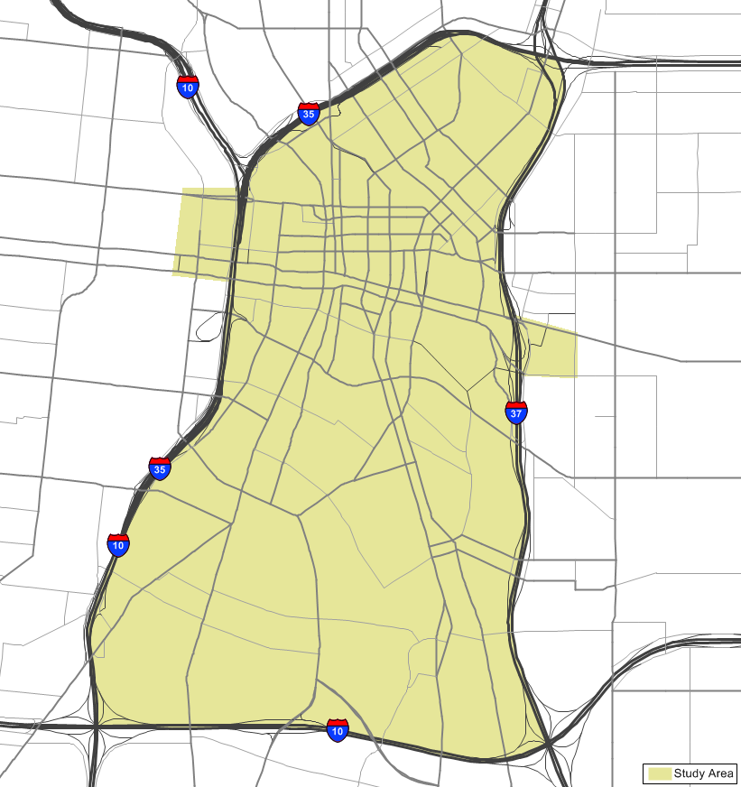
Background
Location:
San Antonio CBD bounded by I-35,
I-10, and I-37
Existing Service:
Rubber-tired streetcar routes (3)
Serve major attractions
Travel time: 9 to 15 min.
10/15 minute headway
2010 avg. wkdy ridership of 2,300
Context:
San Antonio Urban Corridor AA

Slide 6
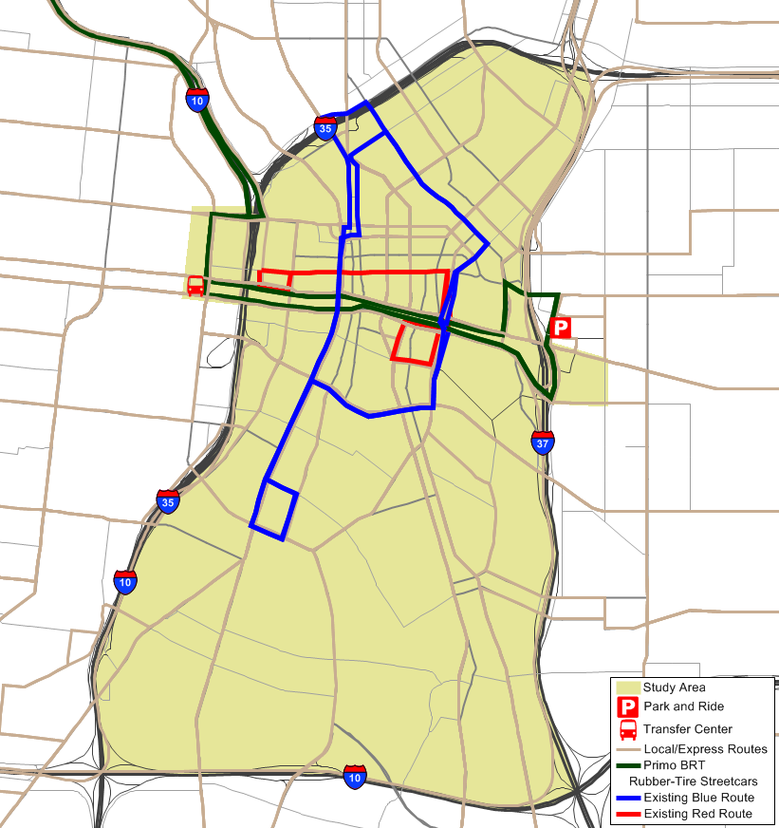
Existing Streetcar Routes

Slide 7
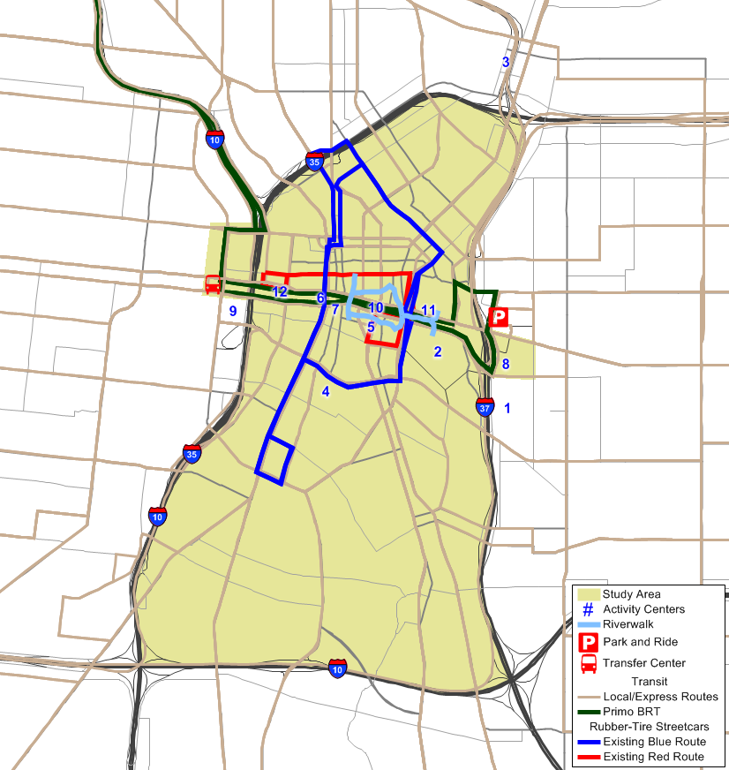
Major Attractions
  Alamodome – seats 65,000
  Henry B. Gonzalez Convention Center
  Pearl Brewery Urban Neighborhood
  H-E-B Corporate Headquarters
  CPS Energy Corporate Headquarters
  City of San Antonio administrative offices
  Bexar County administrative offices and Courthouse
  University of Texas at San Antonio Downtown Campus – 6,400 students
  San Antonio Riverwalk
  River Center Mall
  Market Square

Slide 8
Description of Procedures

Slide 9
On-board Survey Processing
Collected via personal interviews with handheld computers (high quality data)
Survey processing (16,832 records)
  Clean records, reweight, confirm control totals by route and TOD
Trip Purpose | Boardings | No. of Responses
HBW | 46,840 | 5,940
HNW | 64,430 | 8,958
NHB | 15,670 | 2,271
Grand Total | ~127,000 | 16,719

Slide 10
Transit Path Checking
Compare transit paths from survey to model skims
  Is multi-path necessary?
  Use Prediction Success table to compare reported transfers to skim tables

Slide 11
Transit Path Checking
Multi-path test (observed OD pairs)
  Analysis of survey responses
  Many route options into San Antonio CBD
 | Walk - Bus
Interchange with at least 3 or more observations | 786
Interchange with more than 1 path | 500
Percent of zone pairs with more than 1 path | 66.7%

Slide 12
Transit Path Checking
Single Path: 10 minute IVTT, 30-minute headway
Route 1, 10 minutes
30-minute headway
A
B
Route 2, 12 minutes
30-minute headway

Slide 13
Transit Path Checking
Multi-Path: 11 minute IVTT, 15-minute headway
Route 1, 10 minutes
30-minute headway
A
B
Route 2, 12 minutes
30-minute headway

Slide 14
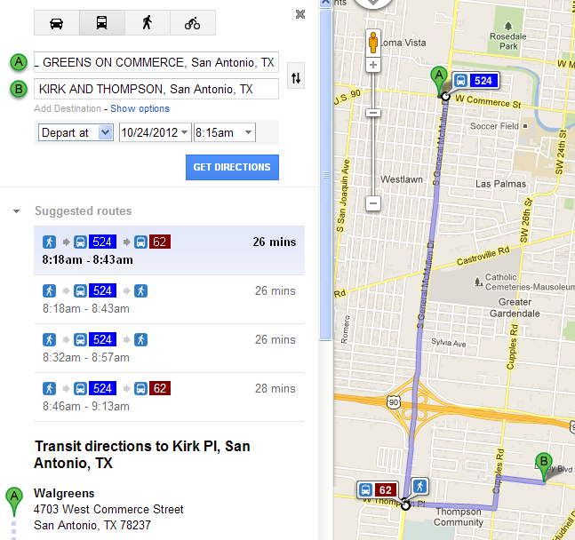
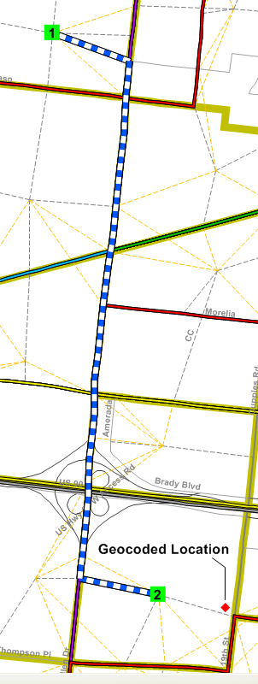
Transit Path Checking
Example: Prediction Success Spot-Check
  Survey: 1 transfer; TransCAD: no transfers
Walk
Bus

Slide 15
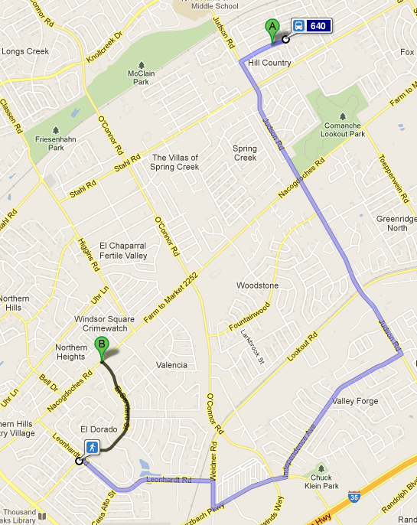
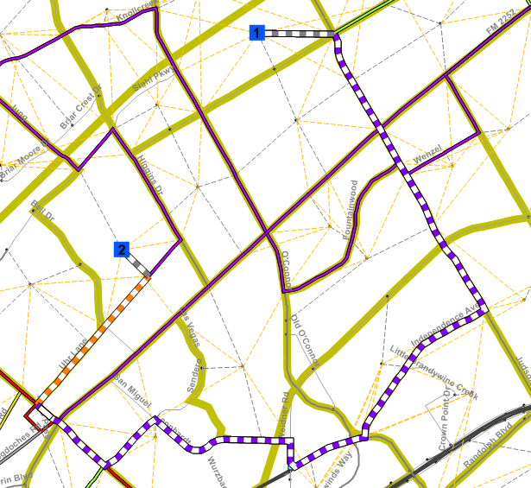
Transit Path Checking
Example: Prediction Success Spot-Check
  Survey: No transfers; TransCAD: 1 transfer
Walk
Bus 1
Bus 2
Geocoded Location

Slide 16
Transit Path Checking
Multi-path checking can be challenging
  Geocoded locations, coarseness of zones and networks
Verify networks are accurate
Multi-pathbuilder may select paths that are non-intuitive
Worked around limitation by programming logic in script

Slide 17
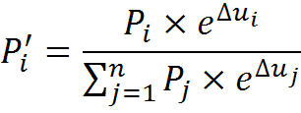
Incremental Structure
Choice
Auto
Transit

Slide 18
Incremental Structure
Binary structure is adequate
  No sub-mode competition (bus vs. rail)
  Model by market
    Trip purpose
    HH income for home-based trips
  Model coefficients (from SA-BC MPO model)
      Out-of-vehicle travel time: -0.0625
      In-vehicle travel time: -0.0250

Slide 19
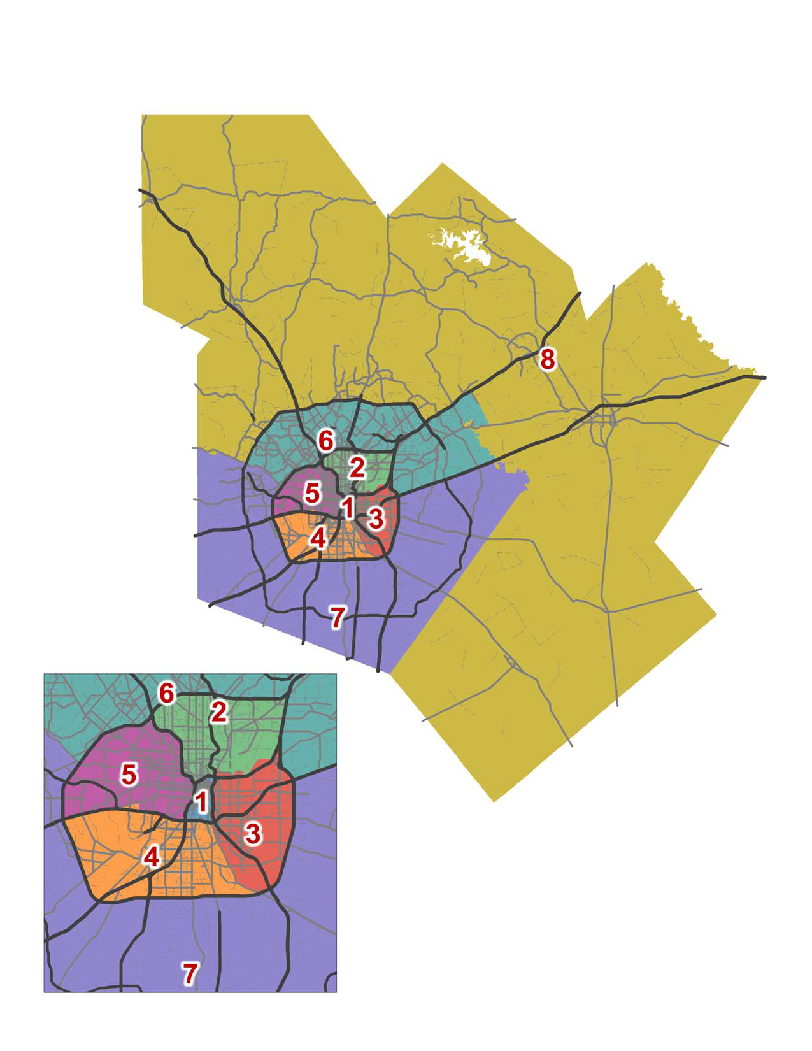
Incremental Structure
Base transit mode shares
  Expanded on-board survey
  Motorized person trips from
  SA-BC MPO model
District structure used
  Survey will be sparse at TAZ
  Grouped “like” TAZs into
  8 districts
  Minimized 0% and >100%
  shares – checked shares for
  reasonability

Slide 20
Base Year Validation

Slide 21
Bus Run Times

Slide 22
Assignment Results
Systemwide Boardings (expanded trip table)
Model matches observed 1.41 average boardings per trip
 | Observed | Modeled | % Error
Metro & Frequent | 113,303 | 113,013 | -0.3%
Express & Skip | 11,348 | 12,394 | +9.2%
Rubber-Tire Streetcar | 2,248 | 2,213 | -1.6%
Systemwide | 126,898 | 127,620 | +0.6%
Study Area Total | 27,738 | 28,174 | +1.6%

Slide 23
Assignment Results
Existing Rubber Tire Streetcar Boardings (expanded trip table)
Results are impressive – akin to validating collectors in a regional model
 | Observed | Modeled | % Error
Red Route | 779 | 693 | -11%
Yellow Route | 967 | 931 | -4%
Blue Route | 502 | 589 | 17%
Total | 2,248 | 2,213 | -2%

Slide 24
Assignment Results
Systemwide Boardings by Route

Slide 25
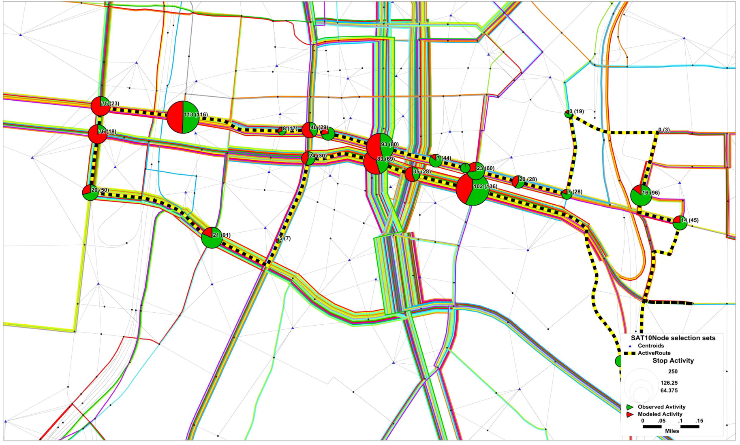
Assignment Results
Activity by Stop

Slide 26
Assignment – Suggestions
Validation specified with initial boarding penalty of 10 minutes
Allows for flexibility in accommodating fixed-guideway benefits (i.e. span of service, station amenities, etc.)

Slide 27
Conclusions

Slide 28
Conclusions
Good on-board survey data are critical!!!!
Multi-path validation is important & can be challenging
Survey data will be sparse at TAZ level; apply model at district level
Suitable for areas with existing transit service; relatively mature land uses
Relatively cost-effective; focus on validating transit components; schedule acceleration or at least, on time!

Slide 29
Questions

