Slide 1

An Improved Methodology for Modeling Truck Contribution to Regional Air Quality
Harikishan Perugu, Ph.D.
Heng Wei, Ph.D. PE
Zhuo Yao, Ph.D. Candidate(Presenter)
School of Advanced Structures
College of Engineering and Applied Science
University of Cincinnati
14th TRB National Transportation Planning Applications Conference, Columbus, Ohio, May 5-9, 2013

Slide 2
Outline
Problem Statement
Methodology
Case study- Cincinnati
Results from Dispersion Model
Contribution of the Research
Conclusions

Slide 3
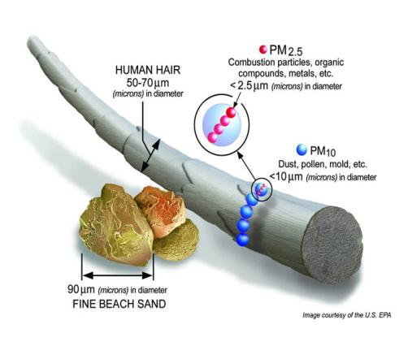
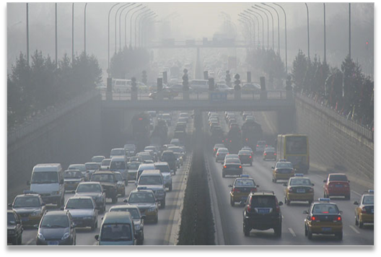
Background & Problem Statement
In urban areas PM_{2.5} mostly contributed by diesel trucks
Travel Demand Models, Emission Models and Dispersion/Photochemical Models are used for modeling
Environmental protection agencies always trying produce better modeling results for truck exhausted PM_{2.5}

Slide 4
Traditional Air Quality Modeling
Activity Data
VMT
Speed
Starts
Fuel Data
Inspection information
Vehicle Registration
Age data
Temperature
Relative Humidity
Adjustment
Factors
Emission Model
No
Detailed Link-Level Activity
Yes
County Level Emission Inventory
Emission Factors
Top-Down Approach
Bottom-Up Approach
Spatial Allocation Using Hourly Surrogates
Link Activity Data
Link Level Hourly Emission Calculation
Chemical Speciation
Gridded, Temporal, and Speciated Emissions
Observed air quality
Air Quality Model

Slide 5
Drawbacks in Current Approach
Very few truck models can model hourly-level truck activity such as truck miles traveled and speeds by truck type
Could not estimate reliable results for gridded inventory
Current practice does not predict trucks impact on urban air quality independently
Improvements in Proposed Approach
A spatial regression based truck activity model is used
More reliable “bottom-up” approach is used
Only truck related emissions are used which are usually very difficult to synthesize

Slide 6






Scope of the Study
Motor homes
Single Unit Short-haul Trucks
Combination Short-haul Trucks
Refuse Trucks
Single Unit Long-haul Trucks
Combination Long-haul Trucks
Typical Weekday Data is used
Only Diesel Trucks are considered

Slide 7
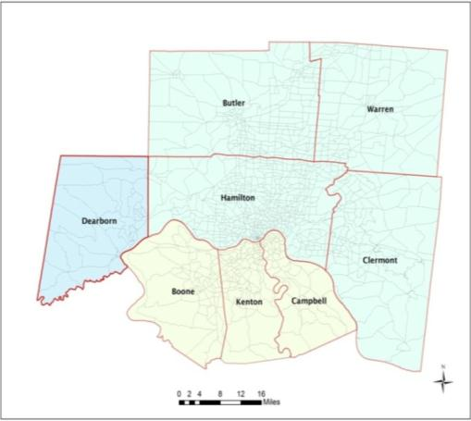
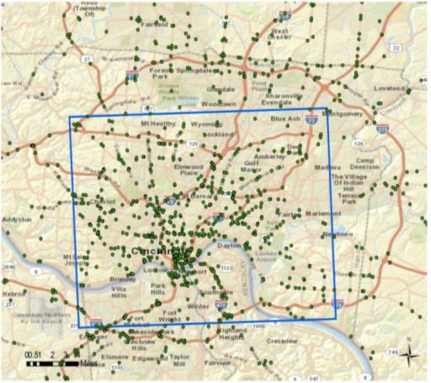
Cincinnati Case Study
Greater Cincinnati data used
Traffic locations around 500 and years 2003-2009 (Validation)
Socio economic data is based on 2000 Census data (Travel Demand Model)
Meteorology and Vehicle Registration data is for 2010 (MOVES)
Air Quality System pollution monitoring data from US-EPA(Validation]
OKI region
Traffic Count locations

Slide 8
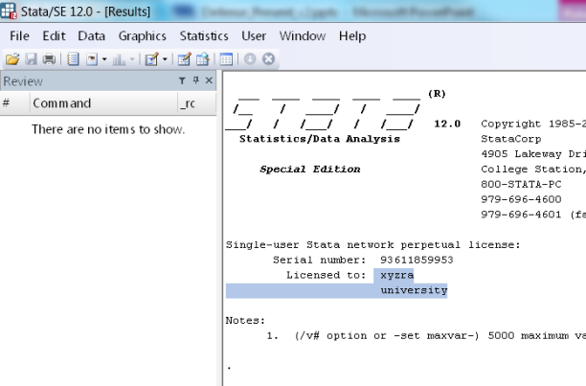
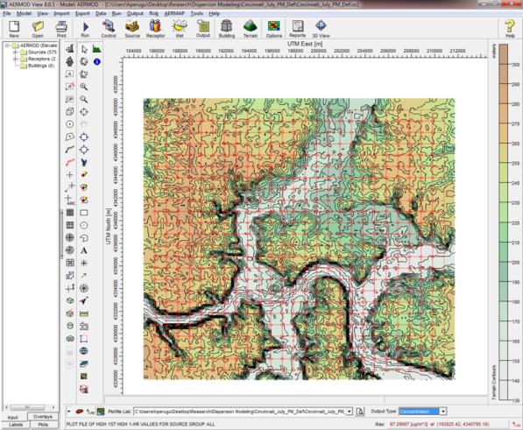
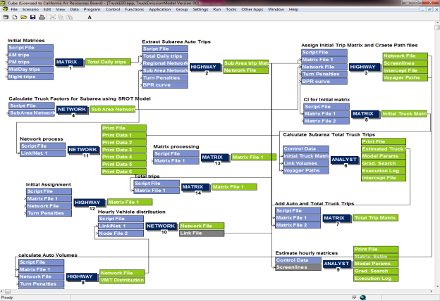
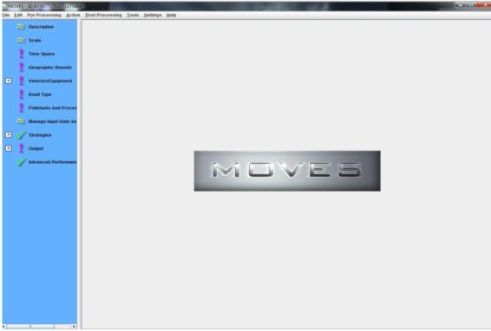
Modeling Tools
STATA
AERMOD
Cube
MOVES

Slide 9
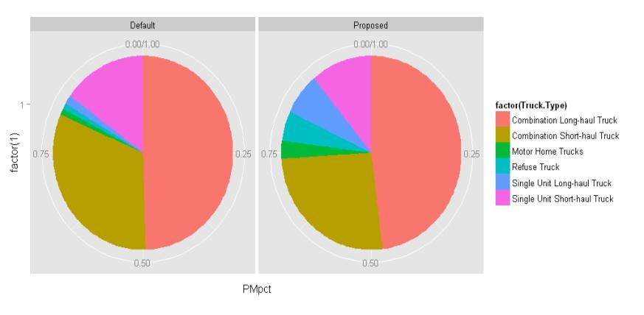
Daily Emissions Comparison
Source use/Truck types | Daily emissions using default inputs (Kg) | Daily emissions using new model based inputs (Kg)
Refuse Trucks | 5.50 | 11.79
Single Unit Short-Haul | 95.85 | 205.73
Single Unit Long-Haul | 12.77 | 329.35
Motor Homes | 4.11 | 49.81
Combination Unit Short-Haul | 202.87 | 351.49
Combined Unit Long- Haul | 321.79 | 620.28
The US-EPA approach predicted lower daily emissions
The contribution of Combination short-haul is over-estimated
The emission contributions from refuse, motor home and single unit short haul trucks are proportion to observed truck miles

Slide 10
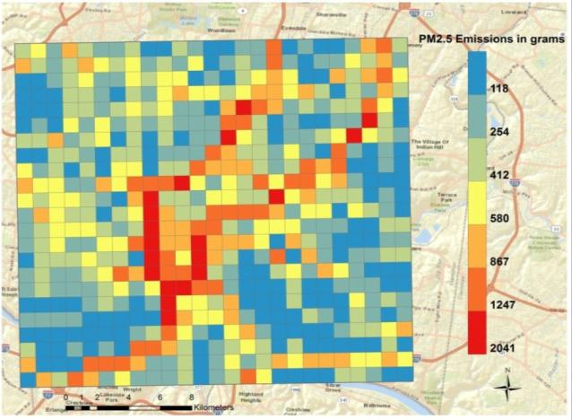
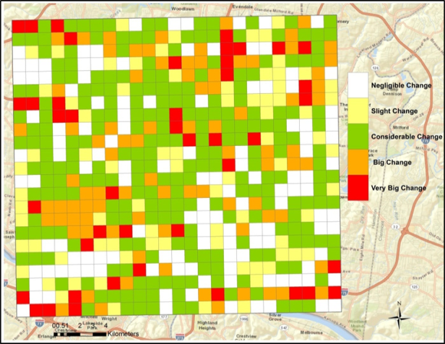
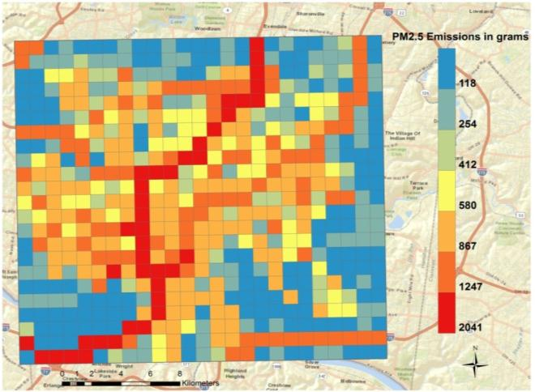
Gridded Comparison
US-EPA Approach
Differences
Proposed Approach
BOTTOM-UP Process is used

Slide 11
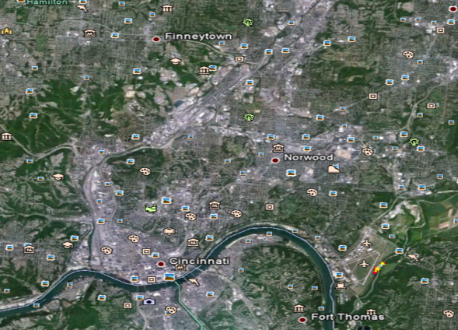
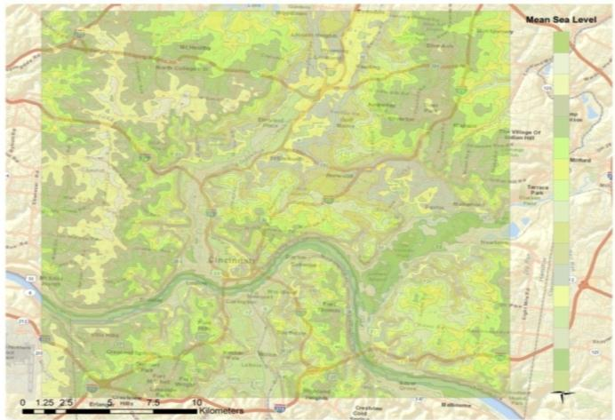
Meteorological & Terrain Data
Wind speed& direction data obtained from Lunken airport location
AERMET for meteorological data processing
Terrain data with 7.5-meter horizontal resolution is used
AERMAP terrain data processing
Domain Terrain
Wind speed & direction

Slide 12
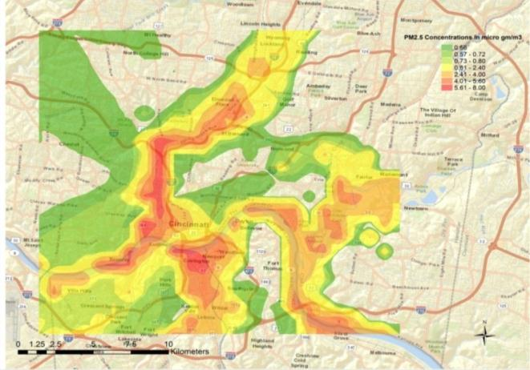
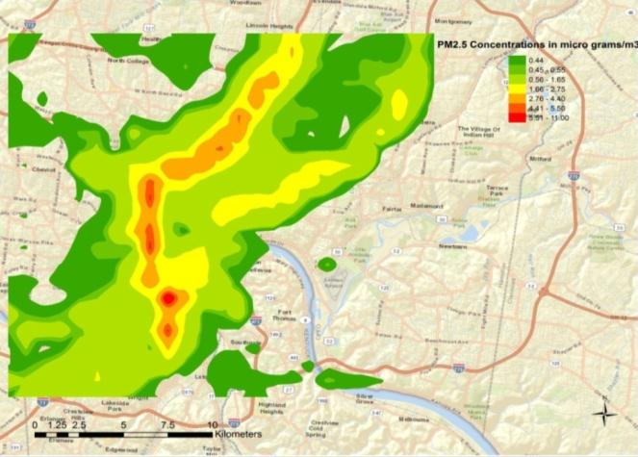
Dispersion Comparison
The default PM2.5 dispersion and concentrations are spread over bigger area
Due to inconsistent truck activity information, the dispersion has been over predicted
The 24-hr max and 1-hr max concentrations predicted in the default model are very similar
The hot-spot location prediction from the proposed model is quite apparent
Default Approach
Proposed Approach

Slide 13

Comparison with Monitored Data
Price Hill Monitoring Station
PM2.5 concentrations are obtained from US-EPA Monitoring Database
Default=US-EPA standard approach
Taft Road Monitoring Station

Slide 14
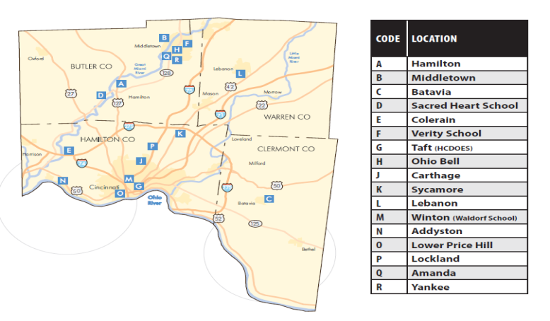
Comparison with Real Data
Location | Method | Monthly Average Estimated Value | Spearman Correlation to monitored values
Price Hill | Default | 3.0792 µg/m³ | 0.5274
 | Proposed | 5.7958 µg/m³ | 0.8503
Taft | Default | 0.9667 µg/m³ | 0.4621
 | Proposed | 2.3029 µg/m³ | 0.9012
Predicted values from the new proposed models has better correlation with observed values
Proposed models also predicted higher PM2.5 pollution in urban areas

Slide 15
Conclusions & Further Steps
A transferrable methodology for truck related air quality modeling
More reliable estimation of emission totals
Better ground-truth prediction of hot-spots
More realistic estimation of the contribution of heavy-duty truck emissions to urban air quality
Further research-
  Week day & weekend models
  Truck specific hourly factors
  Application to other regions
  Update the case study with most recent available datasets

Slide 16
This is a Continuation…
Perugu, H., Wei, H. and Rohne, A. (2012). “Modeling Roadway Link PM_{2.5} Emissions with Accurate Truck Activity Estimate for Regional-Level Transportation Conformity Analysis.” Transportation Research Record: Journal of the Transportation Research Board, Vol. 2270 / 2012:87-95.
Perugu, H., Wei, H. and Rohne, A. (2012). “Accurate Truck Activity Estimate for Roadway Link PM_{2.5} Emissions.” ASCE Proceedings of 12th COTA International Conference of Transportation Professionals (CICTP 2012), Beijing, China. August 3-6, 2012.
Perugu, H., and Wei, H. (2011). “Development of an Integrated Model to Estimate Link Level Truck Emissions.” Proceedings of Futura 2011-Annual International Users Conference, Palm Springs, California, October 29- November 4, 2011 (This paper is the 1st prizewinner of the Cube Student Challenge Competition 2011).

Slide 17
Thank You Very Much!
&
Questions? harikishan.perugu@gmail.com

