Slide 1
Donnelly & Koppelman
Travel Model Credibility as a Criteria for Design and Implementation
TRB Transportation Planning Applications Conference Columbus OH | 7 May 2013

Slide 2
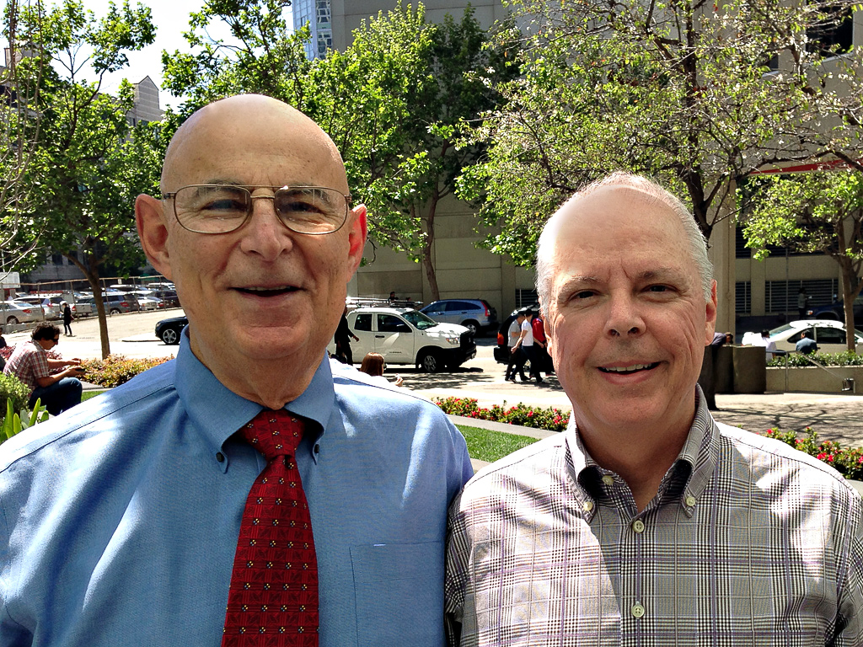
Rick Donnelly – 28 years experience
Senior Modeler at PB and Senior Fellow at University of Melbourne
Co-chair, TRB Committee on Travel Forecasting Resources (ADB45)
Handful of papers, books, and presentations
Frank Koppelman – 38 years experience
Professor emeritus, Northwestern University
Emeritus member, TRB Committee on Travel Demand Forecasting (ADB40)
Hundreds of papers, books, and presentations

Slide 3
Research questions
Do high-level decision-makers view model validity different than we do?
If so, what can we learn from them?
Is there any difference between the views held by public and private sector executives?

Slide 4
How we view model validity
Entirely a statistical exercise
Heavy focus on matching observed traffic counts
Starts when development is over
Matching preconceived ideas about accuracy
Comparison with competing models
DOT guidelines
Accepted norms

Slide 5
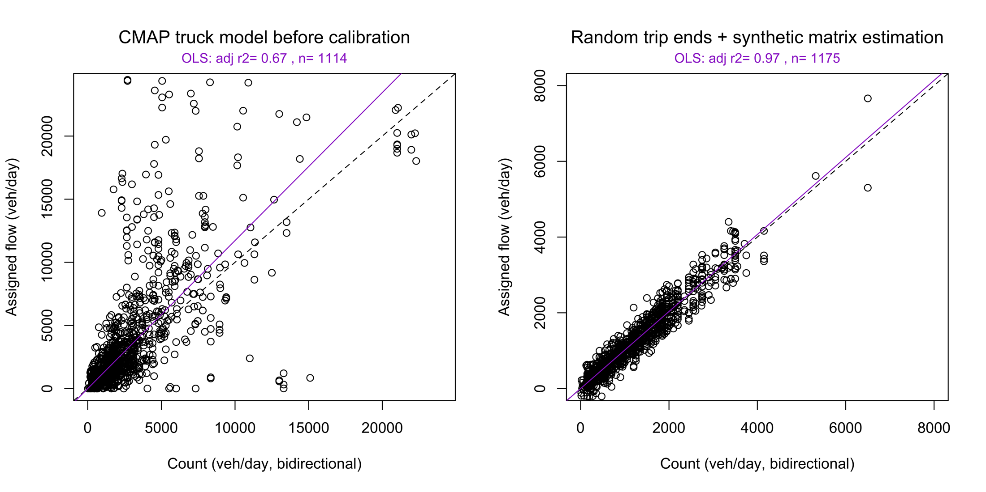
“Better”?

Slide 6
Data points
Investment bankers (3)
State legislators (3)
State DOT directors (2)
HSR board member
HSR executive director
Governor
State Transportation Commissioner (2)
Congressional legal counsel
CEO of infrastructure consulting firm

Slide 7
Data collection
Two questions:
“How do you assess the validity of a travel model or forecast derived from one?”
“What could forecasters do to increase your confidence in their work?”
Administration:
Relaxed social setting
After interacting with forecasts
No advance warning
Ad hoc analysis

Slide 8
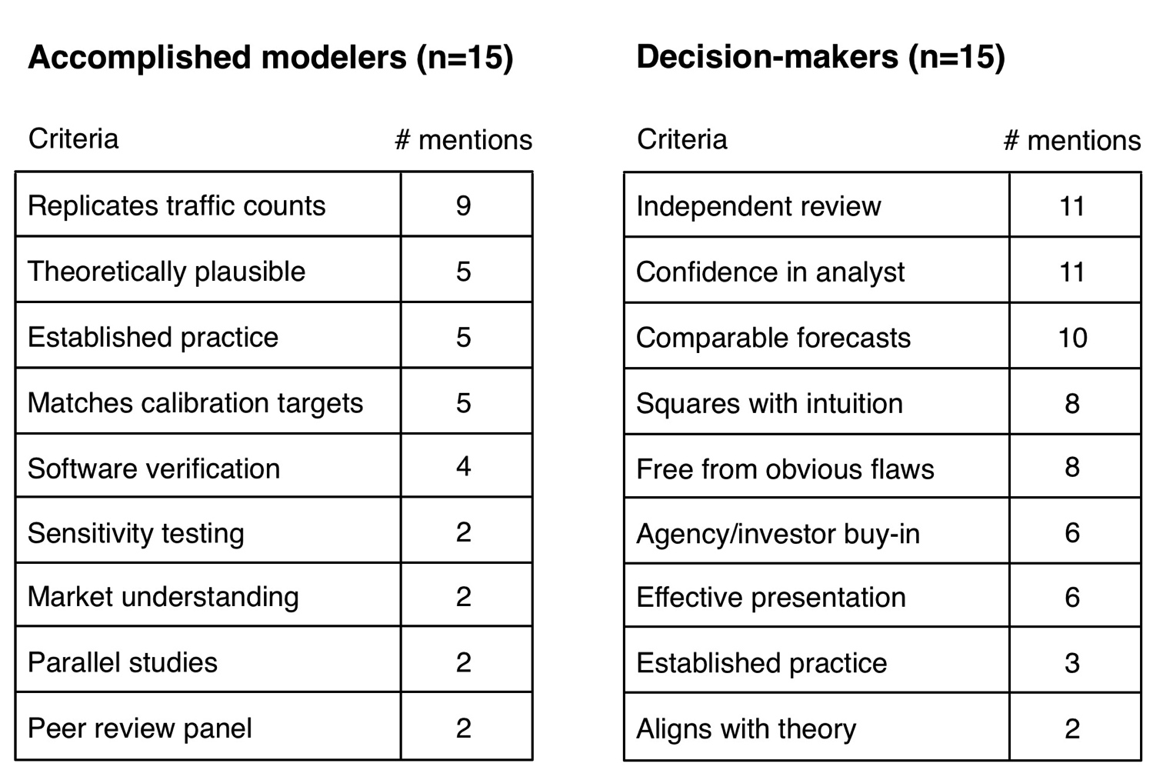
Assessing validity (Q1)

Slide 9
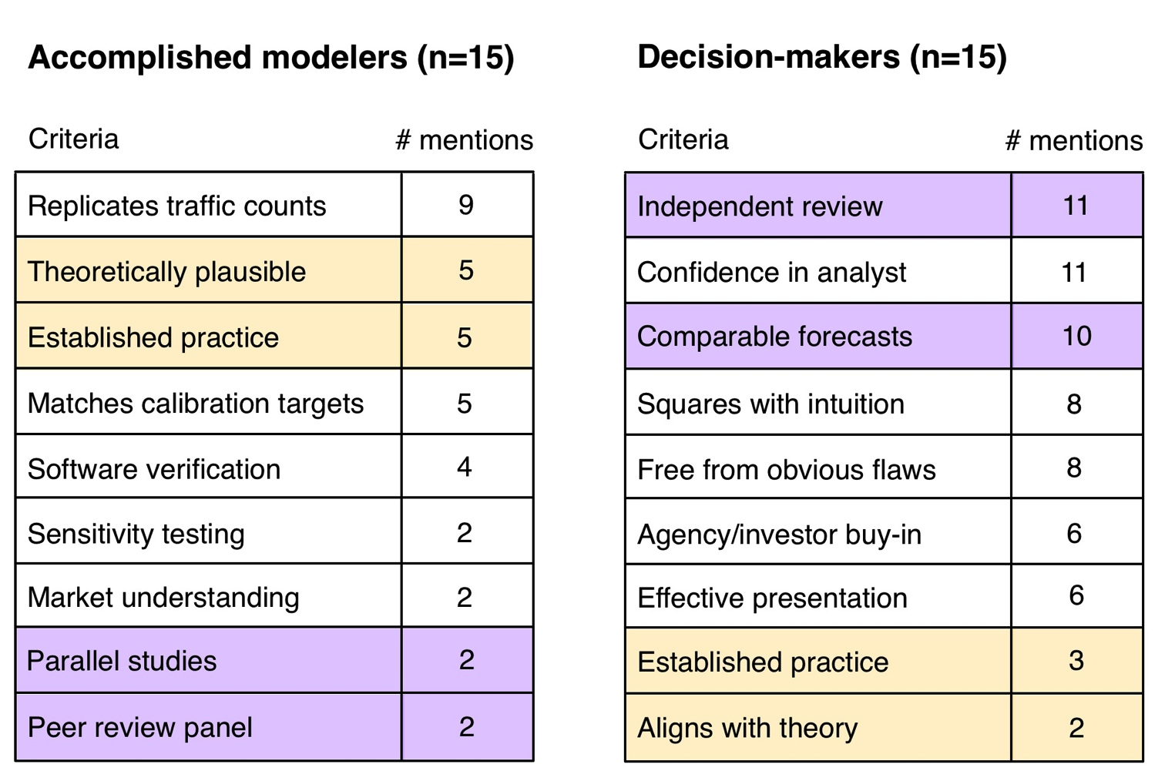
Assessing validity (Q1)

Slide 10
But do they really believe us?
Unexpected changes in exogenous information
Optimism bias
Poor data
Political influences
Methodological issues
“Irrational behavior”
Deception
B Flyvbjerg, N Bruzelius, & W Rothengatter, Megaprojects and risk: an anatomy of ambition, Cambridge University Press (2003)

Slide 11
While we’re on the topic of the future…

Slide 12
Solutions (Q2)
Lose “replication tunnel vision”
Making risk and uncertainty explicit
Standards
Transparency
Delphi panel
Open models (data + assumptions + tools)
“Stakeholder access”
Reference class forecasting (outside view)
Independent review
Crash testing
Model alignment

Slide 13
</story>
Contacts
Rick Donnelly [donnellyr@pbworld.com]
Frank Koppelman [fkoppel@koppelman.pro]

