Slide 1
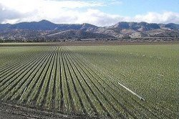

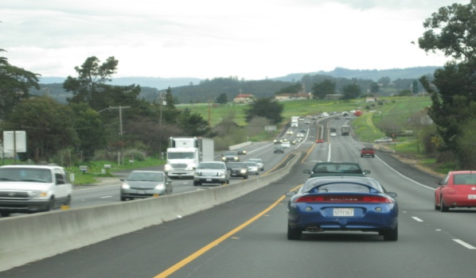

A Case Study in the Deployment of a Web-based Service as a Stakeholder Involvement Tool to Support the Development of a Travel Demand Model
14th Annual TRB Planning Applications Conference
Columbus, OH - Wednesday, May 8, 2013
Bhupendra Patel, PhD, AMBAG
Anais Schenk, AMBAG
Paul Ricotta, P.E., Caliper Corporation

Slide 2
Outline
Overview
Web-based tool: Objective and Functionality
Effort Involved
Demonstration
Conclusions
Notes:
Changed text/formatting

Slide 3
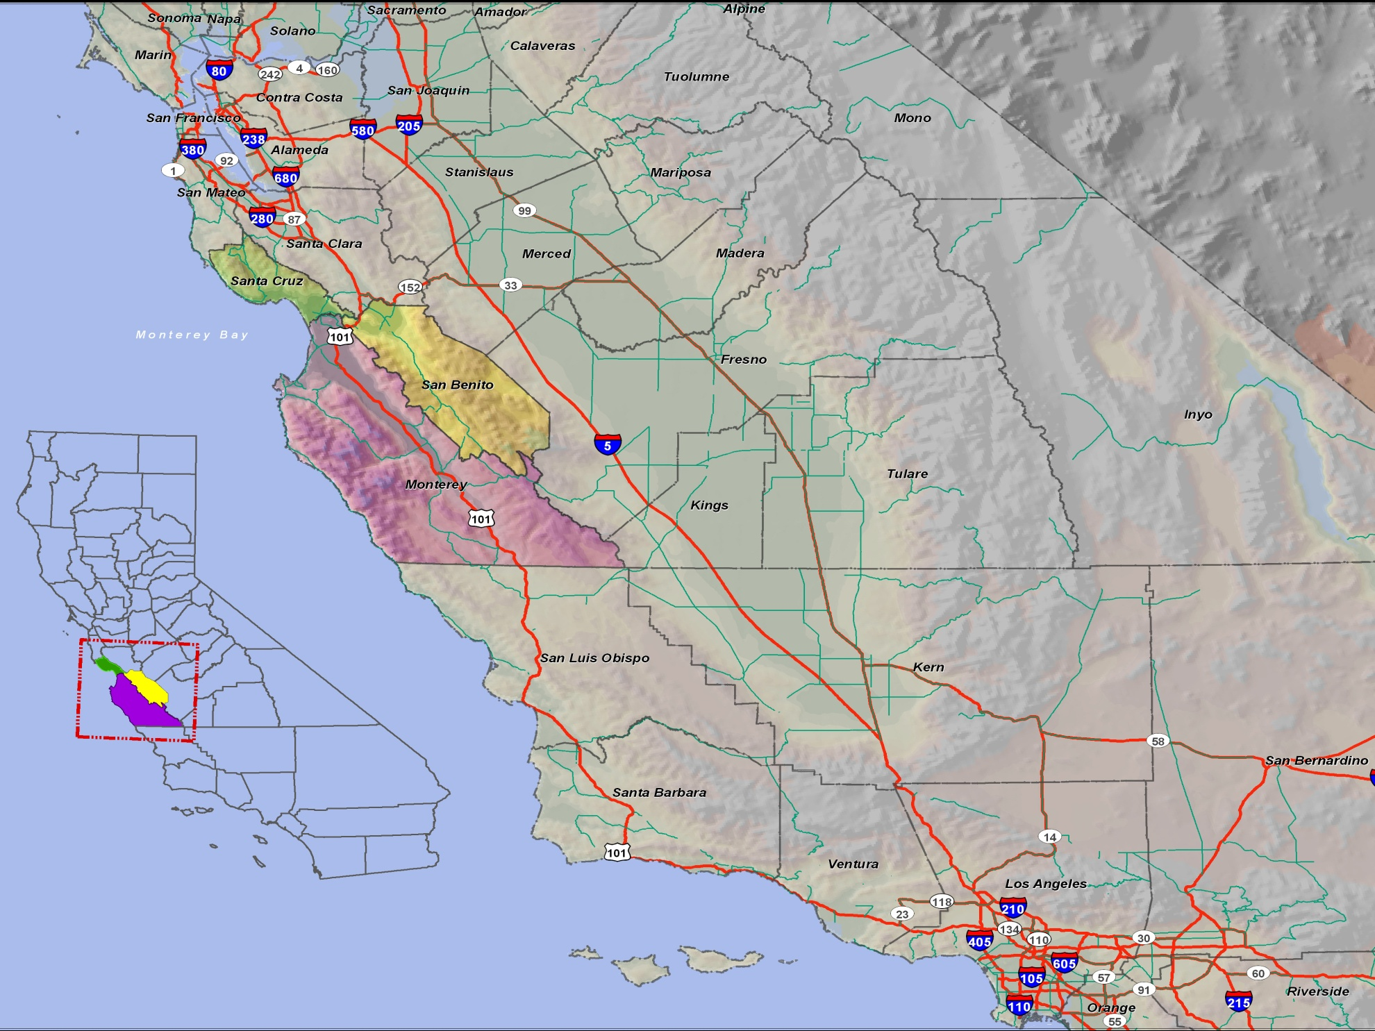
Overview : Monterey Bay Region Covers
3 Counties
18 Cities
3 Transit Operators
3 Regional Transportation Planning Agencies
2010 Population: 774,781
2035 Projected Population: 920,713
Notes:
Deleted commas in list

Slide 4
Overview
Engage stakeholders in the model update process and applications
Develop a web application to support data collection, QA/QC for Model inputs
Create unique user logins and comment logging
Provide training for stakeholders
Follow-up with stakeholder to gauge progress
Process logs, follow-up for increased participation
Validate the changes and update the Model input layers
Host Model outputs for stakeholders and public use
Notes:
Changed text/formatting

Slide 5
Web-based tool: Objective and Functionality
Advantages of a web-based approach
  Accessibility to users
  No prior expertise required - minimal training requirement
  Works across all platforms (Windows, Mac, Unix)
  No software or data required on the client side
Implemented as a browser application (thin-client)
  The client is a Web Browser (Internet Explorer, Firefox, etc)
  No plug-ins required
  Data accessed via server and transmitted as raster images
  Editable fields in the GIS attribute tables
Notes:
Changed some text

Slide 6
Web-based tool: Objective and Functionality
Feasibility considerations
  Targeted toward large audiences
  Non-expert users can interact with the application
  Not all desktop functionality is appropriate in a client server environment
  Data backup
  User support for lost logins, server malfunctions/ reboots, etc.
Notes:
Changed formatting/text

Slide 7
Web-based tool: Functionality
Easy to access map console to illustrate TAZ data, Highway and Transit network data and other critical model input data
Ability to log comments and make corrections for posted speed, number of lanes, functional class , traffic counts and other key link attributes
Toggle themes on various data layers
View aerial photography in conjunction with vector data
Scale dependency of map properties such as labels and visibility of more detailed layers
Notes:
Changed formatting/text

Slide 8
Effort Involved
Hardware and Software
  Appropriate server infrastructure to host site
  Web-based mapping software for the server (TransCAD for the Web in this case)
  Ability for hosting staff to access to control logins, upload new data for maps and reboot server
Maps
  Create maps that are easy to read and understand and that are informative and worth looking at
User Training
  Hosted live demonstration using web-based meeting software
  Minimal technical support required after initial instruction
Notes:
Changed formatting/text

Slide 9
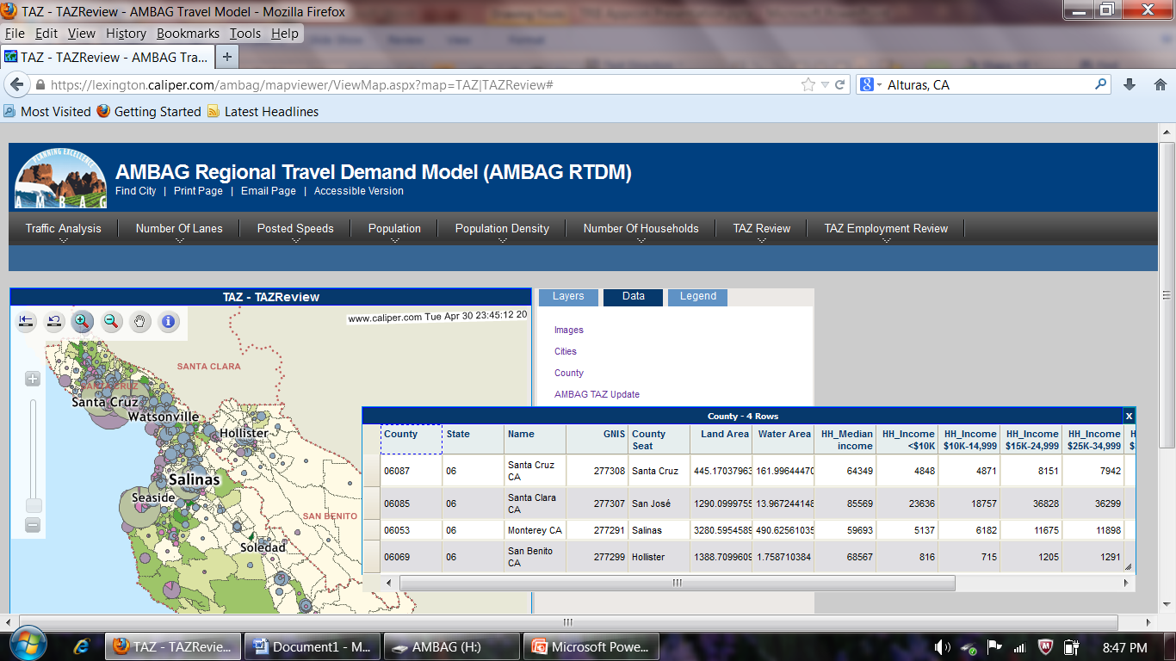
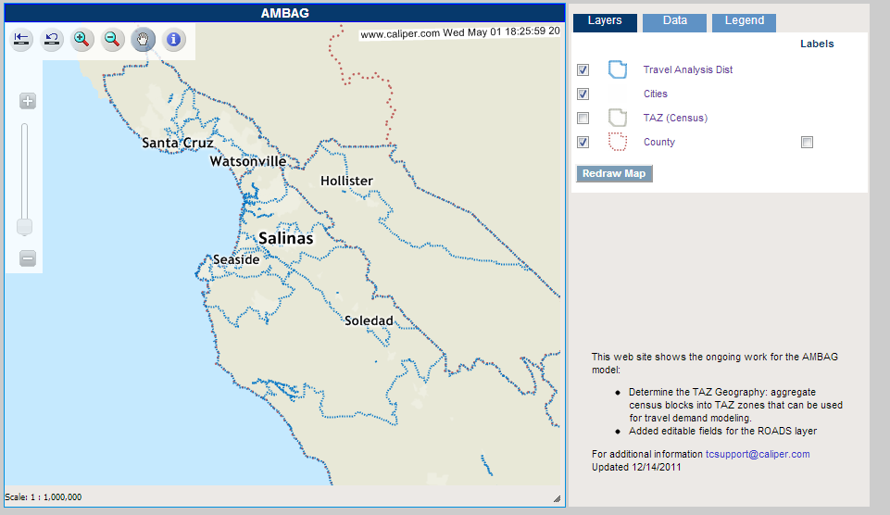
Toggle Button Map Interface
Dynamic Layers and Map Refresh
Notes:
Changed Formatting/ graphics

Slide 10
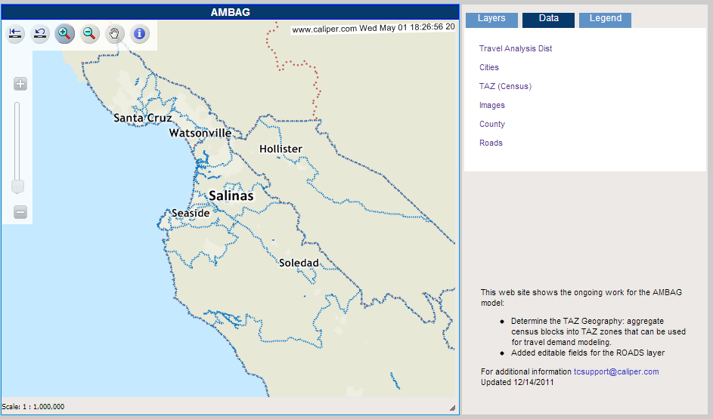
Multi-tab Viewer Functionality
Toolbar Features
Selectable Data Layers and
Auto Opening Attributes Tables
Notes:
Changed Formatting/ graphics

Slide 11
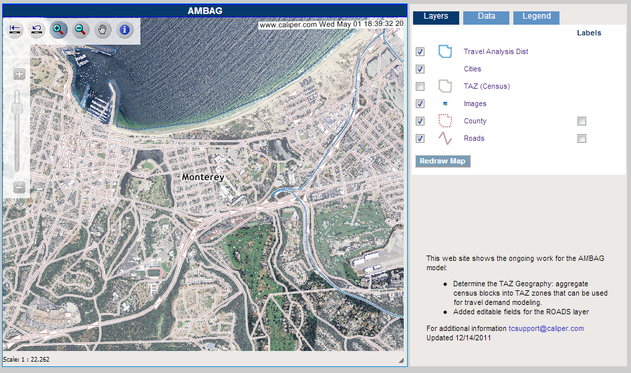
Dynamic Layer Display on Zoom Levels
Selectable Labeling
Notes:
Changed Formatting/ graphics

Slide 12
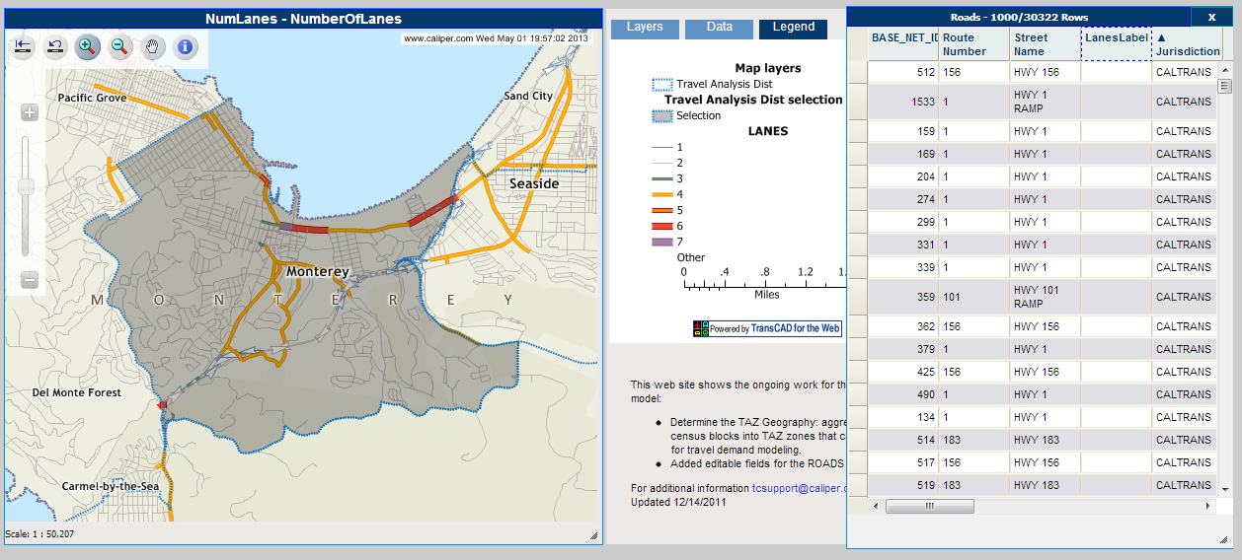
Selectable Travel Analysis District
Road Data Attributes
Notes:
Changed Formatting/ graphics
Changed Formatting/ graphics

Slide 13
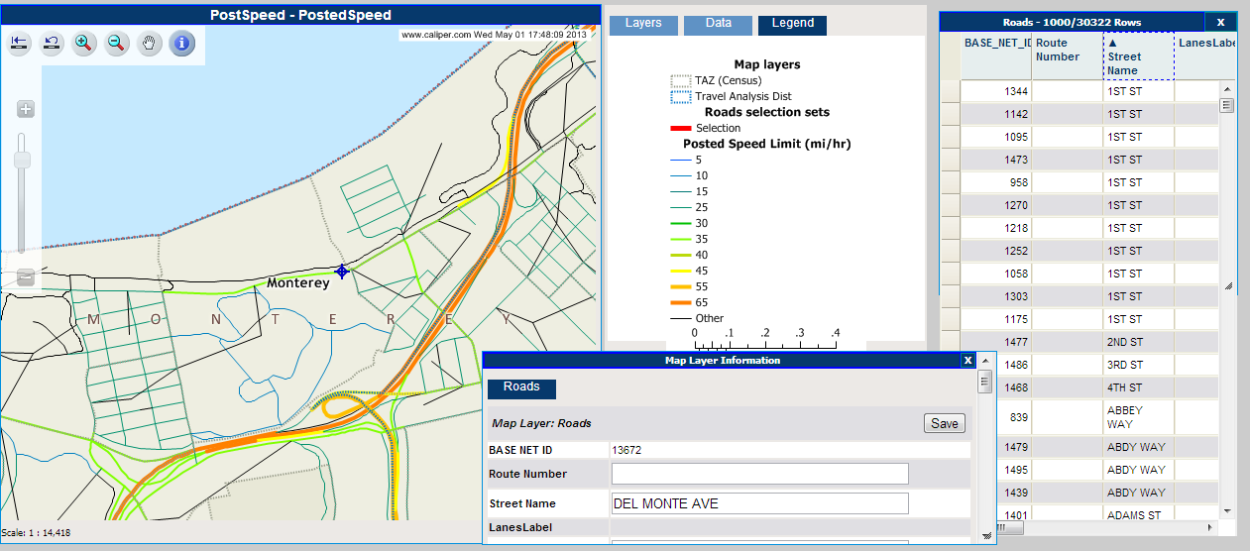
Selectable Layer Information using Info Tool
Layer Information at Feature Class Level
Notes:
Changed Formatting/ graphics

Slide 14
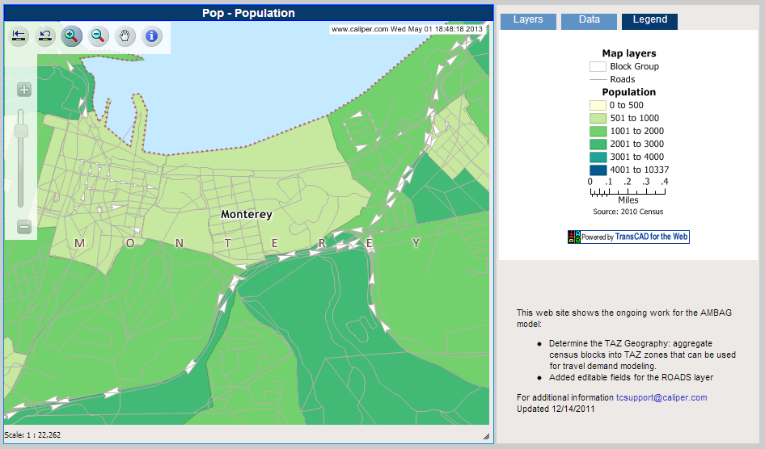
Clear and Concise Legends
Notes:
Changed Formatting/ graphics

Slide 15
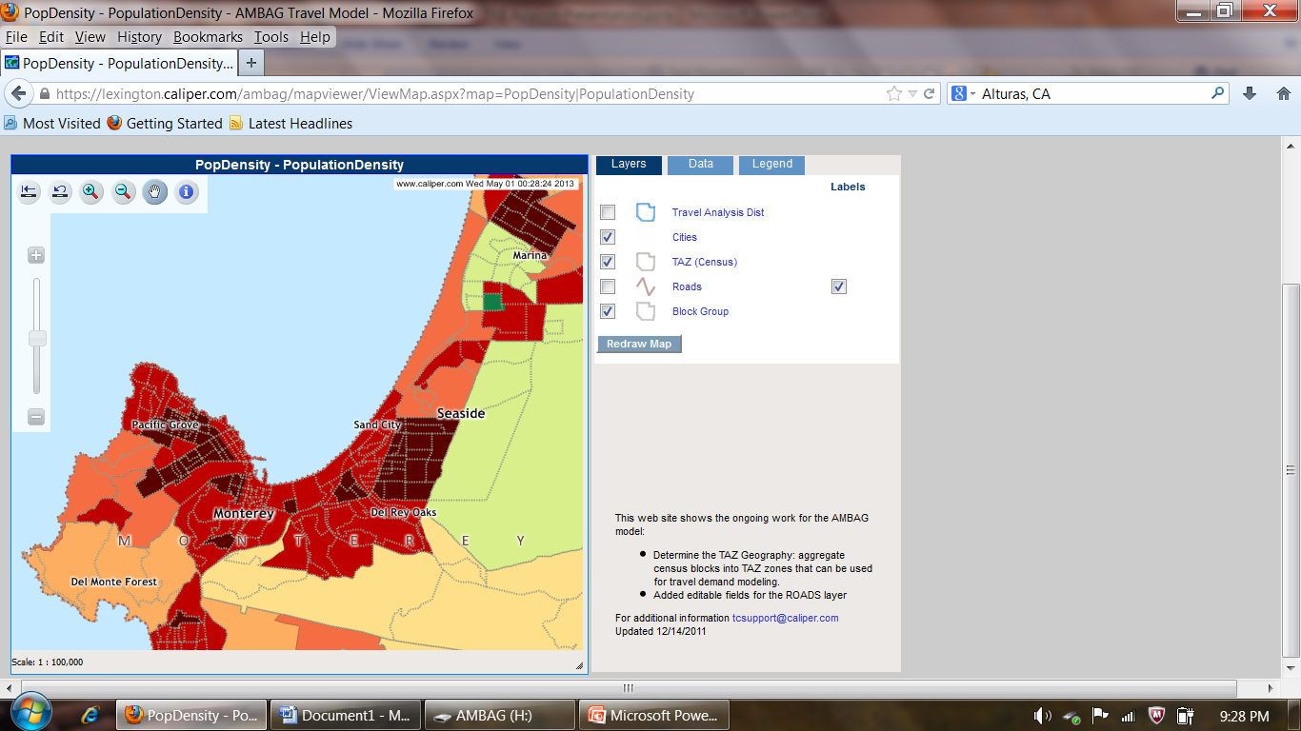
Clear and Concise Legends
Heat based mapping
Notes:
Changed Formatting/ graphics

Slide 16
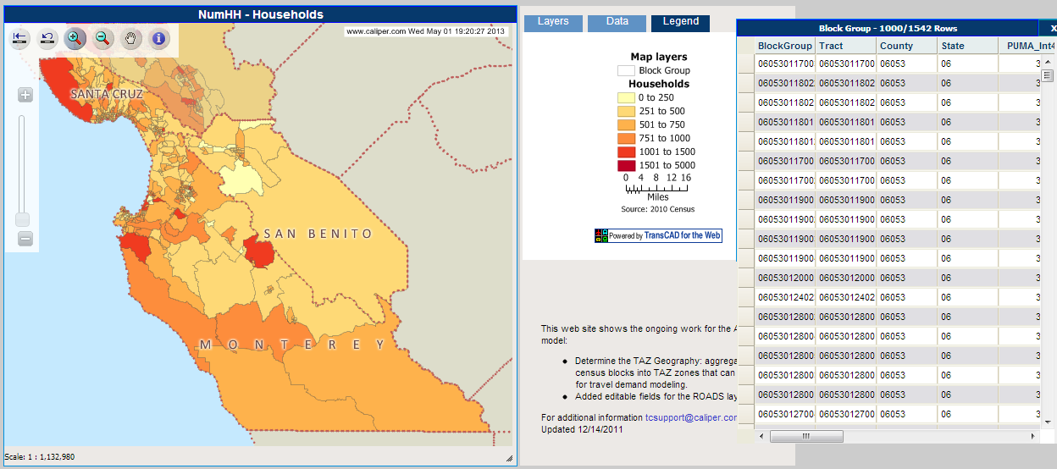
Block Group Attribute Information
Notes:
Changed Formatting/ graphics

Slide 17
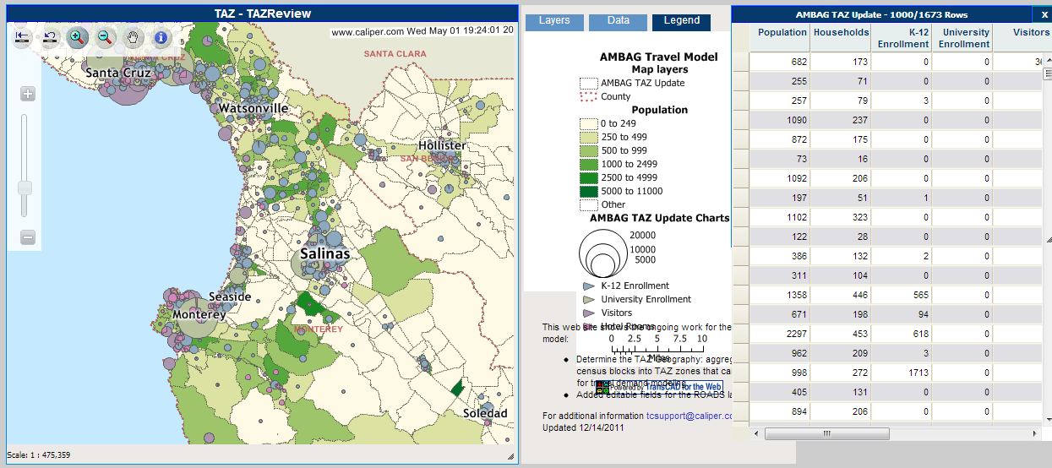
TAZ Information
Notes:
Changed Formatting/ graphics

Slide 18
Findings
We received approximately 200 edits
Overall, the response to the tool was excellent
Proficiency with tools developed quickly
Provided stakeholders with a better understanding and appreciation of the model input data
The requirement of submitting a short comment for an edit was helpful
Notes:
Changed text

Slide 19
Findings
Deadlines helped prevent the project from dragging on
Rapid response to add new data or to seek better map clarity required
While not the primary QA/QC for the model data, soliciting feedback from stakeholders was useful for keeping them engaged in the process and aware of the update progress
Notes:
Changed text

Slide 20
Questions
For any additional questions please feel free to contact:
  Bhupendra Patel (AMBAG): bpatel@ambag.org
  Paul Ricotta (Caliper Corp.): paul@caliper.com
Notes:
Changed text

