Slide 1
A GIS Approach to Pedestrian Level of Service
Natalia Domarad
14th TRB Transportation Planning Applications Conference
Columbus, Ohio
May 5-9, 2013

Slide 2

Presentation Overview
PLOS Background
GIS Approach
Methodology
Benefits

Slide 3
Pedestrian LOS
Evaluates performance of a pedestrian facility
Benefits of HCM 2010 methodology:
  Traveler’s perspective
  Consistent systematic evaluation
  Identify system deficiencies
  Simple results
  Different scales
Introduction

Slide 4



PLOS Methodology
Complex
Many input variables
Computationally intensive
Introduction

Slide 5
GIS Approach
Data can be easily modified and updated
Workflow visualization
Automation
Field measurements from your desk
Geodatabase and tools
Introduction

Slide 6
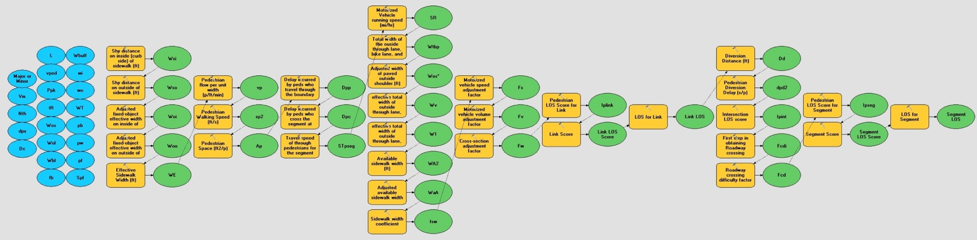
PLOS Organization
ModelBuilder
  Workflow visualization
  Testing workflow
  Track analysis steps
Methodology

Slide 7
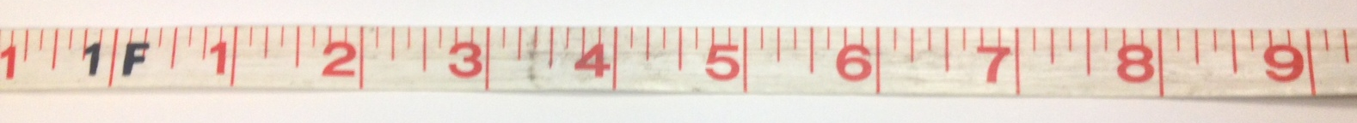
Input Variables
Signal timings
Traffic and pedestrian counts
Measurements
Site characteristics
Methodology

Slide 8
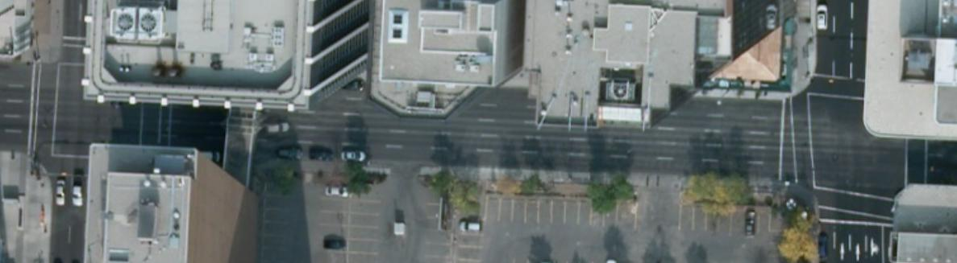
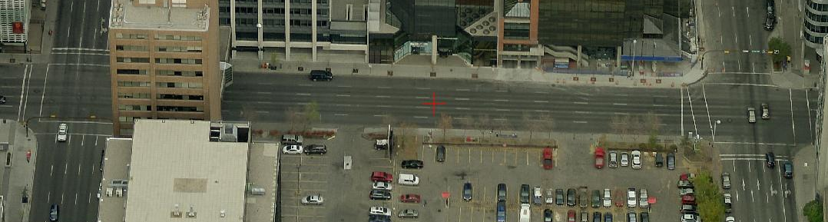
Measurements & Site Characteristics
Aerial Photo
Methodology
Aerial Oblique Imagery
Copyright ©2011 Pictometry International Corp.

Slide 9
Assumptions
Most conservative scenario
  Measurements & site characteristics
  PM peak hour
Mid block pedestrian volumes
Methodology

Slide 10
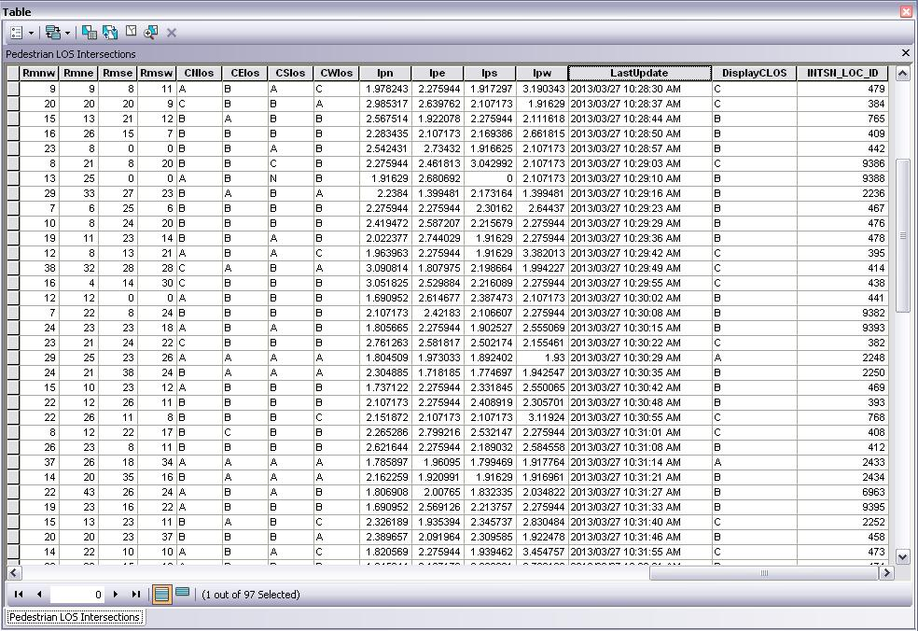
PLOS Geodatabase
Intersections and segments
Traffic count table
Relational
Tools
Methodology

Slide 11
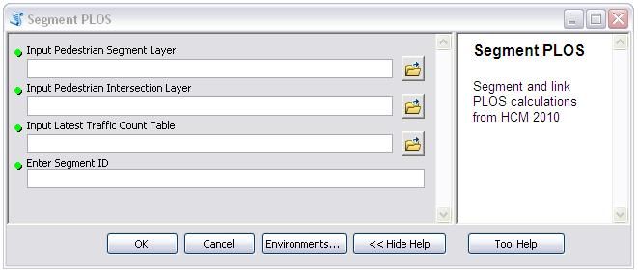
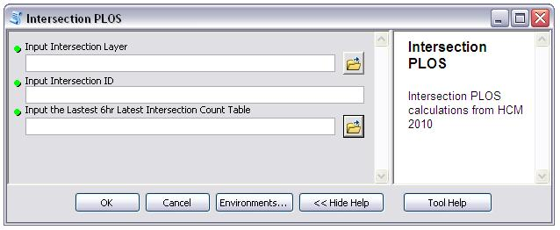
Calculating PLOS
Python script tool
  Fast processing
  Automation
  Error checking
  Documentation
Methodology

Slide 12
PLOS Output
Crosswalk
Average pedestrian space
Link
Segment
Display LOS
Methodology

Slide 13
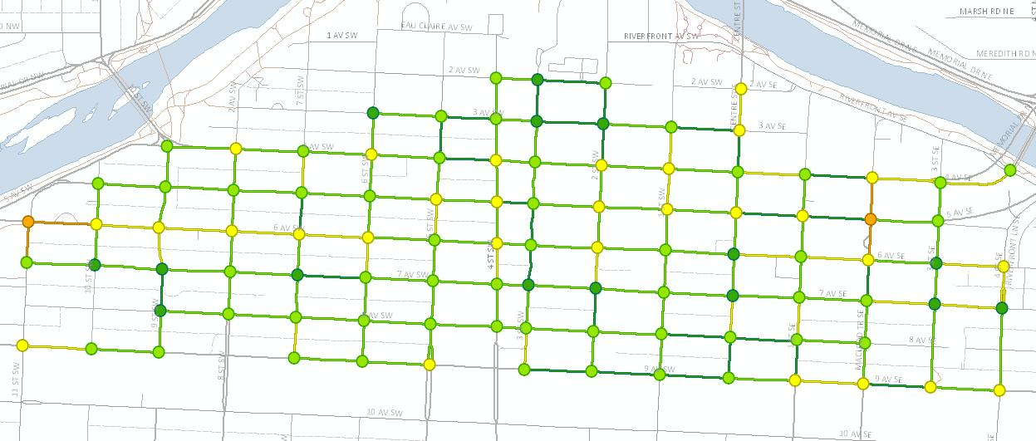
Mapping
Spatial overview of data
Visualize problem locations
Technical/non-technical audiences
Benefits

Slide 14
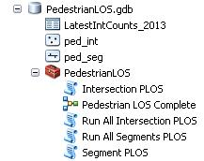
Geodatabase
Allows repetition and modification
Store records of historical PLOS
All data and tools in one location
Benefits

Slide 15
Summary
User friendly
Maintains HCM 2010 level of detail
Eliminates additional field data collection
Next steps:
  Incorporate MMLOS
Conclusion

Slide 16
Thank you!
Questions?
Natalia Domarad
natalia.domarad@calgary.ca

