Slide 1
Estimating Risks Associated with Travel Demand Forecasts
Thomas Adler, RSG
Michael Doherty, URS
Jack Klodzinski, URS

Slide 2
The Problem – Transit New Starts Forecasts
Travel demand model forecasts are not always accurate
Source: Federal Transit Administration, TRB Session 371, January 2008

Slide 3
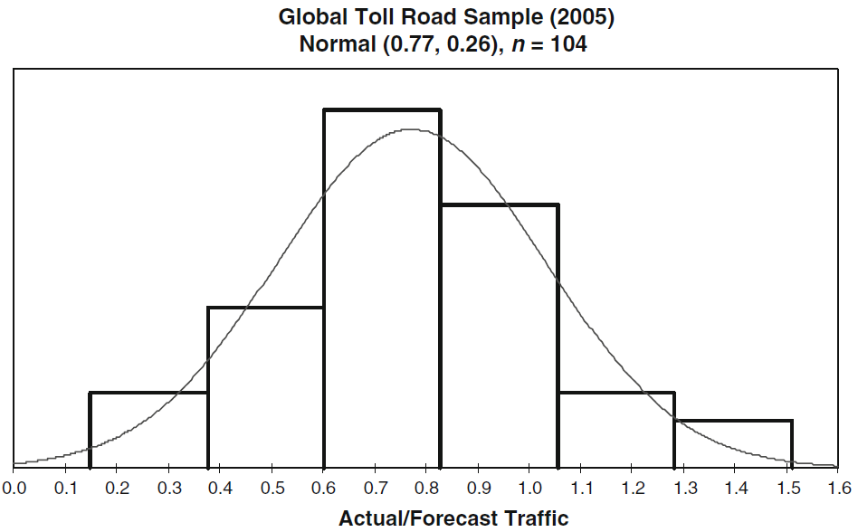
The Problem – Toll Road Projects
Travel demand model forecasts are not always accurate
Source: Bain R, Error and Optimism Bias in Toll Road Traffic Forecasts, Transportation, Vol. 36, No. 5, 2009.

Slide 4
Three major sources of inaccuracy
Model structure and data
  Travel forecasting models are not perfect representations of actual travel behavior
  Data used in models are not perfect representations of transportation system
Analysis bias
  General tendency to be overly optimistic
  May be influenced be desired outcome
Inherent uncertainties about future
  Large uncertainties in many important future conditions
  Uncertainties interact in ways not identified by simple sensitivity analyses

Slide 5
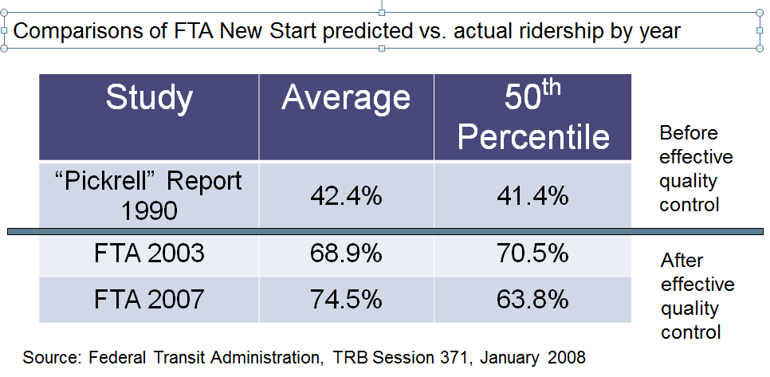
Improving the Reliability of Forecasting Models
There is broad recognition of issues with forecasting models and of the continuing need to improve their reliability.
Improve the models that are used for forecasting
  Progress has been made along a number of fronts
  Model structure
  Model inputs
Improve the review and evaluation process
  Lesson from transit ridership forecasting
Recognize and quantify inherent uncertainties and simplifications
  Quantified probability analysis
focus of this presentation

Slide 6
One Approach: Quantified Probability Analysis
Quantified probability analysis involves two steps:
  Estimating the probability distribution associated with each model uncertainty
  Estimating the resulting probability distribution of the model outputs
Step 1 can use a combination of quantitative and qualitative assessment – still better than just ignoring
Step 2 can in some cases be calculated analytically, and in other cases using Monte Carlo simulation
HOWEVER – most travel demand models take hours or days to run and so running them many times as required by Monte Carlo simulation becomes an intractable problem
  Newer dynamic/agent-based/activity-based models are especially computation time-intensive

Slide 7
Application of quantitative probability analysis process
Uses additional steps to create information that supports a more complete enumeration all reasonable future conditions.
Model Parameters
Forecasting Model
Future Conditions
Response Surface Analysis
Key insight is that corridor traffic can be modeled as a multivariate closed-form function of model inputs.
Delphi, Model Review
Synthesized Model
Delphi, Historical Data
Probability Distribution of Model Parameters
Monte Carlo Simulation
Probability Distribution of Future Conditions
Traffic and Revenue Probability Distributions

Slide 8
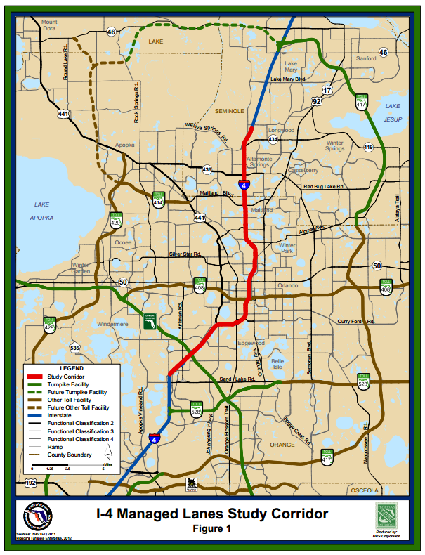
Case Sudy: Orlando I-4 Traffic and Revenue Study
Proposed 21-mile managed lane project
  Existing highway has 4 lanes in each direction
  Project will add 2 dynamically-priced lanes in each direction
  Toll revenue will be important piece of project finance
  Needed 75th percentile traffic and revenue estimates
Regional travel demand model used to estimate demand
  Travelers’ values of time and regional growth rates are key drivers of demand
  The actual future growth rate is highly uncertain
  Model system takes 4-5 hours for a single run

Slide 9
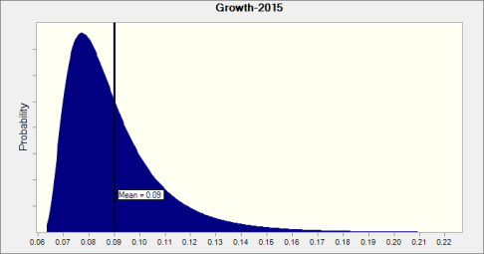
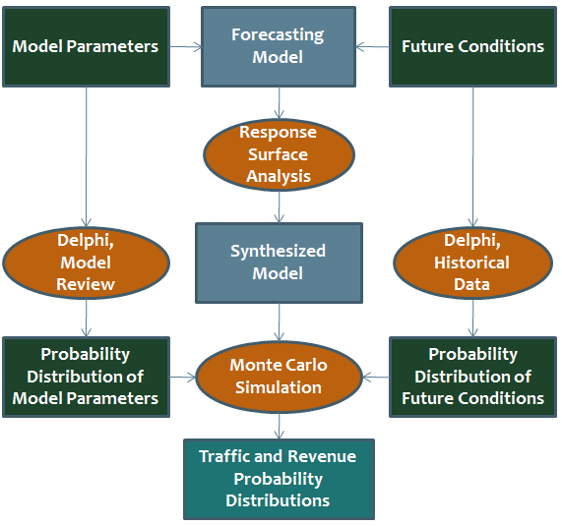
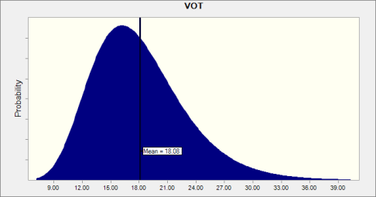
Probability Distributions of Inputs
Land use growth distribution based on historical accuracy of Florida’s official land use forecasts (BEBR); Value of time (VOT) distribution based on sampling error.

Slide 10
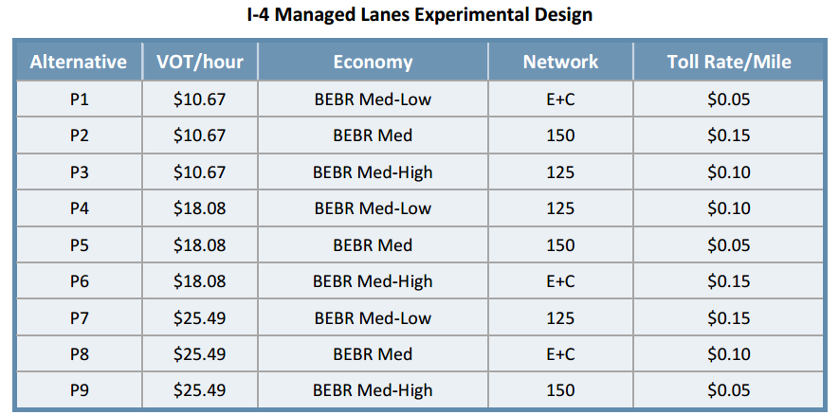
Forecasting Model Runs to Support Response Surface Modeling
Forecasting model runs: 9 orthogonal fractional factorial experiments
Different from sensitivity analysis where inputs are varied individually
Source: Technical Memorandum Planning-Level Traffic and Revenue Study
Interstate 4 Tolled Managed Lanes, URS Corporation, October 2012
E+C is existing plus committed highway projects; 150 and 125 represent additional improvements necessary to keep traffic on all links within 150% and 125% of capacity, respectively

Slide 11
The Synthesized I-4 Models
Where: Traffic is the number of daily one-way trips that use the I-4 Express Lanes
Revenue is the estimated gross revenue from the trips on the I-4 Express Lanes growth is the ratio of dwelling units in the given year to dwelling units in 2010 minus one
tollRate is the average toll rate charged on I-4 in 2010 $
rampUp is the number of years the project has been operating in the given year
roadEC represents the road improvements included only in the E+C conditions
road150 represents an improvement program that maintains all roads below V/C of 1.5
yearCon is a vector of constants representing the years for which the forecasts are
being made
Model R² = 0.98
Source: Technical Memorandum Planning-Level Traffic and Revenue Study
Interstate 4 Tolled Managed Lanes, URS Corporation, October 2012

Slide 12
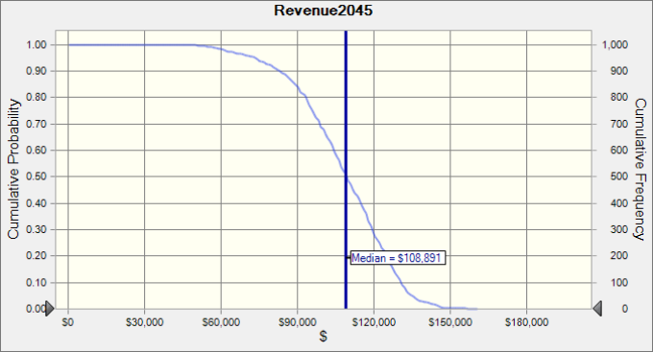
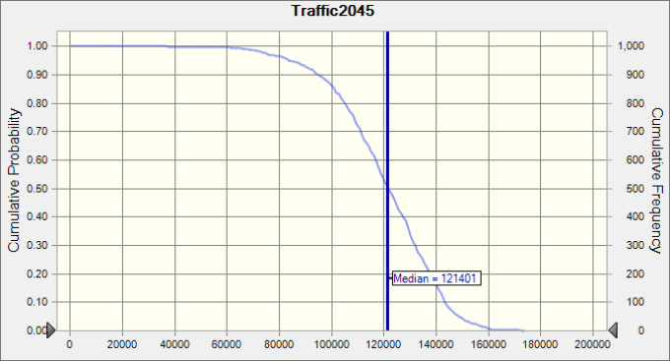
Illustrative Distributions of Outputs*
Outputs reflect 1 million Monte Carlo draws from input distributions; runs took ~30 min. each.
*Note: The data in these graphs are illustrative only and do not reflect the final I-4 project forecasts

Slide 13
Conclusions
Uncertainties and, thus, risks are inherent in travel demand forecasts
For some types of projects, such as those financed by toll revenues, quantification of risks is especially important
Travel demand models are too cumbersome to be used to directly simulate the probability distributions of their outputs
Sensitivity analyses that are commonly conducted do not provide robust information about these distributions because they do not consider interactions among variables
Response surface methods can be used to develop closed-form models that very effectively estimate the effects of key model inputs on corridor traffic and revenue
Response surface models in turn can be used to effectively simulate risks associated with much more complex travel demand forecasting models

Slide 14
Questions?
For More Information
Contact: Tom Adler
RSG
tadler@rsginc.com

