Slide 1
THE PRACTICE OF TOLLING
Theory in Motion
Michael Copeland
Yagnesh Jarmarwala
Justin Winn
May 7, 2013

Slide 2
Agenda
Introduction
  Need for tolling
Generating Capital
  Funding and financing
  Credit enhancement
Assessing Toll Feasibility
  Traffic and revenue
  Costs
  Financial analysis
  Toll rate policies
Recent Toll Projects in the US
Conclusions

Slide 3
Introduction
The Practice of Tolling:

Slide 4
Current State of Transportation Funding
Two primary funding sources for roads
  Taxes
  Tolls and other fees
Buying power of fuel taxes decreasing
  Not indexed to inflation
  Increased fuel efficiency
“There are no free roads”
Notes:
The buying power of the fuel tax continues to decrease.
It is unlikely that corrective action will be taken to remedy this.
Toll roads are becoming an attractive option to states across the US.

Slide 5
Tolling in the United States
States with Toll Facilities
States without Toll Facilities
Notes:
Not just legacy toll roads like Ohio Turnpike, Indiana Toll Road, etc.
NC just opened in December
Texas has opened several new facilities.

Slide 6

Uses of Tolling
Revenue generation to support
  Construction
  Operations
  Maintenance
Traffic management
  Optimization of available capacity
  Management of peak period trips

Slide 7
GENERATING CAPITAL
The Practice of Tolling:

Slide 8
Funding Sources and Financing Methods
Tolling may not provide sufficient revenue for financing
Options
  State tax funds
  Federal tax funds
  Innovative financing methods
Examples
  Maryland ICC
  Triangle Expressway

Slide 9
Innovative Financings
Intercounty Connector
50.1% of total financing backed by toll revenue
Triangle Expressway
55.7% of total financing backed by toll revenue

Slide 10
Credit Enhancement
Leveraging additional resources
  Future tax revenue
  Future revenue of existing toll facilities
Examples
  Sam Rayburn Tollway
    Financed based on the combined revenue potential of both SRT and 60+ additional miles of NTTA toll facilities
  President George Bush Turnpike – Western Extension
    Toll equity loan agreement
Advantages
  Financing may not be otherwise feasible
  Better bond ratings and interest rates

Slide 11
Assessing Toll Feasibility
The Practice of Tolling:

Slide 12
Toll Facility Development Overview
How do we know how much money we can generate from tolling?
  Traffic and Revenue Projection Process
Can we generate enough money to make tolling worthwhile?
  Feasibility Assessment
If we can generate enough money, how do we finance it?
  Project Financing

Slide 13
Elements of a Feasibility Study

Slide 14
Traffic and Revenue: Key Questions
What is the overall travel demand in the corridor?
How much will it grow in the future?
What share of the demand can be expected to use the new facility?
How much will users be willing to pay?
Types of studies
  Sketch level
  Preliminary
  Investment Grade

Slide 15
Project Cost Evaluation
Construction costs
Maintenance costs
Operations costs
Examples

Slide 16
Financial Coverage
Ability for project to meet financial obligations
Components impacting financial coverage
  Costs
    Capital
    Operations
    Maintenance
    Debt (borrowing)
  Revenue
    Traffic
    Toll rates
    Leakage
    Fees and fines
    Other investment revenue
Does the project pay for itself?
Projected Revenue
1.5x Coverage
Debt Obligations

Slide 17
Toll Rate Policies
Toll rate increase options
  As needed to fulfill debt obligation
  Planned periodic increases
    Could strengthen revenue outlook
Removal of tolls
  After debt retirement, removal of tolls from the facility may be proposed
  Operation and maintenance costs should be considered, particularly for aging roadways
  Toll removal may be short-term benefit and long-term liability

Slide 18
Recent toll projects
The Practice of Tolling :

Slide 19
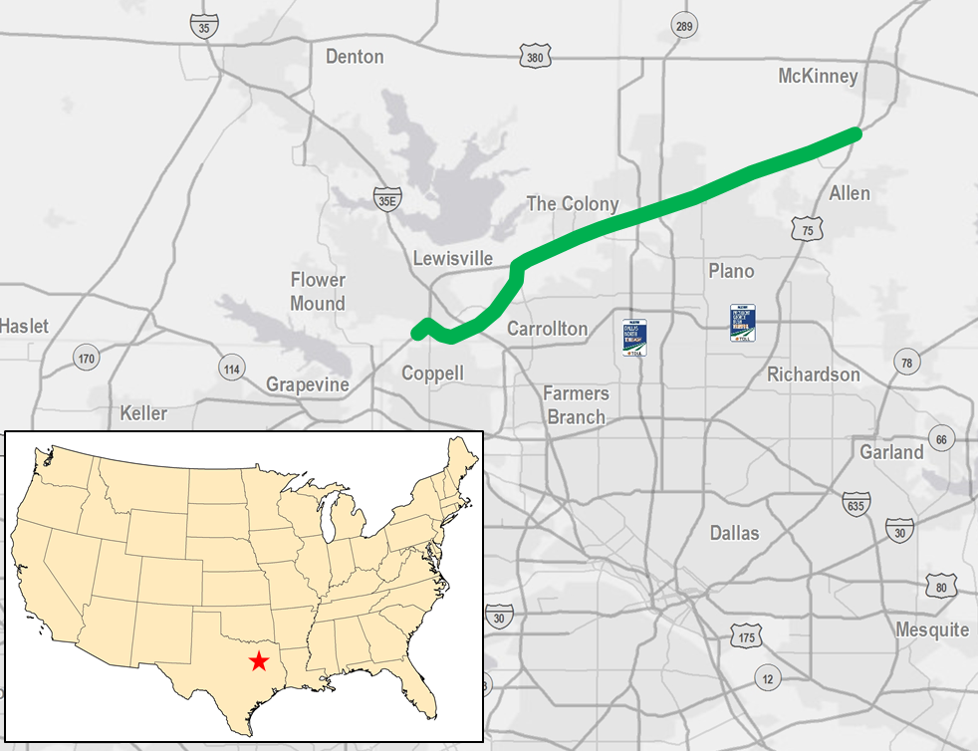
Sam Rayburn Tollway
Dallas-Fort Worth, Texas
26-mile, all-electronic toll road in Dallas’ northern suburbs
Originally pursued as a private concession
  Met with public and political resistance
Awarded to NTTA for a $3.2 billion upfront payment
Financed as part of the 90+ mile NTTA System

Slide 20
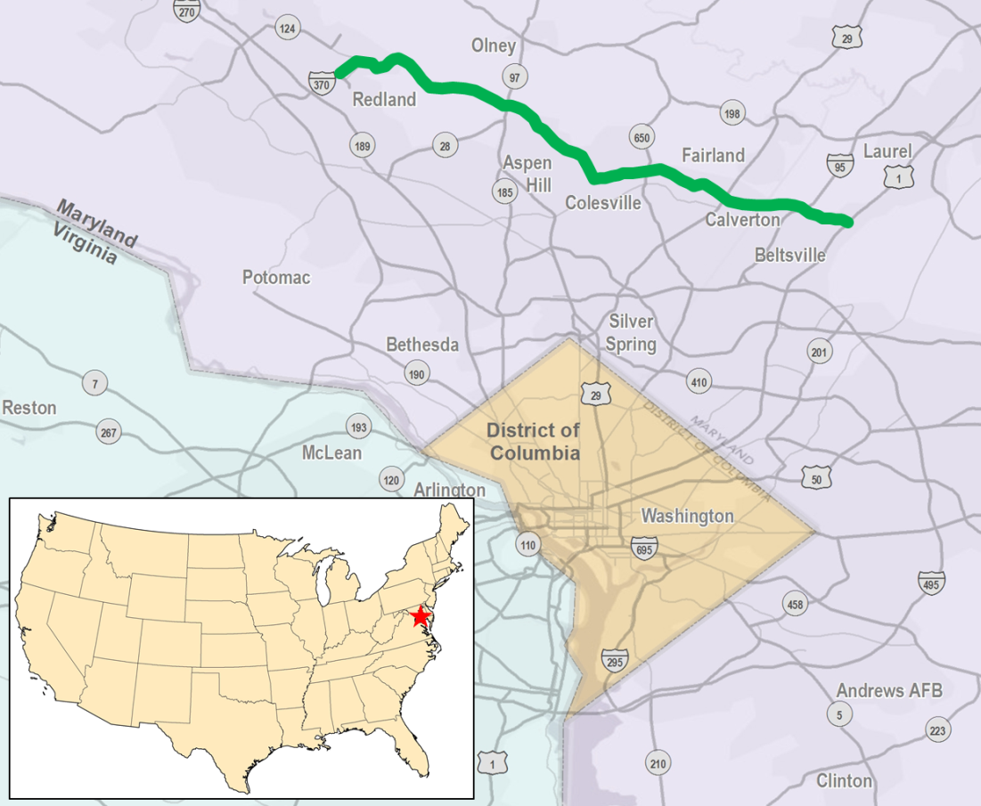
Intercounty Connector
Maryland
Collaborative development between Maryland Transportation Authority and Maryland State Highway Authority
Opened in 2011 as all-electronic toll road
  Operated for one week without tolls for patrons to “try out” the road
Multiple financing methods
  GARVEE bonds, TIFIA loan, toll revenue bonds
Leveraged entire MdTA system

Slide 21
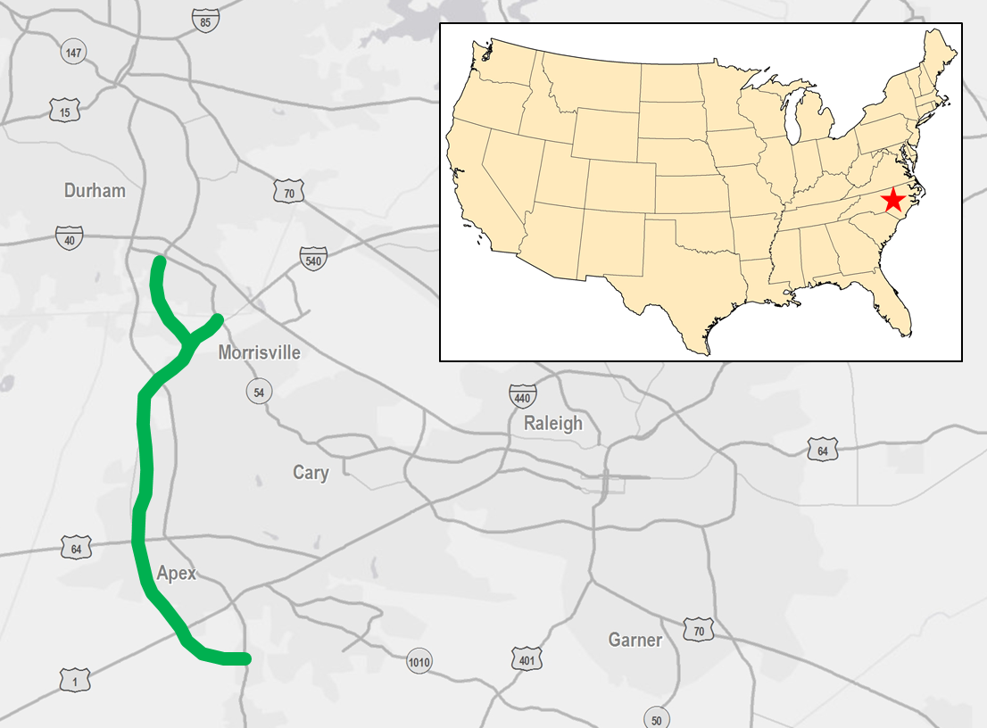
Triangle Expressway
Raleigh-Durham, North Carolina
18.8-miles
Two phases
  Triangle Parkway (opened December 2011)
  Western Wake Freeway (under construction)
All-electronic toll collection
Multiple financing methods
  Toll revenue bonds, TIFIA loan, bonds backed by state tax revenue, additional state funds

Slide 22
Conclusions/Recommendations
The Practice of Tolling:

Slide 23
Conclusions/Recommendations
Tolling has proven to be an effective funding source for new highway capacity as state and federal tax revenues diminish
  In many cases, however, tolling cannot support the entire cost of projects
  Must be supplemented with alternative funding sources
Risk management
  Demographic growth
  Financial coverage
  Public opinion
Consideration of all options, not just tolling, may yield a more sustainable finance plan
Method of evaluating potential toll projects is needed

