Slide 1
Sharing is Caring: Creating an Open Source Counts Management Tool
Lisa Zorn, Dan Tischler, Elizabeth Sall
14th TRB National Planning Applications Conference
Columbus, OH May 5-May 9, 2013
Notes:
Abstract
One of the most persistent problems faced by the San Francisco County Transportation Authority (the Authority) is that of handling a growing collection of counts. Traffic, pedestrian and bicycle counts have been collected by staff, consultants and sister agencies for numerous planning studies at various locations in San Francisco over the years. But how should these counts be organized? Some are in Excel workbooks of varying and spontaneous formats, others consist of scanned handwritten documents, and finally some are on (gasp!) paper.
Since the modeling team at the Authority has a continuous need for these counts in order to calibrate and validate the travel demand model as well as to inform model development, these counts have come under the team’s purview. After a couple of failed attempts to standardize Excel formats and directory structures, the modeling team decided to modernized its counts management system. The Authority first explored proprietary software products, but found them either too expensive, cumbersome, or inflexible. Instead, Authority staff embarked on developing Count Dracula, an open source counts management tool. Count Dracula’s aim is to make uploading, downloading and querying counts easy for Authority staff as well as other interested parties outside the organization. The Count Dracula code base has been designed to be reusable by other agencies with similar needs, and it’s built on GeoDjango, a geographic web framework.
Count Dracula includes a web-based map GUI for visualizing where counts are located (and where more counts are needed), and it includes a query interface so that specific types of counts can be batch-downloaded (for example, midweek counts from the last three years). As it was developed by a modeling team, there is a specific emphasis on counts seamlessly interfacing with model transportation networks. Counts can also be uploaded using this interface, and moderated through an admin interface. This presentation will explain the development of Count Dracula and convince everyone attending to download it and dive in.

Slide 2
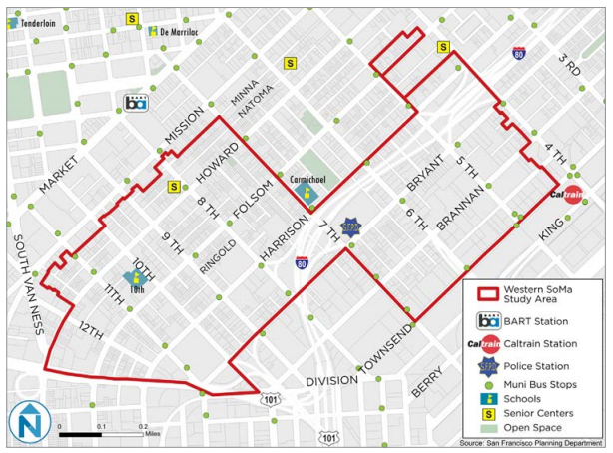
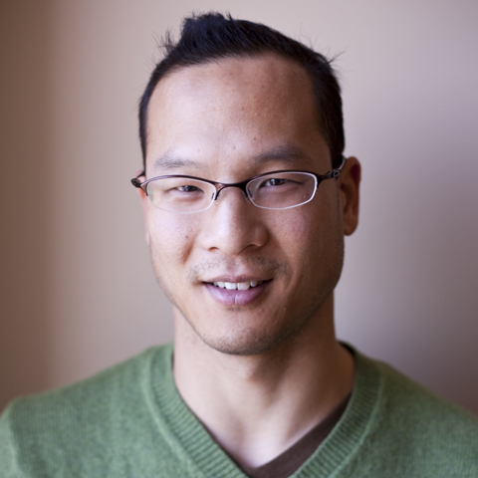
Why?
Neighborhood Study
Notes:
This is Chester, a planner at the TA!
He lead this neighborhood planning study, looking at Western SoMa.
As part of that study, we needed to forecast traffic volumes, and so we needed some counts to inform our modeling forecasts in the area: to see how the modeled volumes are doing in the baseline, and if adjustments to the forecasts would need to be made.

Slide 3
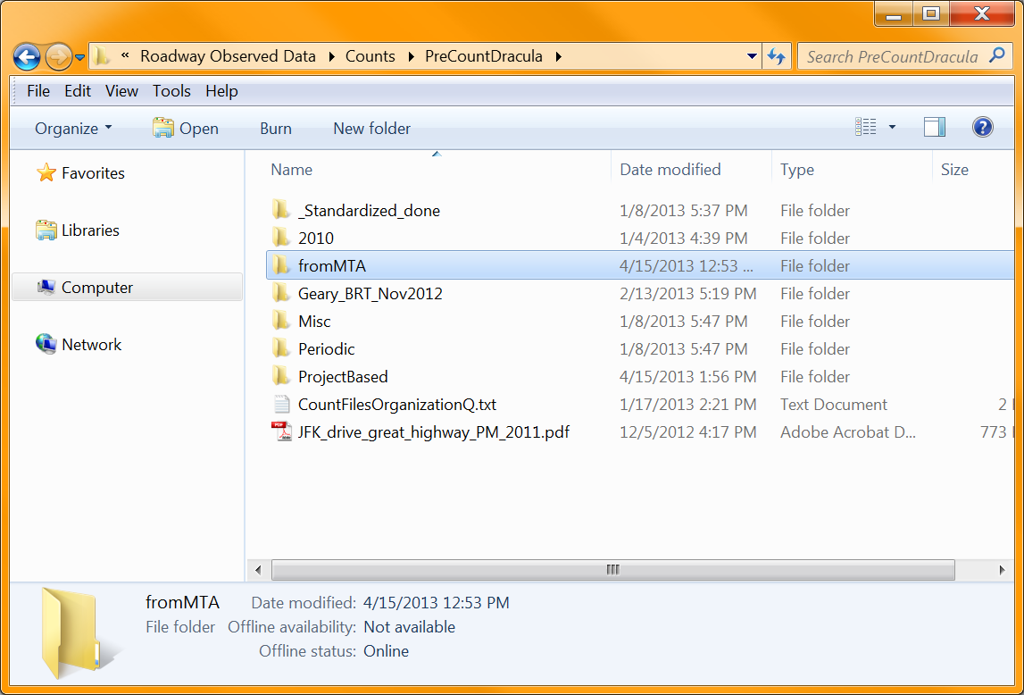
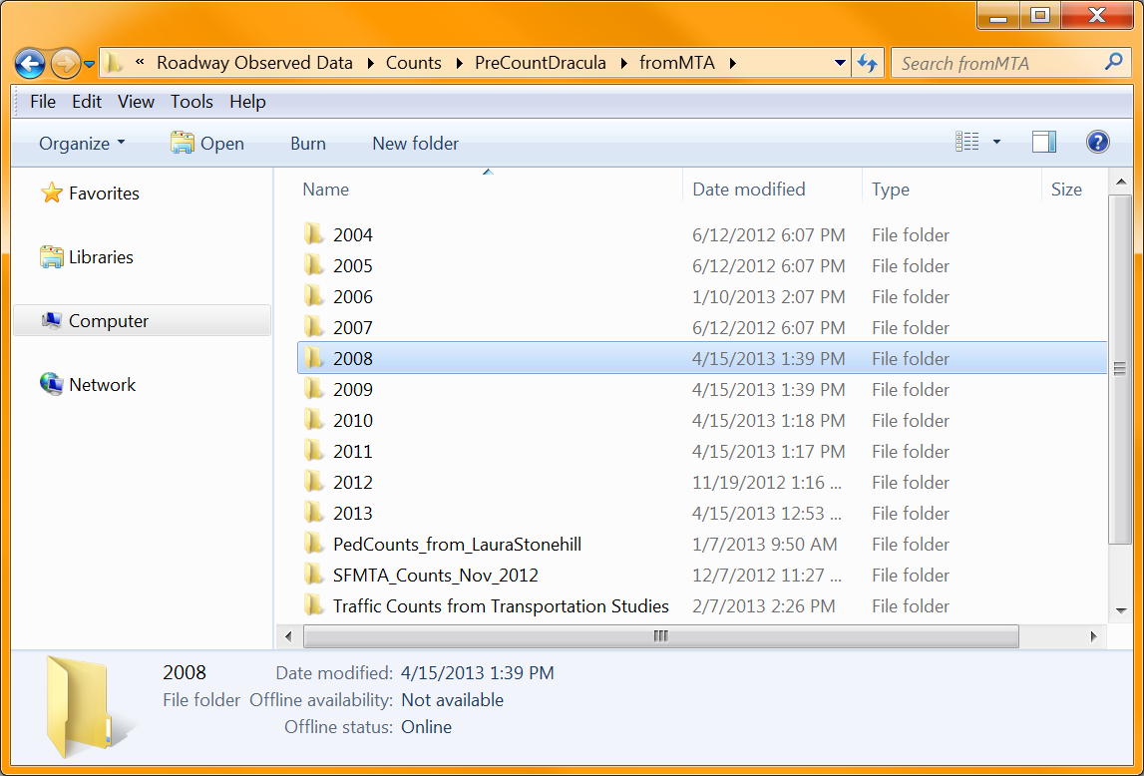
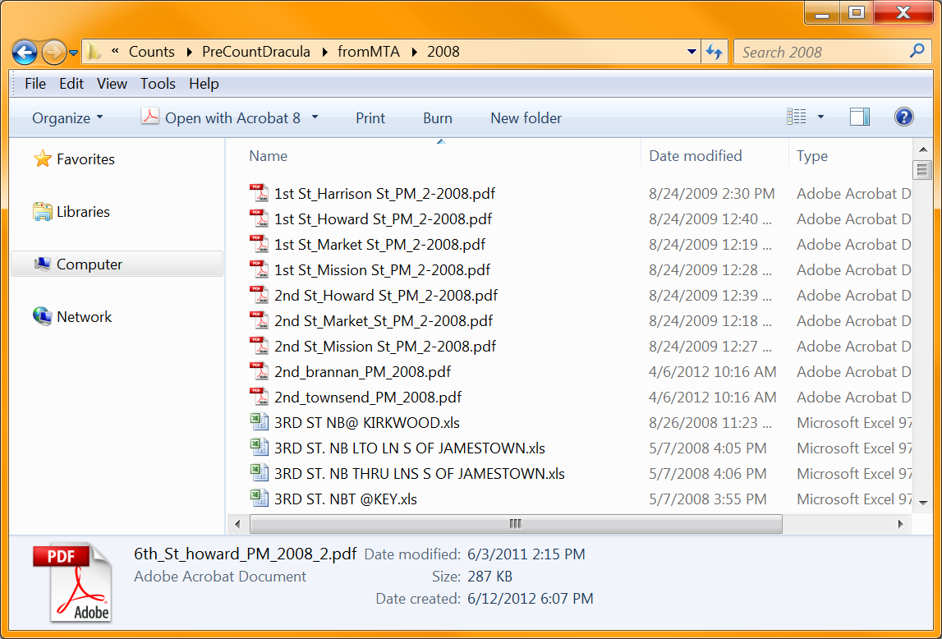
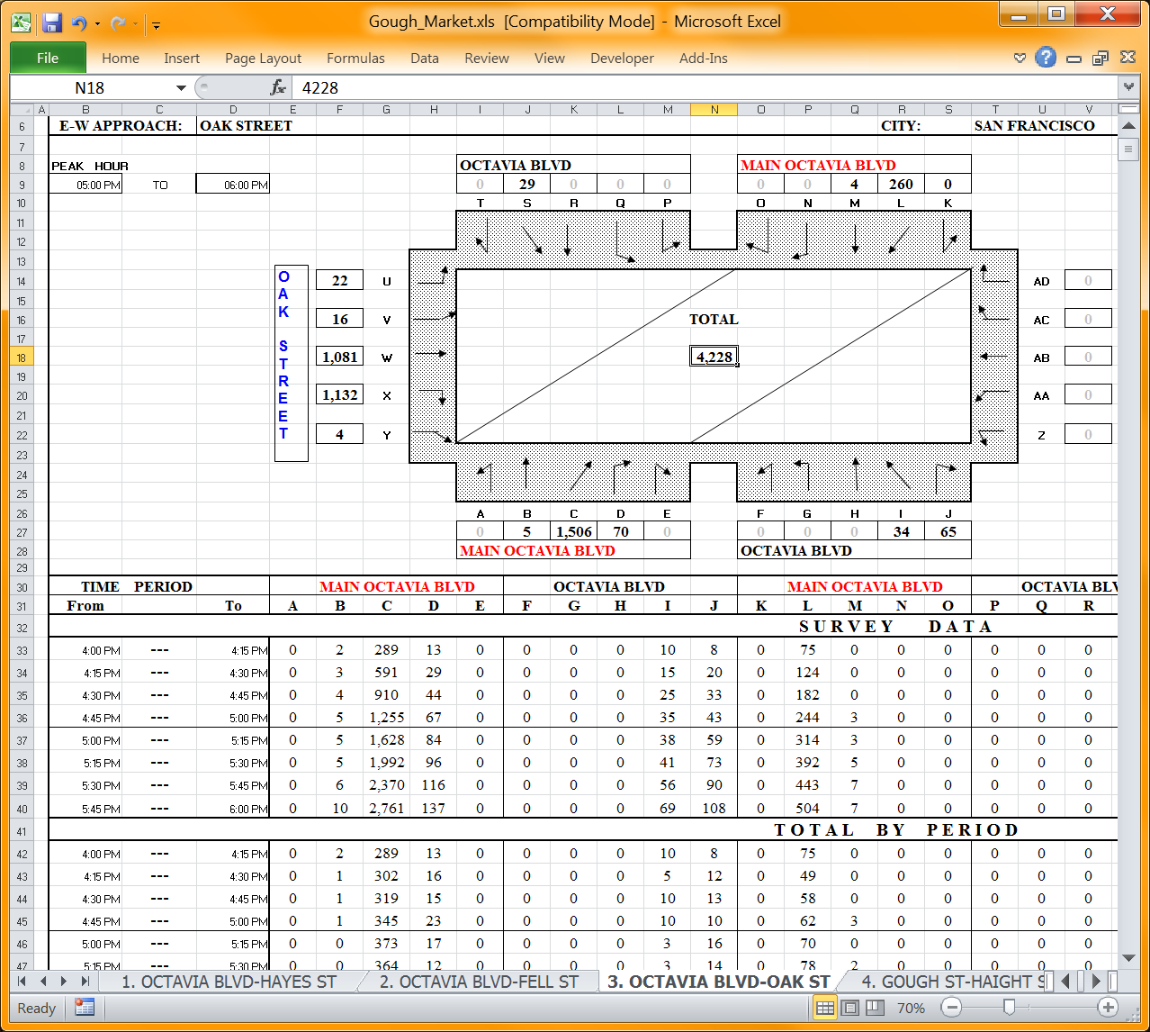
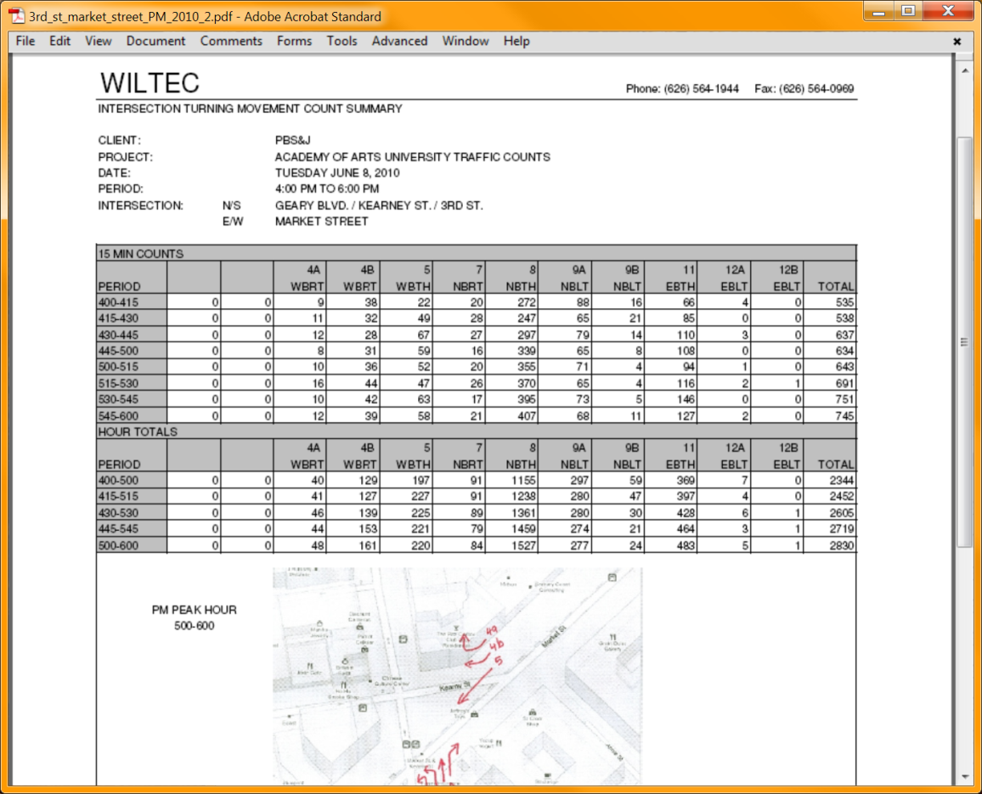
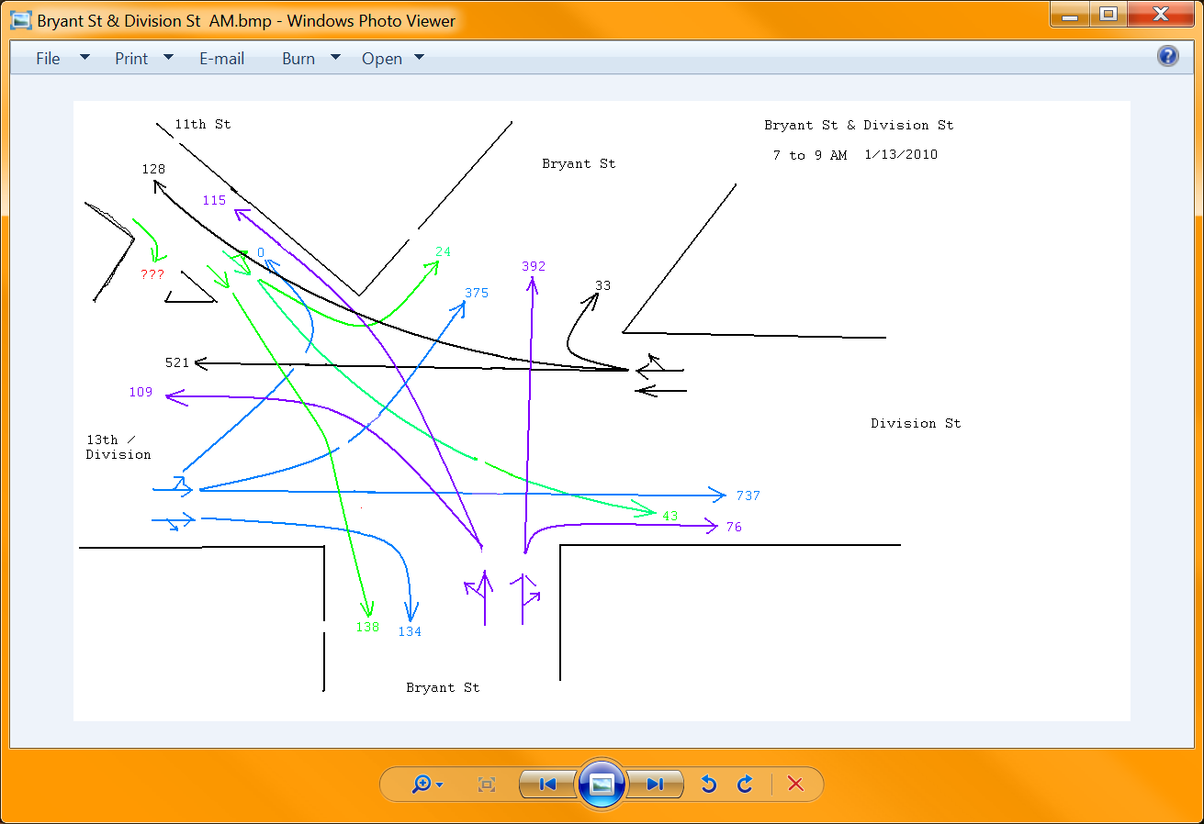
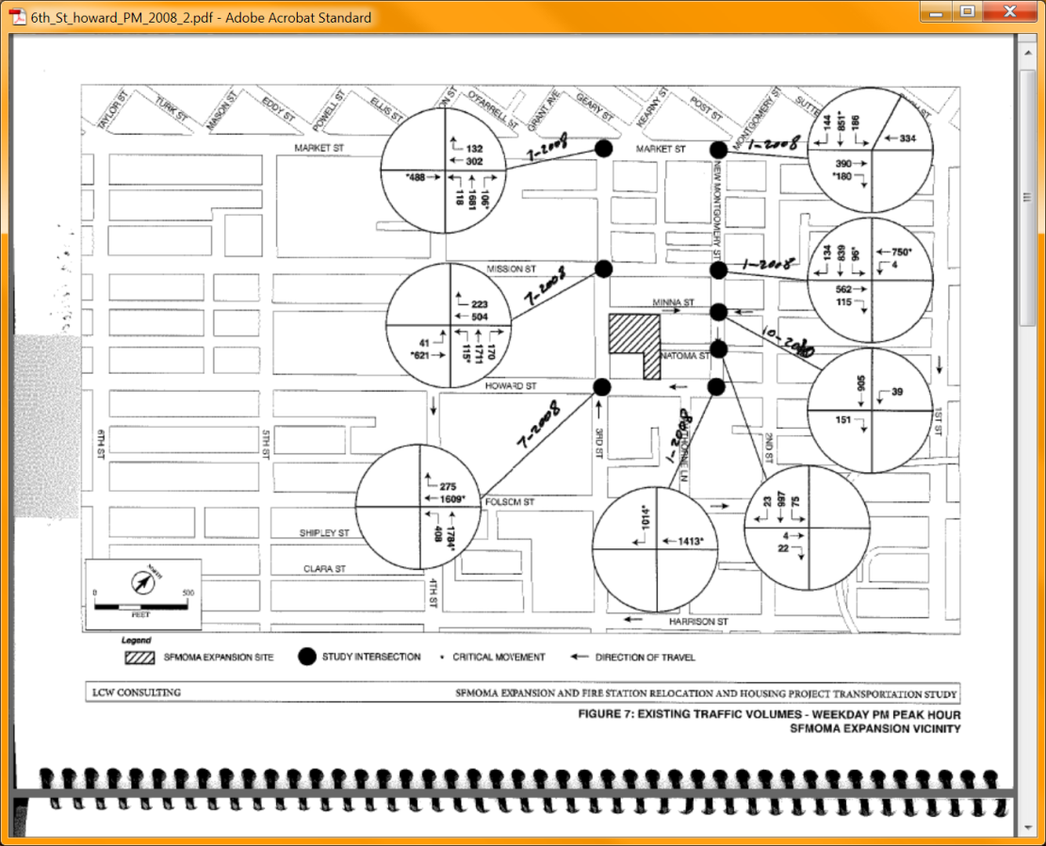
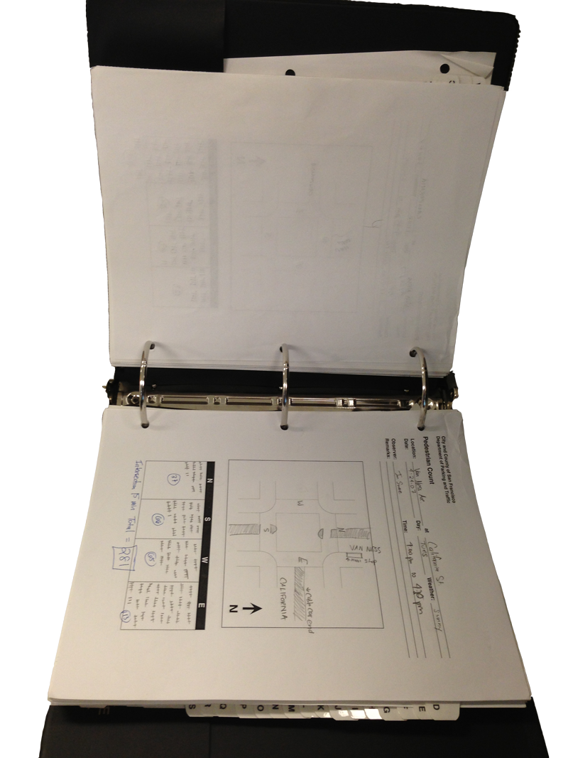
Why?
Neighborhood Study
Notes:
So we’d go searching around in a file system all the time. The file system wasn’t organized in a great way. We could try searching for counts, but many pdfs and image versions of the counts weren’t searchable.
Slow. Tedious. We’d miss stuff. We’d send interns to MTA but it didn’t improve anything in the long term.

Slide 4
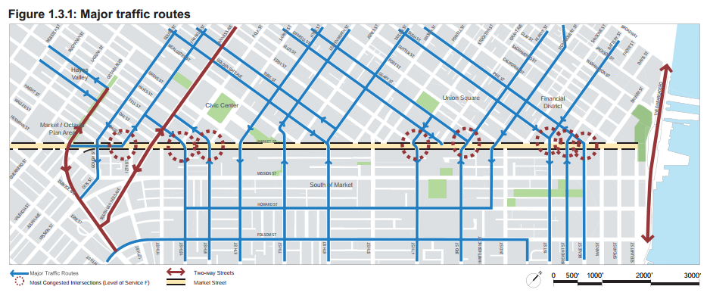
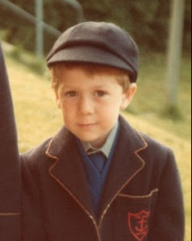
Why?
Consulting Engineer
Notes:
This is similar to the previous case
This is Eric Womeldorff, a consultant (admittedly not a recent photo but still recognizably Eric) who works on numerous city projects
For example, Better Market Street

Slide 5
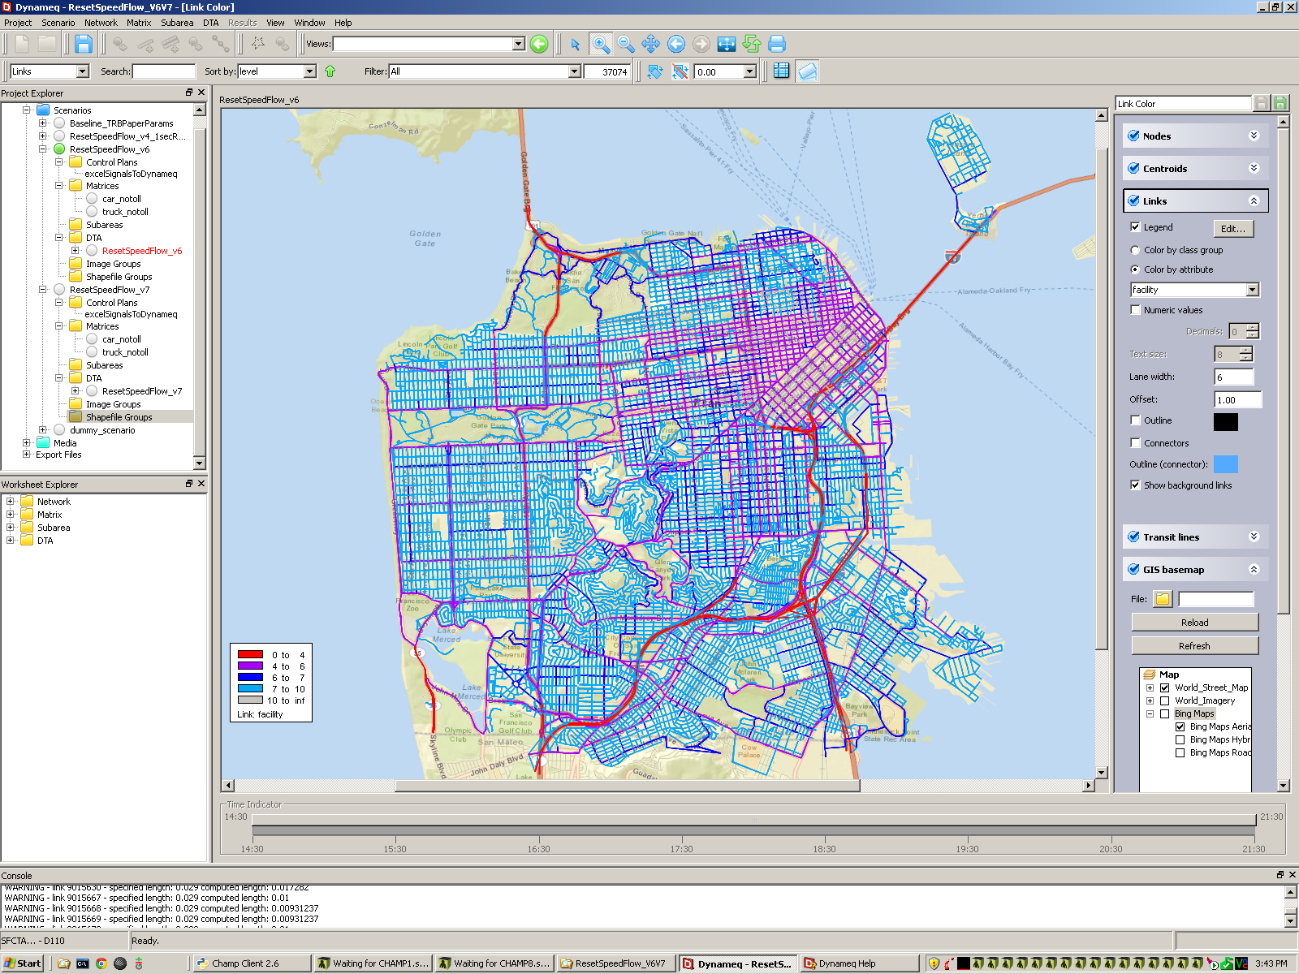
Why?
DTA Validation
ALL RECENT
WEEKDAY COUNTS…
…ATTACHED TO THE
DTA NETWORK
Notes:
As you’ve may have heard in our 3 other presentations, we also worked on a little project to make a citywide DTA model. In order to validate the citywide model, we needed…

Slide 6
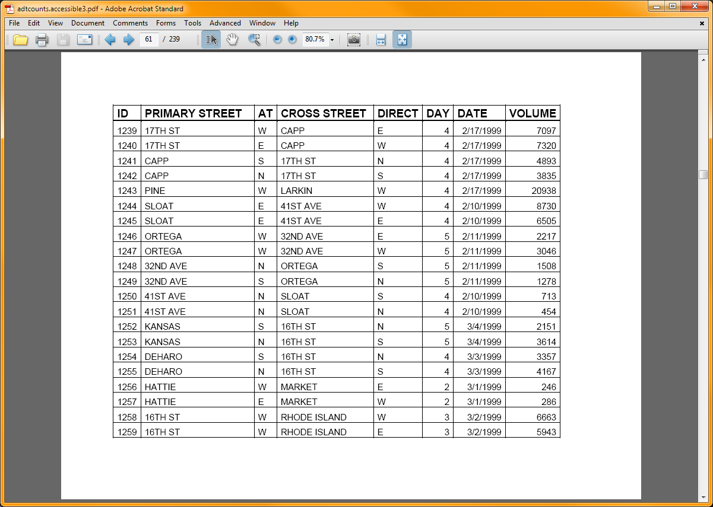
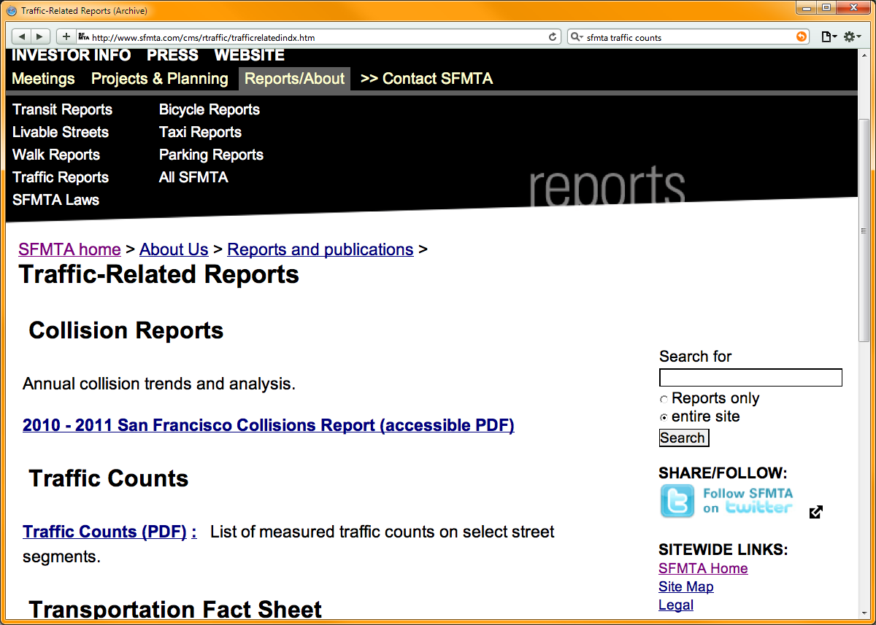
Why?
Public Requests
Notes:
Say you’re a member of the public, and you want traffic to look at traffic counts to make decisions on where to locate your business…
You could download these counts from the SFMTA website!
And find what you want in a 239 page PDF!

Slide 7
Existing Options
MS2 (Midwestern Software Solutions) Traffic Count Database System
Cambridge Systematics Traffic Count Management System
Others?
Notes:
MS2= web-based, not free (? How much?) http://www.trafficcountdata.com/
CS http://www.camsys.com/traffic_count.htm
North Central Texas Council of Governments (NCTCOG) has something on the web: http://www.nctcog.org/trans/data/trafficcounts/indexcdp.asp

Slide 8

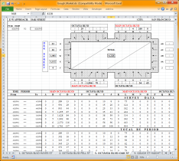
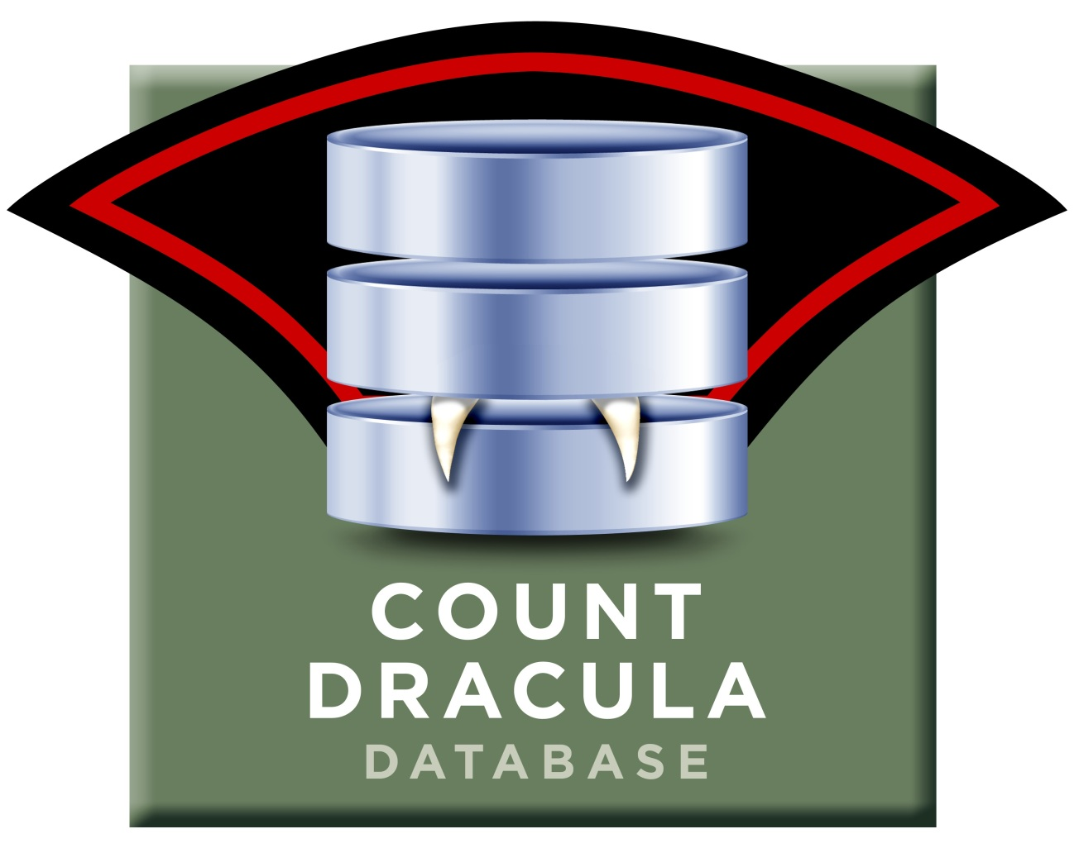

Objectives
UTDF
API
15-min: 3 trucks
60-min: 37 bicycles
5-min: 48 cars
Notes:
Store raw data
Differing temporal granularity
Can be aggregated
Anyone can easily upload -> Users
Anyone can easily download
Maps
Filters (year, vehicle type, day of week, location)
Aggregated to time period desired
API access – this drove actual development
UTDF = Universal Traffic Data Format, for importing into Synchro, etc

Slide 9

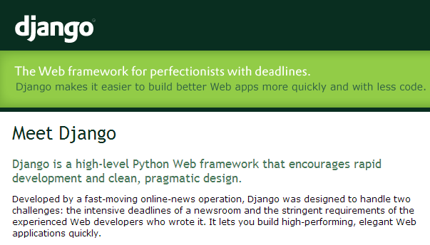
Design
Notes:
Django:
Data models completely in python
Database details are hidden and mostly (so far!) just work
Web-based admin interface, with built-in users and basic editing of objects
Don’t reinvent the wheel
Geodjango:
Adds spatial layer on top of Django by using a spatial database such as PostGIS
Models can now have components like Points, Lines, Polygons and Mult-versions of those
There’s also an understanding of Geography
Spatial indexing for spatial query speed

Slide 10
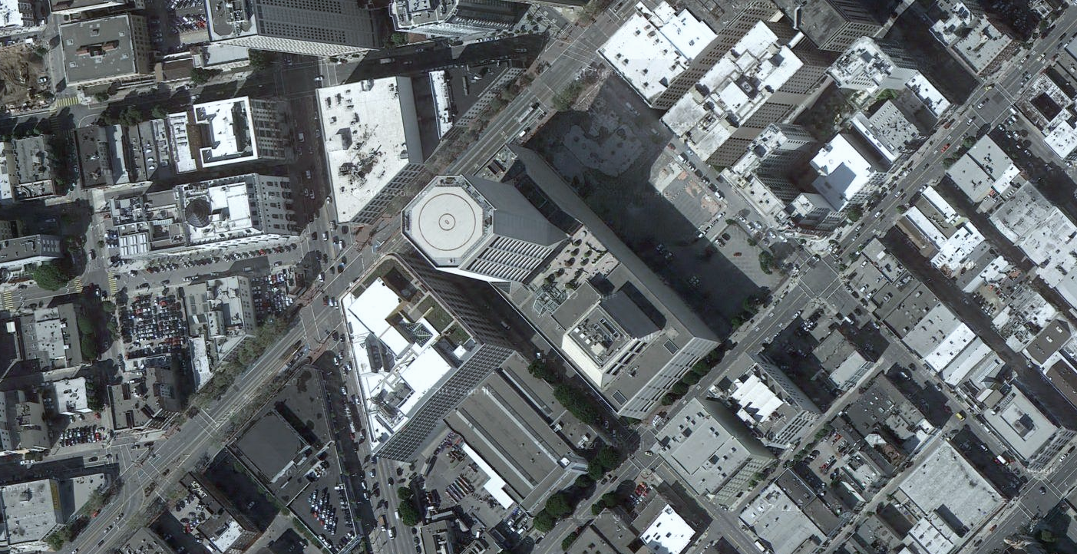
CountDracula Models Overview
@3/13/2013 3p:
3 bikes in 60 min
Van
Ness
Ave
@3/13/2013 3p:
30 bikes in 60 min
Market Street
Notes:
Node: just a location (PointField)
StreetName: Variations on the street name, plus ManyToMany relationship with Nodes
TurnCountLocation: incoming street and direction, intersection node, outgoing street and direction
TurnCount: TurnCountLocation, count, date/time, duration in minutes, vehicle type, source file, upload user
MainlineCountLocation: on street and direction, from street, from node, to street, to node

Slide 11
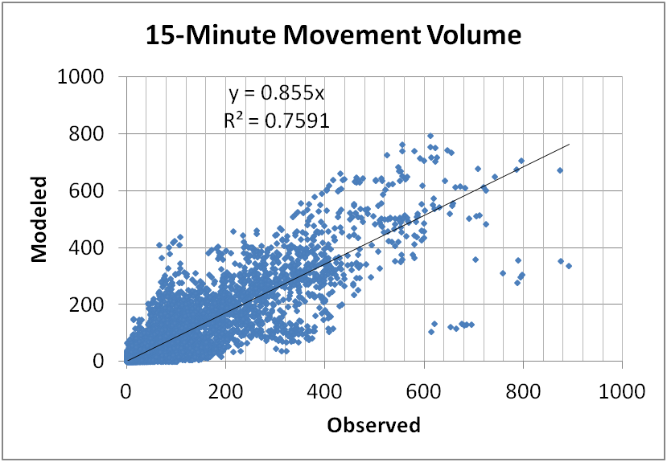
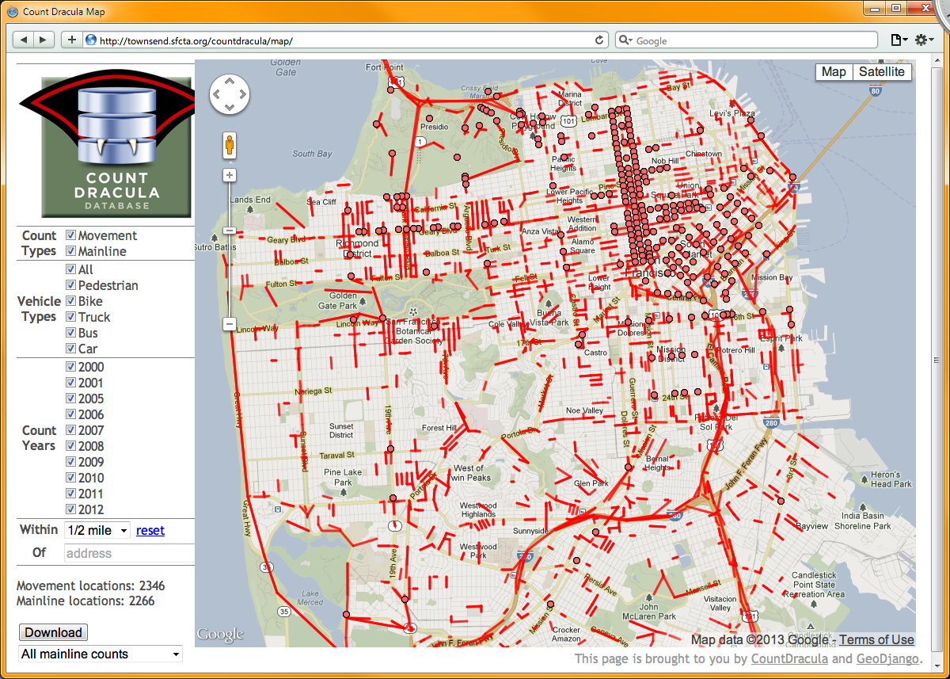
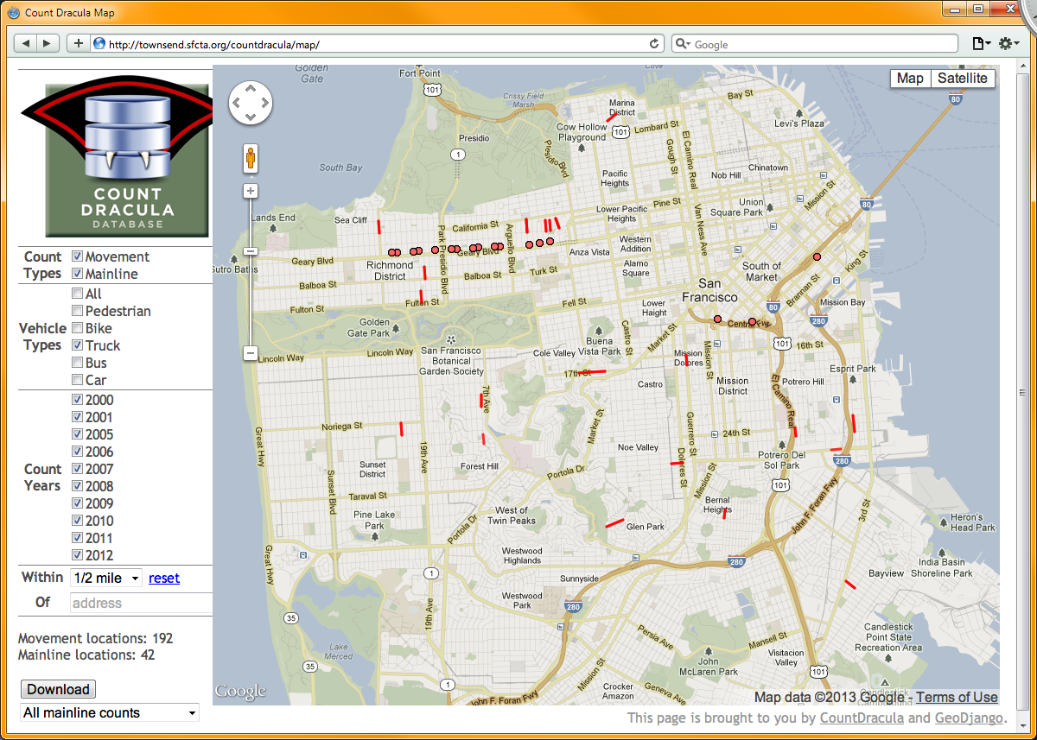
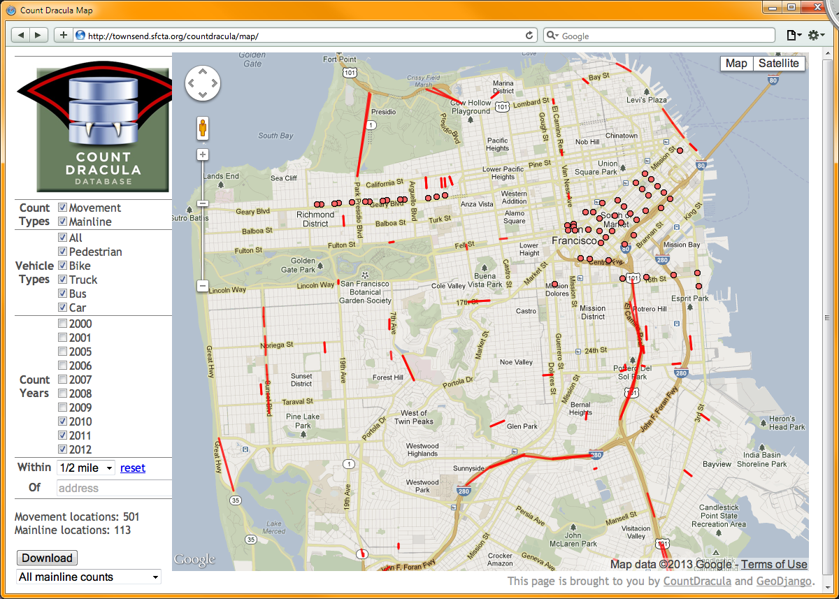
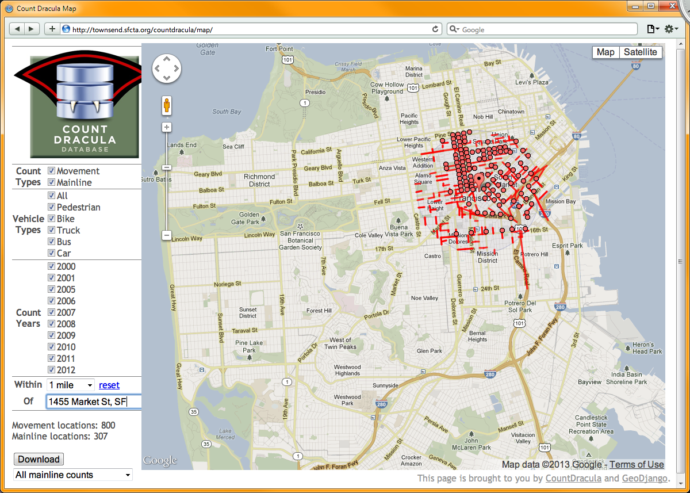
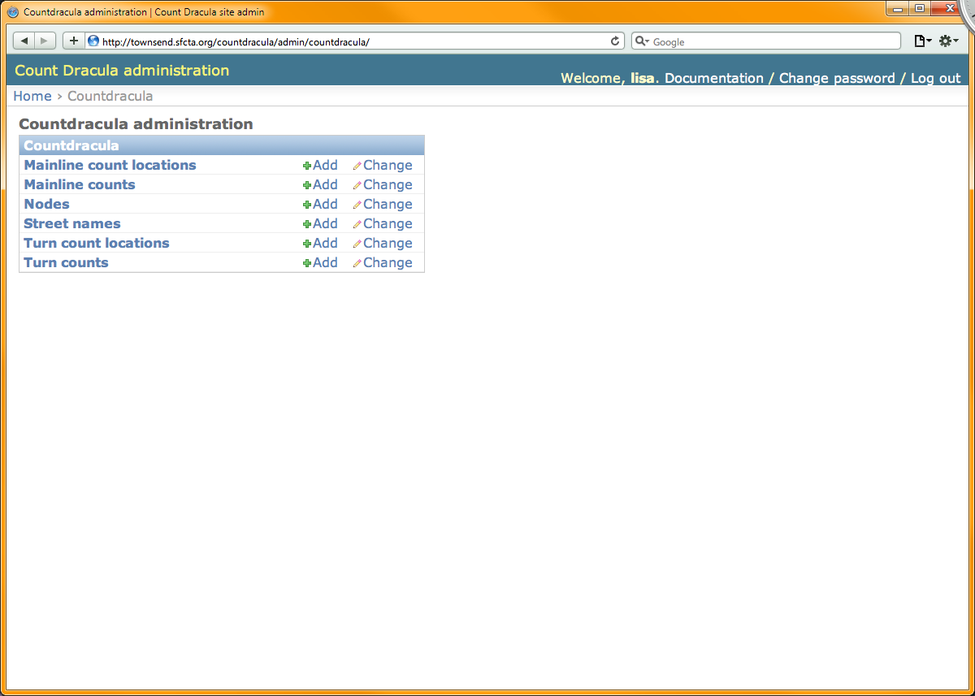
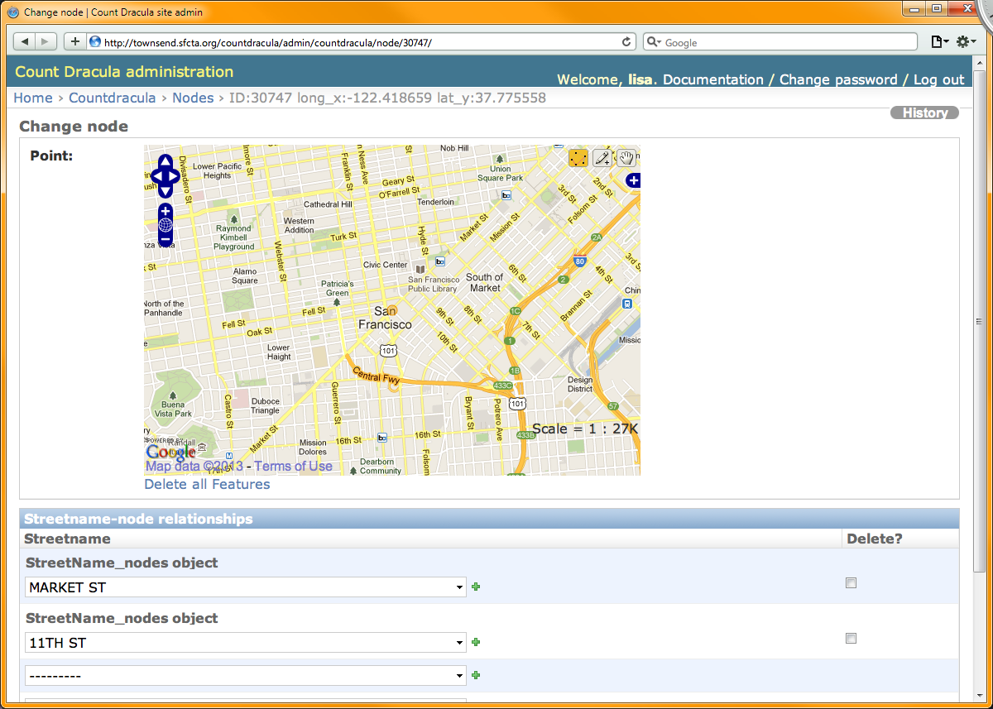
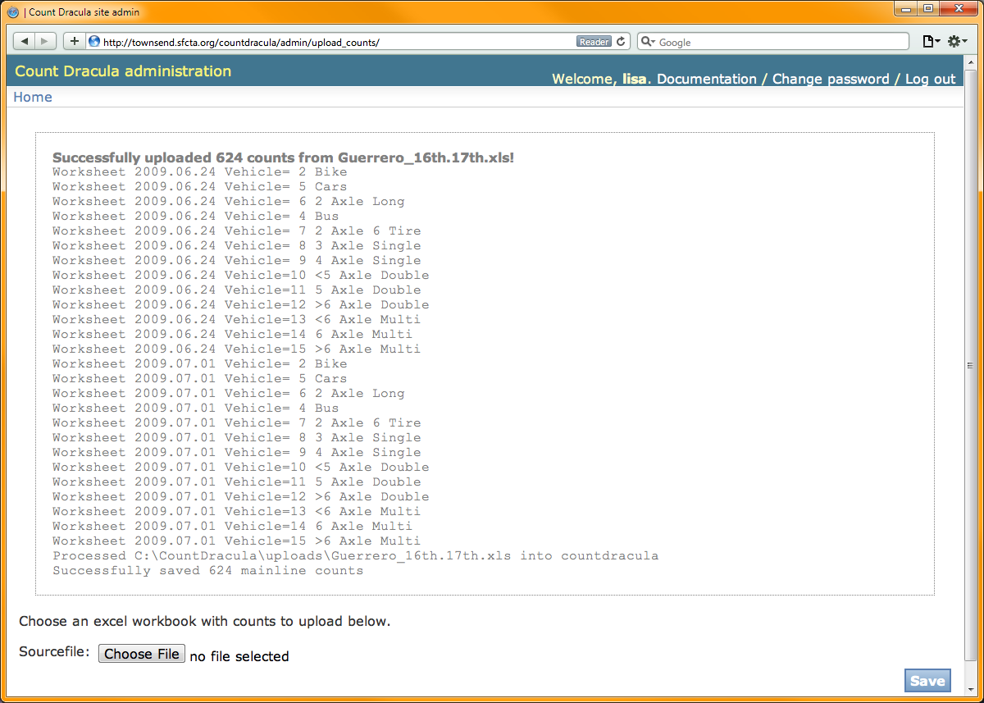
CountDracula Today
API!
Notes:
Today, CountDracula has basic functionality:
A web-based interface including a map view
Vehicle-type filtering
Year-based filtering
Address-based filtering
Download capabilities
An admin interface for each of the elements (top view and node view)
An upload interface for standardized count workbooks
An API that we used in our DTA Validation to correlated counts with our DTA network

Slide 12
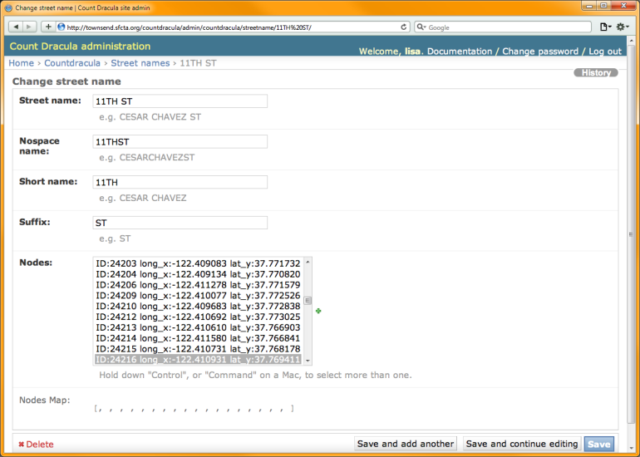
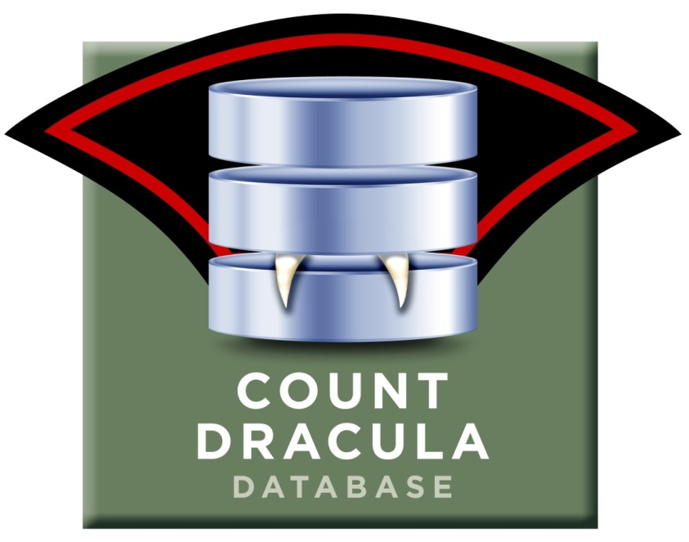

CountDracula Tomorrow

Slide 13
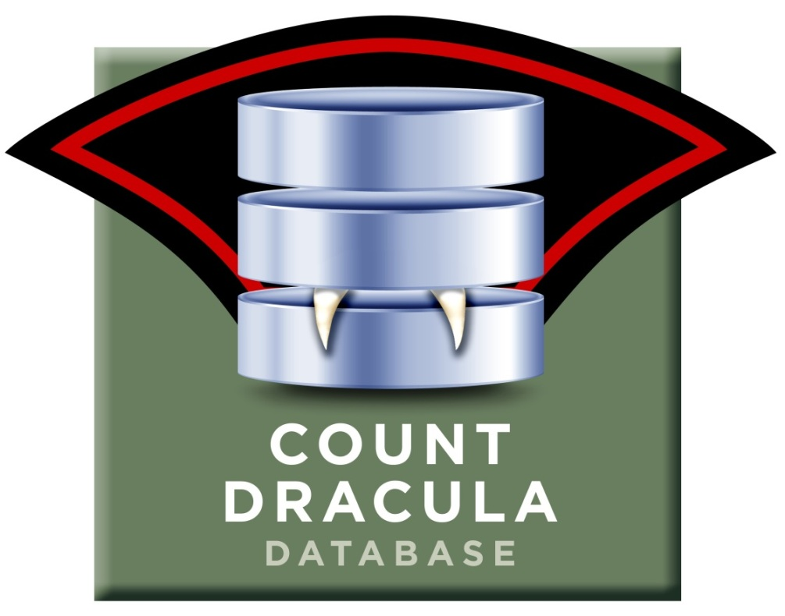
Questions? Suggestions?
Lisa.Zorn@sfcta.org https://github.com/sfcta/CountDracula

