Slide 1
Methodological Considerations for Integrating Dynamic Traffic Assignment with Activity-Based Models
Ramachandran Balakrishna
Daniel Morgan
Srinivasan Sundaram
Caliper Corporation
14th TRB National Transportation Planning Applications Conference Columbus, OH • 5th May, 2013

Slide 2
Outline
Motivation
Activity pattern characteristics
System integration requirements
Challenges for Dynamic Traffic Assignment (DTA)
Challenges for Activity-Based Models (ABM)
Case Study: Jacksonville, FL
Conclusion

Slide 3
Motivation
Activity-Based Models (ABM) capture detailed trip-making behavior by individuals
ABMs in practice rely heavily on static assignment
  Disaggregate trips aggregated into matrices by period
  Level of service (LOS) variables fed back from assignment
Static assignment has limitations for ABM
  ABM’s temporal fidelity lost in transition
  Feedback convergence could be compromised
There is a need for dynamic LOS evaluation to complement ABM

Slide 4
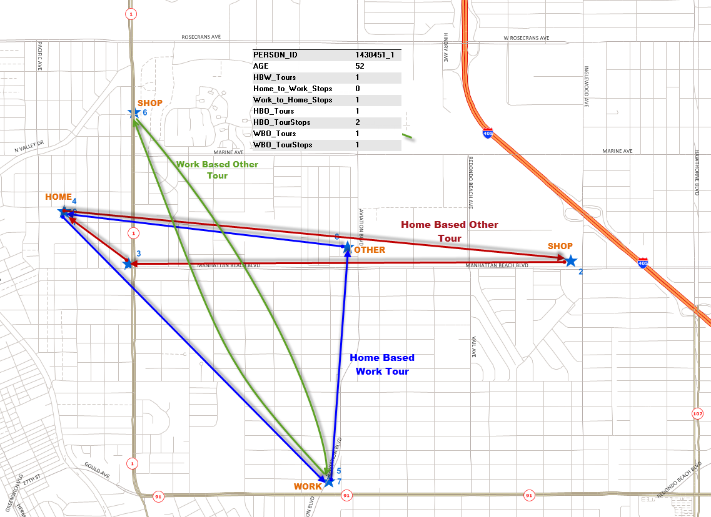
Activity Pattern Characteristics
Sequence of stops
  Person ID
  Departure time, mode
  Activity type
  Household interactions
Time constraints
  Daily available time
  Tours spanning multiple ‘traditional’ time periods
Mode consistency
  Example
    If a person rides the train to work, a car may not be available for work-based-other tour(s)

Slide 5
System Integration Requirements
Synchronized temporal representations
  Coordinate ABM’s tour patterns with DTA’s time steps
Consistent spatial/network representation
  Facilitate exchange of activity locations, network performance metrics, etc.
Appropriate modeling features
  Handle all representative situations observed in the field
Efficient execution
  Allow for meaningful number of feedback iterations

Slide 6
Challenges for DTA
Read ABM output without temporal aggregation
Handle activity locations without spatial aggregation
Use dense street network
  Realistic accessibility, connectivity
Simulate multiple travel modes
Possess practical running times

Slide 7
Challenges for ABM
Provide outputs to support DTA
  Route choice, assignment
Operate on sufficiently fine spatio-temporal resolutions
Re-evaluate activity choices based on DTA predictions
  Modify departure times, activity durations, modes, destinations, etc.
Possess practical running times
  Numerous Monte Carlo simulations across multiple choice dimensions

Slide 8
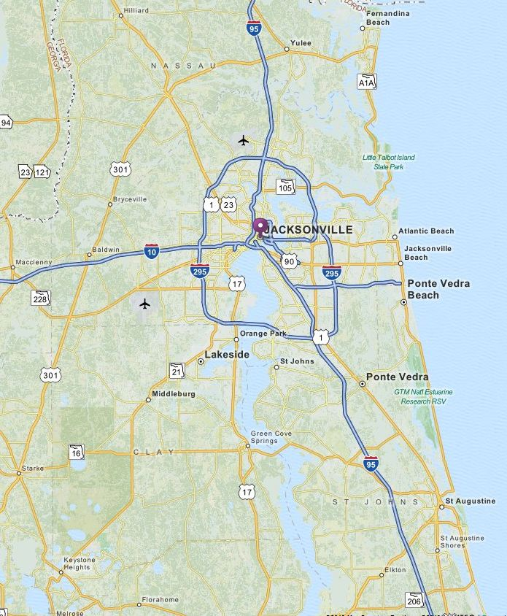
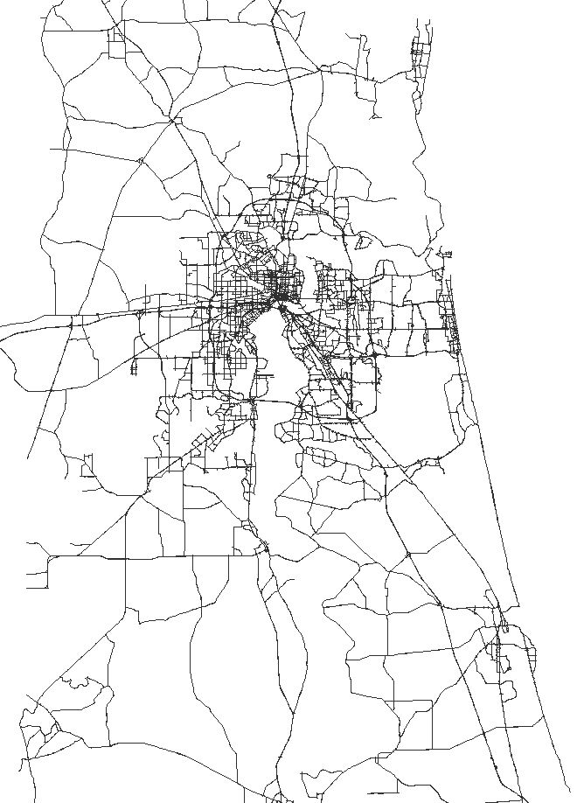
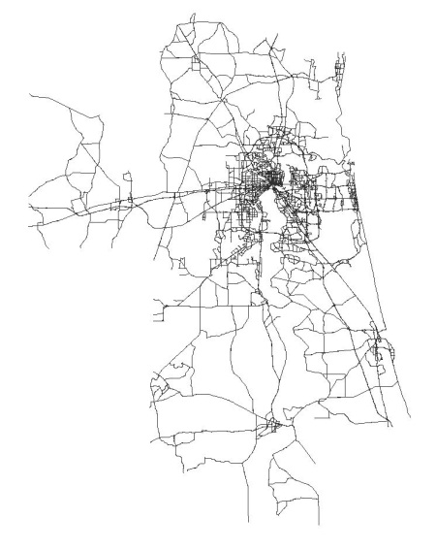
Case Study: Jacksonville, FL (1/8)
ABM source model: DaySim

Slide 9

Case Study: Jacksonville, FL (2/8)
DTA platform: TransModeler
  Scalable microscopic DTA
    Lane-level traffic dynamics
  ABM-ready demand engine
  Travel time feedback
    Relative gaps by departure interval
  GIS network representation
    Links, segments, lanes, connectors
    Vehicle trajectories inside intersections
    Activity locations by coordinates
  Realistic driving behavior, queuing and routing models

Slide 10
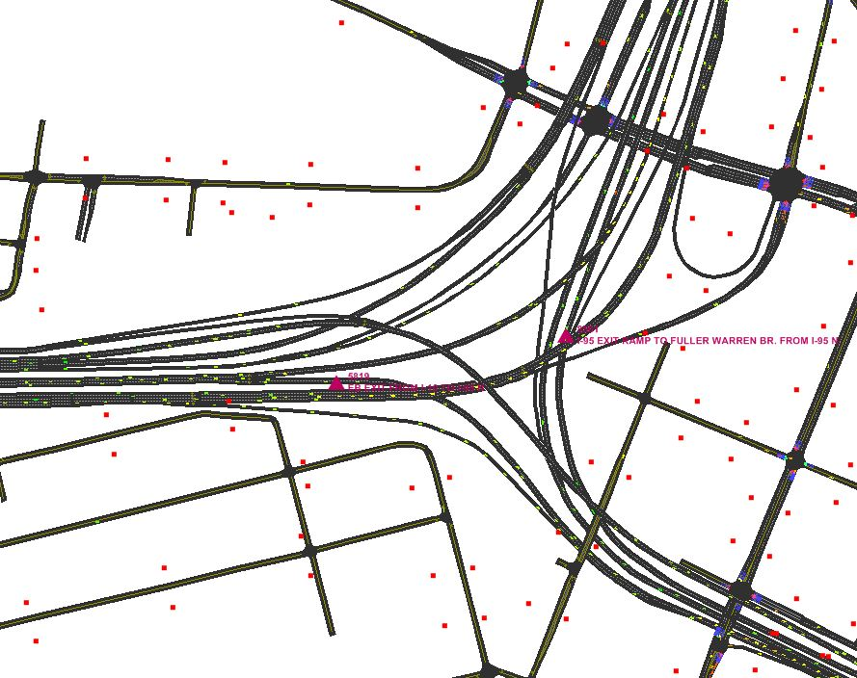
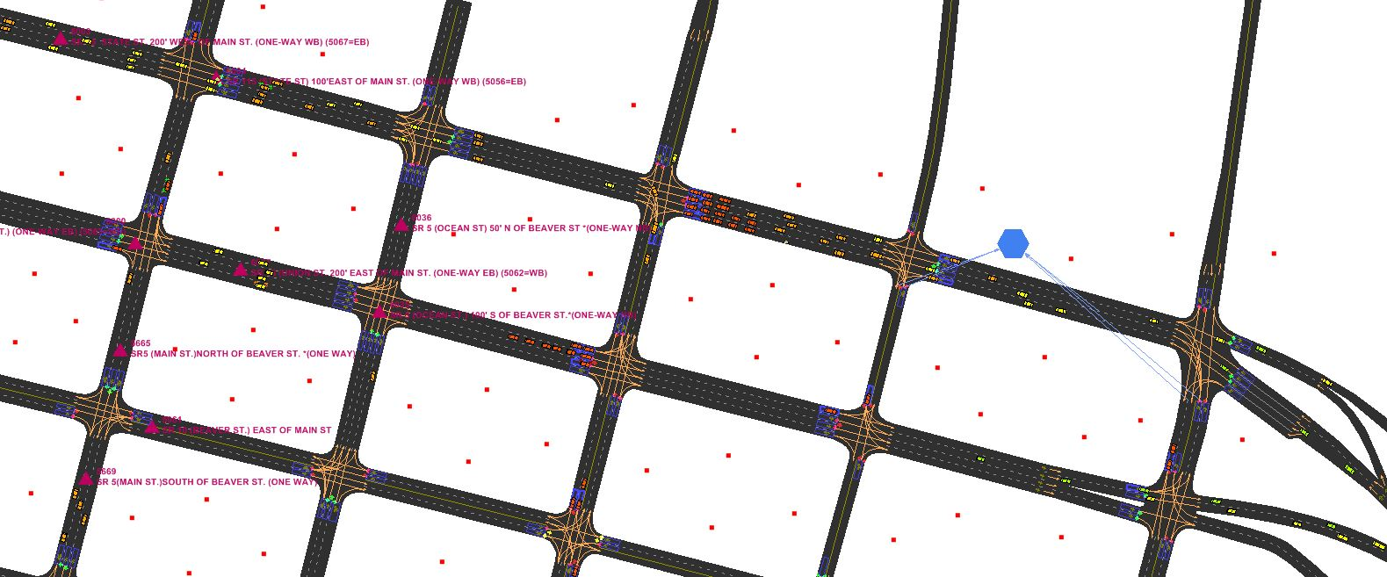
Case Study: Jacksonville, FL (3/8)
Network detail
  Lanes, connectors
  Turns, merges, diverges
  Signals, ramp meters, timing plans
  Intelligent Transportation System (ITS) infrastructure

Slide 11
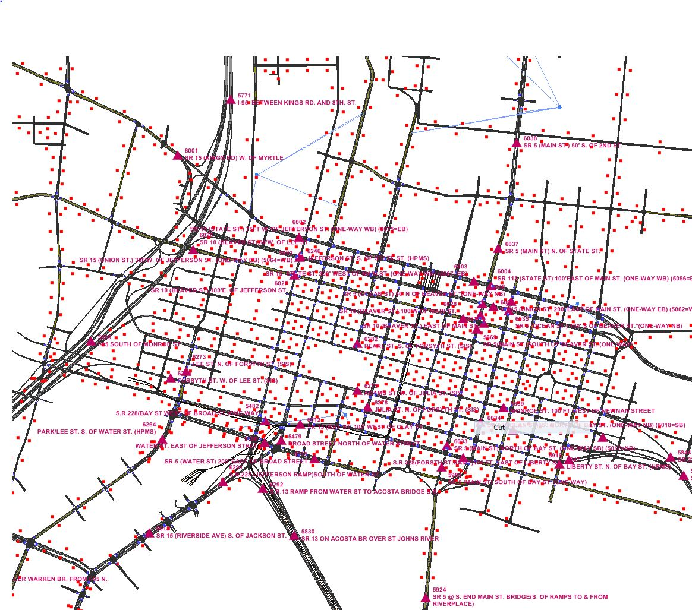
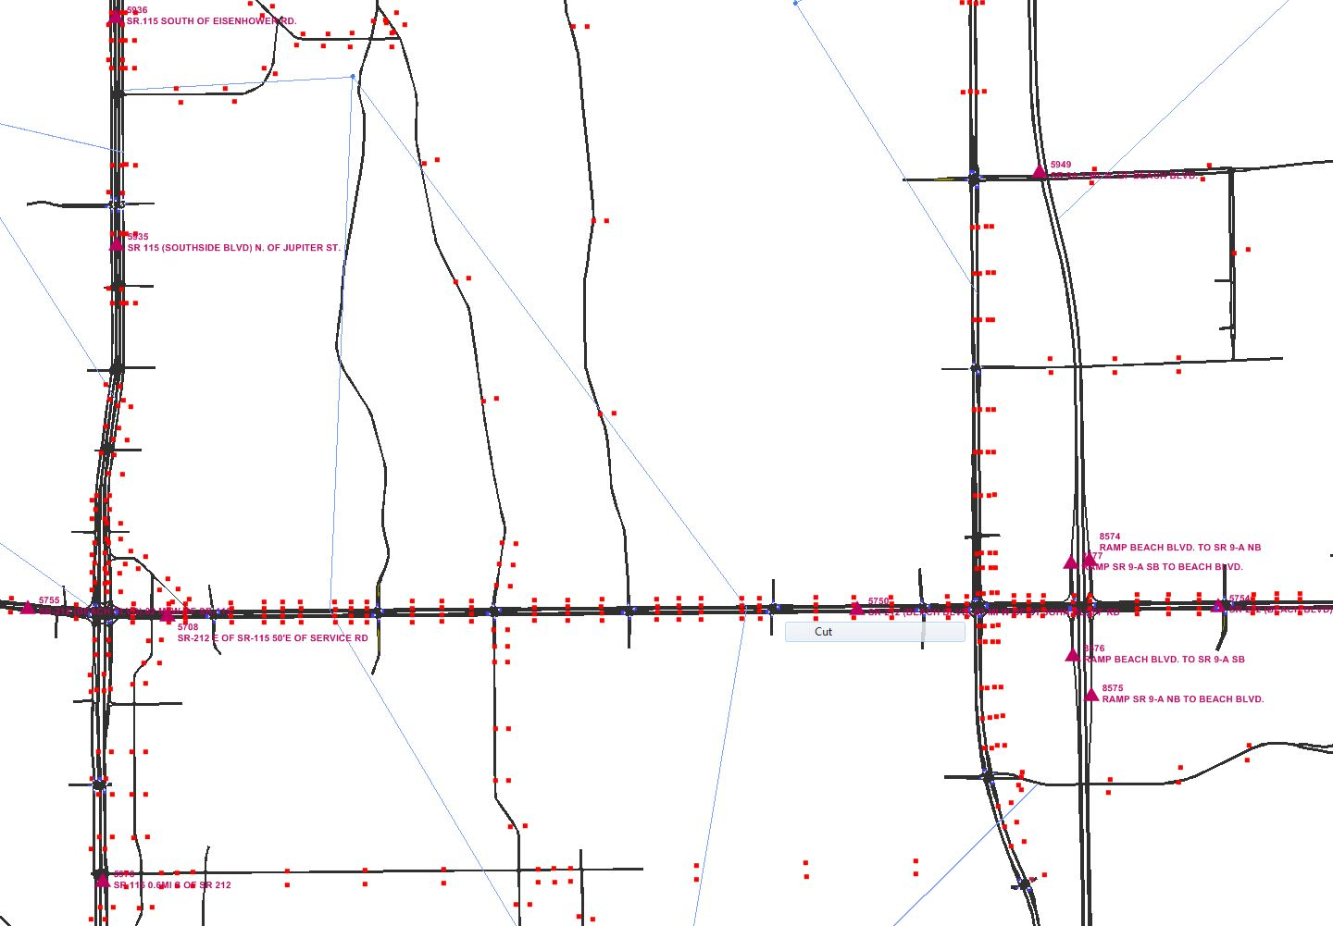
Case Study: Jacksonville, FL (4/8)
Activity locations
  DaySim output
  Geo-coded to the network
  Tagged to nearest link(s)

Slide 12
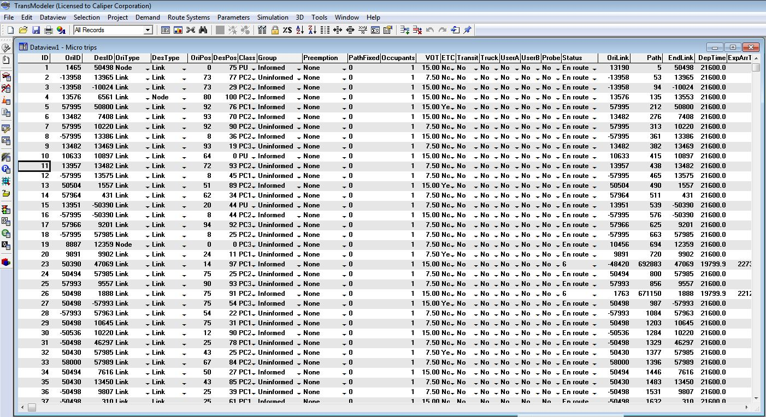
Case Study: Jacksonville, FL (5/8)
Demand: Disaggregate trip tables
  Detailed demographic and trip information
  Approximately 650K trips in 3-hour AM peak [6:00-9:00]

Slide 13
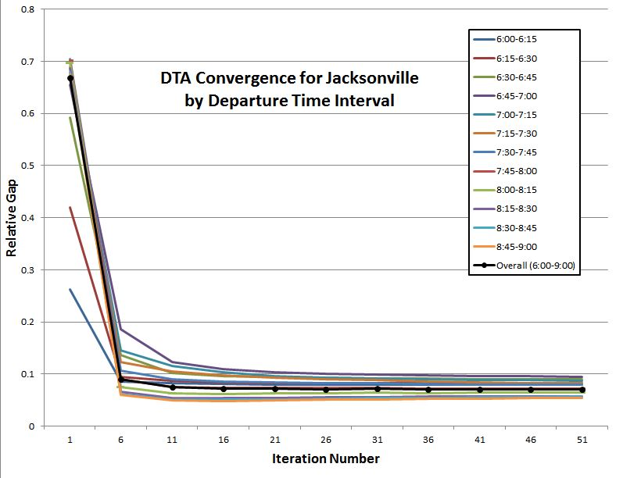
Case Study: Jacksonville, FL (6/8)
Dynamic Traffic Assignment

Slide 14
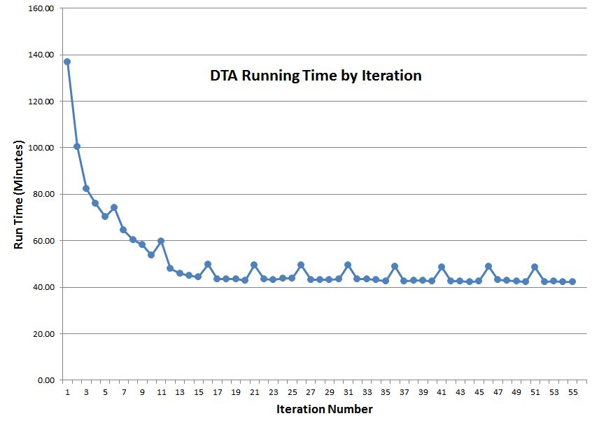
Case Study: Jacksonville, FL (7/8)
DTA running time per iteration
  Approx. 50 minutes overall
  3.1 GHz Intel Xeon Dual-Core 64-Bit CPU, 64 GB RAM

Slide 15
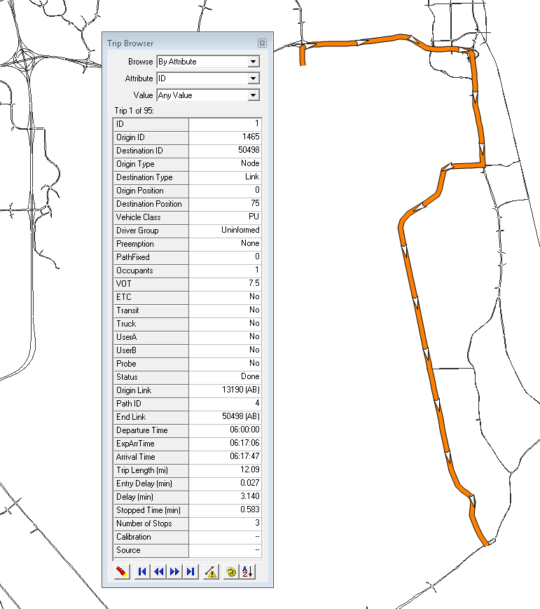
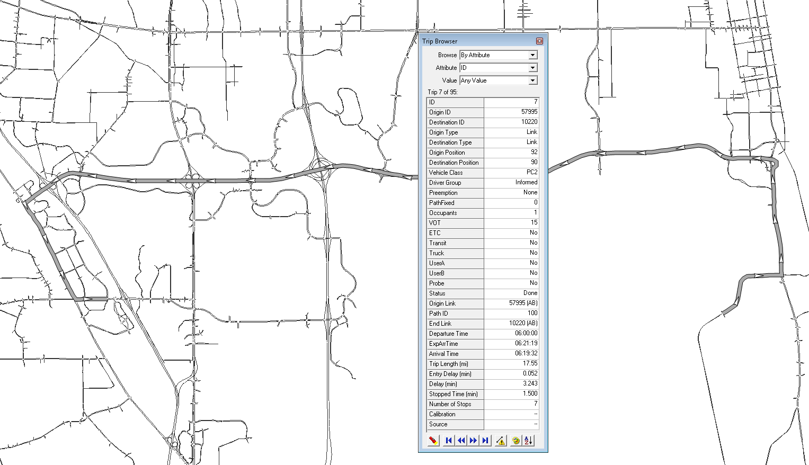
Case Study: Jacksonville, FL (8/8)
Detailed trip statistics
  Simulated, expected metrics
    Example: Arrival time vs. expected arrival time

Slide 16
Conclusion
Microscopic DTA
  Most suitable for integration with ABM
  Efficient and practical for large-scale problems
GIS critical
  Realistic activity representation in DTA
  Accurate feedback of network performance to ABM
Next steps
  Obtain open-source DaySim
  Feed back DTA output to DaySim
  Investigate feedback convergence
  Analyze model sensitivity to demand, network policies

Slide 17
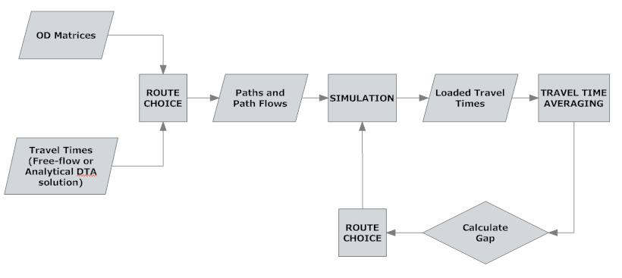
TransModeler DTA Framework (1/2)
Link travel time averaging

Slide 18
TransModeler DTA Framework (2/2)
Averaging method
Choice of averaging factor
  Method of Successive Averages (MSA)
  Polyak
  Fixed-factor

