Slide 1
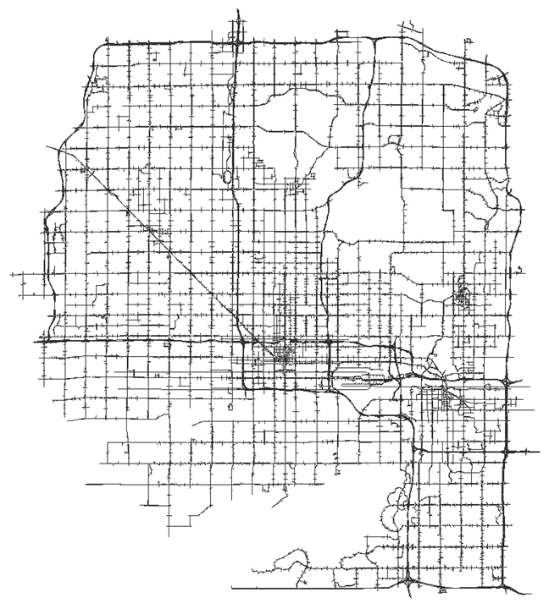

Development and Application of a Traffic Simulation and Dynamic Traffic Assignment Model Framework for Central Phoenix
14th TRB National Transportation Planning Applications Conference
May 8, 2013

Slide 2
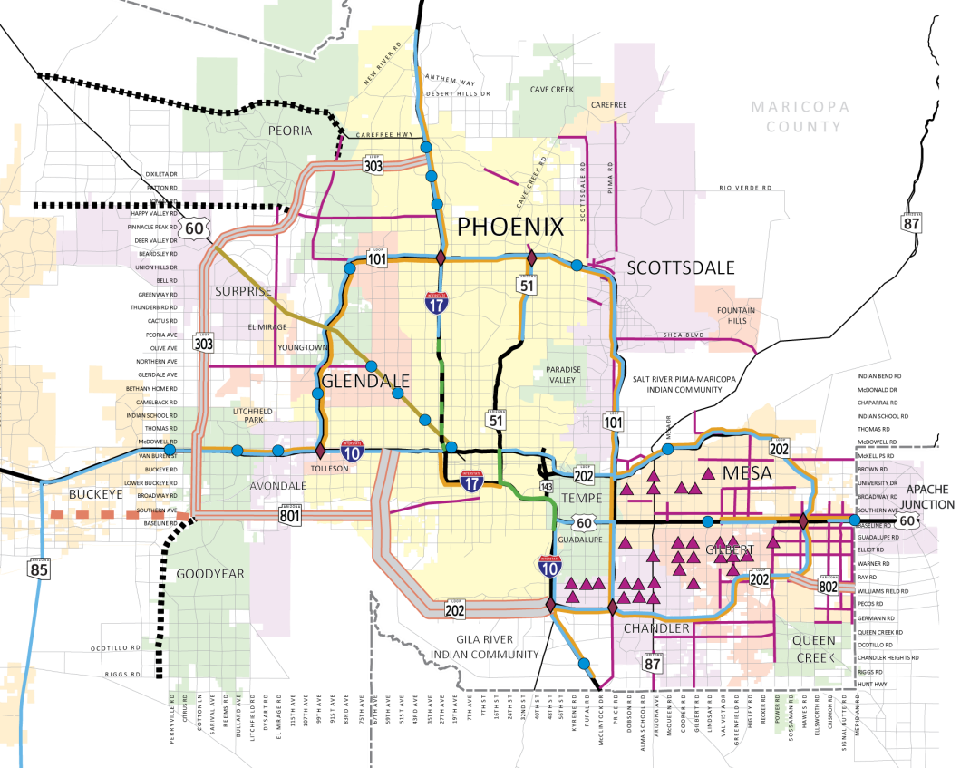
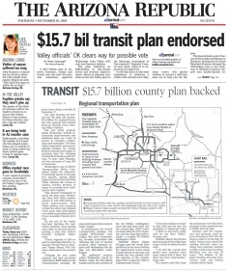
MAG Regional Transportation Plan
Freeways Program – 57%
Regional Transit – 32%
Arterial Program - 9%
Other Programs – 2%
Notes:
Focusing on the Regional Transportation Plan . . .
Current funding allocations.

Slide 3
Regional Freeway and Highway Program
$10.5 billion over 20-years (2006-2026).
New Freeways –SR-24, SR-30, Loop 202/South Mountain, and Loop 303.
New/Improved Traffic Interchanges.
New HOV and add general purpose lanes projects.
US-60/Grand Avenue improvements.
Rubberized asphalt to reduce freeway noise.
Freeway Management System.
Maintenance (litter control and landscaping).
Notes:
Drilling down to the Regional Freeway and Highway Program . . .
Biggest point is a $10.5 billion program over 20-years.
Does include some assistance for US-60/Grand Avenue, including grade separation of the Bell Road intersection.

Slide 4
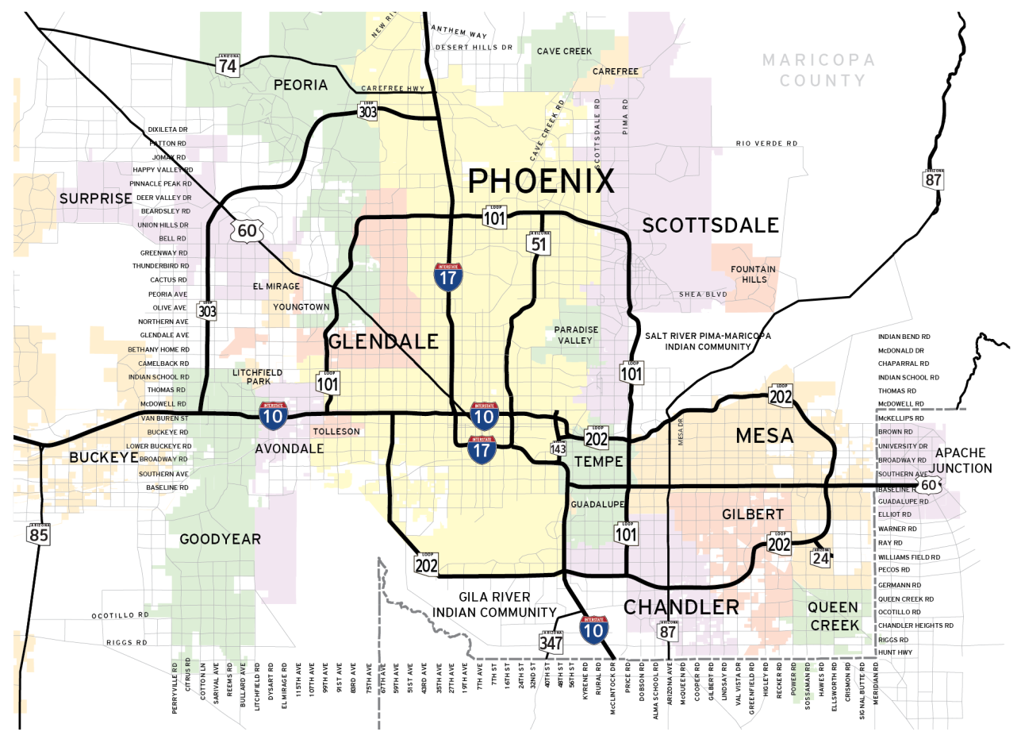
Projects Recently Completed
Loop 303
13-mi of New Freeway
New DHOV Ramp
I-10 at Loop 202
(Pecos Stack)
US-60 Widening to 6-lanes from 83rd Ave to Loop 303
New DHOV Ramp
Loop 101 at Loop 202
31-Miles of new HOV Lanes on Loop 101
11-Miles of new HOV Lanes on Loop 202

Slide 5
Project Under Construction
Loop 303
Interstate 10 to US-60
Construction Complete by 2014
US-60 Reconstruction
from 83rd Ave to 19th Ave
SR-24
Loop 202 to Ellsworth Rd

Slide 6
Projects Still to Come
US-60/Grand Ave
Loop 303 to Loop 101
Intersection Improvements
Loop 101, I-17 to Loop 202
Add Lanes
I-10/I-17 Spine,
Loop 101 to Loop 202
Add Lanes
Loop 202, Loop 101 to Higley Rd
Add HOV and General Lanes
Loop 303, Interstate 10 to MC-85
New Freeway
Loop 101, US-60 to Loop 202
Add Lanes
Loop 202/South Mountain
New Freeway

Slide 7
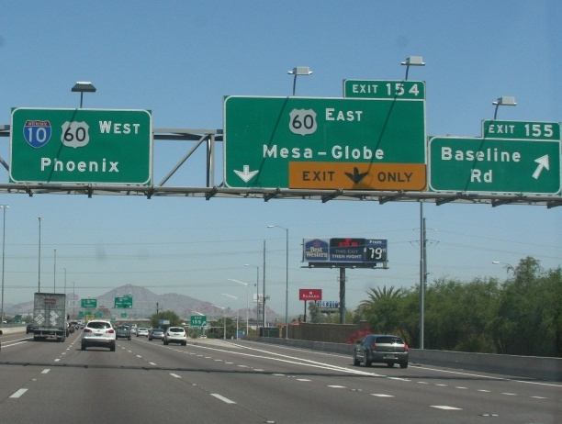


Purpose
MAG INNER LOOP MICROSIMULATION MODEL
Add analysis of operations and traffic simulation modeling to the set of services MAG offers to its member agencies.
Build a model to complement MAG’s regional travel demand model that:
  Has the operational sensitivity to capture effects of signal operations, ITS projects.
  Is able to capture the mobility benefits of major projects whose impacts will be felt throughout Central Phoenix.
  Accurately portrays the traffic impacts of transit improvements, namely on high-capacity transit corridors.
  Provides a calibrated base model from which smaller, more focused studies can be derived.
Approaching in Tempe (Exit 154)

Slide 8
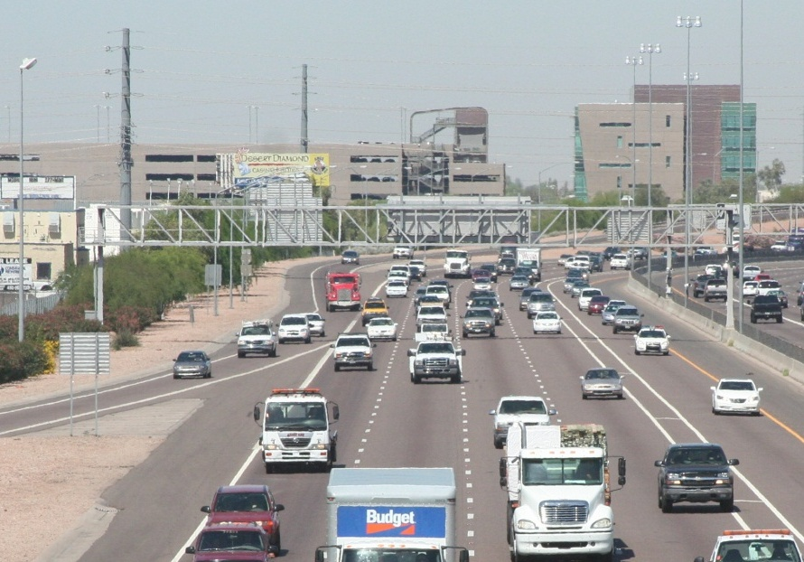
Approach
Study Design Stage:
  Solicit stakeholder input/support.
  Scope the model framework, design parameters, and geographic scope.
Model Data Preparation:
  Assemble traffic count and signal timing data.
  Develop simulation model network and relationship to travel demand model.
Framework Development and Testing:
  Test, calibrate, and validate the model.
Training.
At 40th Street Overcrossing, Phoenix

Slide 9
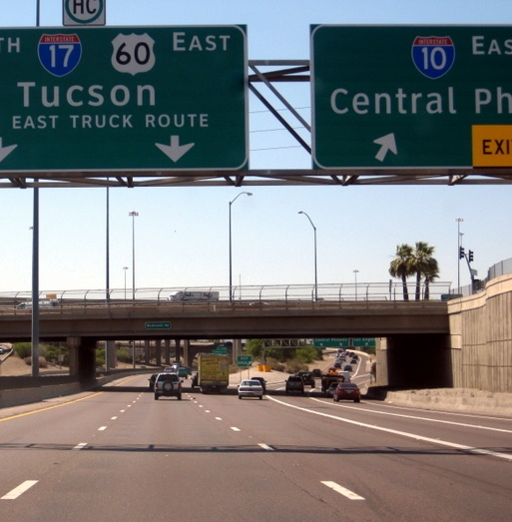

Design
A model congruous with the regional travel demand model:
  Objective: To achieve a degree of integration with the regional travel demand model such that they can share key model data seamlessly.
  Solution: A simulation model in TransModeler capable of reading all file formats and data structures of the regional model in TransCAD and sharing a common zonal system (and, hence, ready exchange of origin-destination matrices).
A multi-resolution traffic simulation model:
  Objective: A simulation model with an appropriate balance of high-fidelity treatment of traffic flow phenomena and practical computational performance.
  Solution: A microsimulation model enabling selective application of lower-resolution (e.g., meso) and multi-resolution (e.g., hybrid micro-meso) models.
Stack Interchange, Phoenix

Slide 10
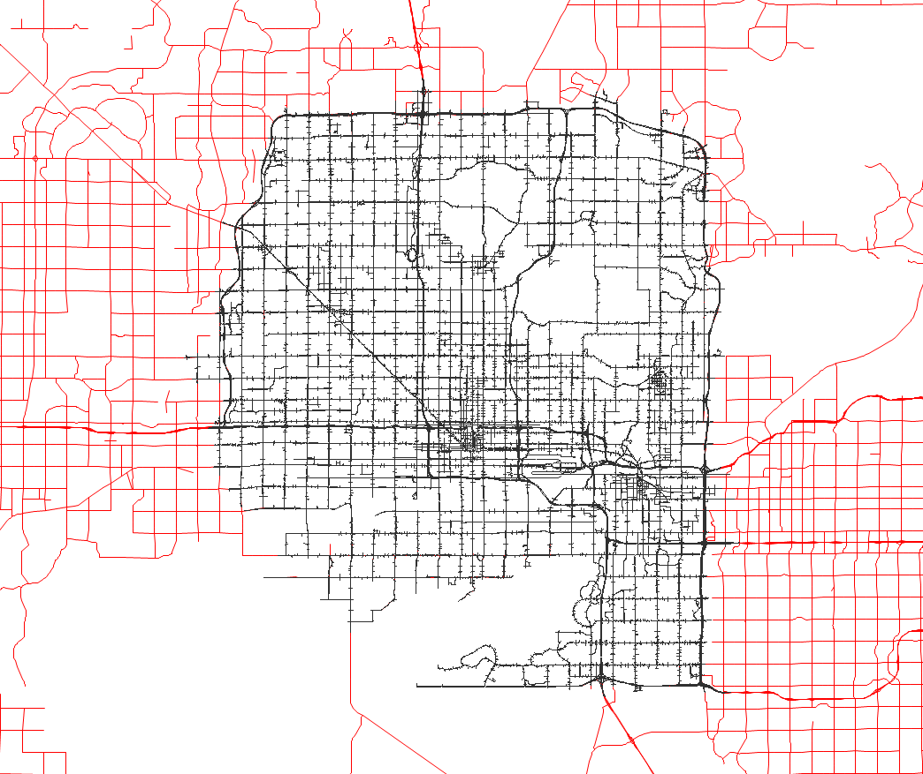
Development
Preparation of highly detailed lane-level geography/geometry.
Import of centroids and connectors from regional model.
Auto-adjustment of TAZ connectivity.
Manual addition of centroids along study area boundary.

Slide 11
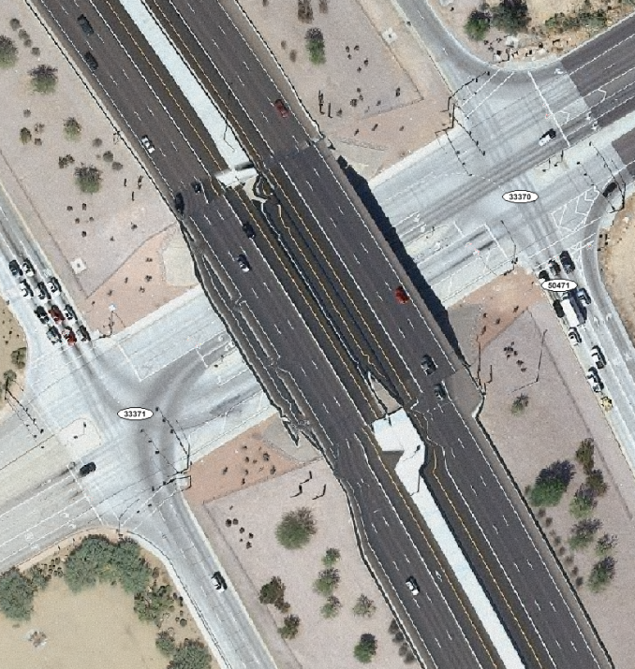
Development
Preparation of highly detailed lane-level geography/geometry.
Import of centroids and connectors from regional model.
Auto-adjustment of TAZ connectivity.
Manual addition of centroids along study area boundary.

Slide 12
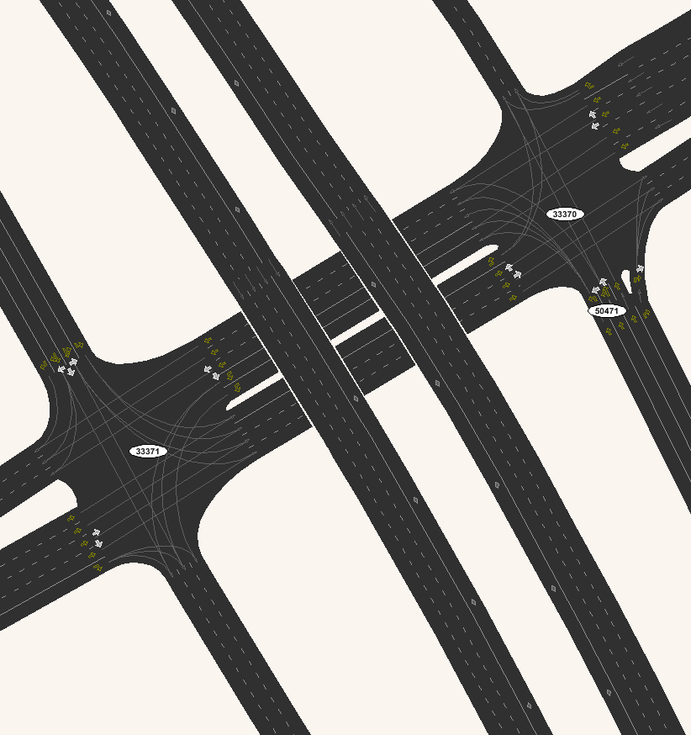
Development
Preparation of highly detailed lane-level geography/geometry.
Import of centroids and connectors from regional model.
Auto-adjustment of TAZ connectivity.
Manual addition of centroids along study area boundary.

Slide 13
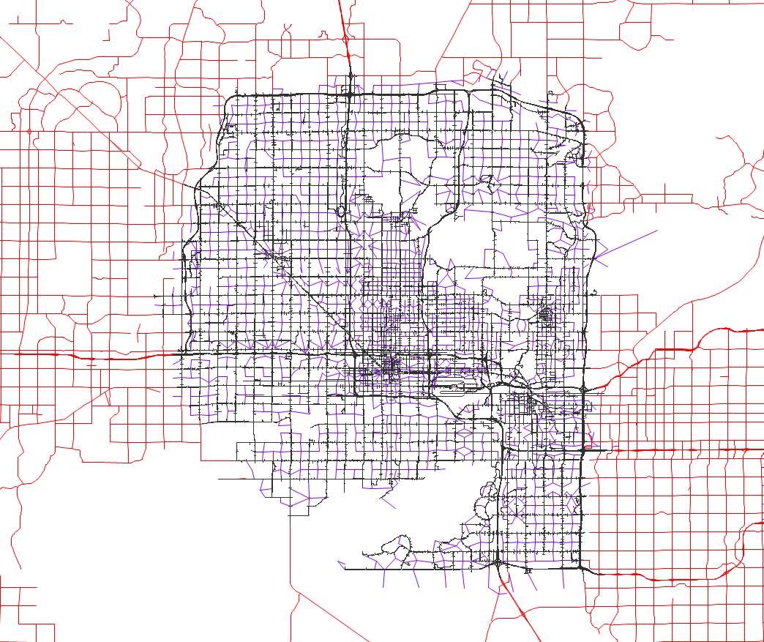
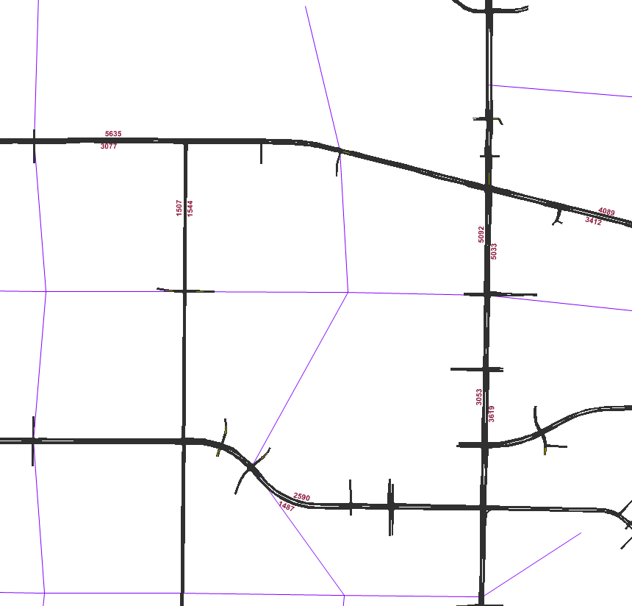
Development
Preparation of highly detailed lane-level geography/geometry.
Import of centroids and connectors from regional model.
Auto-adjustment of TAZ connectivity.
Manual addition of centroids along study area boundary.

Slide 14
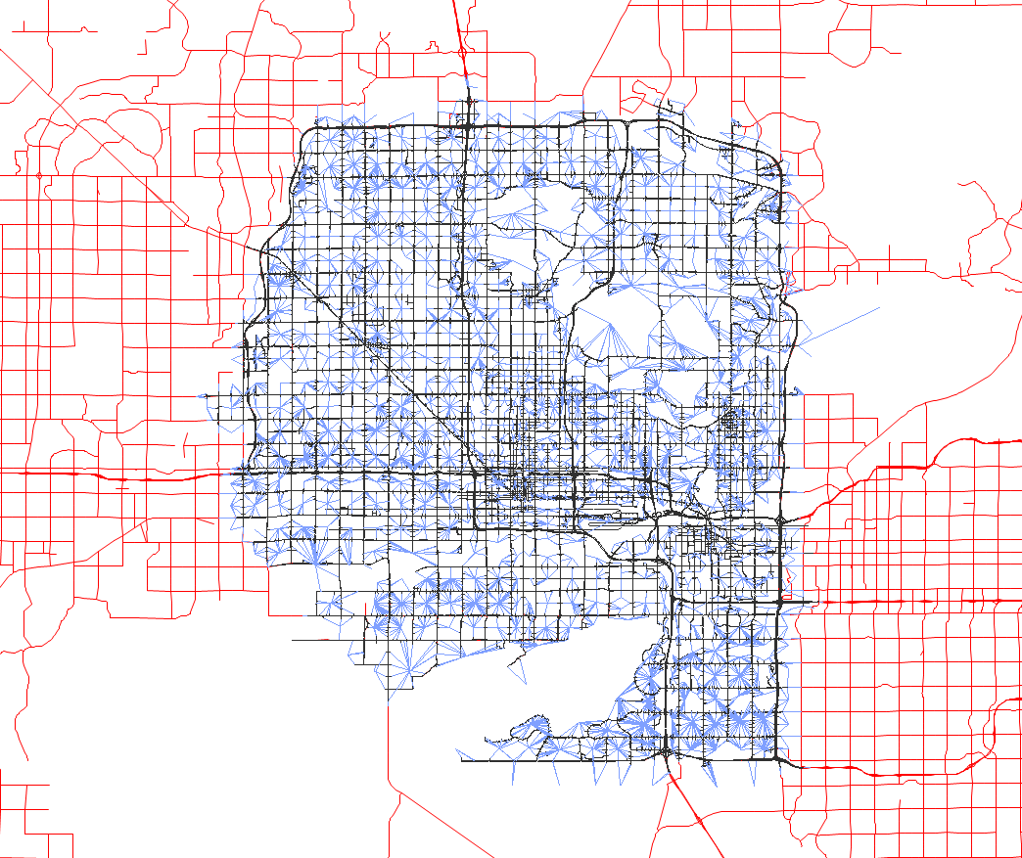
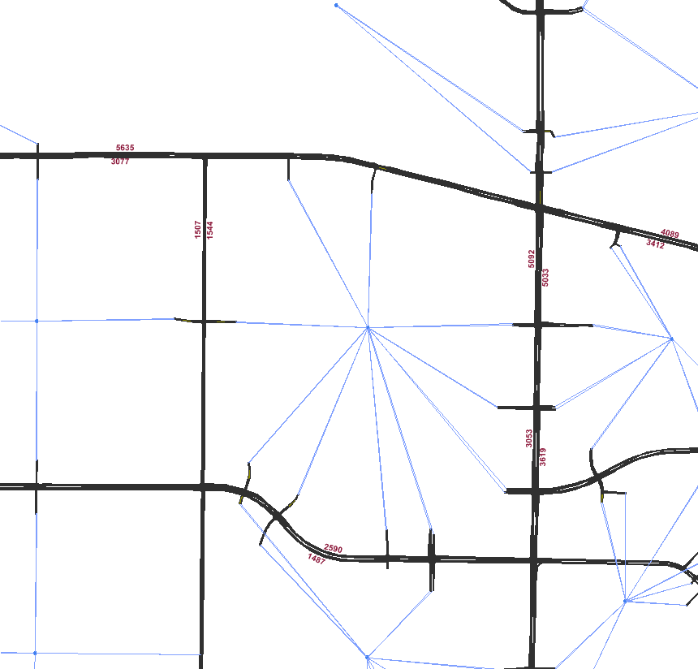
Development
Preparation of highly detailed lane-level geography/geometry.
Import of centroids and connectors from regional model.
Auto-adjustment of TAZ connectivity.
Manual addition of centroids along study area boundary.

Slide 15
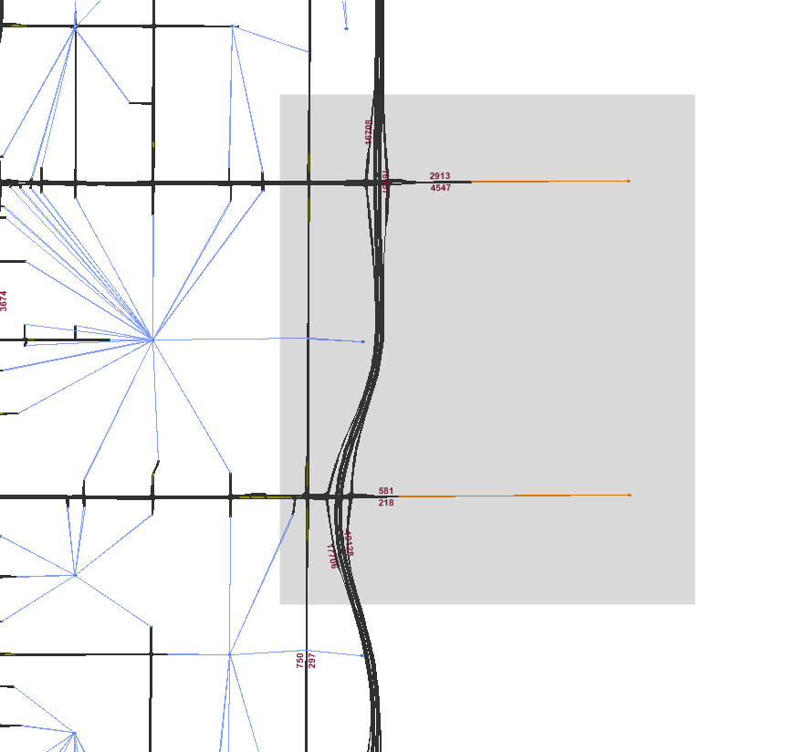
Development
Preparation of highly detailed lane-level geography/geometry.
Import of centroids and connectors from regional model.
Auto-adjustment of TAZ connectivity.
Manual addition of centroids along study area boundary.

Slide 16
Calibration
1
Travel Model
Subarea Analysis
Step 1: Produce initial estimate of O-D traffic demand from MAG Regional Travel Demand Model.
Seed Matrix
Simulation-based Dynamic Traffic Assignment
Simulated Traffic Counts
Historical Travel Times & Delays
Traffic Counts
Simulation-based Dynamic Matrix Adjustment
Satisfactory Match?
Finished
No
Yes

Slide 17
Calibration
Travel Model
Subarea Analysis
Step 2: Simulation-based dynamic traffic assignment to equilibrate route choices.
Seed Matrix
2
Simulation-based Dynamic Traffic Assignment
Simulated Traffic Counts
Historical Travel Times & Delays
Traffic Counts
Simulation-based Dynamic Matrix Adjustment
Satisfactory Match?
Finished
No
Yes

Slide 18
Calibration
Travel Model
Subarea Analysis
Step 3: Compare 15-minute simulated volumes with 15-minute segment and turning counts.
Seed Matrix
Simulation-based Dynamic Traffic Assignment
Simulated Traffic Counts
Historical Travel Times & Delays
3
Traffic Counts
Simulation-based Dynamic Matrix Adjustment
Satisfactory Match?
Finished
No
Yes

Slide 19
Calibration
Travel Model
Subarea Analysis
Step 4: Simulation-based dynamic O-D estimation to improve match with traffic counts.
Seed Matrix
Simulation-based Dynamic Traffic Assignment
4
Simulated Traffic Counts
Historical Travel Times & Delays
Traffic Counts
Simulation-based Dynamic Matrix Adjustment
Satisfactory Match?
Finished
No
Yes
Notes:
Note to Bob: The simulation-based dynamic ODME in step 4 makes incremental adjustments to the trip table such that the change in demand does not change so dramatically as to become inconsistent with the DTA solution in preceding step 3

Slide 20
Calibration
Travel Model
Subarea Analysis
Iterate Steps 2-4: Repeat DTA to “recalibrate” route choice to the changes in demand resultant from the ODME step.
Seed Matrix
2
Simulation-based Dynamic Traffic Assignment
4
Simulated Traffic Counts
Historical Travel Times & Delays
3
Traffic Counts
Simulation-based Dynamic Matrix Adjustment
Satisfactory Match?
Finished
No
Yes

Slide 21
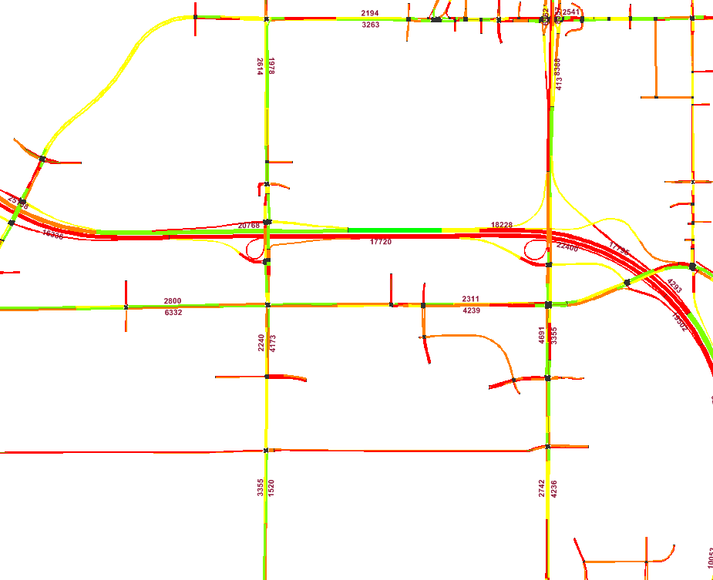
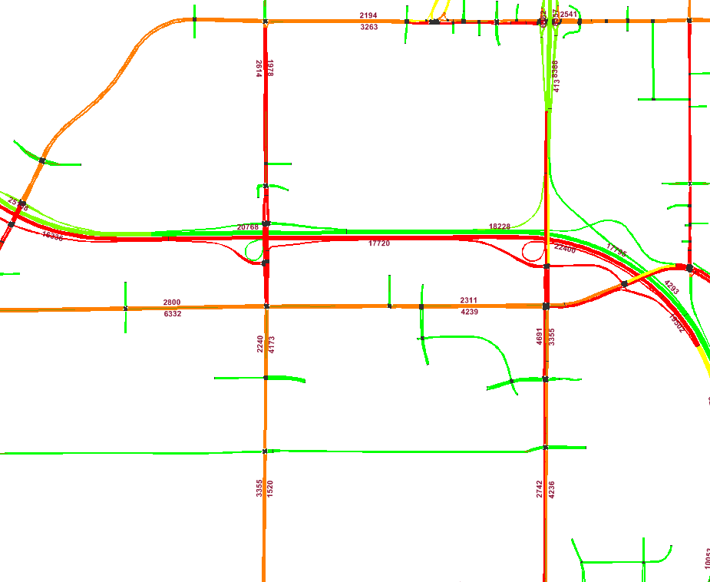
Validation
Travel Model
Subarea Analysis
Visual comparison of 15-min. speed maps with 15-min. INRIX maps to ensure start, severity, duration of bottlenecks.
Seed Matrix
Targeted adjustment of trip table to improve match with bottlenecks while maintaining goodness-of-fit with counts.
2
Simulation-based Dynamic Traffic Assignment
4
Simulated Traffic Counts
Historical Travel Times & Delays
3
Traffic Counts
Simulation-based Dynamic Matrix Adjustment
Satisfactory Match?
Finished
No
Yes

Slide 22
Validation
Travel Model
Subarea Analysis
Continuing and independent research effort to incorporate INRIX speed data into the Dynamic ODME in Step 4.
Seed Matrix
2
Simulation-based Dynamic Traffic Assignment
4
15-min. INRIX Speeds
Simulated Traffic Counts
Historical Travel Times & Delays
3
Traffic Counts
Simulation-based Dynamic Matrix Adjustment
Satisfactory Match?
Finished
No
Yes

Slide 23
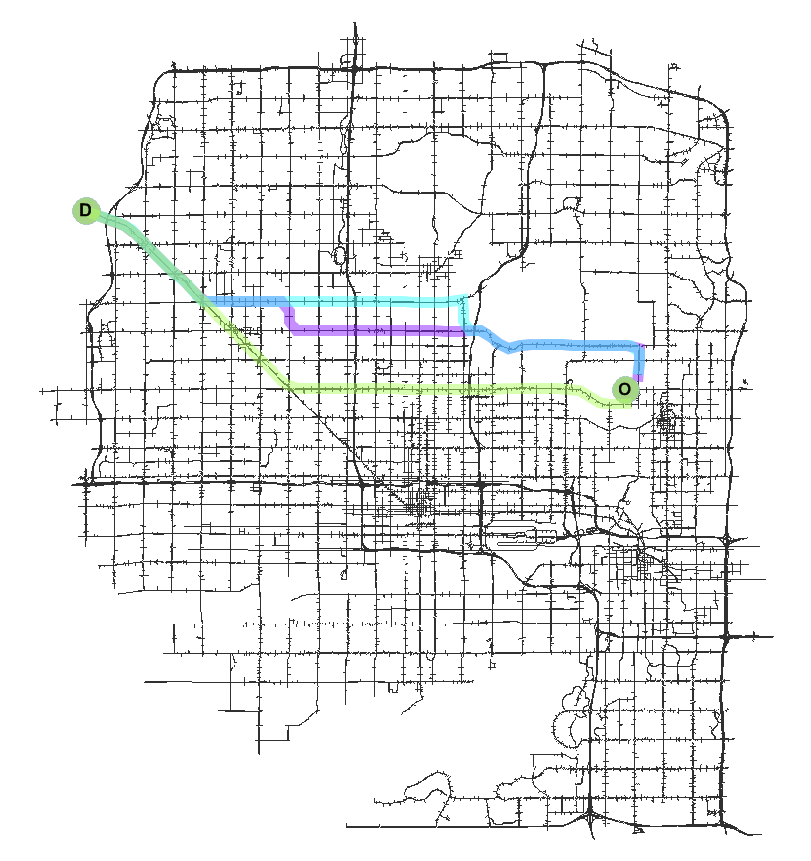
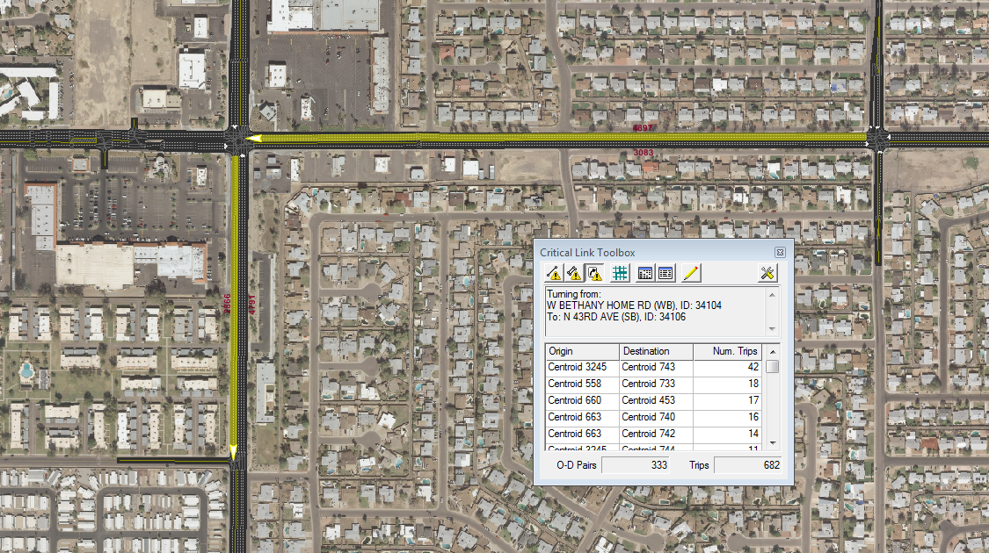
Visual Audit
Do route choices comport with expectations, local knowledge?

Slide 24
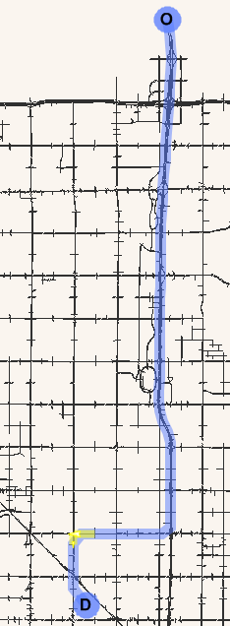
Visual Audit
Do route choices comport with expectations, local knowledge?
Query paths traversing critical link, turning movement, or arbitrary link sequence.

Slide 25
Visual Audit
Query used paths by origin and destination.
Do route choices comport with expectations, local knowledge?
Query paths traversing critical link, turning movement, or arbitrary link sequence.

Slide 26
Goodness of Fit
How well do simulated volumes match the field data? In %RMSE:
AM Period | All Counts | Freeway and Ramp
Observations | 1,497 | 279
6:00 – 7:00 AM | 37.8% | 20.4%
7:00 – 8:00 AM | 31.9% | 18.0%
8:00 – 9:00 AM | 30.7% | 18.0%
6:00 – 9:00 AM | 29.25% | 15.7%
PM Period | All Counts | Freeway and Ramp
Observations | 1,497 | 279
3:00 – 4:00 PM | 31.9% | 17.7%
4:00 – 5:00 PM | 29.6% | 18.7%
5:00 – 6:00 PM | 34.4% | 21.0%
3:00 – 6:00 PM | 28.8% | 16.7%

Slide 27
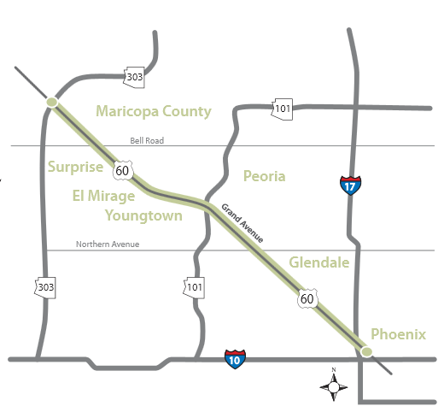
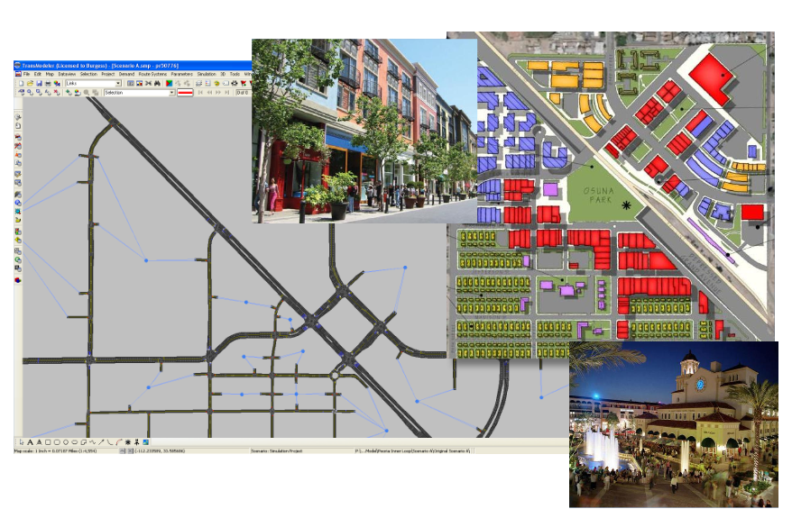

Applications
US-60/Grand Avenue COMPASS Study.
Old Town Peoria Traffic Study.
Various analyses of traffic interchange redesigns and other roadway improvements.

Slide 28
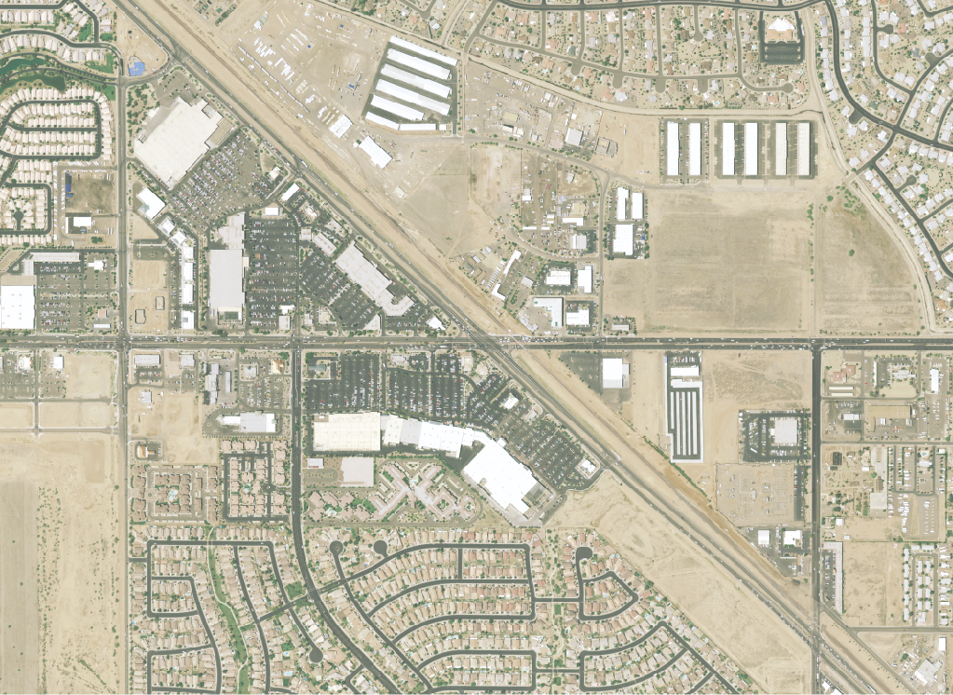
US-60/Grand Ave at Bell Rd
Alternative studies underway since 2007.
Entering intersection volumes exceed 80,000 vpd.
Challenging location due to commercial development.
Design issues with skew and BNSF Railway.
BNSF Railway
Bell Rd
Heavy
Traffic Flow
US-60/Grand Ave

Slide 29
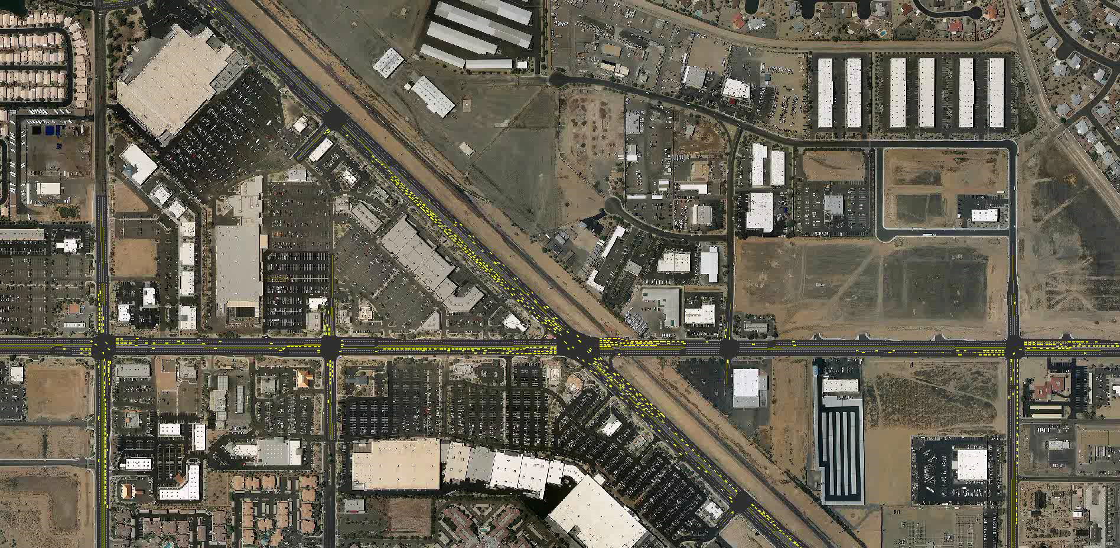
2035 Traffic on Existing Geometry

Slide 30
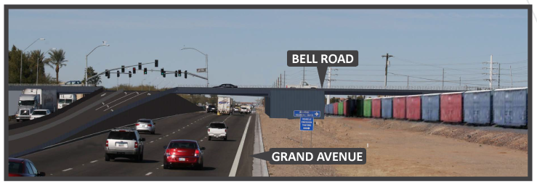
Early Illustration Concept

Slide 31
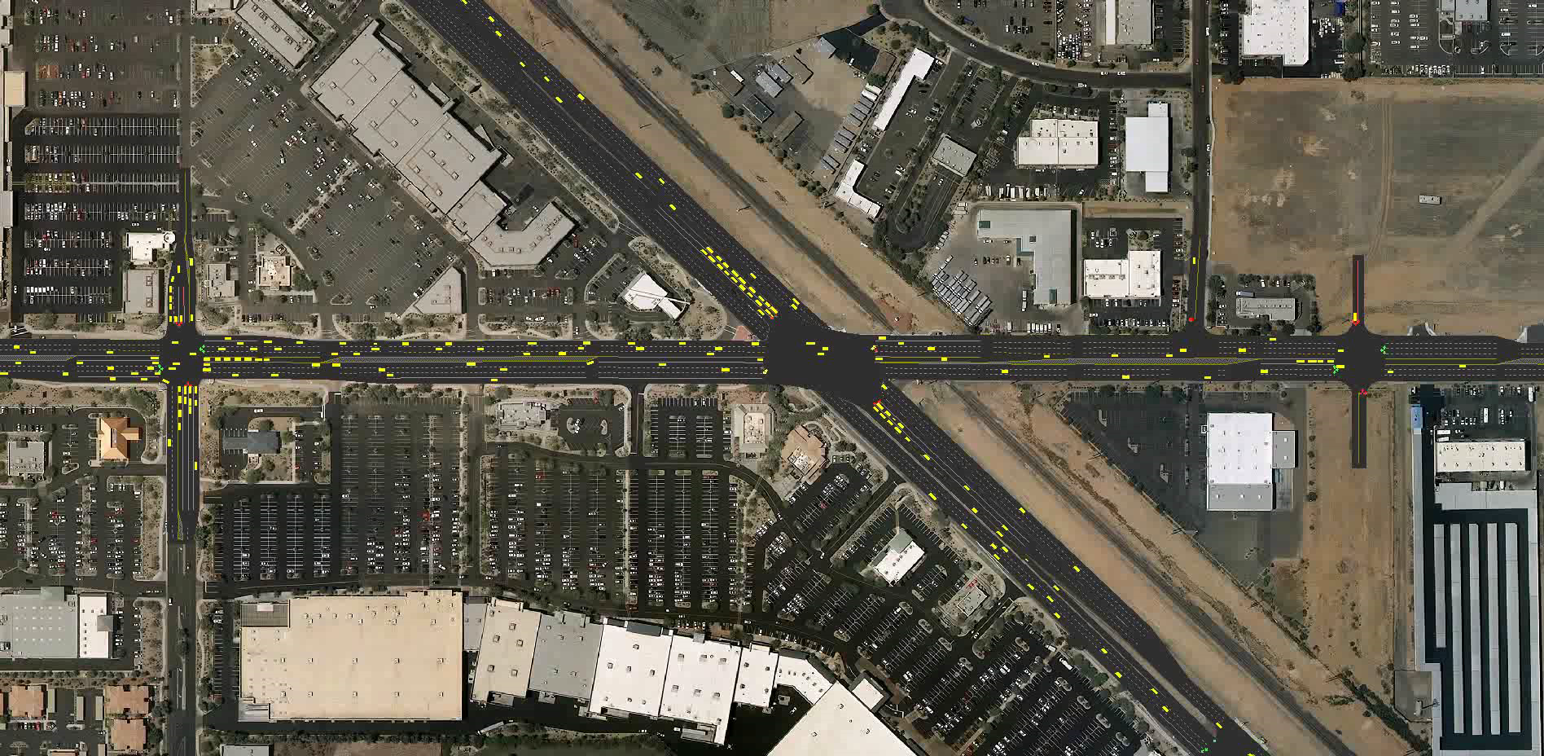
2035 Traffic on Concept 7 Geometry

Slide 32
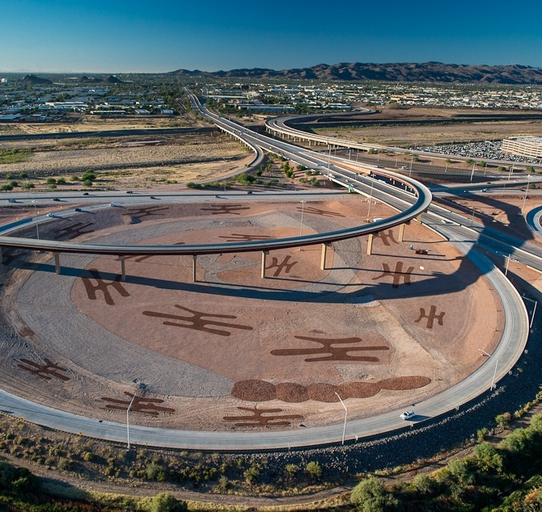


Project Status
MAG INNER LOOP MICROSIMULATION MODEL
Phases I and II largely completed.
  Calibrated, validated, and delivered.
  Model of bus and light rail route operations, derived from GTFS service schedules and MAG stop location data, under review, soon to be delivered.
Model report forthcoming.
Model hand-over and continuing technical support.
East Sky Harbor Blvd Traffic Interchange

Slide 33
Development and Application of a Traffic Simulation and Dynamic Traffic Assignment Model Framework for Central Phoenix
Bob Hazlett
Senior Engineer
602 254-6300
bhazlett@azmag.gov
Micah Henry
Transportation Engineer
602 254-6300
mhenry@azmag.gov
Dan Morgan
Caliper Corporation
617 527-4700
daniel@caliper.com

