Slide 1
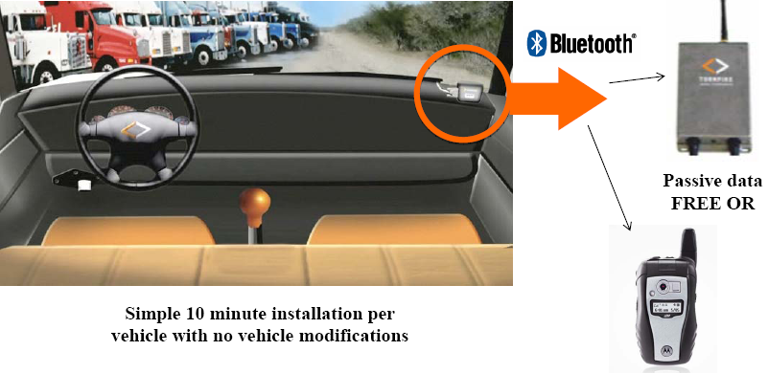
Development of a Tour-Based Truck Travel Demand Model using Truck GPS Data
14th TRB National Transportation Planning Applications Conference
Arun Kuppam
co-authored by Jason Lemp, CS Dan Beagan, CS Vladimir Livshits, MAG Lavanya Vallabhaneni, MAG Sreevatsa Nippani, MAG
May 7, 2013

Slide 2
Overview
Why ?
Who ?
What ?
Where?
Truck trip diary surveys are expensive, with poor response rates
Third party commercial GPS vendors
Deploy GPS units and collect GPS records from truck fleets
Example focuses on specifics from the Phoenix experience
CS applied in Los Angeles, Chicago, Phoenix, Baltimore
How ?
Process GPS data to obtain truck trips and tours

Slide 3
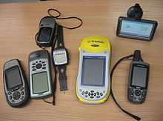
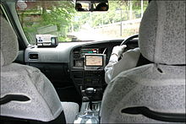
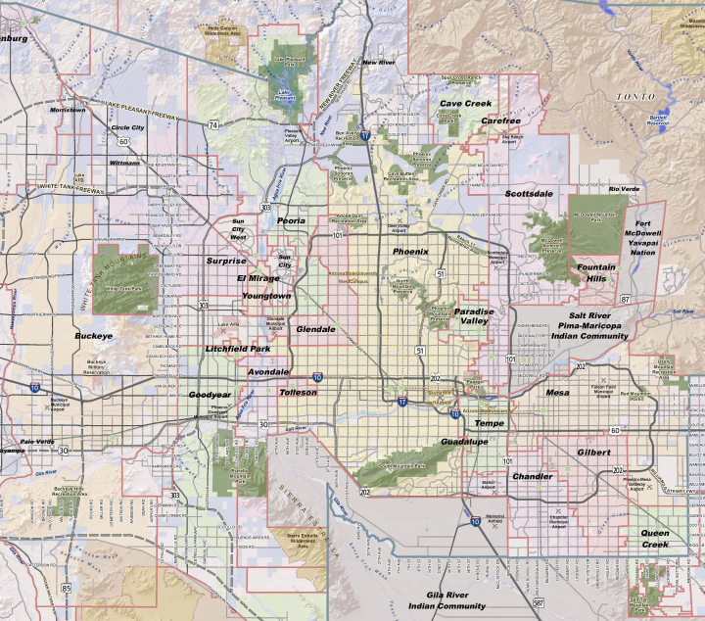
Commercial Vehicle GPS Data
GPS devices are widely deployed in cell phones, autos, and trucks
Truck fleet operators subscribe to GPS services for operational and maintenance purposes
Automatic Vehicle Location (AVL); Events Activated Tracking Systems (EATS); Fleet Telematics Systems (FTS)
Entities (e.g., ATRI) collect and store historical GPS from operators (2004 to present)
Condition of dissemination is that truck ID’s are anonymized
GPS information should be processed before it can be used for truck travel models

Slide 4
ATRI Data Specifics
Cost for one month of data – $10K
ATRI was purchased to supplement heavy truck (FHWA Classes 8-13) trip diary surveys
3.5 million positional records from 22,000 trucks
Close to 60,000 truck tours
Heavy Trucks
Large Sample of Trucks
Relatively Cheap

Slide 5
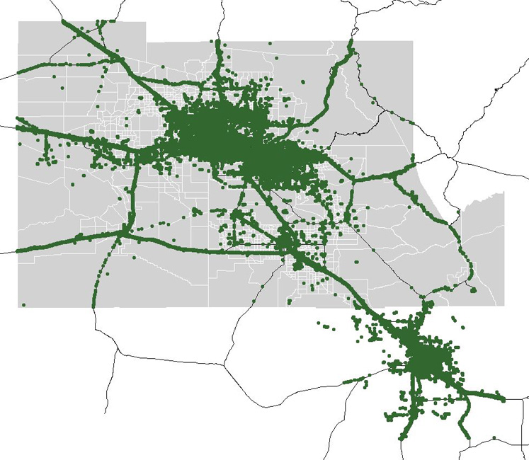
Truck GPS Data from Phoenix All Trucks in April 2011
ATRI GPS All Truck IDs April 2011
ATRI GPS April 2011
All Trucks | April 2011
GPS Events | 3,429,603
Truck Trip Ends | ??
Truck Tours | 58,637
Trucks | 22,657
Notes:
As you can see from this one months of data from ATRI for Phoenix, it can be used to determine the speeds and travel times on I-10, I-18, I-17 , US 93, etc., since the points clearly show these routes. However by collecting the GPS data you get a lot of addtional points , which can be processed to determine OD trip and tour information.
There are 3,429,603 GPS event records. There are GPS event records reported for 22,657 trucks. Assuming an 8 hour gap fro a tour separates tours, there are 158, 637 tours. There is too much data to determine how many trip end there were within the tours. The GPS event includes duplicate stop events and many moving events during a trips. The challenge of processing for OD purposes is to eliminate those records which do not add any OD information.

Slide 6
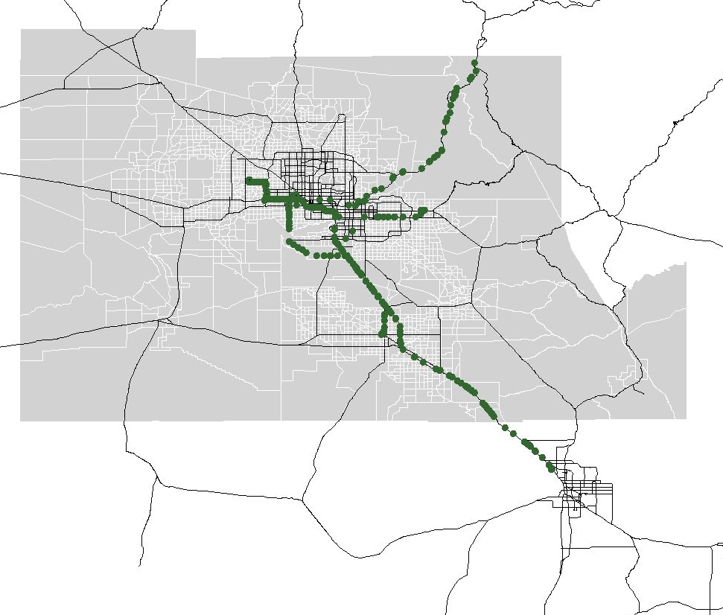
Truck GPS Data from Phoenix One Truck in April 2011
ATRI GPS Truck ID 3570452 April 2011
One Truck (ID 357042) | April 2011
GPS Events | 719
Truck Trip Ends | ??
Truck Tours | 40
Trucks | 1
Notes:
If you look at just the event for one truck, things get more manageable. There are 719 records for this truckID, 67 of which fall south of the current MAG model region in the Tucson region.
A tour is defined as a sequence of GPS events for a TruckID, where the last event is a change of date and a change in time of more than 8 hours. This time check is to allow for tours that extend past midnight. Using this criteria, there are 43 possible tours for this truck ID. There are more possible tours than would be allowed by the 30 days in April, because a possible tour number is assigned when a GPS reading is transmitted at midnight, and an additional possible tour is assigned when the actual tour begins later that morning. The false positives for a tour, which involve only a single late midnight record, will be eliminated during data processing.

Slide 7
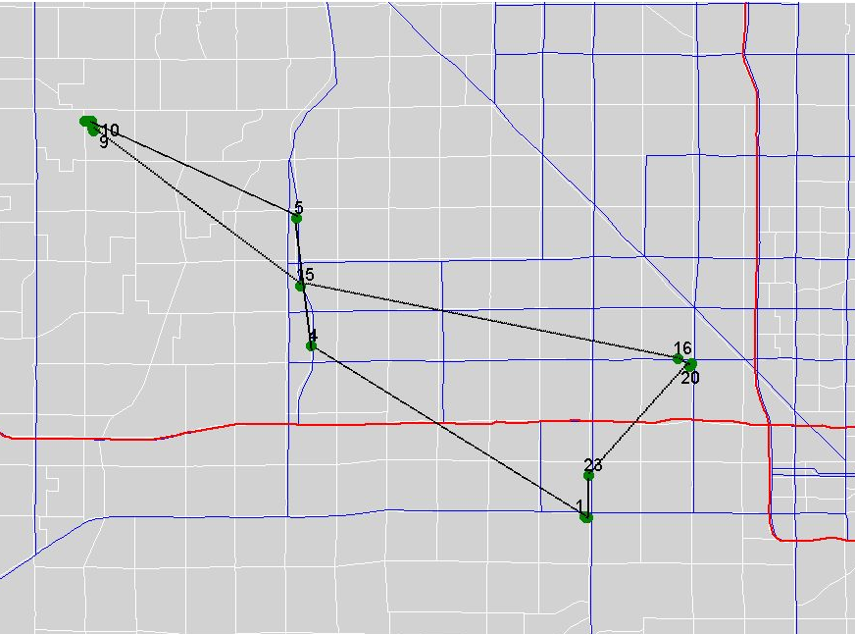
Truck GPS Data from Phoenix One Truck on April 1, 2011
ATRI GPS Truck ID 3570452 April 1, 2011
One Truck (ID 357042) | April 1, 2011
GPS Events | 25
Truck Trip Ends | ??
Truck Tours | 1
Trucks | 1
Notes:
By concentrating on just one truck , the moving and stooped events become more apparent as the events map to a tour. And it is a tour because event 1 is at the same location as event 25 4. The GPS event records are numbered as shown in Table on Slide 5.

Slide 8
Processing of One Truck Tour
Primary Anonymized Data
Processed Data
Truck_ ID | Date | Time | Longitude | Latitude | Event | Trip Distance (miles) |  | Time From Last (min) | Time To Next Min) | Speed From Last (MPH) | Speed To Next (MPH) | Event Type | TAZ | LU
 |  |  |  |  |  | Last | Next
357042 | 4/1/2011 | 3:47:08 A.M. | -112.1695 | 33.4353 | 3 | 0.06 | 6.39 | - | 12.87 | 0.21 | 29.79 | First Starting | 884 | Indus-trial
357042 | 4/1/2011 | 4:00:00 A.M. | -112.2637 | 33.4838 | 4 | 6.39 | 2.53 | 12.87 | 2.63 | 29.79 | 57.6 | moving
357042 | 4/1/2011 | 4:02:38 A.M. | -112.2689 | 33.52 | 5 | 2.53 | 4.56 | 2.63 | 11.1 | 57.6 | 24.67 | moving
357042 | 4/1/2011 | 4:13:44 A.M. | -112.3409 | 33.5475 | 6 | 4.56 | 0.00 | 11.1 | 0.27 | 24.67 | 0.42 | Stopping
357042 | 4/1/2011 | 4:14:00 A.M. | -112.3408 | 33.5475 | 7 | 0.00 | 0.06 | 0.27 | 2.1 | 0.42 | 1.78 | stopped | 413 | Indust-rial
357042 | 4/1/2011 | 4:16:06 A.M. | -112.3398 | 33.5475 | 8 | 0.06 | 0.22 | 2.1 | 6.5 | 1.78 | 2.01 | stopped | 413 | Indust-rial
357042 | 4/1/2011 | 4:22:36 A.M. | -112.3381 | 33.5447 | 9 | 0.22 | 0.03 | 6.5 | 0.63 | 2.01 | 2.64 | stopped | 413 | Indust-rial
357042 | 4/1/2011 | 4:23:14 A.M. | -112.3377 | 33.5449 | 10 | 0.03 | 0.02 | 0.63 | 0.23 | 2.64 | 4.07 | stopped | 413 | Indust-rial
357042 | 4/1/2011 | 4:23:28 A.M. | -112.338 | 33.5449 | 11 | 0.02 | 0.01 | 0.23 | 39.17 | 4.07 | 0.01 | stopped | 413 | Indust-rial
357042 | 4/1/2011 | 5:02:38 A.M. | -112.3381 | 33.5449 | 12 | 0.01 | 0.05 | 39.17 | 20 | 0.01 | 0.15 | stopped | 413 | Indust-rial
357042 | 4/1/2011 | 5:22:38 A.M. | -112.3383 | 33.5456 | 13 | 0.05 | 0.13 | 20 | 7.37 | 0.15 | 1.08 | stopped | 413 | Indust-rial
357042 | 4/1/2011 | 5:30:00 A.M. | -112.3385 | 33.5475 | 14 | 0.13 | 5.22 | 7.37 | 15 | 1.08 | 20.88 | Starting | 413 | Indus-trial
357042 | 4/1/2011 | 5:45:00 A.M. | -112.2673 | 33.5009 | 15 | 5.22 | 7.53 | 15 | 15 | 20.88 | 30.11 | moving
357042 | 4/1/2011 | 6:00:00 A.M. | -112.1391 | 33.4804 | 16 | 7.53 | 0.30 | 15 | 1.23 | 30.11 | 14.61 | moving
357042 | 4/1/2011 | 6:01:14 A.M. | -112.1345 | 33.4784 | 17 | 0.30 | 0.00 | 1.23 | 0.17 | 14.61 | 1.45 | Stopping
357042 | 4/1/2011 | 6:01:24 AM | -112.1346 | 33.4784 | 18 | 0.00 | 0.00 | 0.17 | 1.23 | 1.45 | 0.07 | stopped | 745 | Landfill
357042 | 4/1/2011 | 6:02:38 AM | -112.1346 | 33.4784 | 19 | 0.00 | 0.03 | 1.23 | 80.6 | 0.07 | 0.02 | stopped | 745 | Landfill
357042 | 4/1/2011 | 7:23:14 AM | -112.1351 | 33.4784 | 20 | 0.03 | 0.03 | 80.6 | 10.4 | 0.02 | 0.2 | stopped | 745 | Landfill
357042 | 4/1/2011 | 7:33:38 AM | -112.1345 | 33.4785 | 21 | 0.03 | 0.04 | 10.4 | 0.87 | 0.2 | 2.91 | stopped | 745 | Landfill
357042 | 4/1/2011 | 7:34:30 A.M. | -112.1344 | 33.4791 | 22 | 0.04 | 2.98 | 0.87 | 10.5 | 2.91 | 17.04 | Starting | 745 | Landfill
357042 | 4/1/2011 | 7:45:00 AM | -112.1692 | 33.4472 | 23 | 2.98 | 0.83 | 10.5 | 3.9 | 17.04 | 12.77 | Moving
357042 | 4/1/2011 | 7:48:54 A.M. | -112.1702 | 33.4352 | 24 | 0.83 | 0.00 | 3.9 | 13.77 | 12.77 | 0.01 | Stopping | 884 | Indus-trial
357042 | 4/1/2011 | 8:02:40 AM | -112.1702 | 33.4352 | 25 | 0.00 | - | 13.77 | - | 0.01 | - | Last Stopped
Notes:
This table shows the additional processing which is conducted to determine the condition that can be associated with the event.
For each event, the time and position of the GPS event preceding and following the record is computed.
The Great Circle Distance (e.g., air miles) between the GPS events is calculated based on a comparison of the latitudes and longitudes of the events.
The time between the preceding and following events is calculated based on the timestamp of those events.
The “air speed” in MPH is calculated based on the distance from the last (…or to the next) GPS event divided by the time from the last (…or to the next) GPS event. It is from this comparison of the sequence of time, distances and speeds that a determination can be made as to the action of the GPS Truck vehicle at that event.
It is also noted that the imprecision of the GPS location reading may erroneously give the indication that the truck has moved when it is merely a slightly different GPS location reading. It is for this reason that the criteria for motion with respect to the last or next events is a speed of 5 MPH and not absolute zero.
The Red text shows attributes when event transition between stooped and moving. Stops are a tour occur at those transitions.

Slide 9
Processing of One Truck Tour
Primary Anonymized Data
Processed Data
Truck_ ID | Date | Time | Longitude | Latitude | Event | Trip Distance (miles) |  | Time From Last (min) | Time To Next Min) | Speed From Last (MPH) | Speed To Next (MPH) | Event Type | TAZ | LU
 |  |  |  |  |  | Last | Next
357042 | 4/1/ 2011 | 3:47:08 A.M. | -112.1695 | 33.4353 | 3 | 0.06 | 6.39 | - | 12.87 | 0.21 | 29.79 | First Starting | 884 | Indus-trial
… | … | … | … | … | … | … | … | … | … | … | … | … | … | …
357042 | 4/1/ 2011 | 4:13:44 A.M. | -112.3409 | 33.5475 | 6 | 4.56 | 0.00 | 11.1 | 0.27 | 24.67 | 0.42 | Stopping
… | … | … | … | … | … | … | … | … | … | … | … | … | … | …
357042 | 4/1/ 2011 | 5:30:00 A.M. | -112.3385 | 33.5475 | 14 | 0.13 | 5.22 | 7.37 | 15 | 1.08 | 20.88 | Starting | 413 | Indus-trial
… | … | … | … | … | … | … | … | … | … | … | … | … | … | …
357042 | 4/1/ 2011 | 6:01:14 A.M. | -112.1345 | 33.4784 | 17 | 0.30 | 0.00 | 1.23 | 0.17 | 14.61 | 1.45 | Stopping
… | … | … | … | … | … | … | … | … | … | … | … | … | … | …
357042 | 4/1/ 2011 | 7:34:30 A.M. | -112.1344 | 33.4791 | 22 | 0.04 | 2.98 | 0.87 | 10.5 | 2.91 | 17.04 | Starting | 745 | Land-fill
… | … | … | … | … | … | … | … | … | … | … | … | … | … | …
357042 | 4/1/ 2011 | 7:48:54 A.M. | -112.1702 | 33.4352 | 24 | 0.83 | 0.00 | 3.9 | 13.77 | 12.77 | 0.01 | Stopping | 884 | Indus-trial
… | … | … | … | … | … | … | … | … | … | … | … | … | … | …
One Truck (ID 357042) | April 1, 2011
GPS Transition Events | 6
Truck Trip Ends | 4
Truck Tours | 1
Trucks | 1
One Truck (ID 357042) | April 1, 2011
GPS Events | 3
Truck Trip Ends | 3
Truck Tours | 1
Trucks | 1
Notes:
This table shows the additional processing which is conducted to determine the condition that can be associated with the event.
For each event, the time and position of the GPS event preceding and following the record is computed.
The Great Circle Distance (e.g., air miles) between the GPS events is calculated based on a comparison of the latitudes and longitudes of the events.
The time between the preceding and following events is calculated based on the timestamp of those events.
The “air speed” in MPH is calculated based on the distance from the last (…or to the next) GPS event divided by the time from the last (…or to the next) GPS event. It is from this comparison of the sequence of time, distances and speeds that a determination can be made as to the action of the GPS Truck vehicle at that event.
It is also noted that the imprecision of the GPS location reading may erroneously give the indication that the truck has moved when it is merely a slightly different GPS location reading. It is for this reason that the criteria for motion with respect to the last or next events is a speed of 5 MPH and not absolute zero.
The Red text shows attributes when event transition between stooped and moving. Stops are a tour occur at those transitions.

Slide 10
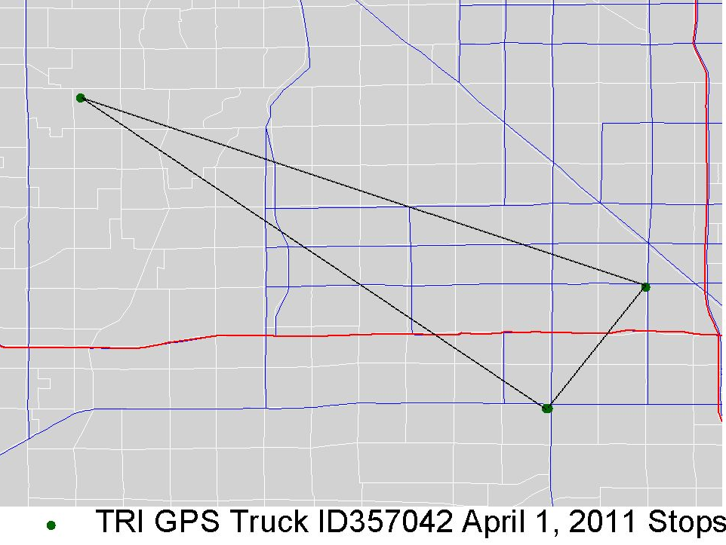
Truck GPS Data from Phoenix Processing of One Truck on April 1, 2011
Processed One Truck | April 1, 2011
Truck Trip Ends | 3
Truck Tours | 1
Trucks | 1
ATRI GPS Truck ID 357402 - April 1, 2011 – Actual Stops
Notes:
Stops on a tour occur at those transitions between stopped and moving.

Slide 11
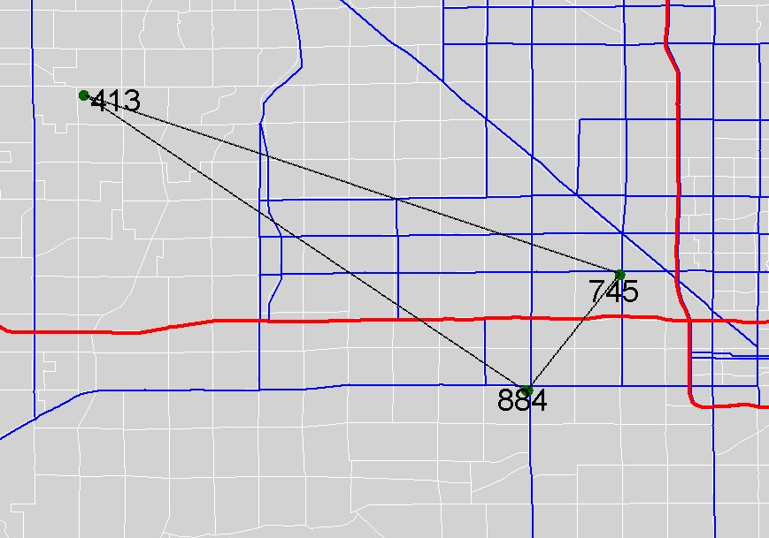
Truck GPS Data from Phoenix TAZ of Trip Ends for One Truck on April 1, 2011
Processed One Truck | April 1, 2011
Truck Trip Ends | 3
Truck Tours | 1
Trucks | 1
Notes:
These locations fall inside TAZs

Slide 12
Truck GPS Data from Phoenix LU of Trip Ends for One Truck on April 1, 2011
Processed One Truck | April 1, 2011
Truck Trip Ends | 3
Truck Tours | 1
Trucks | 1
Industrial
Landfill, Sand & Gravel
Industrial
Notes:
These locations fall within land use polygons.

Slide 13
Trip- and Tour-Based Truck Models
Truck Trip Ends (7 trips, 6 LU)
Truck Tours (2 tours, 6 LU)
Stop 1 (Warehouse)
Stop 2 (Retail)
Stop 3 (Household)
Stop 4 (Home Base)
Stop 5 (Retail)
Stop 6 (Retail)
Destination (Home Base)
Origin (Truck Home Base)
Origin/ Destination
Stop 1 (Warehouse)
Stop 2 (Retail)
Stop 3 (Household)
Origin/ Destination
Stop 5 (Retail)
Stop 6 (Retail)
Notes:
What you are trying to define in travel demand forecasting is trips , separately…or as organized into tours. The problem is getting enough data to develop models of these trips and tours. For trucks we believe that GPS data does that

Slide 14
Truck Tour-Based Model Structure
Tour Generation
Stop Generation
One of 10 stop types
Stop Location
Heavy truck tour rates by industry type
Stop Purpose
1 stop
Tour Completion
Yes – return to home base
No – does not return
Stop TOD Choice
2 stops
……..
11 stops
One of 3,000 TAZs
1st Stop TOD (24 1-hr periods)
Next Stop TOD (24 1-hr periods)
Retail
Constr.
Farming
Resid.
Govt.
Warehs.
Transp.
Office
Industrial
Service

Slide 15
Stop Generation Model Predicts number of stops on each truck tour
Available Set of Choices
Decision Making Variables
Starting LU of the tour
Employment and households at starting TAZ
Accessibility to employment
1 to 11 Stops
1 Stop
2 Stops
3 Stops
……
11 Stops
Model Structure = MNL
Outputs = Number of stops made on tour (any value between 1 & 11)

Slide 16
Tour Completion Model Predicts if truck returns to home base
Available Set of Choices
Decision Making Variables
No of stops by industry type
Total employment in starting TAZ
Employment by industry type
Tour complete or not
Yes
No
Model Structure = Binary Logit
Outputs = Tour is complete or not

Slide 17
Stop Purpose Model Predicts purpose of stop
Available Set of Choices
Decision Making Variables
Previous purpose type
Accessibility to employment
No of stops on tour
Tour purpose type
Log (1 + stop sequence no.)
1 of 10 Stop Types
Retail
Constr.
Farming
Resid.
Govt.
Warehs.
Transp.
Office
Industrial
Service
Model Structure = MNL
Outputs = One of 10 stop purpose types

Slide 18
Stop Location Model Predicts location TAZ of each stop
Available Set of Choices
Decision Making Variables
Travel time between stops
No of stops by type and Employment by type
Accessibility to employment
TAZ 1 to 3,000
TAZ 1
TAZ 2
TAZ 3
……
TAZ 3000
Model Structure = MNL
Outputs = Location TAZ of each stop

Slide 19
Stop TOD Choice Model Predicts TOD of each stop
Available Set of Choices
Decision Making Variables
Indicator for tour completion
Travel time between stops
No of stops on tour
Departure shift variable
Time / No of stops remaining
1 of 24 hours
12-1 am
1-2 am
……
11 pm – 12 am
Model Structure = MNL
Outputs = One of 24 hour intervals

Slide 20
Initial Findings

Slide 21
Next Steps
Perform more rigorous model calibration and validation
Determine adequacy of GPS data both in terms of sample sizes and biases
Implement truck tour model and compare with trip-based model applications
Acquire GPS data for medium trucks and develop a medium truck tour model

Slide 22
Conclusions
Truck model parameters are difficult and expensive to obtain by surveys
Truck GPS data is cost-effective to obtain large volume of information from trucks
Truck tour-based models require large samples by industry type
Tour-based models capture trip chaining patterns of trucks by type

