Slide 1
NCHRP 8-84/Report 735: Long-Distance and Rural Transferable Parameters for Statewide Travel Forecasting Models
presented to 13th TRB National Transportation Planning Applications Conference
Presented by
Robert G. Schiffer, AICP
Cambridge Systematics, Inc.
May 6, 2013
Transportation leadership you can trust.

Slide 2
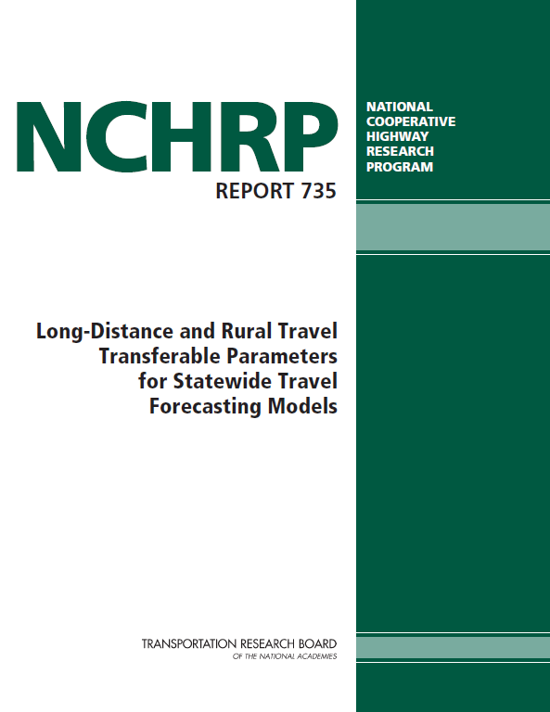
Presentation Outline
Overview of project
Background
Objectives
Differences in rural and long-distance travel
Statewide model statistics on rural and long-distance travel

Slide 3
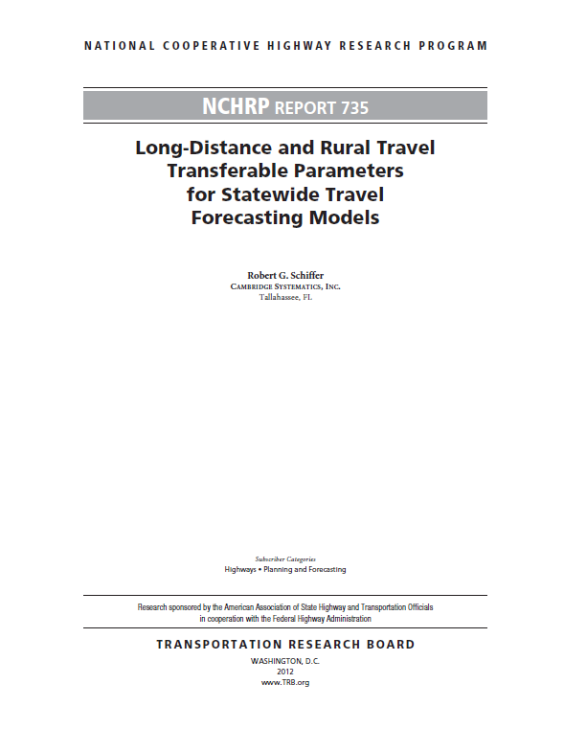
Presentation Outline (continued)
Transferability of rural and long-distance model parameters
Consideration of other trip characteristics
Process for developing model parameters
Study findings
Long-distance travel data… where do we go from here?

Slide 4
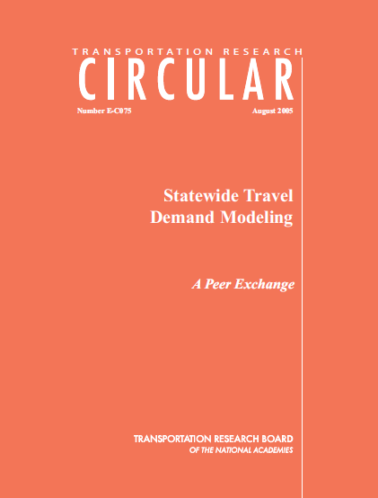
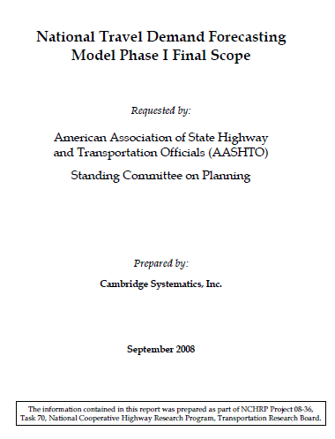
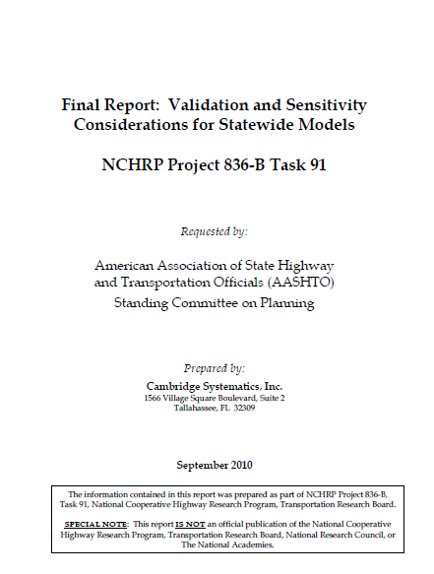
Overview of Project Background
NCHRP 8-84: Rural/LD Parameters
Statewide Model Peer Exchange
September 2004, in Longboat Key, Florida
SWM information exchange
Identification of problem statements for future funding
Transportation Research Circular
Funded problem statements
National model scoping project
Validation and sensitivity considerations for statewide models
Rural and long-distance travel parameters

Slide 5
NCHRP 8-84: Differences in Rural and Long-Distance Travel versus Urban Trips
Rural/long-distance trips have small impact on most* urban models, but have great impact on statewide, multi-state, and national models
* However, long-distance and rural travelers can have a significant impact on regional models where
Tourists/visitors are a large percentage of travelers, OR
Regional models contain large amounts of rural territory
While the greatest percent of trips occurs within urban model geography, percent of miles extends way beyond
Vehicle Trips and VMT by Trip Length

Slide 6
NCHRP 8-84: Differences in Rural and Long-Distance Travel versus Urban Trips (continued)
Long-distance travel surveys
1995 ATS + 2001 NHTS
Statewide household surveys
Recent GPS HHTS data collection
Ohio Long-Distance Travel Survey:
Long-Distance Travel Mode
Michigan Travel Counts: Long-Distance Trip Purpose
Michigan Travel Counts: Long-Distance Travel Mode

Slide 7
NCHRP 8-84: Differences in Rural and Long-Distance Travel versus Urban Trips (continued)
Rural travel surveys
2009 NHTS
Statewide household surveys
Recent GPS HHTS data collection
Item | Rural Samplesª
All Rural (National) | 43,583
New England | 1,560
Mid-Atlantic | 5,721
East North Central | 2,355
West North Central | 2,684
South Atlantic | 19,293
East South Central | 1,570
West South Central | 6,228
Mountain | 1,727
Pacific | 2,445
VMT per Person for Urban and Rural Households by Census Division
NHTS 2009 Sample of Rural Households
ª Includes add-on samples.

Slide 8
Project Overview: Rural/LD Travel Parameters Objectives
NCHRP 8-84 focused on documenting, obtaining, and analyzing available data on rural and long-distance trips
Long-distance travel surveys
1995 American Travel Survey (ATS)
2001 National Household Travel Survey (NHTS) (includes large sample of long-distance trips)
Statewide household surveys (Michigan, Ohio, Oregon)
Recent GPS HHTS data collection (Denver, Atlanta, Chicago, Massachusetts)
Tourism surveys (Florida, Hawaii, Oregon)
National and state park surveys

Slide 9
Project Overview: Rural/LD Travel Parameters Objectives (continued)
Rural travel surveys
2009 NHTS
Statewide household surveys
Recent GPS HHTS data collection
Parameter Summary | 1995 ATS More Than 100 Miles | 2001 NHTS More Than 100 Milesª
Percent of Trips by Mode
Private Vehicle | 78.51 | 87.13
Air | 18.02 | 9.23
Other | 3.47 | 3.64
Percent of Trips by Purpose
Business and Bus/Pleasure | 22.42 | 25.69
Visit Friends/Relatives | 32.58 | 26.31
Leisure | 30.53 | 26.21
Personal/Family or Medical | 11.93 | 9.56
Other | 2.54 | 12.22
Overall Mean Trip Length in Miles (One-Way All Modes)^{b} | 411.88 | 457.57
Mean Trip Length – Air | 1,003.21 | 2,088.78^{c}
Mean Trip Length – Private Vehicle | 276.53 | 301.54
Mean Trip Length – All Other | 404.02 | 482.02
Mean Trip Length by Purpose in Miles (One-Way All Modes)
Business and Bus/Pleasure | 467.89 | 480.93
Visit Friends/Relatives | 398.77 | 478.60
Leisure | 406.70 | 516.44
Personal/Family or Medical | 376.05 | 409.80
Other | 316.03 | 276.28
Overall Travel Party Size (All Modes) | 3.10 | N/A
Travel Party Size – Air | 2.98 | N/A
Travel Party Size – Private Vehicle | 2.42 | N/A
Travel Party Size – All Other | 9.34 | N/A
Travel Party Size by Purpose
Business and Bus/Pleasure | 2.12 | N/A
Visit Friends/Relatives | 2.81 | N/A
Leisure | 3.93 | N/A
Personal/Family or Medical | 2.91 | N/A
Other | 6.34 | N/A
Preliminary Comparative Statistics from ATS and NHTS
ª NHTS 2001 includes trips of 50 miles and more. For this analysis only trips of 100 miles and longer one-way were included.
^{b} 1995 ATS “Round-Trip Distance” was divided in half to provide one-way estimates.
^{c} NHTS Trip Distance includes extreme values. Trip length was capped at the 99th percentile (5,252.18 miles).

Slide 10
Statewide Model Statistics on Rural/LD Travel
Average Trip Length of Long-Distance Trips in Statewide Models
SWM statistics on rural and long-distance travel
Fill data gaps
Identify long-distance trip thresholds used
Assess reasonableness of survey analysis
 | Average Trip Length
 | By Purpose (Minutes or Miles)ª |  |  | Total | Total
 | Business | Tourist | Other | Minutes | Miles
Arizona (Passenger) | – | – | – | 213 | 206
Arizona (Truck) | – | – | – | 228 | 257
Florida | – | – | – | 127 | –
Georgia | – | – | – | 131 | –
Indiana | – | – | – | 121 | –
Louisiana | – | – | – | 168 | –
Ohio |  |  |  |  | 146
Texas (Miles) | 200 | – | 199 | – | 200
Utah | 89 | – | 81 | 85 | –
Virginia (Interstate) | 284 | 308 | 318 | 303 | –
Virginia (Intrastate) | 127 | 124 | 126 | 126 | 136
ª Listed in minutes unless indicated otherwise.
Auto Occupancy Rates in Statewide Models
 | Auto Occupancy Rates
 | By Purpose (Minutes or Miles)
 | Business | Tourist | Other | Average
California | – | – | – | 1.34
Florida | 1.10 | 2.60 |  | 1.85
Indiana | – | – | – | 3.06
Louisiana | 1.86 | 3.44 | 2.64 | 2.65
Mississippi (Interstate) | 1.39 | 2.55 | 2.05 | 2.00
Mississippi (Intrastate) | 1.50 | 2.55 | 2.26 | 2.10
Utah | 1.33 | – | 2.06 | 1.70
Virginia | 1.82 | 2.69 | 2.69 | 1.82

Slide 11
Transferability of Rural/LD Parameters
Conditions conducive to transferability
Population densities
Median income
Available transportation modes
Key employment types/industries
Proximity to tourist destinations
Source of model parameters relative to where being used
Travel Parameters for Urban and Rural Households by Census Division – 2009 NHTS
Source: Author’s analysis of 2009 NHTS. Includes travel on weekends and holidays.
 | Person Trips per Person |  | Average Vehicle Trip Length (Miles) |  | VMT per Household |  | VMT per Person
 | Urban | Rural | Urban | Rural | Urban | Rural | Urban | Rural
All | 3.8 | 3.6 | 8.0 | 12.0 | 43.5 | 72.1 | 17.6 | 27.4
New England | 3.8 | 3.9 | 9.0 | 11.7 | 47.7 | 79.5 | 19.9 | 29.8
Mid-Atlantic | 3.8 | 3.7 | 7.7 | 11.6 | 35.6 | 70.9 | 14.3 | 26.9
East North Central | 4.0 | 3.6 | 7.7 | 11.8 | 43.2 | 75.9 | 18.3 | 28.6
West North Central | 4.1 | 3.6 | 8.2 | 10.6 | 48.3 | 63.2 | 21.5 | 25.3
South Atlantic | 3.7 | 3.6 | 8.3 | 12.6 | 44.4 | 72.0 | 18.5 | 27.8
East South Central | 3.8 | 3.4 | 8.7 | 13.3 | 46.7 | 75.0 | 20.7 | 29.1
West South Central | 3.8 | 3.7 | 8.2 | 12.3 | 47.0 | 72.6 | 18.6 | 26.3
Mountain | 4.0 | 3.8 | 7.6 | 12.0 | 46.0 | 76.6 | 18.3 | 28.5
Pacific | 3.8 | 3.7 | 7.4 | 10.6 | 42.1 | 64.6 | 15.6 | 24.1
VMT per Person for Urban and Rural Households by Census Division

Slide 12
Transferability of Rural/LD Parameters (continued)
Parameters considered for transferability
Daily rural trip rates per HH by rural trip purpose
Annual long-distance trips per HH by long-distance trip types/purposes
Friction factors for rural and long-distance purposes
Auto occupancy rates by rural trip purposes
Party size by long-distance types/purposes
2001 Long-Distance Trips by Purpose and Mode
 |  | Percent Trips by Mode
LD Purpose | Percent by Purpose | Personal Vehicle | Air | Bus | Train | Other
Pleasure | 55.5% | 90.4% | 6.7% | 2.2% | 0.5% | 0.2%
Business | 15.9% | 79.3% | 17.8% | 0.8% | 1.6% | 0.5%
Commuting | 12.6% | 96.4% | 1.5% | 0.5% | 1.7% | 0.0%
Personal Business | 12.6% | 89.3% | 4.7% | 5.6% | 0.3% | 0.1%
Other | 3.4% | 96.6% | 1.9% | 0.5% | 0.0% | 1.0%
Total | 100.0% | 89.5% | 7.4% | 2.1% | 0.8% | 0.2%

Slide 13
Transferability of Rural/LD Parameters (continued)
Reasonableness values/benchmarks
Percentage rural trips by purposes
Percentage long-distance trips by types
Average trip length by modes and rural trip purposes
Average trip length by modes and LD trip type
Percentage of rural and LD trips by modes and travel distances
2001 Long-Distance Trips by Trip Distance
Distance | Trips
50-499 Miles | 90.0%
500-900 Miles | 5.0%
More Than 1,000 Miles | 5.0%

Slide 14
Consideration of Other Rural/ LD Trip Characteristics
Temporal analysis considerations
Seasonal variations
Daily, monthly, or annually (for long-distance trips)
AADT (includes weekends) versus PSWADT (excludes weekends)
Time-of-day
2001 Long-Distance Trips by Geography and Mode
 | Personal Vehicle | Air | Other Modes
Urban | 87.0% | 9.0% | 4.0%
Rural | 95.0% | 3.0% | 2.0%

Slide 15
Consideration of Other Rural/LD Trip Characteristics (continued)
Other aspects of trip definition
Person versus vehicle
Per capita versus household
Long-distance thresholds
Dealing with intermediate stops
Tours versus trips
2001 Long-Distance Trips by Income and Mode
Income | Personal Vehicle | Air | Other Modesª
Less Than $75,000 | 91.0% | 5.0% | 4.0%
More Than $75,000 | 84.0% | 14.0% | 2.0%
ªIncome ranges of less than $25,000 and more than $25,000 were used for other mode/bus trips.

Slide 16
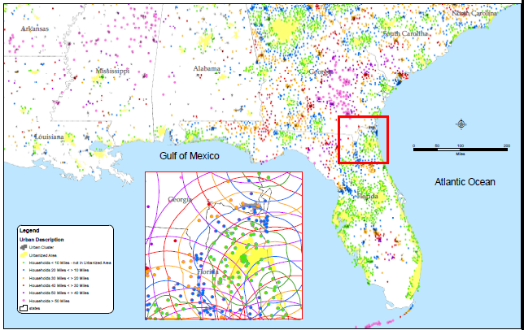
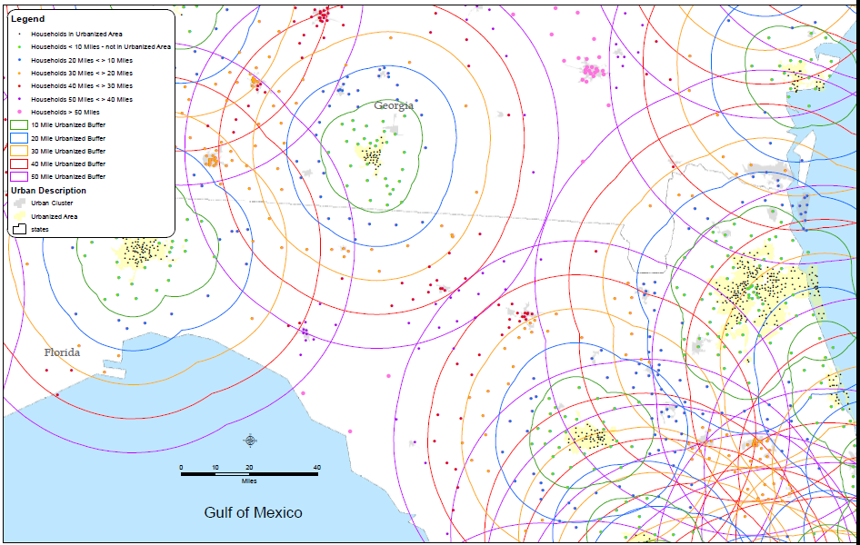
Process for Developing Rural/LD Parameters
Process for developing transferable parameters
Comparisons – rural versus urban versus long-distance
Typologies – household characteristics, density, proximity, purpose/type, length of trip
Geographies – proximity to urbanized areas, small urban versus agrarian, tourist, etc.
Time periods – weekday versus weekend, daily versus annual

Slide 17
Process for Developing Rural/LD Parameters (continued)
Limitations of datasets – ATS, NHTS 2001, NHTS 2009, Michigan, Ohio, GPS surveys
Minimum amount of local data required – comparisons against statistics from statewide models, local surveys
Commute by Transportation Mode: 2006 Canadian Census

Slide 18
Study Findings… Some Might Be Obvious
Long-distance trip rates are generally consistent among different databases. Pleasure trip rates land in the middle
Long-distance trips are generally longer for business travel, and shortest for personal business travel
Auto occupancy rates are considerably higher for long-distance trips than for urban or rural travel
Auto is the primary mode for long-distance trips, especially within a 300-mile range. Air travel begins to increase significantly for distances over 300 miles

Slide 19
Study Findings (continued)
Rural trip rates vary somewhat among different sources: statewide HH survey trip rates (e.g., Ohio, Michigan) are generally lower than 2009 NHTS trip rates
Rural trip rates are generally lower than suburban area trip rates, but otherwise do not vary much from urban trip rates
Rural work trips are a smaller percentage than those in most urban settings
Auto occupancy rates for rural areas are generally higher than for small-to-medium-sized urbanized areas, but lower than for the largest metropolitan areas

Slide 20
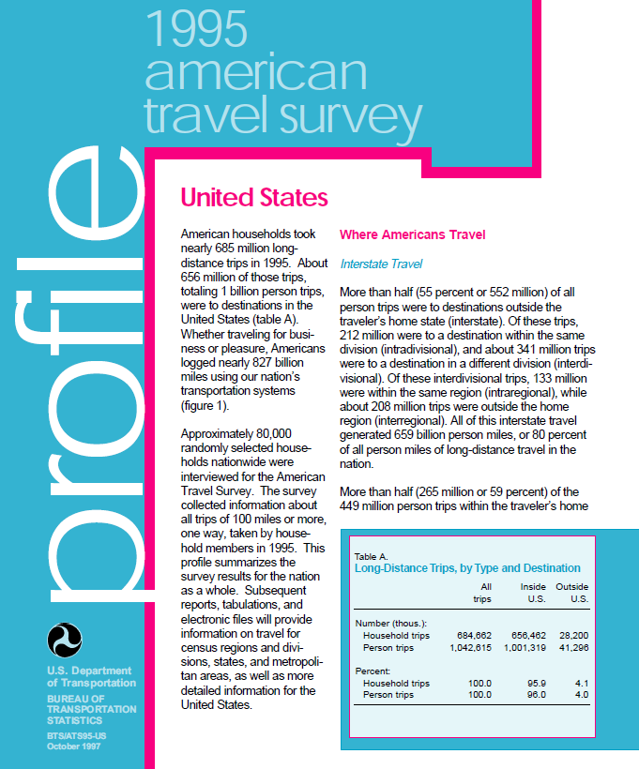
Long-Distance Travel Data Where Do We Go From Here? What’s Out There Now?
1995 American Travel Survey (ATS)
116,000 individuals
556,000 trips
Trips > 100 miles

Slide 21
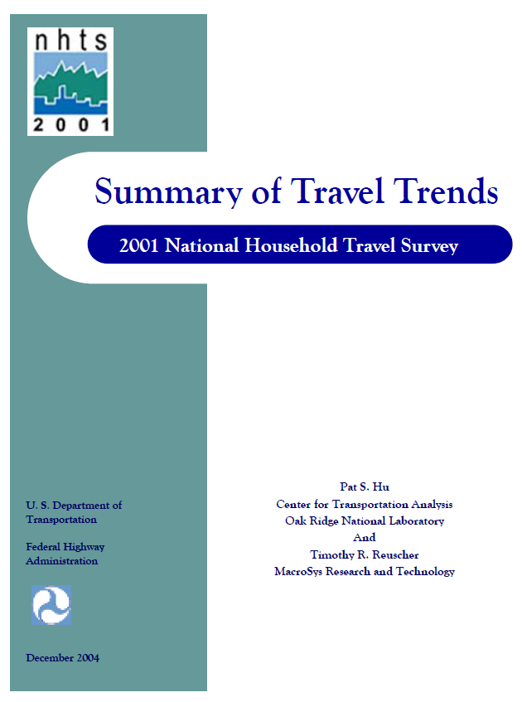
Long-Distance Travel Data Where Do We Go From Here? What’s Out There Now? (continued)
2001 National Household Travel Survey (NHTS)
Included long-distance sample of 60,000 individuals
124,000 trips
New York and Wisconsin also purchased long-distance add-on samples
Trips > 50 miles

Slide 22
Long-Distance Travel Data What Are the Limitations of Currently Available Data?
1995 American Travel Survey (ATS)
Age of data
2001 National Household Travel Survey (NHTS)
Age of data, although less than for 1995 ATS
Smaller sample than 1995 ATS
Use of different mileage threshold than 1995 ATS
Impacts of 9/11 on long-distance travel patterns
2009 NHTS did not include a long-distance sample!
POV Air
Source: 1995 ATS and 2001 NHTS (post-9/11) trips of 100 miles or more, one-way, POV plus air only. Courtesy of Nancy McGuckin.

Slide 23
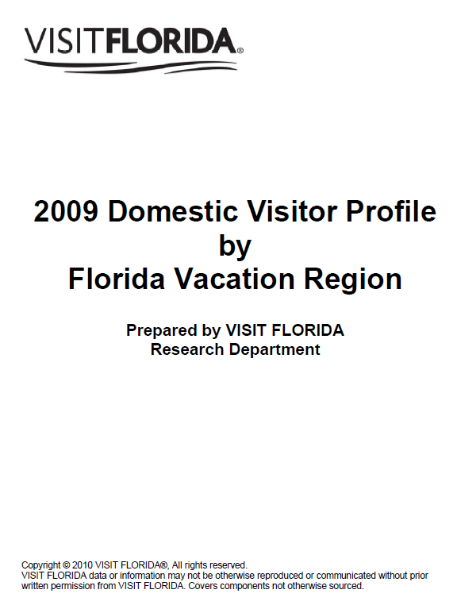
Long-Distance Travel Data What Are the Limitations of Currently Available Data? (continued)
Other data sets
Statewide surveys – largely limited to states where data collected OR possibly states of a similar nature
Recent GPS surveys – long-distance sample somewhat limited
Tourism surveys – not household travel diaries, sampling concerns
National and state park surveys – not household travel diaries
Proprietary data – cost, sampling, not household travel diaries

Slide 24
Long-Distance Travel Data What Are the Data Needs?
We need something more recent than 1995 and 2001 datasets
A full national sample, including those NOT making long-distance trips
Potentially include 50- to 99-mile trips, as well as 100+-mile trips
Include data on auto occupancy, in addition to party size
Source: McGuckin’s analysis of 2001 NHTS Long-Distance, one-way distance.

Slide 25
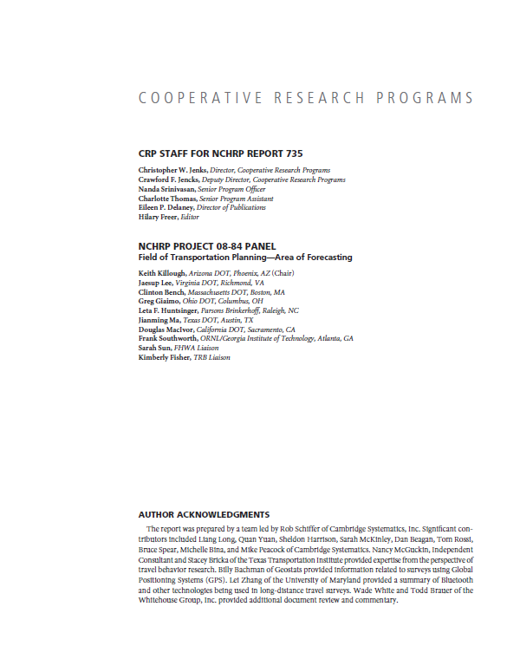
Long-Distance Travel Data What Are the Data Needs? (continued)
Uses of new long-distance travel data
National travel demand model
Statewide travel demand models
Planning for megaregions
High-speed rail and other intercity rail
Regional models and studies in high-tourist locations

Slide 26
Long-Distance Travel Data Where Do We Go From Here?
American Long-Distance Personal Travel Data and Modeling Program identified
FHWA Exploratory Advanced Research Program
Design of a completely new approach for a national household-based long-distance travel survey instrument underway
Better sampling techniques
Use of new technology
Alternative Roadmaps Toward a National Travel Demand Models
Available Data Sources
A. Base-Year Multimodal OD Matrix
B. Aggregate Direct Demand Model
C. Disaggregate Models of Travel Behavior
D. Extensive New Data Collection for Analyzing Behavioral Dynamics
E. Hybrid Aggregate-Disaggregate Demand Model
F. Trip-Based
Four-Step Travel Demand Model
C. Disaggregate Models of Travel Behavior
C. Disaggregate Models of Travel Behavior
Source: A Review of Methodologies and Their Applicability to National-Level Passenger Travel Analysis in the U.S., Lei Zhang, University of Maryland. Part of American LDPT Roadmap documentation.

Slide 27
Contact Information
Nanda Srinivasan, Senior Program Officer National Cooperative Highway Research Program Transportation Research Board of the National Academies 500 Fifth Street, NW Washington, DC 20001 202-334-1896 nsrinivasan@nas.edu
Rob Schiffer, Principal
Cambridge Systematics, Inc. 1566 Village Square Boulevard, Suite 2
Tallahassee, FL 32309 850-219-6388
rschiffer@camsys.com

Slide 28
Transferable Model Parameters: NCHRP 8-84/Report 735
Questions?

