Slide 1
Cost Effectiveness Methods for Safety Investment Decision-Making
Transportation Research Board
Applications Conference – May 7, 2013
Daniel Wu
Transportation Analyst
Cambridge Systematics
Notes:
Good Morning,
I’m Daniel Wu with Cambridge Systematics. I am a part of the team that developed the cost-effectiveness methods for safety investment decision making. We developed these methods as part of an National Cooperative Highway Research Program (NCHRP) project for a comprehensive framework for safety investment decisions.

Slide 2
Overview
Project Purpose and Background
Two Methods for Cost-Effectiveness Analysis
  Quantitative Method
  Sketch Level Method
Application of the Sketch Level Method
Challenges and Opportunities
Notes:
This is a brief overview of my presentation.
I’ll start off by describing the project purpose and provide some background on the impetus for this project.
Afterwards, I’ll describe two cost-effectiveness methods developed as a part of the framework for safety investment decisions: The quantitative method and the sketch level method.
I will hone in on the sketch level method and walk through an application of the method to a group engineering and behavioral projects to simulate how these projects could be prioritized.
Afterwards, I’ll present the challenges in applying this method and some of the additional research opportunities that can advance the field of project cost-effectiveness comparison. There are additional opportunities for reseach in our method, but it’s a first step in comparing cost-effectiveness across the 4E’s.

Slide 3
Purpose of the Project
Public agencies focus on cost-effective investments.
Roadway safety has four types of strategies (Es).
Historically, agencies compared cost-effectiveness in each strategy.
Education
Engineering
Enforcement
Emergency
Notes:
Purpose of the Project
When faced with budget constraints, public agencies focus resources on cost-effective investments.
Typically, the safety community addresses safety issues from a 4 E perspective: education, engineering, enforcement, and emergency service.
Until recently, safety fundings and disciplines were silo-ed. For example, state DOTs often compare cost effective metrics (i.e. benefit cost ratios) for engineering countermeasures funded through the Federal Highway Safety Improvement Program (HSIP).

Slide 4
MAP-21 Encourages Prioritization Across the 4Es
SAFETEA-LU capped flexible HSIP funds at 10 percent.
MAP-21 removes the 10 percent cap.
Projects consistent with the state’s SHSP are eligible.
MAP-21 incentivizes states to prioritize projects across the 4Es.
Education
Engineering
Enforcement
Emergency
Engineering
Education
Enforcement
Emergency
Notes:
Under SAFETEA-LU, states with Strategic Highway Safety Plans have the flexibility to use up to 10 percent of their HSIP funds for behavioral and other safety projects if these projects meet infrastructure and safety needs outlined in their State’s Strategic Highway Safety Plans.
MAP-21 removed the 10 percent cap on flexible funding and expanded highway safety improvement projects such that “HSIP funds can be used for both infrastructure and non-infrastructure highway safety improvement projects that are consistent with the State’s Strategic Highway Safety Plan.”
By the way, States and MPOs are also required to match their LRTP to their Strategic Highway Safety Plan.
This underlines the need for cost effectiveness analysis across the four strategies in order to prioritize safety projects for HSIP funds. This presentation details this first attempt at prioritizing investments across the 4E’s.

Slide 5
Two Methods for Cost-Effectiveness Analysis
Compare Countermeasure Cost-Effectiveness
Quantitative Method
Sketch-Level Method
Notes:
As a part of the (NCHRP) 17-46, we built a conceptual framework for better integrating cost-effectiveness into safety investment decision-making processes across federal, state, and local governments.
This framework provides two methods for comparing the cost-effectiveness of safety countermeasures: a quantitative process and a sketch level process.

Slide 6
Quantitative Method
Safety Countermeasure
Benefits
Costs
B-C Ratio
(Rounded)
Speed Enforcement
264
$0.7 Mil
Pedestrian Median Extensions
$13 Mil
65
$0.2 Mil
Poster at the TRB Annual Conference (January, 2013):
  http://eprints.qut.edu.au/56878/
  http://pressamp.trb.org/aminteractiveprogram/EventDetails.aspx?ID=26403
Notes:
The quantitative method is appropriate when detailed, quantitative results are desired and sufficient basis exists to make quantitative assumptions for all variables in the analysis, including crash modification factors, duration of effectiveness, geographic extent of effectiveness, costs, and so forth.
This method can be conducted in the form of a benefits-cost analysis (as shown in this example) or a cost-effectiveness analysis.
Explain a benefit-cost ratio. An indication of the benefits in dollars for every dollar spent in countermeasure investments. Explain the calculation very quickly.
To calculate benefits, you need crash modification factors, the number of impacted crashes and the duration of effectiveness.
Then you divide that amount by the total cost over project life.
Challenges with the quantitative method:
Time and information intensive analysis as practitioners must establish numerous assumptions to compare costs and benefits over time.
In some cases, these information are not available. For example, there might not be CMFs for a particular countermeasure type.
Sensitivity analysis is critical to show how results vary with different assumptions
CS and Simon Washington of the Queensland University of Technology presented the quantitative method at the TRB Annual Meeting in January 2013. More information are available at the links.
The focus of this presentation is on the sketch-level Method.

Slide 7
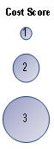
Sketch Level Prioritization Method
Problem Score
Tier 1
Tier 2
4
Lower
Higher
Higher
Effectiveness
Effectiveness
–
Addresses
Larger
Addresses
Larger
Problems
Problems
3
Tier 3
Tier 4
2
Higher
Lower
Lower
Effectiveness
–
Effectiveness
–
Addresses
Addresses
Smaller Problems
Smaller Problems
1
4
3
2
1
Effectiveness Score
Notes:
The sketch-level method is appropriate when quantitative information is unavailable or when detailed results are not required (which in many cases are information or time intensive). The sketch method relies on three scores developed through reference to quantitative and qualitative information.
(Click through animation on the slide)
Effectiveness score that indicates the relative effectiveness of the countermeasure.
Problem score indicating the relative size of the target crash population potentially affected by the countermeasure.
Cost score indicating the annualized cost of the countermeasure relative to other measures.
The three scores can be used to graphically illustrate relative countermeasure costs, effectiveness, and potential impact, and then group countermeasures into tiers by relative priority.
There are four tiers:
Tier 1 – high effectiveness countermeasures that address larger problems.
Tier 2 – high effectiveness counteremeasures that address smaller problems.
Tier 3 – lower effectivneess countermeasures that address larger problems.
Tier 4 – lower effectiveness countermeasures that address smaller problems.

Slide 8
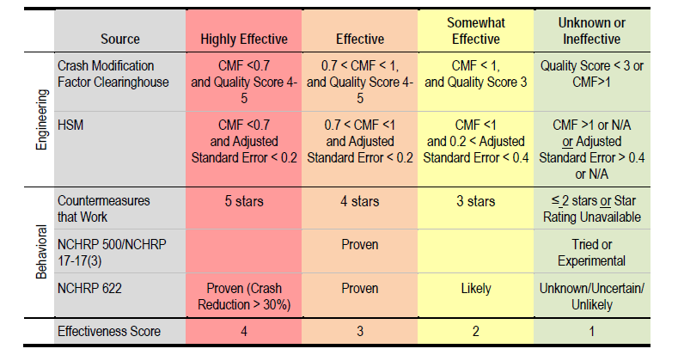
Sketch Method - Select Effectiveness Score
Notes:
In applying the sketch method, the first step is to assign a score of one to four (four being the most effective) to represent the potential effectiveness of the countermeasure. The process for assigning a score involves looking up effectiveness information in the national safety research literature (as shown in left column) and assigning a score based on the countermeasure’s effectiveness and the study qualities behind these effectiveness
Walk through two examples here:
Crash modification factor clearinghouse.
Countermeasures that work.

Slide 9
Sketch Level Prioritization Method
Problem Score
4
3
2
1
4
3
2
1
Effectiveness Score
Notes:
The sketch-level method is appropriate when quantitative information is unavailable or when detailed results are not required (which in many cases are information or time intensive). The sketch method relies on three scores developed through reference to quantitative and qualitative information.
(Click through animation on the slide)
Effectiveness score that indicates the relative effectiveness of the countermeasure.
Problem score indicating the relative size of the target crash population potentially affected by the countermeasure.
Cost score indicating the annualized cost of the countermeasure relative to other measures.
The three scores can be used to graphically illustrate relative countermeasure costs, effectiveness, and potential impact, and then group countermeasures into tiers by relative priority.
There are four tiers:
Tier 1 – high effectiveness countermeasures that address larger problems.
Tier 2 – high effectiveness counteremeasures that address smaller problems.
Tier 3 – lower effectivneess countermeasures that address larger problems.
Tier 4 – lower effectiveness countermeasures that address smaller problems.

Slide 10
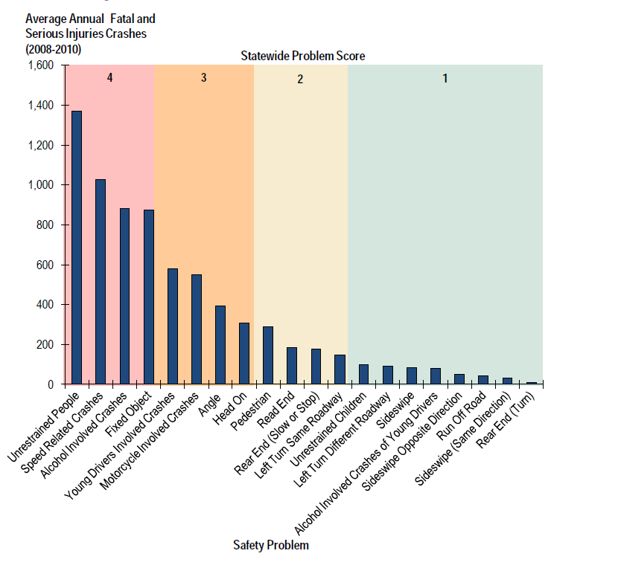
Set Statewide Problem Score
More Severe
Less Severe
Notes:
The next step examines the relative magnitude of safety problems targeted by a project (the problem score). The problem score is determined using a top-down method that first identifies the type of safety problem the project would address, and then scores the significance of that safety problem on a statewide level. This method assumes that practitioners are interested in looking strategically at statewide safety problems and prioritizing projects based on whether they address significant statewide safety problems.
To determine the significance of a particular safety problem statewide, this analysis examined the average annual number of fatal and serious injuries (K&A) crashes. In this example, from 2008 to 2010 in North Carolina; it is shown as the vertical bars in this figure. A safety problem is assigned a subjective statewide problem score from one to four as indicated at the top of the figure; one being the safety problem with the lowest number of fatal and serious injuries. Again, all of these crashes are severe in nature, we are simply comparing the number of crashes on a statewide level.
For example, if a countermeasure targeted unrestrained people, the problem score would be 4. Whereas a countermeasure that only targets rear end crashes would receive a score of 2.
Note that the thresholds for the statewide problem score categories are based on natural breaks in the data and are subject to individual judgment.

Slide 11
Sketch Level Prioritization Method
Problem Score
4
3
2
1
4
3
2
1
Effectiveness Score
Notes:
The sketch-level method is appropriate when quantitative information is unavailable or when detailed results are not required (which in many cases are information or time intensive). The sketch method relies on three scores developed through reference to quantitative and qualitative information.
(Click through animation on the slide)
Effectiveness score that indicates the relative effectiveness of the countermeasure.
Problem score indicating the relative size of the target crash population potentially affected by the countermeasure.
Cost score indicating the annualized cost of the countermeasure relative to other measures.
The three scores can be used to graphically illustrate relative countermeasure costs, effectiveness, and potential impact, and then group countermeasures into tiers by relative priority.
There are four tiers:
Tier 1 – high effectiveness countermeasures that address larger problems.
Tier 2 – high effectiveness counteremeasures that address smaller problems.
Tier 3 – lower effectivneess countermeasures that address larger problems.
Tier 4 – lower effectiveness countermeasures that address smaller problems.

Slide 12
Set Annualized Cost Score
Define the duration of countermeasure effectiveness
Divide the total cost by the duration to estimate annualized cost
Score countermeasures (1-3) on their relative annualized cost
Project Description | Total Cost | Duration of Effectiveness | Annualized Cost
Conduct motorcycle safety checkpoints | $29,000 | 1 | $29,000
Install shoulder guard rail | $1,200,000 | 10 | $120,000
Child protection safety training and outreach | $564,000 | 1 | $564,000
1
2
3
Notes:
The third step is to set annualized cost score.
1) Calculating annualized costs requires an assumption regarding the length of time the countermeasure will be effective. However, research on the duration of effectiveness for countermeasures is very limited, especially for behavioral safety measures. In most cases. During our application of the sketch method, it was necessary to assume behavioral countermeasures are effective only while funded, and engineering countermeasures are effective for the useful life of the infrastructure.
2) The cost score is relative to other countermeasures. This is determined by calculating an annualized cost for each measure and grouping measures together into cost score categories (one to three).

Slide 13
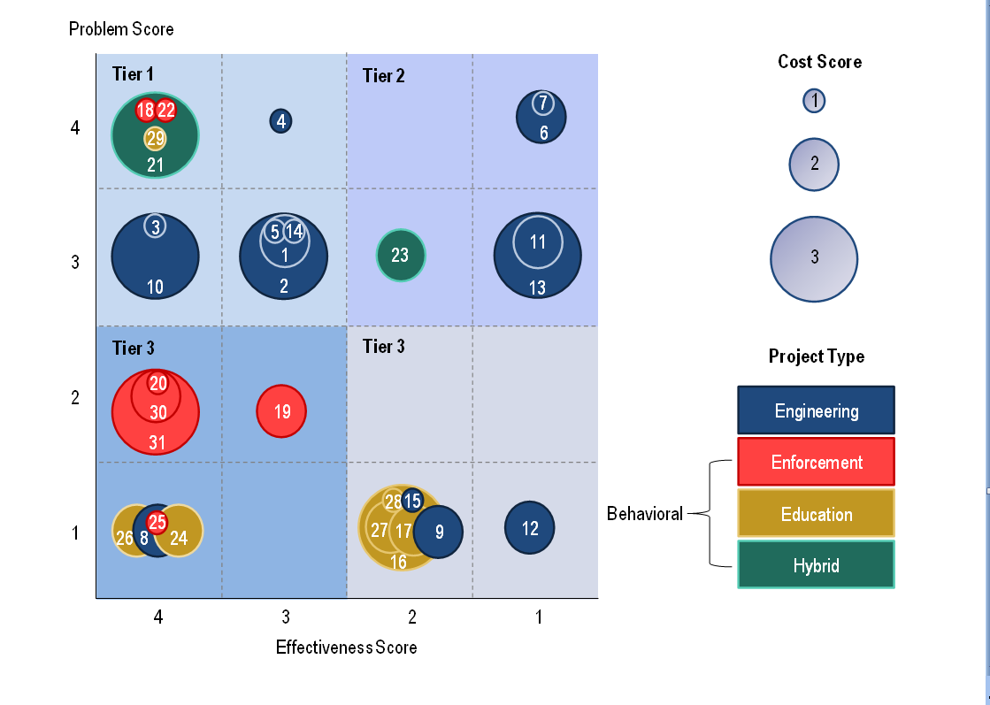
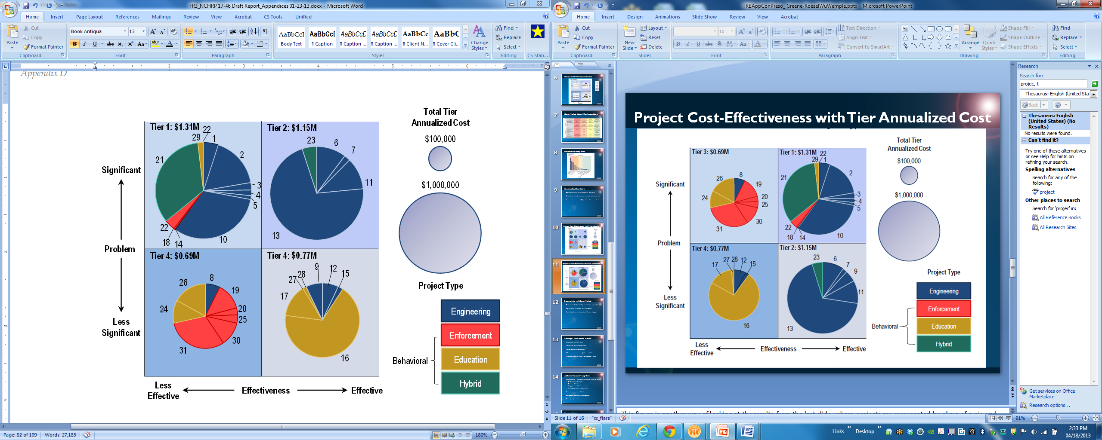
Project Cost-Effectiveness with Prioritization Tiers
Notes:
This slide illustrates the sketch level method results from North Carolina. We applied the method to thirty one projects (each represented by a numbered circle) and placed them into the four tiers. Projects are color-coded by type, with engineering projects represented in blue, enforcement in red, education in yellow, and hybrid projects in green. (What are hybrid projects: alcohol prevention outreach and enforcement..)
Some examples of Tier 1 projects include the following:
Roundabout installation in place of existing intersection (4);
Raised median and pedestrian improvements (1);
Local traffic safety enforcement (seatbelt, speed, and child safety seat (18); and
A BAT mobile unit program (alcohol checkpoints and outreach) (21);
Examples of Tier 2 projects:
Left-turn lane and pavement friction treatment (7);
Install shoulder rumble strips (13); and
Underage alcohol prevention, outreach, and enforcement (23)
Examples of Tier 3 projects:
Widen roadway for a third travel lane (8);
Purchase motorcycles for training and expand motorcycle safety training facility (20); and
Technology purchase to improve enforcement (radars, cameras, and trackers) (31).
Examples of Tier 4 projects:
Realign routes for continuous movement (15);
Child protection safety training and outreach (16); and
Special needs seat distribution and conference/‌state fair outreach (17).
Relative project costs do not affect the tier, but can be seen graphically. Projects with higher annualized costs are represented by a larger circle (cost score of 3), and less costly projects by a smaller circle. The practitioner could visually decide whether to prioritize projects with lower annual costs, or to fund as many higher-tier projects as possible within an available budget.
Examples of High cost projects (3):
Install shoulder rumble strips (4 shoulders total) for 21 miles; and
A BAT mobile unit program (alcohol checkpoints and outreach).
Examples of Low cost projects (1):
Convert existing stop control intersections to signalized; and
Mem units for monitoring high-risk DWI.

Slide 14
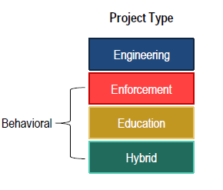
Project Cost-Effectiveness with Tier Annualized Cost
3
Notes:
This figure is another way of looking at the results from the last slide, where projects are represented by slices of a pie and the size of the slice is proportional to the annualized cost of the project to the right of the diagram.
One thing you’ll notice is that there are more engineering projects in tiers 1 and 2, indicating that they are more effective. This is because there is a limited number of studies on the effectiveness of behavioral measures. As more information about other project types emerge, the distribution of projects in the tiers will probably alter.
*** THERE ARE SOME CAUTIONS IN APPLYING THE SKETCH METHOD**
The method should be used to place projects into broad tiers (e.g., most cost-effective, least cost-effective), not to score individual projects.
Application of this method may mean that quantitative information available for certain projects is not fully used. For example, in comparing a group of 20 behavioral and engineering projects, it may be possible to quantitatively estimate cost-effectiveness for some of the engineering measures but not the behavioral ones. To compare all the projects the same way, they must all be scored using the same scoring system even though some quantitative calculations are possible.
2. The results of the scoring process are specific to the projects included in the process and can’t be compared with the results of another set of projects, since the scores are based on relative comparisons among the measures.
This sketch-level process uses a scoring system for each project element; 1-4 for problem and effectiveness, and 1-3 for annualized cost. The practitioner is free to choose a different score range (e.g.,, 1-5) for each element, but clear criteria will need to be established and documented for assigning scores.

Slide 15
Opportunities with Sketch Method
Comparison of different safety project types is possible.
Large numbers of strategies can be compared.
Results help focus on the most cost effective strategies.
Notes:
The analysis illustrated that comparison of different project types is possible. The visual results allow practitioners to compare a larger number of strategies and focus on the most cost effective project types by tier.

Slide 16
Challenges with Sketch Method
Some projects can’t be scored.
Projects have multiple components.
Projects may not be well-defined.
Effectiveness information might be unavailable.
Effectiveness duration is not a well researched topic.
Notes:
Several challenges in applying the method remain. These include:
Identifying projects that cannot be scored because they have no direct impact on safety outcomes;
Assigning effectiveness and problem scores for projects with multiple components
Matching complex projects to close equivalent project types from the national literature
Assigning scores when projects are not well-defined. In many cases, this prevented analysis of the size of the crash population expected to be impacted by specific behavioral measures.
Assigning scores when a local CMF was provided on the project application but no supporting information on the quality of the CMF.
Determining annualized project costs for behavioral projects when the duration of impact is unknown.

Slide 17
Additional Research – Long Term
More effectiveness information for a range of project types:
  Combinations of projects
  Duration of effectiveness
  Geographic area of effectiveness
  Funding required to produce results
Consistent definitions of effectiveness
Better quality crash data
Uniform cost and useful life assumptions
Guidance regarding preparation of behavioral safety project applications
Additional primary research:
Effectiveness, including duration
Dose response relationships
Spillover effects
Notes:
The two methods presented highlighted multiple areas for additional research:
More effectiveness information for a wider range of project types, including combinations of projects. Currently, only limited quantitative information exists, especially for behavioral safety and emergency response projects. NCHRP 17-60 is an active study that is taking a quantitative analytical approach that uses criteria to determine the value of countermeasures.
More high-quality before-and-after evaluations of specific safety strategies are needed to significantly advance the state of the practice. Additional information on duration of effectiveness, geographic area of effectiveness, and on the amount of funding required to produce results, especially for behavioral projects, is also needed.
Consistent definitions of effectiveness. A variety of qualitative and quantitative effectiveness measures exist, all with slightly different definitions. More uniformity in qualitative and quantitative measures of effectiveness is needed to allow apples-to-apples comparisons between different types of safety countermeasures.
Better quality crash data. Evaluating certain types of projects can be very difficult if crash data are inadequate. Particularly, lack of linkage between crash data records and injury and fatality outcomes makes evaluation of emergency response strategies difficult.

Slide 18
Research Needs
Cost-effective methods start evaluations across the 4 Es.
NCHRP-1746 Continuation Panel:
Uniform cost and useful life assumptions
Guidance regarding preparation of behavioral safety project applications
Additional primary research:
Effectiveness, including duration
Dose response relationships
Spillover effects
  Mark Bush, NCHRP Project Manager
  Cynthia Landez, Panel Member
  Kimberly Lariviere, Panel Member
  John Miller, Panel Member
  Shobna Varna, Panel Member
  Esther Strawder, Panel Member
  Kevin Lacy, Panel Chair
  Ning Li, Panel Member
  Alejandra Medina-Flintsch, Panel Member
  Steven Tindale, Panel Member
  Pradeep Tiwari, Panel Member
  Richard Pain, TRB Liaison
Notes:
The two methods discussed in the presentation are a starting point for researchers to think about comparing countermeasures with different types and levels of effectiveness information.
The NCHRP panel standing committee plans to continue this study to fill in the existing knowledge gaps in applying the methods.
This concludes my presentation.
We also want to thank Ryan Greene-Roesel, she was also very involved with the project.
Are there any questions or suggestions?

Slide 19
Thank you!
Questions? Comments?
Please contact:
  Daniel Wu
  510-879-4326
  dwu@camsys.com
Notes:
This concludes my presentation.
We also want to thank Ryan Greene-Roesel, she was also very involved with the project.
Are there any questions or comments?

