Slide 1
Analyzing long-distance truck travel for Statewide Freight Planning in Ohio
TRB Planning Applications Conference
Columbus, OH
May 7, 2013
Presented by:
Gregory D. Erhardt, Parsons Brinckerhoff
With:
Rolf Moeckel, Parsons Brinckerhoff
Gregory Giaimo, Ohio Department of Transportation
Zhuojun Jiang, Mid-Ohio Regional Planning Commission
Howard Wood, Parsons Brinckerhoff

Slide 2
Freight Modeling
2 percent of all trips, but 1/3 of all VMT
Most freight flows travel long-distance
Ohio deals with a lot of through trips (I-80/I-90)
Employment is only a poor substitute for truck trip generation
Goods shipments explain most truck traffic, but some trucks travel empty
Mode share is based on long-term contracts
Highly limited data availability

Slide 3
Outline
Part 1: Methods and Data
Statewide model
Freight Analysis Framework 3 (FAF3)
Empty truck modeling
Combining statewide model and FAF3
Part 2: Planning Questions
How do we define a truck network?
Which bottlenecks most affect freight movements in Ohio?
What if we build new intermodal terminals?
What if we increase truck weight limits?

Slide 4
Methods
Let’s model freight!

Slide 5
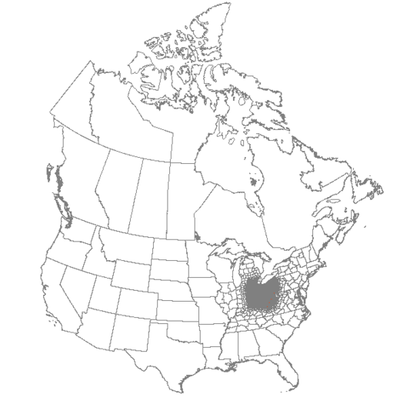
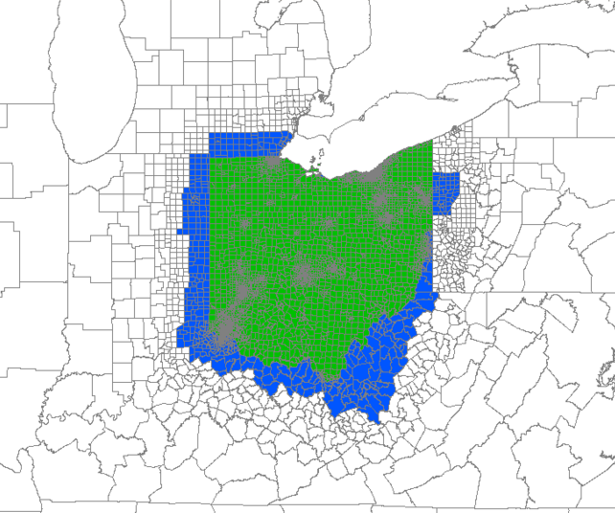
Statewide Model
Maps show TAZs:
Green=Ohio; Blue=Halo

Slide 6
Freight Analysis Framework 3 (faf3)

Slide 7
Freight Flow Disaggregation
FAF data
US county Employment
Freight flows between 3,241 counties
Payload factors
O/D matrix of loaded truck trips
Empty trucks
Truck trip O/D matrix including empty trucks

Slide 8
Empty Truck Trips
-2 trucks
+0 trucks
-5 trucks
+10 trucks
+3 trucks
3 empty trucks
Zone B
10 trucks
-10 trucks
+5 trucks
-8 trucks
+5 trucks
-8 trucks
5 trucks
0 trucks
2 trucks
Zone A
8 trucks
Zone C
-5 trucks
+8 trucks
-0 trucks
+2 trucks
+5 trucks
5 trucks
5 empty trucks

Slide 9
Nationwide Assignment of Trucks

Slide 10
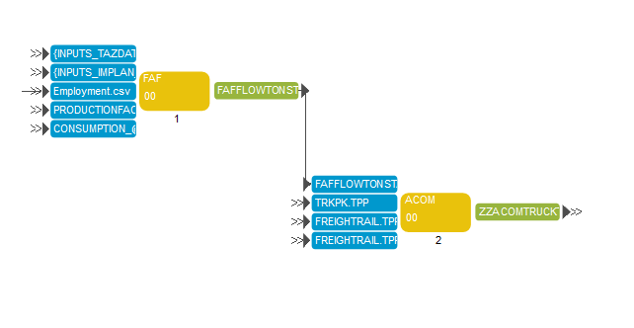
Combining Statewide Model & FAF3
1. FAF – Determine commodity flows by TAZ, in tons
2. ACOM – convert to truck trips

Slide 11
How do we define a truck network?
Which trucks matter?

Slide 12
Trucks by Flow Direction
External-to-External
Internal to Internal

Slide 13
Trucks by Flow Direction
Internal-to-External
External-to-Internal
Internal-to-Internal
Internal-to-External
External-to-Internal

Slide 14
How do we define a truck network?
How many trucks are there?

Slide 15
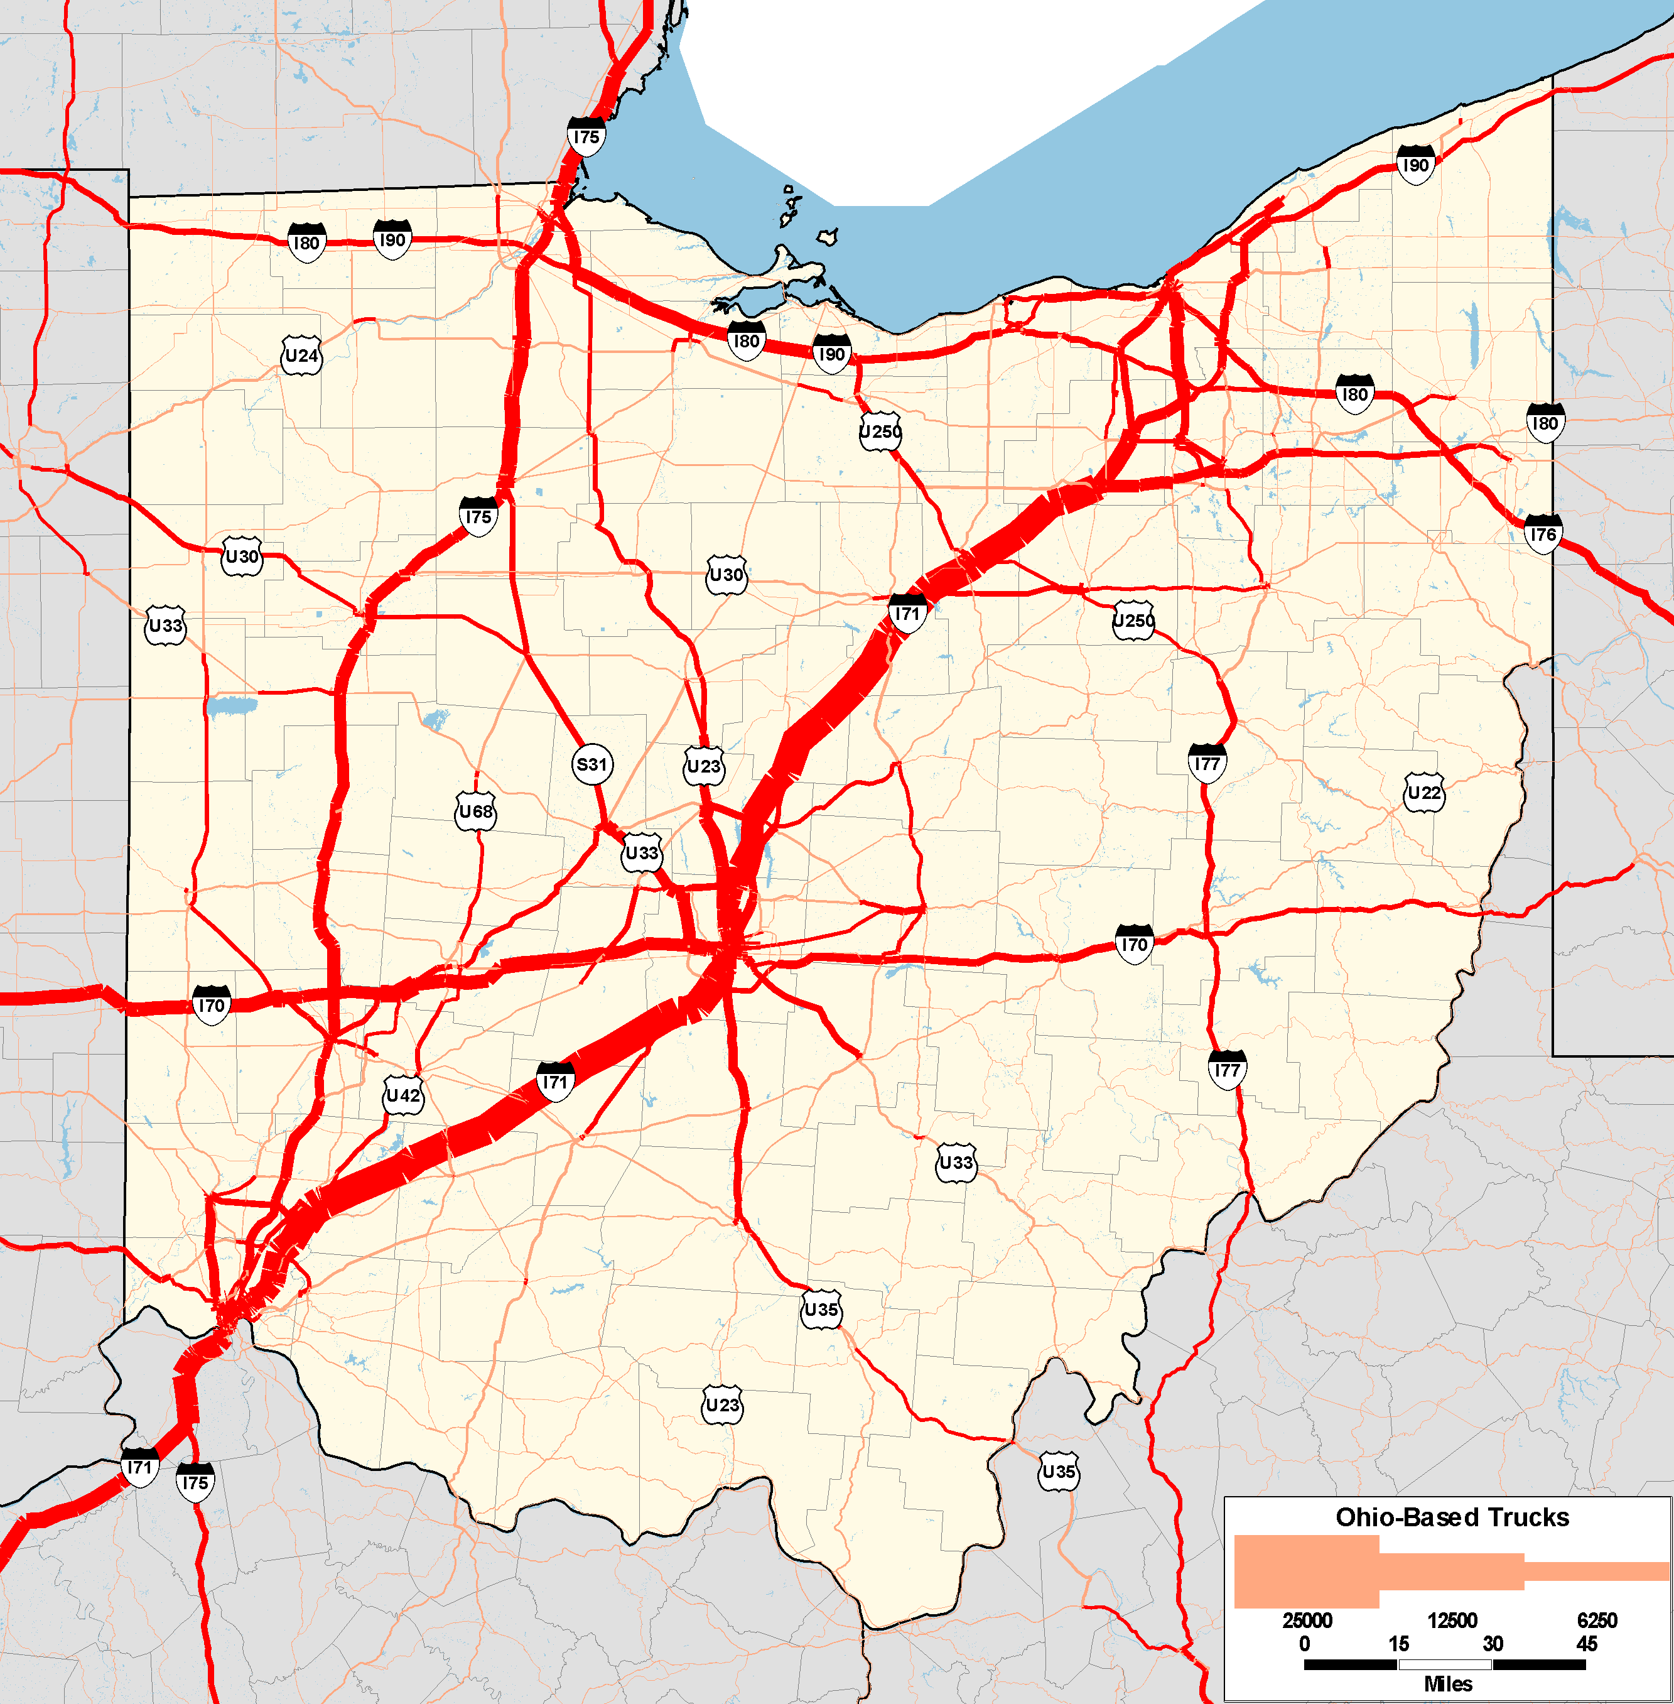
Links with 1,000 Ohio-based trucks or more

Slide 16
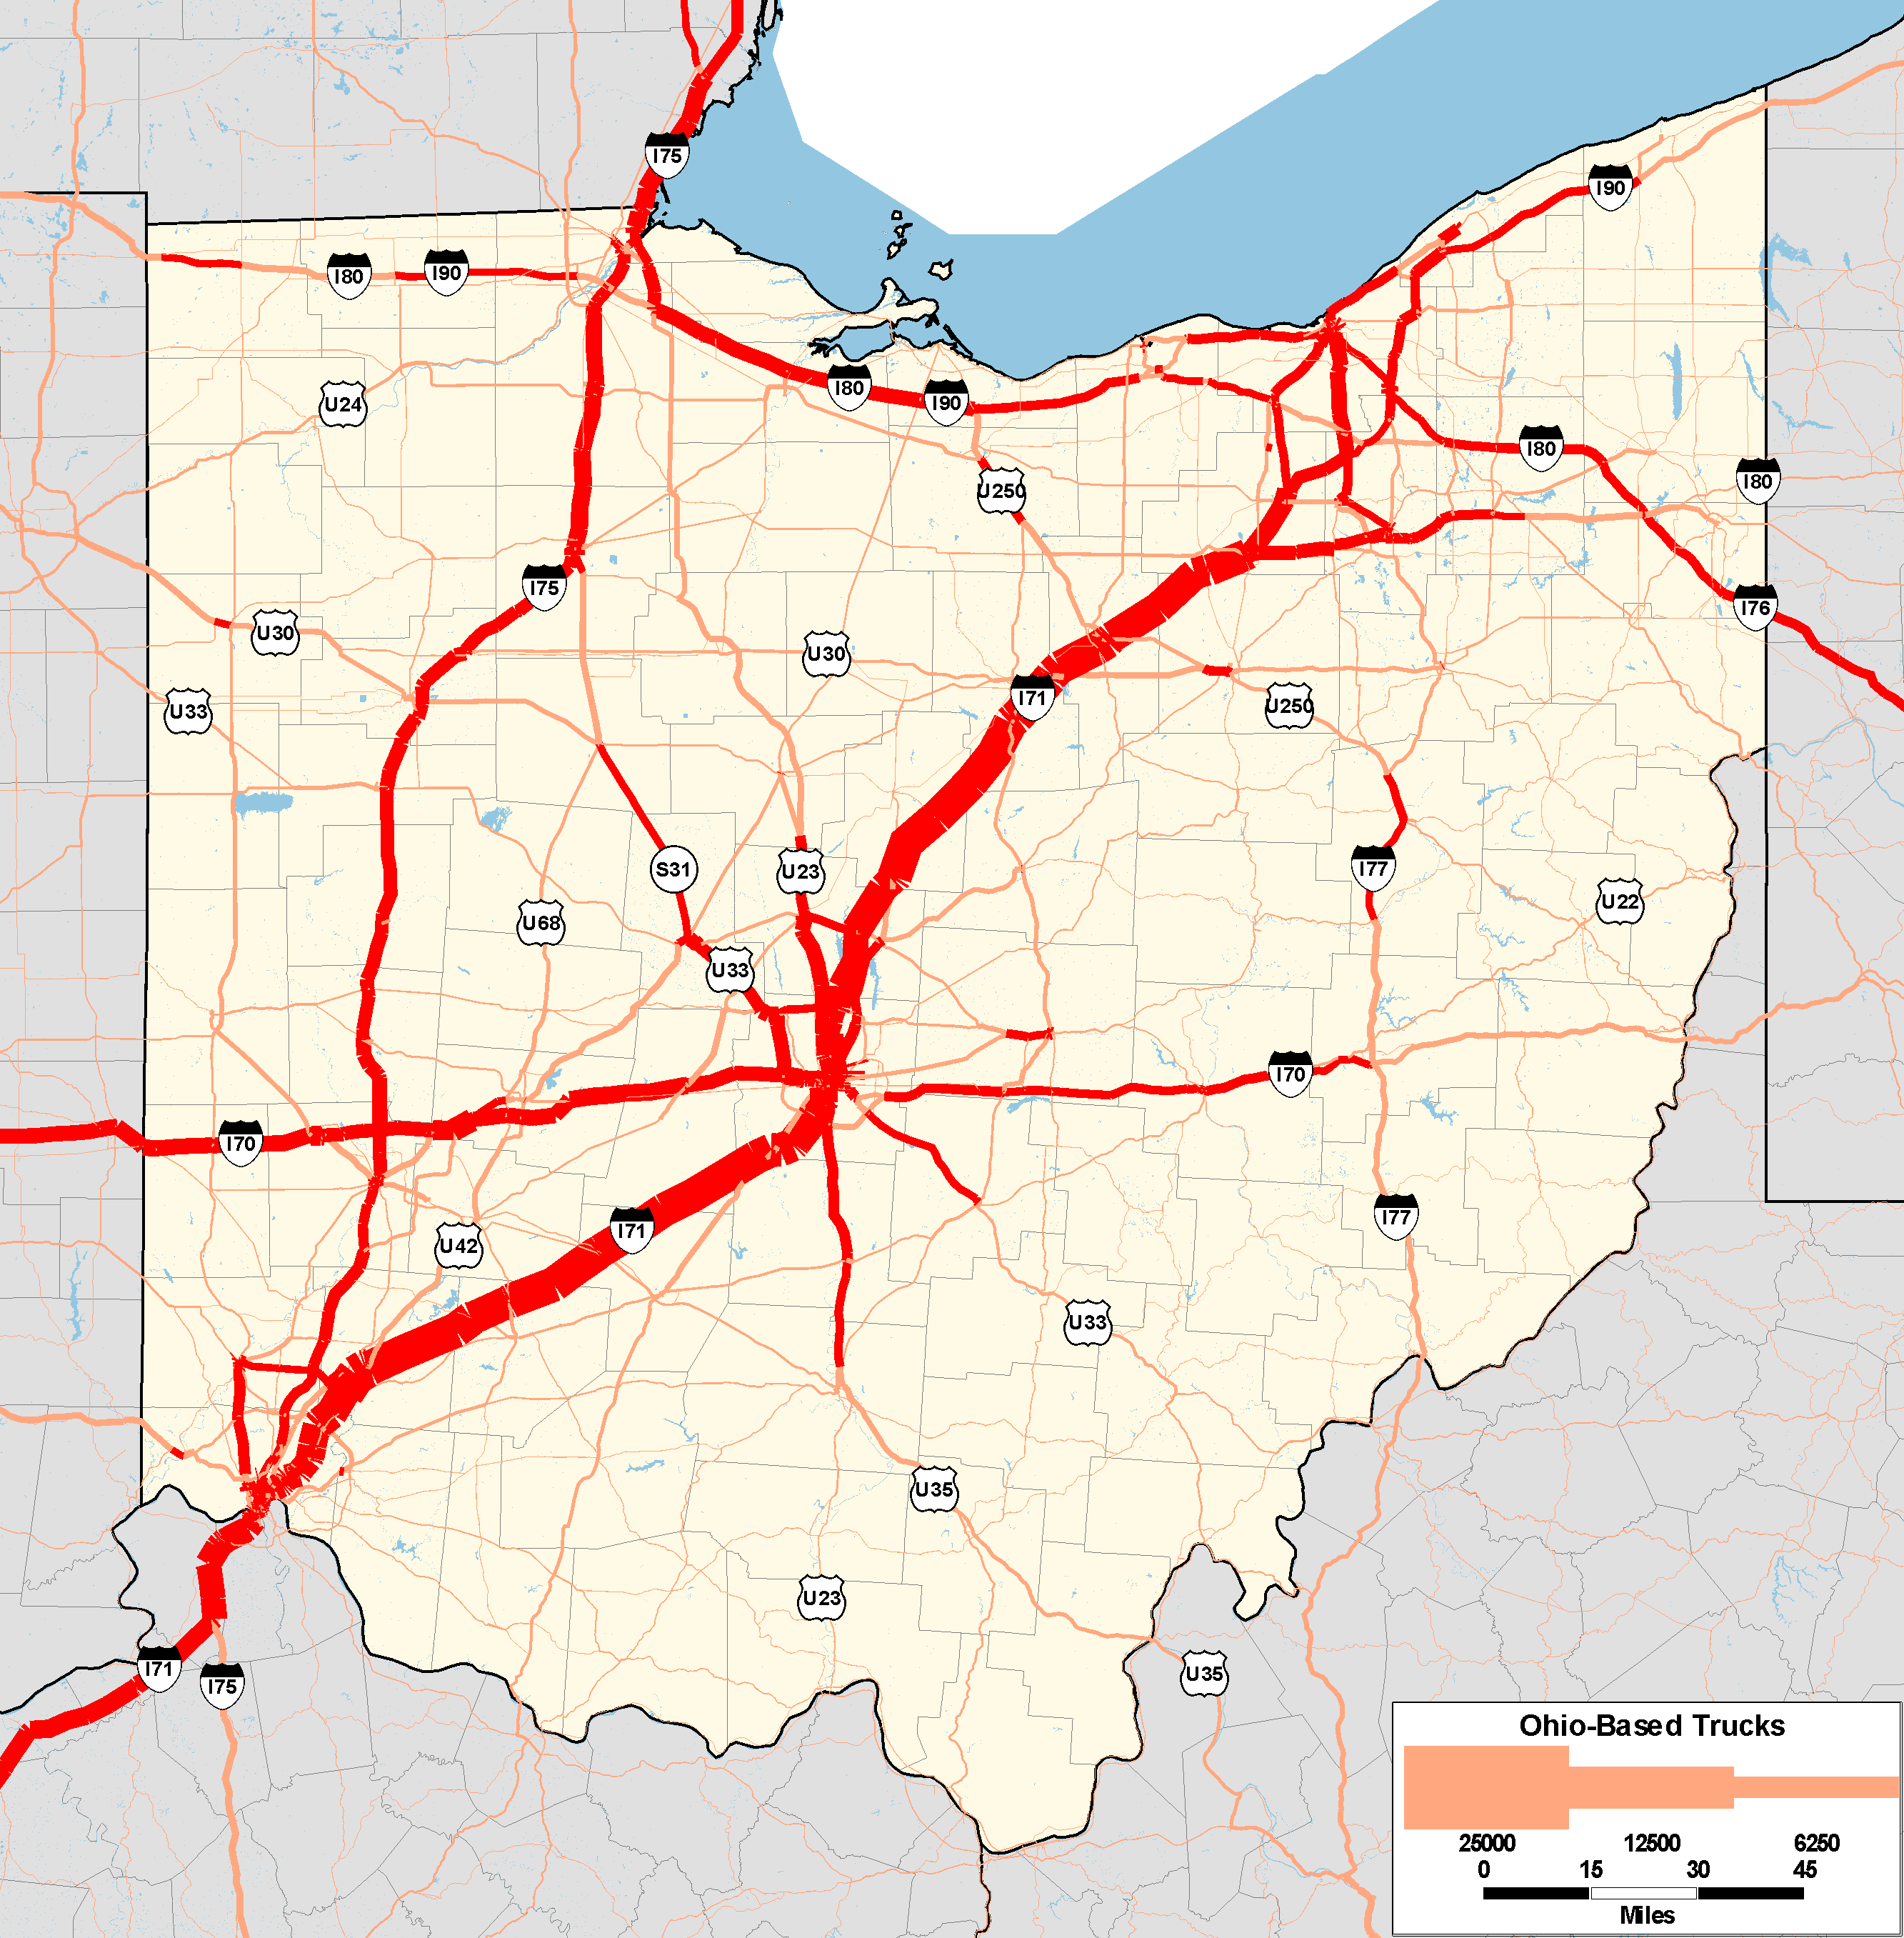
Links with 2,000 Ohio-based trucks or more

Slide 17
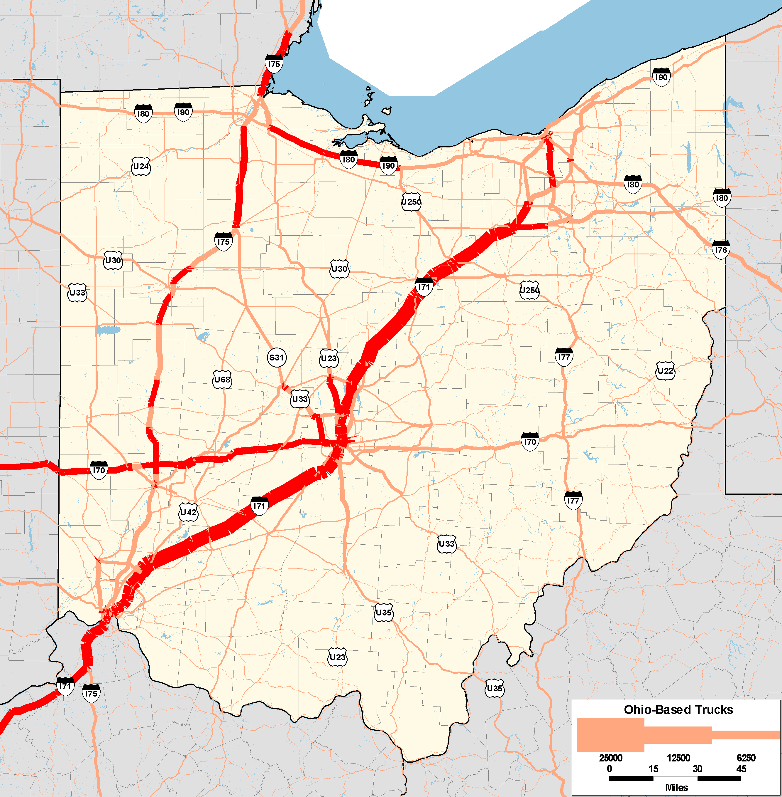
Links with 4,000 Ohio-based trucks or more

Slide 18
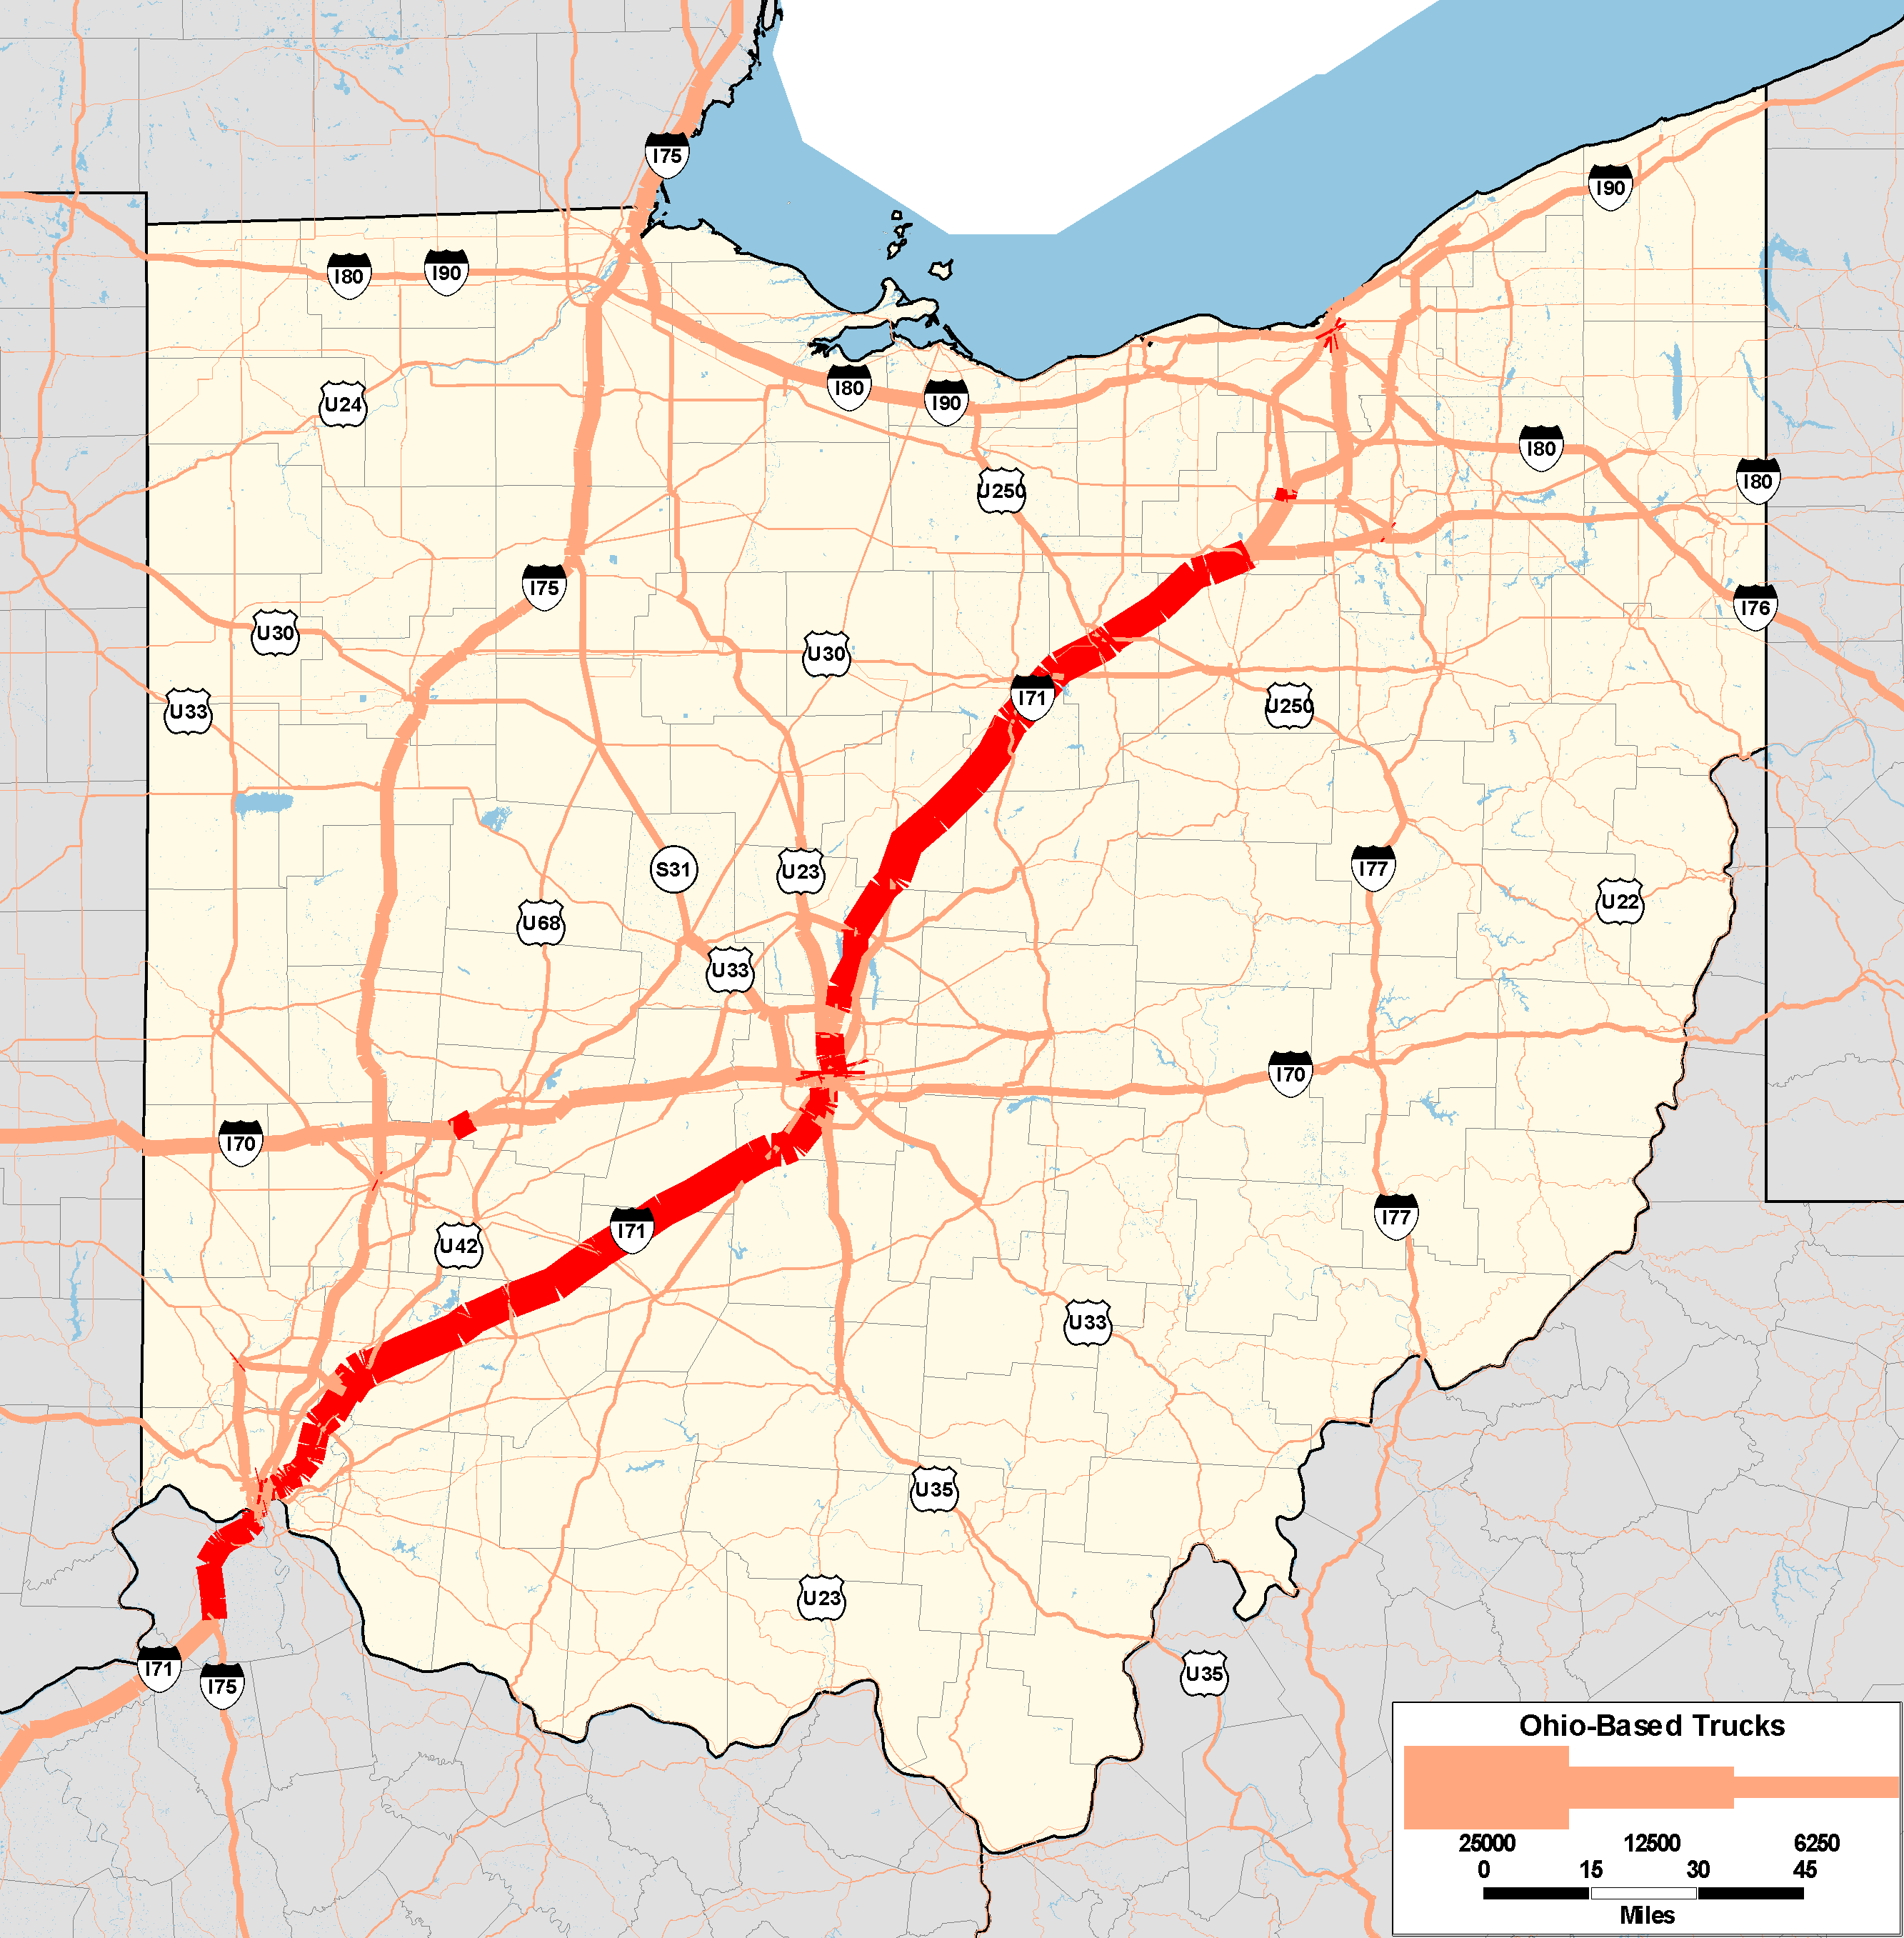
Links with 6,000 Ohio-based trucks or more

Slide 19
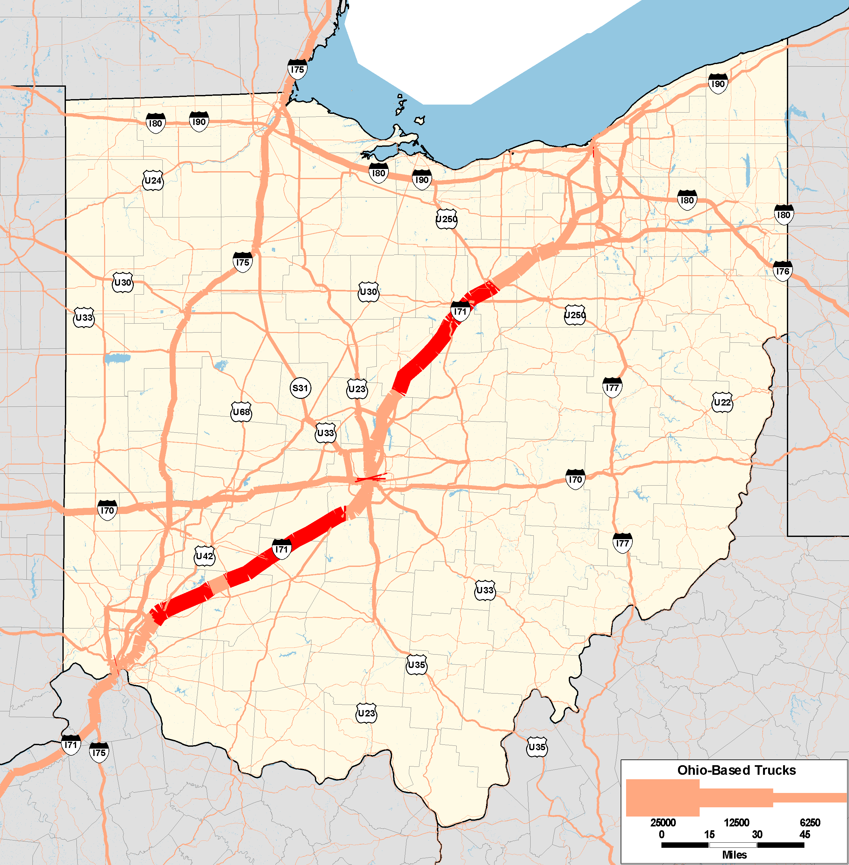
Links with 10,000 Ohio-based trucks or more

Slide 20
Which bottlenecks matter?
Where are the bottlenecks and what commodities move through them?

Slide 21
Following slides show Ohio-based truck flows by commodity group
Only trips with at least one trip end within Ohio are included
The background color shows number of trucks generated and attracted per acre by county, i.e. truck trips are counted twice (at their origin and destination)
Bottlenecks are shown in yellow (identical for every slide, not commodity-specific)
Scale on every slide changes. The relative distribution of truck flows can be compared across different commodities, but not the absolute bandwidth/color

Slide 22
Distinguished Commodity Groups
Group | Commodity
1 | Unprocessed agricultural products
2 | Live animals and live fish
3 | Food products
4 | Petroleum
5 | Automobiles
6 | Coal
7 | Gravel, Sand, Minerals and ores
8 | Waste and scrap
9 | Base metal products
10 | Instruments and electronics
11 | Logs
12 | Wood products
13 | Basic chemicals
14 | Chemical products
15 | Machinery and building stone
16 | Nonmetallic mineral products
17 | Miscellaneous freight

Slide 23
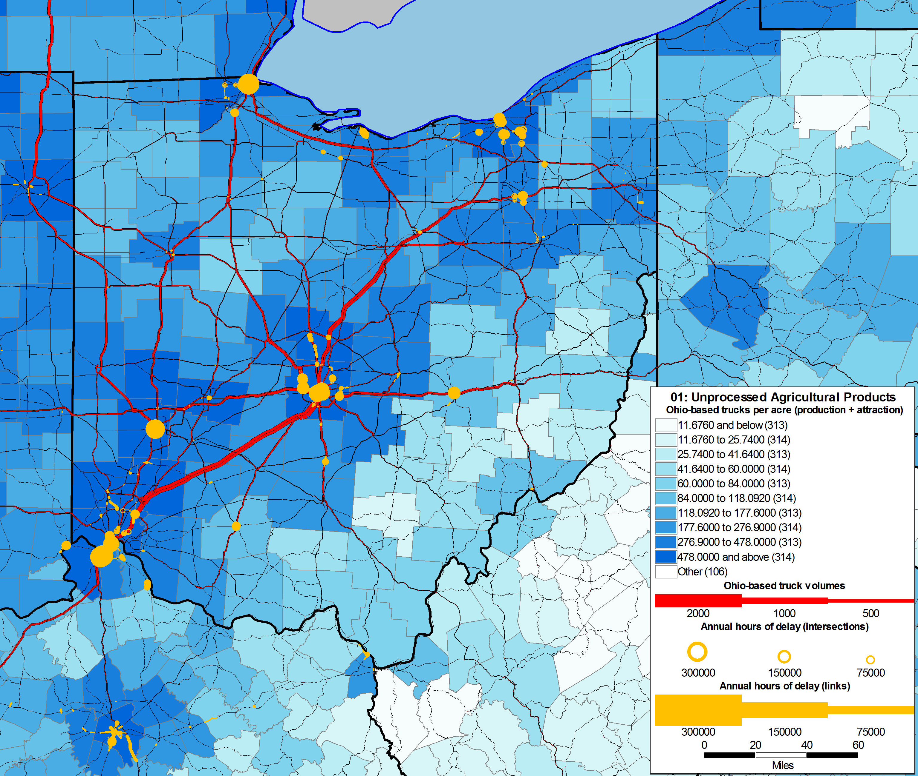
Agriculture

Slide 24
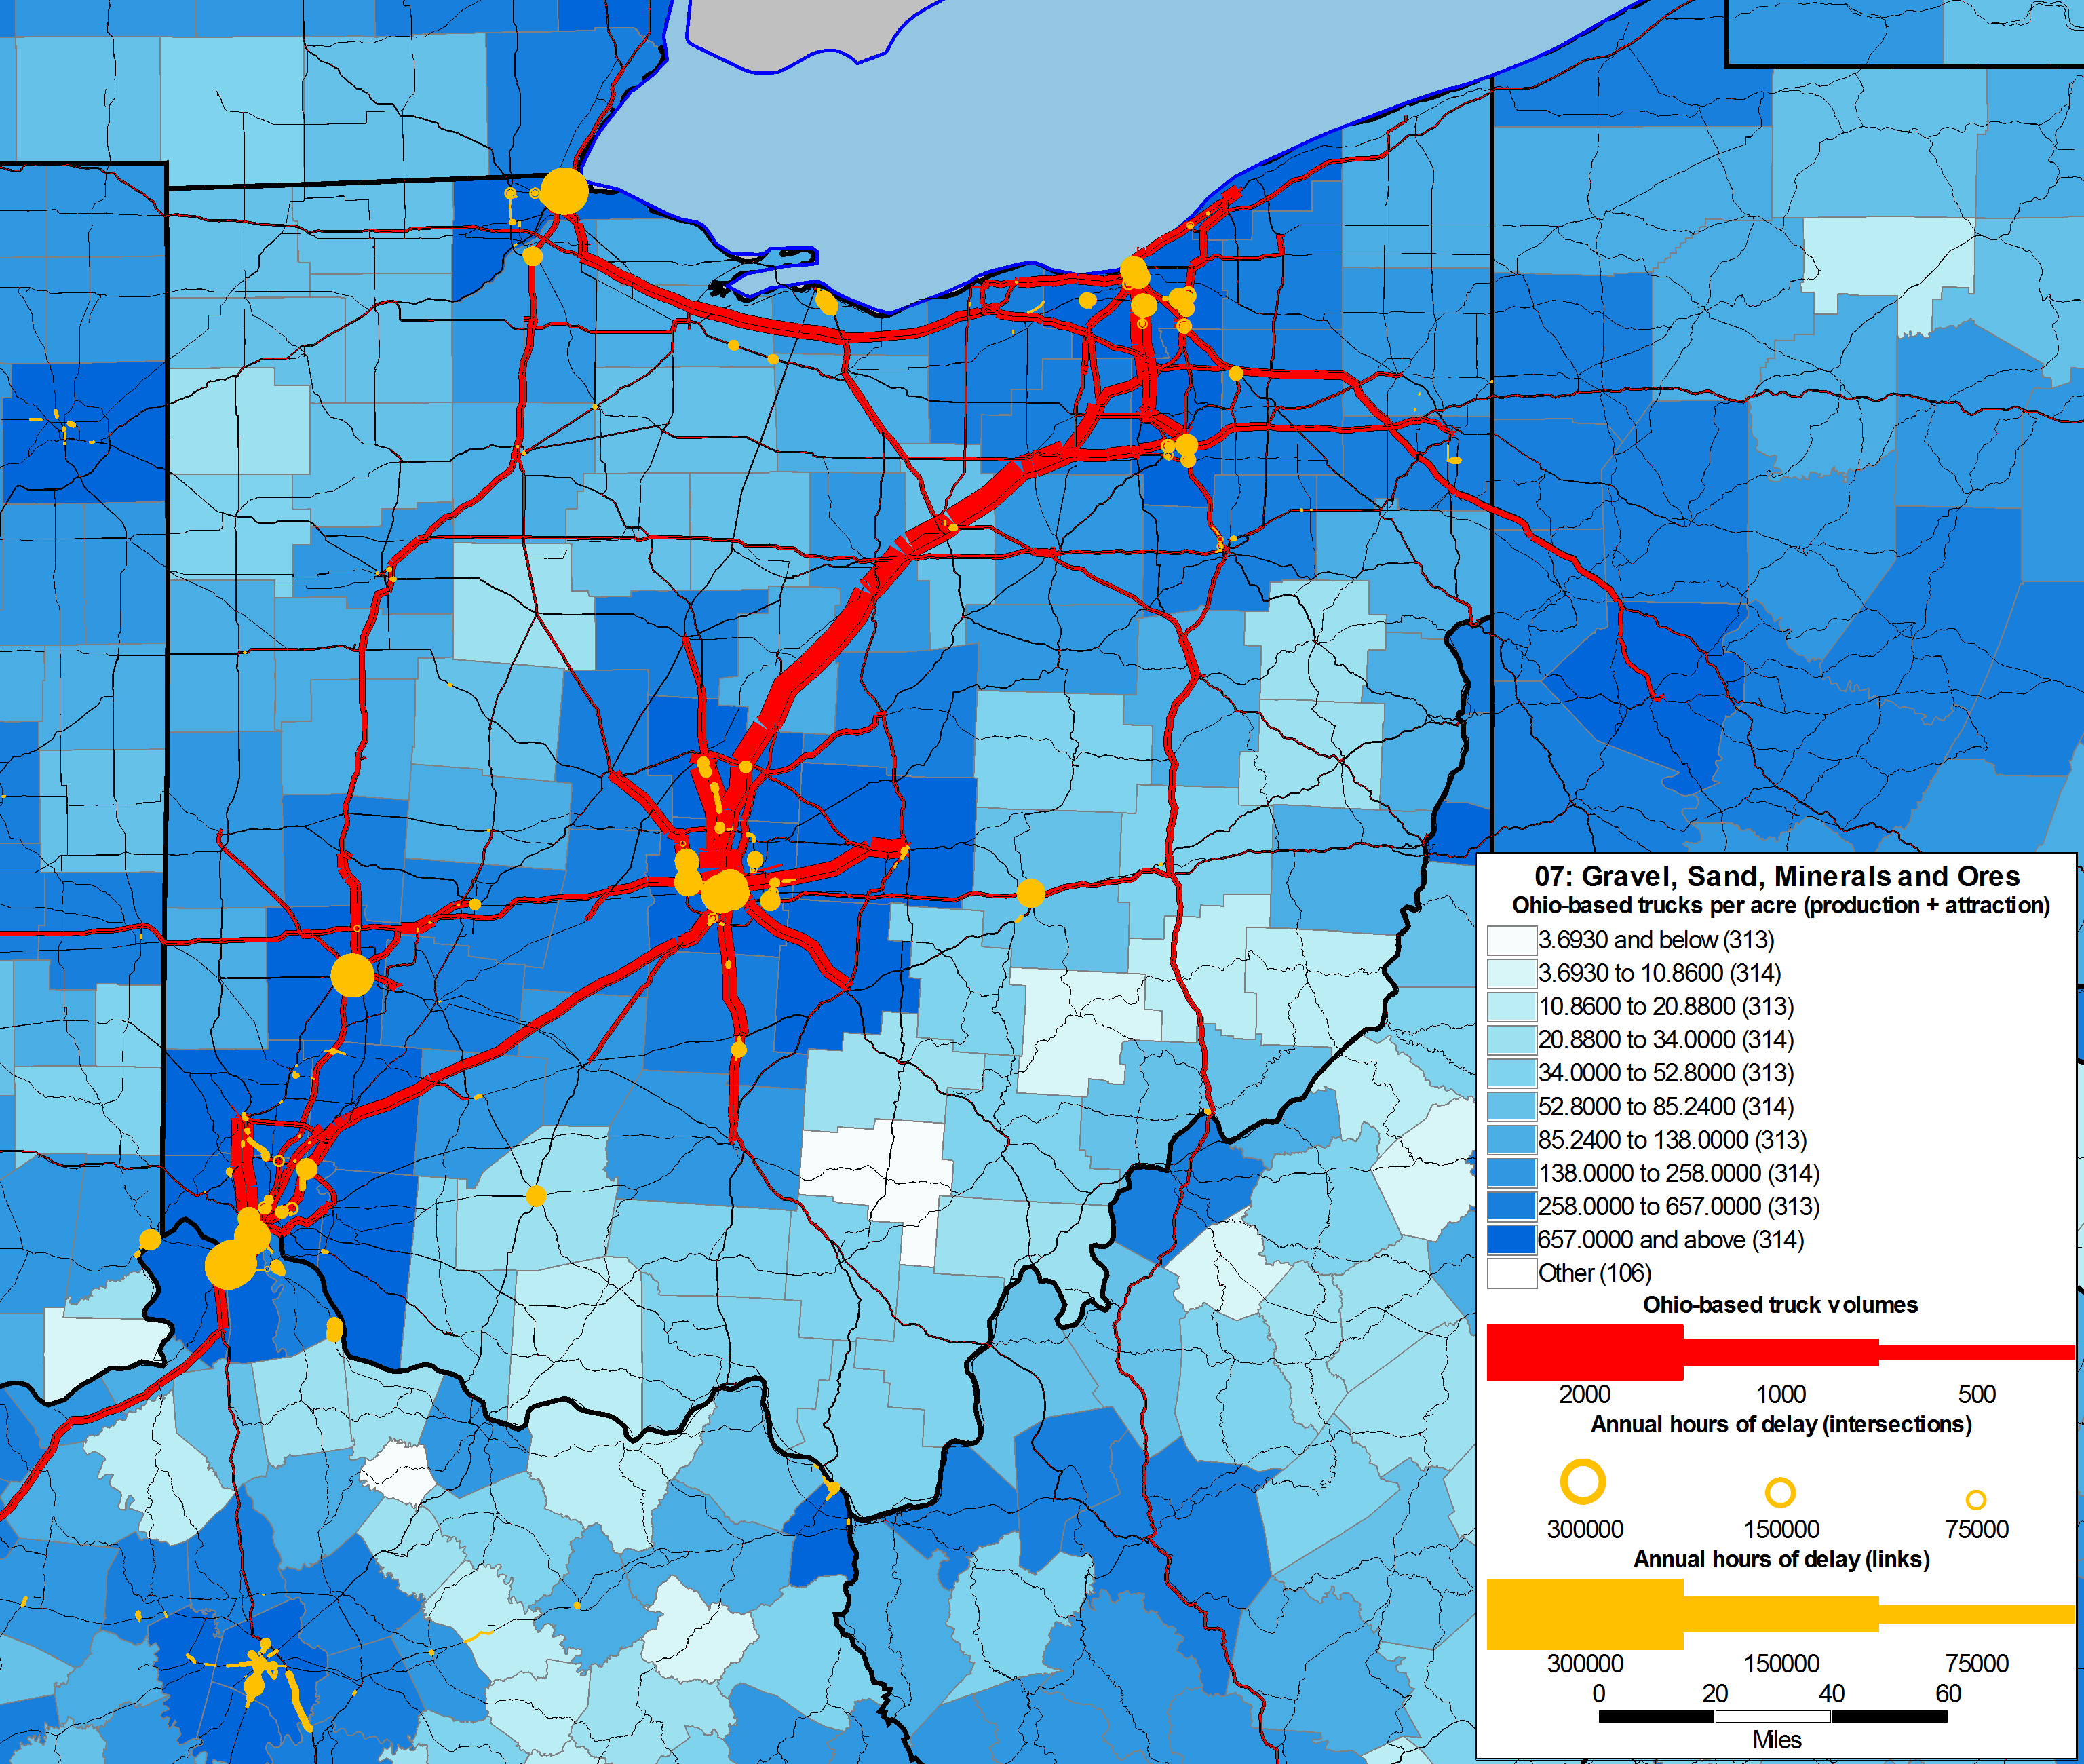
Gravel, sand, minerals

Slide 25
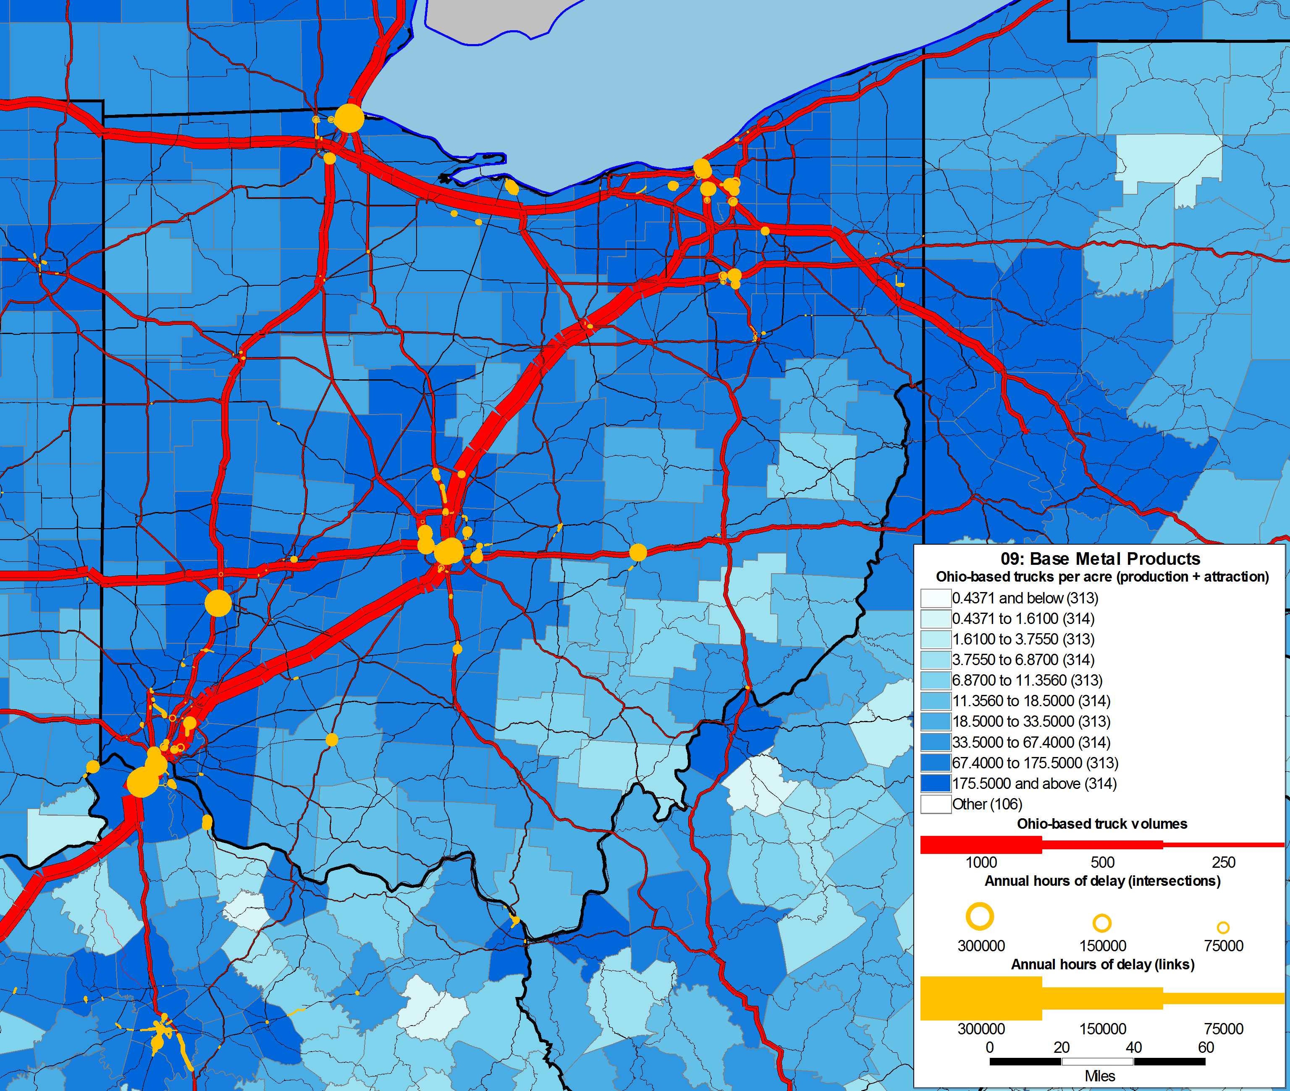
Base Metal Products

Slide 26
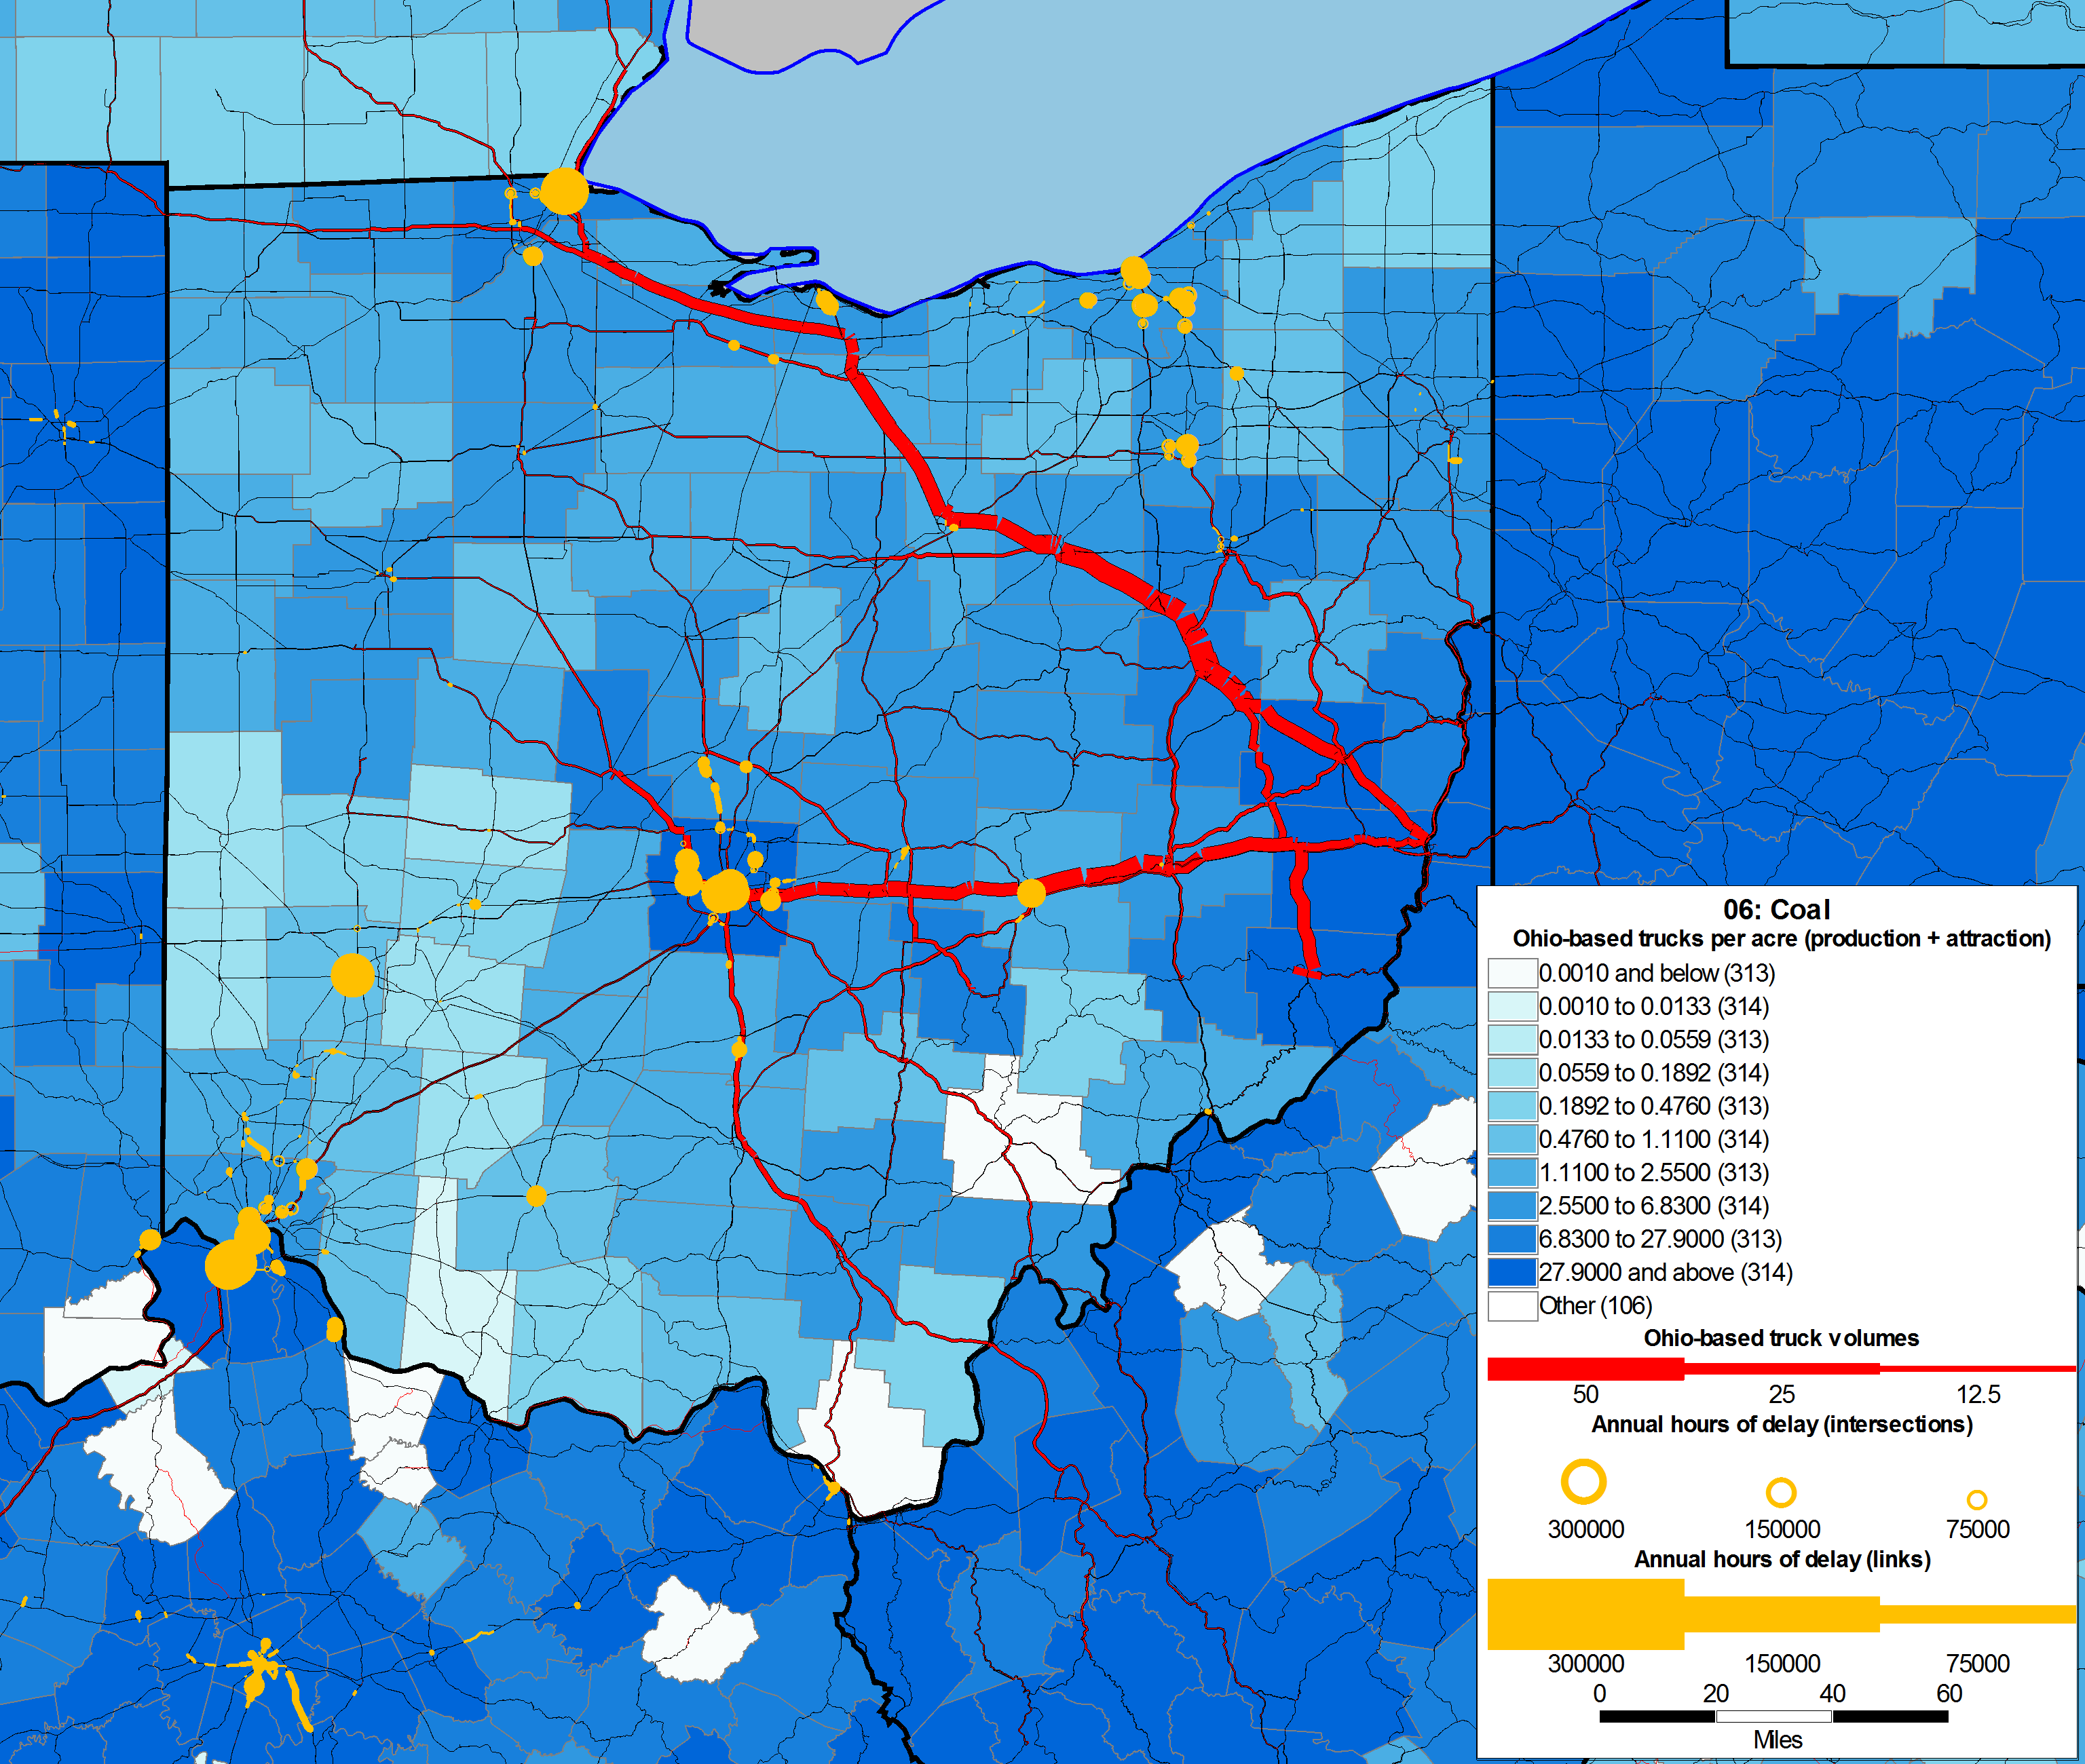
coal

Slide 27
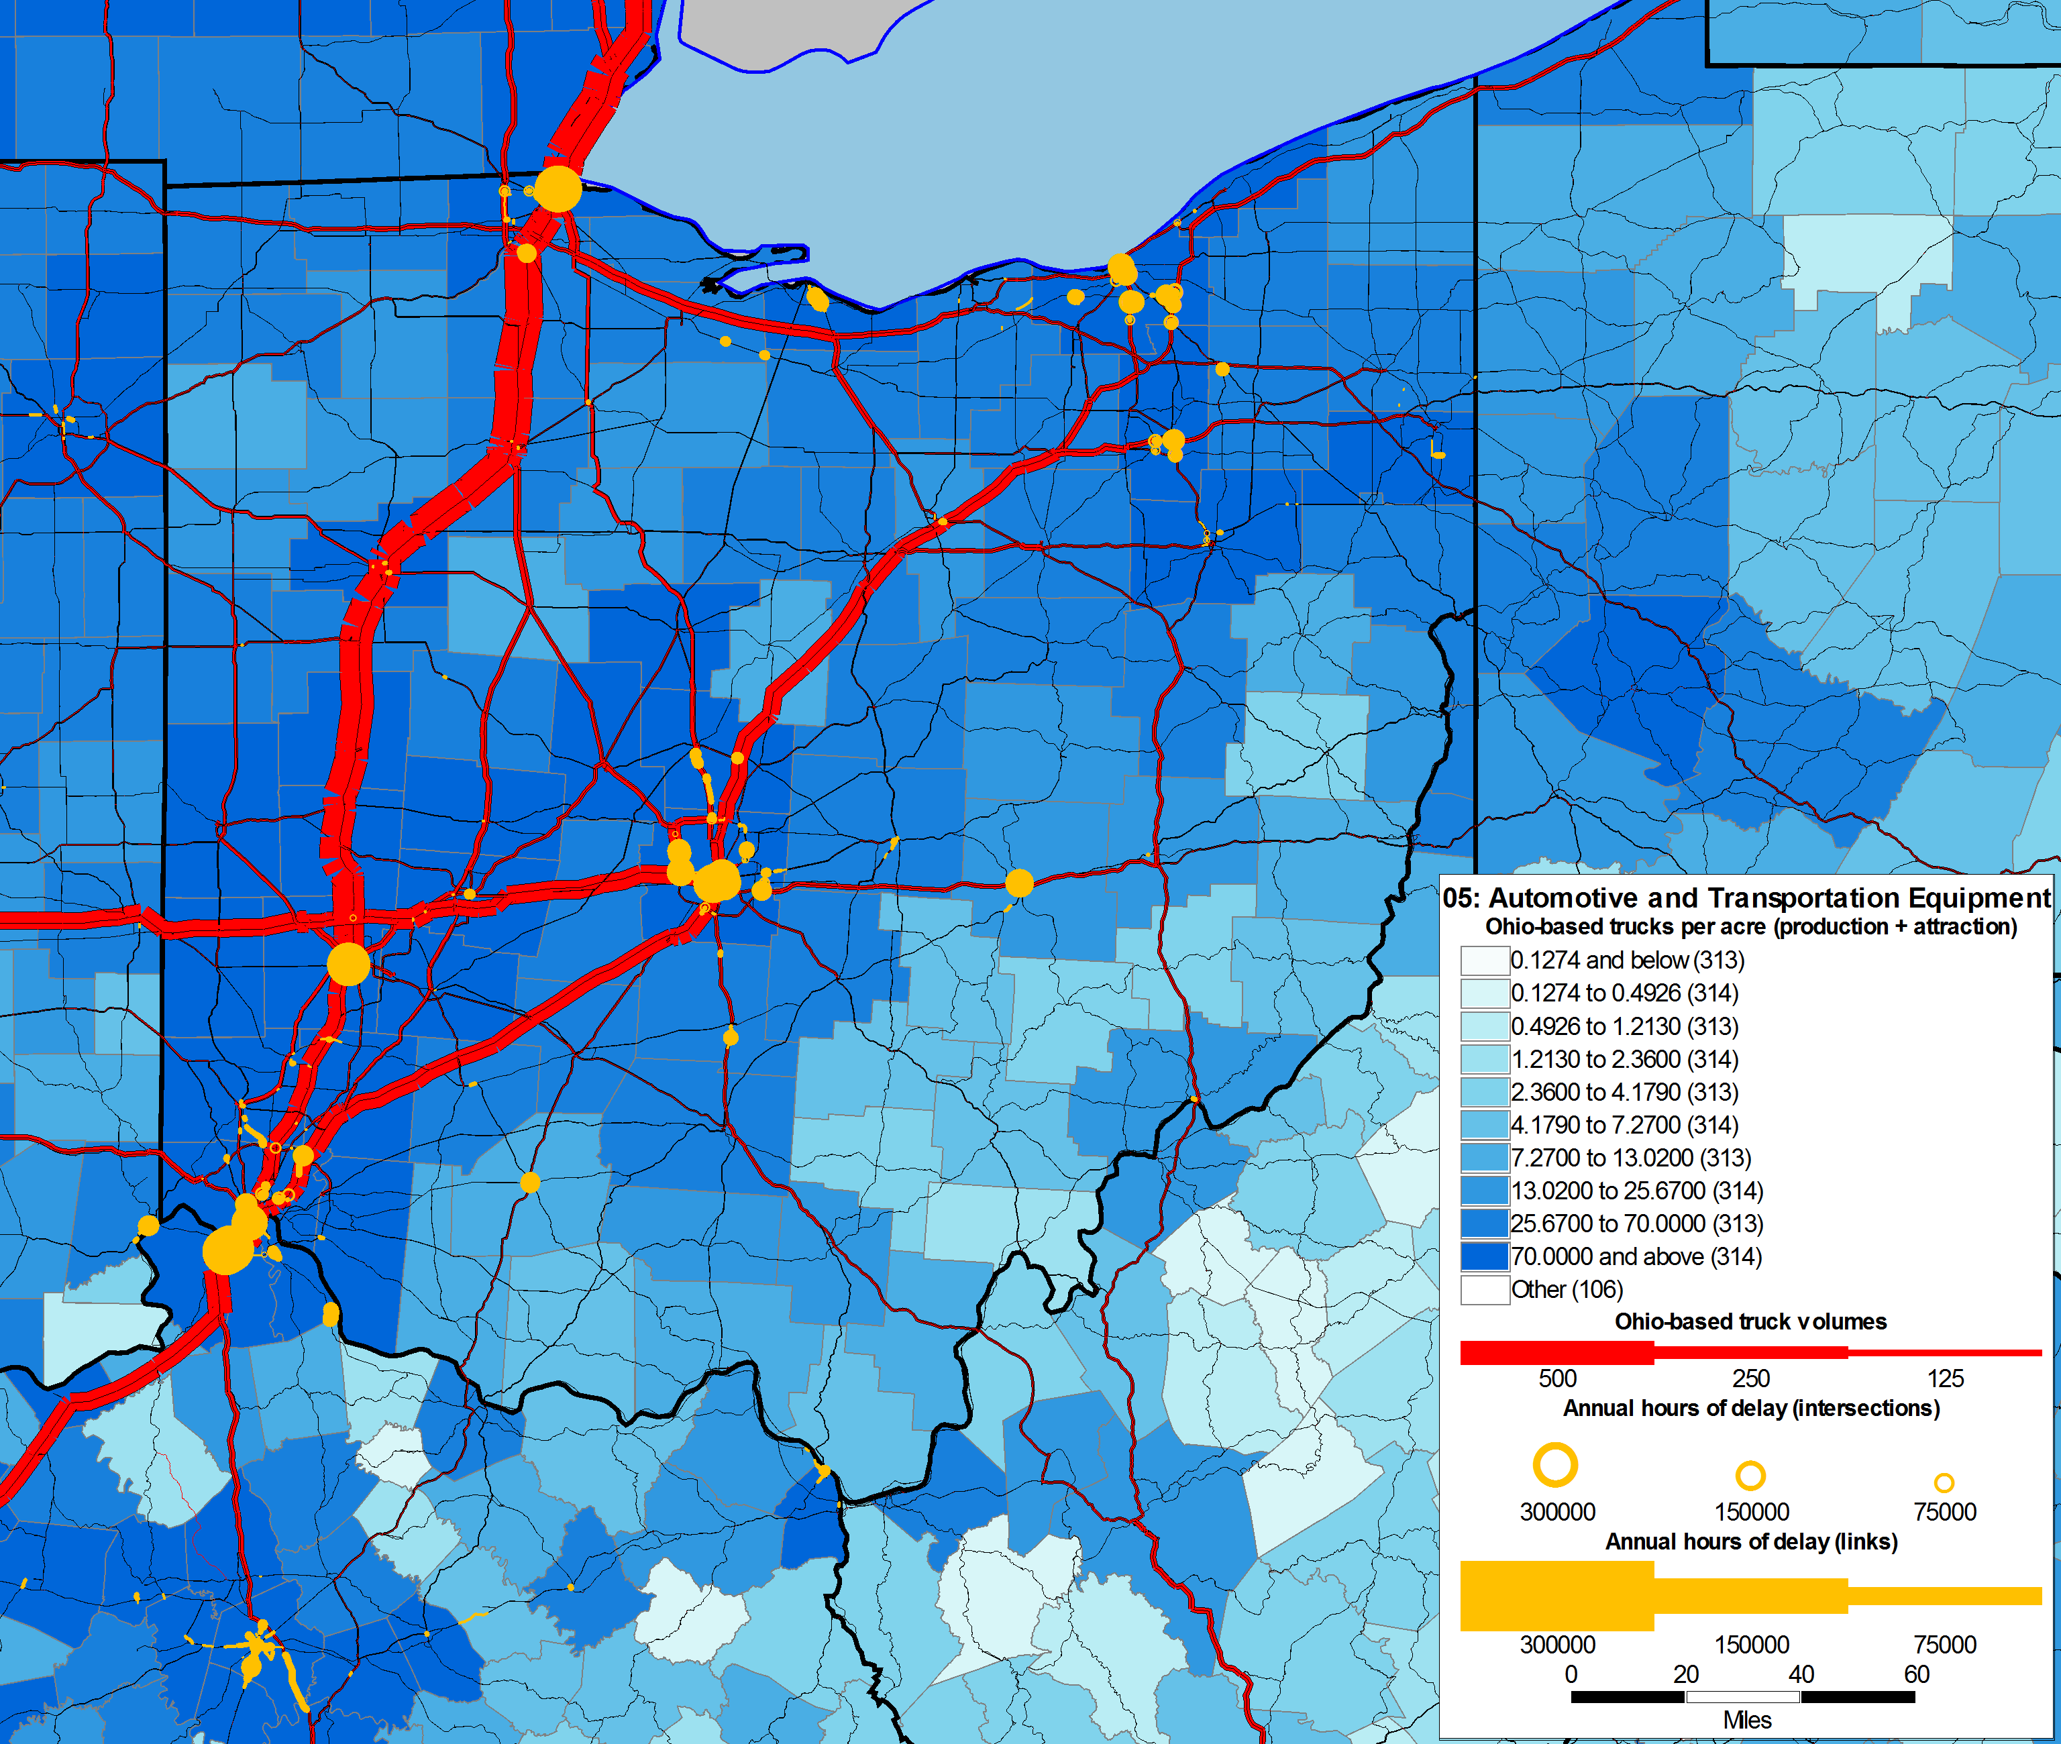
automobiles

Slide 28
What if we build new intermodal terminals?
How much traffic would divert from trucks to intermodal?

Slide 29
Intermodal facilities in Columbus area
 | Tons
Year | MULTIMODAL | TRUCK | RAIL | OTHER | Total
2000 | - | - | - | - | -
2005 | 38,462 | (38,462) | - | - | 0
2010 | 41,398 | (41,398) | - | - | 0
 | Mode Share%
Year | MULTIMODAL | TRUCK | RAIL | OTHER | Total
2000 | 0.0% | 0.0% | 0.0% | 0.0% | 0.0%
2005 | 0.1% | -0.1% | 0.0% | 0.0% | 0.0%
2010 | 0.1% | -0.1% | 0.0% | 0.0% | 0.0%

Slide 30
What if we increase truck weight limits?
How many fewer trucks would be on the road?

Slide 31
Increase Payload factors in MI & OH
Truck Vehicle Miles Traveled
Payload factor | I-I | I-E/E-I/E-E | Total in OH
Original | 63,491,368 | 33,746,501 | 97,237,869
Increased | 62,272,117 | 33,655,403 | 95,927,519
Difference | (1,219,251) | (91,099) | (1,310,349)
% Difference | -1.9% | -0.3% | -1.3%

Slide 32
Conclusions
What did we learn?

Slide 33
Conclusions
Part 1: Methods and Data
Freight needs to be modeled on a large (national) scale
Data matters
Statewide model needed for auto flows
Questions about how much sensitivity to allow
Part 2: Planning Questions
Freight forecasting is not “plug-and-chug”
Creativity needed in framing the questions and searching for insights

Slide 34
Acknowledgements
Many thanks to:
Joe Bryan
Carlee Clymer
Mark Locker
Rebekah Anderson

Slide 35
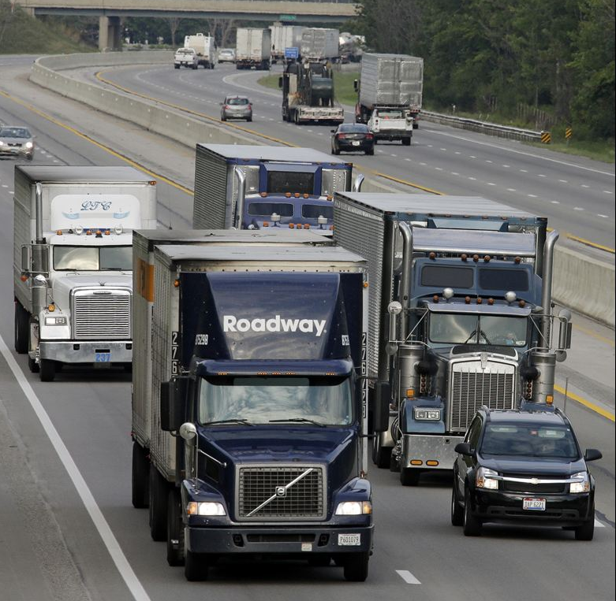
Questions?
Greg Erhardt
Parsons Brinckerhoff
415-307-6974
erhardt@pbworld.com

