Slide 1
Developing, Implementing, and Visualizing Performance Measures in the Metropolitan Transportation Planning Process
May 7, 2013
Andy Taylor, AICP
Amelia Costanzo
Daniel Eisenberg

Slide 2
What we have to cover:
Development of Goals, Objectives and Targets
Measure Progress
Show Progress

Slide 3
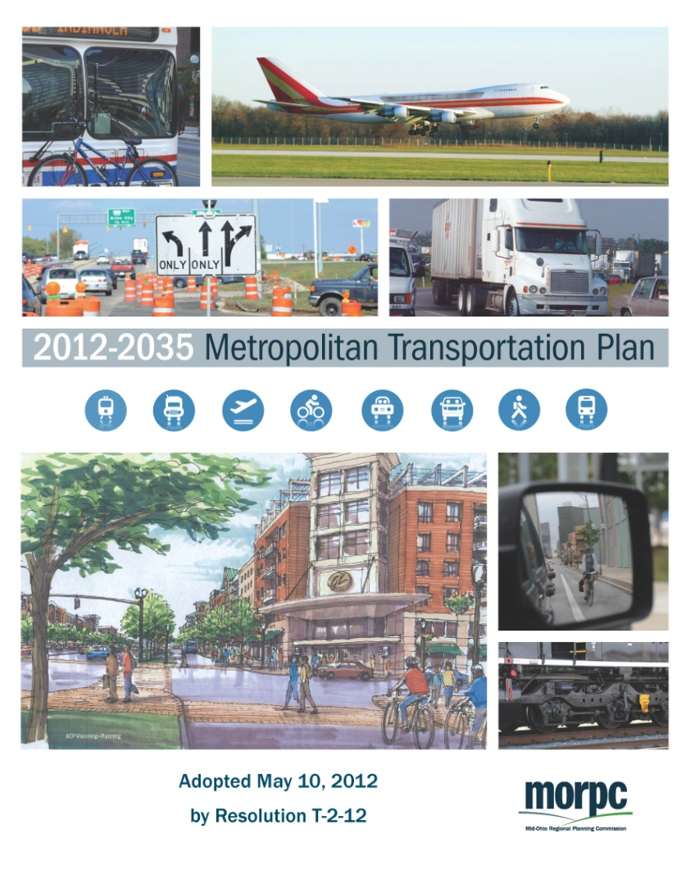
Development of Goals, Objectives, Targets
6 Broad Goals
16 System Objectives
25 Measures
13 Targets
www.morpc.org/tplan
Notes:
The plan began by incorporating 6 broad goals. These goals were intended for use in multiple regional planning efforts – not just the MTP.
Because these goals were so broad, we used the 16 measurable objectives to apply them to the transportation system.
In order to measure progress toward those objectives, we identified 25 measures. 13 have specific short- and long-range targets.

Slide 4
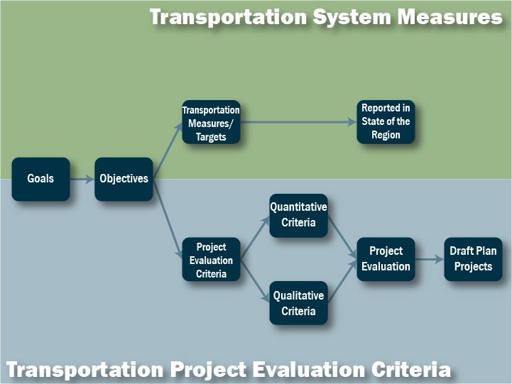
Notes:
We worked quite a bit with our committees and other stakeholders understand the difference between system-wide measures and the project-focused evaluation criteria they were more familiar with from previous planning cycles. We began that process before the objectives were established.

Slide 5
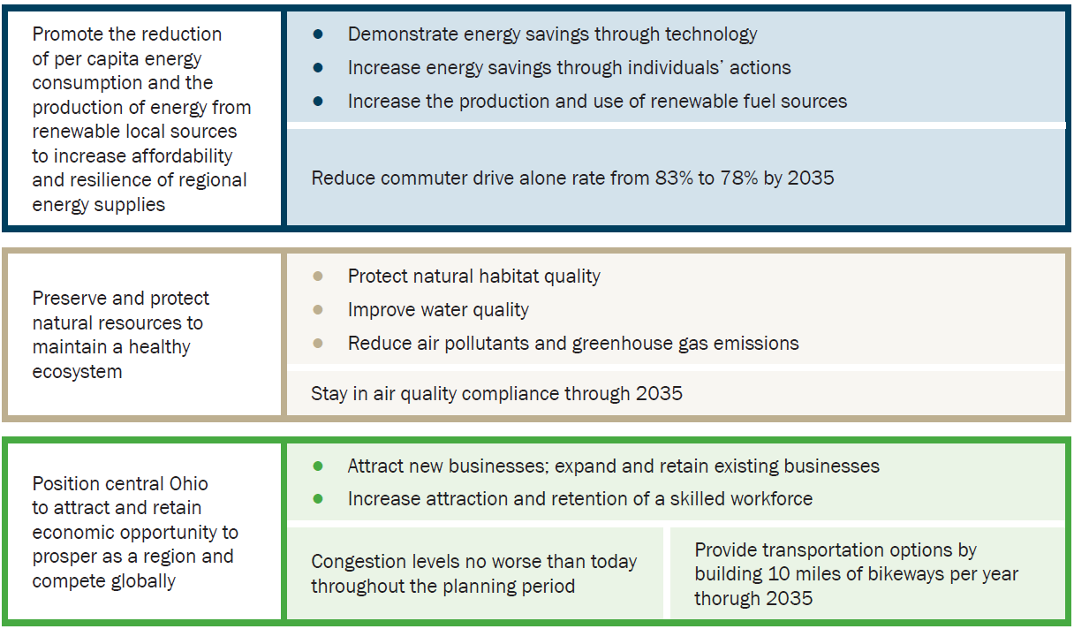
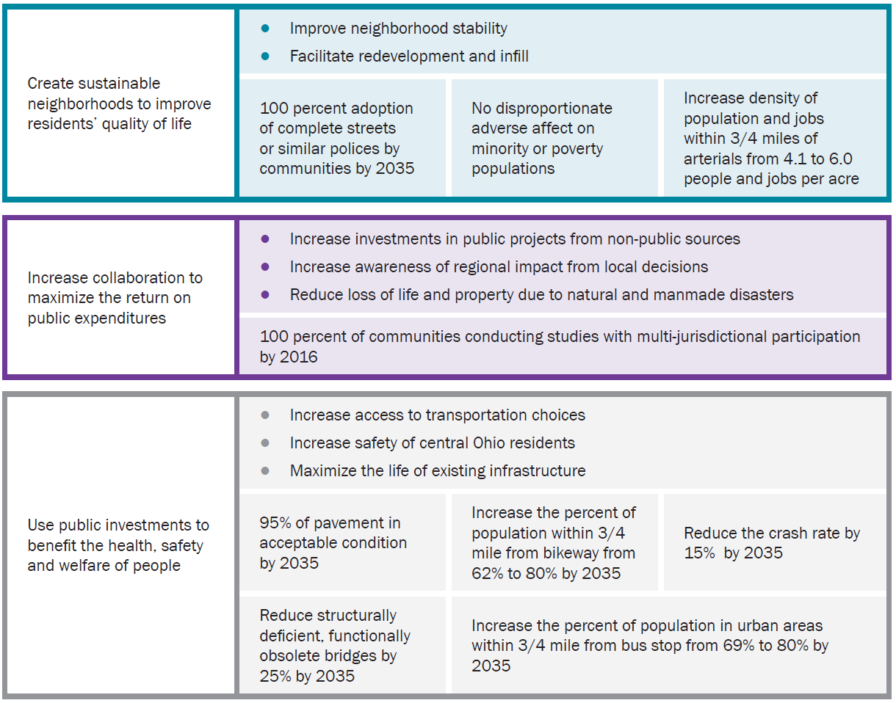
Goals → Objectives → Performance Measures

Slide 6
MTP Target Topics:
Congestion
Air Quality
Bridge Condition
Pavement Condition
Safety
Disadvantaged Population Travel
Bikeway Miles
Bikeway Proximity
Transit Proximity
Local Complete Streets Policies
Density along Arterials
Ridesharing
Multi-Jurisdictional Studies

Slide 7
MAP-21 Target Topics:
}
Congestion
Air Quality
Bridge Condition
Pavement Condition
Safety
Reliability
Freight Movement
Topics identified for performance measurement by Congress through MAP-21
Notes:
The five in bold overlap with the 7 targets identified by MAP-21

Slide 8
Example: Safety
Goal: Use public investments to benefit the health, safety and welfare of people
Objective | Measure | 2012 Benchmark | 2016 Target | 2035 Target
Increase safety of central Ohio residents
A 15 percent reduction by 2035 in crashes for all travelers per million vehicle miles traveled on collector or above roadways.
Notes:
Here’s an example of how the targets were communicated in the plan. The 5-column format helps reinforce the connection between target and objective, while also showing existing conditions and the short- and long-range targets.
The agreed upon language is below.

Slide 9
Example: Safety
Goal: Use public investments to benefit the health, safety and welfare of people
Objective | Measure | 2012 Benchmark | 2016 Target | 2035 Target
Increase safety of central Ohio residents | Crashes for all travelers, per million vehicle miles traveled, on collector or above roadways
A 15 percent reduction by 2035 in crashes for all travelers per million vehicle miles traveled on collector or above roadways.
Notes:
Here’s an example of how the targets were communicated in the plan. The 5-column format helps reinforce the connection between target and objective, while also showing existing conditions and the short- and long-range targets.
The short-range targets will help us determine if adequate progress has been made by the next plan.

Slide 10
Example: Safety
Goal: Use public investments to benefit the health, safety and welfare of people
Objective | Measure | 2012 Benchmark | 2016 Target | 2035 Target
Increase safety of central Ohio residents | Crashes for all travelers, per million vehicle miles traveled, on collector or above roadways | 2.31 crashes per million VMT | 2.25 crashes per million VMT | 2.00 crashes per million VMT
A 15 percent reduction by 2035 in crashes for all travelers per million vehicle miles traveled on collector or above roadways.
Notes:
Here’s an example of how the targets were communicated in the plan. The 5-column format helps reinforce the connection between target and objective, while also showing existing conditions and the short- and long-range targets.
The short-range targets will help us determine if adequate progress has been made by the next plan.

Slide 11
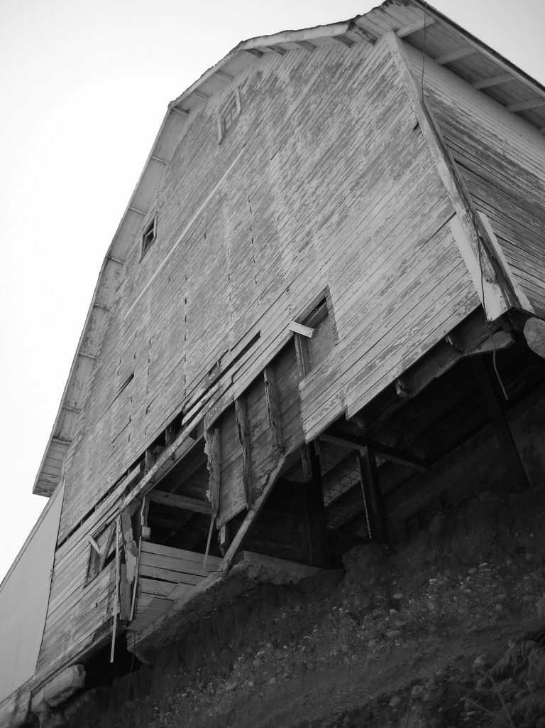
Lessons Learned
Make a good foundation
Outcomes vs. Outputs
System Performance vs. Impact
Notes:
(cc) mrcupofcoffee on flickr
Put work into goals and objectives – they’re the foundation for performance measures (and our project evaluation criteria)

Slide 12
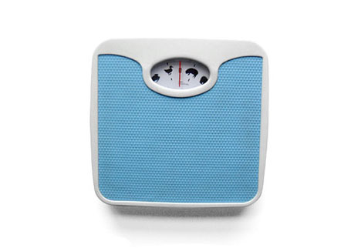
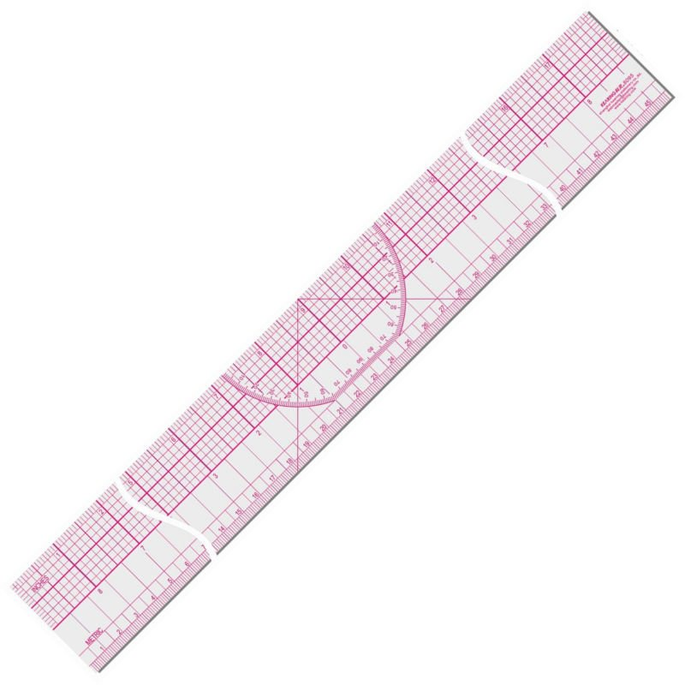
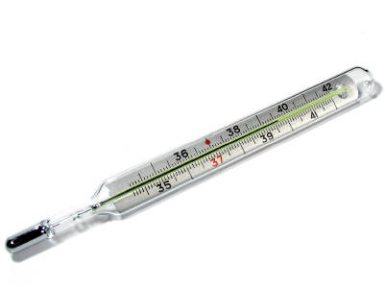
Measure Progress
Collect data
Analyze
Review results
Notes:
Collect Data:
Collect updated data – I need to keep track of how often new data is available, the source (publication, person, entity, web, phone), who is responsible for collecting it in my agency (I am not always the appropriate person to do that)
Analyze:
The data isn’t usually in the form I need it to be in when I get it. I need to know what output I’m seeking, how to manipulate the data, and who the appropriate person in my agency is to do that (I am not always the appropriate person to do that)
Review Results:
Do they make sense? Sometimes the data is broken. Sometimes I have an epiphany that the way I showed it previously isn’t the best way. What is the analysis saying – are we working toward our goals?

Slide 13
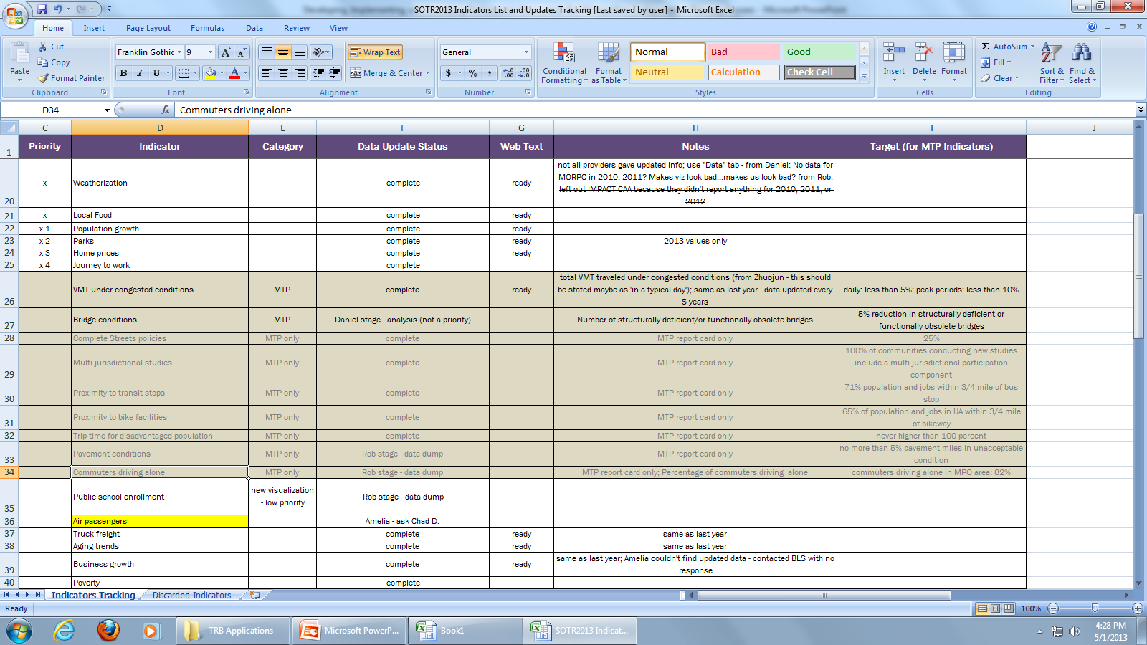
Be organized!
Notes:
In order to do all of that, I have to stay organized. This is how I do it:
Indicator – what measures are we tracking?
Data update status – where are we in the process of updating this data? I use names so people are clear what is assigned to them when they look at the spreadsheet.
Notes – notes to myself, notes to my team mates, notes about glitches in the process, notes about methodology
Other columns I add and delete as needed – sometimes I don’t need to prioritize, other times I do. Sometimes I need different categories, sometimes I don’t.
This is how I stay organized and keep my team organized. You might choose another method or methods. The main point is that assignments and progress and processes need to be documented and in an easily accessible spot.

Slide 14
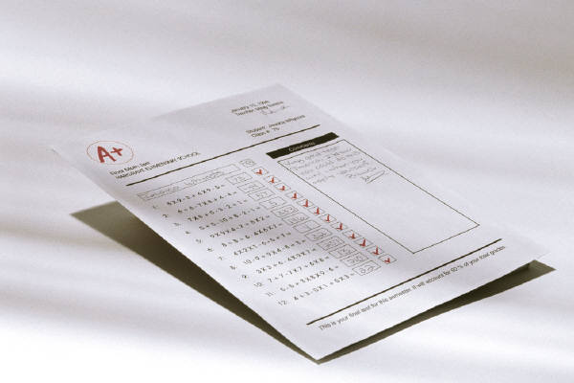
Lessons Learned
Documentation
Communication
Notes:
Documentation:
Keep track of who, what, when, where and why, otherwise you are in for a rude awakening as staff change, sources die, and time ticks on (forgetful)
Example: When looking at the crash rate for the current year, we noticed it was significantly different than the previous year. That didn’t make sense. We thought we remembered how we had calculated crash rate for this particular purpose, but we didn’t have a centralized place for documentation and therefore had a heck of a time piecing together the process.
Communication:
Make sure people know their assignments and timelines
Documentation plays into this – if staff changes or people forget a process from the last tracking cycle, they can reference documentation notes
Our use of the data is different than someone else’s within the agency – differences in geography and parameters
Example: I asked our staff member who works with crash data daily for the crash rate for the most recent time period. It hadn’t occurred to me that he was going to give it to me for our area of interest rather than the planning area relevant to the process under which I was working. No surprise the number looked completely off.
Modeling vs. Measuring:

Slide 15
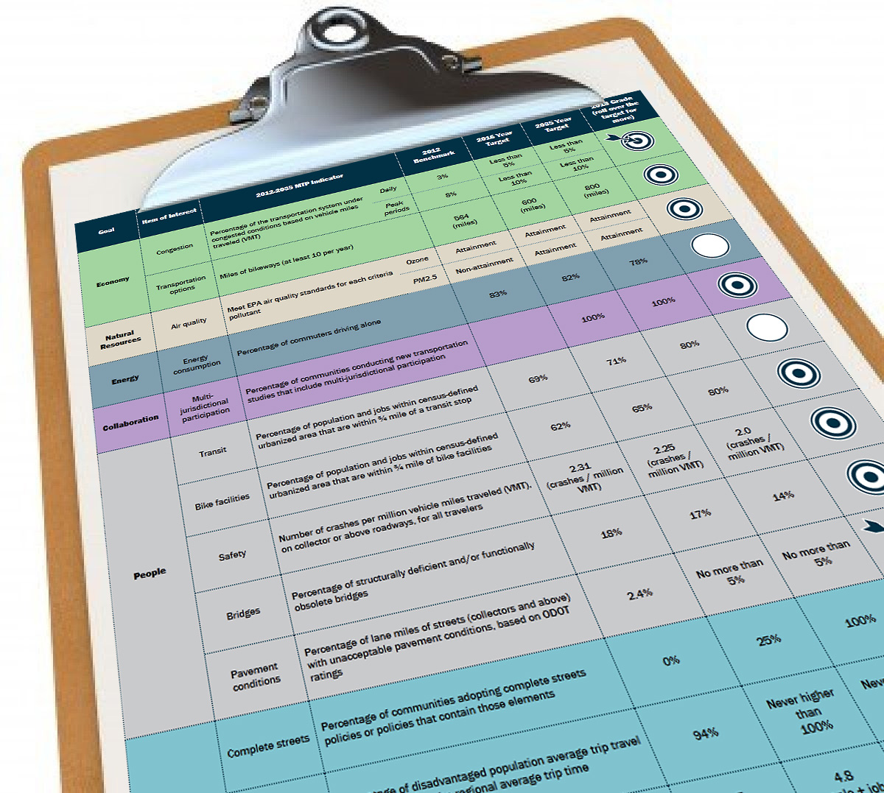

Showing Progress: Report Card
Targets and progress reported on website
Meets target
On track to meet target
Not on track to meet target
http://weave.morpc.org/sotr/indicators.html?ct=Transportation
Notes:
MTP Report Card
Just like in school, there is a need to report on progress, so we are using a “Report Card”
- Makes our progress more accessible to public at large – everyone from our most technical stakeholders to those who are not involved in the technical aspects of transportation planning.
The MTP report card uses iconography to demonstrate whether we are on track to meet the target or not.
Colors relate to the plan goals, just like in the MTP
If you mouse-over the icon on the website, a textbox pops up over it to display our rationale for why we assigned each indicator to the target category

Slide 16
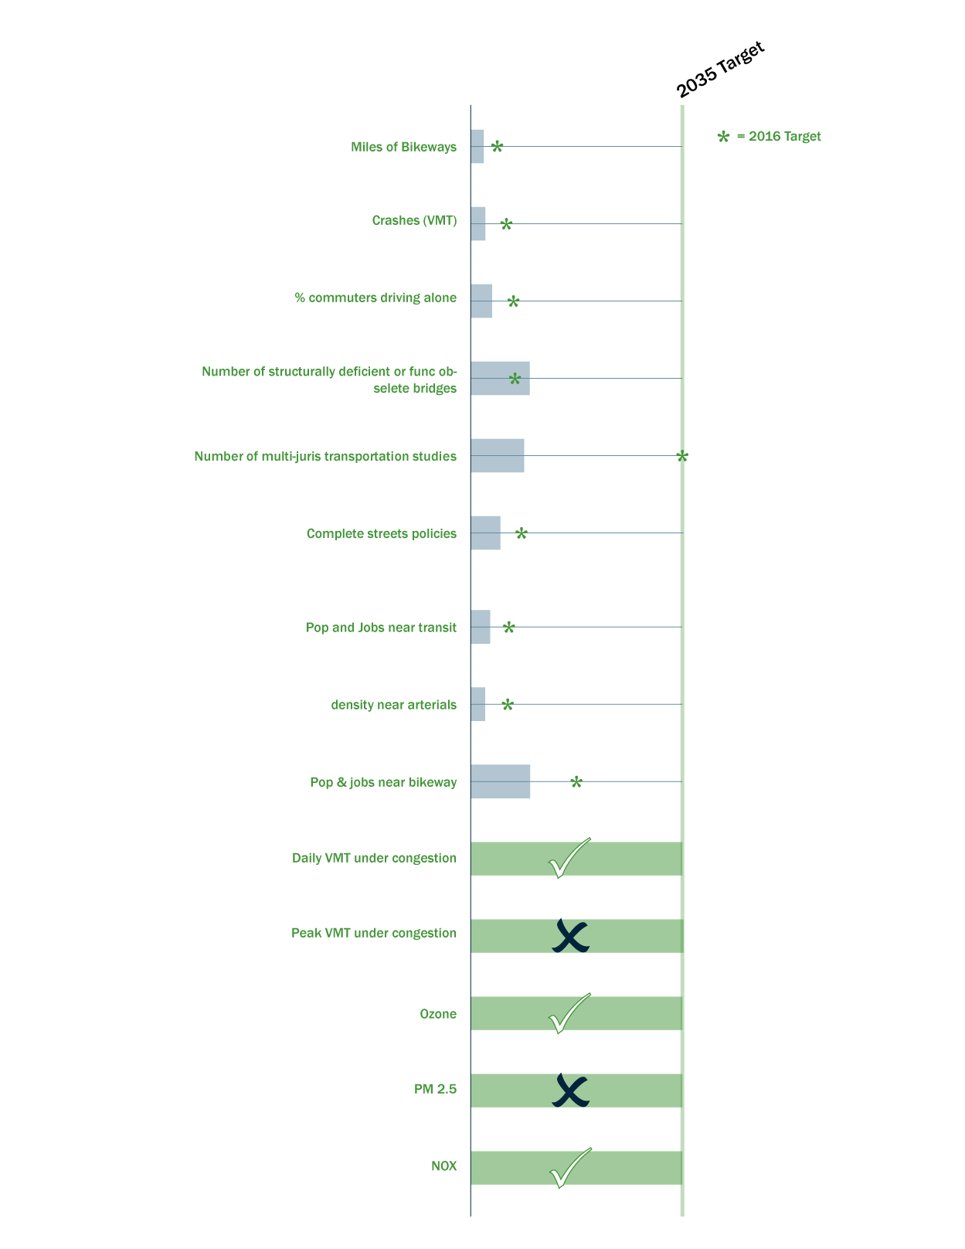




Show Progress: Report Card
Targets creation process
?
Meets target
On track to meet target
Not on track to meet target
Notes:
Target creation process:
As in any process, this went through a number of iterations
- The first one was to graph progress along a “track”
- This led to problems because some of the indicators are not a straight % measurement – some of the targets represent minimum thresholds to achieve.
---Example: Daily congestion should always be held under 5% to be on target, for both 2016 and 2035.
- Another problem with it was that is was not always easy to tell at a glance if we are on or off.
We also discussed a “Grade” system to make it like a report card in school, (A,B,C,D,F)
Instead we opted for iconography
Criteria: needed to make sense to both a layperson and a professional, needed to be simple, and needed to be reproducible in black and white (for color-blind people)
We decided against using pie-wedges and half-moons
-both have similar problems as the % measurement, symbol implies 25% or 50% completion, etc
- also, the half moon can be interpreted “upside-down”
We decided on the bulls-eye
Not too many categories – decided 3 would be easy to understand at a glance (Ahead, On, Off)
- We also discussed the language to match this icon, ie “On track to meet target” not just “on target”

Slide 17
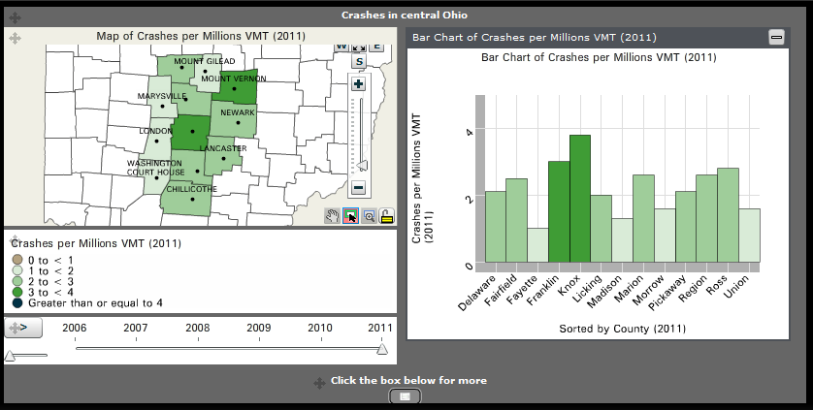
Interactive Visualizations
“Visualize” data over time
Weave software
Weave has the ability to tie together a piece of data across different charts
http://weave.morpc.org/sotr/indicators.html?ct=Transportation
Notes:
Interactive Visualizations:
- In addition to the Report Card, we use data-driven “visualizations” to show the state of indicators over time
We sometimes call them “vizzes”
Updated on our website every year for our State of the Region event
Taking the data and making it visually appealing as a way to illustrate progress for policy-makers and the public.
Available to play with interactively or to download data for their own study
These visualizations are created using software called Weave
Weave is an open-source application created by Umass Lowell as part of the Open Indicators Consortium, of which MORPC is a member
Other members include universities, non-profits such as Columbus’ Community Research Partners, and other MPO’s around the country (ex: Atlanta)
Weave has the ability to tie together a piece of data across different charts, over time -- rolling over a map feature will highlight the relevant data point for a given time period

Slide 18
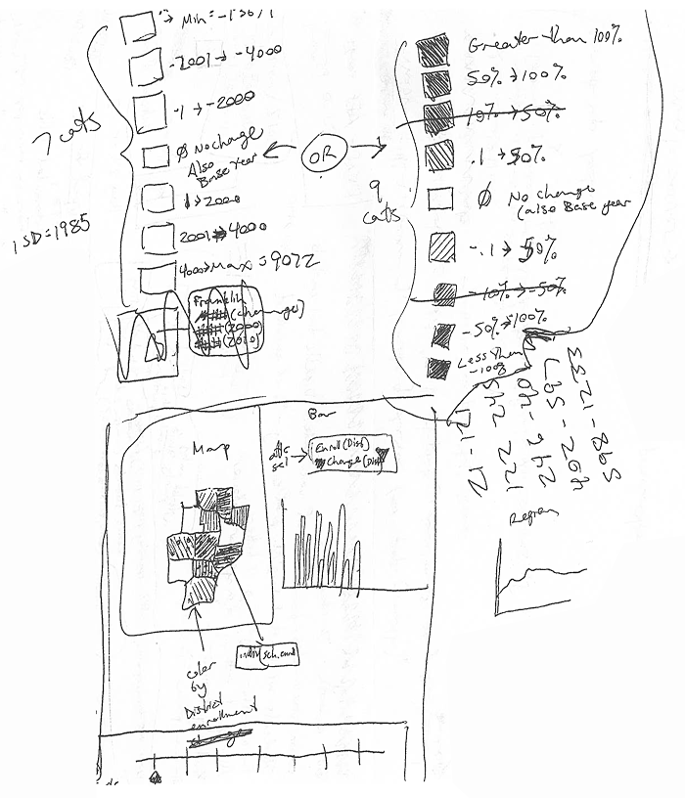
Lessons Learned
Choose symbols that make sense, and are easily legible
Don’t be afraid to reevaluate – the result will likely be stronger
Sketch it out before committing
Notes:
Lesson 1: Make sure the targets (icons, language) make sense, both for the data being shown and for people to see
Lesson 2: Make sure the icons are easily “legible,” not too many categories
Lesson 3: Re-evaluate scores, symbols, and language – stronger result because of this process

Slide 19
Questions?
Contact info:
  Andy Taylor: ataylor@morpc.org
  Amelia Costanzo: acostanzo@morpc.org
  Daniel Eisenberg: deisenberg@morpc.org
Links
MTP: www.morpc.org/tplan
State of the Region: www.morpc.org/stateoftheregion
Open Indicators Consortium: www.oicweave.org
Notes:
Links:
MTP:
http://www.morpc.org/transportation/mtp/mtp_main.asp
Report Card, State of the Region site (linked to on MORPC main page, under “Regional Development” → “State of the Region”
http://weave.morpc.org/sotr/indicators.html?ct=Transportation
http://www.morpc.org/regional_dev/region/region.asp
Open Indicators Consortium (OIC) – developers of Weave Open Source software
http://www.oicweave.org/

