Slide 1


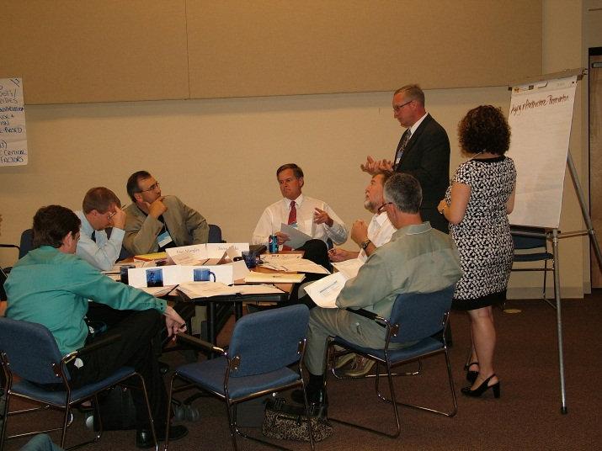
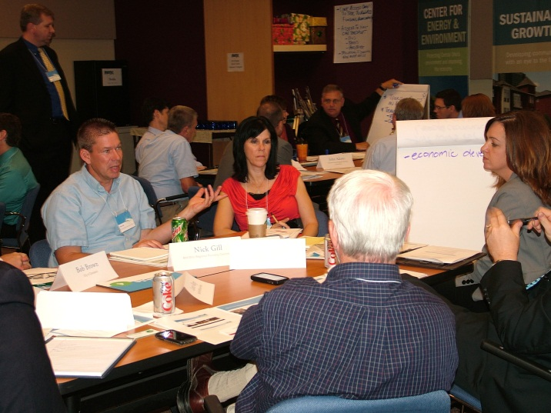
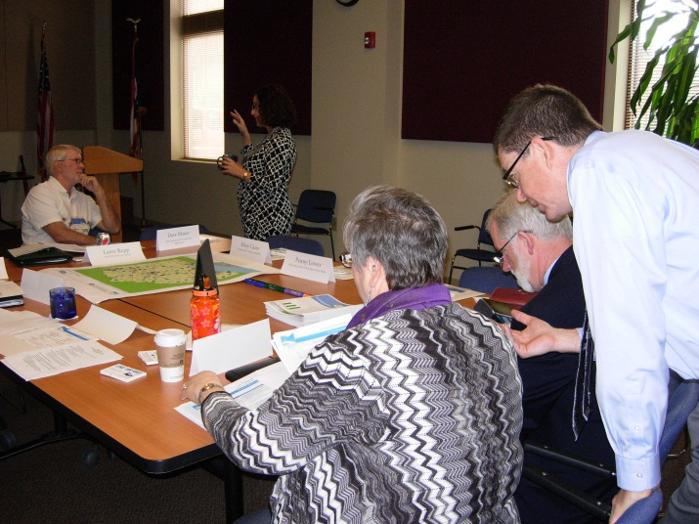
WELCOME
Dealing with Steak-holders
Statewide Public Involvement in the Electronic Era
May 7, 2013
Steering Committee Meeting #1

Slide 2
Access Ohio Overview
What is AO40?
AO40 is a realistic and achievable vision for Ohio’s transportation system in the year 2040
Why plan for 2040?
Federal regulations (23 USC 135)
Transportation investments are long lived

Slide 3
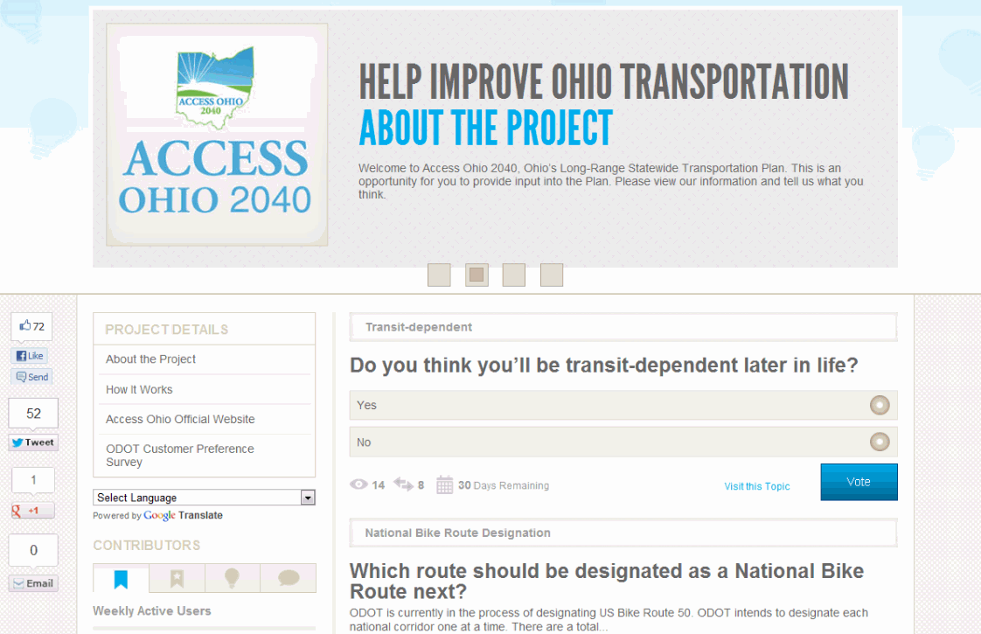
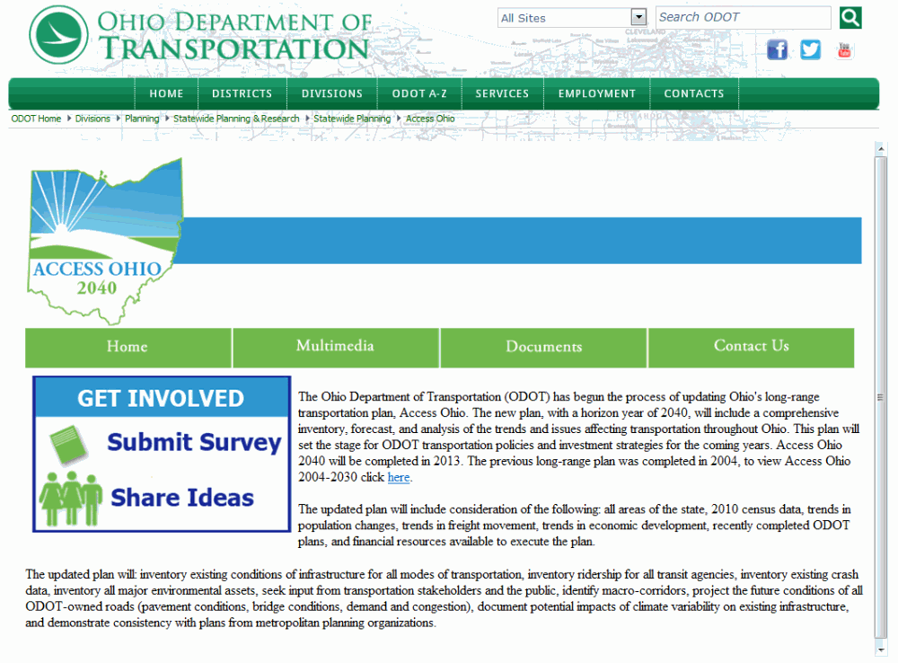
Public Involvement
Overview
Customer Preference Survey
Steering Committee
Project Website
Public Involvement Website
Outposts

Slide 4
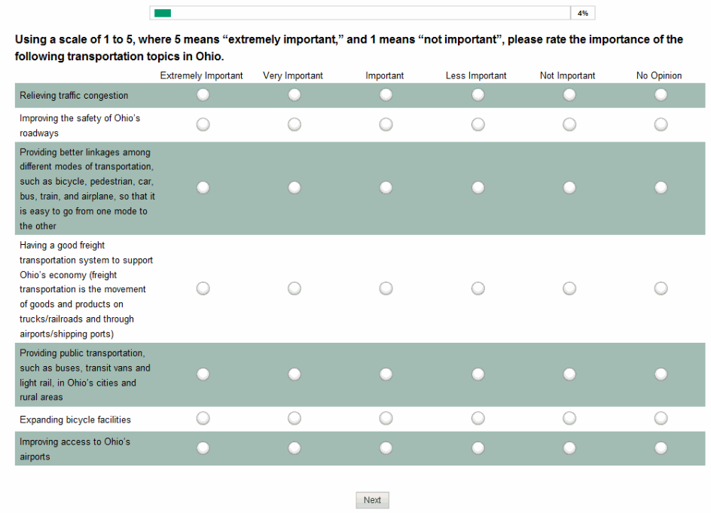
Public Involvement
Four Types of Electronic Communication
Survey
Websites
Email
Social Media

Slide 5

Public Involvement
Why Electronic Communication?
74% of people have access to a desktop/laptop
87% of people own a cell phone
45% of adults own a smartphone
Source: http://themainstreetanalyst.com/2012/12/29/the-rise-of-smartphones-demographics-and-facts-infographic/

Slide 6
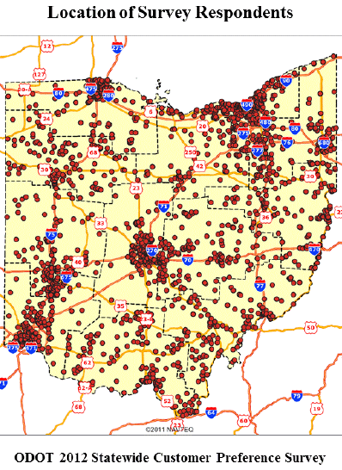
Customer Preference Survey
Customer Preference Survey
1st public involvement activity
Conducted in spring 2012
Valid statewide sample of 1,900 Ohio households

Slide 7
Customer Preference Survey
Customer Preference Survey
Duplicated the survey instrument on Survey Monkey
2,895 responses collected in three months
  66% of respondents had a least a bachelors degree
  70% of responses from Cleveland, Cincinnati, Columbus, and Dayton areas

Slide 8
Websites
Project Website
Draft Reports and Maps
E-Newsletters
Survey Link
Email Notifications
Presentations
www.access.ohio.gov

Slide 9
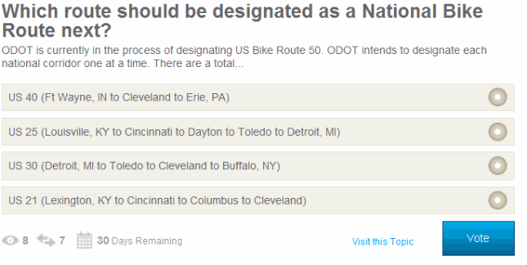
Websites
Public Involvement Website
MindMixer
Participants can vote in polls or post comments on a variety of topics
Participants have to register to vote or comment, but anyone can view topics
ODOT retains the ability to change topics
www.accessohio2040.com

Slide 10
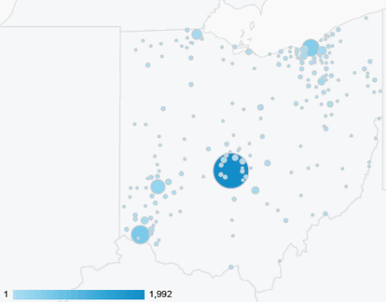
Websites
Measuring Success
Project Site Google Analytics
  5,000+ unique visitors
  Geographic diversity
MindMixer Reports
  9,700 page views
  Participants by zip code, gender, and age

Slide 11
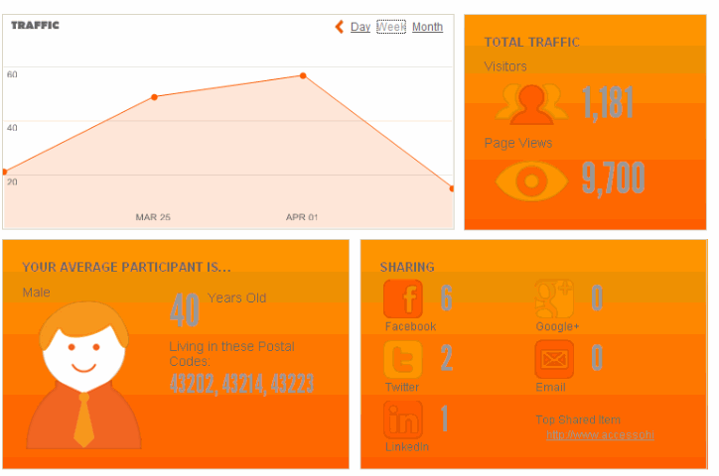
Websites

Slide 12


Website
Electronic Meetings
Not used to-date
May be utilized in the roll-out of the draft plan

Slide 13
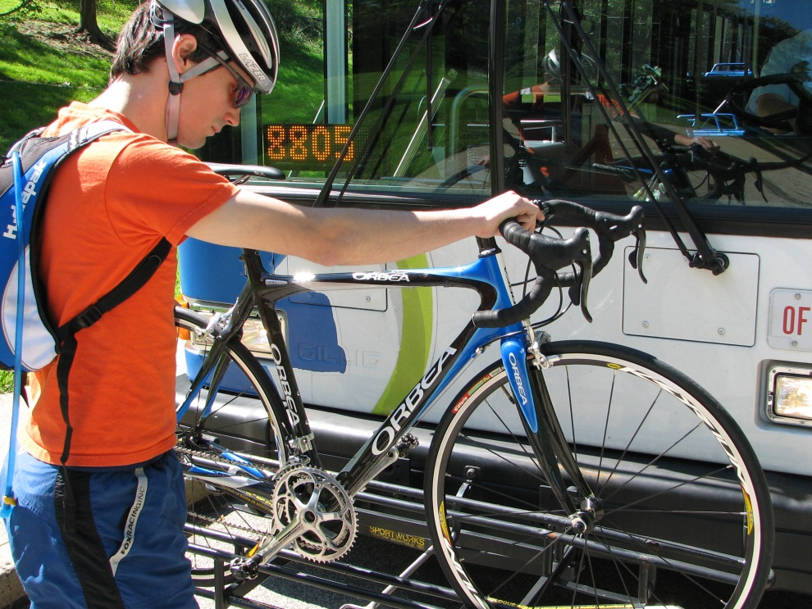
Email
Project Email Account
Utilize to interact with three groups
  MPOs
  Steering Committee
  Stakeholders (500+)
Communications
  Updates to the project website
  E-Newsletter
  New topics on the public involvement website

Slide 14


Social Media
Facebook and Twitter
Posts focus on opportunities to participate
  Survey
  New topics on the public involvement website
  Release of draft documents

Slide 15
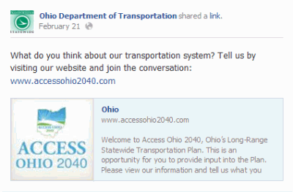
Social Media
Facebook and Twitter
Utilize existing ODOT accounts
  Statewide
  Districts
Utilize strategic partners
  MPOs
  Transit Agencies
  Non-Profits
  Media

Slide 16
Questions
Sara Walton
Transportation Planner
Sara.Walton@dot.state.oh.us
(614) 995 -0754

